Slide 1
NA2.2 – Communications, Marketing & Events
Neasan O’Neill
Communications Manager
EGI.eu

Slide 2
Contents
Aims and objectives
Overview of communications team
Audiences
Channels
Past activities
Future plans
Summary

Slide 3
Communications for EGI
Aim
Communicate the work of the EGI and its user communities both within the project and worldwide
Promoting/Publicising:
EGI’s Strategic objectives
EGI’s Core Values
Documents
Communications & Marketing Plan (D2.22)
Marketing and Communication Handbook (MS228)
The Community Outreach Strategy

Slide 4
Communications Effort
EGI.eu
1 Manager
2.5 FTEs
National Grid Initiatives (NGI)
NGI International Liaisons
Some NGIs have separately funded effort
Partner Projects & organisations
Some partner projects also have effort

Slide 5
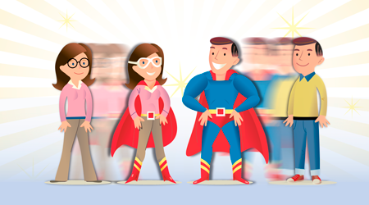
Champions
Enthusiastic scientists using EGI for their research and keen to go to conferences and spread the word about the benefits of working with EGI
http://go.egi.eu/champs

Slide 6
Audiences
Research Communities
EGI needs an engaged and broadly satisfied user community
Policy makers and collaborating projects
Key to future funding and decide on strategic priorities
Keeps our work on their agenda
NGIs, EIROS and (future) Partner Projects
EGI’s key stakeholders and source of funding, strategy and resources
Media & General public
Mainstream media can improve EGI’s visibility within the scientific community and with policy makers
Informs the public about the benefits of grid through case studies relevant to them

Slide 7
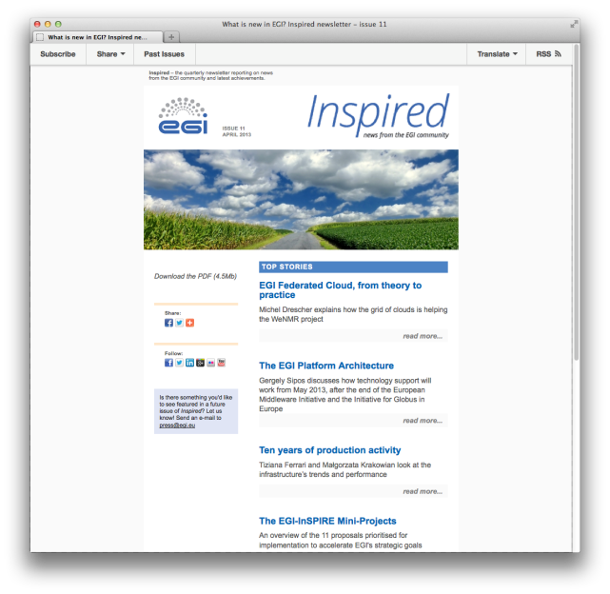
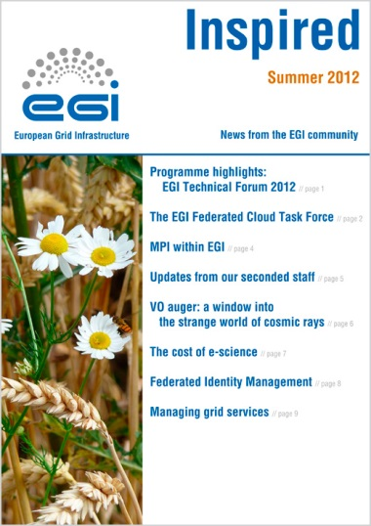
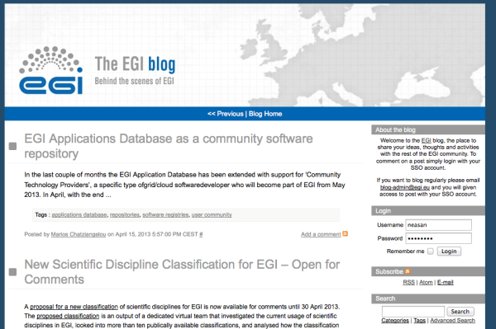
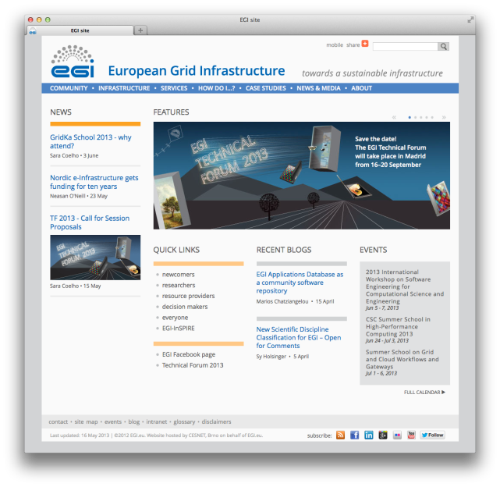
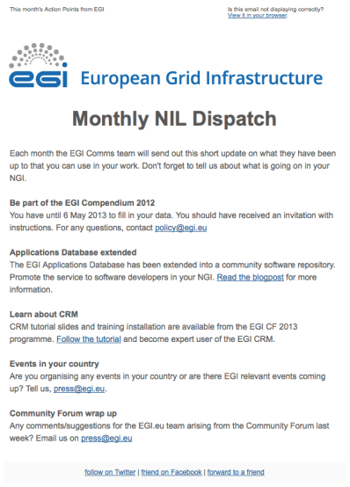
Channels & Activities
Web
Social Media
Newsletters
Publications
Videos
Events
Scientific Papers
Virtual Teams
Notes:
Website – Wiki & Blog
Social Media
Newsletters, dispatches and Letters
Publications -> Brochures, Book of abstracts, Annual Report, Posters

Slide 8
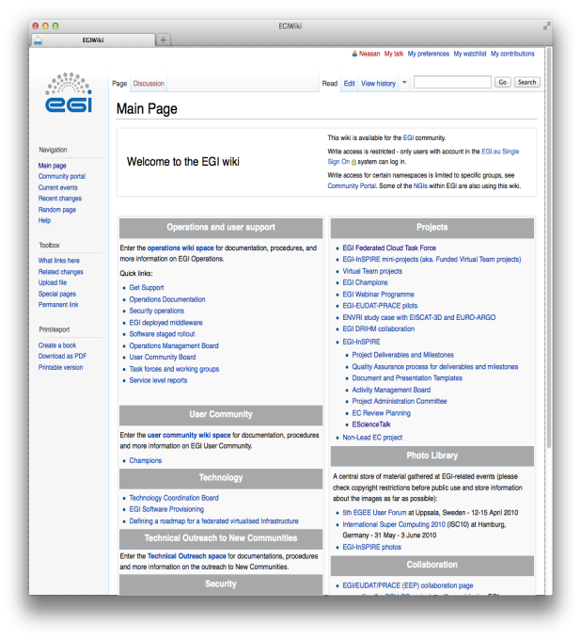
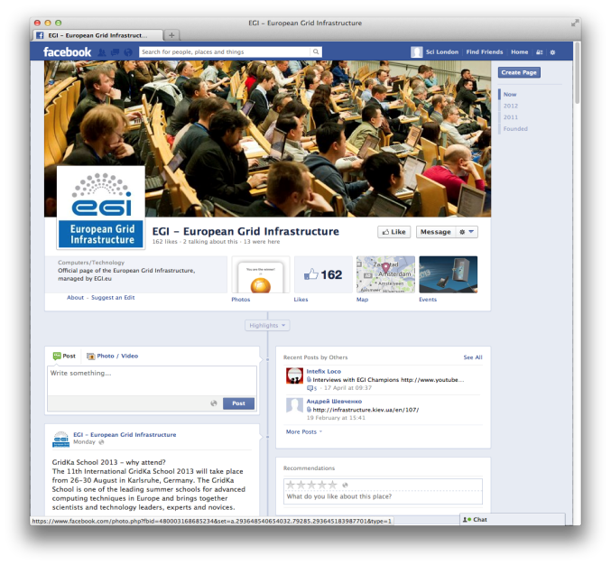
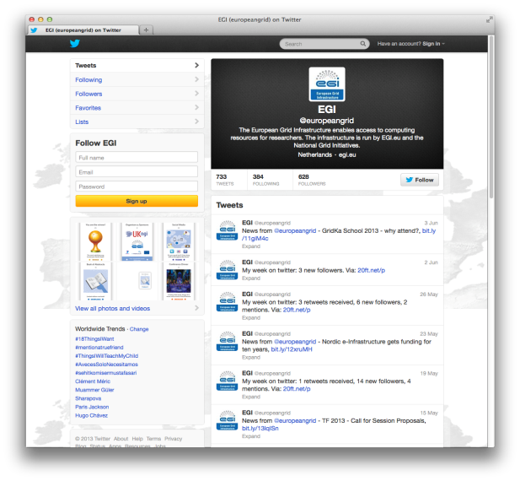
Web
Main Site
Information Portal
Design refreshed
Recent Restructure
Blog
Publicly Viewable
Community platform
~150 posts in total
Wiki
A working space/repository for the community and related projects
Social Media
Facebook & Twitter
Google+, LinkedIn & YouTube
Notes:
Main Site
Information portal, All material produced by EGI available here
Design refreshed before last review
Content and structure being looked at all times
Recent restructure of the 'Services’, 'Case Studies’, 'Infrastructure’, 'Community’ and 'Strategy and Policy' sections, in conjunction with User Support, policy, technology and operations teams
Blog
Publicly viewable
Open for entire (SSO) community to blog almost 150 posts
Wiki
A working/collaboration space for various projects including VTs and mini projects
Added info:
'Services' section: adding more info on the services we provide, to whom, etc 'Case Studies' section: divided by scientific field, add a 'Who is using EGI now' subsection (a list of mini-case studies) 'Infrastructure' section: adding info on the Platform Architecture, simplifying Ops & Technology, expand the Fed Cloud area 'Community' section: now expanded to include NGI (and pages therein) and the projects 'Strategy and Policy' section: to simplify the Policy part and expand on the Strategy

Slide 9
Statistics
News Items
68 News Items
33 Blogs
Traffic to website from external sources has significantly increased:
Facebook up 90%
Twitter up 30%
iSGTW.org by 90+%
Wikipedia is up by 80%
Traffic from LinkedIn has dropped slightly (14%)
Social Media Stats | 2011 | 2012 | 2013
Twitter Followers | 94 | 312 | 628
Facebook likes | n/a | 59 | 162
FB Friends of likes | n/a | 18,000 | 63,000
Notes:
Twitter - 200% increase on last year,
Facebook – 274% increase on last year

Slide 10
Newsletters
Inspired
Quarterly
Email
PDF
HTML
Dispatches
NILs, monthly
Champions, bi-monthly
Directors Letter
Monthly
Notes:
Inspired
Redesigned
Online mail system called mailchimp
Let’s us track total clicks/opens not individual users/opens
Dispatches
NILs asked for, actions as bullet points
Champions being worked on
Developers future devlopment
Directors letter
Continued since EGEE days, read and enjoyed
May move to Mailchimp

Slide 11
Activities & Impact
4 Issues of Inspired
2 on mailchimp
~2,000 opens an issue
~400 clicks an issue
NILs Dispatch
Sent 7 up to May 2013
40% open rate, 20% click rate

Slide 12
Publications
Brochures
Scientific Disciplines
EGI Services and Tools
FederatedCloud
AppDB
UCST
General Introduction
Book of Abstracts
Only for Community Forum
Annual Report
Case for EGI
Posters
Our events
Mirror brochures
Notes:
Brochures
Earth Science and Life Science, working with Champions to improve existing and create new ones revolving around tools
UCST and the AppDB
Book of Abstracts, produced 3 one for each Community Forum
Case for EGI, new document produced to explain EGI’s added value
Copies of most of these are in your pack, please ask if you want to see any thing else

Slide 13
Activities & Impact
Publications
General EGI Brochure
Community Forum Book of Abstracts
Fed Cloud Leaflet
Press Releases
2 central press releases
External Publications
Public Service Review, Pan-European Networks, International Science Grid This Week, International Innovation, Hortonworks blog, CONNECT, Pan European Networks, Public Service Review
Clippings
Discover Magazine, Wired, Bloomberg Business Week, Panorama (Italy) Belarusian Telegraph Agency, Supercomputer (Ukraine) HPCWire, CERN Bulletin, HPC in the Cloud

Slide 14
Videos
Internal
Stories from the Grid
Corporate
External
Gridcast
Notes:
GridCast run by eScienceTalk at events to record and discuss the event as it is happening

Slide 15
Activities & Impact
9 Videos on YouTube
Only push the 4 stories from the grid
EuropeanGrid | 2011 | 2012 | 2013
Views | n/a | 5,605 | 9,503
Subscribers | n/a | 53 | 82
58 GridCast Videos
6786 views in total
 | 1st | 2nd | 3rd
TF Videos | 5 | 8 | 7
TF Views (per video) | 858 (171) | 1041 (130) | 320 (45)
CF Videos | 11 | 15 | 12
CF Views (per video) | 1704 (154) | 2196 (146) | 667 (55)
Notes:
YouTube Views – 170% increase on last year, ~3,000 for the Top Quark video
YouTube Subscribers – 155% increase

Slide 16
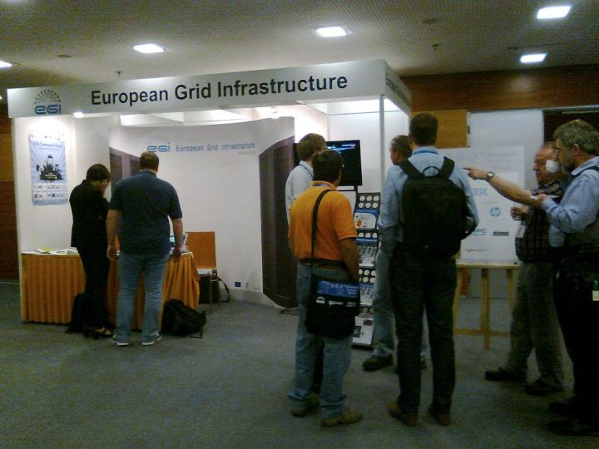
Events
Internal
Community Forum (Spring)
Technical Forum (Autumn)
External
Scientific
Technology/peer events

Slide 17
EGI Technical Forum 2012
Held in Prague, Czech Republic, 17-21 September 2012, with the with CESNET, the consortium of Czech universities and the Czech Academy of SciencesTheme: adoption of a federated virtualised infrastructure for European researchers
Co-located with the 2nd GlobusEUROPE event & an EC workshop on DCIs
415 participants registered for the forum
The sessions included 305 contributions.
The Technical Forum website (http://tf2012.egi.eu) received almost 2,417 unique visitors, with about 21,027 page views
The #tf2012 tag was mentioned in 509 tweets; 19 photographs uploaded to Flickr; 17 blog posts, 9 videos
190 people used the conference4me iPhone/Andorid app
Notes:
203 speakers (less than 50%)
356 tweets not from EGI accounts, Tuesday 18th was the busiest day
Issued a press release with Globus and the Initiative for Globus in Europe

Slide 18
EGI Community Forum 2013
Held in Manchester, UK, from 8-12 April 2013, co-organised with the UK NGI
The event showcased the services, technologies and tools available to new and existing scientific communities
Held in conjunction with the 3rd EMI Technical Conference and co-located with the 3rd annual meeting of the European Globus Community Forum.
380 registered for the event that featured 287 contributions
The Community Forum website (http://cf2013.egi.eu) had about 19,000 page views.
The #cf2013 tag was mentioned in 341 tweets; 69 photographs uploaded to Flickr; iPhone & android free apps downloaded by 223 users, 24 blog posts, 14 videos
Notes:
199 speakers
62 individual tweeters at the events

Slide 19
External Events Attended
Scientific Meetings
EGU General Assembly 2013
HealthGrid 2012/IWSG-Life 2012
European Conference on Computational Biology ECCB'12
Technology Meetings
Supercomputing
International Supercomputing
International Symposium on Grids and Clouds
Cloudscape V
iPv6 World Launch
SciTech12
IT and Research Infrastructures
CRISP 2nd annual event
5th CAPRI Evaluation meeting

Slide 20
Future External Events
Scientific Meetings
European BioPhysics
European Conference on Computational Biology
Theory and Practice of Digital Libraries
IEEE Engineering in Medicine and Biology Society
Technology Meetings
Supercomputing
International Supercomputing
ICT2013
Notes:
Clear switch in emphasis on attending tech vs scientific meetings

Slide 21
Virtual Teams
Ad-hoc, short term, working groups created to solve individual issues in the EGI ecosystem
Scientific Publications Repository, designing and implementing a process to track scientific publications produced using EGI resources
Inter-Usage Report, to produce a report detailing the usage of computing resources by the NGIs
Website Content, to improve the website structure, content and navigation
Environmental & Biodiversity Virtual Team, to collect information about the Environmental and Biodiversity research communities and begin the process of creating a VRC for them

Slide 22
Scientific Papers
Around 80 papers published
They cover Computing, Physics, Economics, Chemistry, Ecology, Engineering and more
Examples
Use of High Performance Computing infrastructure for solving the complex problems of economic modeling
Pathways of cryptic invasion in a fish parasite traced using coalescent analysis and epidemiological survey
P/2006 VW139: A Main-Belt Comet Born in an Asteroid Collision?
Electron-Phonon Coupling in Crystalline Organic Semiconductors: Microscopic Evidence for Nonpolaronic Charge Carriers
Variability of Soil Strength Parameters and its Effect on the Slope Stability of the Želazny Most Tailing Dam
Scientific Repositories VT is also working with OpenAIRE to apply an algorithm to identify papers that used EGI
Great source for News Stories and Case studies
Notes:
Plus the large exposure that grid computing got generally during the blanket coverage of the Higgs announcement

Slide 23
Future Activities
Web
Continue to seek feedback from community/stakeholders for content and structure
No change to style/design of the site
Encourage use of the blog, highlight its benefits
Website review in August
Social Media
Maintain current social media campaign
Increase level of interaction on the UCST, Tech & Ops and Policy channels
Investigate new platforms that fit with EGI’s strategy

Slide 24
Future Activities
Newsletters
Continue Directors Letter, Inspired & NIL Dispatch
Start Champion and Developer Dispatch
Publications
Update existing brochures
Expand discipline portfolio
Videos
Promote existing Stories from the Grid & Corporate Video
Create a shorter, more general video using existing footage
Events
Increased attendance at scientific events
Notes:
Discipline brochures will come in 2 flavours, Science & Tools
Attendance at events primarily by NILs & Champions with support from EGI.eu team

Slide 25
Summary
Communicate EGI’s benefit, strategy and values
Collaboration of EGI.eu, NGIs and Champions
Produce quality targeted material/products through relevant channels for particular audiences
Continue to innovate and be a recognised leader in communicating e-infrastructures and their benefits

