Slide 1
European Grid Infrastructure
A pan-European Research Infrastructure supporting the digital European Research Area
Michel Drescher
Technical Manager, EGI.eu
Michel.Drescher@egi.eu
TPDL 2013
Panel: e-Infrastructures and Digital Libraries

Slide 2
EGI Vision
To support the digital European Research Area through a pan-European research infrastructure based on an open federation of reliable services that provide uniform access to national computing, storage and data resources.
Notes:
Support digital Research Area
Pan-European research infrastructure
Open federation of reliable services
Uniform access to national resources

Slide 3
EGI Mission
To connect researchers from all disciplines with the reliable and innovative ICT services they need to undertake their collaborative world-class and world-spanning research
Core Values
Leadership | Openness
Reliability | Innovation
Notes:
Connect researchers
Reliable & innovative ICT
World-class world-spanning research

Slide 4
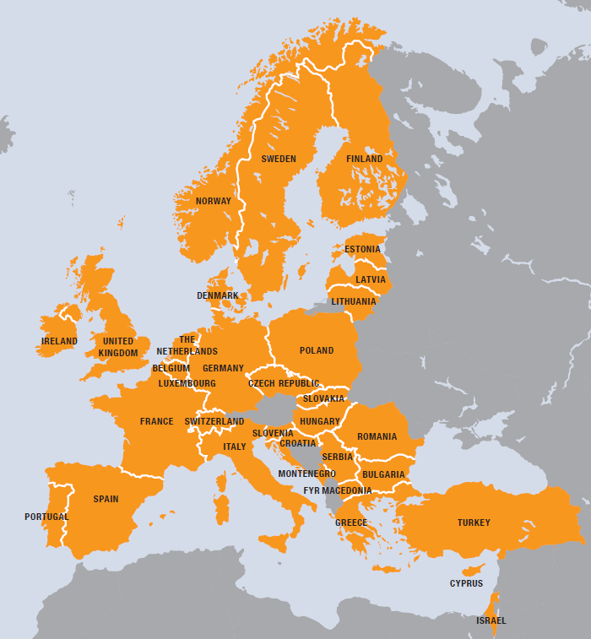
EGI
European
Over 35 countries
Grid
Secure sharing
Infrastructure
Computers
Cloud
Data
Instruments
…. and others
Notes:
Clearly European
Grid == secure sharing AND federation!

Slide 5
EGI.eu
Coordination for European Grid resources
Established February 8th 2010
Central policy & services needed to run a grid
Sustainable small coordinating organisation
Based in Amsterdam
Coordinating core (~25 people) in Amsterdam
Technical services from partners (~20 people)
EGI and EGI.eu: Supported by the EGI-InSPIRE project
Notes:
EGI.eu coordinating body of EGI

Slide 6
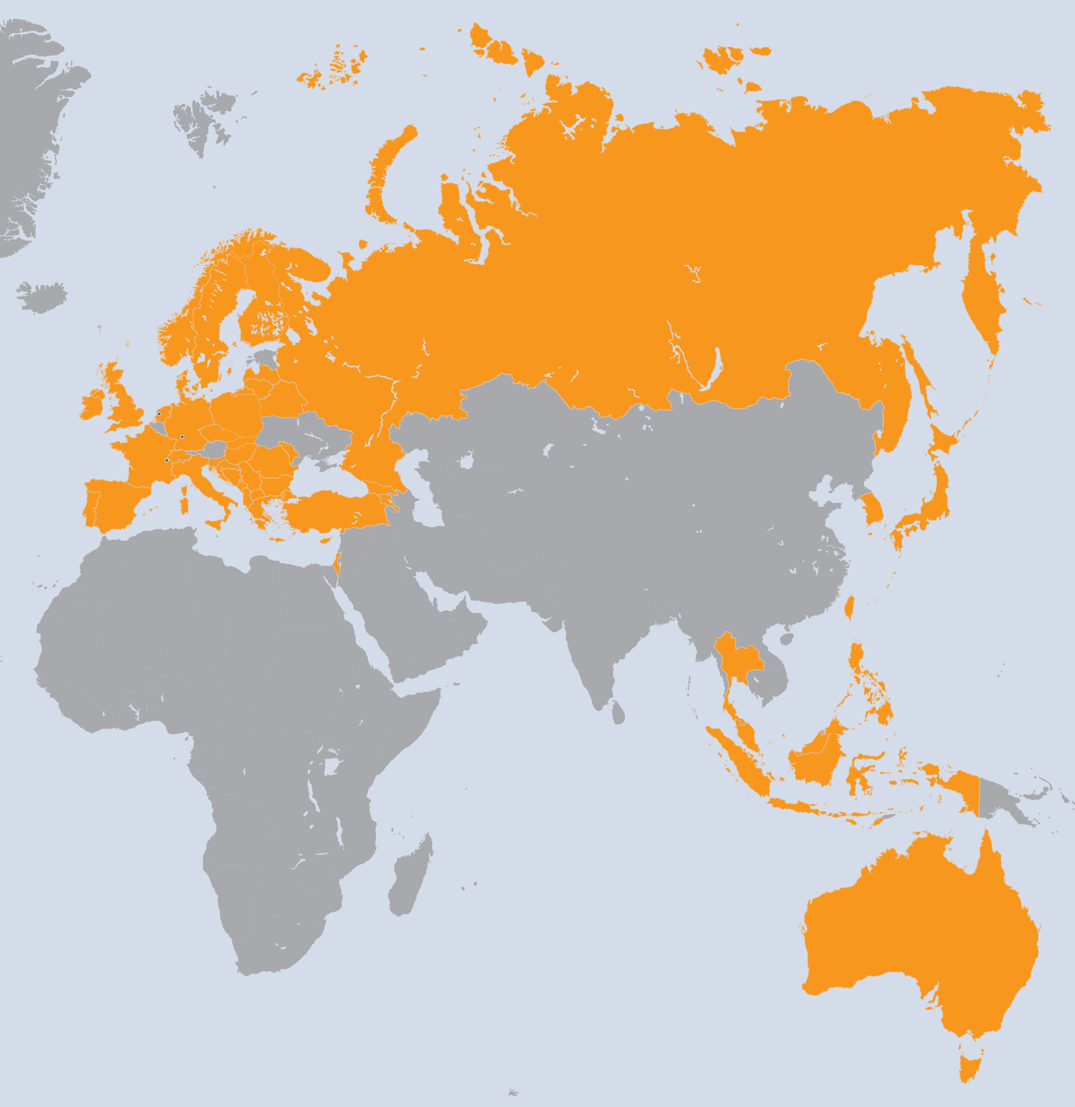
EGI-InSPIRE Project
Integrated Sustainable Pan-European Infrastructure for Researchers in Europe
A 4 year project with €25M EC contribution
Project cost €72M
Total Effort ~€330M
Effort: 9261PMs
Project Partners (50)
EGI.eu, 38 NGIs, 2 EIROs
Asia Pacific (9 partners)
Notes:
Clearly a large overlap with EGI
World-wide scope
Though funding scoped to EU member states

Slide 7
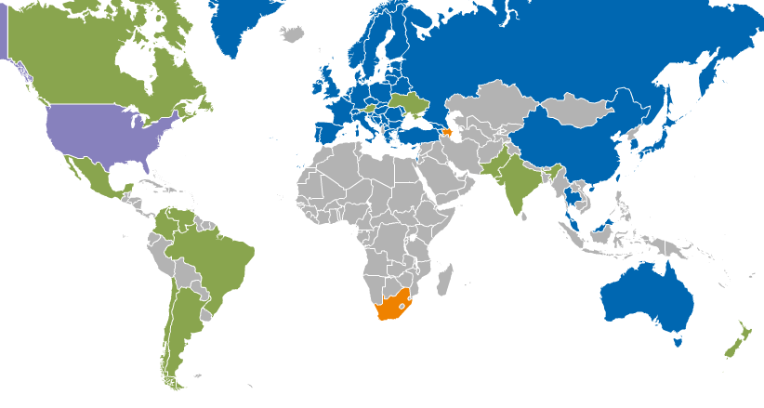
Operational Infrastructure
Registered Users: 22,197 VOs: 237
LCPUs: 361,300 Disk: 235PB Tape: 176PB
Jobs: 1.44 million/day
Resource Centres | EGI-InSPIRE & EGI Council members | 319
 | Including integrated RPs | 347
Countries | EGI-InSPIRE & EGI Council members | 42
 | Including integrated RPs | 53
Integrated EGI-InSPIRE Partners and EGI Council Members
External Resource Providers (integrated)
Internal/External Resource Providers (being integrated)
Peer Resource Providers
Notes:
Integrated external → using operational services and platform
Peered Resources → operational data is exchanged in interoperable formats and processes

Slide 8
EGI Solutions Portfolio
Federated Infrastructure Operations
Federated High-Throughput Data Analysis
Federated Infrastructure as a Service Cloud
Community Networks and Support
Community Driven Innovations

Slide 9
EGI.eu Service Portfolio
Coordination
Consulting and Support
Marketing and Outreach
Software and Services
Project and Programme Management
Operations Coordination
Technology Coordination
Security Coordination
Specialised Consultancy
Strategy and Policy Decision Support
Policy Development
Technical Consultancy and Support
Helpdesk Support
Marketing
Outreach
Federated Operations
Applications Database
Training Marketplace
Repository of Validated Software
http://www.egi.eu/services/
Notes:
EGI provides services of four types

Slide 10
NGI / RC Service Portfolio
Core Platform
HTC Platform
Cloud Platform
Information Service
Grid Compute
Cloud Compute
VO Membership Management
Grid Storage
Data Management
Cloud Storage
Workflow Manager
Service Hosting
NGI = National Grid Infrastructure
RC = Resource Centre
http://www.egi.eu/services/
work in progress
Notes:
Portfolio definition in flux!
Currently showing only software and services!

Slide 11
EGI’s Platforms for H2020
ERA needs an open ecosystem of VREs & services
EGI Collaboration Platform
“Tools & Services enabling cross-community collaboration”
Virtualised Community
Platform (VRE)
Hybrid
Community Platform (VRE)
Integrated Community
Platform
(VRE)
EGI Cloud Infrastructure Platform
“A federated IaaS Cloud infrastructure”
EGI Core Infrastructure Platform
“Operational services necessary for the management of federated DCDIs”

Slide 12
Thank you!
Questions?

Slide 13
BACKUP

Slide 14
Decade-long legacy
2001 – 2004
EDG
2004 – 2010 EGEE I – III
From 2010 EGI

Slide 15
From Homogeneity …
EDG & EGEE were homogenous projects
Resources, Software & Users
EGEE served the “Heavy User Communities”
High-energy Physics / WLCG
Astrophysics
Earth Sciences
Life Sciences
… with one Grid middleware.
Notes:
EU “large flagship project” model
Include all that’s necessary
WLCG is by far the biggest community
Strong influence
Others tagged along as see fit

Slide 16
… to Heterogeneity
20k researchers
2M researchers!
Few related use cases
Many diverse use cases

Slide 17
EGI’s Core Infrastructure
The services that federate and integrate the functional services deployed in the production infrastructure
EGI Core Infrastructure Platform
Information
Discovery
(BDII)
Federated AAI
Monitoring
Accounting
Metrics
Visualisation
(gstat)
Service
Catalogue
(GOCDB)
Messaging
Operations Portal
For e-Infrastructures, Research Infrastructures & Community Platforms

Slide 18
EGI’s Cloud Infrastructure
Enable an open ecosystem of services
EGI Collaboration Platform
EGI Cloud Infrastructure Platform
VM
Mgmt
Storage
Mgmt
Information
Image Repository
Cloud Management Stacks
(OpenStack, OpenNebula, …)
Image Metadata Marketplace
EGI Core Infrastructure Platform
Federated AAI
Central Service
Registry
Monitoring
Accounting

Slide 19
Cloud services for VREs
EGI Core Infrastructure
AAI
VOMS Proxy
Service Availability
SAM
Image Metadata
Marketplace
User Interfaces
Configuration DB
GOCDB
OCCI Clients
rOCCI; WNoDeS-CLI
SlipStream, VMDIRAC, CompatibleOne
CDMI Clients
Libcdmi-java
Appliance
Repository
Accounting
APEL
Resource Providers
Information System
Top-DBII
VOMS proxy
OpenNebula
OpenStack
StratusLab
WNoDeS
Syneffo, others
SSM
External Services
Monitoring
Nagios + community probes
Certification Authorities
OCCI server
Vmcatcher
Vmcaster
ID Management Federations
CDMI server
Marketplace client
LDAP
VO
PERUN server

Slide 20
Collaboration services
Virtualised Community
Platform (VRE)
EGI Collaboration Platform
People/Social
Technical/Infrastructure
Meeting planner
Audio conferencing
VM Marketplace
Wiki
Discussion forum
Software Repository
Requirements tracker
CRM system
Document DB
Training Marketplace
Application Database
User space federated AAI

