Slide 1
DRIHM-EGI collaboration
2nd coordination telcon
19/July/2013
Gergely Sipos gergely.sipos@egi.eu

Slide 2
Goal and task
Goal:
Setup a science gateway with workflows for hydrometeorology research communities
Task:
Integration of
Simulation models: WRF, DRIFT, RainFARM, RIBS (DRIHM)
gUSE gateway framework (SCI-BUS)
Workflows (ER-flow)
Computing and storage resources (NGIs and IGE)

Slide 3
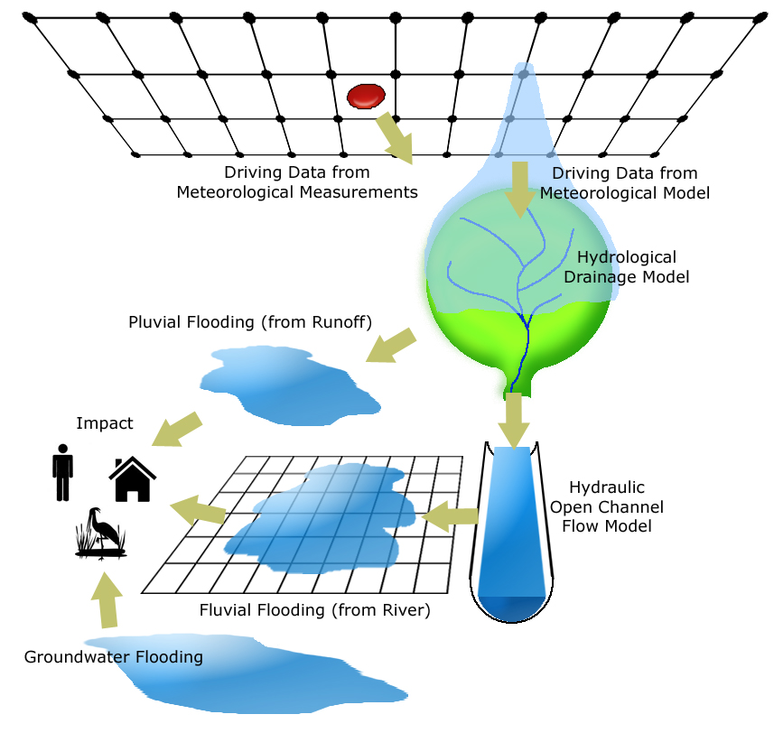
Envisaged workflows (DRIHM model chains)
RHMSS
CIMA
CNRS
“Large” Scale
Meteorological
WRF-NMM
COSMO-Model
Arome EPS
Meso-NH
Deterministic
Ensemble
Probability
RHMSS
UPM
“Small” Scale
Meteorological
WRF-NMM
RainFARM
Measured Rainfall
Deterministic
Ensemble
Probability
Hydrologic
HBV
HYPROM 2D
DRiFt
RIBS
Deterministic
Ensemble
Probability
Hydraulic
TELEMAC-2D
HYPROM 1D
SOBEK-FLOW
Delft3D-FLOW
Deterministic
Ensemble
Probability
Impact
Property Damage
3

Slide 4
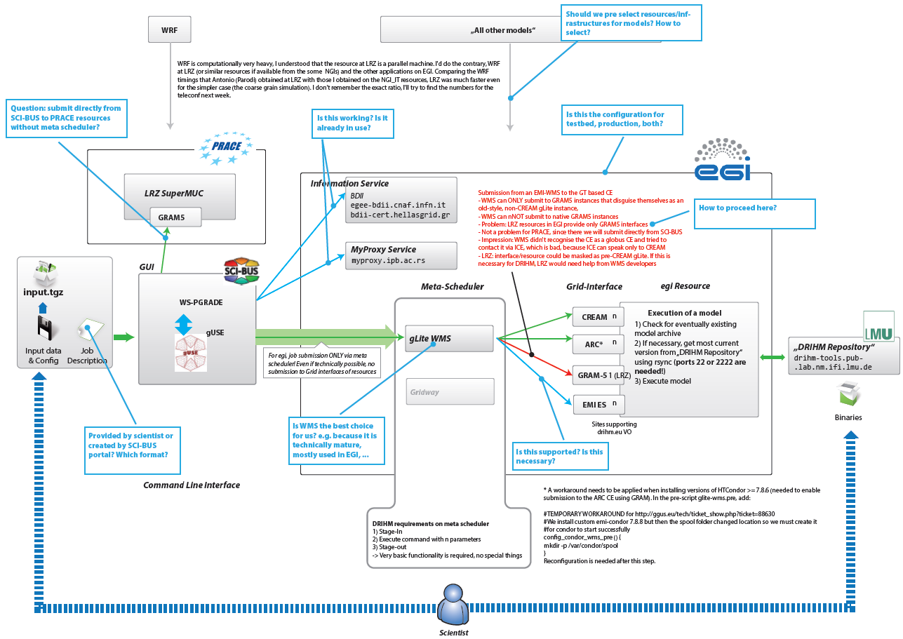
System architecture

Slide 5
Status reports
Running WRF in the grid (Christian, Daniele C.)
Running DRIFT, RainFARM, RIBS in the grid (???)
Workflow portal setup (SCI-BUS)
Workflow development (???)

