Slide 1
Towards the Big Data Strategies for EISCAT-3D
Yin Chen
ChenY58@cardiff.ac.uk

Slide 2
Opportunities for new Research
EISCAT-3D New Measurement Capabilities
Instantaneous, adaptive control of beam positions
Simultaneous multiple beams/interlaced beams
High-resolution coding of polarisation, phase and amplitude
Aperture synthesis imaging – small-scale 3D imaging(sub-beam-width)
Multi-beam volume imaging – large-scale 3D imaging
Full-profile vector measurements – large/small-scale 3D vector imaging
High-speed object tracking
* Estimated for 3 MW Tx: improvement at least x 10 better
Notes:
motivations

Slide 3
Opportunities for new Research
EISCAT-3D e-Infrastructure capabilities
Real-time data access
Virtual observation
Support long-tail scientists
Search through all levels of data, e.g.,
Find specific signature at all levels
Plasma features, meteors, space debris, astronomical features
Search for other ISR data resources
User specifying data analysis/processing
New Applications, e.g.,
Space weather
Visualisation

Slide 4
The Big Data Challenges in EISCAT-3D
3 +1 Vs
Volume.
5PB/year in 2018, 40PB/year in 2023
Operate for 30 years, data products to be stored for > 10 years
Velocity.
Each antenna : 120MB/s
160 * antenna group (100 antennas): 2 Gbit/s/group
5* Ringbuffer: each 125 TB/h
Variety.
Measurements: different versions, formats, replicas, external sources ...
System information: configuration, monitoring, logs/provenance ...
Users’ metadata/data: experiments, analysis, sharing, communications …
Value.
Meaningful insights that deliver analytics/patterns from deep, complex analysis based on machine learning, statistical modelling, graph algorithms ...
Go beyond traditional approaches to the space science
Notes:
challenges

Slide 5
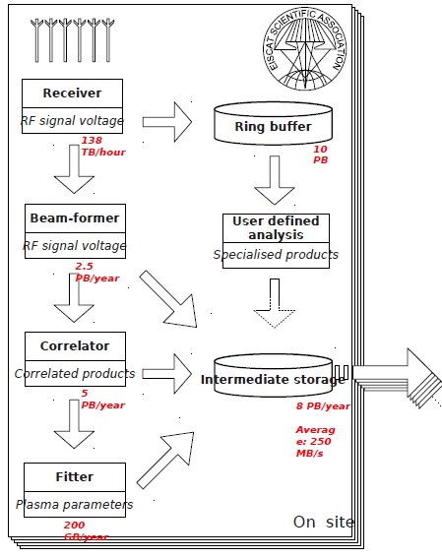
EISCAT-3D Data Acquisition
5 Types of data
Raw antenna (group) data (10 PB/day)
Voltage beam formed data (10 PB/year)
Correlated products (1 PB/year)
Fitted data (1GB/year)
(User) Specialised Products

Slide 6
EISCAT-3D Data Acquisition
Each antenna
30 Msamples/s (120MB/s)
Antenna group (core site)
Computes a number of (broad) beams from a small number of antennas (FPGAs)
100 antennes → 1 beam 2 polarisations
At 30 MHz IQ this is 32 * 30 * 2 = 2 Gbit/s/group
These data are stored in a ringbuffer
160 groups → 125 TB/h

Slide 7
EISCAT-3D Data Acquisition
2nd stage beamforming
160 antenna groups → 100 beams
Decimation to 1MHz→ 200 Gflop/s
Continuing sampling 32bit words (I/Q)
100*1e6*2*32 → 1GB/s
2* 10MHz bands correlated data → 2GB/s
In total 10TB/h to be stored in archive
Lag profile inversion
2-3 Tflops/s/beam
Total 5-10 + beams*(2-3) Tflops
8-13 Tflops for 1 beam
200-300 Tflops/s for 100 beams

Slide 8
EISCAT-3D Data Acquisition
One want occasionally do offline work on the ringbuffer data
Need transfer to HPC
Link or physical transport
1Tb/s → 1 month, better to do the calcs on-site?
125 TB/h * 1 day → 3 PB
In total ~10PB storage at HPC (72h data)
HPC computing
Higher resolutions (spatial and time)
4Pflop/s*24h → 10⁵ Pflop

Slide 9
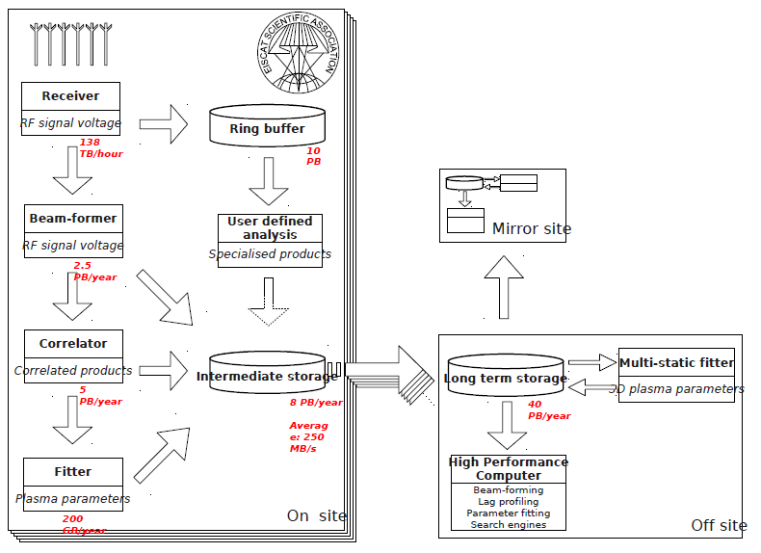
EISCAT-3D Data Curation
Data Acquisition
Tire 1
Tire 0

Slide 10
EISCAT-3D Tire 0 Curation
Existing EISCAT
Small, EISCAT archive (1981-2013) 60TB
EISCAT_3D 1st stage (2018)
Moderate, EISCAT archive 1PB/year
2-3 Mirrors (North + South Europe+Japan)
Analyis software + Search engines
HPC for detailed studies/developments
Storage 1PB, 1Pflop/run
EISCAT_3D 2nd stage (2023)
High, EISCAT archive 10PB/year
HPC, Storage 10PB, 10 Eflop/run

Slide 11
EISCAT-3D Tire 1 Curation
Data Access & Processing
Tire 0
Tire 1

Slide 12
EISCAT-3D Tire 1 Curation
Data staging
Long-term perservation
Security service, e.g., single sign-on, authentication, authorisation
Large scale virtualization of data/compute center resources to achieve on-demand compute capacities
Computing sites and workload management
Metadata service
File catalogue, application registration
Safe Replication service, e.g., dynamic data streams
Simple Store, e.g., drop-box like service for data
Semantic annotation services
A web based science gateway system

Slide 13
EISCAT-3D Data Access & Processing
Unlock the hidden-value of the big data
Discovery & Access
Intelligent filter
Signature search, similarity, pattern
Connecting big data with existing research analysis
To support discovery of “unknowns”
Metadata-based
Integration of other resources
Processing
Statistical analysing, correlation process
Visualisation
Domain Applications, e.g. , space weather service

Slide 14
EISCAT-3D Data Access & Processing
A digraph will be provided here …

Slide 15
Objective 1: Support EISCAT Science Community
Real-time data access
Community driven design
Virtual research environments
Support Long-tail scientists
Global data sharing and integration

Slide 16
Objective 2: Common Services for Big Data
Identify common requirements, challenging issues, state-of-the-art design experiences
LOFAR
LHC
SKA
The Pierre Auger Observatory
Cherenkov Telescope Array
Advance existing technologies
Proof of concepts /prototypes of data infrastructure-enabling software
Support to the evolution of EGI
EUDAT:
Common storage, computing, metadata services to large research communities (typically ESFRI)
Robust solutions to replicate and optimize data access.

Slide 17
Objective 3: Training of Data Scientists
The 4th paradigm for science
A new data-centric way of conceptualising, organising and carrying out research activities
New approaches to solve problems that were previously considered extremely hard/ impossible to solve
This will lead to serendipitous discoveries and significant scientific breakthroughs

Slide 18
Participating Organisations
Cardiff University
CERN
CSC
CSC provides IT support and resources for academia and research institutes.
CSC is a part of the Finnish national collaboration on building EISCAT-3D in coordination with the other member states.
Planned role to provide capacity and expertise in data management, HPC/Cloud services and connecting the EISCAT stations with high-speed networks.
CSC’s modular Data Center in Kajaani offers >2200 Tflops HPC capacity in 2014.
EGI
EISCAT
EUDAT
University of Edinburgh

