Slide 1
EGI.eu in EISCAT_3D project
Gergely Sipos
gergely.sipos@egi.eu
Technical Outreach Manager EGI.eu

Slide 2
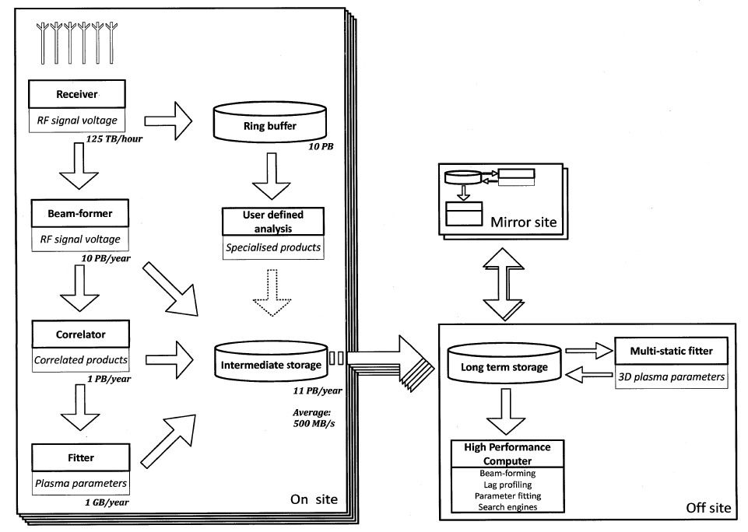
Context
Now
End of ENVRI 31 Oct 2014
H2020 submit Mar 2014?
H2020 project Nov 2014?
(2) Register files and metadata
EISCAT science gateway
(3) Lookup data and metadata
Authentication,
Authorisation, Single sign-on
EISCAT archive data
Metadata catalogue
File catalogue
Applications from EISCAT_3D
Sites from the NGIs (EGI)
App. 1
App. 2
...
(1) Migrate files
(4) Read files,
run applications
...

Slide 3
EGI priority for the ENVRI study case
Demonstrate the value of the ‘grid services’ that are already deployed in the NGIs E.g.
AMGA metadata catalogue
LFC file catalogue
Storage element
File Transfer Service
EUDAT services
Portal for application development & hosting (e.g. SCI-BUS)
Access control
Output for EISCAT_3D: Usable solution with compromises
Identify use case(s) and requirements for cloud systems (e.g. Federated Cloud, HelixNebula)

Slide 4
EGI priority for the H2020 project
Goal:
Produce the ‘Virtualised Appliance’ for EISCAT_3D off sites
Deploy sustainable, fully operational ‘Off sites’ from the appliance
EGI.eu’s contribution
Technologies for virtualised appliances
Roll-out and operation of new services within the NGIs
E-infrastructure community outreach and coordination

Slide 5
Requirements needed to start the work
ENVRI phase:
About the EISCAT archive. (Structure, accessibility, used file formats, expected metadata structure, possible need for replication, expected user base, expected usage pattern, etc.)
About the applications that EISCAT researchers would like to use to process, visualise, and in any other way manage and interpret the archive data.
H2020 phase:
Complete set of user requirements (broader set of applications, new data types, etc)
Operational requirements (Cloud technologies)

