Slide 1
e-ScienceTalk – WP2
André-Pierre Olivier - WP2 Leader, APO

Slide 2
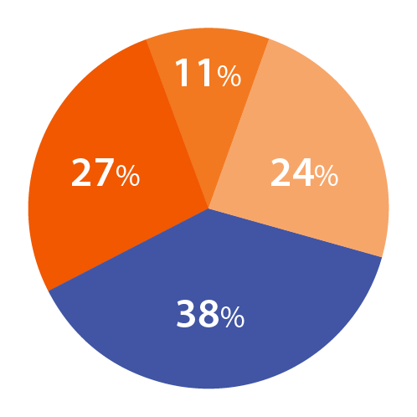
WP2 Overview
Participant
Effort distribution
Beneficiaries: 4
Effort: 72 PMs / 2.2 FTEs
WP4: Management
WP3: iSGTW
WP1:
Policy
23 PM
10 PM
WP2: GridCafé
25 PM
Task 2.1 GridCafé
APO and CERN
Task 2.2 Real Time Monitor and GridGuide Imperial with APO, CERN and QMUL
Task 2.3 GridCast
QMUL with APO and CERN
14 PM

Slide 3
WP2 Objectives
Keep the GridCafé at the cutting edge of grid and e-Science dissemination by refreshing the look and feel and keeping it constantly updated with new material, expanding the content to cover other forms of computing.
Explore interactive environments and new web tools to ensure that GridCafé and GridCast have impact on their audiences and are easy to use.
Update the GridCast website and expand the marketing of the GridCast site to the grid and e-Infrastructure community and beyond.
Expand the GridGuide to cover more sites, improve its impact and develop further interactive functionality between the GridGuide and the Real Time Monitor.
Explore the continuation of the BELIEF Digital Library and support the e-concertation meetings.

Slide 4
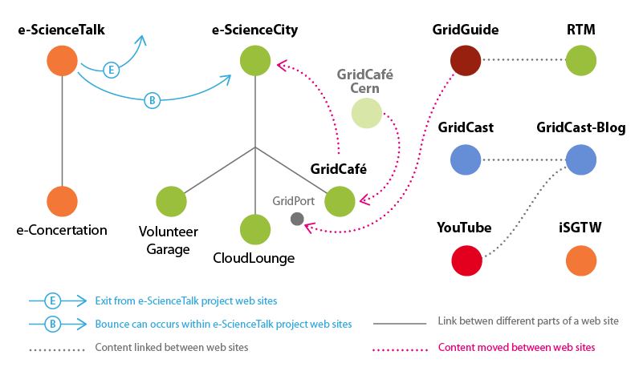
WP2 sites

Slide 5
WP2 Major achievements

Slide 6
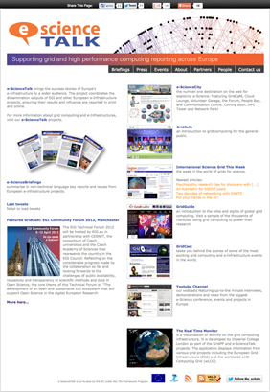
e-ScienceTalk website
1
e-ScienceTalk is the project website;
it is designed to be a simple-to-use portal,
guiding people to our different websites.
It also gives access to a lot of the project's material such as e-ScienceBriefings (in PDF and HTML versions), posters, leaflets, and other documents produced since the beginning of the project.
New additions:
1 - Improved Social media links
2 - Briefing update
3 - New Event section
5 - Link to the new Grid Port
5 - Improved link to YouTube channel
2
3
4
5

Slide 7
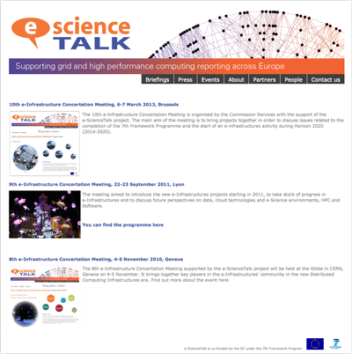
e-ScienceTalk Event section
634 Unique visitors
2,415 Pages viewed

Slide 8
e-ScienceTalk Briefing section
Briefing update
Compendium 2010-2013
17,281
briefings
downloaded

Slide 9
e-ScienceTalk YouTube
260 videos (+ 31)
140 Subscribers (+ 33)
245,044 video views (+ 31,764)

Slide 10
WP2 Major achievements

Slide 11
e-ScienceCity concept
e-ScienceCity replaced the GridCafé as the main web site.
GridCafé become one of the sections of the site like the others:
Cloud Lounge, Volunteer Garage, HPC Tower...
In parallel a virtual e-ScienceCity is also available in a 3D virtual world hosted by New World Grid.
e-ScienceCity was launched in September 2011, and has been updated during year 3 of the project with the addition of 2 new sections and updates of other parts.

Slide 12
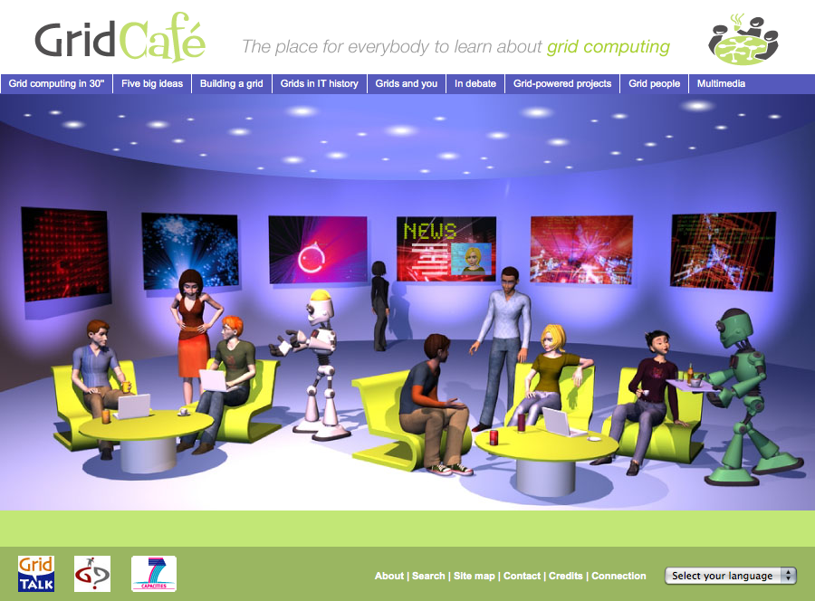
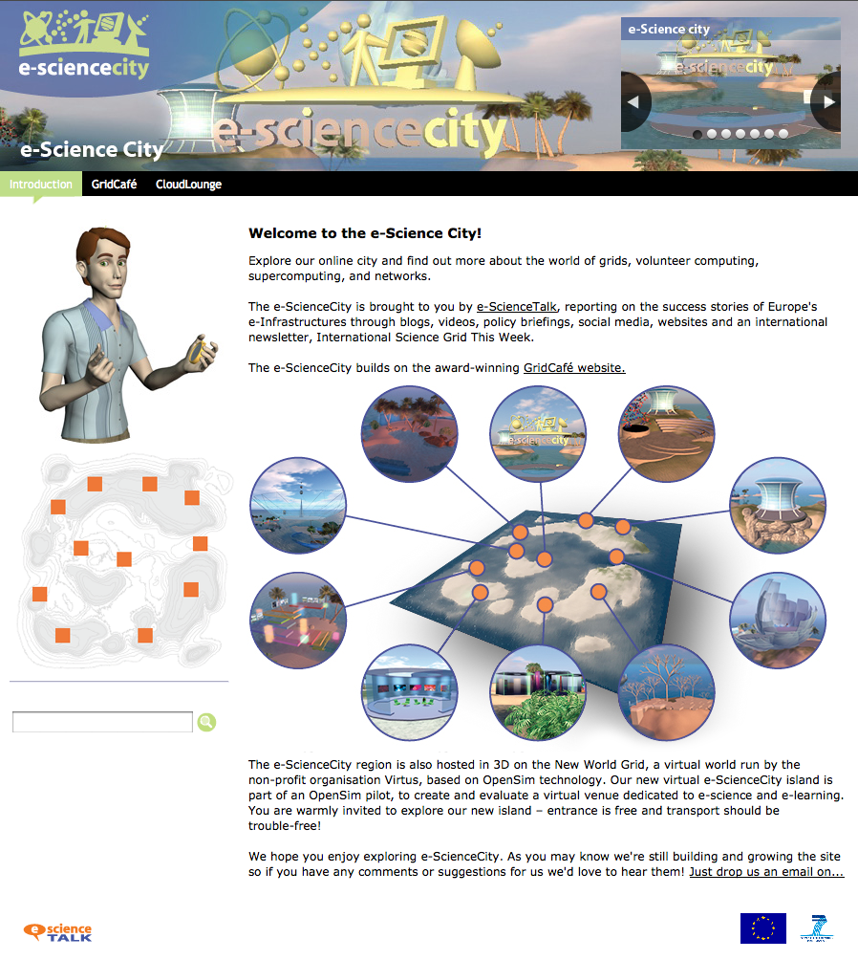
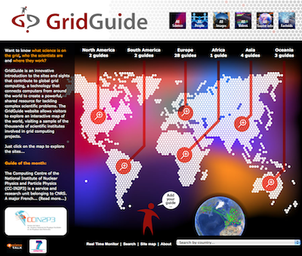
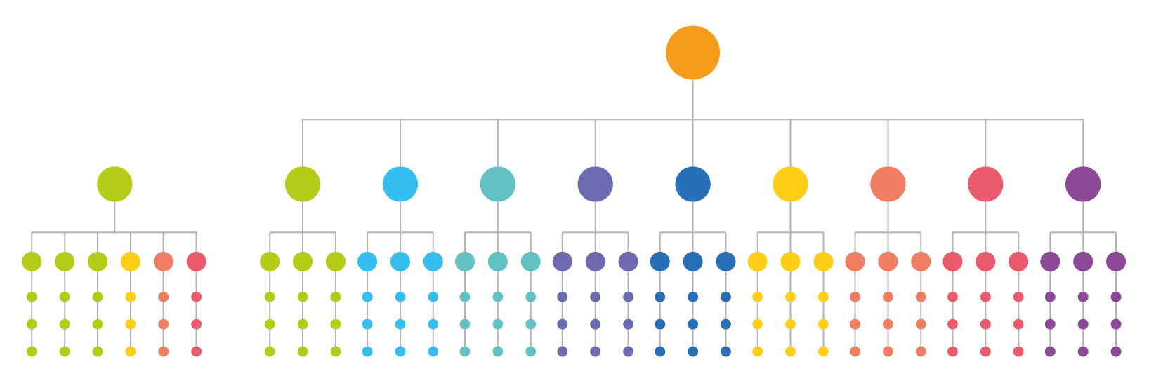
The evolution
From Grid Café to e-ScienceCity

Slide 13
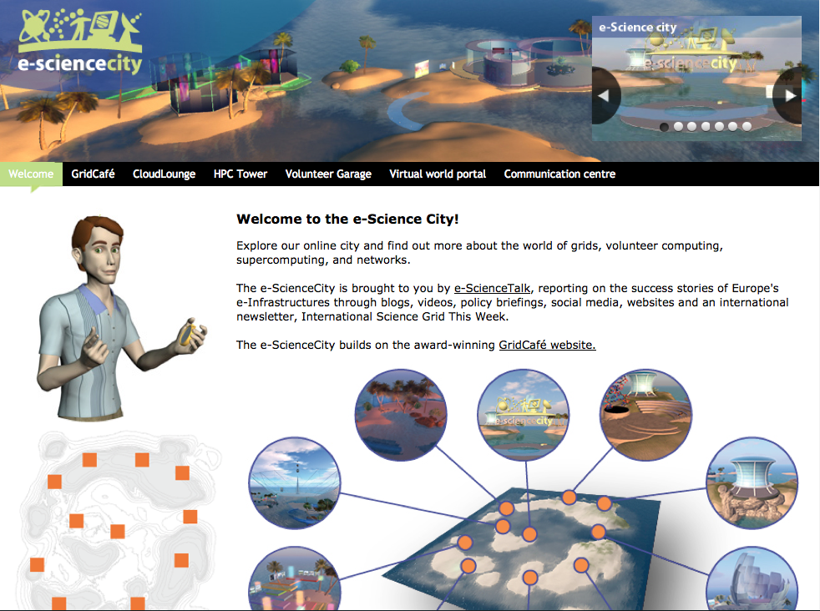
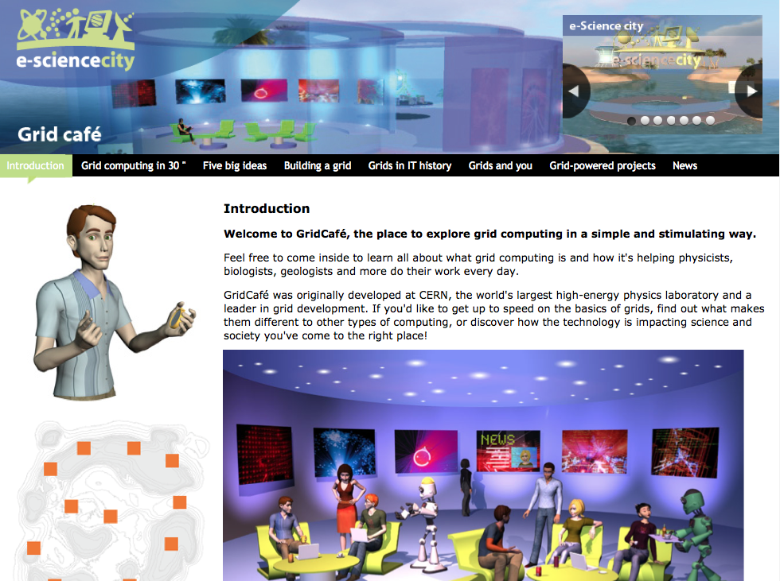
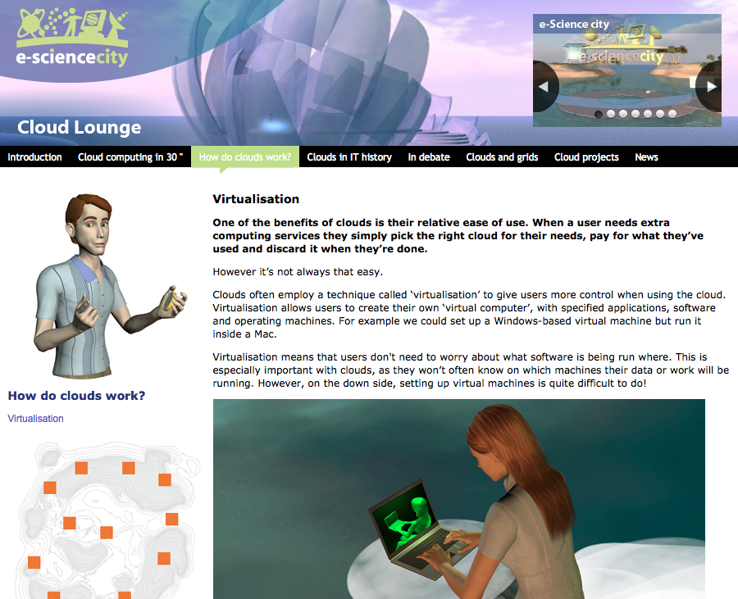
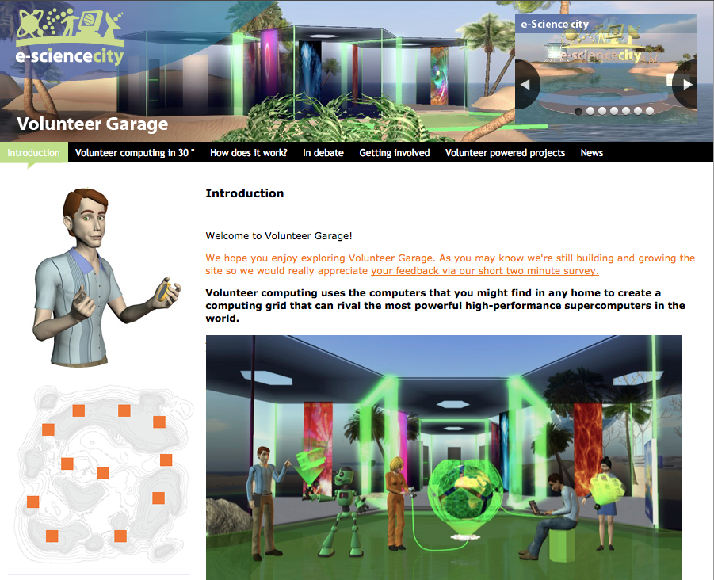
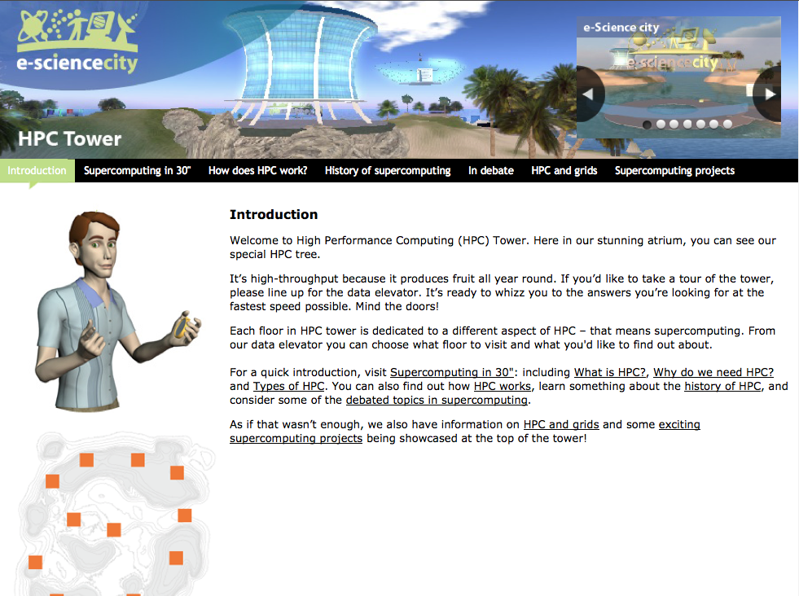
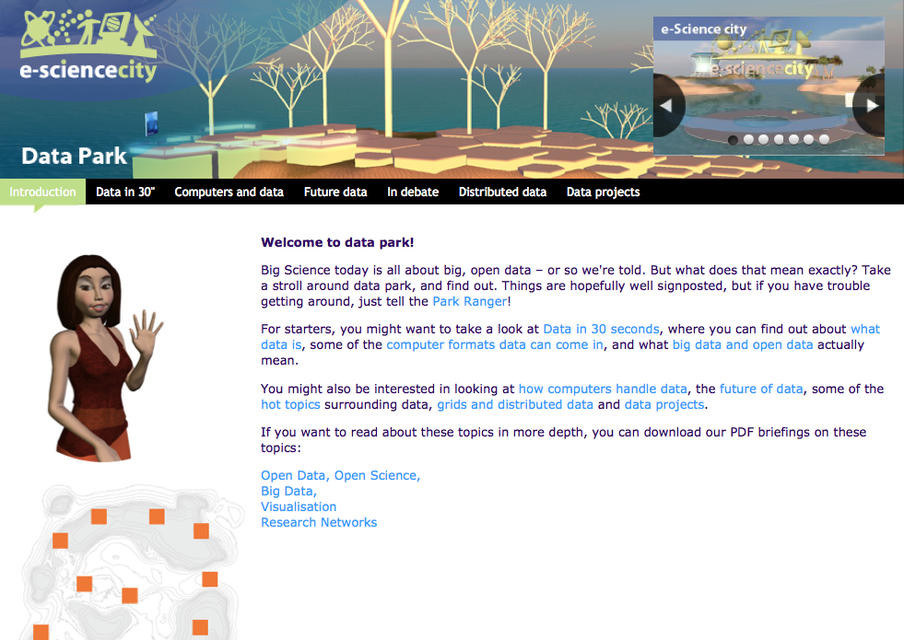
e-ScienceCity website - 1
e-ScienceCity
GridCafé
Cloud Lounge
Volunteer Garage
HPC Tower
Data Park

Slide 14
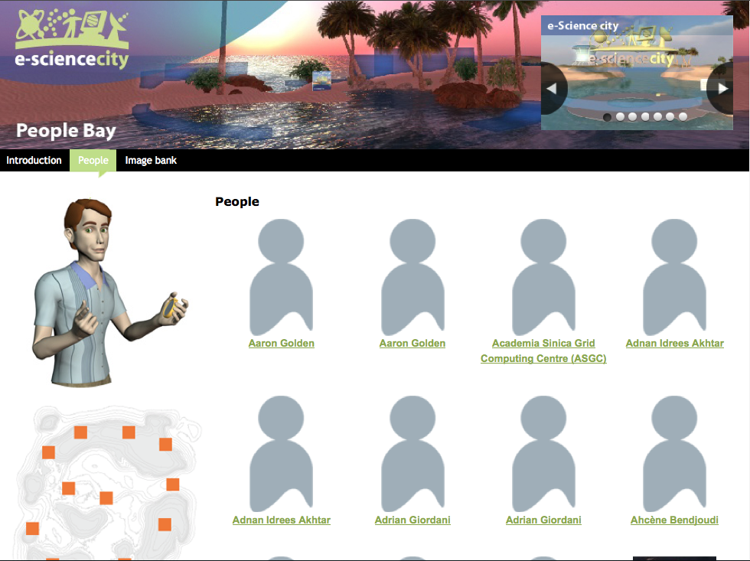
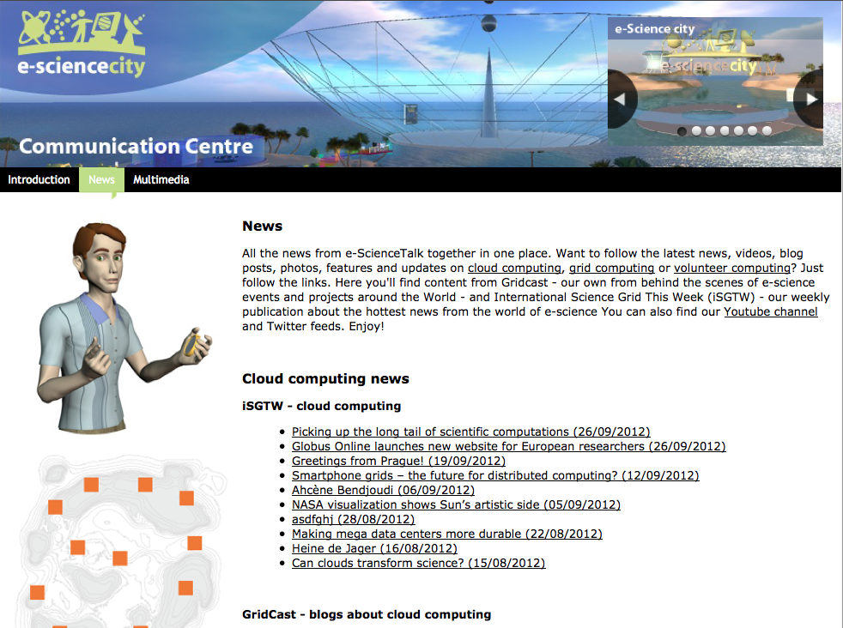
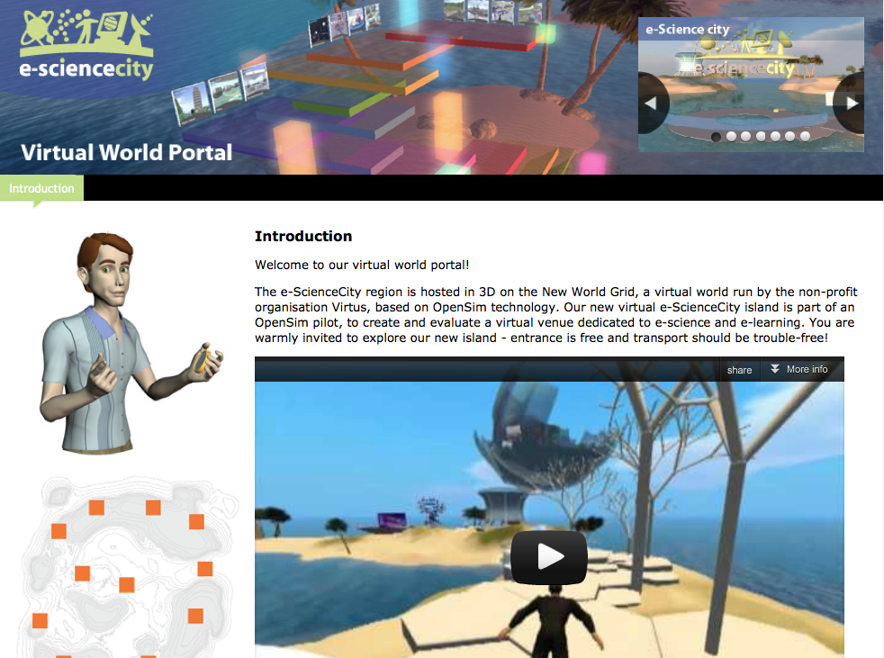
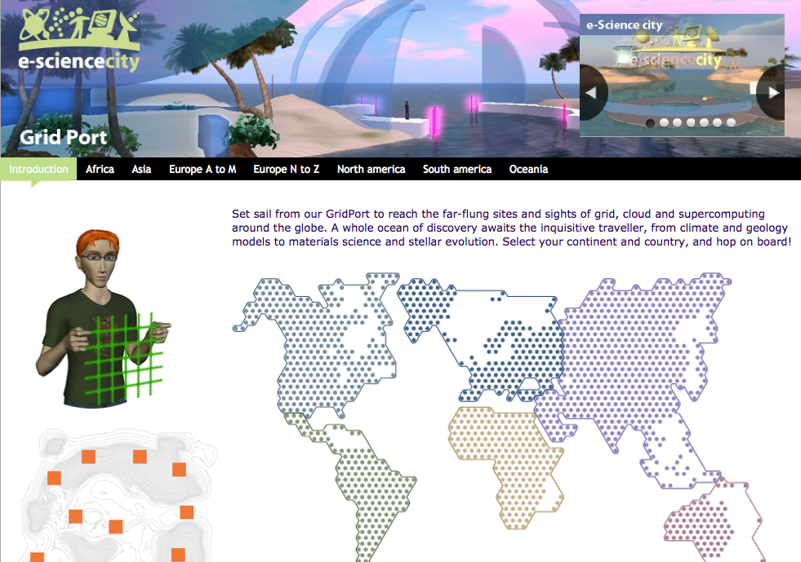
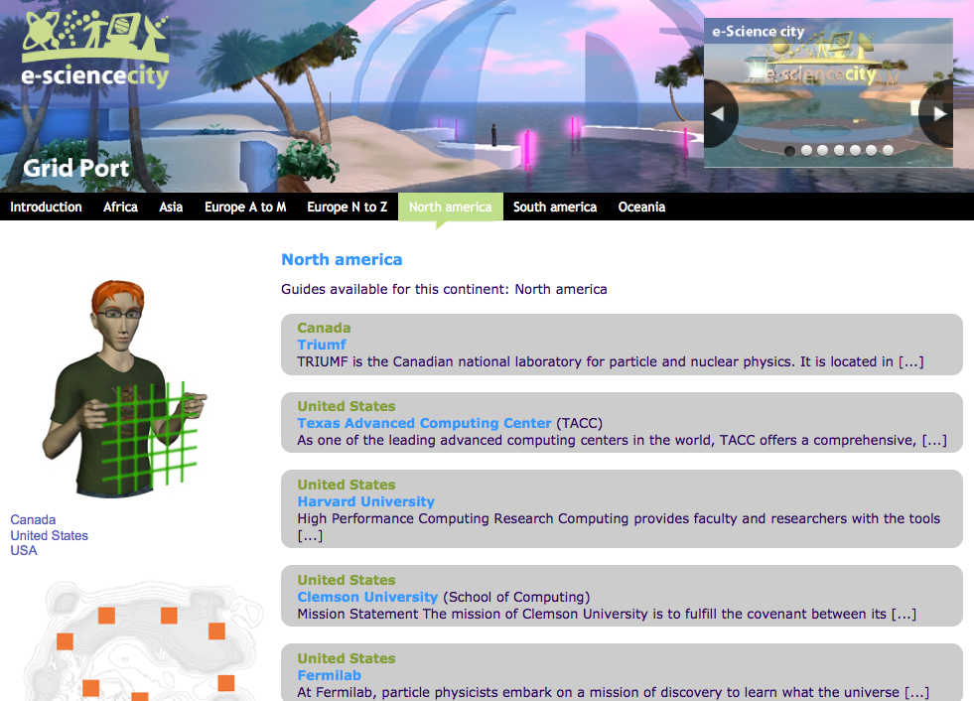
e-ScienceCity website - 2
People Bay
Communication Centre
Virtual World Portal
Grid Port
Grid Port - list
Grid Port - guide

Slide 15
e-ScienceCity website - 3
Total pages : 365 (+229)
GridCafé : 39 pages
CloudLounge : 21 pages
Volunteer Garage : 31 pages
HPC Tower : 35 pages
Data Park : 25 pages
Grid Port : 111 pages
People Bay : 97 pages
Virtual World portal : 1 page
Communication centre : 5 pages
Communication Centre
People Bay

Slide 16
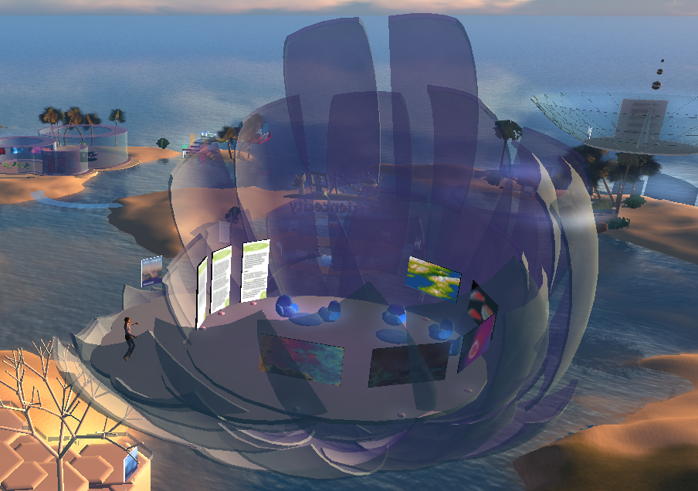
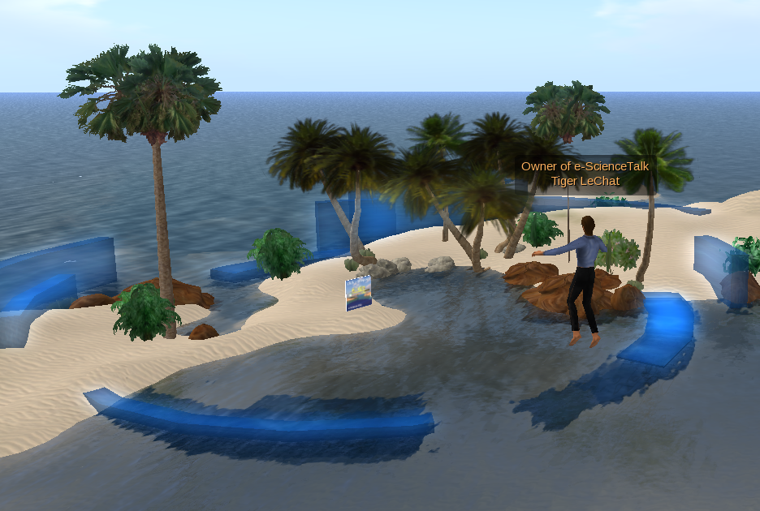
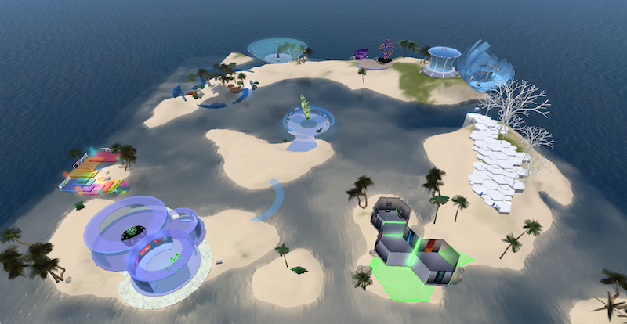
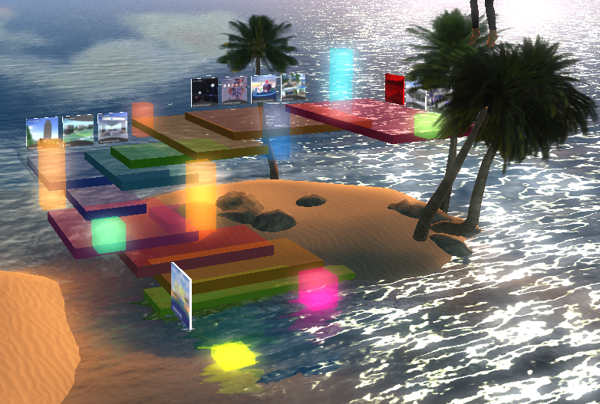
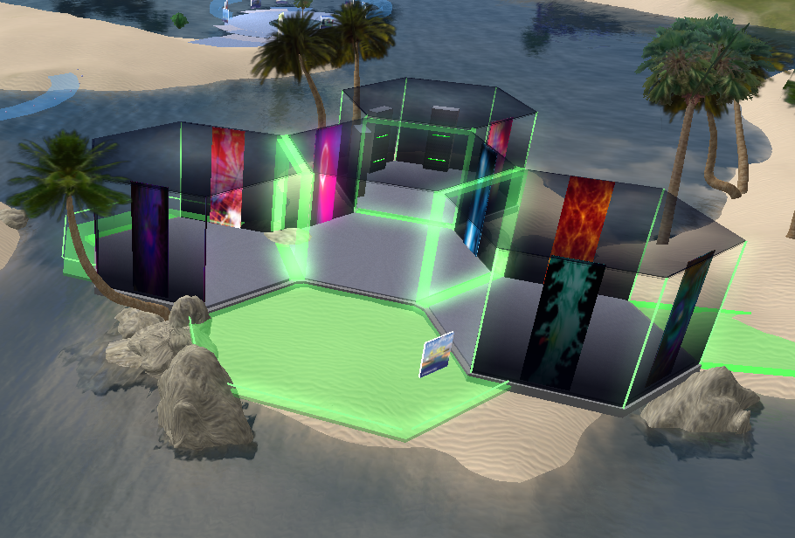
Virtual e-ScienceCity
General view of the virtual e-ScienceCity
with updated venues

Slide 17
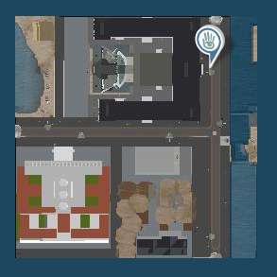
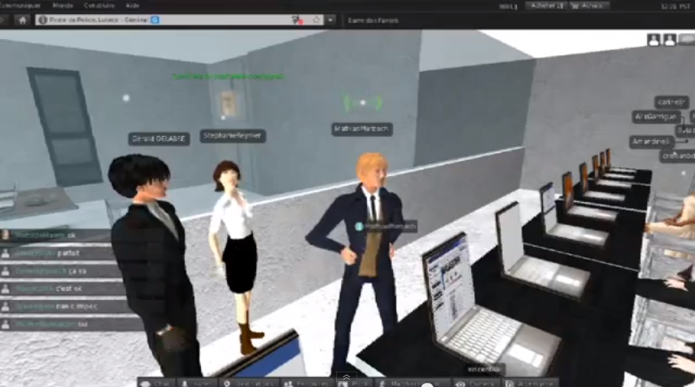
Virtual World promotion
Pédagogie, Universités et Mondes Virtuels, Lyon, 23-24 May 2013
Le Centre Droit et Nouvelles Technologies de la Faculté de Droit de l'Université Jean Moulin Lyon 3 organise une série de colloques consacrés au droit dans les mondes virtuels.
EJournée du
e-Learning,
Lyon,
27-28 June 2013

Slide 18
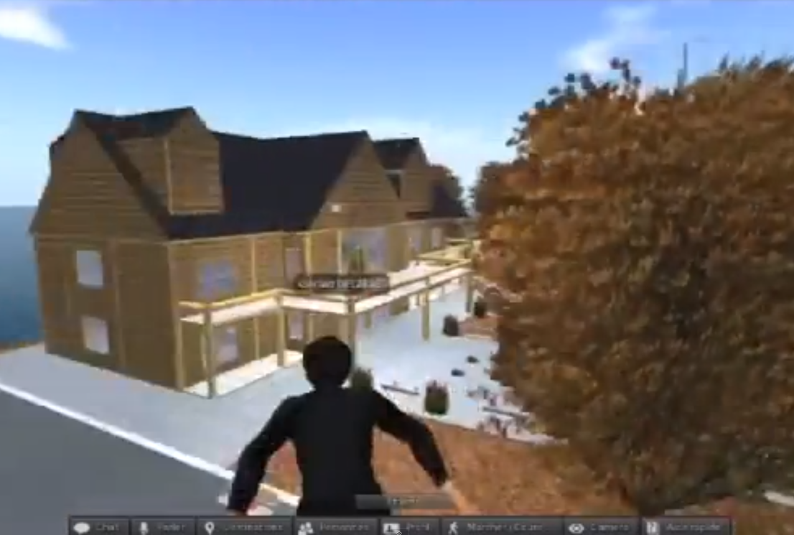
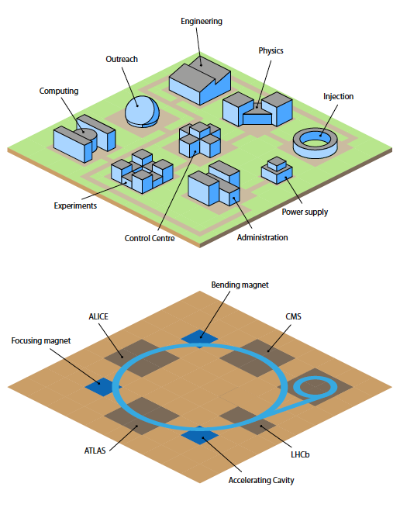
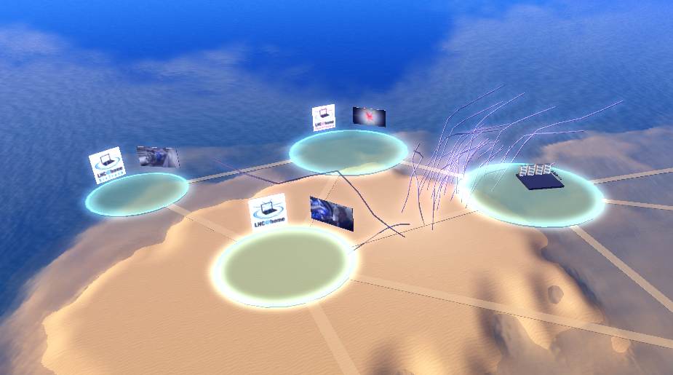
Virtual World linked projects
Possible future collaboration with a project of the Virtual University.
- Open course
- MOOC
- Serious game
“massive open online courses”
CCC project examples
for Volunteer Computing

Slide 19
WP2 Major achievements
Notes:
GridCasts

Slide 20
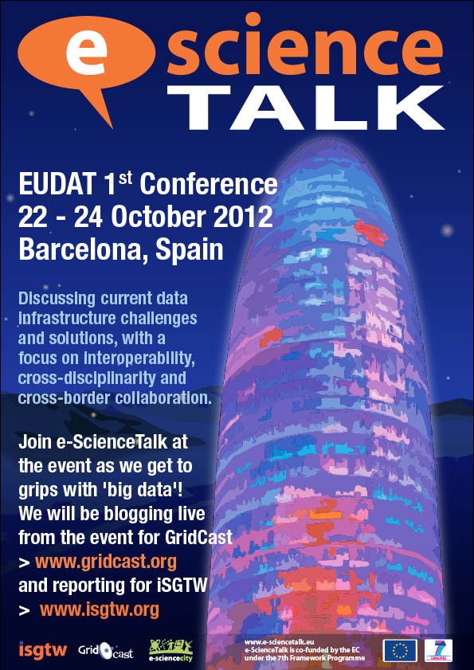
Grid Cast - 1
GridCasts are blogs from major grid computing conferences, taking readers behind the scenes of these events. e-ScienceTalk has held 16 GridCasts in PY3:
EGI Technical Forum 2012, Prague
eChallenges 2012, Lisbon
EUDAT Annual meeting, Barcelona
eIRG meeting, Amsterdam
CloudScape V, Brussels
Notes:
GridCasts

Slide 21
Grid Cast - 2
10th e-Infrastructure Concertation meeting, Brussels
International Symposium on Grids and Cloud 2013, Taipei
EGI Community Forum 2013, Manchester
5th CAPRI Evaluation Meeting, Utrecht
e-IRG workshop, Dublin
ISC’13, Leipzig
XSEDE’13, San Diego
139 posts
Notes:
GridCasts

Slide 22
WP2 Major achievements
Notes:
GridCasts

Slide 23
Grid Guide
GridGuide shows the sites and sights of grid computing. Users can view a sample of the sites worldwide that use the grid, introducing the scientists, the science and their institutions.
In total, 102 guides are currently available worldwide.
43 new guides (sites) have been added, with new content.
North America : 21 (+11)
South America : 5 (+1)
Europe : 53 (+ 17)
Africa : 7 (+6)
Asia : 11 (+6)
Oceania : 5 (+2)
Link to Grid Port

Slide 24
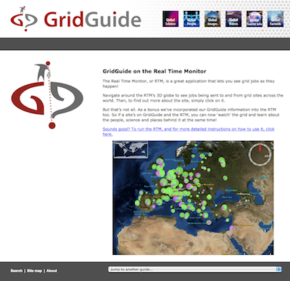
Grid Guide evolution
The e-ScienceGuide is still available
but an updated version is now available
as a new section in e-ScienceCity.
The related virtual venue is under
construction in the virtual e-ScienceCity
Since mid-june
468 page views
345 unique visitors
1:03 min.
75% bounce rate but 29% exit

Slide 25
WP2 Major achievements
Notes:
GridCasts

Slide 26
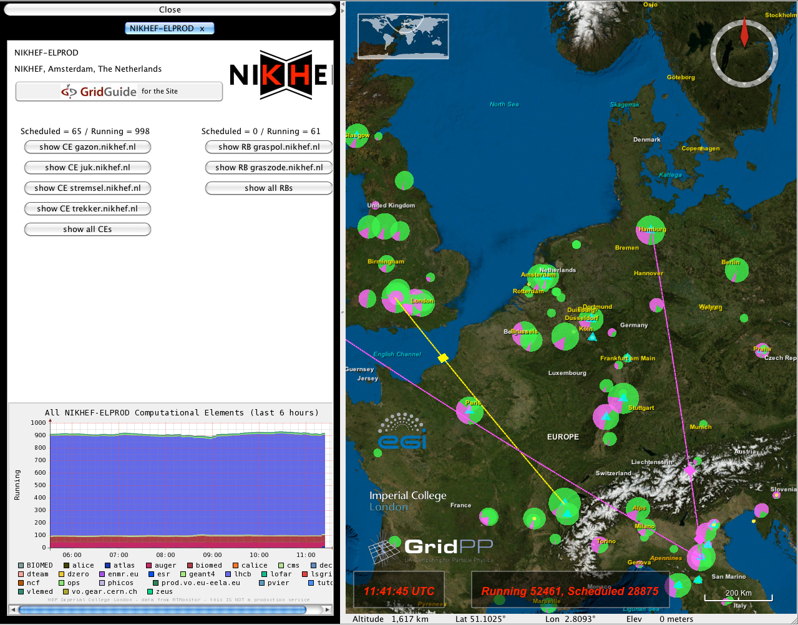
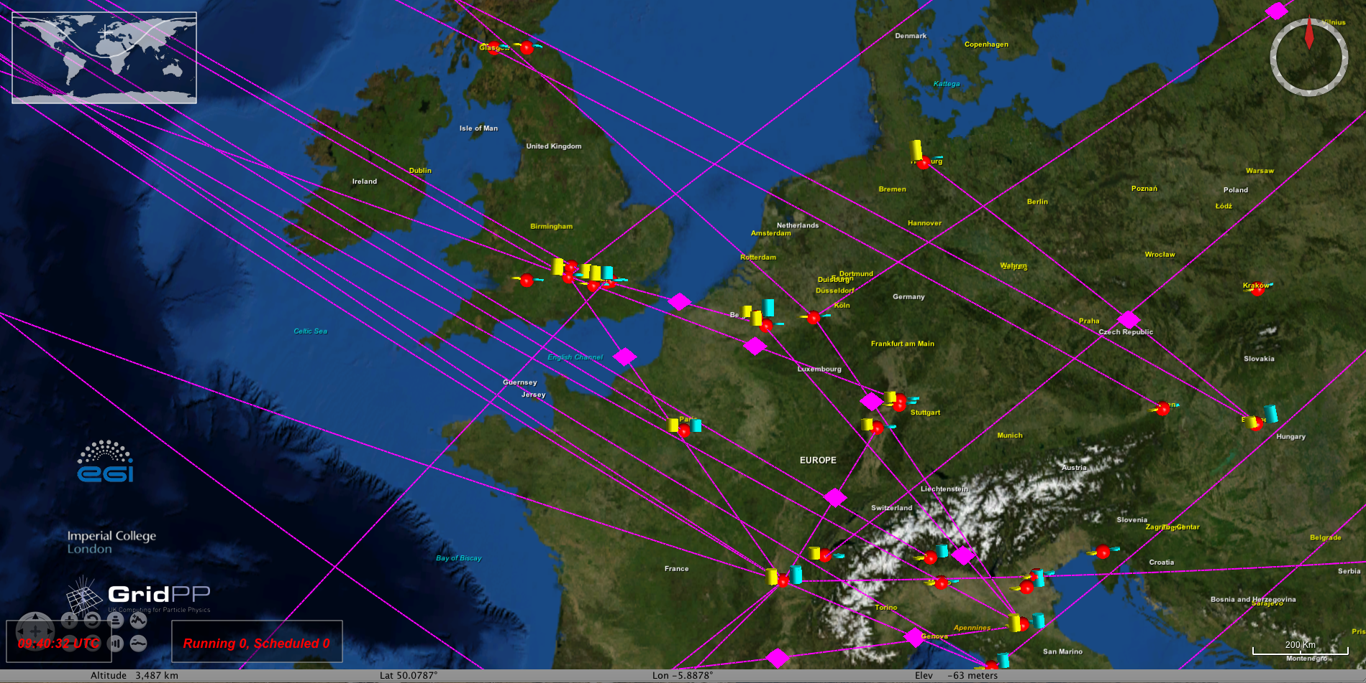
Real Time Monitor

Slide 27
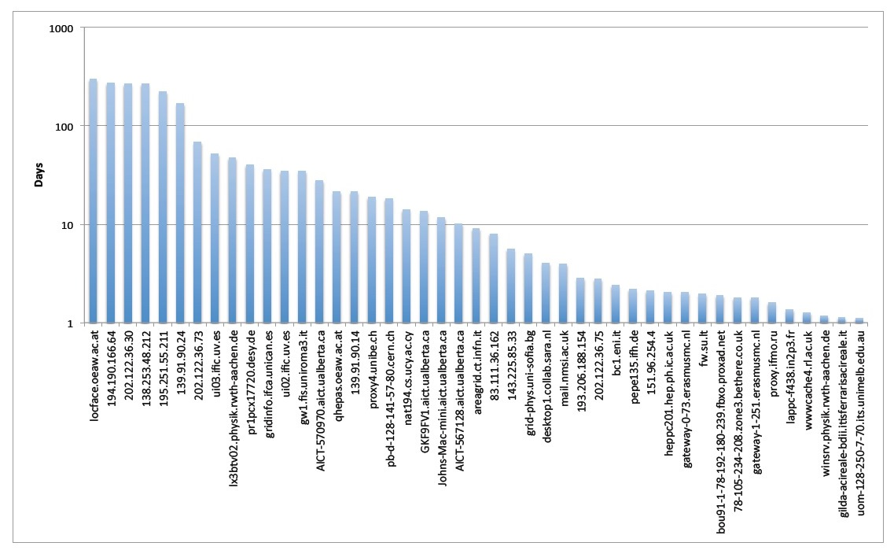
Real Time Monitor

Slide 28
Real Time Monitor
Over 9100 unique visitors to the website
Upgraded to the latest version of the WorldWideWind
In total 59 GridGuide sites are also in the RTM
PhEDEx data from the CMS experiment at CERN fully included
Interface improvements for the Collider exhibition at the London Science Museum
Displayed at events with 30,000 delegates

Slide 29
WP2 Issues
Travel costs
Twitter feed on home page (not solved)
Time needed for development of the virtual city

Slide 30
Web statistics - Y3
e-Science
Talk
e-Con
certa-
tion
e-Science
City
Grid
Café
esc
Grid
Café
cern
Cloud
Lounge
Volunteer
Garage
Grid
Guide
Grid
Cast
Grid
Cast
Blog
iSGTW
Unique
visitors
1,482
634
4,072
2,864*
524
11,121
1,284
705
980
9,665
191,257
1,972
-
1,869
8,761
1,590
516
358
1,470
1,156
9,625
161,624
1,339
-
-
13,852
2,352
-
-
1,549
8,293
-
125,539
Pages
viewed
3,954
2,519
14,317
5,009
1,558
21,895
3,136
1,191
1,966
17,969
529.582
5,741
-
7,695
46,381
21,065
1388
1,298
2,352
2,282
19,643
316,352
450
-
-
26,748
138,843
-
-
2,685
20,373
-
-
265,539
Duration
of visit
in mn
01:22
01:21
04:10
01:09
2:03
01:33
01:41
00:55
00:40
01:18
02:22
01:32
-
02:55
09:51
10:08
01:53
02:37
00:55
00:40
01:24
01:37
01:30
-
-
01:24
00:04
-
-
00:57
02:23
-
01:36
68% 56
44% 41
65% 36
73% 70
58%
78% 57
67% 50
83%
83%
74% 67
66%
Bounce
rate
69%
-
60%
64%
75%
69%
62%
81%
86%
73%
71%
72%
-
-
72%
98%
-
-
79%
73%
-
73%
New
visits
65%
60%
77%
80%
86%
89%
80%
76%
57%
79%
75%
59%
-
67%
36%
25%
80%
68%
80%
59%
73%
76%
48%
-
-
76%
2%
-
-
75%
65%
-
71%
2116 uv
* 6 months
19935 pv / 10645 uv
Y3 e-Sci. City unique visitors : 20,570 (+ 7,476)
Y3 Total unique visitors : 33,435 ( + 6014)
Y2 e-Sci. City unique visitors : 13,094 (- 3,110)
Y2 Total unique visitors : 27,317 ( - 92)
Y1 e-Sci. City unique visitors : 16,204
Y1 Total unique visitors : 27,409

Slide 31
Web statistics - Y3 - summary
e-ScienceTalk
17,281 briefing downloaded
e-ScienceCity
GridCast
6.473
47.106
19.935
RTM
YouTube
iSGTW
9.176
245.044
est. 30,000 view
from events
529.582

Slide 32
What has been done? - 1
e-ScienceTalk
- Update and improvement of e-ScienceTalk portal web site
- New Event section
YouTube
- 31 new videos on YouTube channel to a total of 260
e-ScienceCity
- e-ScienceCity completed and replaced the original GridCafé web site
- Content is now divided into 9 sections with a total of 365 pages
- New content : Data Park, Grid Port; update of People Bay
- Updated content on virtual island (work in progress for newer sections)

Slide 33
What has been done? - 2
GridCast
- GridCast participation to 16 events
- 139 posts on the GridCast blog
GridGuide
- 43 new guides added to the GridGuide for a total of 102 guides in 5 continents
- Embedded version of GridGuide in e-ScienceCity web site
RTM
- Regular update, improvement and presentation of RTM

