Slide 1
The future of e-ScienceTalk
Catherine Gater
e-ScienceTalk Project Coordinator, EGI.eu
www.e-sciencetalk.eu

Slide 2
Content
Impact and sustainability
Activities in PY3
Long term sustainability
Summary

Slide 3
Impact and sustainability
www.e-sciencetalk.eu

Slide 4
Impact and sustainability
Assessed the impact of each product during PY3
Estimated what is needed in terms of effort and/or funds to maintain the product beyond e-ScienceTalk
Explored how this might be achieved
Made changes to promote sustainability

Slide 5
e-ScienceBriefings
Impact
People are aware of the Briefings at meetings
Downloads tripled in PY3 to 17,281
Mailed to policy makers directly
Subscriber list increased by 22%
Sustainability
In order to develop future issues of the e-ScienceBriefings, time and effort would have to be funded (3 weeks for content curation, 1-2 days design)
Sponsor would need to have over-arching policy aims e.g. e-IRG
Will be added to SEED Resource Library
Notes:
*Currently e-IRG features a summarised version of the Briefing

Slide 6
GridCast
Impact
Wide reaching with 162,575 page views in its lifetime
YouTube channel has grown by 40% in subscribers, 18% more views
Creates a self-perpetuating cycle of information sharing with the community
‘Long tail’ of interest after the event
Sustainability
Built on Blogger, a low cost platform
Some funded effort needed for moderation and recruitment of bloggers
Videos are a major draw and again need funded effort
Could be funded through media partnerships and ESFRI cluster collaborations on a per event and per project basis
Rename to reflect its wider scope eg eCast

Slide 7
e-ScienceCity
Sustainability
What is the main barrier to impact?
Improve discovery via pro-active marketing of GridCafé and e-ScienceCity
Have we demonstrated value?
Success drivers/ attributes for potential funders (high quality content, Open Access/ShareAlike, cross-disciplinary appeal)
Assessed both usability and value of sites as an information resource e.g. measure change in knowledge pre- and post-test visit for sites
Added new sections e.g. data park, comms centre, GridPort

Slide 8
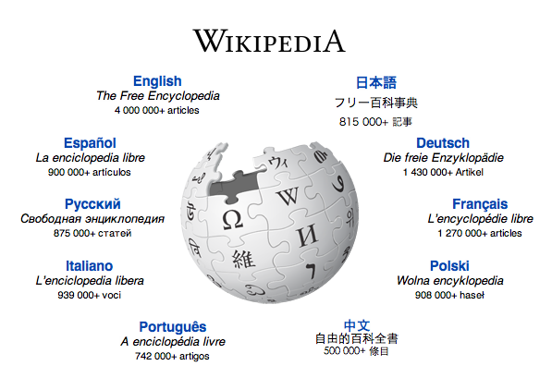
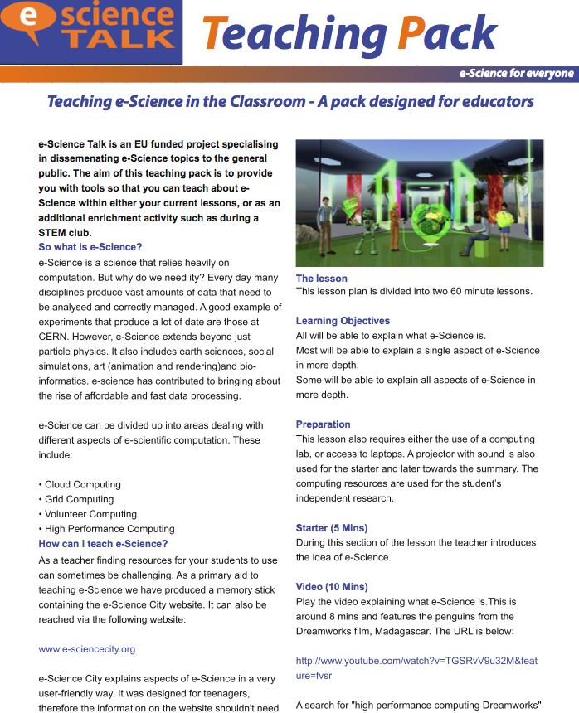
e-ScienceCity
Sustainability: PY3 Marketing
Marketing plan: wikipedia, social media, iSGTW, internal linking, schools pack, conferences, videos
Notes:
INSERT JAMES Marketing plan

Slide 9
e-ScienceCity
Impact
Google Page Rank of 6.0
Dip in traffic to GridCafe due to change in link forwarding policy at CERN
Since Sep 2011, received 20,473 page views and 5424 unique visitors
Cloud Lounge has grown from 1388 page views in PY2 to 17,834 in PY3
Visitors found the sites informative and wanted to read more
A useful educational resource
Sustainability
Potential to become a community hub with added multimedia resources
Platform to promote the achievements of e-science under H2020
Continuing professional development
Initial low maintenance but funding needed for development and marketing
Notes:
*Currently e-IRG features a summarised version of the Briefing

Slide 10
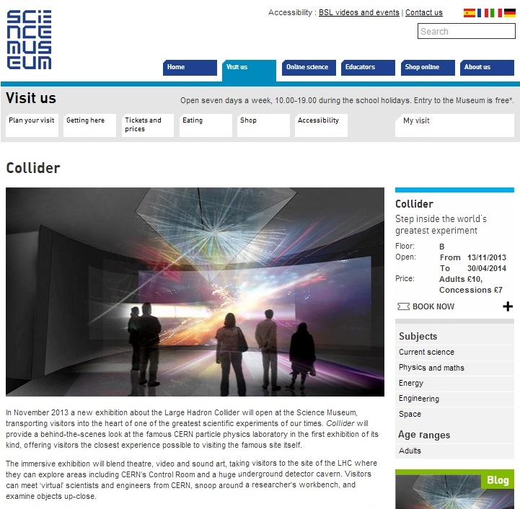
GridGuide and RTM
Impact
GridGuide
Now 102 sites on GridGuide
Used by researchers to promote their projects
Incorporated into e-ScienceCity as GridPort
Real Time Monitor
Seen by around 30,000 at events
Adopted by the Science Museum for the Collider exhibition – potentially tens of thousands of visitors

Slide 11
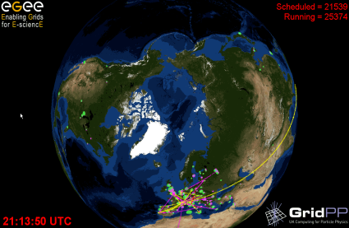
GridGuide and RTM
Sustainability
GridGuide
Low response to our campaign to increase the content on existing guides
Sustained as GridPort within the e-ScienceCity
RTM
One of our most popular products
Users are interested in developing the RTM
Potential for new LHC data to be included
RTM can not be maintained long term using best effort or volunteer effort

Slide 12
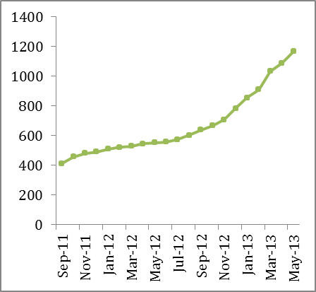
iSGTW
Impact
1297 Facebook likes
1796 Twitter followers
Greater % referrals from social media
iSGTW website has received 421,222 unique visitors and over 1 million page views
Over 8770 subscribers, 241 more than the project target

Slide 13
iSGTW
Sustainability
ISGTW continues to nurture a network of unfunded contributors from a wide range of projects in all its contributing regions.
One of the unique selling points is our independent voice in support of all areas of science and e-science.
Positioned iSGTW as the preferred channel for the research community and major e-infrastructures in Europe (e.g. ESFRI, PRACE etc.)
Ongoing media partnerships (ISC Cloud Conference 2013, ISC 2013, ISC Big Data)
Indiana University has secured NSF funds for an iSGTW US editor for 3-5 years.
Funding is needed from the EU side for a dedicated editor role.
Current funding is for 0.75 FTE for 12 months
Content reduced to keep iSGTW sustainable as a weekly publication

Slide 14
Future sustainability
e-ScienceBriefings
Will not be produced after the e-ScienceTalk project has ended.
Policy work to continue with EGI.eu
Will be uploaded to the SEED Resource Library (Insight Publishers)
GridCafé and e-Science City
GridCafé is a long-lasting and sustainable product, having been launched in 2004.
Maintenance of the website in terms of updating content is expected to be relatively low now the e-ScienceCity is completed.
URLs purchased for 6 years
Available as a standalone site on a USB key for the Schools Pack
Created plain static versions of the websites that do not use databases/scripts and the full site has been archived
Funding needed for future development and marketing.

Slide 15
Future sustainability
GridCast
GridCast was originally produced by CERN and therefore has already been shown to be sustainable.
Voluntary blogging by people outside the e-ScienceTalk project has built an online community of over 100 regular contributors.
Moderator needed to ensure content is up-to-date, relevant and appropriate to the users and to recruit bloggers.
Funded effort needed to continue video contributions.
GridGuide and Real Time Monitor
GridGuide audience not as well defined as the other products.
GridGuide now incorporated into the e-ScienceCity to make it more sustainable.
The RTM has previously received development funding from GridPP, the UK’s grid for physics
Supported by Imperial on a best effort basis for the Collider exhibition

Slide 16
Future sustainability
iSGTW
iSGTW has built up many loyal subscribers over the years.
e-ScienceTalk will continue to explore media sponsorship and in-kind support from collaborating projects e.g. SC’13, ISC series, EUDAT
Due to its partnership with the Indiana University in the US, iSGTW cannot currently accept advertising revenues.
Covering more commercial topics could risk alienating the audience we have built so far.
Positioned iSGTW as the preferred channel for the research community and major e-infrastructures in Europe for Horizon2020.
Contributions of editorial effort from other institutions around the world, including in the Asia-Pacific region and US.
iSGTW continues to nurture a network of unfunded contributors from a wide range of projects.
Secure ongoing support for the website hosting and CMS maintenance / upgrade.

Slide 17
DoW budget changes PY3
Moved estimated underspent budget to central budget for:
management travels
final e-Concertation meeting (6-7 March 2013)
Finalised costings for support of the iSGTW website to the end of the project
Legal protection of e-ScienceTalk products beyond the end of the project
Moved MS3 from PM26 to PM31
No-cost extension to the project to 31 July 2013

Slide 18
Beyond e-ScienceTalk
www.e-sciencetalk.eu

Slide 19
Impact of e-ScienceTalk
The reviewers further suggest that
the consortium explores a possible future role in providing a dissemination platform and services for e.g. eInfrastructure and other EU-funded projects. This approach could provide long-term sustainability for eScienceTalk products while assuring a useful and needed service.
EC PY1 Review
The reviewers urge the Commission to recognise this opportunity and to consider some form of direct funding for the professional skills and services developed by e-ScienceTalk, perhaps along the lines of OpenAIRE.
EC PY2 Review
Together, these e-ScienceBriefings show that e-Science in Europe is reaching a real maturity and delivering tangible results, which in turn are promoted and disseminated by projects such as e-ScienceTalk. We can look forward to a bright future on the horizon for European science and society.
Thierry van der Pyl, Director EC
DG Communications Networks

Slide 20
Beyond e-ScienceTalk
WP1: Policy and impact
E-ScienceTalk: 1.6 FTE QMUL
In-kind after 2013: not currently foreseen
WP2: GridCafe, GridGuide and RTM
E-ScienceTalk: 1 FTE APO, 0.5 FTE Imperial
In-kind after 2013: 0.1 - 0.2 FTE Imperial
APO hosting costs for websites
WP3: iSGTW
E-ScienceTalk: 2 FTE CERN
In-kind after 2013: 1 fellow CERN editorial 0.75 FTE, QMUL 0.1 FTE CMS and hosting, US Desk Editor 1 FTE
WP4: Management
E-ScienceTalk: 0.5 FTE EGI.eu
In-kind after 2013: 0.1 FTE to keep consortium together and coordinate project proposals.
In kind resources proposed on the assumption that the Commission foresees funding for these activities in Horizon2020.
E-ScienceTalk consortium is an ideal vehicle to provide communication channels for the e-Infrastructure projects, going into Horizon2020.
Support may lapse if not partnered by the Commission or focus may move away from the EC projects.

Slide 21
ScienceTalkToo
To showcase the project results from e-science and big data coming out of Europe’s Distributed Computing and Data Infrastructures (both e-Infrastructures and Research Infrastructures), to support societal challenges.
The project will highlight success stories through a regular online publication, iSGTW, websites such as e-ScienceCity, blogs, social media channels and will be coupled with a virtual world.
The channels will be informed and supported by establishing a ‘bottom up’ network of e-science ambassadors across Europe who will go behind the scenes at events to communicate the impact of e-infrastructures to researchers in the ‘long tail’ of science, in Europe and beyond.
In order to develop human capital, the project will also provide specialist communications and marketing training to the ambassadors and to members of both Research Infrastructures and e-Infrastructures projects.
The policy and impact team will produce policy briefings aimed at DCDI stakeholders on key community issues and will communicate the exciting possibilities presented by the infrastructures for academia, RIs and Industry.
The project will build on the successes of e-ScienceTalk to facilitate cooperation between European e-infrastructures with their non-European counterparts through international collaborations such as iSGTW.
A clear set of metrics and Key Performance Indicators will monitor results and impact.

Slide 22
Summary
High overall impact for the e-ScienceTalk products.
Sustainability activities now in action to continue products beyond e-ScienceTalk.
Established e-ScienceTalk as an ongoing platform for promotion of e-Infrastructures by providing additional services.
Prepare for Horizon2020 calls.

