Slide 1
e-ScienceTalk – WP2
André-Pierre Olivier - WP2 Leader, APO

Slide 2
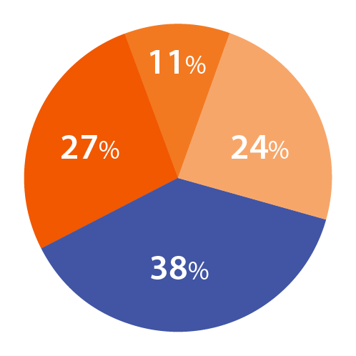
WP2 Overview
Participant
Effort distribution
Beneficiaries: 4
Effort: 72 PMs / 2.2 FTEs
WP4: Management
WP1: iSGTW
WP1:
Policy
23 PM
10 PM
WP2: GridCafé
25 PM
Task 2.1 GridCafé
APO and CERN
Task 2.2 Real Time Monitor and GridGuide Imperial with APO, CERN and QMUL
Task 2.3 GridCast
QMUL with APO and CERN
14 PM

Slide 3
WP2 Objectives
Keep the GridCafé at the cutting edge of grid and e-Science dissemination by refreshing the look and feel and keeping it constantly updated with new material, expanding the content to cover other forms of computing.
Explore interactive environments and new web tools to ensure that GridCafé and GridCast have impact on their audiences and are easy to use.
Update the GridCast website and expand the marketing of the GridCast site to the grid and e-Infrastructure community and beyond.
Expand the GridGuide to cover more sites, improve its impact and develop further interactive functionality between the GridGuide and the Real Time Monitor.
Explore the continuation of the BELIEF Digital Library and support the e-concertation meetings.

Slide 4
Web statistics - Y2
e-Science
Talk
e-Con
certa-
tion
e-Science
City
Grid
Café
esc
Grid
Café
cern
Cloud
Lounge
Volunteer
Garage
Grid
Guide
Grid
Cast
Grid
Cast
Blog
iSGTW
Unique
visitors
1,372
594
3,703
2,864
523
9,222
1,140
645
813
8,925
-
1,972
-
1,869
8,761
1,590
516
358
1,470
1,156
9,625
161,624
1,339
-
-
13,852
2,352
-
-
1,549
8,293
-
125,539
Pages
viewed
3,656
2,415
13,122
5,009
1,557
17,834
2,822
1,082
1,704
16,943
-
5,741
-
7,695
46,381
21,065
1388
1,298
2,352
2,282
19,643
316,352
450
-
-
26,748
138,843
-
-
2,685
20,373
-
-
265,539
Duration
of visit
in mn
01:20
01:21
04:22
01:09
2:03
01:30
01:41
00:54
00:41
01:18
-
01:32
-
02:55
09:51
10:08
01:53
02:37
00:55
00:40
01:24
01:37
01:30
-
-
01:24
00:04
-
-
00:57
02:23
-
01:36
68%
44%
65%
73%
58%
79%
67%
84%
83%
74%
-
Bounce
rate
69%
-
60%
64%
75%
69%
62%
81%
86%
73%
71%
72%
-
-
72%
98%
-
-
79%
73%
-
73%
New
visits
65%
60%
77%
80%
86%
89%
79%
77%
57%
79%
-
59%
-
67%
36%
25%
80%
68%
80%
59%
73%
76%
48%
-
-
76%
2%
-
-
75%
65%
-
71%
Y3 e-Sci. City unique visitors : 18,097 (+ 5,003)
Y3 Total unique visitors : 29,801 ( + 2484)
Y2 e-Sci. City unique visitors : 13,094 (- 3,110)
Y2 Total unique visitors : 27,317 ( - 92)
Y1 e-Sci. City unique visitors : 16,204
Y1 Total unique visitors : 27,409

Slide 5
WP2 Major achievements

Slide 6
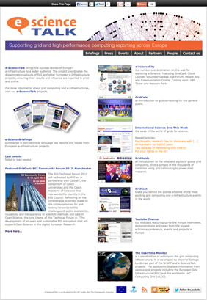
e-ScienceTalk website
1
e-ScienceTalk is the project website;
it is designed to be a simple-to-use portal,
guiding people to our different websites.
It also gives access to a lot of the project's material such as e-ScienceBriefings (in PDF and HTML versions), posters, leaflets, and other documents produced since the beginning of the project.
New add :
1 - Improved Social media links
2 - New Event section
3 – Link to the new GridPort
4 - Improved link to YouTube channel
2
3
4

Slide 7
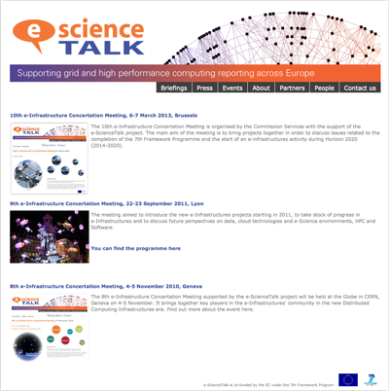
e-ScienceTalk Event section
594 Unique visitors
2,415 Pages viewed

Slide 8
e-ScienceTalk YouTube
260 videos (+ 31)
140 Subscribers (+ 33)
245,044 video views (+ 31,764)

Slide 9
e-ScienceTalk
What has been done?
Update of e-ScienceTalk portal web site
New Event section
Update of YouTube channel (+ 31 videos)
New sections in e-Science City (Data Park – Grid Port)
New content on virtual island
Grid Cast participation to ?? events
Regular update of GridCast blog
New guides added to the Grid Guide (+ 43)
RTM improvement

Slide 10
WP2 Major achievements

Slide 11
e-ScienceCity concept
e-ScienceCity replace the Grid Café as the main web site.
Grid café become one of the section of the site like the other :
Cloud Lounge, Volunteer Garage, HPC Tower...
In parallel a virtual e-ScienceCity is also available in a 3D virtual world hosted by New World Grid.
e-ScienceCity was launched in September 2011, and has been updated during year 2 of the project. We continue to create new content and sections to populate the site (Network Park...).

Slide 12
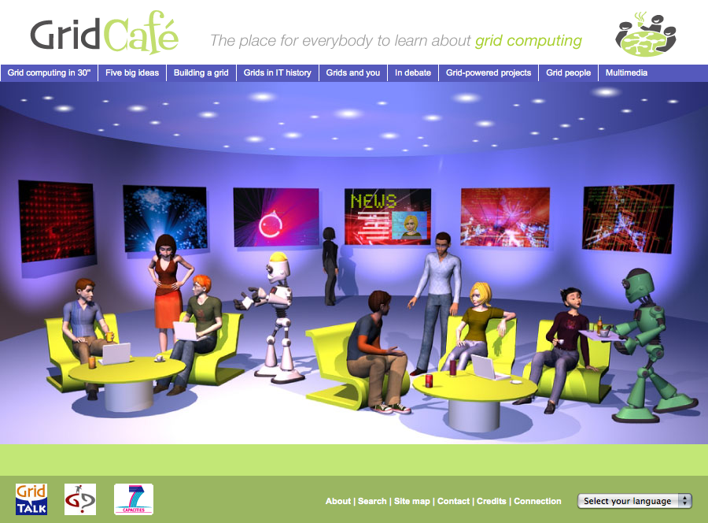
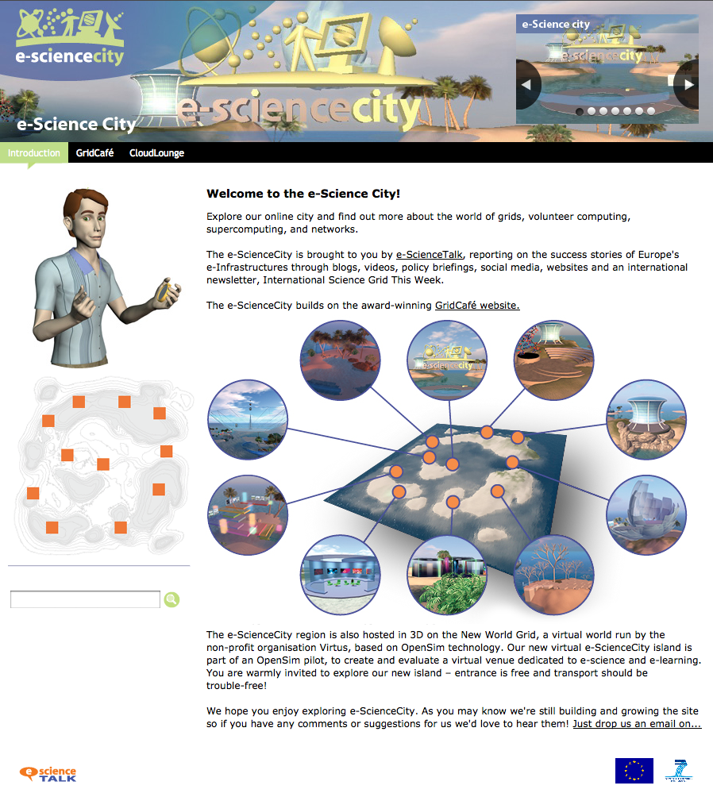
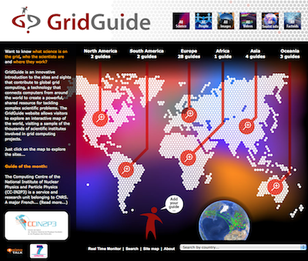
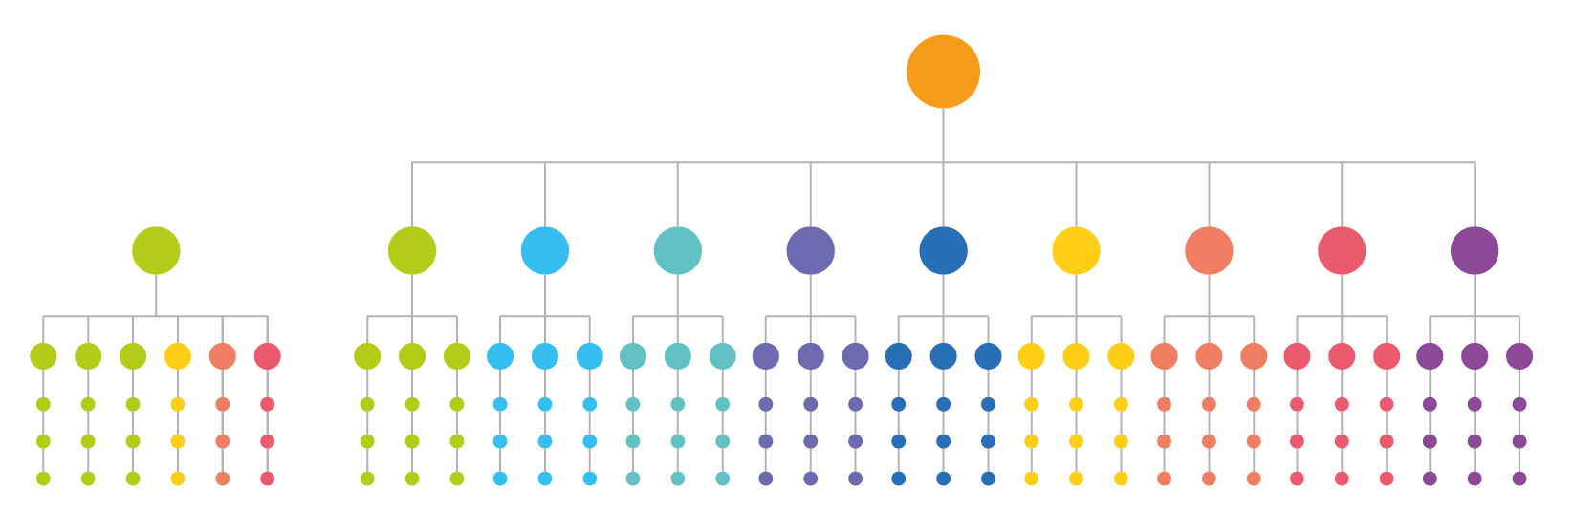
The evolution
From Grid Café to e-ScienceCity

Slide 13
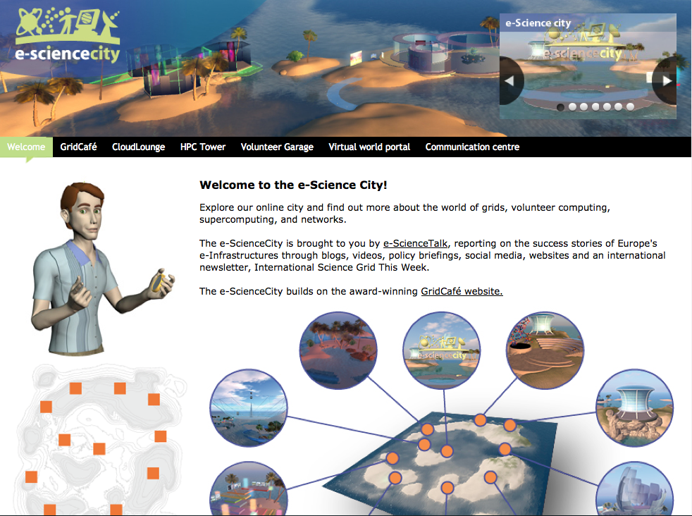
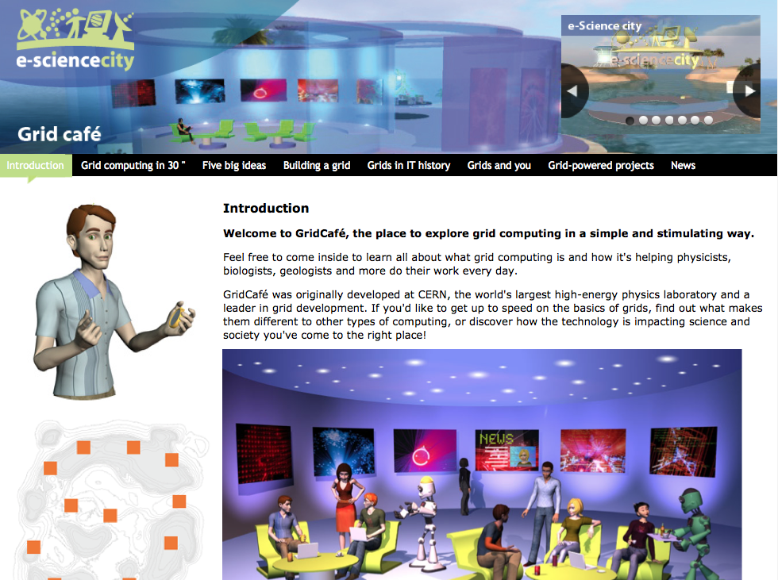
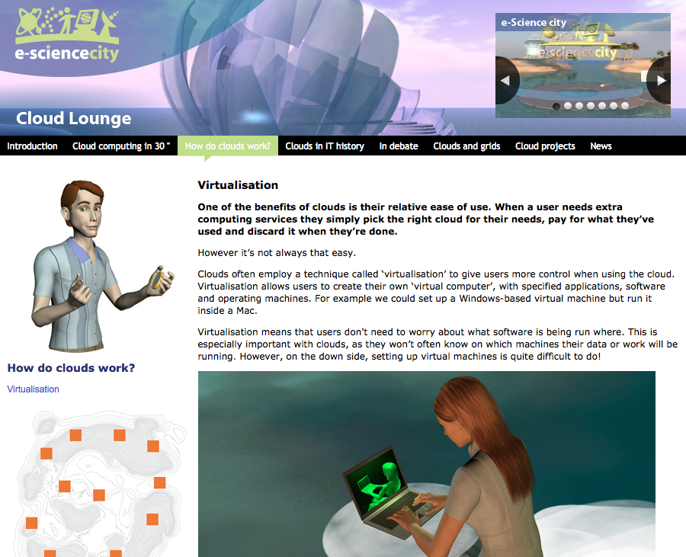
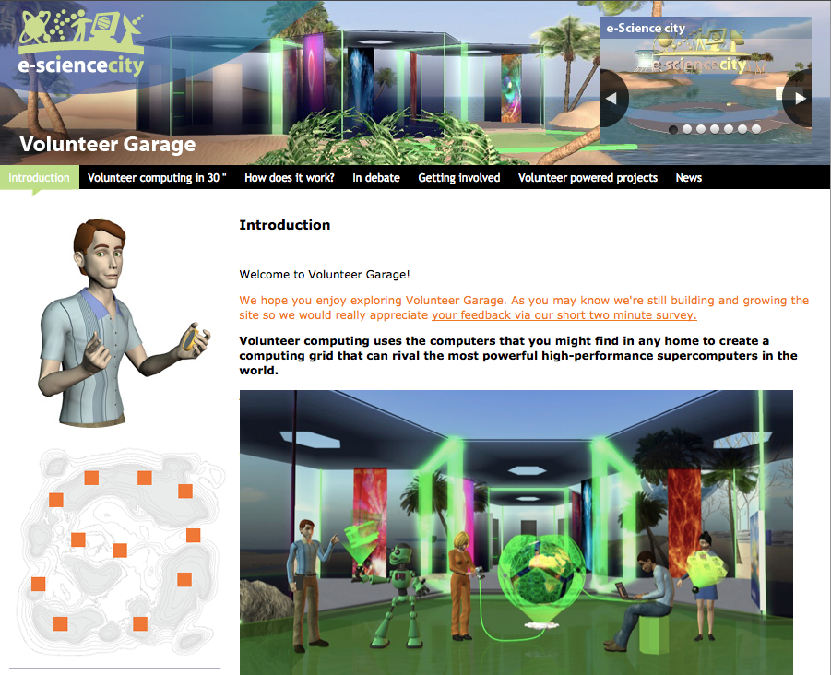
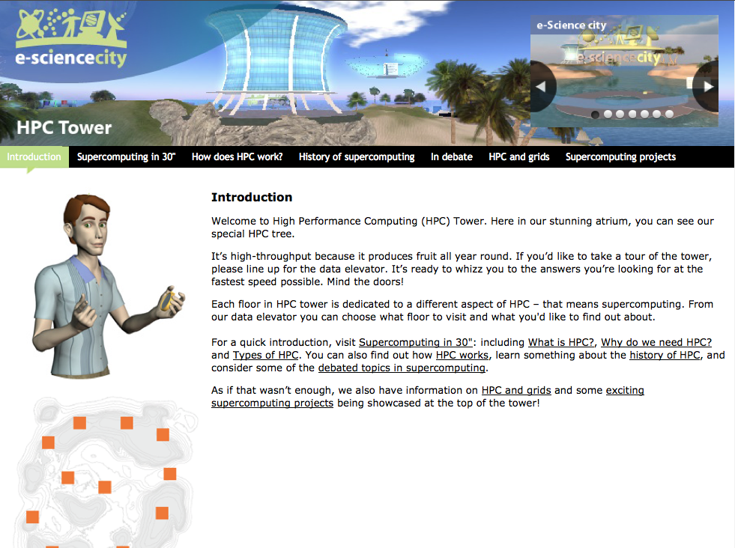
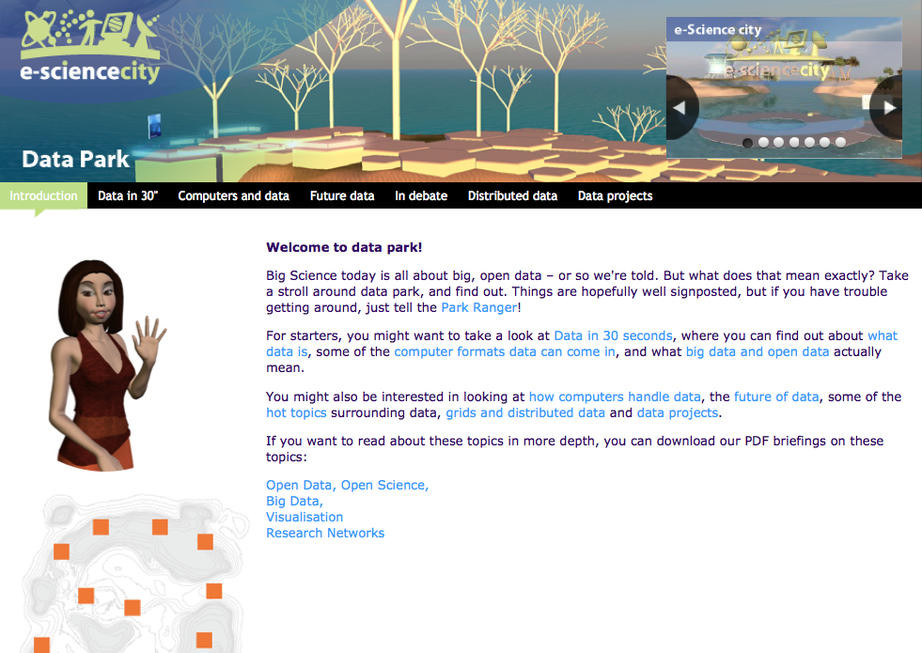
e-ScienceCity website - 1
e-ScienceCity
GridCafé
Cloud Lounge
Volunteer Garage
HPC Tower
Data Park

Slide 14
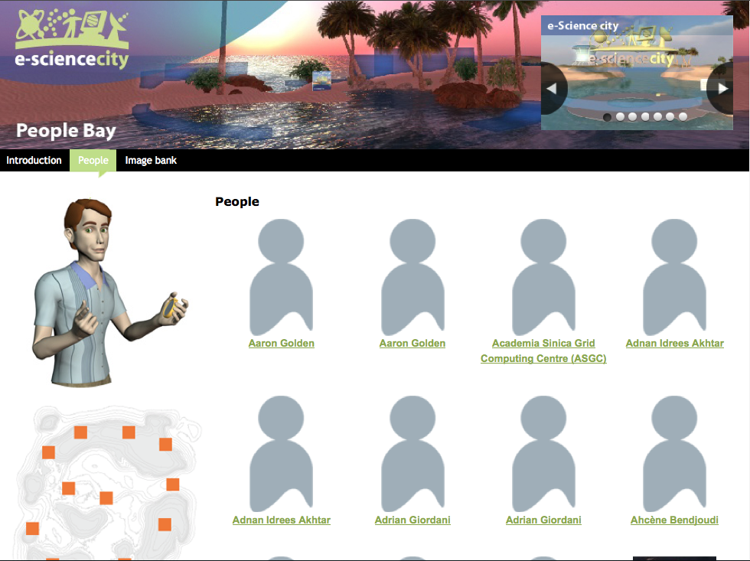
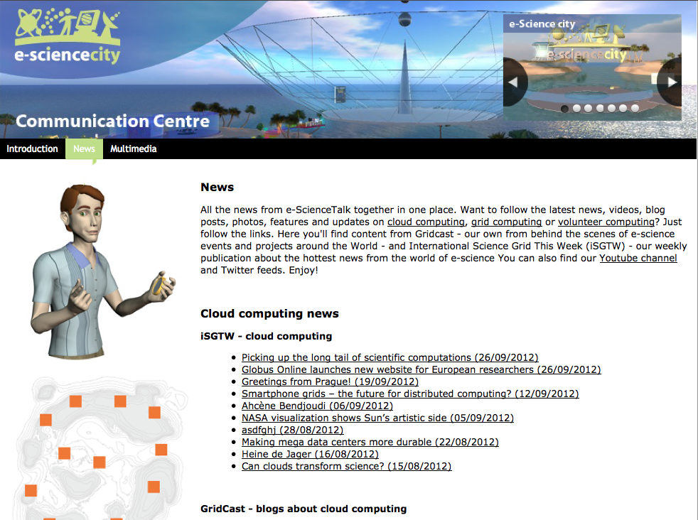
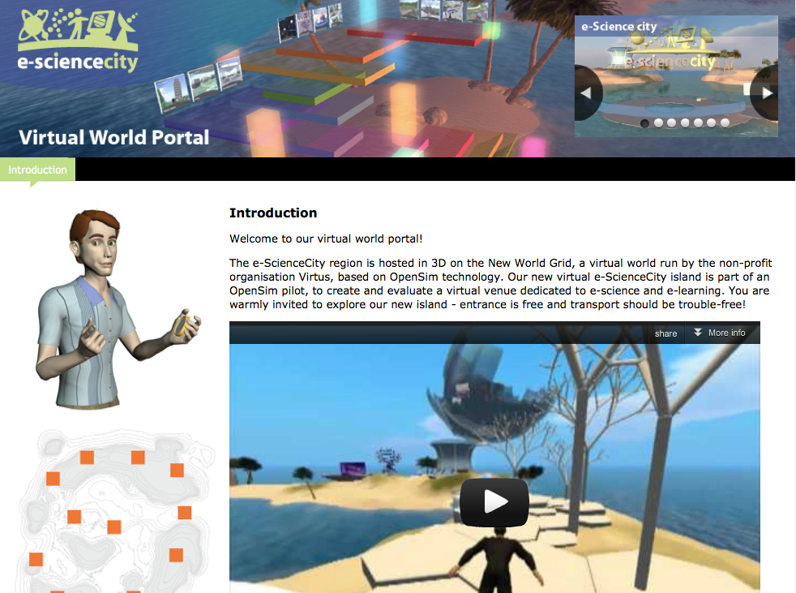
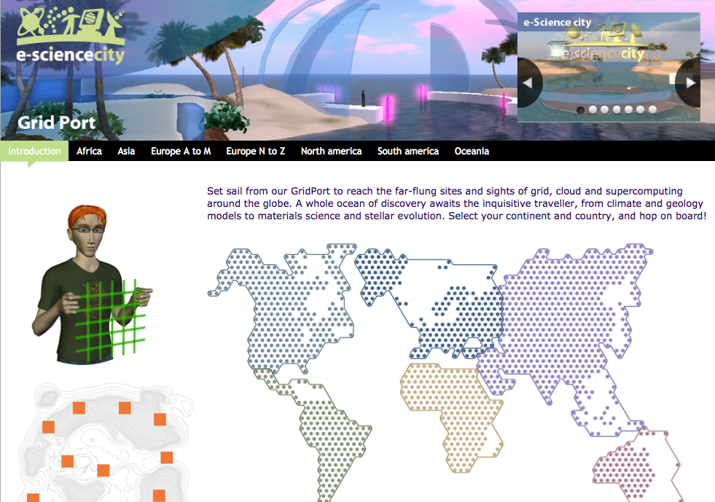
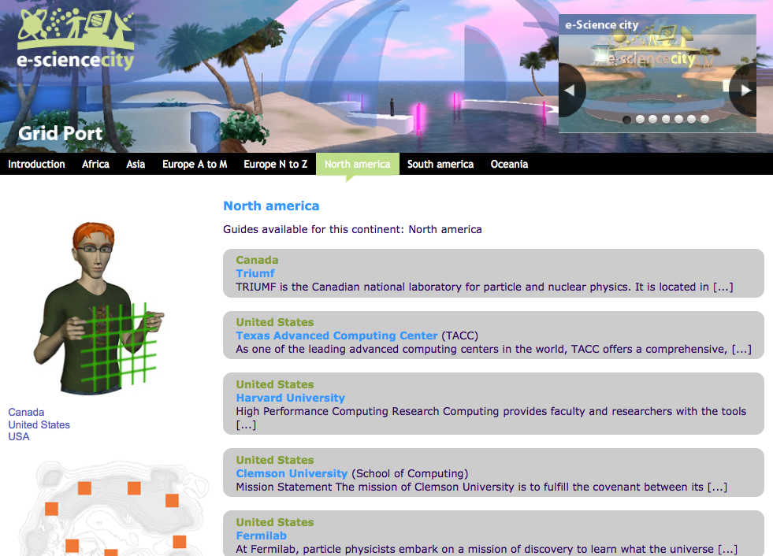
e-ScienceCity website - 2
People Bay
Communication Centre
Virtual World Portal
Grid Port
Grid Port - list
Grid Port - guide

Slide 15
e-ScienceCity website - 3
Total pages : 365 (+229)
GridCafé : 39 pages
CloudLounge : 21 pages
Volunteer Garage : 31 pages
HPC Tower : 35 pages
Data Park : 25 pages
Grid Port : 111 pages
People Bay : 97 pages
Virtual World portal : 1 page
Communication centre : 5 pages
Communication Centre
People Bay

Slide 16
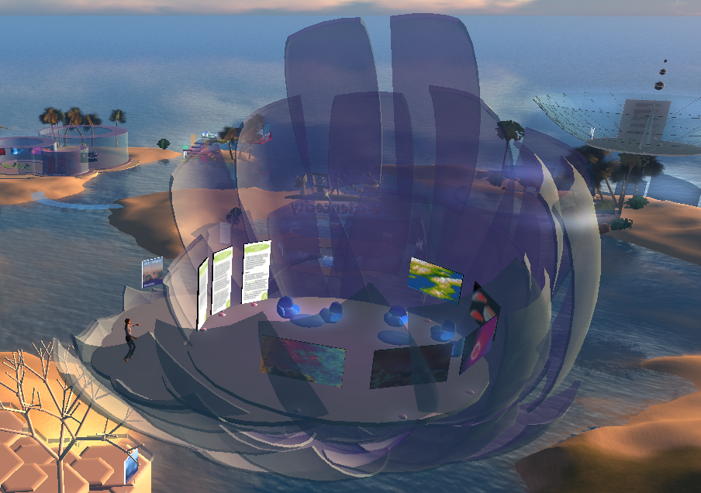
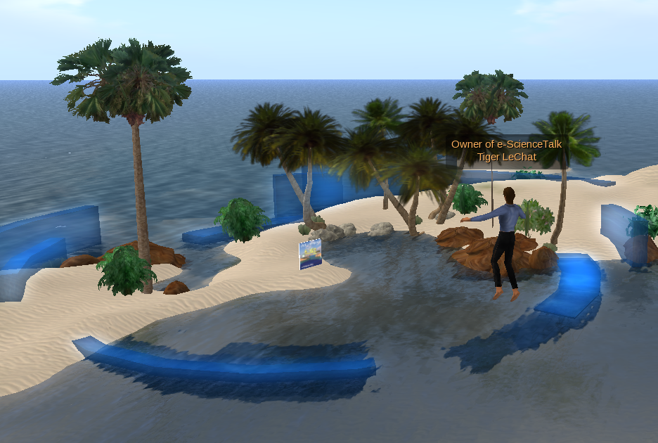
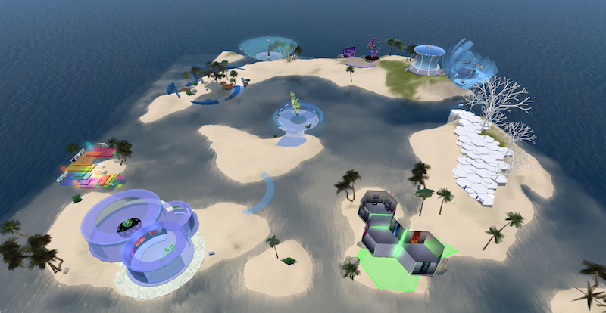
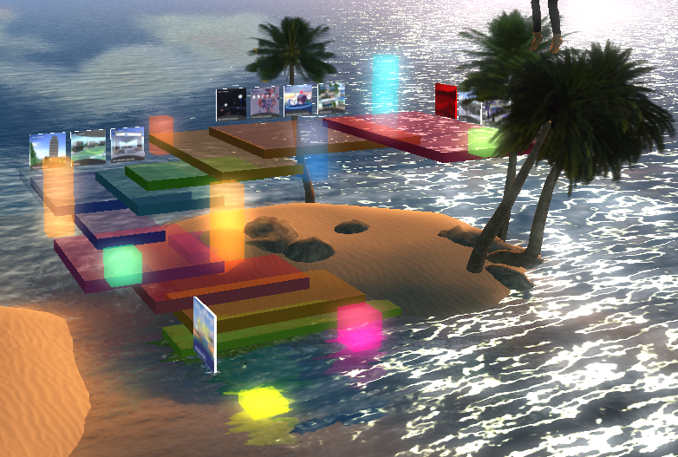
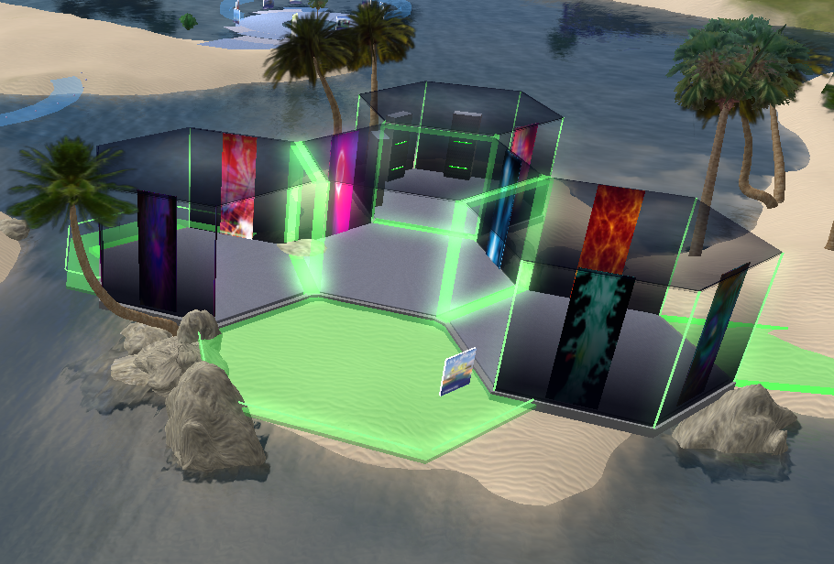
Virtual e-ScienceCity
General view of the virtual e-ScienceCity
with updated venues

Slide 17
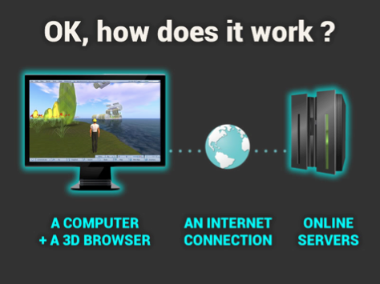
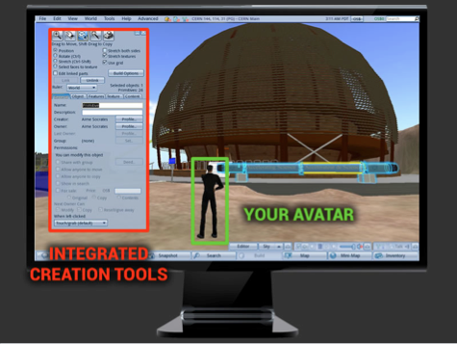
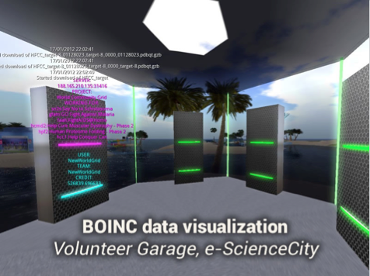
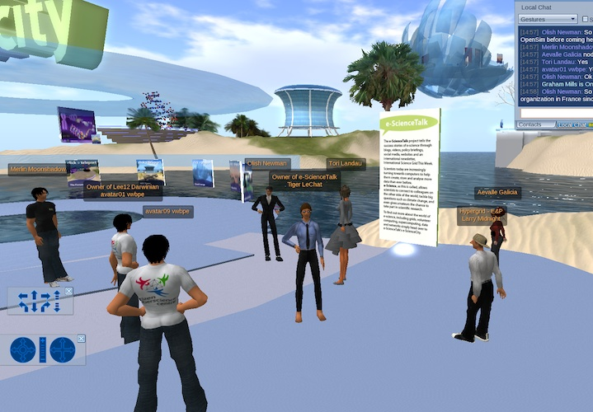
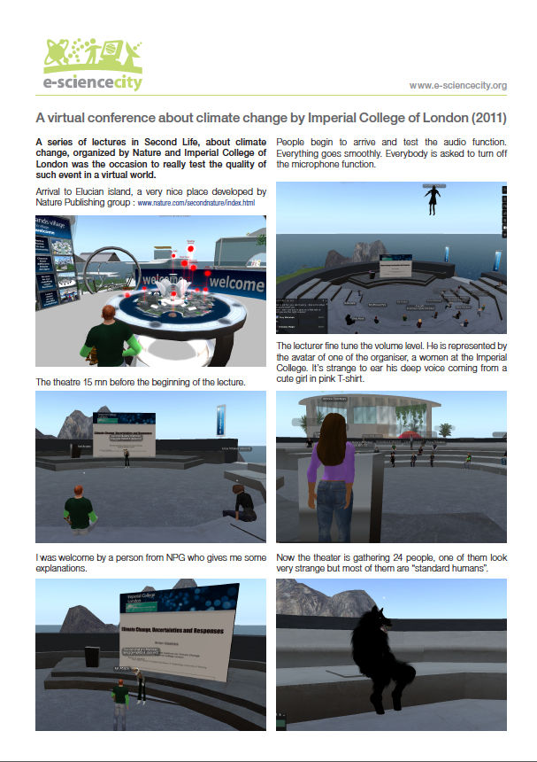
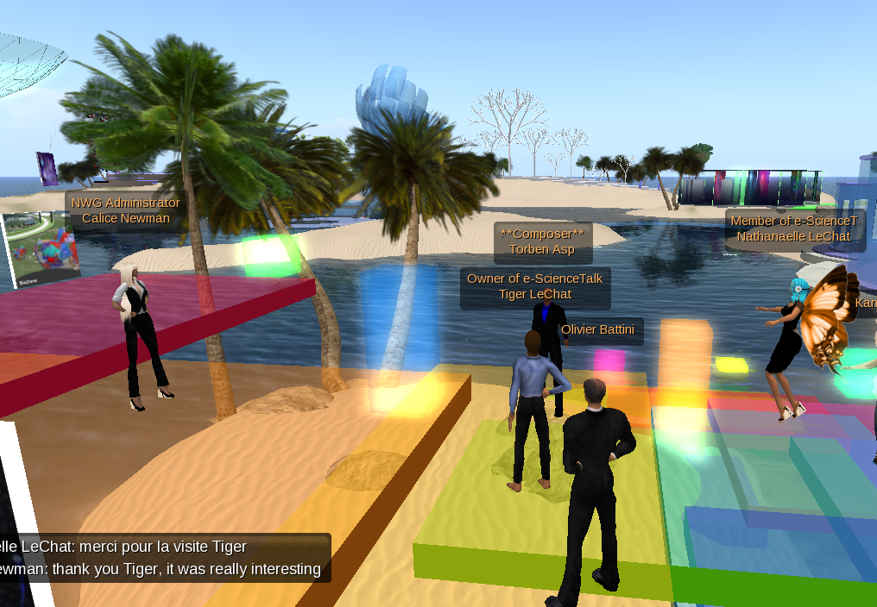
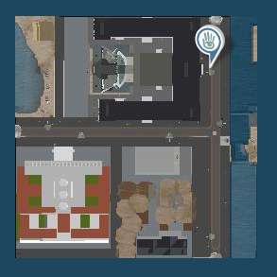
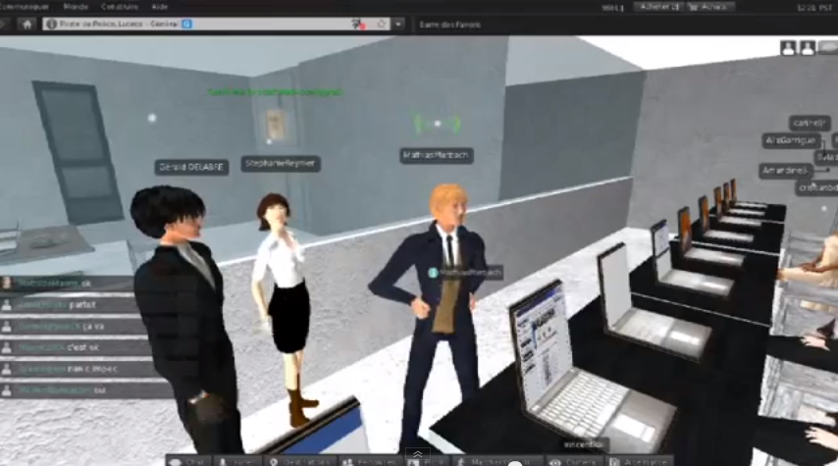
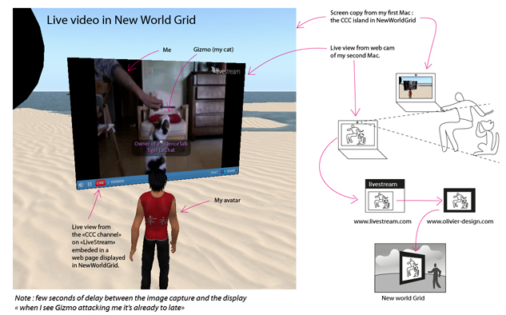
CERN Web Fest with
CCC and Mozilla foundation
Virtual World promotion
Pédagogie, Universités et Mondes Virtuels, Lyon, 23-24 May 2013
Le Centre Droit et Nouvelles Technologies de la Faculté de Droit de l'Université Jean Moulin Lyon 3 organise une série de colloques consacrés au droit dans les mondes virtuels.
Virtual World Best Practice
in Education conference
EJournée du
e-Learning,
Lyon,
27-28 June 2013
New World Grid
OpenDay
Help, test and
tutorial about virtual world and OpenSim

Slide 18
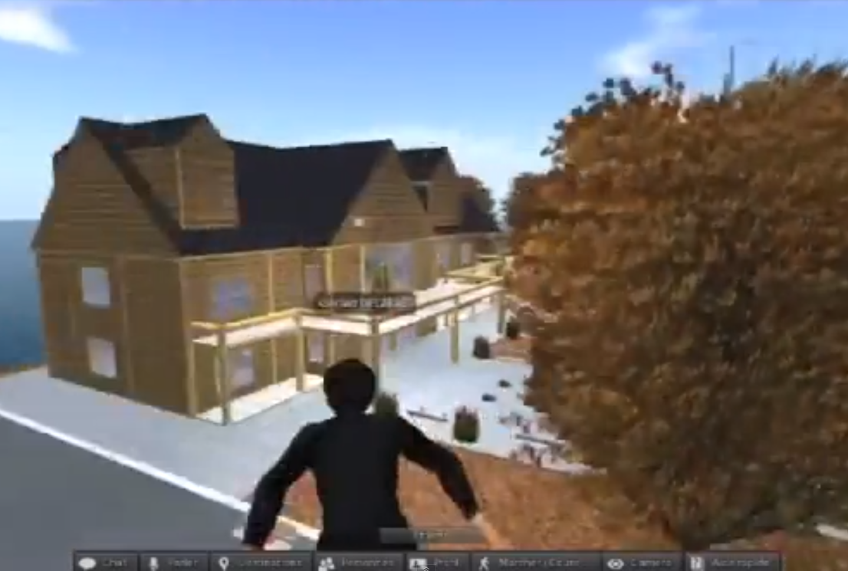
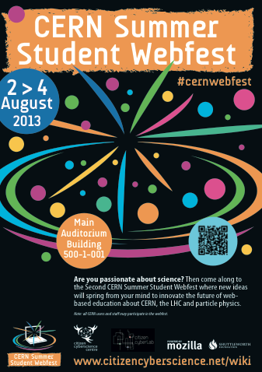
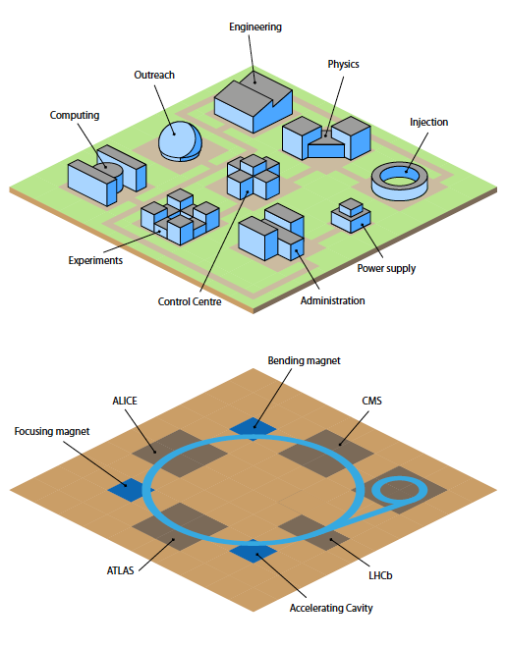
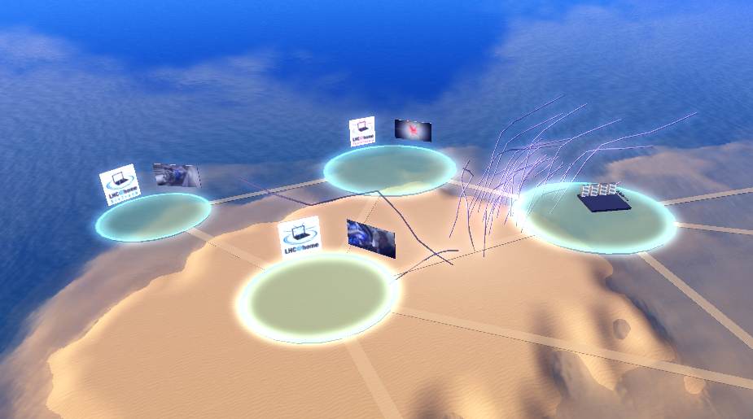
Virtual World linked projects
Possible future collaboration with a project of Virtual University.
- Open course
- MOOC
- serious game
CCC project examples
for Volunteer Computing

Slide 19
WP2 Major achievements
Notes:
GridCasts

Slide 20
Grid Cast - 1
GridCasts are blogs from major grid computing conferences, taking readers behind the scenes of these events. e-ScienceTalk has held 6 GridCasts in total:
International Symphosium on Grid and Cloud: Taipei, 17 - 3 March 2013
EGI Community Forum : Manchester, 8 - 12 April 2013
ISC’13 : Liepzig, 16 - 20 February 2013
Notes:
GridCasts

Slide 21
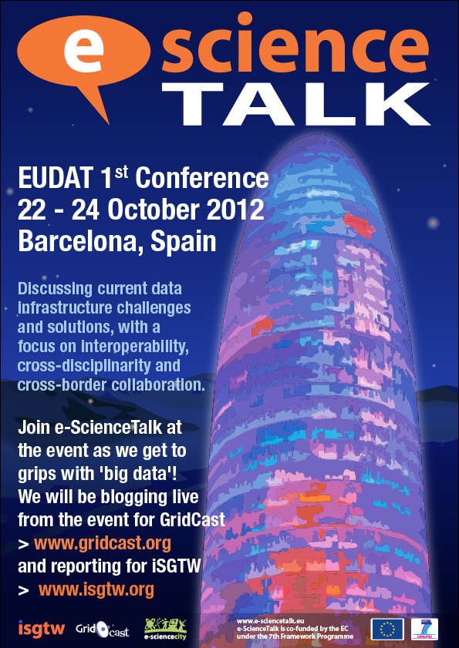
Other ?
Eudat 1st Conference : Barcelona, 22 - 24 October 2012
Notes:
GridCasts

Slide 22
WP2 Major achievements
Notes:
GridCasts

Slide 23
Grid Guide
GridGuide shows the sites and sights of grid computing. Users can view a sample of the sites worldwide that use the grid, introducing the scientists, the science and their institutions.
In total, 102 guides are currently available worldwide.
43 new guides (sites) have been added, with new content.
North America : 21 (+11)
South America : 5 (+1)
Europe : 53 (+ 17)
Africa : 7 (+6)
Asia : 11 (+6)
Oceania : 5 (+2)
Link to Grid Port

Slide 24
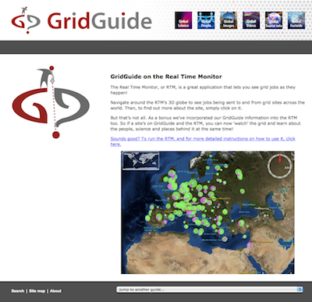
Grid Guide evolution
The e-ScienceGuide is still available
but an updated version is now available
as a new section in e-ScienceCity.
The related virtual venue is under
construction in the virtual e-ScienceCity

Slide 25
WP2 Major achievements
Notes:
GridCasts

Slide 26
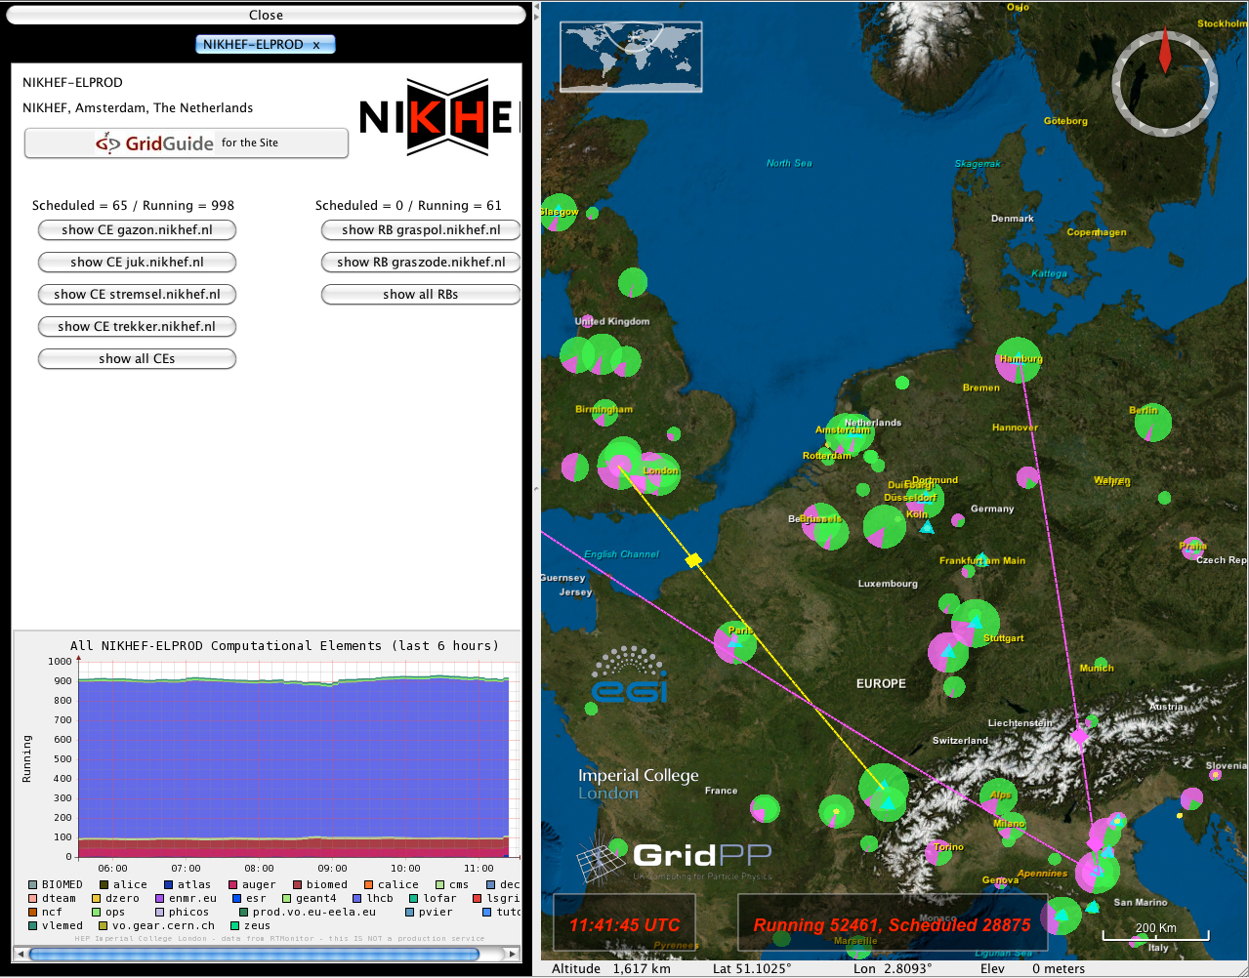
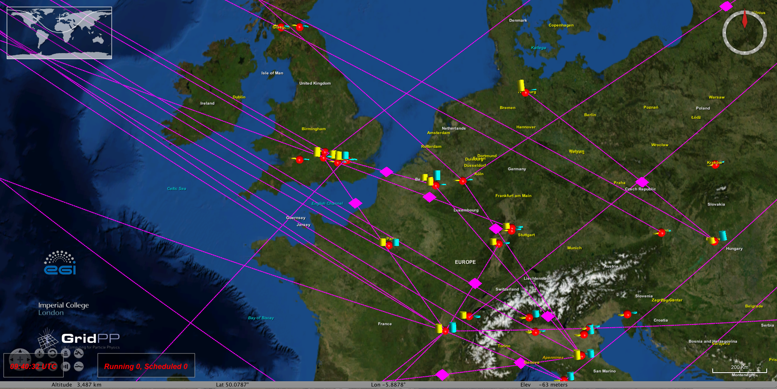
Real Time Monitor

Slide 27
WP2 Issues
Travel costs
Twitter feed on home page (not solved)
Time needed for development of the virtual city

Slide 28
WP2 Summary
Project website launched and branding rolled out to templates eg posters, briefings… ?
You tube channel upaded with 31 videos (total 260)
e-ScienceCity completed for a total of 9 section and 365 pages
3D pilot of the e-ScienceCity available in NewWorldGrid
GridCasts at 3 events... (?)
Total of --- posts and -- webcasts –
102 sites on the GridGuide (43 new guides in 4 continents)
Embedded version of Grid guide in e-ScienceCity web site
RTM .... (?)
“I like the animations and layout, its imaginative”
“I wouldn't change anything”
“I found your site on the web and used it to dive into the topic. The animations and texts really help people with less information
about this topic to understand fast what the topic is all about.”

