Slide 1
WP3: International Science Grid This Week
Andrew Purcell
iSGTW editor, CERN
www.e-sciencetalk.eu

Slide 2
Objectives
WP3 Overview
Structure
Challenges
A typical issue
Top stories
Conference coverage
Metrics and readership survey
Summary

Slide 3
Objectives
Produce a weekly electronic newsletter to disseminate information about grid-related projects, as well as other e-infrastructure projects around the world, including:
clouds
volunteer grids
supercomputing
networks and data, etc.
Not just reporting on e-infrastructure, but also the science it underpins.
Draw from the other e-ScienceTalk products and events for sources of stories and to maximise the impact of the work.

Slide 4
Objectives
Notes:
http://www.wordle.net/delete?index=7015703&d=XTJA
http://www.wordle.net/delete?index=7015791&d=ROKZ

Slide 5
WP3 Overview
3 Beneficiaries
52 PMs
1.6 FTEs
Participant no. | Name | Effort (PM)
5 | CERN | 39
2 | QMUL | 8
3 | APO | 5
Task 3.1 Weekly publication (CERN with QMUL)
Task 3.2 New media outlets eg Twitter, Nature Networks (CERN with APO and QMUL)

Slide 6
Structure
Editor based at CERN.
- 0.75 FTE, as of August 2013.
- Previously full time.
US desk editor based at University of Indiana
- Full time, since November 2012.
Advisory board
- Currently includes: Open Science Grid, University of Indiana, Queen Mary University of London, Fermilab, EGI.eu, Academia Sinica Grid Computing, CERN.
Notes:
In partnership with the US

Slide 7
Challenges
Quantitative analysis of readership
Qualitative analysis of readers’ views
Staffing
Future funding
Website development
Notes:
In partnership with the US

Slide 8
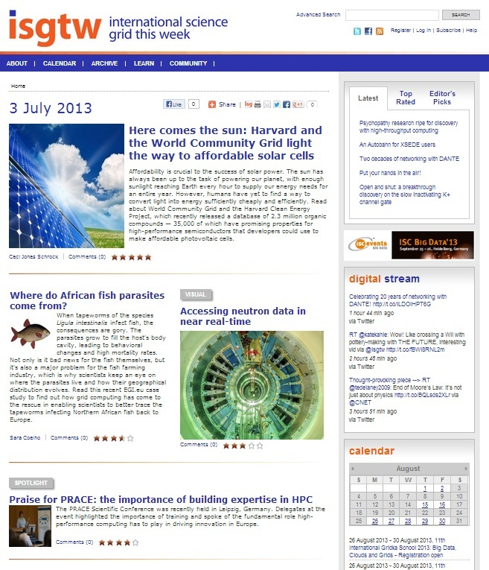
A typical issue
Visual
Picture, video or infographic
~ 100 words
Two
feature
articles
Broad,
in-depth
~ 850
words
Spotlight
Fun, narrow focus
~ 350 words
Notes:
This is what we see in the newsletter and on the homepage of the website.

Slide 9
A typical issue
Most popular, top-rated and editor’s pick stories
Twitter feed
calendar
Notes:
This is what we see in the newsletter and on the homepage of the website.

Slide 10
A typical issue
In the news News from other publications
Blogs
Other blogs about science or computing
Announcements
Press releases from other organisations
Notes:
In the news: such as HPC Wire, HPC in the cloud,
AUTO-POPULATE

Slide 11
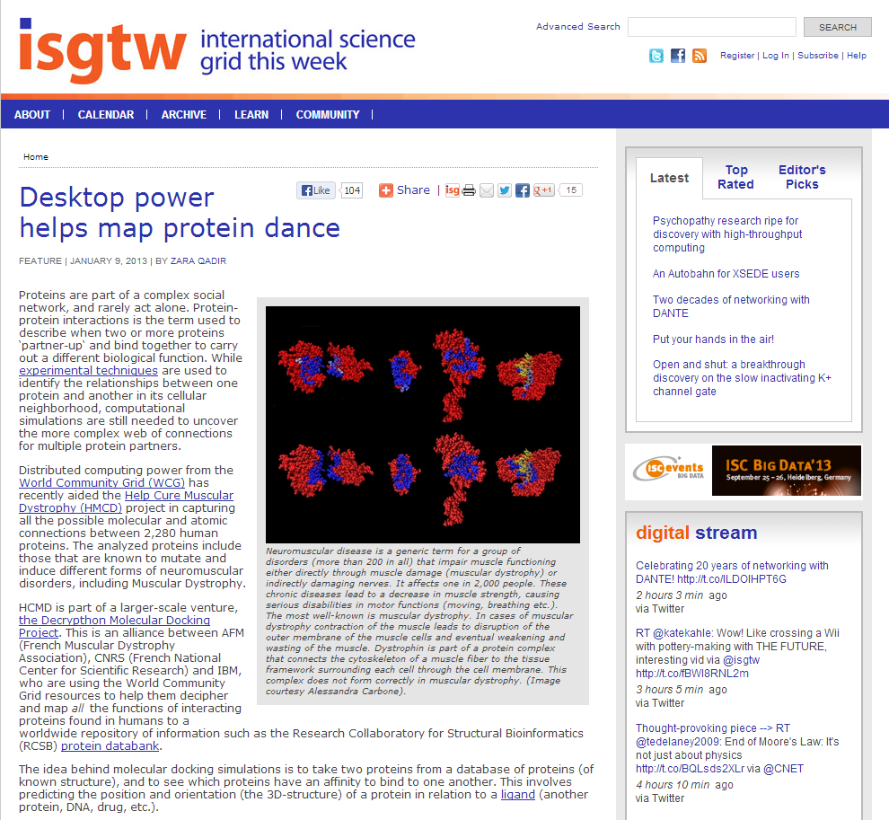
Our stories
Author:
Zara Qadir
Date of publication:
9 Jan 2013
Page views:
4,371
Ave time on page:
03:06
Scientific field:
Biomedicine
e-Infrastructures:
Grid
Notes:
http://

Slide 12
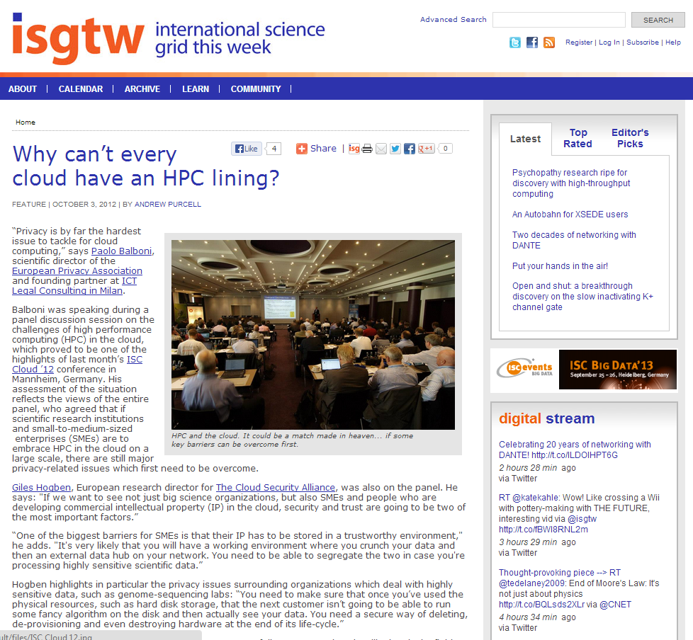
Our stories
Author:
Andrew Purcell
Date of publication:
3 Oct 2012
Page views:
4,104
Ave time on page:
02:54
Scientific field:
Industry and policy
e-Infrastructures:
Clouds and HPC
Notes:
http://www.isgtw.org/feature/desktop-power-helps-map-protein-dance

Slide 13
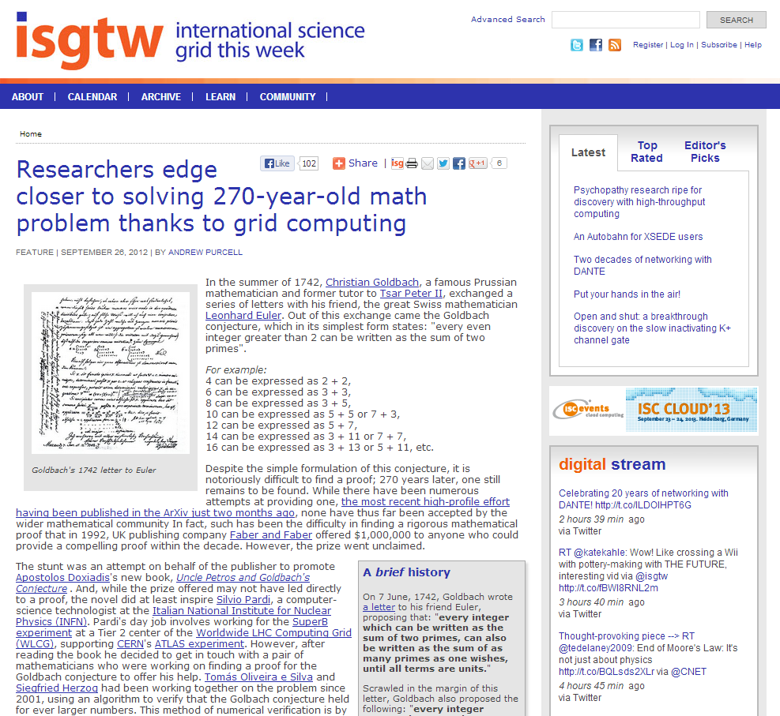
Our stories
Author:
Andrew Purcell
Date of publication:
26 Sept 2012
Page views:
3,656
Ave time on page:
05:18
Scientific field:
Mathematics
e-Infrastructures:
Grid
Notes:
http://www.isgtw.org/feature/desktop-power-helps-map-protein-dance

Slide 14
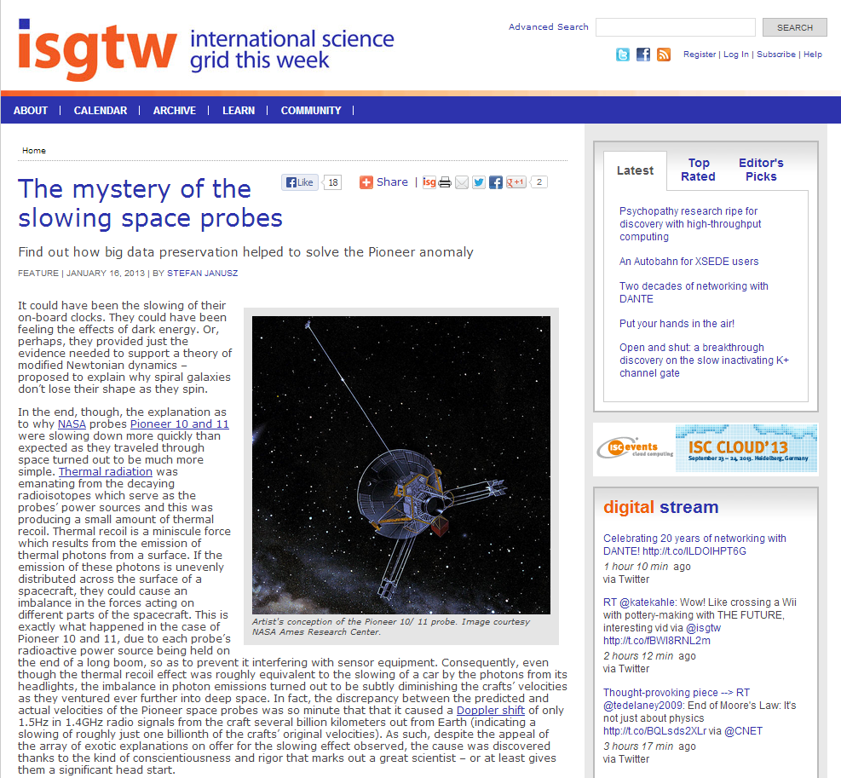
Our stories
Author:
Stefan Janusz
Date of publication:
16 Jan 2013
Page views:
3,481
Ave time on page:
02:01
Scientific field:
Physics and astronomy
e-Infrastructures:
Big data
Notes:
http://www.isgtw.org/feature/desktop-power-helps-map-protein-dance

Slide 15
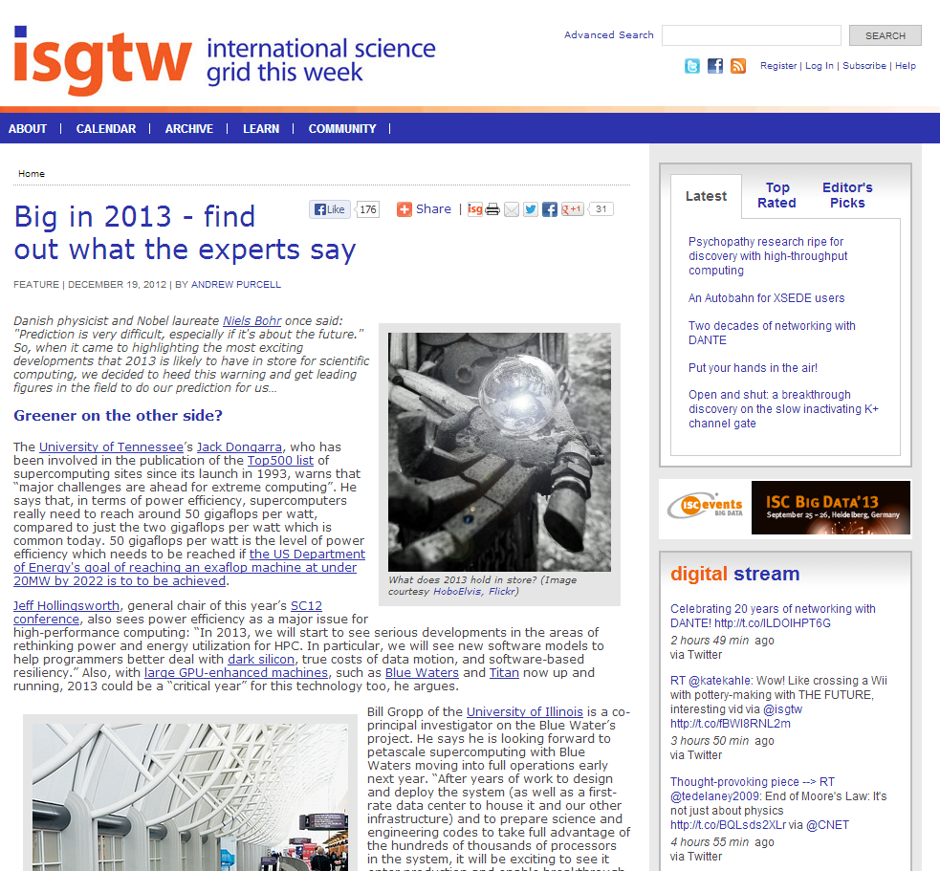
Our stories
Author:
Andrew Purcell
Date of publication:
19 Dec 2012
Page views:
3,267
Ave time on page:
02:56
Scientific field:
N/A
e-Infrastructures:
HPC, HTC, grid, clouds, big data, etc.
Notes:
http://www.isgtw.org/feature/desktop-power-helps-map-protein-dance

Slide 16
Conference coverage
Media partnerships
Event highlights
Exclusive stories
In-depth analysis
Brand awareness
Increase readership
Notes:
Munich egi community forum

Slide 17
Conference coverage
Notes:
Discuss media partnerships

Slide 18
Metrics & analysis
Newsletter subscriber numbers, some indication of how these subscribers interact with the newsletter.
Readership survey, conducted annually.
Website statistics from Google Analytics.
Social media interactions.

Slide 19
Subscribers
8,784 newsletter subscribers
Subscriber numbers had reached a plateau
Growth has now resumed
Changing ways in which people access our content…

Slide 20
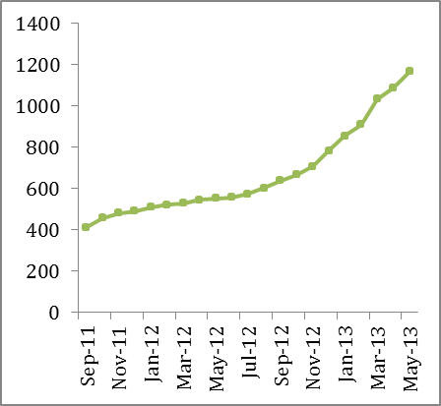
Social media
Klout score: 56
News aggregator sites also very important.
(e.g. Reddit, StumbleUpon, Slashdot, Digg, Paper.le, etc.)
1796 Twitter followers
1297 Facebook likes
Notes:
Facebook doubled since this time last year
Put Klout score into perspective
Higher than projects institutions talking about…
EGI: 49
TACC: 46
Open Grid Forum: 42
GEANT: 49
Esnet: 49
NERSC: 51
iMentors: 39
Better than many large universities…
EPFL: 52
ETH Zurich 49
Better than science/tech/environment desks of world’s leading newspapers…
Daily Mail Science: 38
NYT Environment: 42
Times of India Tech desk: 55
Die Zeit (Kultur): 52
Better than major journals…
PNAS: 54
Nature Physics: 52
NPG: 47
Royal Society of Chemistry: 50
PLoS Computational Biology: 53
Better than competitors…
Primeur: 44
Datanami: 51
HPC in the cloud: 48

Slide 21
Web stats
From the end of November, onwards…
More than doubled page views!
Visitors up 40%
Average time spent on site up and number of pages viewed per visit both up by half.
Number of unique visitors up by one third.
Bounce rate down 6.5%
Page views by project year
Notes:
Over half a million page views in the last year!
Over quarter of a million visits last year – 190,000 of these unique visits.

Slide 22
Readership survey
Ran survey in May
17 questions, predominately multiple choice
Over 100 respondents
We asked readers for their age, profession, gender, interests, what they liked about iSGTW, how they access/use our website, etc.
Newsletter main source of traffic, but social media becoming more important
Almost one quarter of readership is female
Difficulty targeting young readers – just 10% under 30
Notes:
Lots of unsolicited feedback from partners

Slide 23
Readership survey
Announcements/events continues to be used by around only half of readers
Highly engaged readership
Majority read at least 3 out of every 4 issues.
80% have forwarded/discussed articles
Over half have bookmarked articles
13% have cited or linked to iSGTW in a blog, paper, poster or talk
Used as a source by others in media
Over 1 in 10 visitors to the site are journalists/science communicators
Articles pitched at right difficulty level and cover good range of topics and regions
Raising awareness of e-science tools
Aiding research and exposure
Notes:
Over two thirds say iSGTW has raised awareness of specific e-science tools, services, resources, projects, initiatives, and/or potential collaborators
Over one third of respondents reported that iSGTW has helped them with their research work and others reported that that iSGTW had helped improve the exposure of their work and that iSGTW is a useful resource in terms establishing new research collaborations.
.

Slide 24
The future
Shape editorial policy
Continue with efforts to attract more female readers and young readers
Increasing visitors through social media and subscribers
Improve usage of announcements/events section
Collaborate closely with events, other projects, publications

Slide 25
Summary
Huge increase in traffic to site – solid foundation.
Maintaining broad scope, both geographically and in terms of subject areas.
Dedicated audience, which is growing. Continue using social media and collaborations to grow further.
At the heart of the distributed computing community.
“Keep doing a fab job”
“This is a very important online journal”
“You’re doing a great job”
“ISGTW beats all the
center newsletters“
“Keep up the good work.”
“Thanks for your excellent work”
Notes:
Helping to sustain to sustain the community

