Slide 1
Toward an open-data infrastructure for WeNMR and structural biology-related services
Alexandre M.J.J. Bonvin
WeNMR Project coordinator
Bijvoet Center for Biomolecular Research
Faculty of Science, Utrecht University
the Netherlands
a.m.j.j.bonvin@uu.nl
With contributions from
Dr. Antonio Rosato (RDA structural biology interest group)
Dr. Yannick Legre (Life Sciences VRC and bioinformatics)
Dr. Martin Walsh (INSTRUCT)

Slide 2
Research in Structural Biology and Life sciences
Global
Multidisciplinary
Integrative
Researchers often not experts in e-Science solutions
Data often tightly linked to specific projects

Slide 3
Open data access
What is the data lifecycle in Structural Biology?
Should we store/preserve everything?

Slide 4
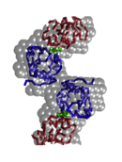
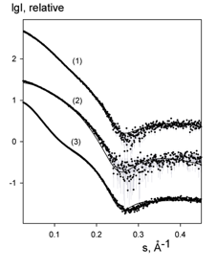
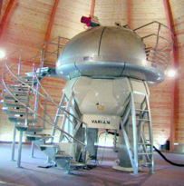
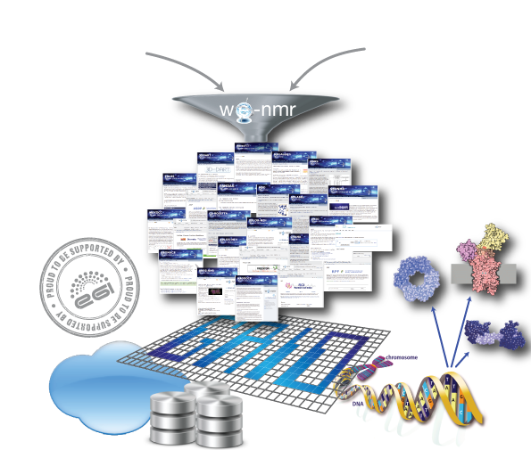
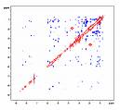
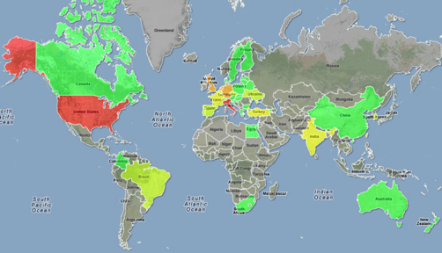
NMR SAXS
A worldwide
e-Infrastructure for NMR and structural biology
WeNMR VRC (Nov. 2013)
One of the largest (#users) VO in life sciences
> 580 VO registered users (35% outside EU)
> 1000 VRC members
~ 90 000 CPU cores
> 4.7M CPU hours over the last 12 months
> 1.8 million jobs over the last 12 months
User-friendly access to Grid via web portals
www.wenmr.eu

Slide 5
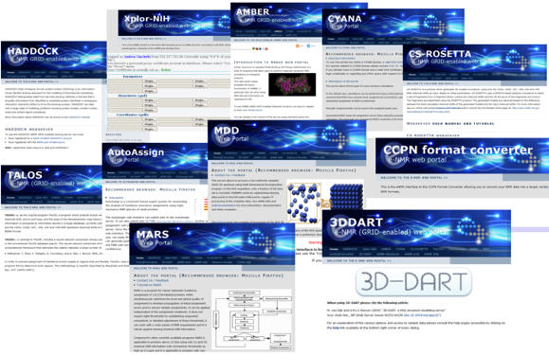
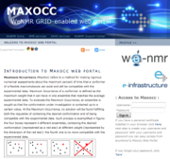
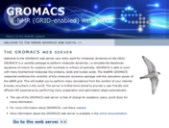
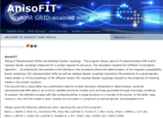
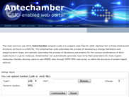
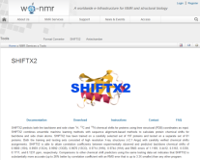
The WeNMR service portfolio
Our policy is to shield as much as possible the end user from the grid and all middleware related issues and commands
We chose to develop mainly web portals providing “protocolized” access to the grid
To facilitate operation, we use when possible robot certificates
33 portals (6 developed by external teams) are currently embedded in the WeNMR gateway and provide services for NMR and SAXS spectroscopists
11 of these run calculations on the grid

Slide 6
The WeNMR Virtual Research Community
Consultancy
Third-party aggregation
Tutorials
Wiki docs
Movies
Knowledge
Grid
Services
But where are the data?
VRC
Help Centers
SSO
Marketplace
Portals
Blogs, news,
events…
(often picked up
from eScienceTalk/GridCast)
Exposure
Facebook,
Linkedin
www.wenmr.eu
Users
Notes:
Marketplace: community specific non-intrusive advertisement
The marketplace allows the members of the worldwide NMR community to list, advertise and search information about Events, Jobs, Products, Services and Training
Disperse and aggregates news; blogs, events.. Often picked up by eScience Talk and GridCast

Slide 7
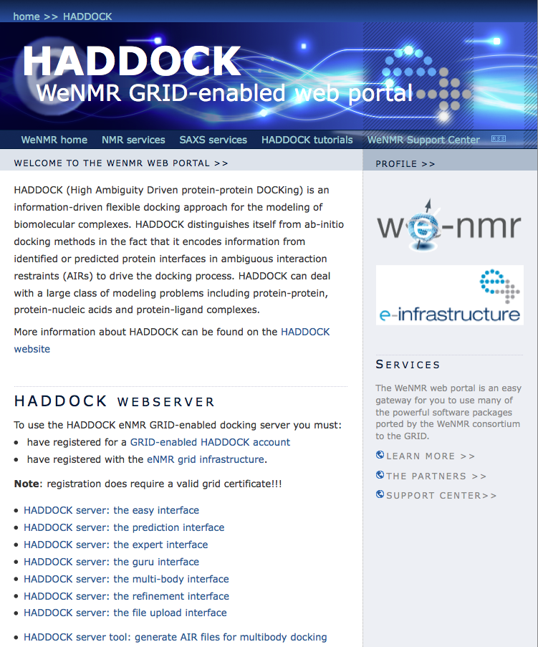
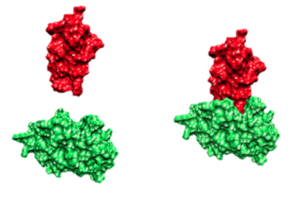
Haddock web portal

Slide 8
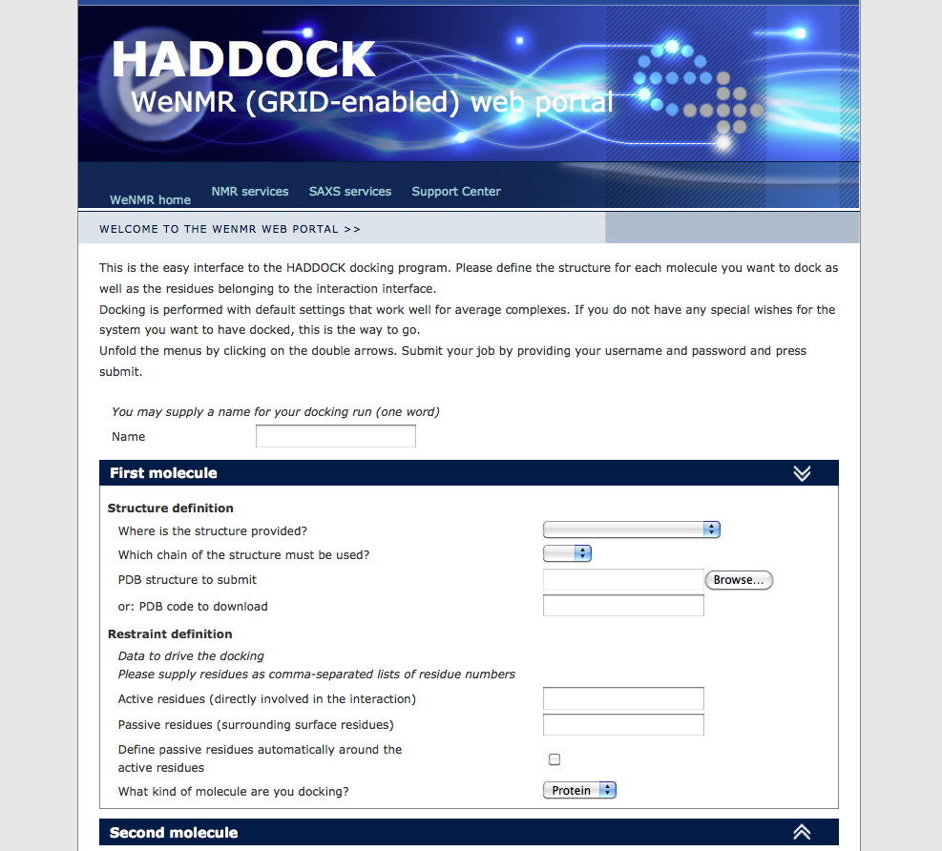
User friendly easy interface
> 3400 registered users
(Since. Nov. 2013 all with grid access via robot)
> 58000 served runs since June 2008
~ 12% on the GRID

Slide 9
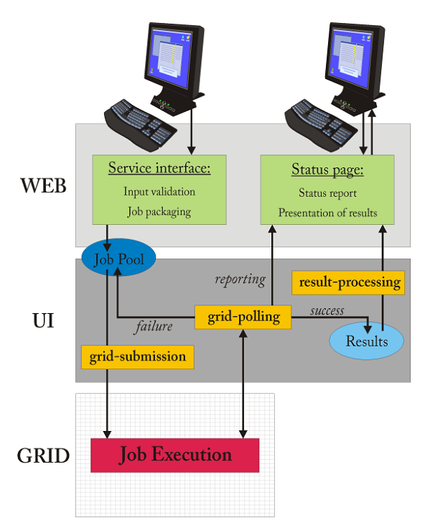
Grid daemons beyond a portal
Data transfer / jobs
User level – data transfer via web interface:
Data input: ~10 kB to 10 MB
Data output: ~10MB to a few GB
Local cluster– data/jobs transfer:
Job submission: ~10 to 50 single jobs
Data: a few GB
Grid level – data/jobs transfer
(UI<->WMS<->CE<->WN):
Job submission: ~250 to 2500 single jobs
Data transfer: ~1 to 10MB
Output: ~1-20MB per job
Some portals make use of storage elements for the data
Notes:
9
9

Slide 10
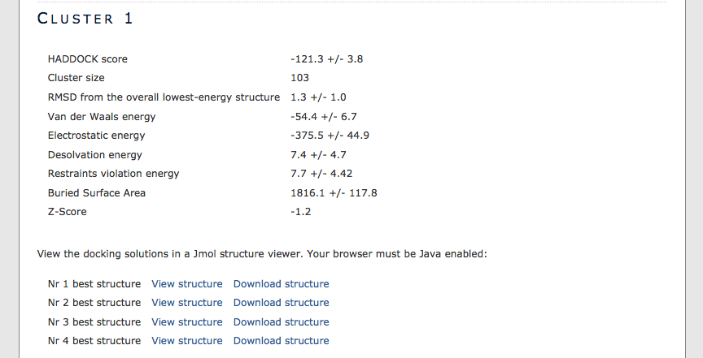
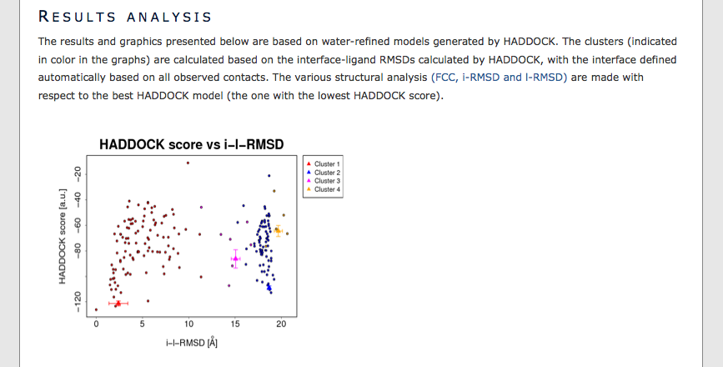
HADDOCK Results

Slide 11
Data volumes vary
Some WeNMR portal generate 0.5 – 5GB of compressed data per run
Translates into 50-100 GB per day
Users only typically see a fraction of those data
Currently data from WeNMR portals are not stored:
Usually deleted within a few weeks
Responsibility of user to save data
Some experimental facilities are generating in the order of 1-6 TB a day (X-ray beamline at DIAMOND synchrotron)

Slide 12
Current data model

Slide 13
Data challenges and opportunities for a federated data infrastructure
Link data generation (at instruments) with data processing and analysis (at remote locations and on e-Infrastructure)
Persistent storage for (original) data and derived data (results)
Persistent? storage for intermediate results
Fast access – dedicated light paths?

Slide 14
Data challenges and opportunities for a federated data infrastructure
Provide collaborative environments to share / process / analyze data (“à la Dropbox)
Provide simple mechanisms to manage the data: sharing / protection / deletion
Various access levels depending on security requirements
Personal X.509 certificated – not user friendly
robot certificates
open access
Provide mechanisms for citation / recognition

Slide 15
Add value to the data!
Provide additional analysis of the data (post-processing / analysis as a service to users
Involve software developers and help them incorporate their solutions into the data repositories (software is often a limiting factor)
This however calls for data storage close to processing power
Need for innovative tools for enhanced visualization of structural data
E.g. to enable comparison of data from different sources and technique

Slide 16
The data web from a user perspective
Bad model from a user perspective:
N sites <-> N connections / SLAs

Slide 17
The data web from a user perspective
Better model:
Organization X

Slide 18
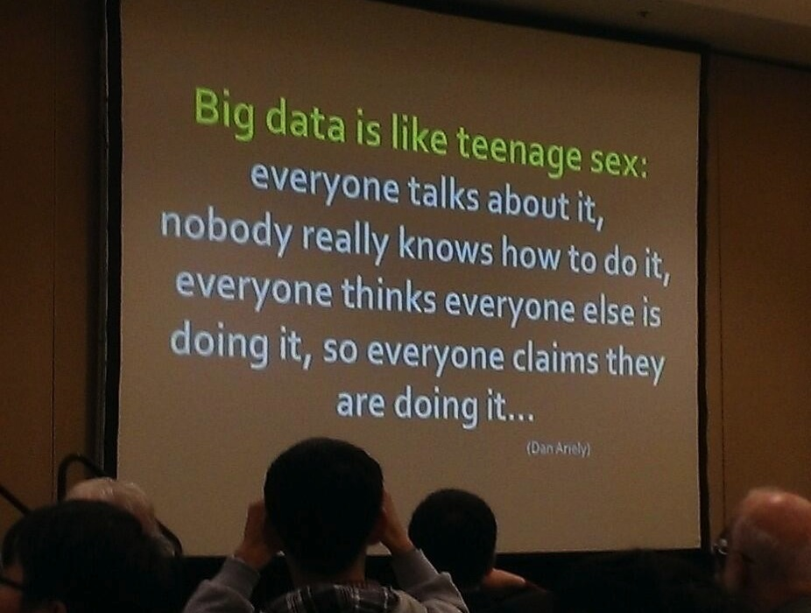
https://twitter.com/iwonabb/status/396035959050870784/photo/1

Slide 19
Acknowledgments
The team
Alexandre M.J.J. Bonvin
Andrea Giachetti
Antonio Rosato
Anurag Bagaria
Christophe Schmitz
Eric Frizziero
Gijs van der Schot
Harald Schwalbe
Hendrik R. A. Jonker
Ivano Bertini
Johan van der Zwan
Lucio Ferella
Marc van Dijk
Marco Verlato
Mikael Trellet
Mirco Mazzucato
Nuno Loureiro-Ferreira
Peter Güntert
Rolf Boelens
Sjoerd J. de Vries
Stefano Dal Pra
Torsten Herrmann
Tsjerk A. Wassenaar
Victor Jaravine
Wim F. Vranken
Danny Hsu
Simon Lin
The partners
Utrecht University, Bijvoet Center for Biomolecular Research, NL
Johann Wolfgang Goethe Universität Frankfurt a.M., Center for Biomolecular Magnetic Resonance DE
University of Florence, Magnetic Resonance Center, IT
Istituto Nazionale di Fisica Nucleare , Padova, IT
Raboud University, Nijmegen, NL
University of Cambridge UK
European Molecular Biology Laboratory, Hamburg, DE
Spronk NMR Consultancy, LT
Academia Sinica, TW
Contract n°: RI-261572

Slide 20
wordle.net

