Slide 1
The Mission of APARSEN and the Virtual Centre of Excellence: Persistent Identifiers infrastructure, an exemplary collaboration with EGI
Ruben RIESTRA – INMARK
Dr. Stefano BORTOLI – OKKAM
Amsterdam, 04.12.2013

Slide 2

Participant Types in APARSEN
Universities and Research Institutes
Vendors
National Archives & Libraries
Big Data Science Communities
Membership Organisations

Slide 3






























APARSEN Network of Excellence

Slide 4
The mission of APARSEN
Foster Defragmentation in Digital Preservation R&D
Promote sustainable Digital Preservation practices
Design and launch a Virtual Centre of Excellence for providing Digital Preservation related services

Slide 5
Virtual Centre of Excellence - VCoE
Target markets
  Research data producers
  Research data archives and Information curators
  Scientific data distributors & consumers
  Cloud resource/service providers

Slide 6
Virtual Centre of Excellence - VCoE
The VCOE Unique Value Proposition
We offer a coherent approach based on value and which can be applied to any kind of digital objects
We are backed by the combined experience of the DP pioneers both in the research field and, more importantly, as worldwide earliest adopters of DP practices.

Slide 7
Virtual Centre of Excellence - VCoE
Products and Services Offering
  Technical methods and software tools
  DP implementation support services
  DP Consultancy
  Training

Slide 8
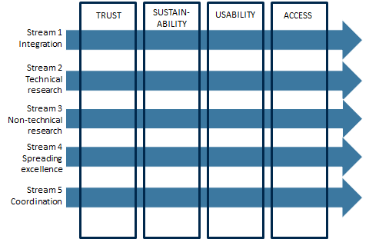
APARSEN‘s VCOE Matrix

Slide 9
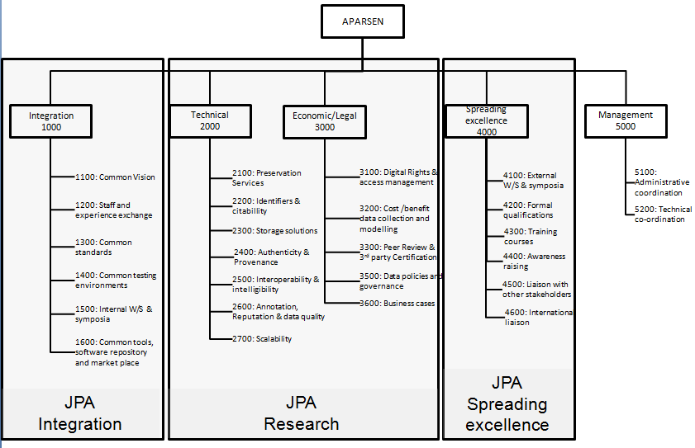
APARSEN VCOE Portfolio of Services

Slide 10
Overcoming Fragmentation in PI Infrastructures
Workshop on Interoperability for Persistent Identifiers systems
13 Dec 2012 - Florence
www.rinascimento-digitale.it/workshopPI2012
EUDAT
EUROPEANA
RDA
OPF
DATACITE
SARA
EPIC
SCAPE
PersID
DOI Foundation

Slide 11
Challenge:
Persistent Identifier Interoperability
Contents from all PI domains now
are accessible in the same way
ISNI
VIAF
INTEROPERABILITY
FRAMEWORK
CERN
ORCID
New services
cross-domains
for users requirements
FRD
DNB
DANS
NBN
Handle
DOI
ARK
STM
GLOBIT
CERN

Slide 12
Solution:
APARSEN PI Interoperability Framework
DANS
Schema
Protocols
http://93.63.166.138/demonstrator/
Dublin Core
DNB
SRU
IKB
SPARQL
Dublin Core
JLIS
D2R
S1
PI
Harvesting &
processing
OAI-PMH
SQL
RDF
FRD
Dublin Core
S2
PI
OAI-PMH
CERN
MARCXML
WEB
Interoperability
Services
DC-FRBR mapping
MARCXML – FRBR mapping
CERN - Author
WEB
proprietary
Notes:
12

Slide 13
Service:
ENS – Entity Name System
APARSEN’s Entity Name System for
Persistent Identifier
Interoperability

Slide 14
Background
Entity Name System:
a public infrastructure supporting mining and reuse of globally unique persistent identifiers for non-web entities
2007/9: FP7 Okkam IP, 16 partners, 3 prototypes, scalable infrastructure
2010+: Okkam SRL (Univ. Trento spin-off) exploits, maintains and develop prototype (current version 4.2 Edgar Davids)
  3 projects with Italian Tax Agencies
  2 EU funded projects
  DOPA, integrating large scale web data pool
  TAGCLOUD, creating a platform for Cultural Heritage adaptive content and Engagement in cultural activities

Slide 15
ENS Core Services
Available as SOAP and REST APIs:
  ID Lifecycle Management: creation, storage, update, linking, merge, split, [delete]
  Entity Matching: given an arbitrary entity description (e.g. a database record), returning the ENS id for the corresponding entity (or more than one in a ranked list)
  ID mapping: given any entity ID, returning the list of known identifiers for the same entity

Slide 16
ENS in Numbers (Nov. 13)
8.6 million entity identifiers
  largest part Locations, Persons, Organizations
6 top-level categories
  person, location, organization, event, artifact type and artifact instance
5 general purpose Matching Modules
  Fingerprint, FBEM, Jolly Matcher, Group Linkage, Eureka
3 different Persistence layers available
  Apache HBase 0.9x (Hadoop), Oracle MySQL 5.5, Apache Solr (3.6 and 4.5)
79% worst case Top-k rated accuracy
  on the benchmark query set defined in 2009 during Okkam FP7 project
~0,2-0,4 second per query (matching)
  deployed on 8 server cluster (144 core AMD Opteron 2,6 GHz) at Unitn
An Entity Name System for Persistent Identifiers

Slide 17
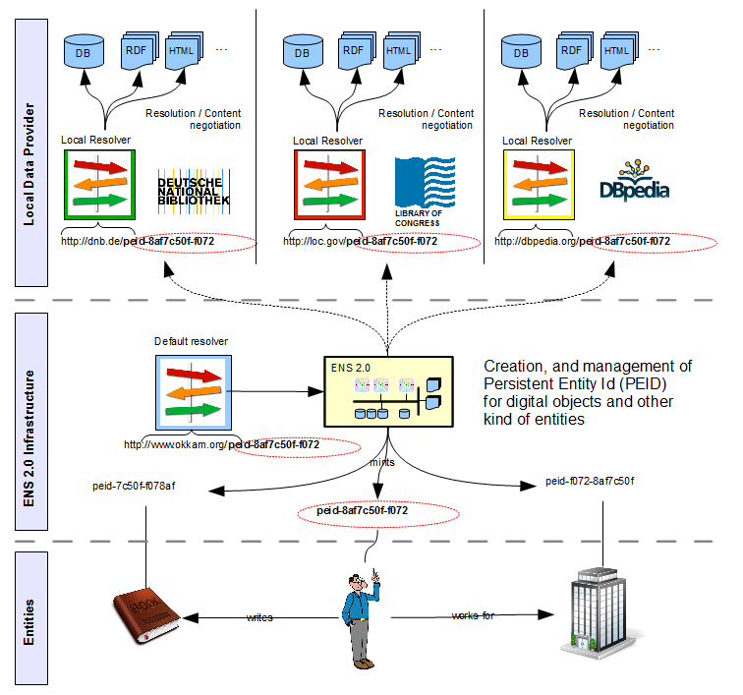
ENS Adoption – a vision

Slide 18
Persistent Identifiers
http://www.local-res1.org/
http://www.local-res2.org/
eid-8af7c50f-f072-4384-905b-03875c341863
eid-8af7c50f-f072-4384-905b-03875c341863
LOCAL RESOLVER 1
LOCAL RESOLVER 2
eid-8af7c50f-f072-4384-905b-03875c341863
PERSISTENT ENTITY IDENTIFIER
http://www.okkam.org/eid8af7c50f-f072-4384-905b-03875c341863
DEFAULT RESOLVER

Slide 19

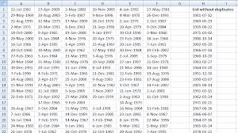
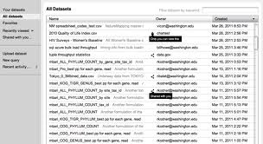
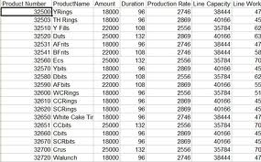
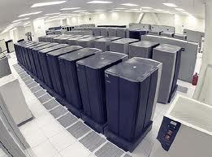
The process for data curators
Value-added
community
services
Dataset_1
Dataset_2
Dataset_n
Entity alignment (ENS2.0 id)
ENS2.0
  Lifecycle management
  Entity matching
  Add mappings to exiting IDs

Slide 20
ENS Benefits
Ensures the persistence of the binding between an entity and its persistent IDs
Defines a thin, neutral ID management system
Sustainable cost model, no big costs are involved
It is going to be managed as an open Public Trust
Introduces a very light form of centralization
It is maintained as an open distributed platform, perhaps it could become part of EGI

Slide 21
Thanks for your attention
Any Questions?
Dr. Stefano Bortoli
ENS Technical Director
bortoli@okkam.it
Okkam Srl
Via Segantini 23,
38121 Trento (Italy)

