Slide 1
EGI - future strategies for the European Research Area
T. Ferrari/EGI.eu

Slide 2
Status 2010-2014
Vision and Mission
Strategy for Open Data Commons
Distributed Competence Centre

Slide 3
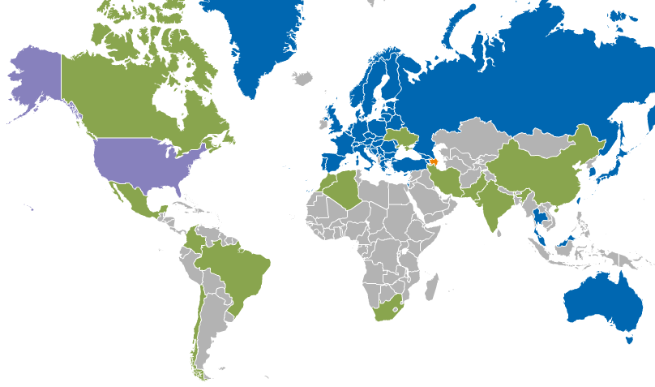
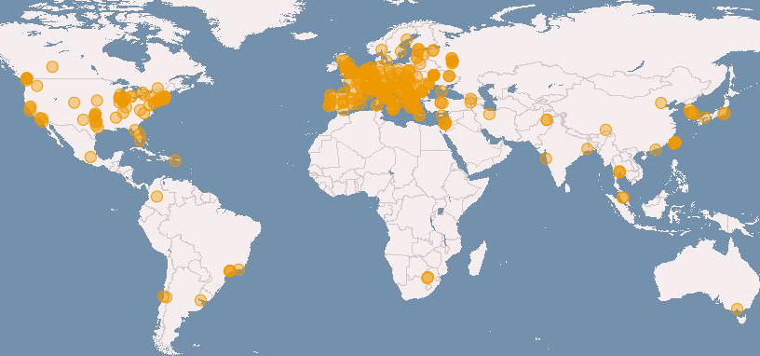
Current capacity (Grid)
Distributed and federated data and computing facilities
Grid and Cloud compute platform
350 data centres in 40 National Grid Initiatives/EIROs
400,000 logical CPU cores
10 years of support to science
> 200 research projects
190 PB disk, 180 PB tape
1.6 M job/day
> 99.6% reliability
Notes:
With integrated

Slide 4
Federated Cloud
15 certified resource
centres
12 countries

Slide 5




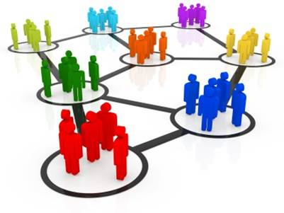


EGI Solutions Portfolio
Individual Researchers
& Teams
Federated Operations
Community Driven Innovations and Support
High-Throughput Data Analysis
Federated Cloud
Research Communities
& Institutions
Resource Centres & Institutions
http://www.egi.eu/solutions

Slide 6

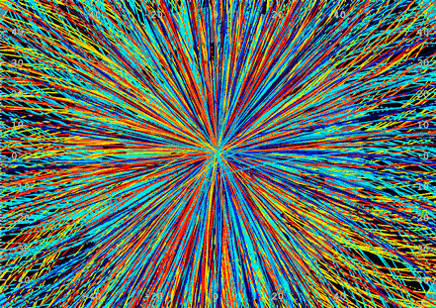
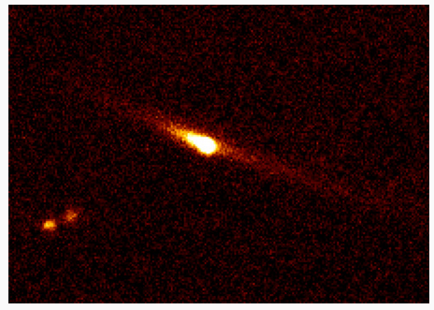
2010-2014
Discipline | Increase | Million CPU wall time, normalized HP06 (cumulative)
Astronomy and Astrophysics | +543% | 1,200
High Energy Physics | +304% | 46,370
Computational Chemistry and Materials Science | +183% | 263
LifeScience | +103% | 767
Multidisciplinary science | +124% | 155
Other | +1620% | 3,259

Slide 7
EGI Vision
researchers from all disciplines can easily connect to the most innovative ICT services, data, knowledge and expertise they need for performing collaborative excellent research
Services
Open Data
Knowledge

Slide 8
By 2020 …
By 2020, European researchers will be able to:
Access a single point of contact for obtaining the necessary ICT services (integrated and interoperable) the related capacity and support from the various e-Infrastructures (including commercial providers)
Connect to the best expert consultancy to understand the services they need or to support developing new solutions to perform their digital research
Freely discover, share, use, re-use research outputs (publications, data, software, workflows, …)
Open Science Commons

Slide 9






EGI Mission
to be a core player of the “backbone” for federation-enabling services for compute, storage, data, communication, knowledge and expertise for the ERA complementing community specific capabilities
RI
RI
RI
RI

Slide 10
Backbone and wave (EC, 2010)
^{How}

Slide 11
EGI Solutions Portfolio
Individual Researchers
& Teams
Federated Operations
Community Driven Innovations and Support
High-Throughput Data Analysis
Federated Cloud
Research Communities
& Institutions
Resource Centres & Institutions
http://www.egi.eu/solutions

Slide 12
Strategy for e-Infrastructure Commons
Strengthen the relationship between e-Infrastructures towards a common backbone of federated services
Policies, processes and business models for joint capacity planning
Open integrated marketplace including commercial providers
e-Infrastructure
Open Data
Knowledge

Slide 13
EGI-Engage
EINFRA-1 (6)
30 months
Jan 2015
Complemented by other non-lead proposals

Slide 14
E-Infrastructure Commons
EGI Core Infrastructure
Federated ID Management
PID translation services
Computing
Data
Data management
Data preservation services
Cloud
IaaS
PaaS
SaaS
Data dissemination
Data curation
Data catalogues
Data provenance..
Federated operations
Accounting (data, compute, storage)
Monitoring
Service registry
Policy
International cooperation
Marketplace
Service procurement
Operations and policy Coordination
Grid
Coordination
Coordination
Security
Service Registry
Innovation

Slide 15
Strategy for Open Data Commons
Expand services for open data sharing, curation and long-term preservation
  EINFRA-1 (1) and collaboration with EUDAT
Stimulate sharing of current and future research outputs (open access policy)
Integrate with OpenAIRE
e-Infrastructure
Open Data
Knowledge

Slide 16
Strategy for Knowledge Commons
Distributed Competence Centre (DCC) embracing connectivity, compute, data services, data management planning, data archives certification
  User engagement
  Training
  User Support
  Joint calls for use cases
Collaboration with Centre of Excellence (CoE) from the HPC strategy
Facilitate knowledge transfer to private sector
  To increase opportunities for socio-economic impact
e-Infrastructure
Open Data
Knowledge

Slide 17
Ingredients for
Business Model Innovation
Pay for Use for NGIs/EIROs
  Raise awareness of economic value of services
  Open up possibility to direct charge to users
  Combine infrastructure services with consultancy/expertise
EGI.eu as Broker
  Different business models may apply
    E.g. technical vs. financial vs. one-stop-shop
  Need to find the right incentives for members to contribute capacity
Public Procurement of Cloud services
  Pre-Commercial Procurement (PCP)
  Public Procurement for Innovative solutions (PPI)

Slide 18
New services
Examples of innovations planned:
  Federated Storage: Enhanced Cloud STaaS service with a single entry point, for virtually unlimited storage
  iPaaS: General-purpose integration Platform-as-a-service
  Data access and dissemination: A general-purpose system for storing, extracting metadata, cataloguing, and accessing scientific data
  Virtual Laboratory-as-a-Service: Integrated system for integrating easily Virtual Laboratories
  Secure Personal Storage: Storage solution for data sharing and collaboration
Proof of concepts
  https://wiki.egi.eu/wiki/Fedcloud-tf:Users#Current_FedCloud_Users_and_Communities

Slide 19
From 2014
Distributed Competence Centre
Identify and Develop EGI’s Human Capital to upskill the research communities supported by EGI in establishing within NGIs national centres of excellence that can transfer skills from within EGI to tomorrow’s data scientists
Use cases
Requirements
Development, application porting
testing
Pre-production
Engagement strategy: https://documents.egi.eu/document/2079

Slide 20
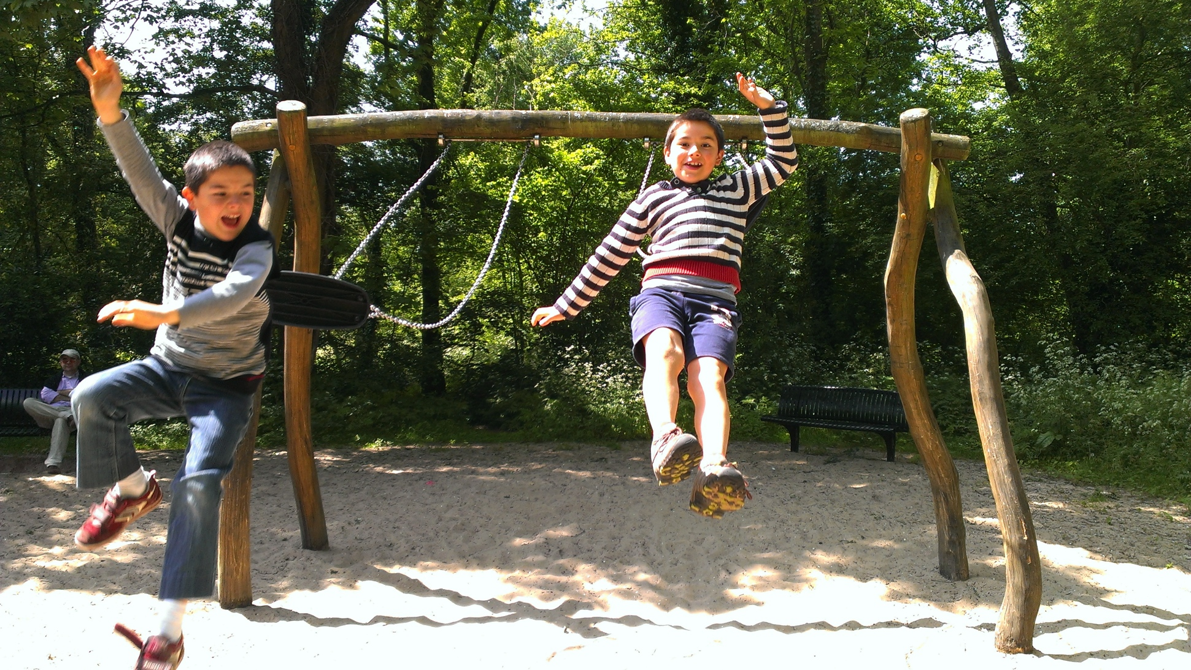
Time for the next leap
June 2014:
Call for Competence Centres
Info: egi-engage@mailman.egi.eu

Slide 21

See you in…
Amsterdam, Sep 23-26
co-located with
the 4th plenary of RDA

