Slide 1
Building an European Research Community through Interoperable Workflow and Data
Gabor Terstyanszky
University of Westminster

Slide 2
Challenges and Motivation
Challenges
  Learn how to create and use workflows
  Many different workflow systems exists → We expect no change
  Technological choice isolates users and user communities
  Technological choice selects DCI/middleware (WS, gLite, Globus, …)
Benefits of the SHIWA Simulation Platform
  Share your own workflow, re-use workflows of others
  Create and execute ‘meta-workflows’: built from smaller workflows that use different workflow languages/technologies
  Combine workflows and DCIs
SHIWA ←→ ER-flow
  SHIWA: FP7 R&D project. Created the SHIWA Simulation Platform (2010-2012)
  ER-flow: FP7 support action project. Disseminates the SHIWA technology (2012-2014).

Slide 3
Key Players and Challenges
Researchers
Researchers of one particular research field, for example Astrophysicists, Computational Chemists, Heliophysicists, Bio Scientists, etc. with basic computing knowledge
10 or 100 thousands or millions
Challenges: They are not familiar with the technology to run experiments on computing infrastructures and probably they will never learn it.
Workflow developers
They are familiar with both Computer Science and a particular research field
up to a few thousands
Workflow engine developers
Computer Scientists with knowledge about data and compute technologies
up to a few hundreds

Slide 4
What Do Researchers Need?
They want…
to run experiments
They need…
to run experiments seamlessly
i.e. executing workflows which access to data and compute resources hiding all technical details
Workflow Repository
Science Gateway
Supercomputer
based SGs
(DEISA, TeraGrid)
Cluster based
service grids (SGs)
(EGEE, OSG, etc.)
Local clusters
Clouds
Desktop grids (DGs)
(BOINC, Condor, etc.)
Supercomputers
Grid systems
4
E-science infrastructure

Slide 5
Co-operation between Communities and ER-flow
Phase 1 – introduction to the workflow technology
Target group: communities without any or basic experience in the workflow technology
Phase 2 – creating and running workflows
Target group: communities those use workflows to run experiments
Phase 3 – combining workflows of different workflow systems
Target group: communities those use workflows to run experiments and are interested in using workflows of other workflow systems

Slide 6
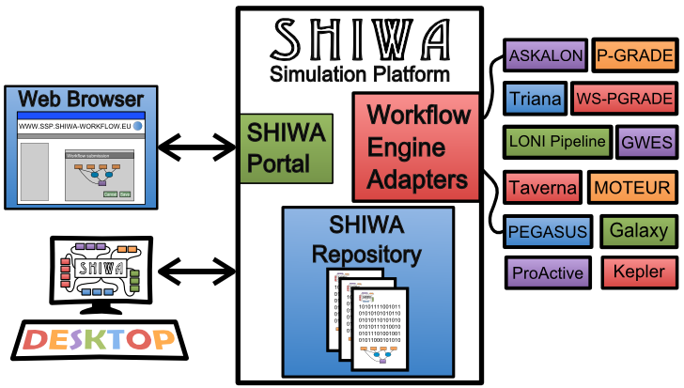
SHIWA Simulation Platform = SSP

Slide 7
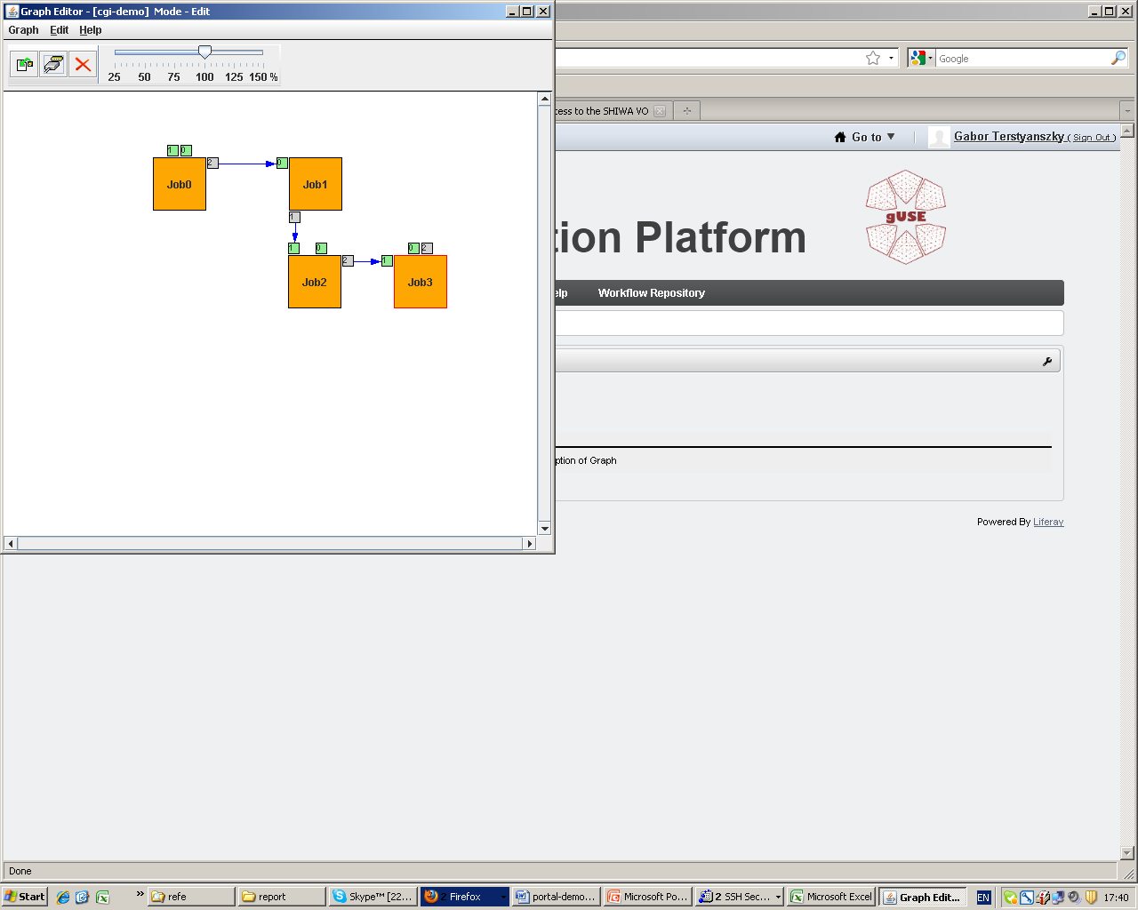
SHIWA Portal: Editing Workflow
7

Slide 8
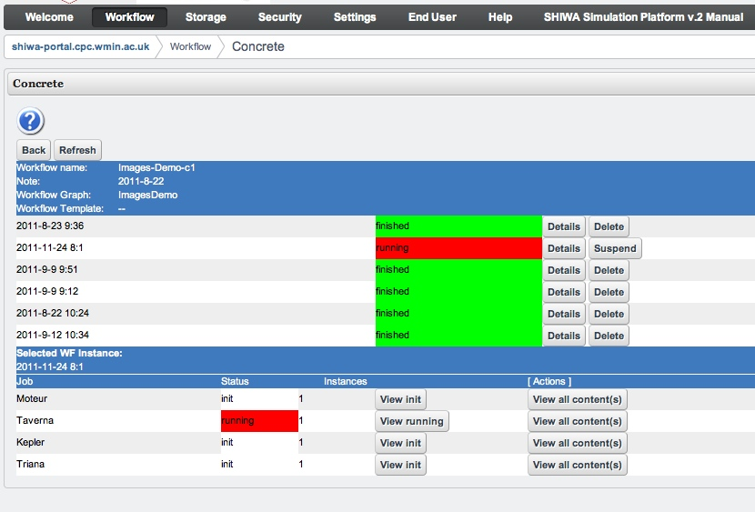
SHIWA Portal: Executing Workflow

Slide 9
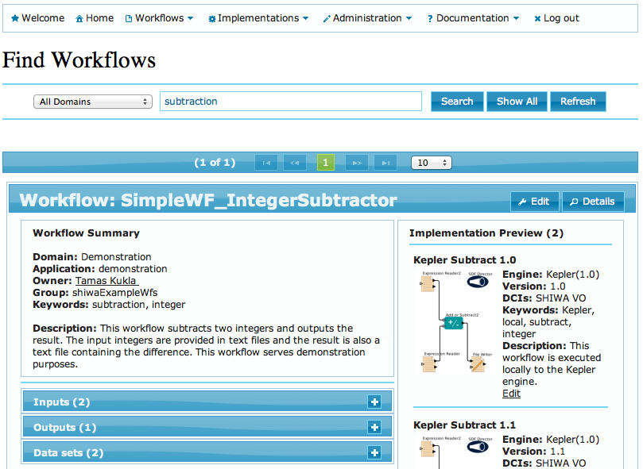
SHIWA Workflow Repository
Facilitates publishing and sharing workflows
Supports:
Abstract workflows with multiple implementations of over 10 workflow systems
Concrete workflows with execution specific data
Available:
From the SHIWA Portal
http://ssp.shiwa-workflow.eu
Standalone interface:
http://repo.shiwa-workflow.eu

Slide 10
Phase 1:
Workflow Development Environment
SHIWA Simulation Platform
workflow developer
create
migrate
execute
publish
WFs
Execute native WF
SHIWA
Portal
DCIs
Publish WF
SHIWA
Repository

Slide 11
Phase 1:
Workflow Execution Environment
SHIWA Simulation Platform
researcher
import
execute
WFs
Execute native WF
SHIWA
Portal
DCIs
Import WF
SHIWA
Repository

Slide 12
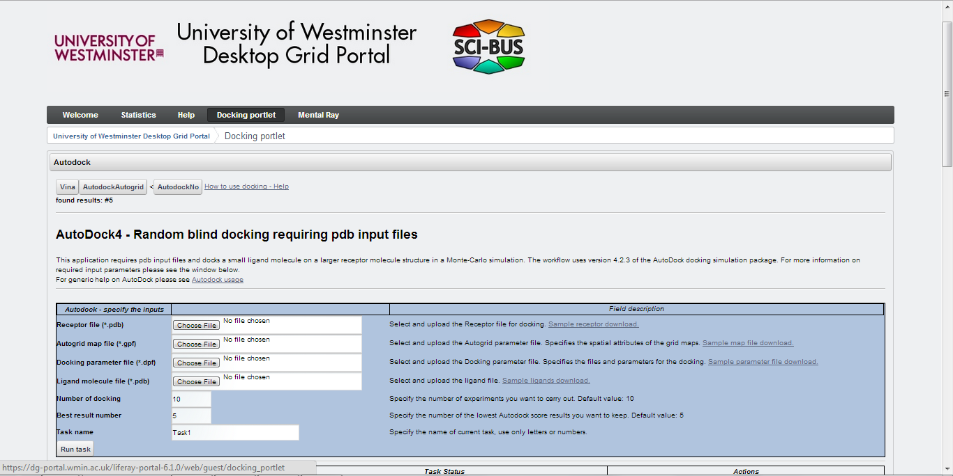
Usage Scenario: End User View

Slide 13
Phase 2:
Workflow Execution Environment
SHIWA Simulation Platform
SHIWA
Repository
researcher
Import WF
Execute native WF
execute WFs
Community
Portal
DCIs
Community gateway

Slide 14
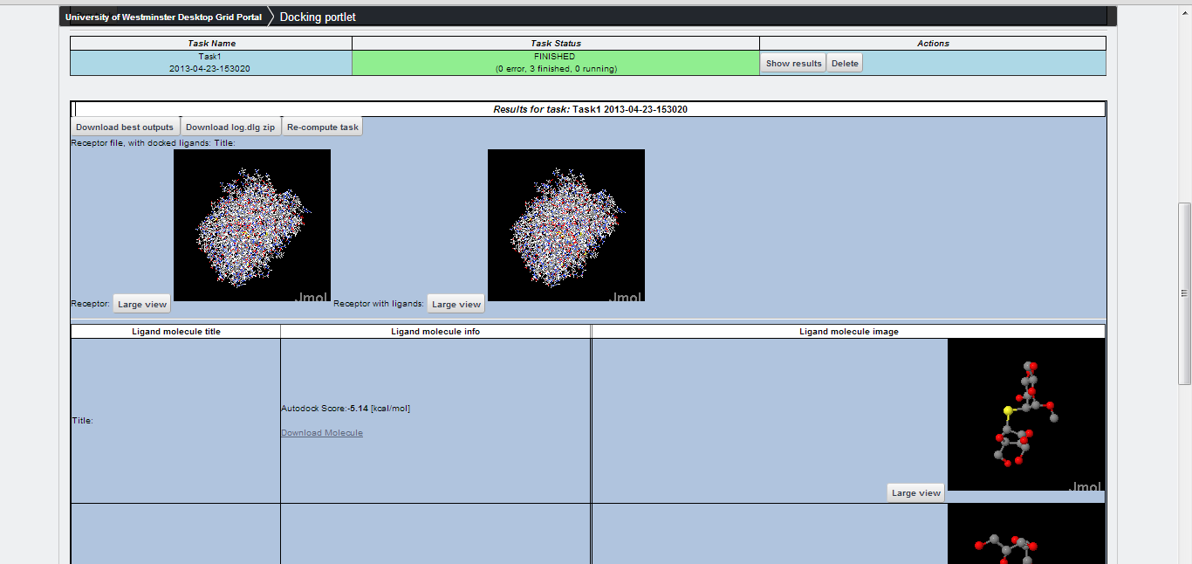
Usage Scenario:
Domain Customised Portlet

Slide 15
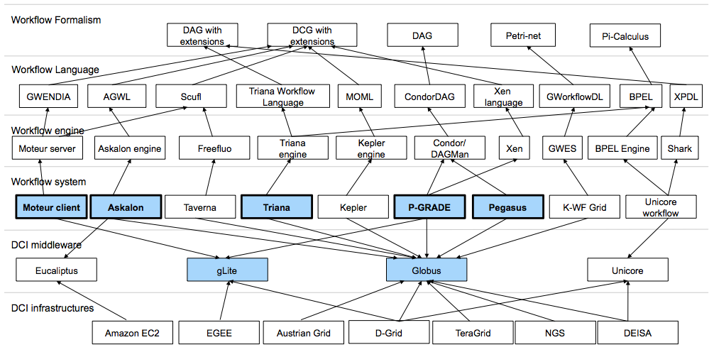
Workflow Interoperability Challenges

Slide 16

Coarse-grained Interoperability
(CGI)
CGI concept = workflow engine integration
Submission Service Client
Submission Service
Workflow Engine B
Workflow Engine A
Workflow Repository
Distributed Computing Infrastructure

Slide 17
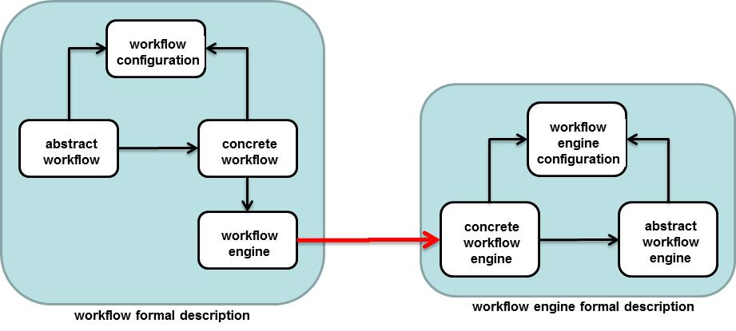
Formal Description of WEs and WFs
formal description of workflows
WF = :{WF_{abs}, WF_{cnr}, WF_{cnf}, WF_{eng}}
where WF_{abs} - abstract workflow
WF_{cnr} - concrete workflow
WF_{cnf} - workflow configuration
WF_{eng} - workflow engine
formal description of workflow engines
WE = :{WE_{abs}, WE_{cnc}, WE_{cnf}}
where WE_{abs} - abstract workflow engine
WE_{cnr} - concrete workflow engine
WE_{cnf} - workflow engine configuration

Slide 18
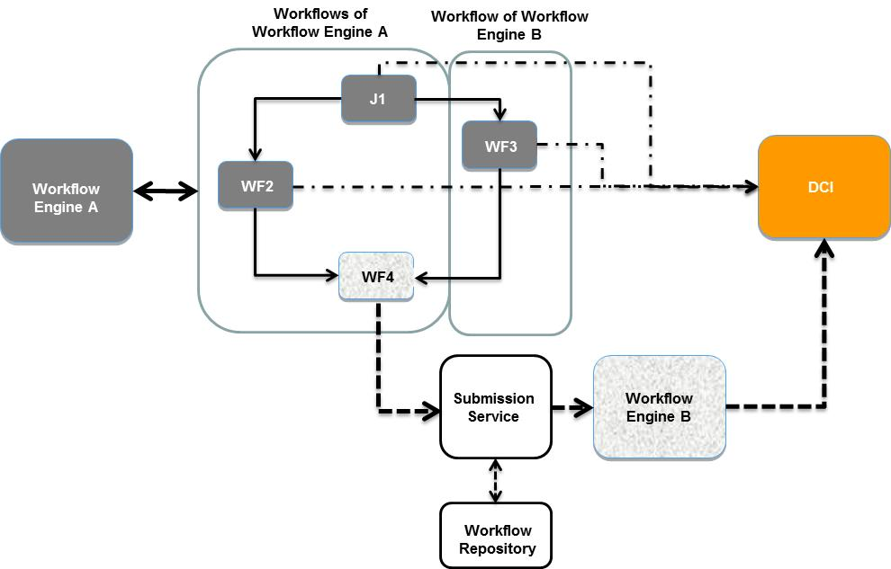
CGI Usage Scenario

Slide 19
CGI platform:
SHIWA Simulation Platform
SHIWA Gateway
Portal
SHIWA
Repository
API
Workflow engine
PGRADE workflows
submit
API
API
SHIWA Submission Service
DCI Bridge
cloud
cluster
service grid
desktop grid
super
computer

Slide 20
Phase 3:
Creating and Running Workflows of Different Workflow Systems
SHIWA Simulation Platform
workflow developer
create
migrate
execute
publish
WFs
Execute native WF
SHIWA
Portal
DCIs
Export WF
SHIWA
Repository
Execute non-native WF
Execute non-native WF
SHIWA
Submission Service
Workflow Engines

Slide 21
Phase 3:
Creating and Running Workflows of Different Workflow Systems
SHIWA
Portal
SHIWA Simulation Platform
SHIWA
Repository
Execute non-native WF
DCIs
Export WF
Execute non-native WF
SHIWA
Submission Service
Workflow Engines
researcher
create
migrate
execute
publish
Import WF
Execute native WF
WFs
Community
Portal
import
execute
WFs
Community gateway
workflow developer

Slide 22
Research Community Support
ER-flow partners
AstroPhysics community 7 workflows
Computational Chemistry community 16 workflows
Heliophysics community 6 workflows
Life Sciences community 13 workflows
External communities
Hydrometeorology community DRIHM 10 workflows
Seizmology community VERCE 50 workflows

Slide 23
Research Community Support
Phase 1 – introduction to the workflow technology
Platform: SHIWA Simulation Platform
Support: workflow creation and execution
Training: platform and workflow training
Phase 2 – creating and running workflows
Platform: SHIWA Simulation Platform or community portal
Support: portal deployment + workflow porting
Training: gateway deployment and management
Phase 3 – combining workflows of different workflow systems
Platform: SHIWA Simulation Platform + community portal
Support: access to repository + submission service
Training: CGI training

Slide 24
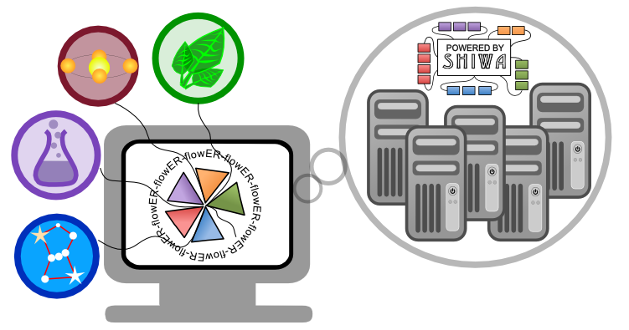
Questions?
SHIWA User Forum: www.erflow.eu/shiwa-user-forum
Website: www.erflow.eu

