Slide 1
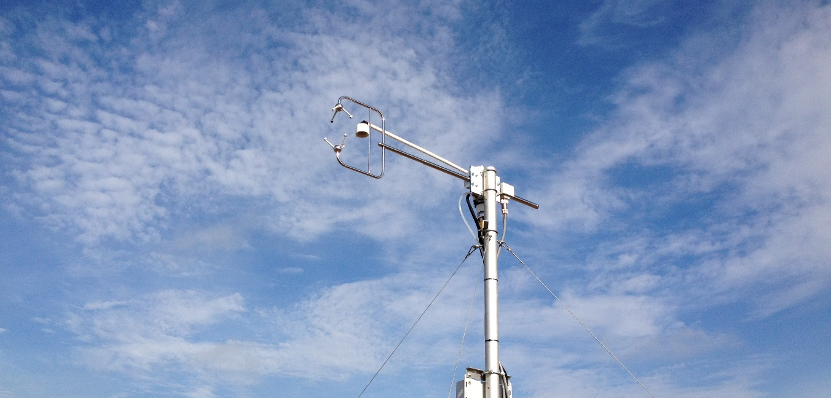
The Integrated Carbon Observation System ICOS
Werner L. Kutsch, Director General of ICOS RI, Helsinki, Europe
Helsinki, 21. May 2014

Slide 2
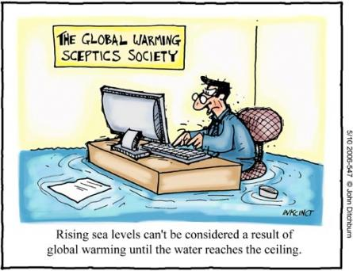

Introduction and background
Climate changes caused by
the increase of greenhouse gases
represent a major challenge to mankind.
Precise, long-term and internationally comparable measurements are a key factor in improving our knowledge of the complex interactions between climate on the one hand and biosphere, hydrosphere and atmosphere on the other. They are the best investment for avoiding surprises and reducing uncertainties about what tomorrow holds.
ICOS will provide these measurements.

Slide 3
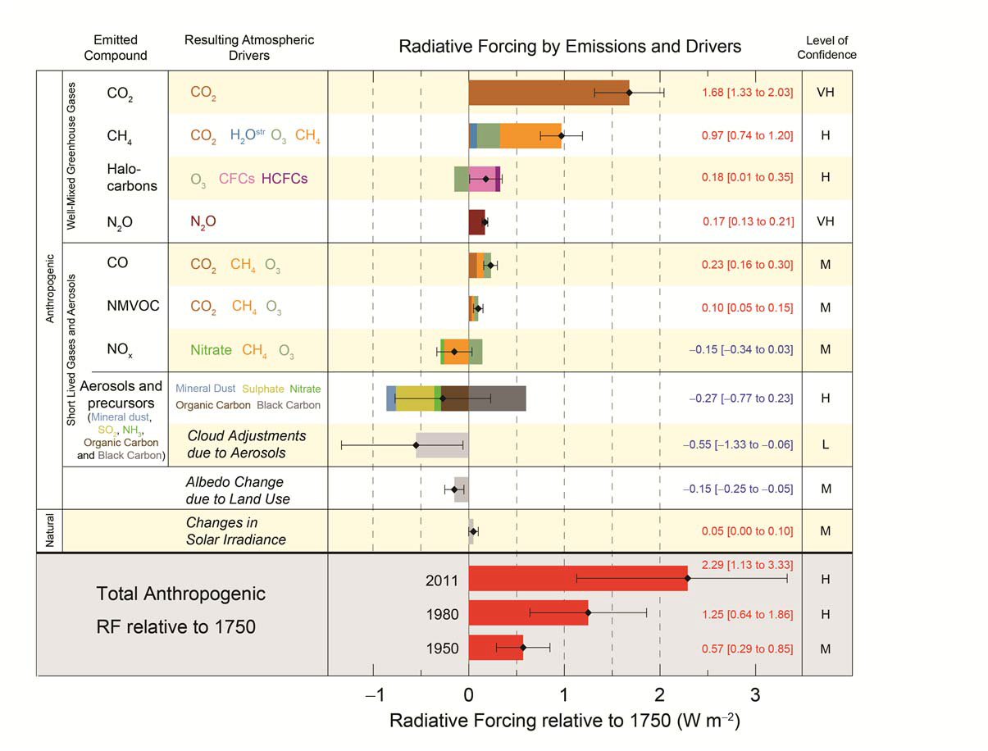
Climate and greenhouse gases
IPCC, 2013

Slide 4
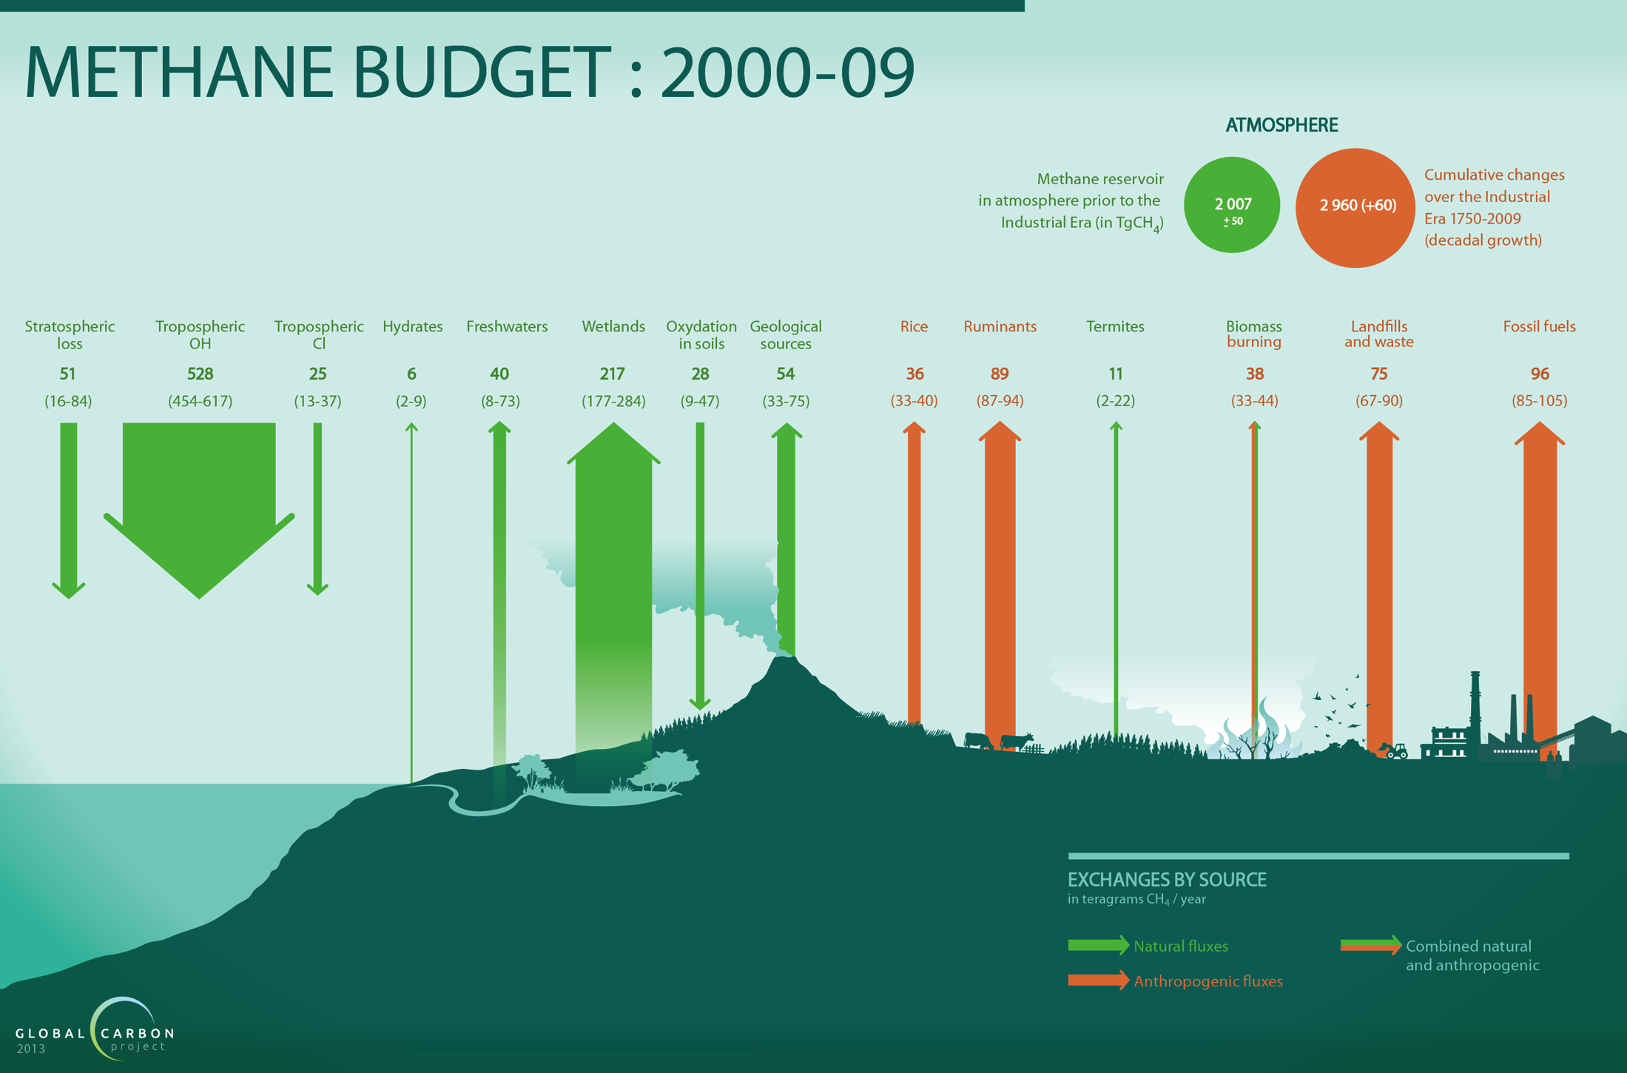
Global Carbon Project 2013; Figure based on Kirschke et al. 2013, Nature Geoscience

Slide 5
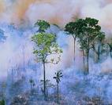
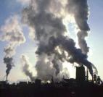
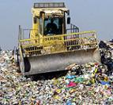
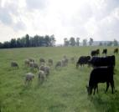
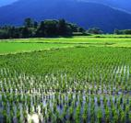
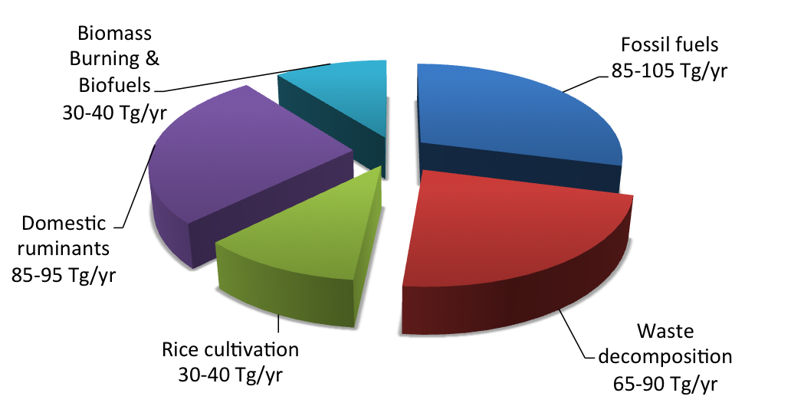
Anthropogenic Methane Sources (2000s)
Global Carbon Project 2013; Figure based on Kirschke et al. 2013

Slide 6
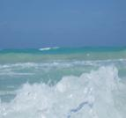
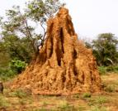
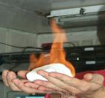
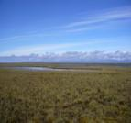
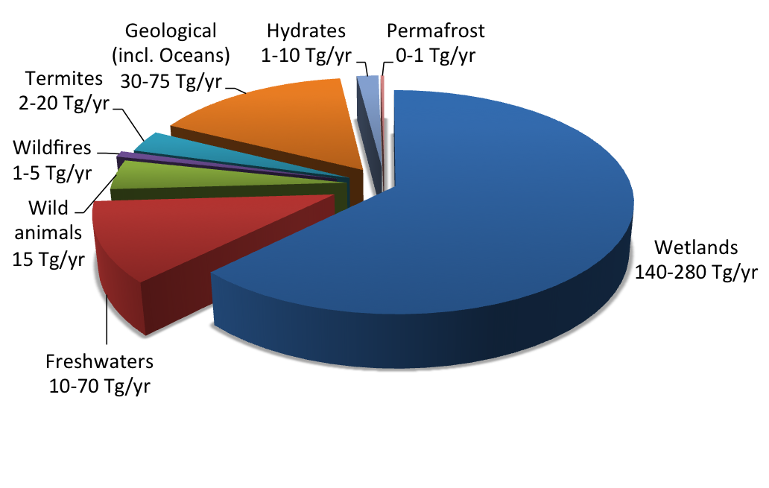
Natural Methane Sources (2000s)
Global Carbon Project 2013; Figure based on Kirschke et al. 2013

Slide 7
The vision and the scientific mission of ICOS
fundamental understanding of carbon cycle, greenhouse gas budgets and pertubations and underlying processes,
ability to predict future changes,
verify the effectiveness of policies aiming to reduce greenhouse gas emissions,
technical and scientific innovation,
education and capacity building.

Slide 8
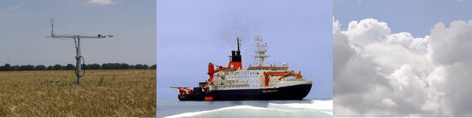
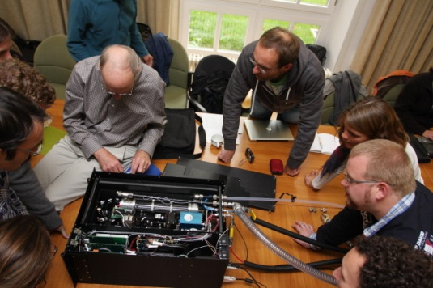
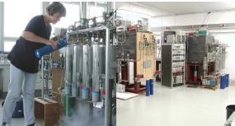
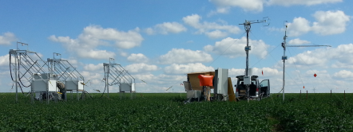

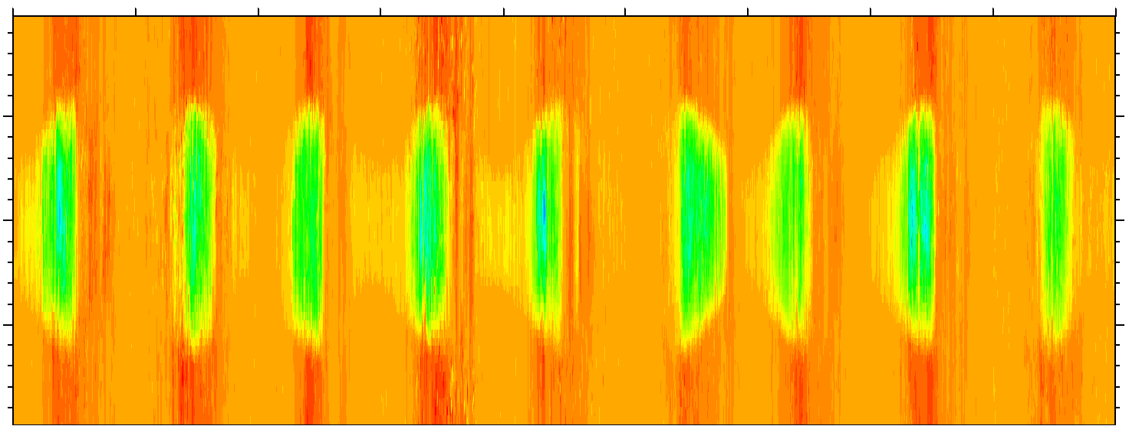
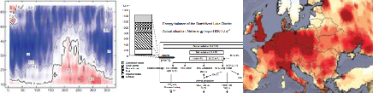
The vision of ICOS
All important parameters
State of the art techniques
Representative networks
Relevant data products
Optimum data streams
Long-term financial security
of all partners
A community to produce
higher level output

Slide 9
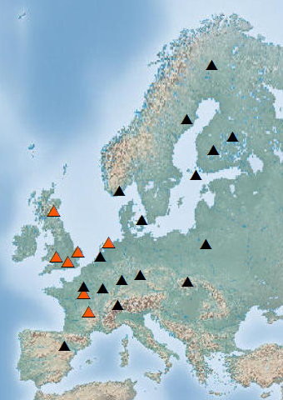
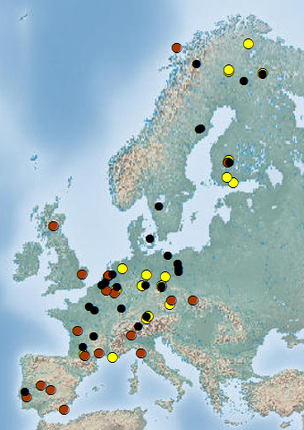
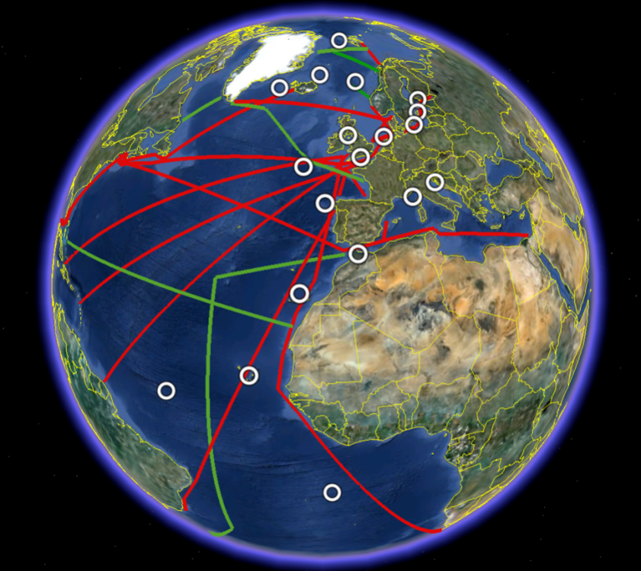

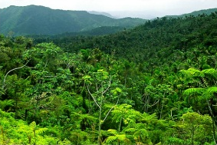

The ICOS station network today
….and anticipated ICOS station network 2020

Slide 10
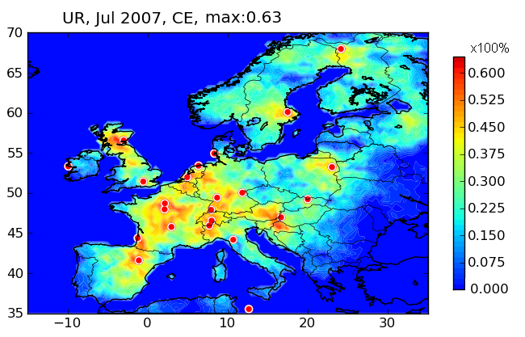
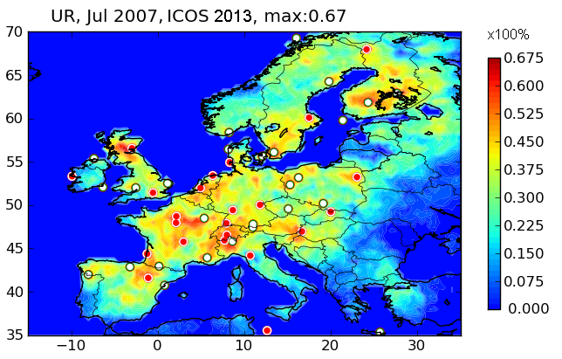
ICOS atmospheric stations and inverse modelling of CO₂ fluxes
ICOS 23 stations Europe
ICOS 50 stations Europe
Kadygrov et al. EGU 2013
Uncertainty reduction on CO₂ fluxes during the month of July 2007
red = CO₂ flux is better constrained
[courtesy J.D. Paris]

Slide 11
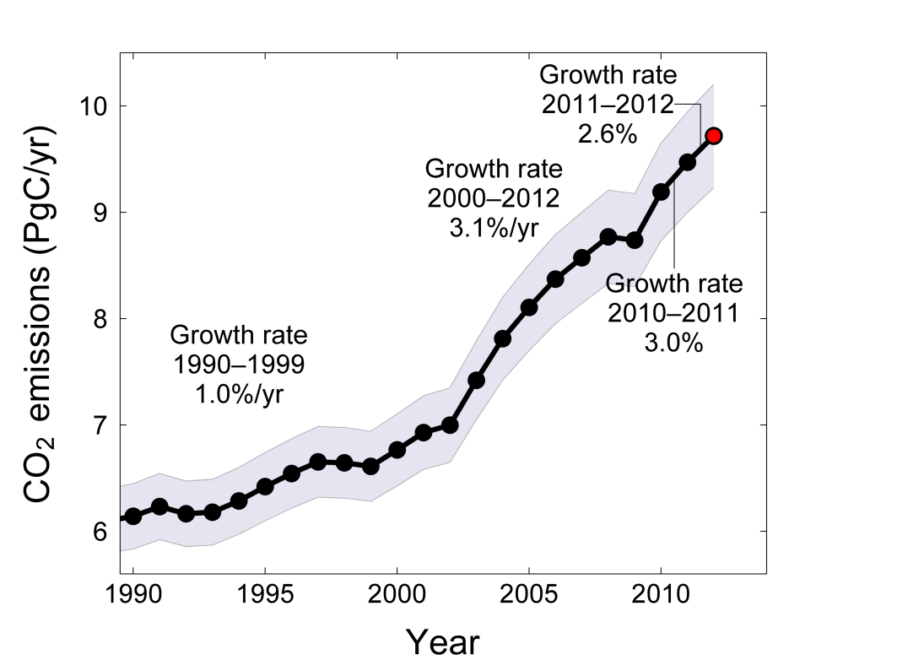
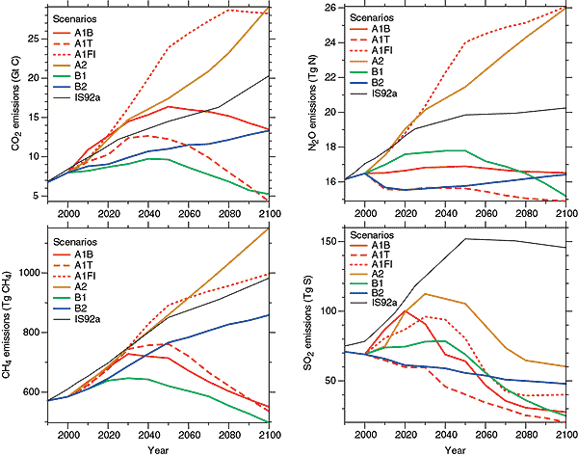
Verification of policies to reduce GHG emissions
Sources: IPCC; Peters et al. 2012a; Le Quéré et al. 2012; CDIAC Data; Global Carbon Project 2012

Slide 12
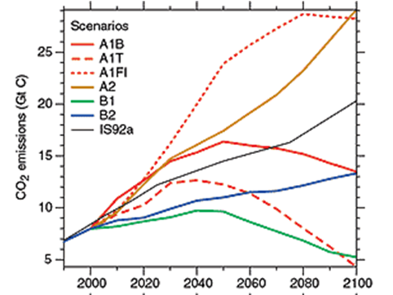

Verification of policies to reduce GHG emissions
Post-Kyoto agreement (2020)
Develop observing techniques
Establish baselines
Critical Verification Period
Robust verification, fine grid
Initial capability, ERIC (2014)
Fully operational (2020)
Future enhancements (2030…)

Slide 13
Development of ICOS
R&D, design studies
2001-2008
Preparatory phase (EC-FP7)
2008-2013
Construction phase
2011-2016
Operational phase
2015-…
ICOS ERIC 2014
European Research Infrastructure Consortium
CarboEurope-IP, CarboOcean-IP
Other research projects
National networks
EU funding
Transition phase
ESFRI Roadmap 2006
ICOS listed
National contributions
[courtesy J.D. Paris]
National contributions + EU funding

Slide 14
The structure of ICOS: internal administration
European Level
ICOS internal administration
ICOS will become a European Research Infrastructure Consortium in 2014. It has administrative bodies (orange) that are part of the ERIC and distributed central facilities that are mostly funded nationally and connected to the ERIC via contracts.
National Level

Slide 15
The structure of ICOS (Germany as example)
European Level
National Level
Data
Administration
Money

Slide 16
Scetch of the ICOS data structure
(ecosystem network)
Instrument
Computer or other data storage and processing unit
Data post-processing and QC
Feedback between
PI and ETC
Data archive
Data processing, usage for production of L3 products
Product, e.g. scientific publication or report

Slide 17
External e-infrastructures
Cloud
L0 Archive
L1, L2
doi
doi
system
doi
L0
L0
doi
L1, L2
doi
L0, oL1
L1, L2
doi
L0
Web interface
L3
doi
PI Arch
TC
Arch
CP
Arch
L0, oL1, piL1, piL2
L1, L2
doi
iL3
doi
doi
PI
ETC
Carbon Portal
doi
Special external users
e.g. fluxnet
„External“ L3 producers
doi
doi
doi

Slide 18
Cloud
L0 Archive
L1, L2
doi
doi
system
doi
L0
L0
doi
Report on data usage,
Visibility of sites and PIs
L1, L2
doi
L0, oL1
L1, L2
doi
L0
Web interface
L3
doi
PI Arch
TC
Arch
CP
Arch
L0, oL1, piL1, piL2
L1, L2
doi
iL3
doi
doi
PI
ETC
Carbon Portal
doi
Special external users
e.g. fluxnet
„External“ L3 producers
doi
doi
doi

Slide 19
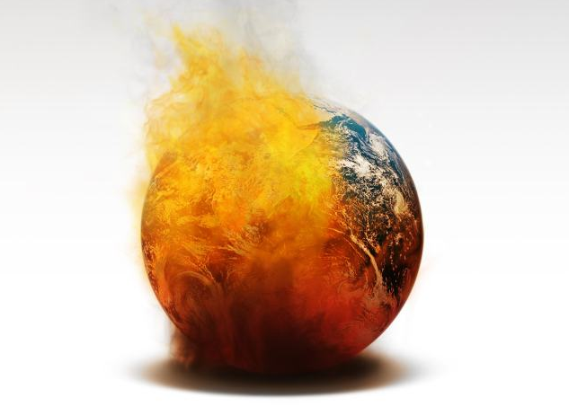
Grand Challenges for mankind
Global warming
Earthquakes
Climate
change
Air quality
Fresh water
Volcanoes
Ocean acidification
Energy
Deforestation
Epidemic
diseases
Biodiversity loss
Food supplies
Chemicalization
Notes:
The research themes in environmental sciences, such as global warming, climate change, pollution, freshwater and food supply, deforestation, biodiversity loss, volcanoes and earthquakes - are typically broad and have high societal relevance
But the same time the environmental grand challenges are complex and coupled and therefore require systemic and highly interdisciplinary approach
(We may ask that are the current research structures sufficient the support novel enviromental research and enhancing our capacity to meet the global environmental challenges?)

Slide 20


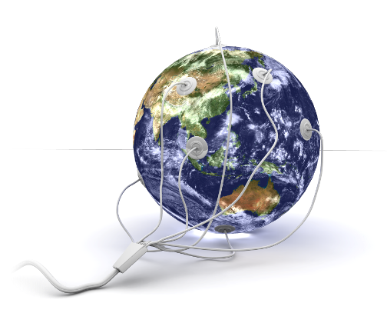
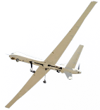


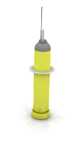

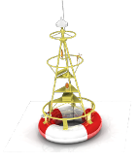
Common message for environmental research
Crucial scientific questions for mankind
Complex and unique system
The planet is our laboratory
Large-scale approach is unavoidable
Restructure the scientific community
Environmental research infrastructures are interconnected
More innovation is urgent
Funding policies are invited to adhere

Slide 21
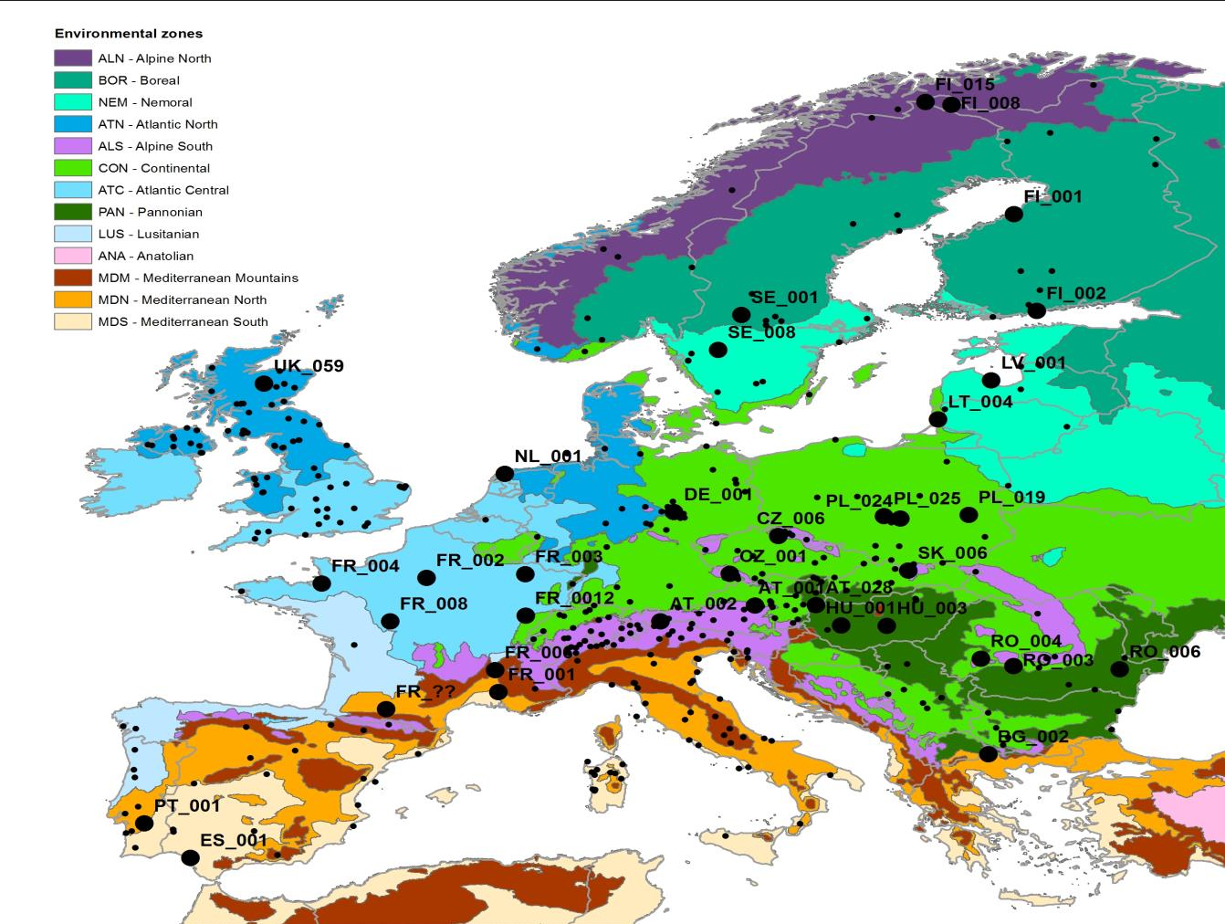
Observations

Slide 22
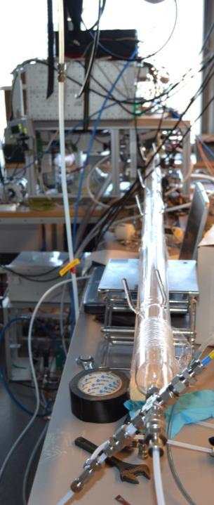
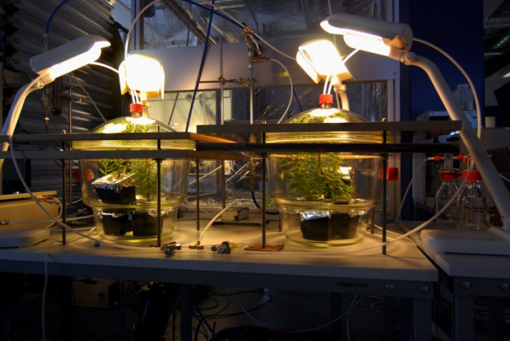
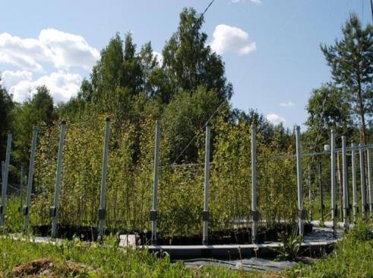
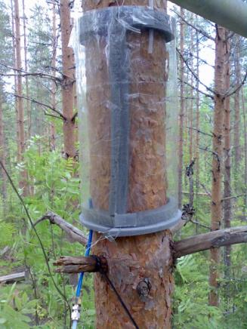
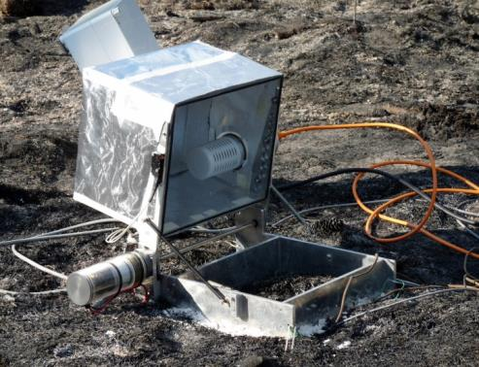
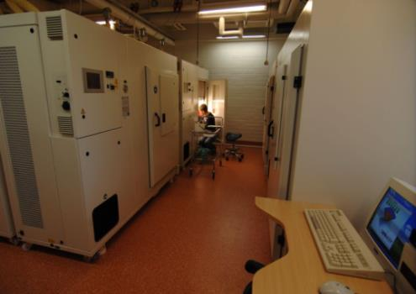
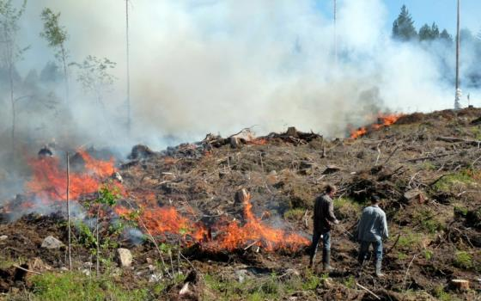
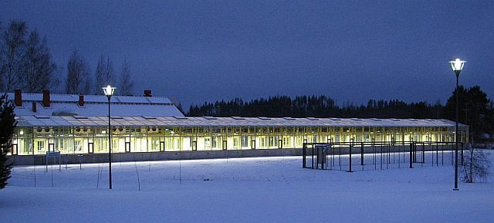
EXPERIMENTS
Dynamic tree responses
Pollutant exposures
Plant – air studies
Forest fire
Soil organism responses
Indoor growth chambers
Large phytotrons
APi-TOF

Slide 23
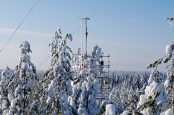

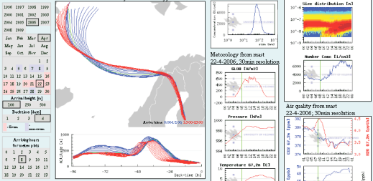
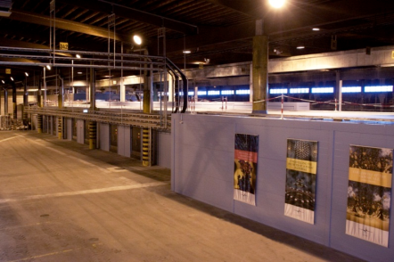

Databases & data portals make data available and discoverable
Data
Descriptions
Contextual datasets
User
interface
Permanent storage
Users
Users
Notes:
All observations are stored as contextual data (data+metadata) in a permanent storage facility (CSC)
Available and discoverable via user interface
Submission to international networks

Slide 24
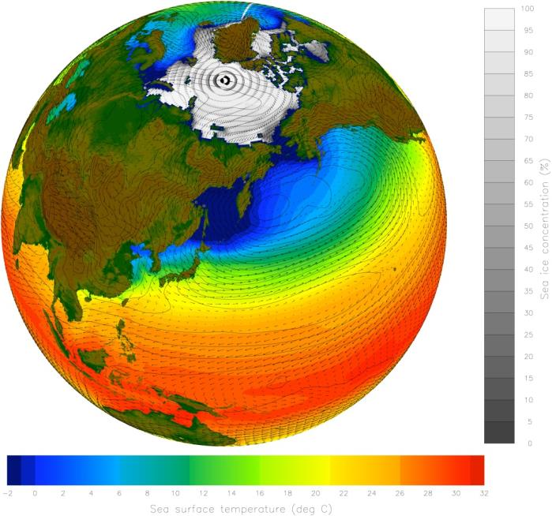

Modelling platforms
Climate change
Weather processes
Ecosystem changes
Spatial scale (nm - km)
Local processes
Nanoprocesses
Temporal scale (sec to centuries)

Slide 25
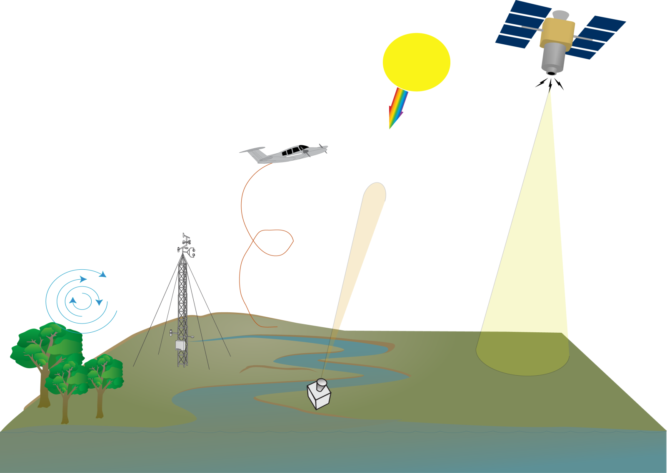
Carbon observations
Ground based remote sensing:
Permanent monitoring
Good accuracy
Satellite calibration
Aircraft:
Vertical sampling
High accuracy
Multispecies
Satellite remote sensing:
Vertical column, Global coverage
Poor - good accuracy
Masts, Tall towers:
Permanent monitoring
High accuracy
Multispecies
IAGOS
CONTRAIL
FTIR
TCCON
GOSAT
OCO-2
MERLIN (CH₄)
…
Eddy covariance:
“Direct” measurement of local fluxes
ICOS
NOAA/GMD
ICOS
NEON
[courtesy J.D. Paris]

Slide 26
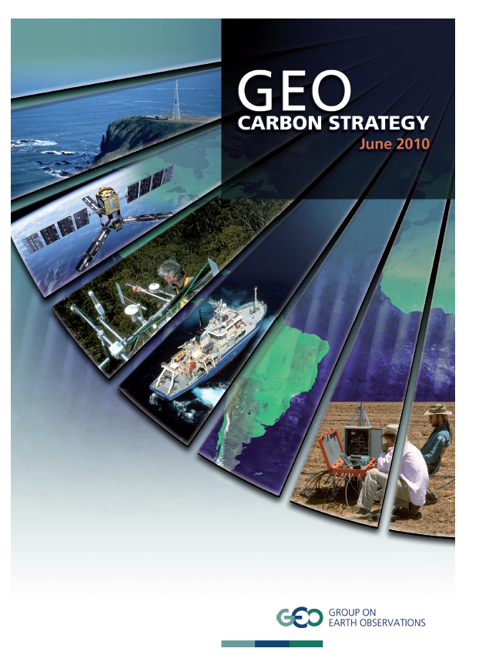

GEO Carbon strategy

Slide 27

Potential cooperations between environmental RI and e-infrastructures
Data services:
  Data Integrity (example shown),
  Data collection
    dispersed data (e.g. on biodiversity or taxonomy, Lifewatch),
    older data sets,
  Data visibility (metadata),
  Monitoring of downstream data usage,
  Non-commercial (public!) data storage.

Slide 28
Potential cooperations between environmental RI and e-infrastructures
Computing services:
  Fair and democratic big data analysis
    own computing facilities are only affordable for big players,
    environmental scientists need long time for aquiring necessary skills,
  Computing services for modeling,
    model-data integration for ES models,
    interfaces between ES models and e.g. economic models.

Slide 29

But:
  Many environmental e-infrastuctures have their own internal e-infrastructures.
  Earth system models are complex and need long-term infrastructures.
  Thus, many users of environmental data have their own e-infrastructures.

Slide 30

ICOS and GEO
Thank you!
werner.kutsch@helsinki.fi
www.icos-infrastructure.eu

