Slide 1
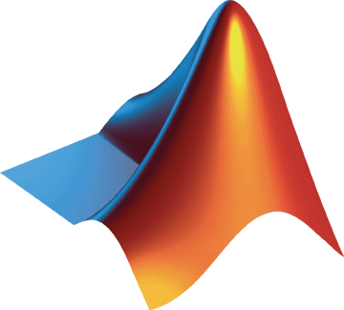
Scaling MATLAB applications to the bwHPC project
MS. Silvina Grad-Freilich
Senior Manager, Parallel Computing
MathWorks
Dr. Marek Dynowski –
HPC Manager, Tübingen University
Head of HPC-Competence Center for Bioinformatics and Astrophysics in Baden-Württemberg
Dipl. Inf. Michael Janczyk
HPC Manager, Freiburg University
Head of HPC-Competence Center for Particle Physics, Neuroscience and Microsystems Technology in Baden-Württemberg

Slide 2
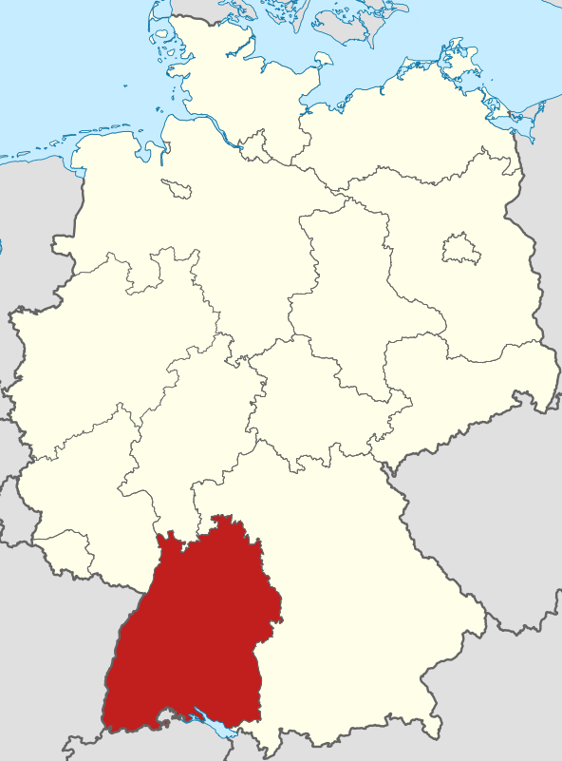
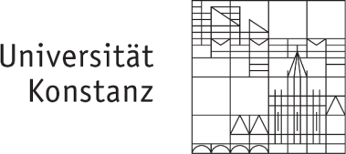
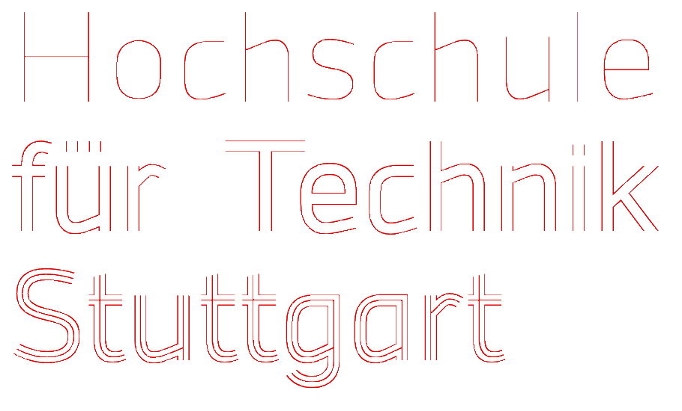
bwGRiD and bwHPC Projects Baden-Württemberg (BW), Germany
Partners:
©Wikipedia
Notes:
Den Wissenschaftlern in Baden-Württemberg stehen moderne/aktuelle HPC-Systeme aller Leistungsklassen zur Verfügung.
Die TIER 0 und TIER 1 Ebene stellen die höchste Leistungsklasse dar, die für hochparallele Spezialanwendungen oder für große Wissenschaftliche Projekte mit hohem Leistungsbedarf zur Verfügung stehen.
Die TIER 2 Ebene stellt das Bindeglied zwischen der Einstiegklasse in das Hochleistungsrechen (TIER 3) und dem höchstleistungsrechnen dar.

Slide 3
bwGRiD
bwHPC
Aggregation of homogeneous compute nodes (bwClusters)
Operated by 8 state universities
Focused on transparent centralization into a grid that offers easy to use HPC services
Ended in December 2013
Aggregation of heterogeneous resources (bwClusters)
Operated by 5 state universities
1x bwUniCluster (universal cluster, general purpose)
4x bwForCluster (research clusters): Focus on user support for research areas
Provision of software and training
Coordination of Tiger Teams
Detection of projects to migrate to a higher TIER level
Notes:
bwGRiD was the name of the concept and the grid clusters on Tier 3.
bwHPC is the HPC concept for the state (for all Tiers 0-3), but the clusters are called different. On Tier 3 they are called bwClusters (not a grid anymore), which could be seen as the successors of the bwGRiD.
bwUniCluster is the universal / general purpose cluster, the bwForClusters are research clusters for the specified areas. Tier 3 clusters are "HPC Enablers".
bwHPC is the Strategy for HPC in the state of BW
bwHPC-C5 are the federated user and IT support activities for bwHPC
C5: Coordinated Compute Cluster Competence Centers
bwForCluster are research cluster
bwUniCluster is the universal cluster

Slide 4
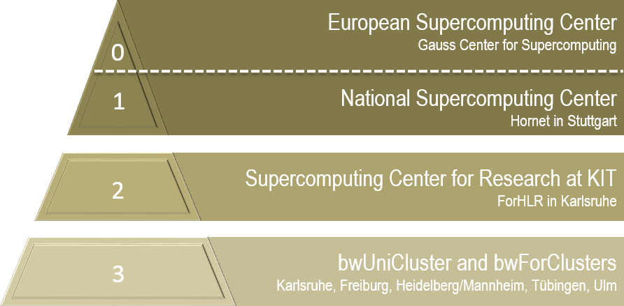
bwHPC Strategy in Baden-Württemberg

Slide 5
The TIER 3 Level in Baden-Württemberg
Universal resources
Resources for particular Research Areas
bwUniCluster
small parallel jobs
Teaching
non-bwFor Research areas
bwForCluster
Theoretical chemistry
bwForCluster
Bioinformatics
Astrophysics
2014
2014
2014
UL
TÜ
MA/HD
FR
bwForCluster
Structural- and Systems biology
Economic sciences
Social sciences
bwForCluster
Neurosciences
Micro Systems Technologies
Elementary particle physics
2014
2014
All Universities in Baden-Württemberg

Slide 6
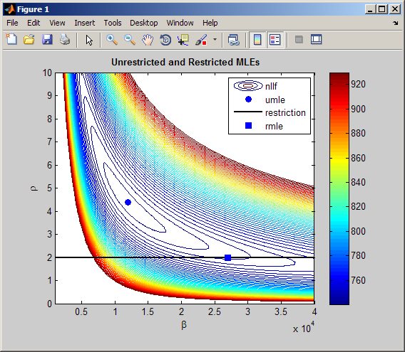
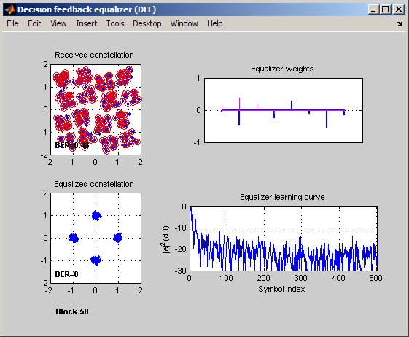
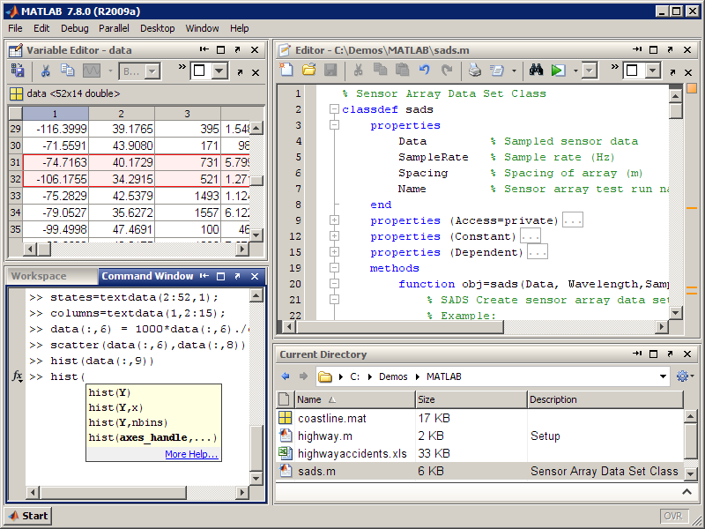
MATLAB ® The leading environment for technical computing
Interactive development environment
Technical computing language
Data analysis and visualization
Algorithm development
Tools for signal and image processing, statistics, optimization, and others
Application deployment
Notes:
So what is MATLAB? MATLAB is an interactive development environment as well a technical computing language. This means you can use a graphical point and click interface, OR a programmatic textual interface to perform your complex data analysis and visualisation, as well as your algorithm and application development.

Slide 7
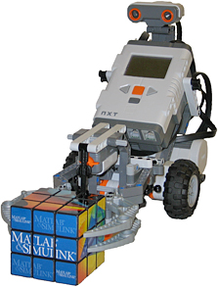
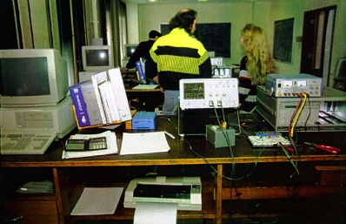
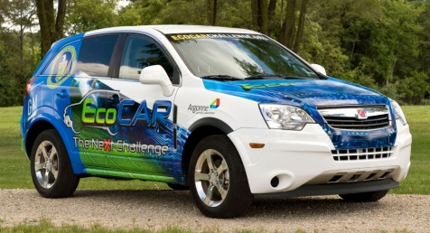
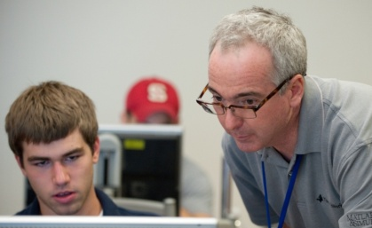
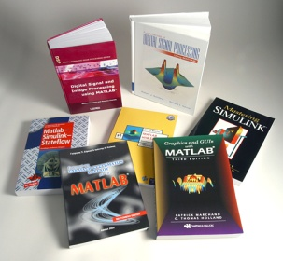
MathWorks Deeply Rooted in Education and Research
5000+ universities around the world
1500+ MATLAB and Simulink based books
Academic support for research, fellowships, student competitions, and curriculum development
“Everyone that comes in as a new hire already knows MATLAB, because they all had it in college. The learning curve is significantly lessened as a result.”
Jeff Corn, Chief of Engineering Projects Section, U.S. Air Force

Slide 8
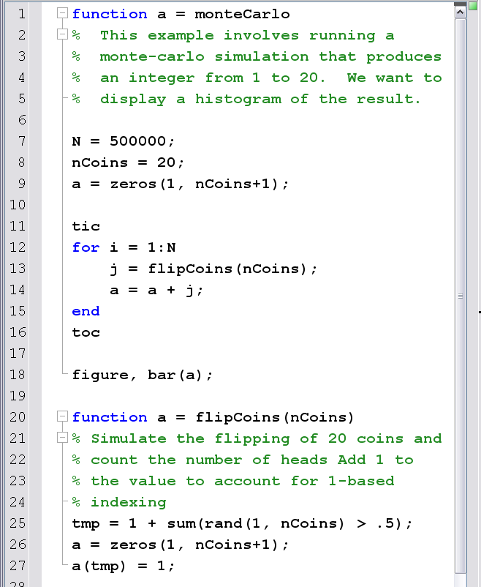
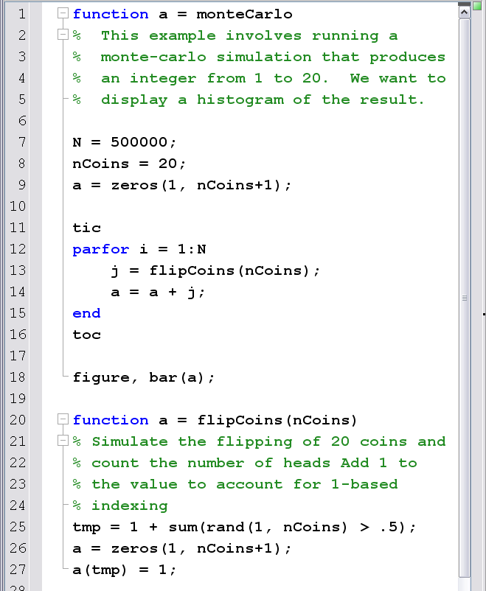
Parallel Computing with MATLAB Task-parallel: parfor loop
Notes:
The MathWorks
8
Parfor loops provide an easy way of converting your serial code into something that will run in distributed mode; it is a task-parallel language construct. Parfor loops are written in the same functions as your serial code, and MATLAB will automatically run the code inside the loop on a matlabpool, if there is one running.
You can start up additional MATLAB sessions using the matlabpool command. These additional MATLAB sessions may reside on your cluster, or even on your local machine. You can think of the matlabpool as being a bit like being able to connect to many different printers on your PC.
M-Lint analysis now works on parfor loops, making it easier for you to identify if your existing “for” loops can simply be modified to “parfor” with no additional changes.
The MathWorks have introduced a new keyword into the MATLAB language: parfor, or parallel for loop. A parfor will take a existing for loop and transform it into something that can run on a cluster of MATLAB sessions. You can see on the right how easy it was to convert my Monte Carlo code into something that will run on a cluster.

Slide 9
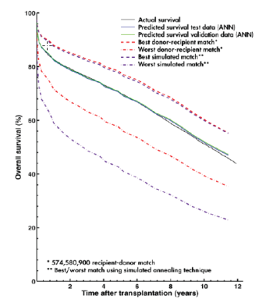
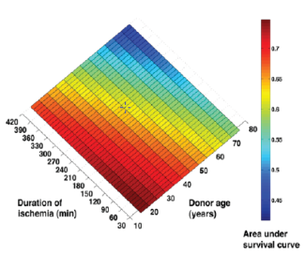
Lund University Develops an Artificial Neural Network for Matching Heart Transplant Donors with Recipients
Challenge
Improve long-term survival rates for heart transplant
recipients by identifying optimal recipient and donor matches
Solution
Use MathWorks tools to develop a predictive artificial neural network model and simulate thousands of risk-profile combinations on a 56-processor computing cluster
Results
Prospective five-year survival rate raised by up to 10%
Network training time reduced by more than two-thirds
Simulation time cut from weeks to days
Plots showing actual and predicted survival, best and worst donor-recipient match, best and worst simulated match (left); and survival rate by duration of ischemia and donor age (right).
“I spend a lot of time in the clinic, and don’t have the time or the technical expertise to learn, configure, and maintain software. MATLAB makes it easy for physicians like me to get work done and produce meaningful results.”
Dr. Johan Nilsson Skåne University Hospital Lund University
Link to user story
Notes:
Primary Industry: Biotech and Pharmaceutical
Secondary Industries: Academia
Product Capabilities: Data Analysis, Mathematical Modeling, Parallel Computing
Applications: Computational Biology
Products Used: MATLAB, MATLAB Distributed Computing Server, Neural Network Toolbox, Parallel Computing Toolbox
Country: Sweden
Lund University Develops an Artificial Neural Network for Matching Heart Transplant Donors with Recipients
A heart transplant recipient’s survival depends on dozens of variables, including the weight, gender, age, and blood type of both donor and recipient, and the ischemic time— or the time during a transplant when there is no blood flow to the organ.
To better understand transplant risk factors and improve patient outcomes, researchers at Lund University and Skåne University Hospital in Sweden use artificial neural networks (ANNs) to explore the complex nonlinear relationships among multiple variables. The ANN models are trained using donor and recipient data obtained from two global databases: the International Society for Heart and Lung Transplantation (ISHLT) registry and the Nordic Thoracic Transplantation Database (NTTD). The Lund researchers accelerated the training and simulation of their ANNs by using MATLAB, Neural Network Toolbox, and MathWorks parallel computing products.
“Many of the techniques we use are computer-intensive and time-consuming,” says Dr. Johan Nilsson, Associate Professor in the Division of Cardiothoracic Surgery at Lund University. “We used Parallel Computing Toolbox with MATLAB Distributed Computing Server to distribute the work on a 56-processor cluster. This enabled us to rapidly identify an optimal neural network configuration using MATLAB and Neural Network Toolbox, train the network using data from the transplantation databases, and then run simulations to analyze risk factors and survival rates.”
The Challenge
Understanding how various risk factors affect survival rates involved hundreds of thousands of computationally and data-intensive operations—for example, the team had to test hundreds of ANN configurations to identify the best one. An analysis of six variables requires the simulation of 30,000 different combinations. Simulating all these combinations for 50,000 patients took weeks using an open-source software package.
Nilsson and his colleagues encountered reliability problems with the software they were using, as well. “The software was unstable, which led to crashes during long, multiday simulations,” Nilsson explains. “In addition, some of the results it produced were not quite right. When we publish our findings, we need to be very sure we can trust the results.”
“I spend a lot of time in the clinic, and don’t have the time or the technical expertise to learn, configure, and maintain software. MATLAB makes it easy for physicians like me to get work done and produce meaningful results.”
- Dr. Johan Nilsson, Skåne University Hospital, Lund University
The Solution
To address the speed and reliability challenges, Lund University researchers developed their initial ANN model using MATLAB and Neural Network Toolbox. To find the optimal network configuration, they wrote MATLAB scripts that varied the number of hidden nodes used in the network for a range of weight decay (or regularization) values.
The team used Parallel Computing Toolbox and MATLAB Distributed Computing Server to accelerate the simulation of more than 200 ANN configurations. They then evaluated the results to find the best-performing configuration.
After training the ANN using donor and recipient information from the databases, they verified the model’s accuracy by simulating outcomes for 10,000 patients that had been omitted from the training set. They then compared the results against actual survival rates.
In the next phase, the team conducted thousands of simulations in parallel to rank the 57 risk factors considered in the study for predicting long-term survival.
Using results from Monte Carlo simulations on the computer cluster and simulated annealing techniques, the researchers identified the best and worst possible donors for any particular recipient.
As a final step, the team developed an automated process that ranks the recipient waiting list to identify the best candidates for a prospective donor.
In the next major phase of the project, Lund University researchers are using the ANN to investigate the use of Human Leukocyte Antigen (HLA) genetic profiles to match donors with recipients.
The Results
■ Prospective five-year survival rate raised by up to 10%. “In a simulated randomized trial, the preliminary results show that the ANN model we developed using MATLAB and Neural Network Toolbox would transplant approximately 20% more patients than would have been considered using traditional selection criteria,” says Nilsson. “The prospective five-year survival rate for the ANN-selected patients was 5–10% higher than those matched with the criteria physicians use today.”
■ Network training time reduced by more than two-thirds. “Using Neural Network Toolbox and MATLAB, it took us 5 to 10 minutes to train our ANNs,” says Nilsson. “Training took 30 to 60 minutes using open-source software. That is a big difference, because we were training and evaluating hundreds of network configurations.”
■ Simulation time cut from weeks to days. “When we switched to MATLAB and MathWorks parallel computing technologies, we completed experiments that regularly took 3 to 4 weeks in about 5 days,” says Nilsson. “More importantly, the simulations were completed reliably, with no crashes.”
Learn More About Lund University: www.lunduniversity.lu.se, www.med.lu.se/aicts
This project is a collaboration with:
• The Department of Clinical Sciences Lund at Lund University and Skåne University Hospital
• The Department of Astronomy and Theoretical Physics at Lund University
• The Competence Center of Clinical Research at Skåne University Hospital

Slide 10
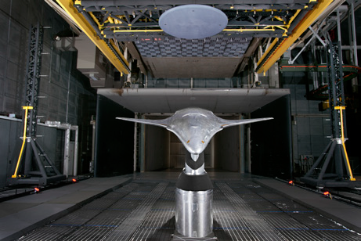
NASA Langley Research Center Accelerates Acoustic Data Analysis with GPU Computing
Challenge
Accelerate the analysis of sound recordings from wind tunnel tests of aircraft components
Solution
Use MATLAB and Parallel Computing Toolbox to
re-implement a legacy program for processing acoustic data, and cut processing time by running computationally intensive operations on a GPU
Results
Computations completed 40 times faster
Algorithm GPU-enabled in 30 minutes
Processing of test data accelerated
Wind tunnel test setup featuring the Hybrid Wing Body model (inverted), with 97-microphone phased array (top) and microphone tower (left).
“Our legacy code took up to 40 minutes to analyze a single wind tunnel test; by using MATLAB and a GPU, computation time is now under a minute. It took 30 minutes to get our MATLAB algorithm working on the GPU—no low-level CUDA programming was needed.”
Christopher Bahr
NASA
Link to user story
Notes:
Industries: Aerospace and defense
Application Areas: Digital signal processing
Capabilities: Data analysis, Algorithm development, Parallel computing
Products Used: MATLAB, Parallel Computing Toolbox, Signal Processing Toolbox
Country: United States
NASA Langley Research Center Accelerates Acoustic Data Analysis with GPU Computing
As both air traffic and housing and business development near airports increase, reducing the noise produced by commercial aircraft during takeoff and landing continues to be a high priority. To explore and evaluate noise-reduction techniques, researchers at NASA Langley Research Center are analyzing novel aircraft designs, such as the Hybrid Wing Body (HWB).
The engineers use MATLAB and Parallel Computing Toolbox to accelerate the processing of acoustic data on NVIDIA GPUs.
“MATLAB replaces a much older algorithm for processing acoustic data, and Parallel Computing Toolbox accelerates the new algorithm by executing it on a GPU, with little change to the code,” says Christopher Bahr, research aerospace engineer at NASA Langley Research Center, Aeroacoustics Branch. “We now analyze data during the wind tunnel tests, which considerably reduces downtime.”
Challenge
NASA engineers use up to 126 microphones to record sounds generated by an aircraft component during wind tunnel tests. After 30 seconds, the engineers reposition the microphones and begin another 30-second recording. A single run may include up to 14 recordings. Multiple runs may be conducted at different wind tunnel speeds or with different orientations of the aircraft. A single test may comprise hundreds of runs.
The engineers were using a legacy program written in Fortran, which took 20–40 minutes to process the approximately 2 gigabytes of data generated during each recording. The team wanted to reduce processing time so that they could identify hardware problems, as well as make on-the-fly decisions for upcoming run configurations. Further, they wanted to process the data in the facility, reducing data transfer overhead and simplifying data security procedures.
They knew that multicore processing on a single machine would not provide the required processing speed. The team needed GPU processing to meet their requirements.”
“Our legacy code took up to 40 minutes to analyze a single wind tunnel test; by using MATLAB and a GPU, computation time is now under a minute. It took 30 minutes to get
our MATLAB algorithm working on the GPU—no low-level CUDA programming was needed.”
- Christopher Bahr, NASA
Solution
NASA engineers re-implemented the old code in MATLAB and used GPU computing with Parallel Computing Toolbox to reduce processing times.
Working in MATLAB, the engineers developed an algorithm to process the 16-bit integer data from the data acquisition system. The MATLAB algorithm converts the data to a pressure signal, breaks the signal into blocks, transforms the blocks into the frequency domain, corrects for instrumentation and filter effects, and averages across the blocks to construct a covariance matrix that provides estimates of the power common to each pair of microphones.
The algorithm incorporates Hamming, Kaiser, and flat-top window functions from Signal Processing Toolbox™, as well as fast Fourier transforms (FFTs) and matrix multiplication operations. It was first developed for standard CPU operation.
To verify the MATLAB implementation, the team compared the results it produced with the results produced by the legacy code, ensuring a match to within acceptable tolerances. They then updated the MATLAB code, using Parallel Computing Toolbox to transfer acoustic data to a K20 GPU and execute computationally intensive operations.
To simplify batch processing of recordings, the engineers created a graphical interface in MATLAB for specifying algorithm options and selecting recordings to process. They developed a second interface for generating plots of results, including narrowband spectra and one-third octave band spectra plots. These plots helped assess noise source behavior and data quality, and are used to develop advanced noise suppression models.
The team plans to develop additional advanced processing algorithms in MATLAB. These algorithms will enable them to more accurately pinpoint the source of noise during wind tunnel tests.
Results
■ Computations completed 40 times faster. “Our legacy code took up to 40 minutes to analyze a single wind tunnel test,” says Bahr. “The initial MATLAB implementation cut that time to 20 minutes. The addition of GPU computing with Parallel Computing Toolbox cut it to under a minute, with most of that time spent on data transfer.”
■ Algorithm GPU-enabled in 30 minutes. “Many operations we perform, including FFTs and matrix multiplication, are GPU-enabled MATLAB functions,” says Bahr. “Once we developed the initial MATLAB code for CPU execution, it took 30 minutes to get our algorithm working on the GPU—no low-level CUDA programming was needed.”
■ Processing of test data accelerated. “In the past, our data processing algorithms were too slow to process sound data in this way during wind tunnel tests,” Bahr recalls. “With MATLAB code running on the GPU, we analyze data after each recording, identify any problems with the test setup, and correct them immediately.”
Learn more about NASA Langley Research Center: www.nasa.gov/langley

Slide 11
Parallel Applications and MATLAB
 | Built-in support with toolboxes
 | Simple programming constructs: batch, parfor, distributed, gpu arrays
 | Advanced programming constructs: createJob, labSend, spmd, CUDA kernels
Ease of Use
Greater Control

Slide 12
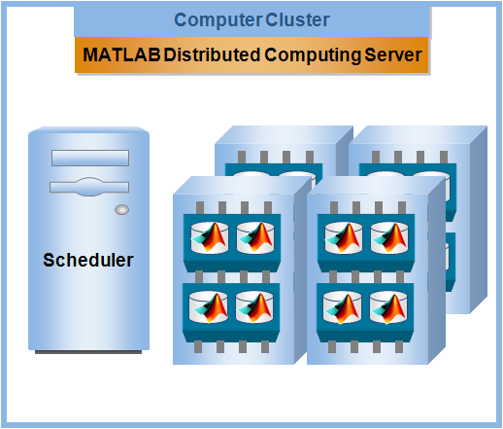
Scaling beyond your desktop
Desktop Computer
Parallel Computing Toolbox
bwGRiD/bwHPC provide MDCS access to all Baden-Württemberg MATLAB users
Notes:
Same way, you can scale to grids and clouds. All if you have MDCS installed in their resources.

Slide 13
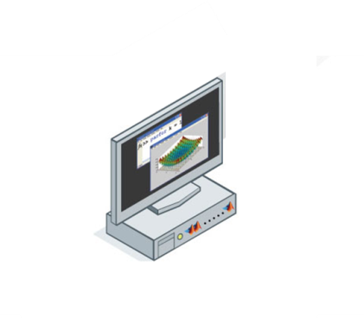
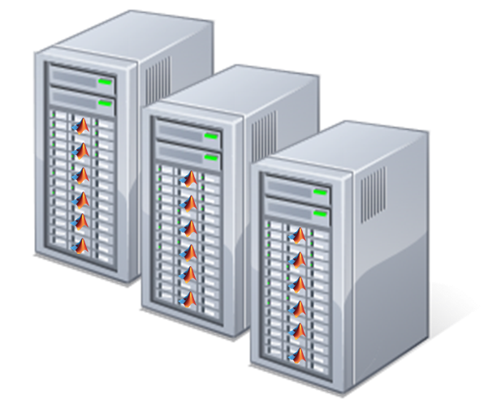
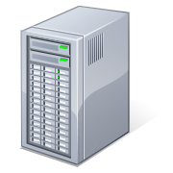
1 - Job submission from head node
>> batch
>> parpool
Compute
nodes
Remote Desktop
User desktop
Headnode (TORQUE, Moab)
File System
Notes:
What KIT would like to do
SNIC implementation
Remote desktop (VNC) or they use a NO/NX machine (similar to VNC)
(torque/moab) under the head node. This might show that more submitters (Batchsystems) are supported.

Slide 14
2 - Job submission from user’s desktop
>> batch
Compute
nodes
ssh
User desktop
Headnode (TORQUE, Moab)
File System
Notes:
Freiburg, Tobb
Only batch because the compute notes can’t see the desktop
If they were using MJS, they probably could use parpool
Cannot run parpool

Slide 15
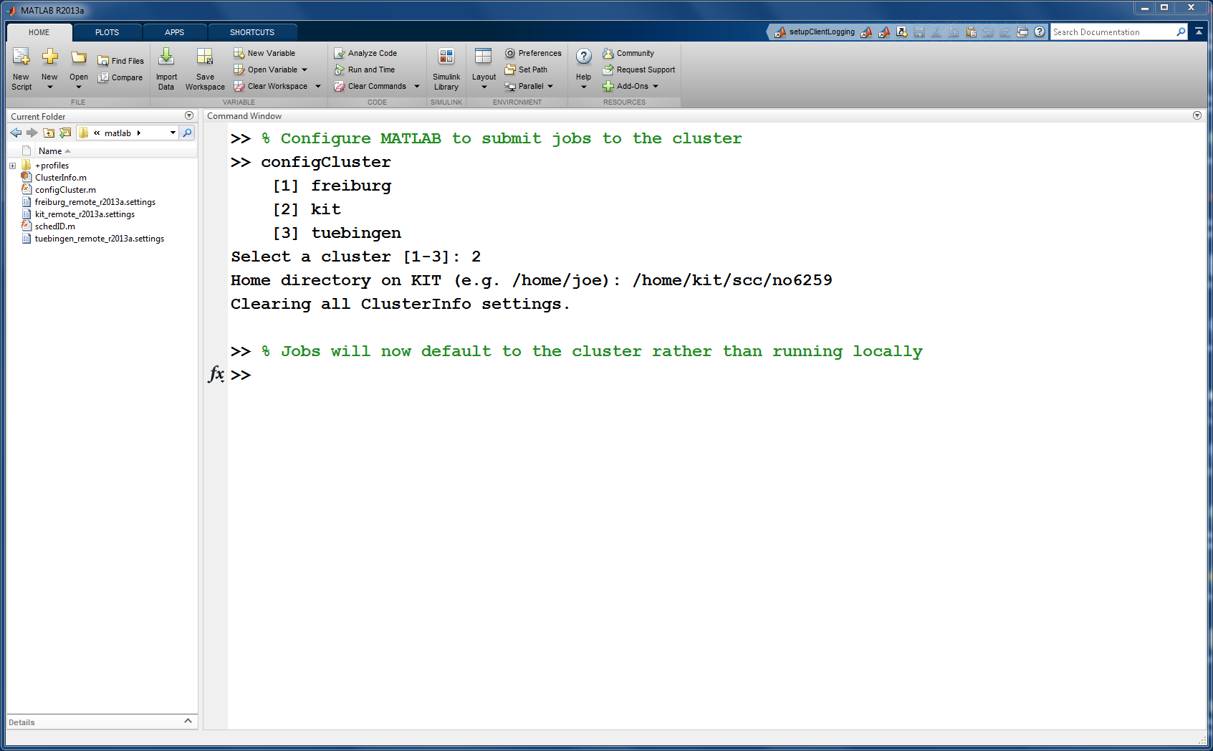
User configures the cluster by running the configCluster tool
Tool imports cluster profile
Scheduler and resource manager are hidden from the user

Slide 16
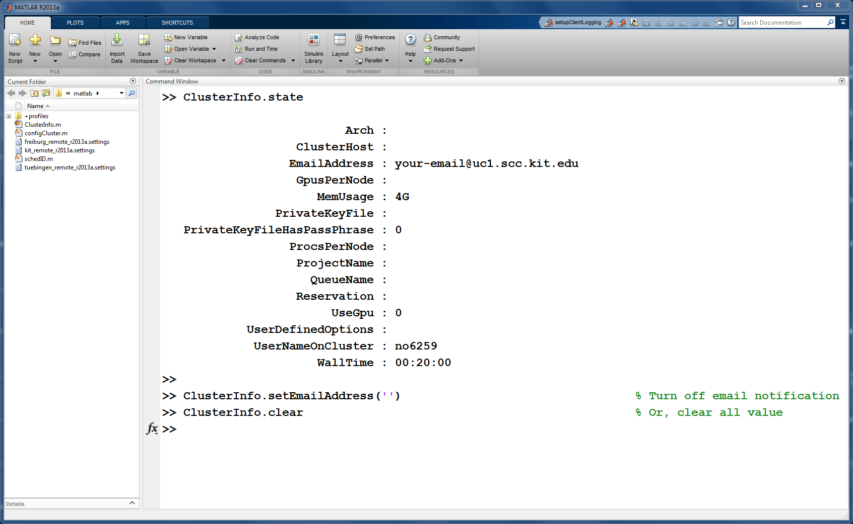
User specifies job parameters using ClusterInfo tool
Notes:
Any parameters set with ClusterInfo will be persistent between MATLAB sessions

Slide 17
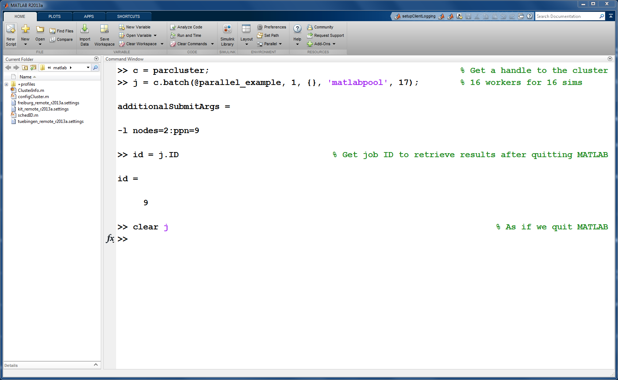
User submits serial and parallel jobs to the cluster
Notes:
Any parameters set with ClusterInfo will be persistent between MATLAB sessions

Slide 18
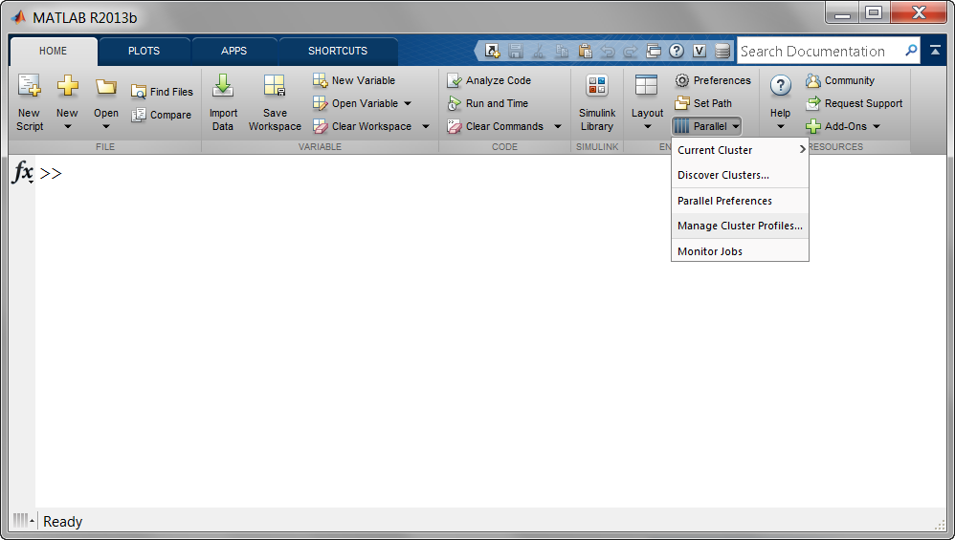
User can submit jobs to different clusters
Notes:
* We do not want to say that this is going to be released in R2012b.
Key Points:
HPC on Cloud is possible – it is not longer a pipe-dream. Amazon now offers high-end EC2 instances geared towards high-performance computing.
We are actively working towards an offering that would let users launch MATLAB and Simulink computations on these Amazon EC2 instances using our parallel computing products.
Organizations or Users that need additional computing resources to supplement in-house resources or do not have the budget to make significant investments in hardware and software to meet unpredictable and transient demand for computing resources would find this very useful.
Our offering that does (or will do) three things:
Provide access to compute resources when users want
Simplifies and accelerates the setup
User interaction model is preserved
We have created a MathWorks Cloud Center web application that greatly accelerates and simplifies how users configure and start Amazon EC2 resources to run MATLAB Distributed Computing Server workers.
Within 15-minutes you can have a cluster of 32, 64 workers setup for you. Once a MATLAB cluster has been started on EC2, users interact with it using Parallel Computing Toolbox just as they would with any other cluster.

Slide 19
Tiger Teams
Solve specific computational problems
Consist of experts and users
Experts can be internal and external (MathWorks)
Mixture is problem dependent
Transfer user projects to HPC resources
Optimize code for parallel HPC systems

Slide 20
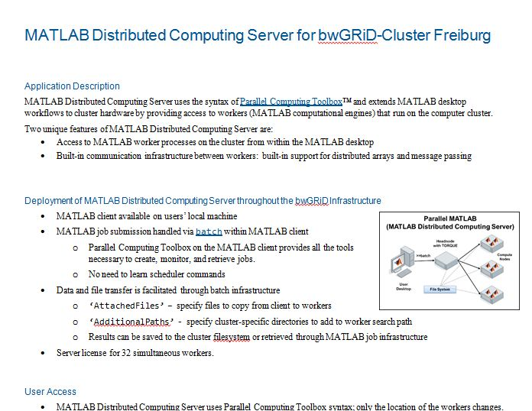
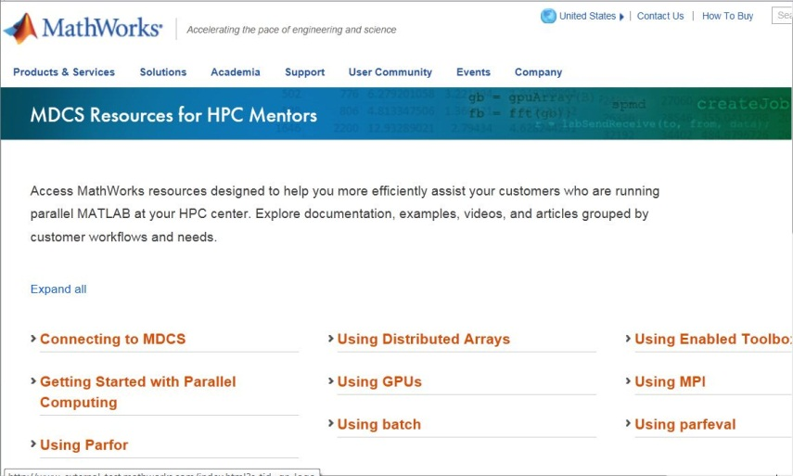
Tiger Team MATLAB
Consists of BW cluster administrators and MathWorks MATLAB experts
Goals
Integrate MATLAB into bwClusters
Provide same look and feel on every cluster
Solve licensing issues
Nurture bwHPC MATLAB Champions
Assist users on running parallel MATLAB applications on bwClusters
Form a virtual organization
Share experiences, challenges
Request support, material, etc.

Slide 21
Status
Current status
Clusters
bwUniCluster is in production
Ulm call for bids is done, cluster might be in production in Q3 2014
Mannheim/Heidelberg is currently preparing their call for bids
Freiburg/Tübingen will send cluster proposal the week of May 19th
MDCS is integrated into old Tübingen and Freiburg clusters
1-2 users that are field-testing the implementation
Next steps
Rollout our implementation to each of the 5 data centers
Transfer knowledge to cluster admins of each center and MATLAB Champions
Train MATLAB users on parallel computing with MATLAB

Slide 22
END

Slide 23
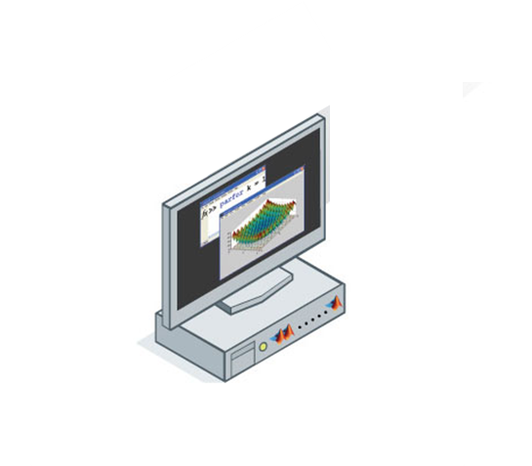
Parallel Computing with MATLAB Scaling beyond the desktop
Your Organization

