Slide 2
The ENVRI Reference Model
Why we need it
How we built it
And what it is
Early adoption and use
Benefits and conclusions
Creative Commons by Quinn Dombrowksi, used under CC-BY-SA 2.0, cropped
Notes:
Start by saying how we all speak a common language but often, despite using the same words we say different things. This is a problem for us because it makes it difficult to reach common understanding and it leads to incompatibilities between systems.

Slide 3
Why we need it?
To help the community reach a common vision
To provide a common language for communication
To provide a uniform framework into which RIs’ components can be placed and compared
To provide common solutions to common problems
To secure interoperability
To enable reuse, share of resource/experiences, avoid duplication efforts
Notes:
The motivations of creating a reference model for environmental science research infrastructures are:

Slide 4
Why we need it?
To help the community reach a common vision
To provide a common language for communication
To provide a uniform framework into which RIs’ components can be placed and compared
To provide common solutions to common problems
To secure interoperability
To enable reuse, share of resource/experiences, avoid duplication efforts
Intended audience
Implementation teams
Architects, designers, integrators, Engineers
Operations teams
Third party solution / component providers
Notes:
The motivations of creating a reference model for environmental science research infrastructures are:

Slide 5
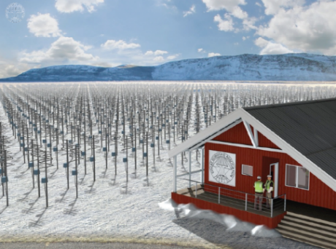
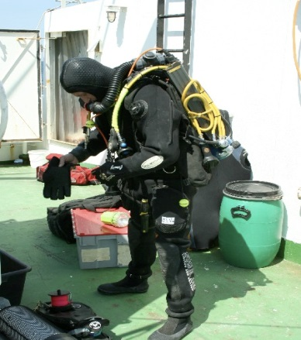
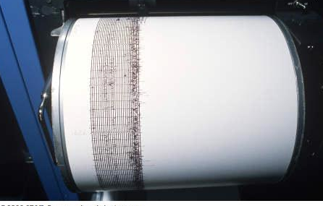
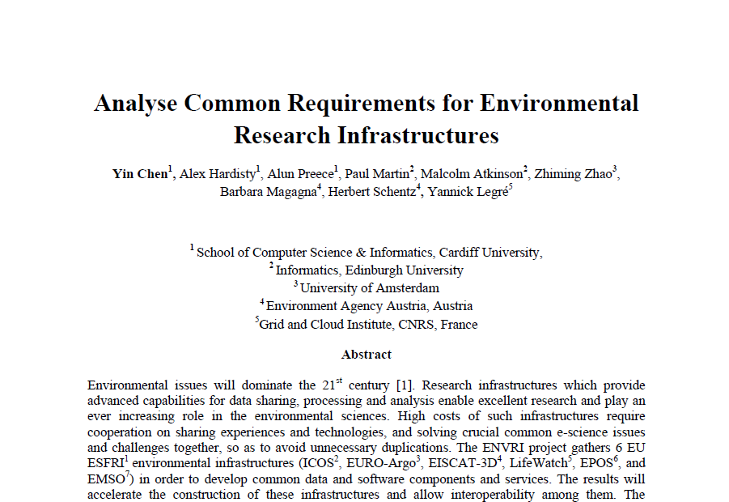
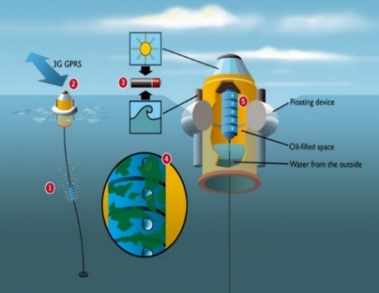
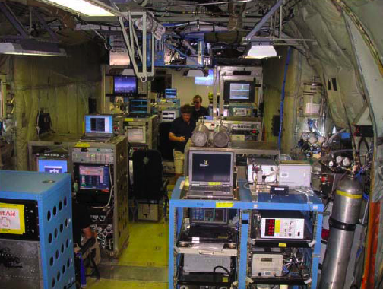
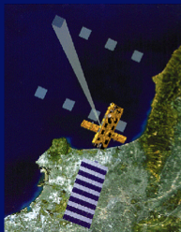
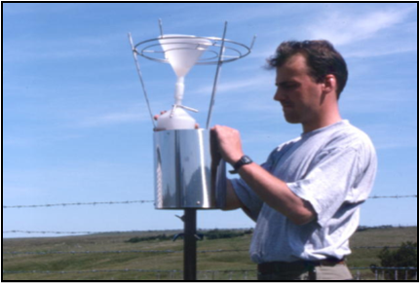
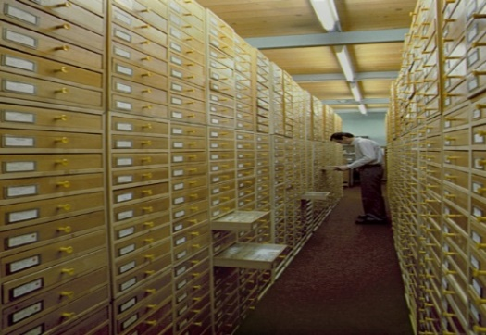
How did we build it?
By analysing common requirements of Environmental Research Infrastructures
EISCAT 3D
EMSO
EPOS
EURO Argo
COPAL
IAGOS
ICOS
LifeWatch
SIOS

Slide 6
How did we build it?

Slide 7
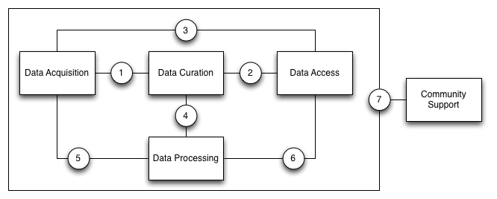
How did we build it?
We identified 5 common subsystems:
with points of references between them

Slide 8
ENVRI Common Subsystems
manages / maintains quality data (reproducible data)
facilities for discovery and access (published data)
brings measurements / data streams into the infrastructure (non-reproducible data)
facilities for analysis, mining, experiments (combined/derived data)
supports users to conduct their roles in communities (data about users)

Slide 9
Common Functions (Curation)
Identified the functions/operations of Data Curation
Functions/Embedded Services | ICOS | EPOS | EMSO | EISCAT-3D | LifeWatch | EURO-Argo
Data Quality Checking | Yes | Yes | Unknown | Yes | Not Applicable | Yes
Data Quality Verification | Yes | Unknown | Unknown | Unknown | Not Applicable | Yes
Data Identification | Yes | Yes | Yes | Unknown | Not Applicable | Unknown
Data Cataloguing | Unknown | Yes | Yes | Unknown | Not Applicable | Unknown
Data Product Generation | Yes | Yes | Yes | Yes | Not Applicable | Yes
Data Versioning | Yes | Unknown | Unknown | Unknown | Not Applicable | Unknown
Workflow Enactment | No | Yes | Unknown | Yes | Not Applicable | No
Data Preservation | Yes | Yes | Yes | Yes | Not Applicable | Yes
Data Replication | No | Yes | Unknown | Yes | Not Applicable | Yes
Data Replication Synchronisation | No | Unknown | No | Unknown | Not Applicable | Yes

Slide 10
Common Functions (Access)
Identified the functions/operations of Data Access
Functions/Embedded Services | ICOS | EPOS | EMSO | EISCAT-3D | LifeWatch | Euro-Argo
Access Control | Unknown | Yes | Unknown | Yes | Unknown | Unknown
Data Conversion | Yes | Yes | Yes | Yes | Yes | Yes
Data Compression | No | No | No | No | Yes | No
Data Visualisation | Yes | Yes | Yes | Yes | Yes | Yes
Data Publication | Yes | Unknown | Yes | Unknown | Yes | Yes
Data Citation | No | Unknown | Yes | No | Unknown | No
(Resources/Data) Annotation | Yes | Yes | Yes | No | Yes | Yes
Metadata Harvesting | Unknown | Unknown | Yes | No | Unknown | No
Resource Registration | Unknown | Yes | Yes | No | Yes | No
Semantic Harmonisation | No | Yes | Yes | No | Yes | No
Data Discovery and Access | Yes | Yes | Yes | Yes | Yes | Unknown
A full function list is on ENVRI RM website: http://confluence.envri.eu:8090/x/GwAF

Slide 11
How did we build it?
Analysis of common requirements resulted in a set of common functionalities
Identified a minimal model
Focuses on core interactions
Represents the most fundamental functionalities
A skeleton that can be extended
Future development based on community interests

Slide 12
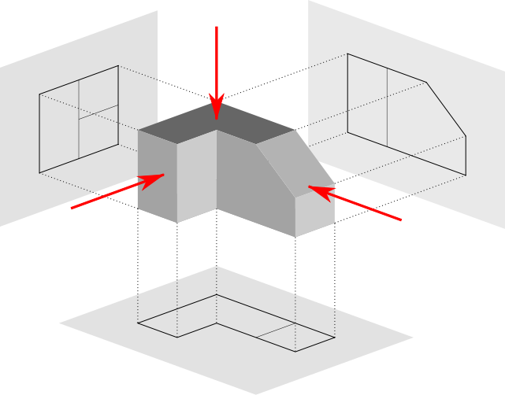
How did we build it?
Using Open Distributed Processing (ODP)(ISO/IEC 10746)
A framework for structuring specification of large-scale complex distributed systems
An object modelling approach
A viewpoints-based approach
Notes:
Industrial strength, based on more than 30 years experience in telecommunications, defence, public sector, etc.

Slide 13
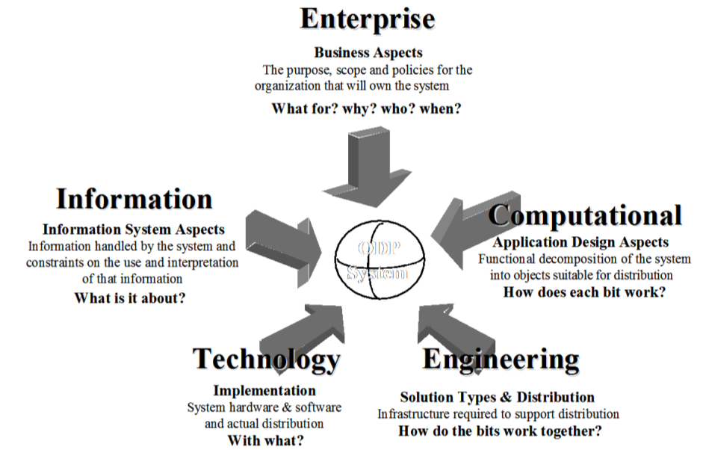
ODP Viewpoints
Science
Notes:
ODP defines 5 viewpoints, from 5 viewpoint to consider how to build the distributed system

Slide 14
ENVRI RM: Science Viewpoint
We derive from common requirements, identifying communities, roles, behaviours
Model defines:
5 common Communities according to 5-subsystems
Data Acquisition community collects raw data
Data Curation community manages and archives quality data
Data Publication c. assists publication, discovery & access
Data Service Provision c. provide services to derive knowledge
Data Usage community who make use of data/services
For each community: roles & behaviours
e.g.: Acquisition Roles: Scientist, Technician, Observer, Sensor, etc.
Behaviours: Design of measurement model, Instrument configuration, calibration, data collection

Slide 15
ENVRI RM: Information Viewpoint
Data-oriented approach:
Follow the data-lifecycle in each subsystem
Identify information objects, actions, state changes when events/actions occur
Model defines:
A set of information objects handled by a subsystem
A set of action types that cause the state changes
Dynamic schema - how info objects evolve as the system operates, incl. constraints on state-changes
Static schema: instantaneous views at life-cycle stages

Slide 16
ENVRI RM: Computational VP
Service-oriented, brokered approach
Core functionalities encapsulated as a set of service objects
Model defines two types of service objects
A set of computational objects
Each encapsulates specific functionalities
Each provides a set of interfaces to invoke functions
A set of binding objects to coordinate multi-party interactions
Notes:
Three viewpoints take particular priority: the Science, Information and Computational View-points, which gives better focus on the core objective of ENVRI: to develop an understanding of the common requirements and to provide the design solutions for common data and operation services.

Slide 17
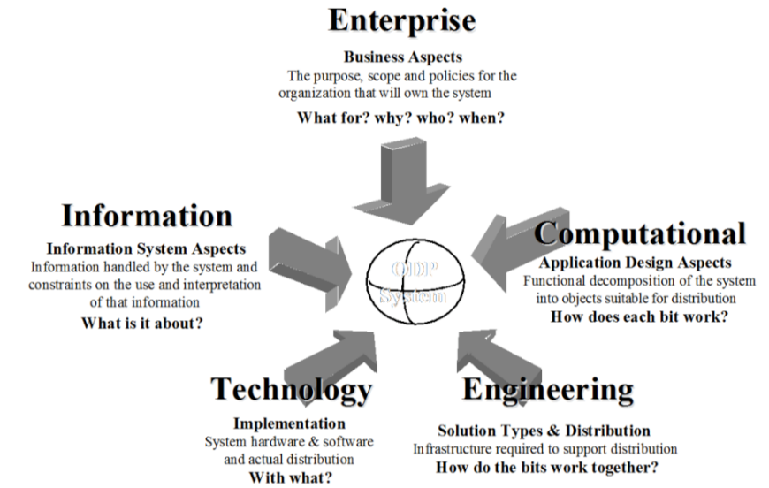
Acquisition Subsystem
Community: Roles: Scientist, Technician, Observer, Sensor, etc.
Acquisition Behaviours: Design measurement model, Configure instrument, Calibrate, Collect data
Information objects:
Specification of measurements
Measurement result
Persistent data
Data state
Metadata
Persistent identifier
Action types (cause state change):
Perform measurement
Add metadata
Check quality
Store data
States:
Raw, Reviewed, Published
Processed, etc.
Computational objects:
Instrument host
Acquisition service
Interfaces:
Configure instrument
Acquire data
Import data
Reference interactions:
Raw data collection coordinates above objects with the Import service object and the Raw data object in the Curation subsystem
Science
http://envri.eu/rm
Notes:
ODP defines 5 viewpoints, from 5 viewpoint to consider how to build the distributed system

Slide 18
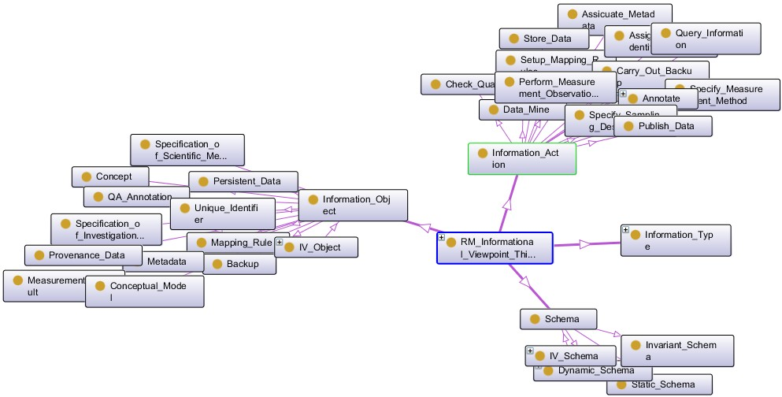
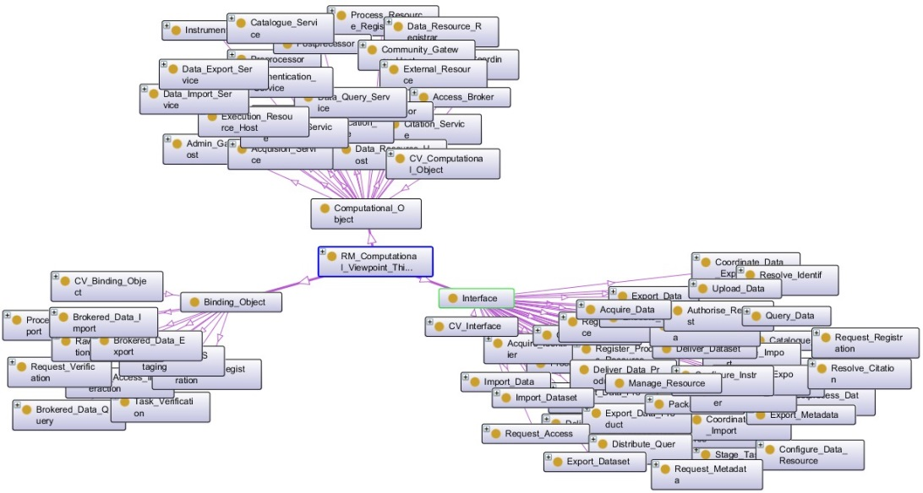
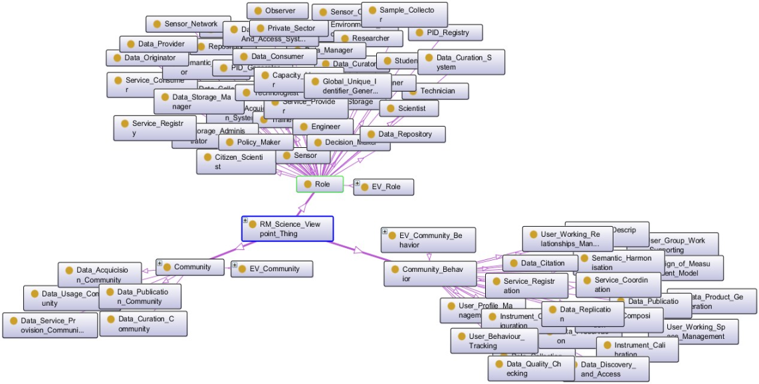
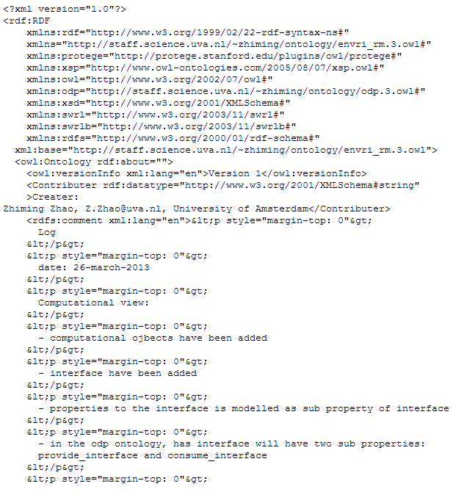
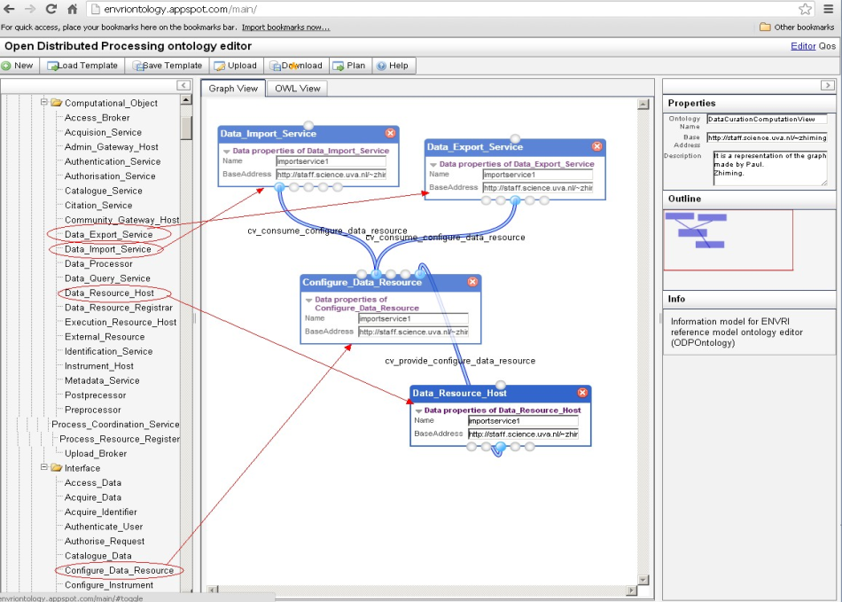
Reference Model Ontology
Information Viewpoint
Computational Viewpoint
Science Viewpoint
RM Owl version: http://staff.science.uva.nl/~zhiming/Ontology/http://envriontology.appspot.com/main/.
The online tool: http://envriontology.appspot.com/main/.

Slide 19
Early Adoption and use of the RM
Interactions with target audiences:
ESFRI ENV RIs : EISCAT 3D, ICOS, EPOS, EMSO
Others: GFBio, Helsinki University
All starting to use the language and model concepts
RDA Data Foundation & Terminology
Use case for evaluation
DASISH (ESFRI social sciences and humanities cluster)
ODP & Reference Model workshop, Colchester, 17 March 2014
CROSSING: Cross-cutting Services to Support data sharing
A top 5 topic for further study by (almost) all RIs

Slide 20
EISCAT 3D Research Infrastructure
EISCAT: European incoherent scatter radar for atmospheric, geospace research
EISCAT 3D: next generation 3D imaging radar
Studies how Earth’s atmosphere is coupled to space, is uniquely located for studies into arctic ionosphere
Pilot study, Feb 2013 to date, dialogue continues
EISCAT International Symposium, Lancaster, 10 Aug 2013

Slide 21
Integrated Carbon
Observation System
“A pan-European research infrastructure for quantifying and understanding the greenhouse gas balance of the European continent and adjacent regions”
Integrating atmospheric, marine and ecosystem measurements with standardized procedures and analysis, operational by 2016/17

Slide 22
ICOS RI dataflow with RM labels
Scientists
Policy makers
General public
Community
support
Externally produced elaborated products
ICOS Carbon Portal
Data Processing & synthesis
Elaborated products & synteses
Data & metadata curation
Externally compiled data
Data Curation
Atmospheric Thematic Center
Ecosystem Thematic Center
Oceanic Thematic Center
Data acquisition
ICOS measurement station networks

Slide 23
Data acquisition
Functionality | No. | HO | CP | *TCs | *S-PI
DATA ACQUISITION | A
Configuration logging | A.5 |  |  | develop, recommend? | yes?
Data collection | A.10 |  |  | recommend? | yes
Data sampling | A.12 |  |  | develop? | ?
Noise reduction | A.13 |  |  | develop, operate?
Realtime data collection | A.11 |  |  | ? | ?
Data transmission | A.14 |  |  | develop, operate
Data transmission monitoring | A.16 |  |  | yes | yes?
Realtime data transmission | A.15 |  |  | yes: ATC, OTC | ??
Instrument access | A.4 |  |  | ? | yes
Instrument calibration | A.3 |  |  | CAL | yes
Instrument configuration | A.2 |  |  | ? | yes?
Instrument integration | A.1 |  |  | ? | yes?
Instrument monitoring | A.6 |  |  | yes? | yes?
Parameter visualization | A.7 |  | provide links to TCs | provide, operate
Realtime parameter visualization | A.8 |  | provide links to TCs, stations | operate | operate?
Process control | A.9 |  |  | coordinate | yes?
Discussions since January 2014 with tech and management. First try! NOT final by any means!
A next workshop (London, June 2014 )

Slide 24
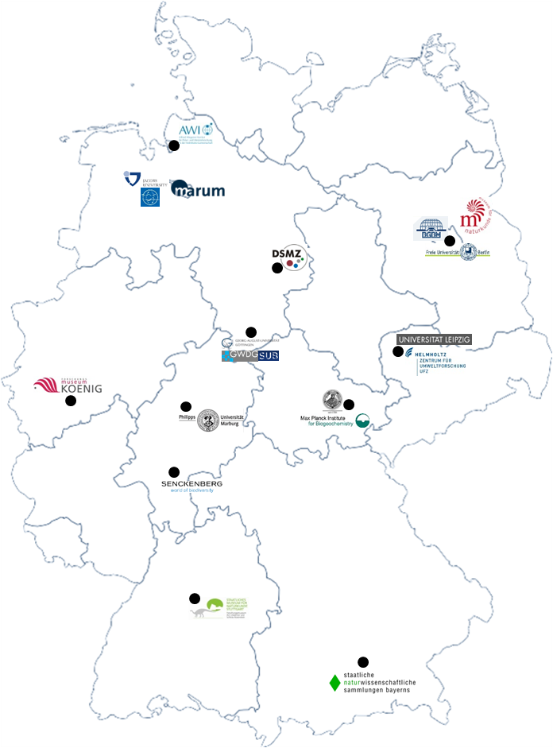
GfBio
German Federation for the Curation of Biological Data
Sustainable, service oriented, national data infrastructure facilitating data sharing for biological and environmental research
Based on well established archives e.g., MARUM, PANGAEA
ENVRI RM as common terminology
Architecture - define and document GfBio service portfolios and critical components based on minimal model and common functions
Business model - estimate GfBio costs and compensation models required for operation of these services
Initially for PANGAEA, Bexis, and DWB

Slide 25
ENVRI RM and GfBio PANGAEA portfolio
©http://libraryjumpers.webs.com/
B | Data Curation Subsystem | offered service | cost, justification | cost numeric | cost category | compensation model
B.1 | Data Quality Checking | Technical quality control, plausibility checks | computing |  | per dataset | in kind
B.2 | Data Quality Verification | Iterative data peer-review process by data curators in cooperation with PI | curation |  | per dataset | charges
B.3 | Data Identification | Persistent and unique identification and citability of data with a Digital Object Identifier (DOI) | computing |  | per dataset | in kind
B.4 | Data Cataloguing | Iterative metadata completion and ontology harmonisation by data curators | curation |  | per dataset | charges
B.4 |  | Provision of PANGAEA editorial system | software licence, maintenance, administration |  | basis cost or per project | charges
B.4 |  | Project data curator training | training |  | per project | charges
B.5 | Data Product Generation | Preparation of data compilations | curation |  | per compilation | charges
B.6 | Data Versioning
B.7 | Workflow Enactment | Provision and maintenance of Data submission and Ticket System (Jira) | licences, maintenance |  | per user | in kind
B.8 | Data Storage & Preservation | Long-term archiving and storage of data according to the ICSU WDS practices incl data authenticity and integrity checks | curation |  | per dataset | charge
B.8 |  | Iterative data reformatting and ingest by data curator | curation |  | per dataset | charges
B.8 |  | Long-term provision and maintenance of 4D Metadata catalogue | licences, maintenance |  | basis | in kind
Notes:
Single point of contact for collection, archiving, curation, integration, publication and deployment of data
Following here the successful model of PANGAEA we would like to make data management an integral and funded part of research projects.
(species 2000 IAPT bei den projekten raus und zu den Standards)
Kurze Charakterisierung der Partner –was sind die highlights bei einzelnen Partnern (Auswahl)
Critical mass – comprising the essential players in this field in Germany.
We are not starting from sratch, our archives are well established, some of them are active for decades
Multidisciplinary – that is we are covering all relevant fields
Expertise – in terms of data and infrastructure. GFBio archives and services are embedded into research facilities. Most of the facilties have been set up complementary to in house research. We understand the science behind the data, we are experienced in building infrastructures, and we also have experience with the management of such infrastructures.
An finally most of the partners are engaged international networks, projects, and programs. Examples on the European level are EU projects ELIXIR or Lifewatch, internationally GBIF and the marine part OBIS, where already now most of the german collection facilities and also PANGAEA is feeding data to. Beyond the biological infrastructures, PANGAEA is also member of the World Data Systems of the WMO and the ICSU and a number of further international consortia – alles listen was Bedeutung hat: ELIXIR, Marine Genomics, WDS, WMO, … Logos einblenden an der Seite
Hier müssen noch viele Logos rein, für Projekte, Netzwerke etc.
examples on the European level are EU projects ELIXIR or Lifewatch, internationally GBIF and the marine part OBIS, where already now most of the german collection facilities and also PANGAEA is feeding data to. Beyond the biological infrastructures, PANGAEA is also member of the World Data Systems of the WMO and the ICSU and a number of further international consortia.

Slide 26
Benefits of Using the RM (Immediate 1-5 years)
Professional framework for clearly defining roles and processes in RI operations
Makes it far easier to design RI in the Construction Phase
Helps to evaluate current RIs for division of tasks
Helps to find missing or duplicated actions
Easier definition of requirements of IT components
Enabling a more modular approach for the RI IT solutions
Makes easier to use external suppliers (e.g. international IT co-operation projects) for the component development

Slide 27
Benefits of Using the RM (Intermediate 5-10 years)
A common language ensures common understanding
Avoiding duplications
Enabling re-use of components, solutions & policies
The use of planned standard modular approach enables scalable design solutions
Better risk management of RI development, due to possibility of changing individual modules and operations of the RIs, without needing to completely redesign the systems due to some ad-hoc solutions
Improving the trustworthiness of the RI products due to clearly defined and standardized ways to present workflows

Slide 28
Benefits of Using the RM (Long-term 10-20 years)
Greater level of interoperability through the use of common standards, enabling data usage and communication between the RIs to become commonplace
Support of cross-disciplinary perspectives and products and enablement of systems science approach
Larger potential user base due to easier use of the RI products, which increases the impact and return on investment of RIs

Slide 29
http://envri.eu/rm
We need the same language to make things fit together
Thank you – Any questions?
Picture is Creative Commons by www.glynlowe.com, used under CC-BY-SA 2.0

