Slide 1
Cloud services for biomedical research
Pekka Lehtovuori, Ph.D.
Director, Service for Research
CSC – the IT Center for Science

Slide 2
Overview
CSC in the nutshell
Cloud Services
History of BioMedInfra IaaS Cloud
Future plans

Slide 3
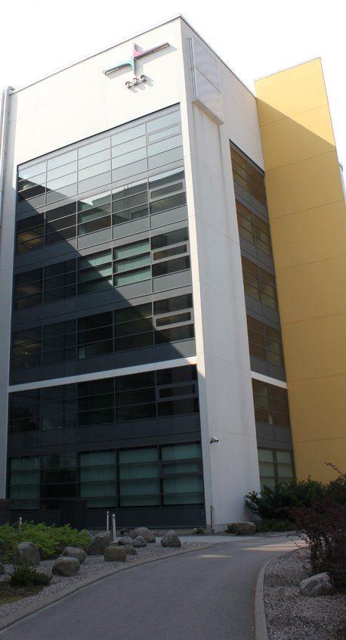
CSC at a Glance
Founded in 1971 as a technical support unit for Univac 1108
Connected Finland to the Internet in 1988
Reorganized as a company, CSC – Scientific Computing Ltd. in 1993
All shares to the Ministry of Education and Culture of Finland in 1997
Operates on a non-profit principle
Facilities in Espoo, close to Otaniemi campus (of 15,000 students and 16,000 technology professionals) and Kajaani
Staff 250
Turnover 2012 29.2 million euros

Slide 4
Finnish ELIXIR node
CSC operates Finnish node for ELIXIR
Focus on two services
  IaaS cloud service for Biomedical institutions
  Identity federation authentication and authorisation support and tools (REMS https://rems.csc.fi) for sensitive data access management

Slide 5
CSC IaaS cloud services
cPouta
  Scientific computing IaaS,
  free to use service for Finnish researchers
BioMedInfra IaaS
  Guaranteed capasity for organizational customers
  Different funding model, can still appear as a free to use service for end user
sPouta
  BioMedInfra v2.0

Slide 6

cPouta – IaaS for Scientific computing
IaaS service delivered form the CSC HTC computing cluster Taito
OpenStack based service
Ratio between virtual resources and bare metal part can be altered based on customer needs
Free to use capacity for Finnish University and Polytechnics researchers
Resources are granted as same billing units as for other CSC computing servers
Designed for Scientific computing (HPC): no overbooking of resources, no HA services
  https://research.csc.fi/cloud-computing

Slide 7
BioMedInfra service in a nutshell
Infrastructure as a Service
  targeted for organizations
Compute capacity
  Virtual machines on dedicated hosts
Storage capacity
  Private NFS shares
  Scratch disk
Network connectivity
  dedicated lightpaths or FUNET internet access
  10Gbit/sec network between the VMs

Slide 8



2013
Biomedicum, Helsinki
Turku
Oulu
Internet
VPN
SSH
EBI
OpenStack API
SSH to VMs
OPN
MVMs
Egde switch
10GE switches
BridgeX IB
EqLogic
SAN
VPN
SSH
VPN
SSH
IB FDR
VPN
SSH
VPN
SSH
VPN
SSH
NetApp
NetApp internal
Scale outs
DDN
Blades
Scale outs
CSC Keilaniemi, Espoo
CSC Kajaani Data Center

Slide 9
Tailored IAAS services for customer organizations

Slide 10
What will happen in 2014
sPouta moved to production
  For OPN connected customers
  Based on BMI requirements, build with OpenStack
  Highly available frontends
  Live migration for VMs
  Dedicated storage cluster in addition to the current NFS shares
  Aim to meet legal requirements for sensitive data processing
Active replication of key EBI datasets over lightpath

Slide 11
Thank You
ACKNOWLEDGEMENTS
Tommi Nyrönen
Olli Tourunen
Jarno Laitinen

