Slide 1
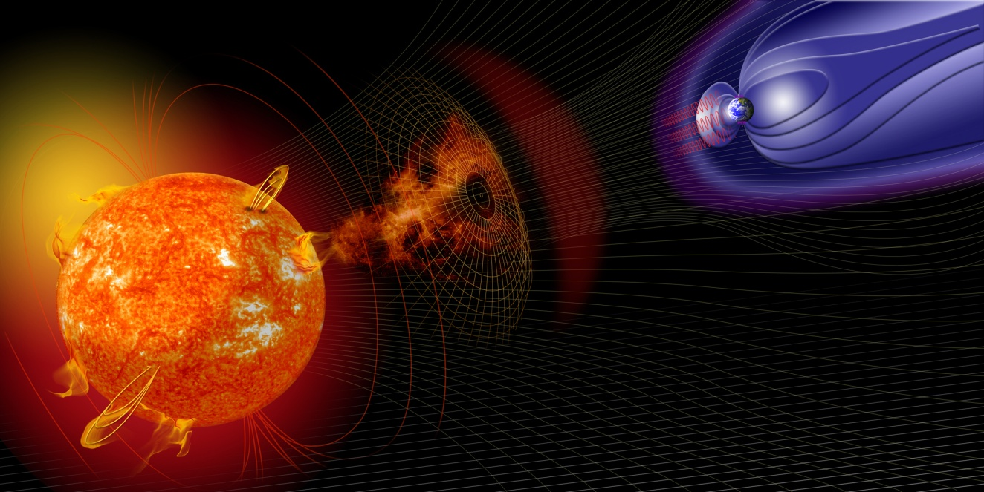
Workflows for Propagation Models in Heliophysics
Dr. Gabriele Pierantoni
Dr. Eoin Carley

Slide 2
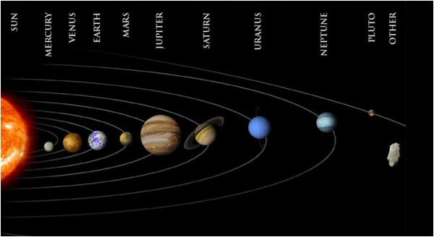
HELIoPhysics
Heliophysics is the science that studies the system composed of the Sun’s heliosphere and the objects that interact with it.
Notes:
Heliophysics is a word coined by Dr. George Siscoe of Boston University and subsequently used by the NASA Science Mission Directorate to encompass the study of the system composed of the Sun's heliosphere and the objects that interact with it—most notably, but not limited to, planetary atmospheres and magnetospheres, the solar corona, and the interstellar medium. Heliophysics combines several other disciplines, including several branches of space physics, plasma physics, and solar physics. Heliophysics is closely tied to the study of space weather and the phenomena that affect it. To quote George Siscoe from a recent conference presentation:

Slide 3
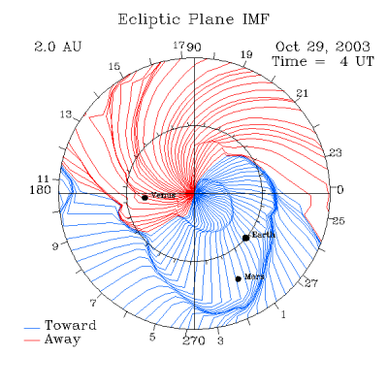
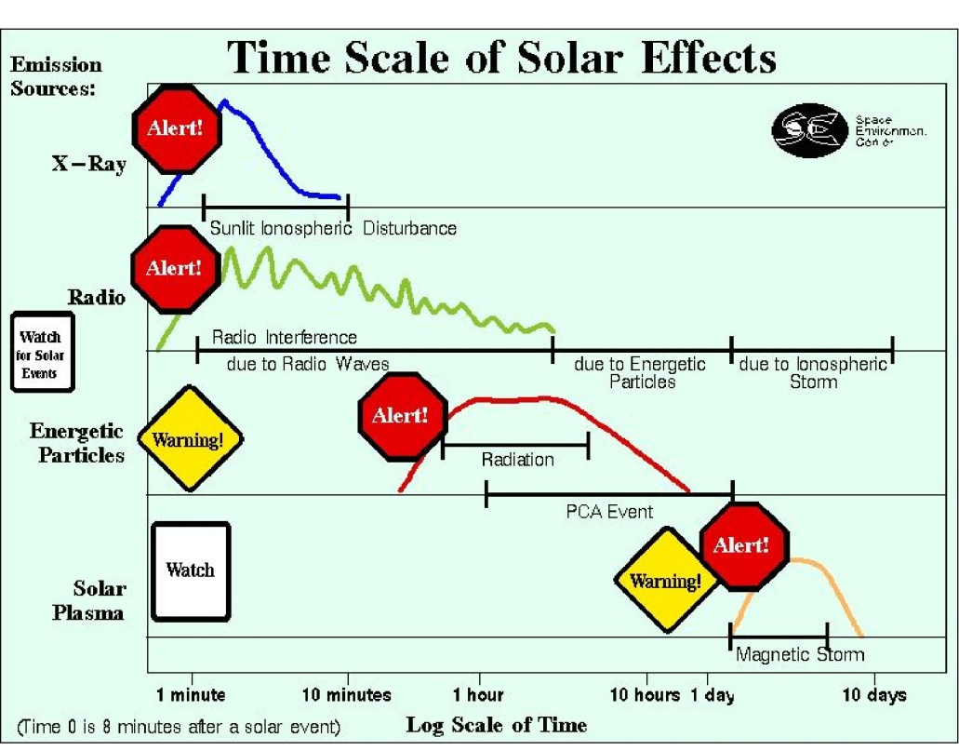
Propagation models
A propagation model is used to help determine which observations, where and when may be of interest in order to satisfy the user's search criteria.

Slide 4
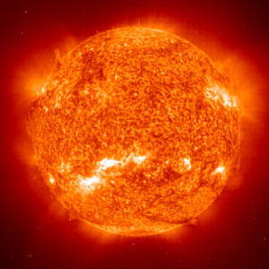
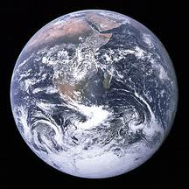
Propagation model
How do we determine the
parameters ?
Origin
Target
t
t
ETA
Range
E
How do we validate our choice ?

Slide 5
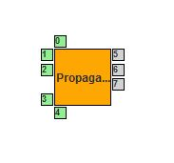
Propagation models
Propagation Model
Input
Parameter
ETA
Simple Propagation Model
The user sets the values
and validates the results

Slide 6
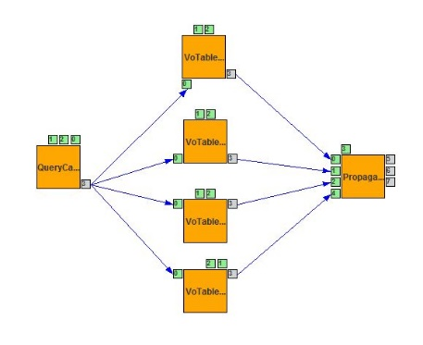
Assisted model
Propagation Model
Input
Parameter
ETA
Assisted Propagation Model
Values are inferred from online catalogues

Slide 7
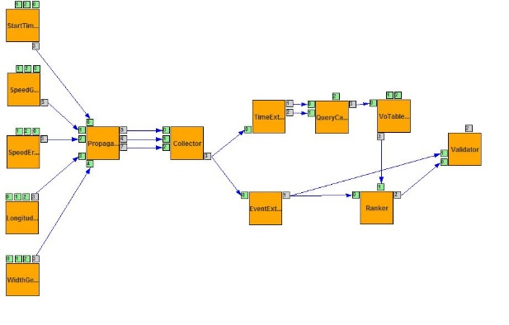
Parametric validated model
Propagation Model
Input
Parameter
Input
Parameter
ETA
Input
Parameter
ETA
ETA
ETA

Slide 8
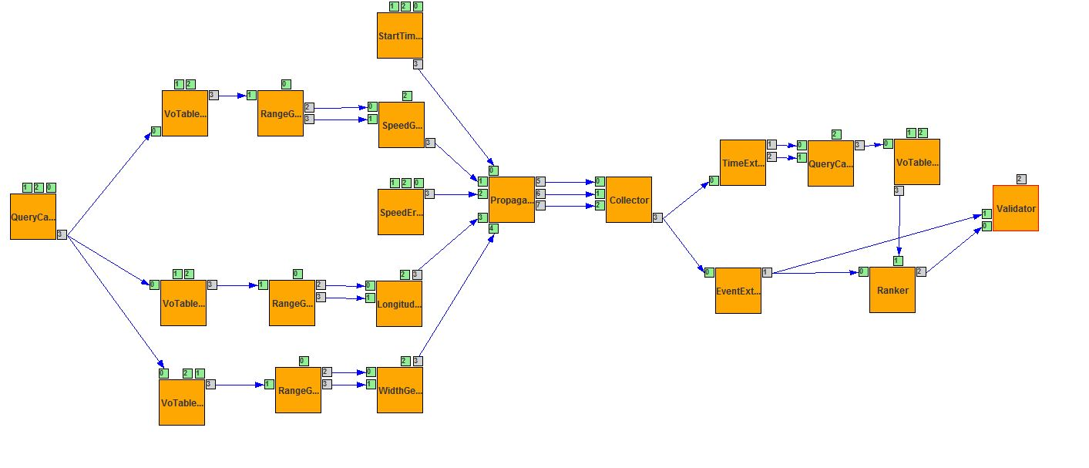
Assisted parametric model
Propagation Model
Input
Parameter
Input
Parameter
Input
Parameter
ETA
ETA
ETA
ETA

Slide 9
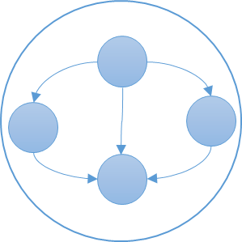
Meta-workflows and workflow interoperability
WS-Pgrade Metaworkflow
Execution in WS-Pgrade enabled portals
Coarse Interoperability through the SHIWA Platform
TAVERNA metaworkflow
Execution on the TAVERNA line command tool
Execution on the TAVERNA line command tool
TAVERNA Worfklows

Slide 10
3-tier approach
Type of Worklfow | Technology | Driven by | Usage
Atomic Workflow | WS-PGRADE and TAVERNA | Use Case | Invocation of services VOTABLE Manipulation Ancillary Services
Meta Workflows | WS-PGRADE and TAVERNA | Science Case | Orchestration of Atomic Workflows
Iterative Meta Workflows | WS-PGRADE | Iterative Science Case | Parameter-Sweep Execution of Science Cases

Slide 11
3-tier approach
WS-PGrade Workflows and Metaworkflows
TAVERNA Workflows and Metaworkflows
HELIO Infrastructure
HELIO Web Services
HELIO Applications
HEC
ILS
HPS
SHEBA
VO Table Parses
HFC
ICS
MDES

Slide 12
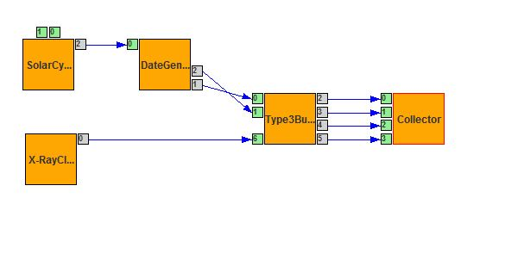
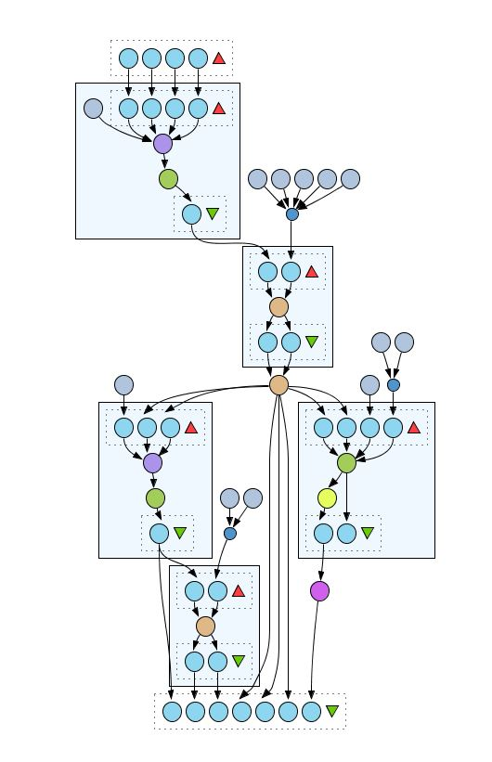
3-Tier approach
WS-PGrade Metaworkflow
(Parametric Science Case)
Course grained interoperability
WS-PGrade sub-workflow
(Use Case)
TAVERNA Metaworkflow
(Science Case)
HELIO Web Services
HEC
ILS
HPS
TAVERNA Workflows
Use Case
HFC
ICS
MDES

Slide 13
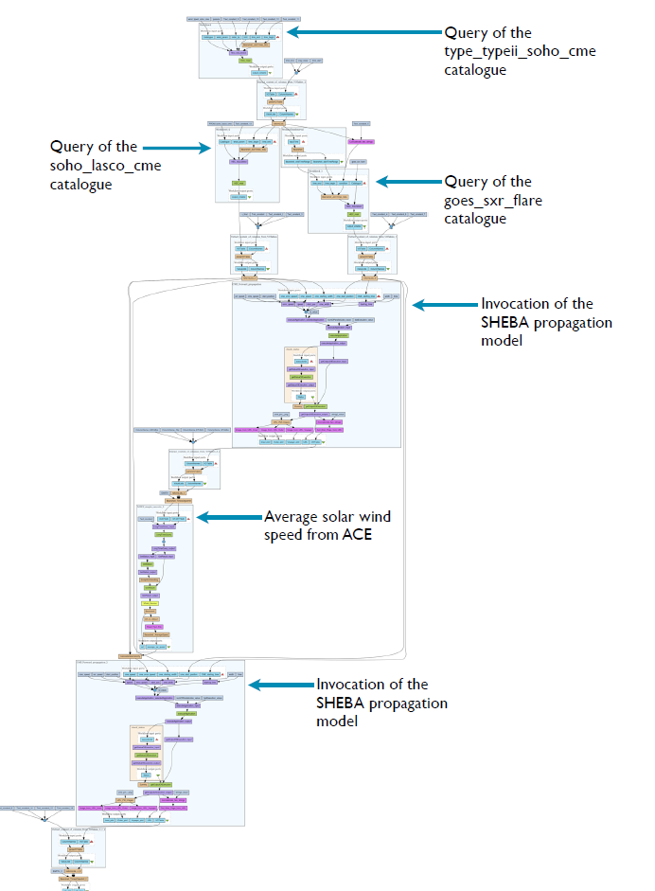
TAVERNA Example

Slide 14
Workflow users
I am happy with one of the models
but I want to modify it
A
I do not want to use WS-PGRADE
B
I care only about results, not workflows
C

Slide 15
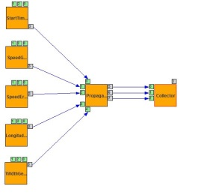
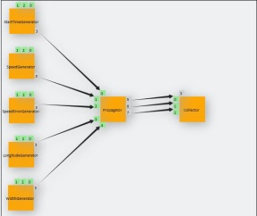
Around a workflow
Abstract
Graph editor
Define the topology of the workflow
A
Concrete
Workflows
Interface
Define workflow parameter
Concrete
Define applications and
Sub-workflows
B
C
End User View
Focus only on relevant parameters
C
APM Portlet
Costumize the GUI
End User
Interface

Slide 16
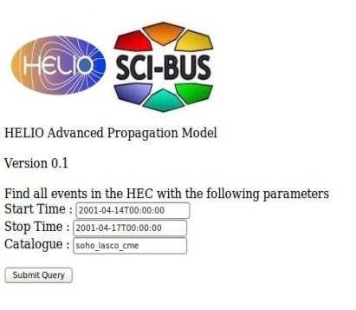
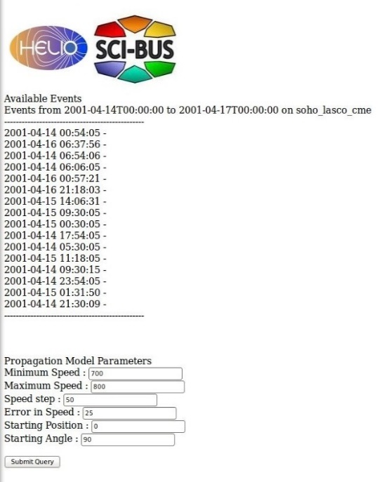
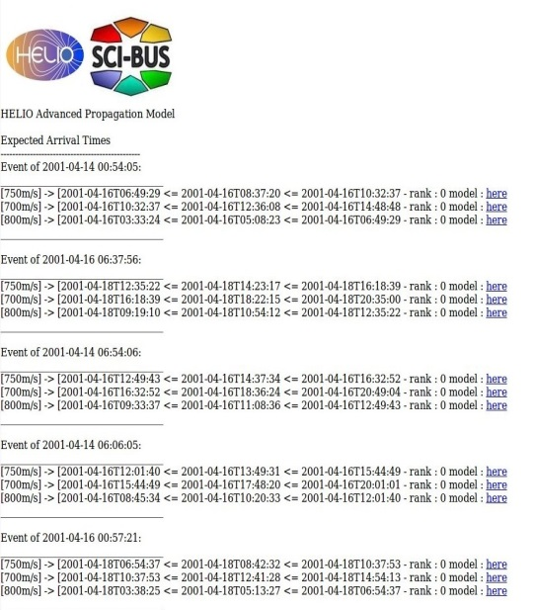
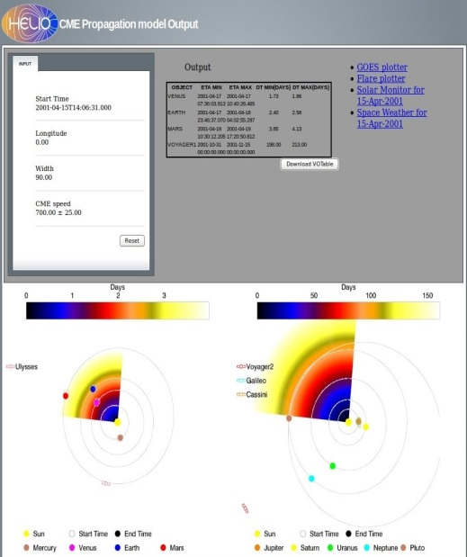
Advanced propagation model portlet
Step A
The user defines the time range
and the Event Catalogue that has to be used.
Step B
A list of event times is returned and the
users defines the
Parameter ranges and values for the execution.
Step C
The list of results is returned with a Boolean value
indicating if they have been validated successfully

Slide 17
This is all, for now…

