Slide 1


The Finnish Grid Infrastructure Computing Environment and Tools
Wednesday, 21st of May 2014 - EGI Community Forum 2014 Helsinki
Luís Alves
Systems Specialist at CSC – IT Center for Science, Ltd. Finland
luis.alves @ csc.fi

Slide 2
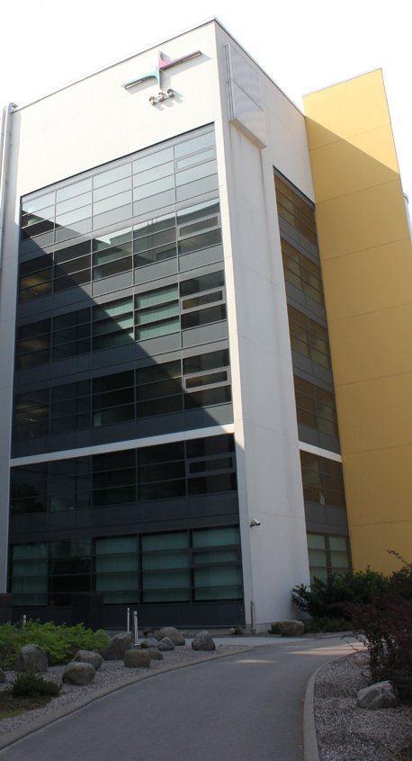









CSC - IT Center for Science, Ltd.
Private and non-profit company owned by the Ministry of Education and Culture;
Provides IT support and resources for academia, research institutes and companies;
Part of the Finnish national research structure;
Finnish partner on:
Notes:
Founded on 1971

Slide 3
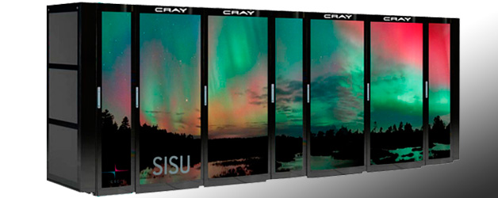
Computing Resources for Science
Sisu - Cray XC30 Super Computer [Upgrading]
  Massive computational challenges
  > 10 000 cores, > 23TB memory
  Theoretical peak performance > 240 Tflop/s
Taito - HP-Cluster [Upgrading]
  Small and medium-sized tasks
  Theoretical peak performance 180 Tflop/s
Hippu - Application server
  Interactive usage, without job scheduler
  Post-processing, e.g. vizualization
Pouta - Cloud Service [New]
  Openstack
Finnish Grid Infrastructure (FGI)

Slide 4
About FGI

Slide 5
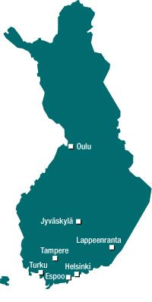
In the beginning, we had M-Grid
Interest in Grid technology rose in Finland during 2003
  A consortium of 7 Universities, HIP and CSC was formed which successfully obtained funding for the FIRST Finnish Computing Grid – M-Grid
  Effort was driven by CSC and Kai Nordlund (HU)
M-Grid was operational from 2005 to 2011
  9 Sites
  Theoretical total computing capacity ~ 2.5 TFlops
  Infrastructure had aged significantly by end 2008
Notes:
2. M-grid
Mgrid was the predecessor to FGI and was active 2005 – 2010
FGI is built on the experiences of M-grid

Slide 6











Then, FGI is born
Second generation “M-Grid” planned since 2009
  Application for funding made in October 2010
  FIRI grant approved beginning 2011
  Consortium of 9 universities and CSC
Notes:
== FGI as a national grid ==
1. FGI background (a few slides, use slides from the CSC info)
FGI is a consortium of 9 universities and CSC.
Funded by the Academy

Slide 7
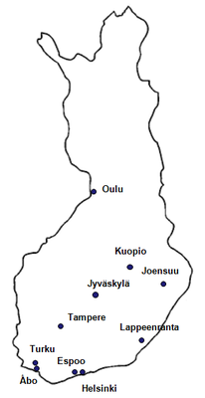
Finnish Grid Infrastructure (FGI)
10 Computing Clusters connected through network and Grid middleware that provide a peak capacity of 154 TFLOPS;
Available to any researcher affiliated to a Finnish Research Institution;
Operations and coordination by CSC;
Notes:
One of CSC’s project is FGI
Funded by the Academy of Finland, Universities and CSC;
1 - peak capacity

Slide 8

FGI in EGI
FGI is the Finnish NGI and EGI sees us as NGI_FI
CSC is the Finnish Operations Center
  Uses the monitoring and service tools provided by EGI
  Follows EGI procedures for operations
  Manages the Regional Operational on Duty team

Slide 9
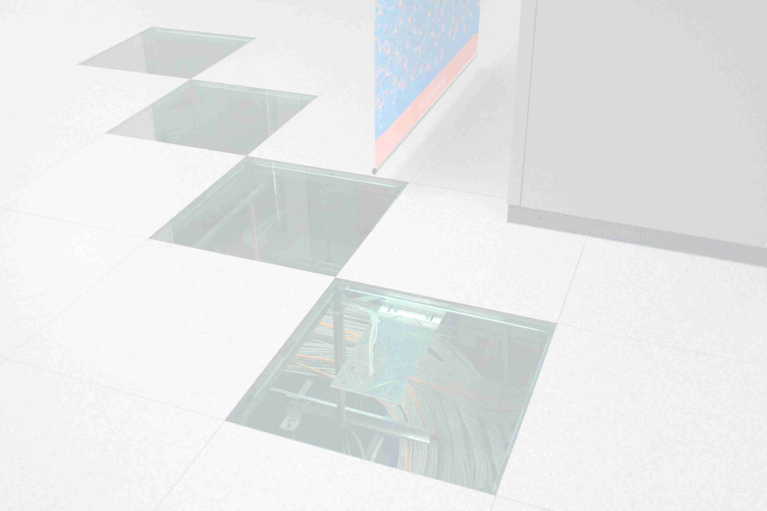
FGI - also a Federation
Sites maintain their own clusters
  Local use is open at all sites
Site administrators are encouraged to collaborate and communicate
  Attending weekly admin meetings
  Providing Grid software support for users
  Becoming part of the FGI community
Small team from CSC coordinates general administration and support
Notes:
3. FGI status
All cluster have been installed on sites, and are in local use
Fine Print: Local policies will determine who has access to local usage.

Slide 10



Hardware details
Standard node configuration
  HP SG7 scale out dual 6 core 2.67GHz Xeon X5650
  24 GB memory (min.)
Big Memory nodes
  HP Proliant DL 580 G7 server
  1 TB memory
GPGPU nodes
  2 Nvidia Tesla cards in a standard compute node
Disk servers:
  Total storage capacity of about 1 PB
QDR InfiniBand & Gigabit ethernet for interconnect and network.

Slide 11
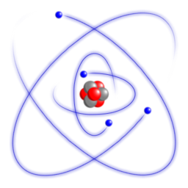
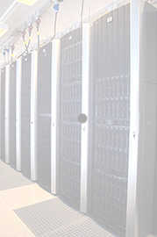

Operating System and Scheduler
Hardware distribution
Aalto: 112 nodes, 8 GPGPU nodes, two 1TB big memory nodes
Lappeenranta: 16 nodes
Eastern Finland: 64 nodes
Helsinki: 49 nodes, 20 GPGPU nodes, one 1 TB big memory node
Jyväskylä: 48 nodes, 8 GPGPU nodes
Oulu: 30 nodes
Tampere (TUT): 37 nodes, 8 GPGPU nodes, one 1 TB big memory node
Turku: 20 nodes
Åbo Akademi: 8 GPGPU nodes
CSC: 24 nodes (with 96GB memory)
Operating system is Scientific Linux 6
Scheduler used is Slurm
Notes:
Delivery started early November and installation at sites was done within one to two days of delivery
Operating system is Scientific Linux 6
Scheduler used is SLRUM
Acceptance tests were run immediately
All systems were passed and accepted – just in time for Xmas

Slide 12
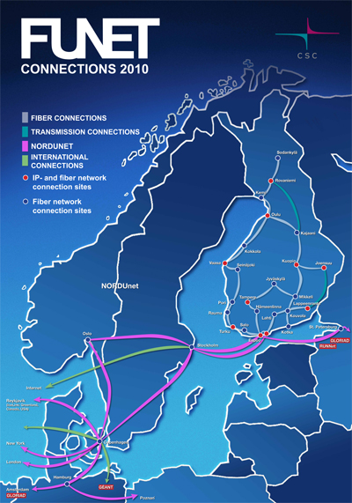
Finnish University and Research Network
FUNET is an advanced data communications network serving the Finnish research community. It connects about 80 research organizations and over 350 000 users.
Membership in Funet is open to all Finnish university-level academies and public research institutions.
http://goo.gl/kRQWtk
Notes:
One of CSC’s project is FGI
Funded by the Academy of Finland, Universities and CSC;
1 - peak capacity

Slide 13

Grid Middleware
FGI uses the ARC middleware
  Developed by NorduGrid, part of the European Middleware Initiative (EMI)
  More info: http://goo.gl/QB4LNK

Slide 14
Software distribution - Cern VM-FS
Central repository for FGI’s software
Makes it easy to distribute software
Modules and Runtime Environments are shared through CVMFS
Each Cluster has a Squid proxy that caches most used files
More details on Ulf Tigerstedt presentation “Managing multidisciplinary software repositories for grid with CernVM-FS” here: http://goo.gl/jgeXz6
Notes:
Software is distributed by CVMFS

Slide 15
FGI Computing Environment and Tools

Slide 16
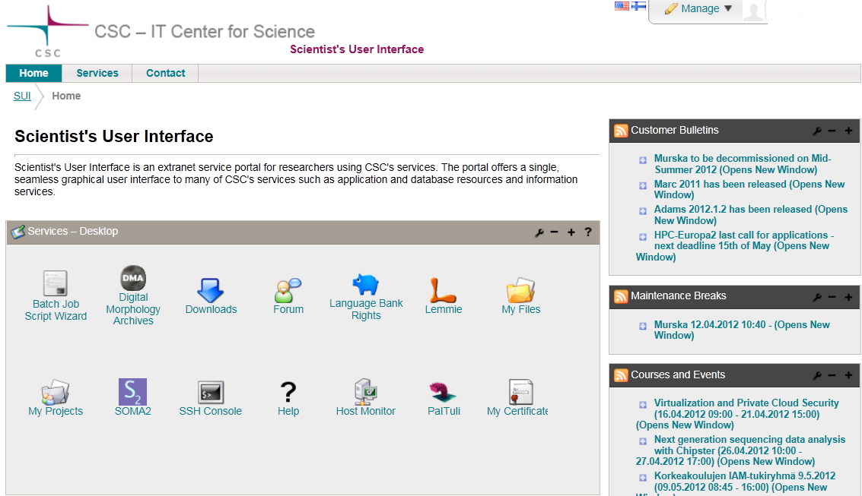
Scientist's User Interface (SUI)
More info at: http://goo.gl/dChdm0
Notes:
Additional slide if needed
16

Slide 17
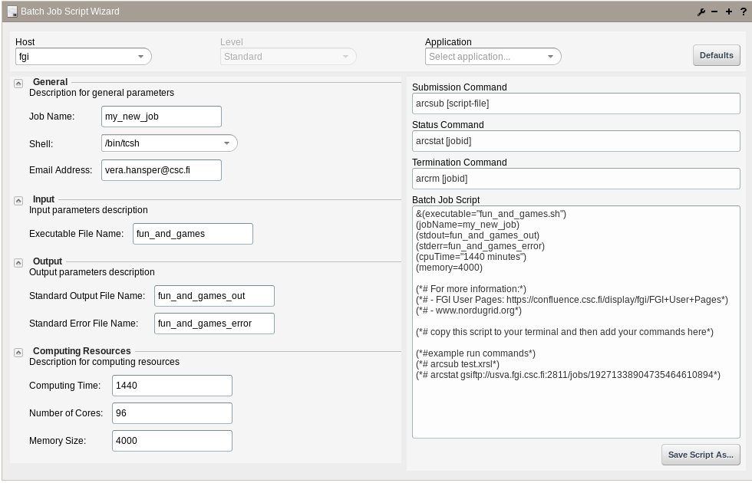
ARC xRSL file generator tool on SUI

Slide 18
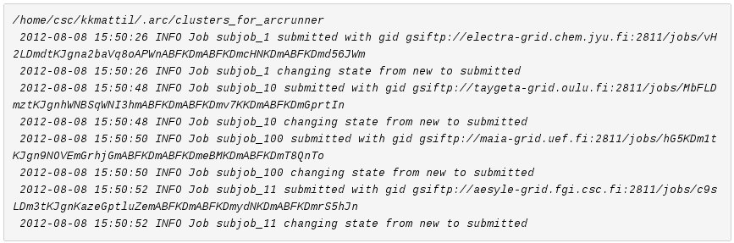
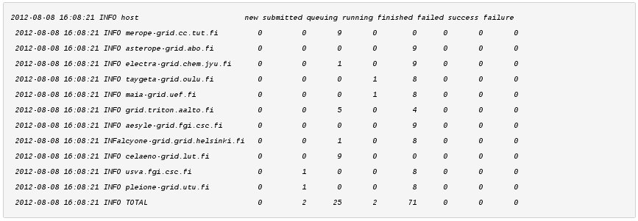
arcrunner – Grid Job Submission Manager
“Gridification” tool developed and maintained by Kimmo Mattila (CSC)
Actively used to run large job sets on FGI
i.e. BLAST, InterProScan, Exonerate
Selects suitable and available resouces, Submits, Monitors and Fetches jobs outputs
arcrunner -xrsl average.xrsl
Notes:
4. What can FGI offer you (based on FGI slides)
Hardware resources
Software
Support

Slide 19
Runtime Environments (RTE)
Available RTEs:
  AMBER
  AutoDock
  BLAST
  Bowtie 0.12.7 and 2.0.5
  BWA
  Cufflinks
  Elmer
  EMBOSS
  Exonerate
  FreeSurfer
  GPAW
  Gromacs
  GSNAP
  HMMER 3.0
  Interproscan5
  Matlab Compiler Runtime
  MISO
  MrBayes
  NAMD
  ORCA
  R-3.0.2
  SAMtools
  SHRiMP
  TopHat
Extended Resource Specification Language (xRSL) file example:
&
(executable=runamberMPI.sh)
(jobname=amber-test)
(stdout=std.out)
(stderr=std.err)
(gmlog=gridlog_1)
(walltime=1h)
(memory=200)
(disk=1000)
(count=6)
(runtimeenvironment=ENV/ONENODE)
(runtimeenvironment=APPS/CHEM/AMBER-12)
(inputfiles=
( "gbin" "gbin" )
( "md12.x" "md12.x" )
( "prmtop" "prmtop" )
)
(outputfiles=
( "output.tar" "output.tar" )
)
Notes:
4. What can FGI offer you (based on FGI slides)
Hardware resources
Software
Support

Slide 20
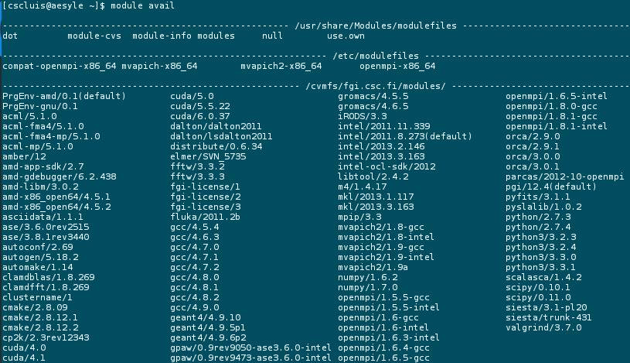
Modules
Notes:
4. What can FGI offer you (based on FGI slides)
Hardware resources
Software
Support

Slide 21
Results

Slide 23
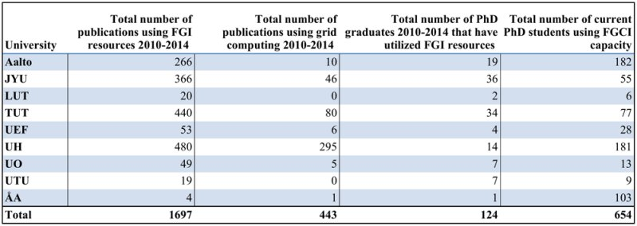
FGI

Slide 24
FGI in the Clouds

Slide 25

Future: A Grid-Cloud Hybrid
Cloud-Enabled FGI
Application for funds submitted in April 2014

Slide 26
Thank you
Questions?
Credits and special thanks to:
  Jura Tarus;
  Ulf Tigerstedt;
  Kimmo Mattila;
  Universities’ FGI admins;
  CSC’s CE group and Staff;
  FGI’s former members;
  FGI users.
More information about and how to use FGI: http://goo.gl/DhqfNk

Slide 28
Conclusions
Performance comparison
  Per core performance
  ~2 x compared
  to Vuori/Louhi
  Better interconnects enhance scaling
  Larger memory
  Smartest collective communications
Notes:
The scaling on sisu is very good, but as we don’t have the machine yet and the tendering process data is partially under NDA we dont’ have graphs to show … but scaling is good!

Slide 29
Sisu&Taito vs. FGI vs. Local Cluster
 | Sisu&Taito (Phase 1) | FGI | Merope
Availability | Available | Available | Available
CPU | Intel Sandy Bridge, 2 x 8 cores, 2.6 GHz, Xeon E5-2670 | Intel Xeon, 2 x 6 cores, 2.7 GHZ, X5650
Interconnect | Aries / FDR IB | QDR IB
Cores | 11776 / 9216 | 7308 | 748
RAM/core | 2 / 4 GB 16x 256GB/node | 2 / 4 / 8 GB | 4 / 8 GB
Tflops | 244 / 180 | 95 | 8
GPU nodes | in Phase2 | 88 | 6
Disc space | 2.4 PB | 1+ PB | 100 TB

