Slide 1
e-GRANT: EGI Resource Allocation Tool Current status and development roadmap
Roksana Różańska, Tomasz Szepieniec
ACC Cyfronet AGH, Poland

Slide 2
What is e-GRANT?
Dedicated tool supporting EGI Resource Allocation Process (https://wiki.egi.eu/wiki/Resource_Allocation) - allowing researchers to request an amount of compute and storage resources, for a given amount of time
Result of mini-project (concluded March 2014), extensions planned in EGI Inspire Y5 (JRA2)
Process implemented by Cyfronet based on Agreemount Framework
Promoted on EGI main web
page
Notes:
Licencja dla Frame –propriatary licence, cyfronet ma licencja na ten framework w egi

Slide 3
Implementation Status
Released final version enabled in production operation infrastructure (https://e-grant.egi.eu), status of tool’s requirements:
Implemented Customer’s and Provider’s authentication and authorisation
GOCDB based mechanisms for Providers
EGI SSO based mechanisms for Customers
UI for Provider, Broker and Customer
Pools management for Providers
Pool creation (policies, QoS, metrics)
Pool allocation visualisation
Handling RA activities:
Request creation and negotiation
OLA-related actions (OLA creation – pool matching, (re)negotiation, confirmation/rejection)
SLA-related actions (SLA creation , negotiation, signing)
SLA Sections negotiation

Slide 4
RA Process
OLA1
Provider A
Re-quest
Broker
OLA2
Customer
Provider B
SLA
SLASec1 (OLA1)
SLASec2 (OLA2)
Request submission
Matchmaking
Propose & Sign OLAs
Creating SLA
Propose & Sign SLA
Notes:
Input/output
Actors
Documents
Activities
RA Taskforce implemented RA PRocess

Slide 5
Demo movie
Available on-line:
https://drive.google.com/file/d/0B_YtID4o7LsmVzJpX0dyV3ZHM1k/edit?usp=sharing

Slide 6
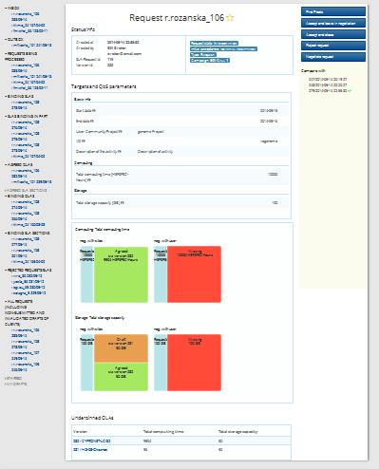
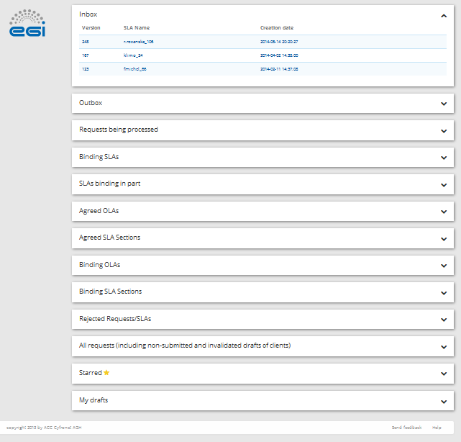
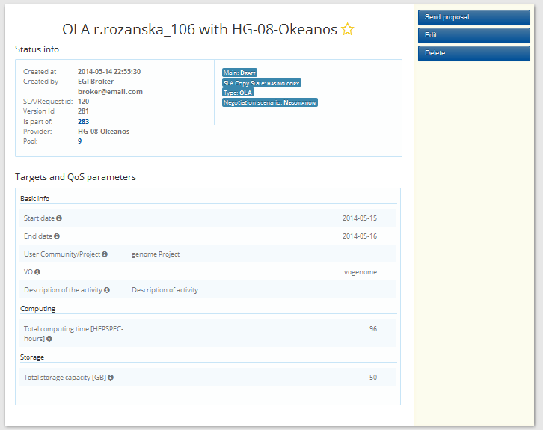
Broker Functionalities
Request /SLA Handling
Dashboard
OLA Handling

Slide 7
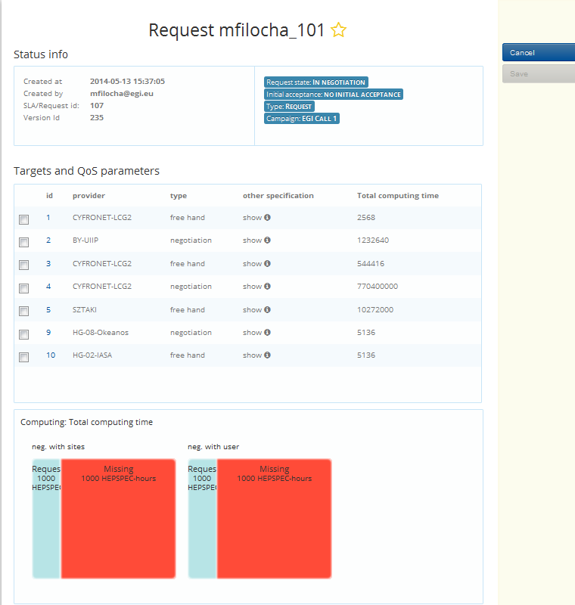
Broker Functionalities II
Pool Matching:
Finding pools with parameters adequate to Request’s metrics
Allowing Broker to choose most suitable pools
Creating OLAs in which technical parameters are calculated automatically based on Broker’s choice

Slide 8
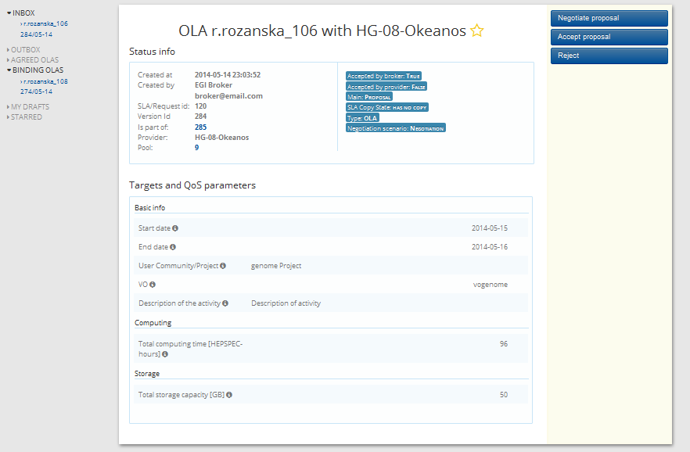
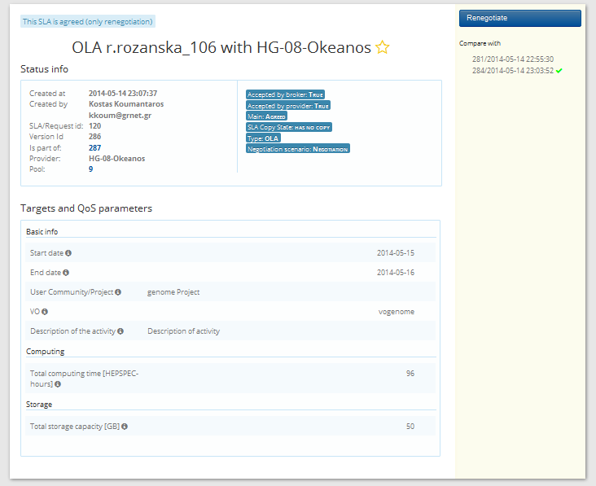
Provider Functionalities
OLA Negotiation
OLA Renegotiation

Slide 9
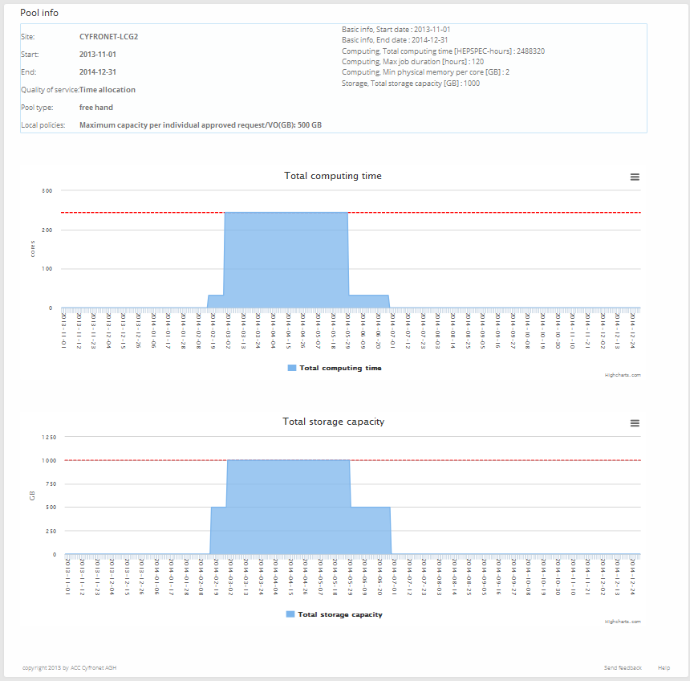
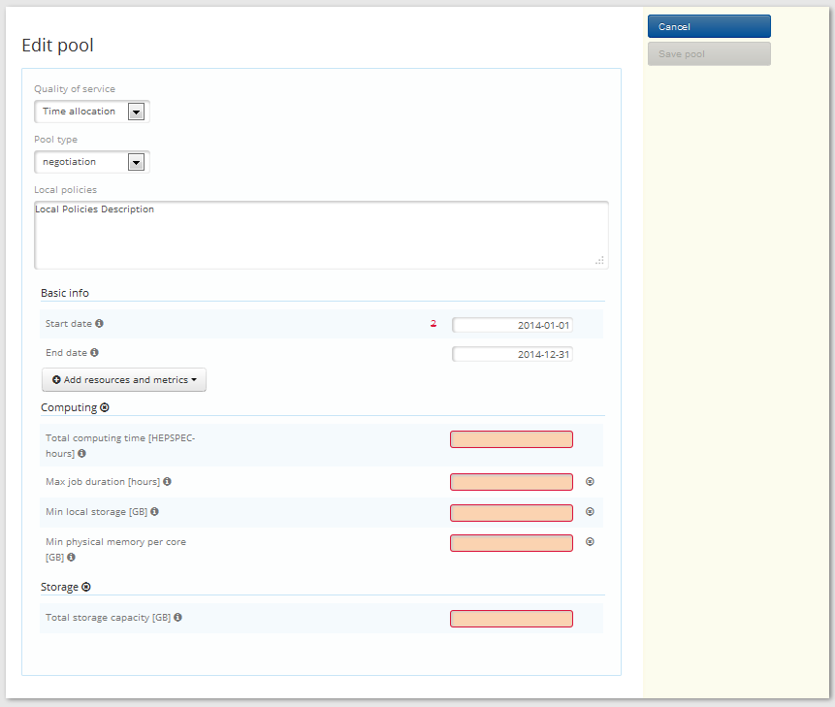
Pool Management – Provider
Pool Allocation Visualization
Pool Creation
List of Pools

Slide 10
Plans for EGI-Inspire Y5
FedCloud resources integration
Changes in RA proces: e.g. present offers to the users
Pay-per-use integration
Extentions needed for efficient brokering of resources

Slide 11
Summary
Project realization: March 2013 – March 2014
Further development needed, plans for extensions due to EGI Inspire
https://e-grant.egi.eu
Contact us:
T.Szepieniec@cyfronet.pl
R.Rozanska@cyfronet.pl

