Slide 1
The HADDOCK WeNMR portal: From gLite to DIRAC submission in three hours
DIRAC workshop@EGI-CF 2014, Helsinki, May 21th, 2014
Alexandre M.J.J. Bonvin
Project coordinator
Bijvoet Center for Biomolecular Research
Faculty of Science, Utrecht University
the Netherlands
a.m.j.j.bonvin@uu.nl

Slide 2
The WeNMR VRC

Slide 3
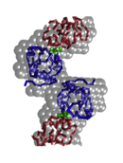
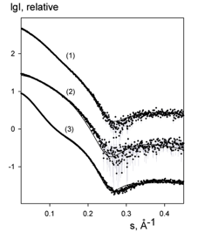
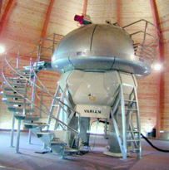
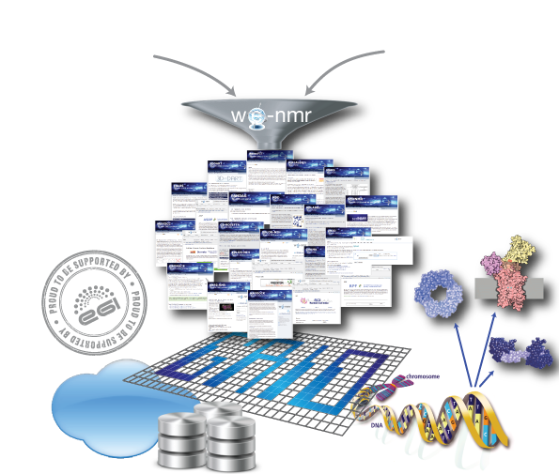
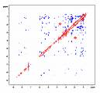
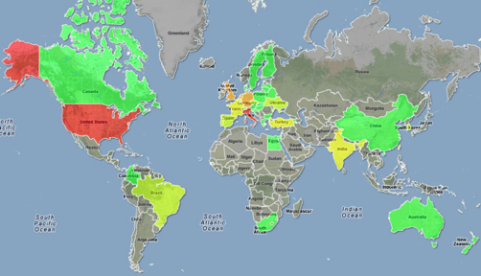
NMR SAXS
A worldwide
e-Infrastructure for NMR and structural biology
WeNMR VRC (May 2014)
One of the largest (#users) VO in life sciences
> 620 VO registered users (36% outside EU)
~ 1200 VRC members (>60% outside EU)
~ 100 000 CPU cores
> 2000 SI2K CPU years
> 5M jobs
User-friendly access to Grid via web portals
www.wenmr.eu

Slide 4
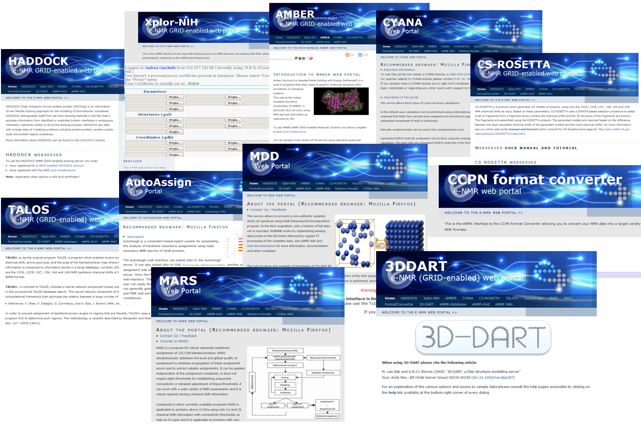
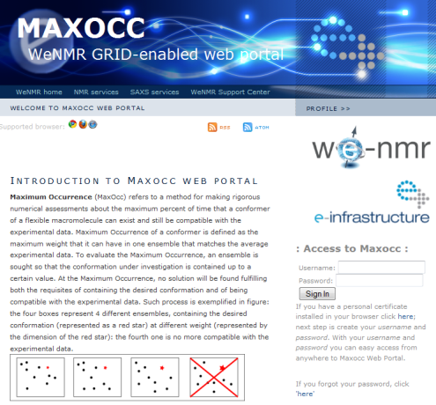
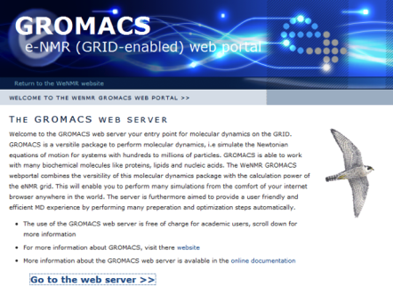
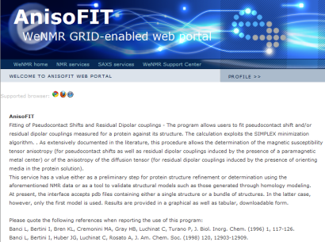
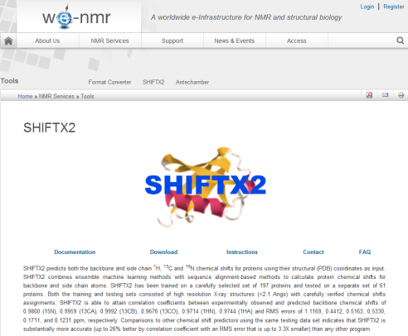
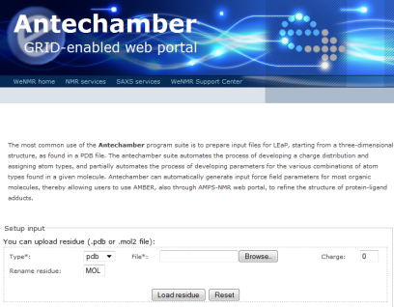
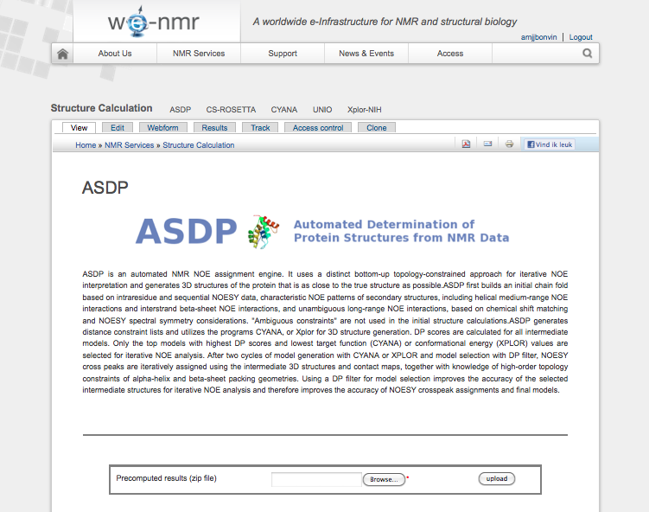
A glimpse of the WeNMR services portfolio
Notes:
4
4

Slide 5
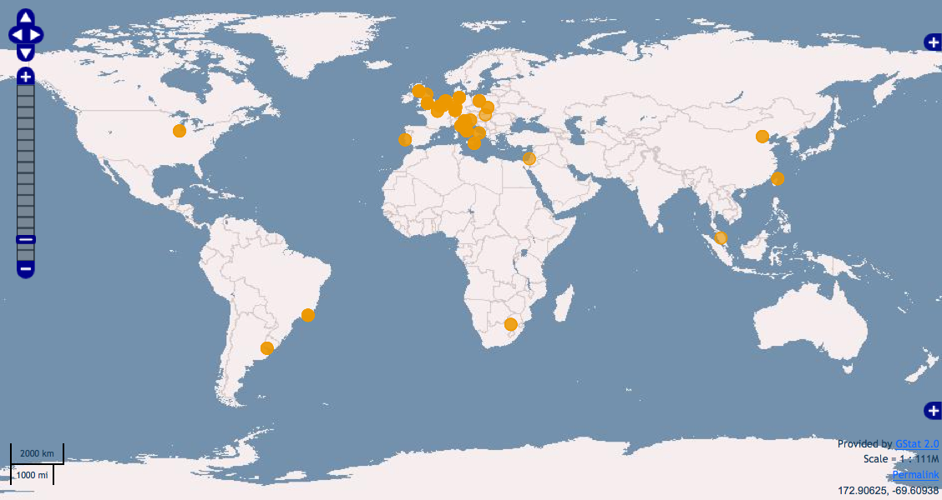
Distribution of resources
Currently (May 2014) ~ 100’000 CPU cores

Slide 6
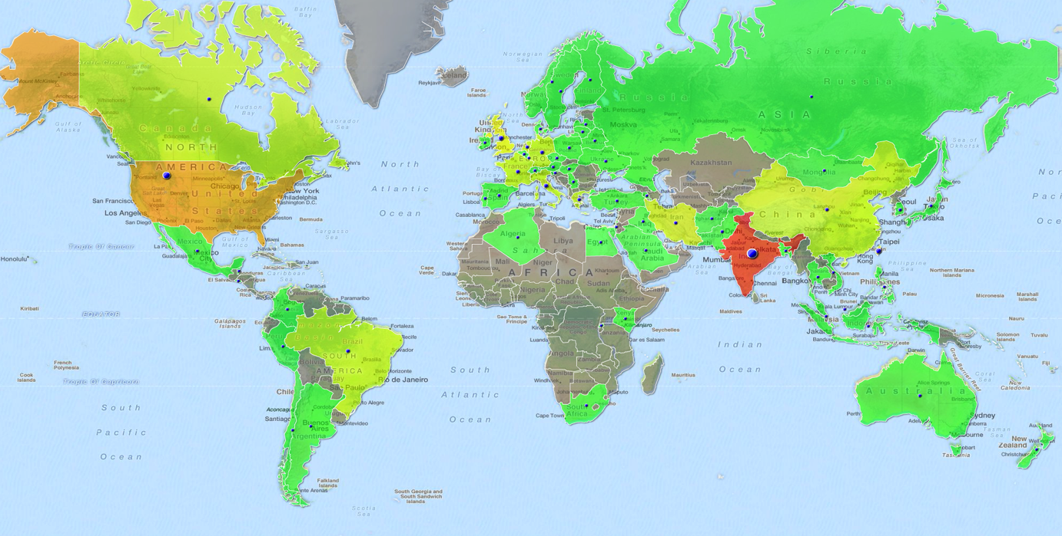
WeNMR VRC users distribution
Over 1200 VRC and 620 VO members (64% / 36% outside Europe)!
(May 2014)

Slide 7
The HADDOCK portal

Slide 8
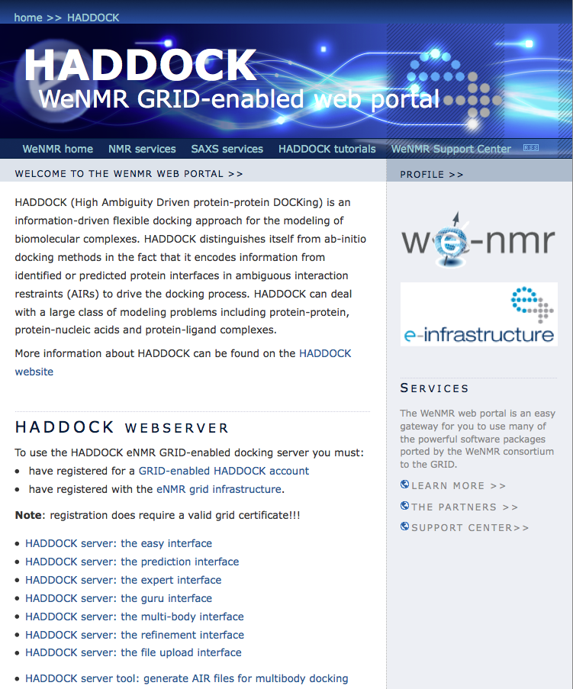
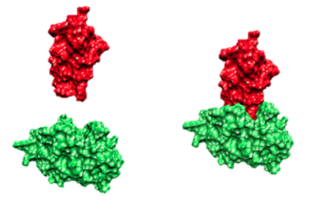
Haddock web portal

Slide 9
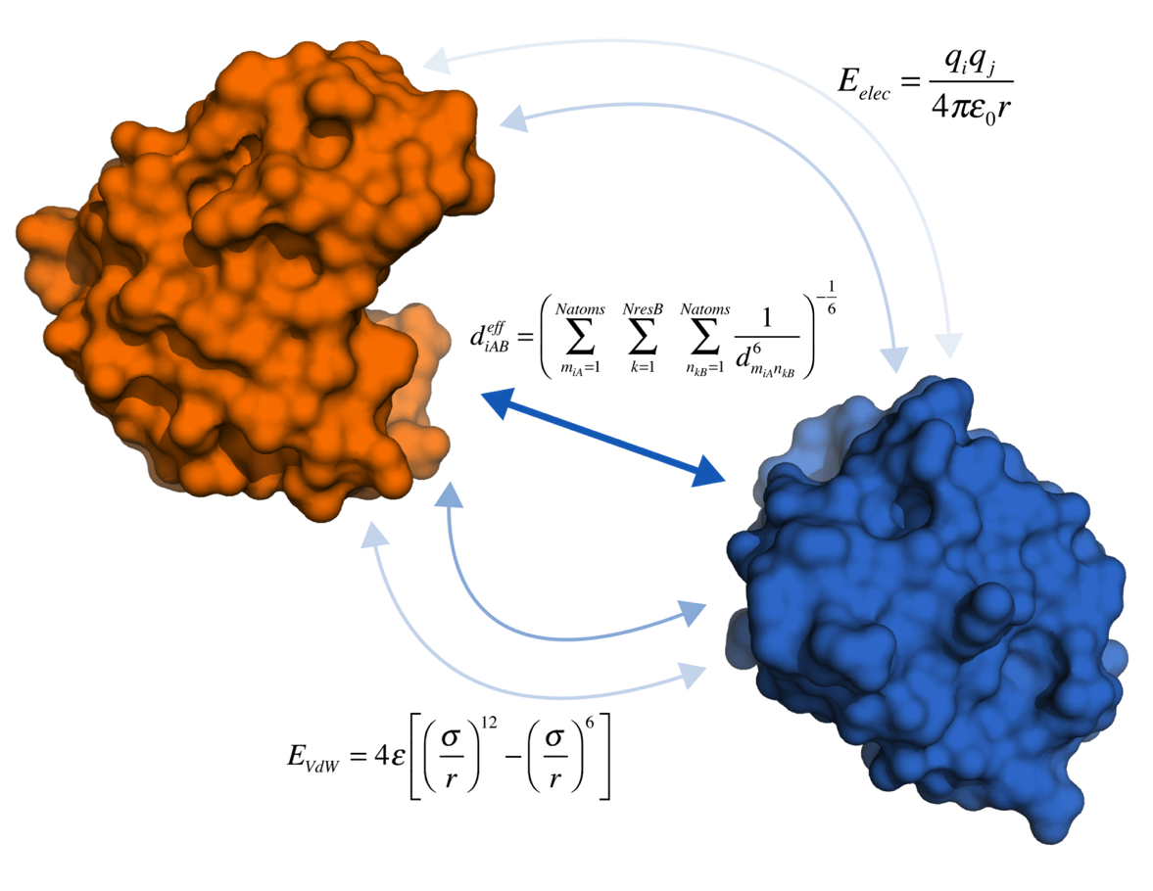
Molecular Docking
Notes:
HADDOCK score consists of different energy terms, from which E_{AIR} is the most important one. Additionally, BSA, Desolv and extra restraint data, if available, are added. In it0 E_{vdW} is unimportant, because rigid body. In water electrostatics are turned off.

Slide 10
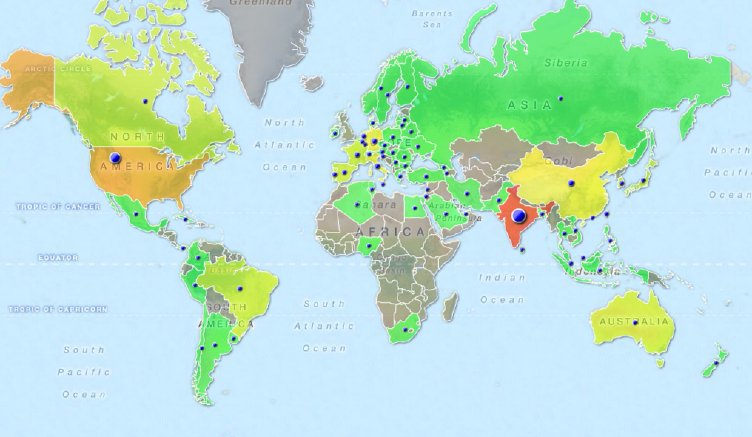
HADDOCK server users distribution
Over 4000 registered (now all have access to the grid-server via robot cert)

Slide 11
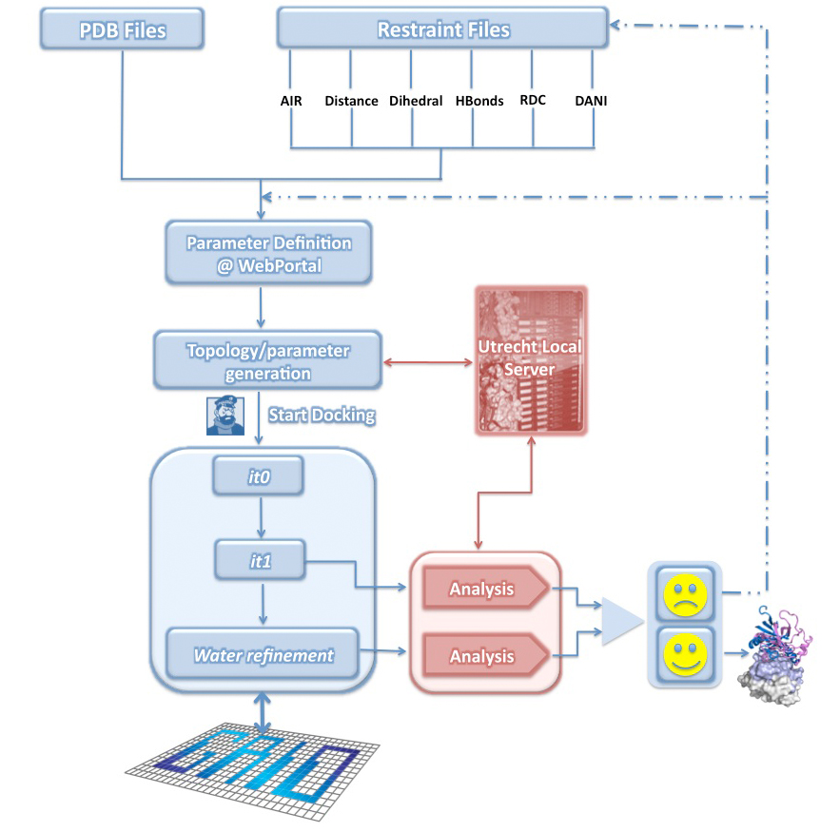
What is happening behind the scene?
Notes:
Behind the scenes

Slide 12
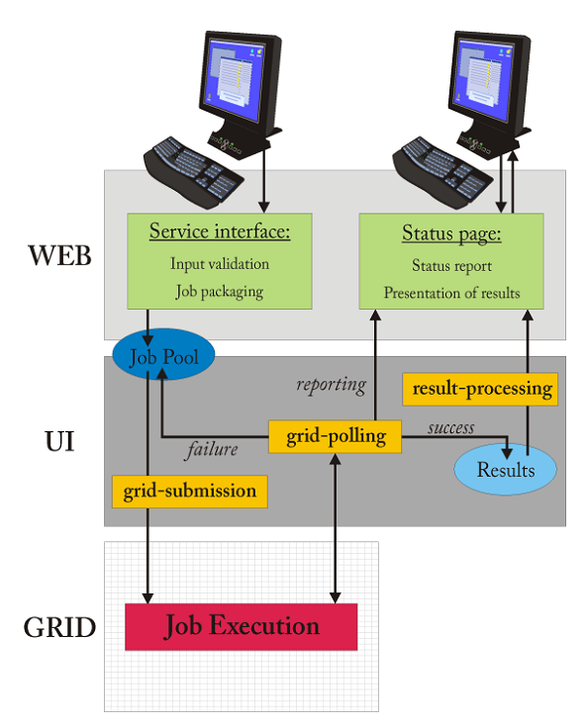
Grid daemons beyond a portal
Data transfer / jobs
User level – data transfer via web interface:
Data input: ~10 kB to 10 MB
Data output: ~10MB to a few GB
Local cluster– data/jobs transfer:
Job submission: ~10 to 50 single jobs
Data: a few GB
Grid level – data/jobs transfer
(UI<->WMS<->CE<->WN):
Job submission: ~250 to 2500 single jobs
Data transfer: ~1 to 10MB
Output: ~1-20MB per job
Some portals make use of storage elements for the data
Notes:
12
12

Slide 13
HADDOCK Grid submission
Each job in the pool directory consists of:
Shell script to be executed on WN
Compressed tar archive containing the data/directory structure for the job
File specifying the location where results should be copied
JDL script with requirements/ranks for selecting suitable sites, e.g.:
Requirements = (Member("OSG_VERSION",other.GlueHostApplicationSoftwareRunTimeEnvironment) ||
(other.GlueCEPolicyMaxCPUTime < 720 && other.GlueCEPolicyMaxCPUTime > 110 &&
Member("VO-enmr.eu-CNS1.2",other.GlueHostApplicationSoftwareRunTimeEnvironment)) );
Rank = ( other.GlueCEStateFreeJobSlots > 0 ? other.GlueCEStateFreeJobSlots :
(-other.GlueCEStateWaitingJobs * 4 / ( other.GlueCEStateRunningJobs + 1 )) - 1 );
Software is remotely deployed and CE tagged with a software tag:
For HADDOCK: VO-enmr.eu-CNS1.2
Submission via robot proxie – fully automated – no user/operator intervention.
Notes:
13
13

Slide 14
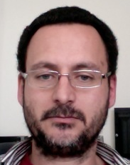
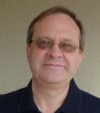
HADDOCK goes DIRAC
DIRAC submission enabled at minimum cost!
In one afternoon, thanks to the help or Ricardo and Andrei
Clone of the HADDOCK server on a different machine
No root access required, no EMI software installation required
Minimal changes to our submission and polling scripts
Requirements and ranking no longer needed, only CPUTime
JobName = "dirac-xxx";
CPUTime = 100000;
Executable = "dirac-xxx.sh";
StdOutput = "dirac-xxx.out";
StdError = "dirac-xxx.err";
InputSandbox = {"dirac-xxx.sh","dirac-xxx.tar.gz"};
OutputSandbox = {"dirac-xxx.out", "dirac-xxx.err","dirac-xxx-result.tar.gz"};
Very efficient submission (~2s per job – without changing our submission mechanism), high job throughput
Notes:
14
14

Slide 15
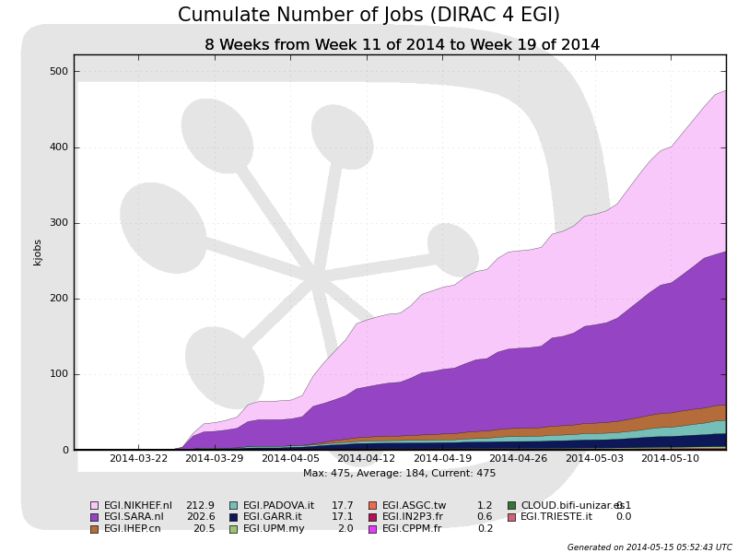
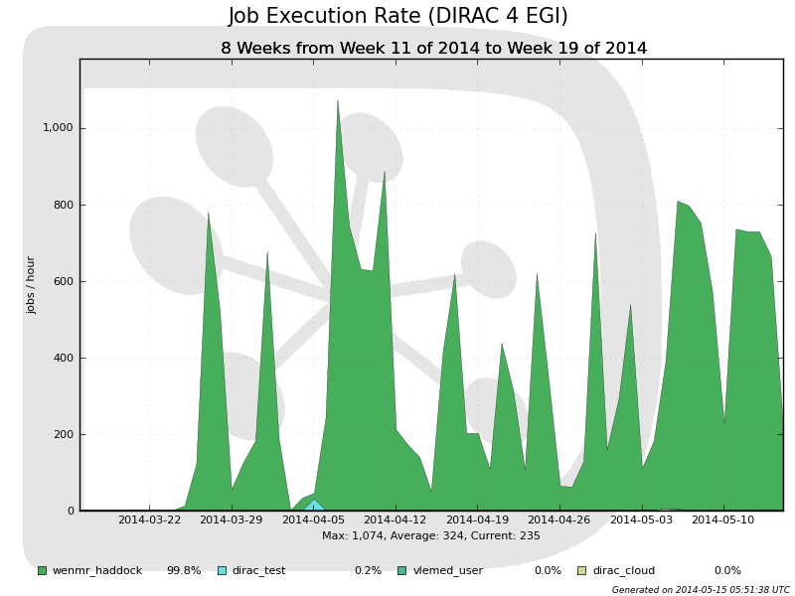
Some statistics
Notes:
15
15

Slide 16
Some statistics
HADDOCK server grid jobs (total 2014 ~2.5M / DIRAC~1.35M)
Notes:
16
16

Slide 17
Conclusions
Successful and smooth porting of the HADDOCK portal to DIRAC4EGI (initially tested on DIRAC France Grilles)
Higher performance / reliability than regular gLite-based submission
Currently almost all HADDOCK grid-enabled portals redirected to DIRAC

Slide 18
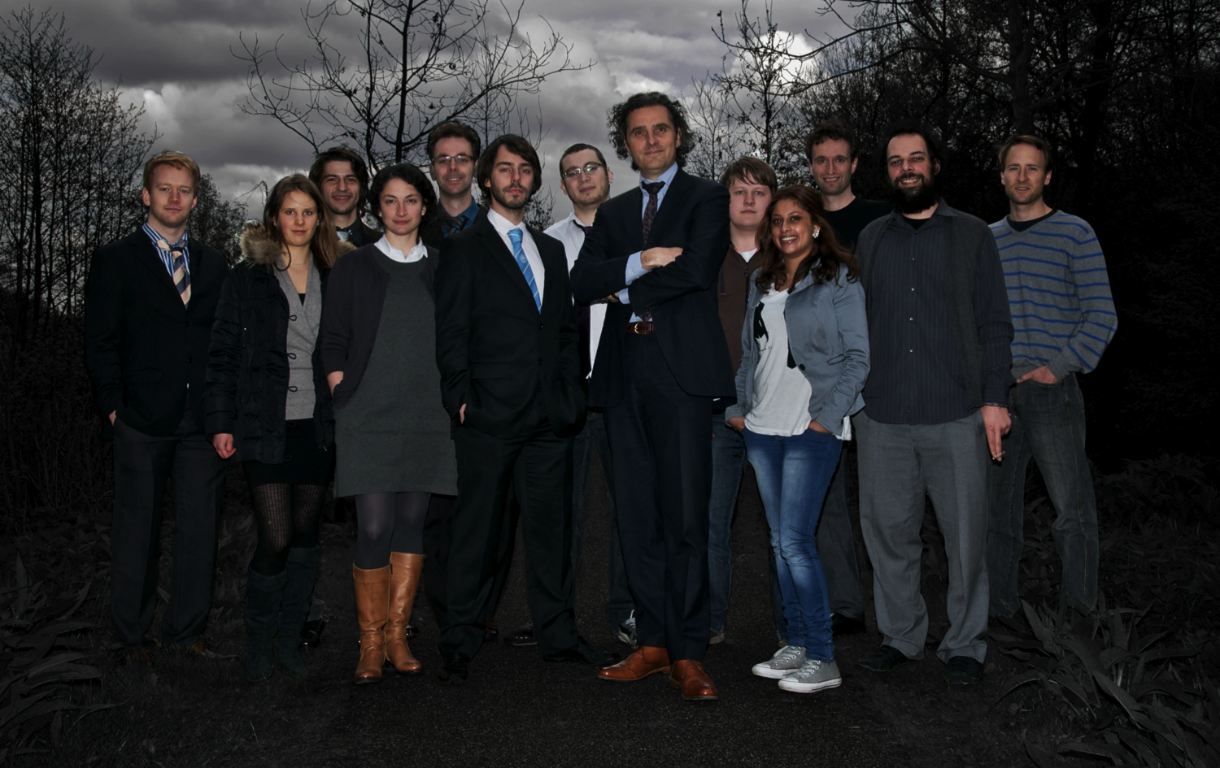
Acknowledgments
Arne Visscher
VICI
NCF (BigGrid)
DIRAC4EGI VT
Ricardo Graciani, Andrei Tsaregorodtsev, ...
BioNMR
WeNMR
HADDOCK Inc.
Gydo van Zundert, Charleen Don, Adrien Melquiond, Ezgi Karaca, Marc van Dijk, Joao Rodrigues, Mikael Trellet, ..., Koen Visscher, Manisha Anandbahadoer, Christophe Schmitz, Panos Kastritis, Jeff Grinstead
DDSG

Slide 19
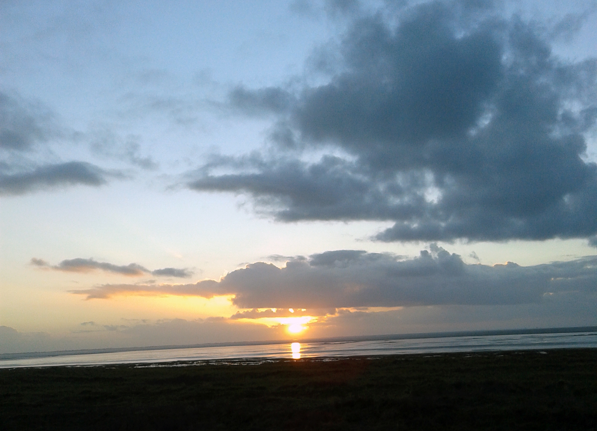
The End
Thank you for your attention!
HADDOCK online:
http://haddock.science.uu.nl
http://nmr.chem.uu.nl/haddock
http://www.wenmr.eu

