Slide 1
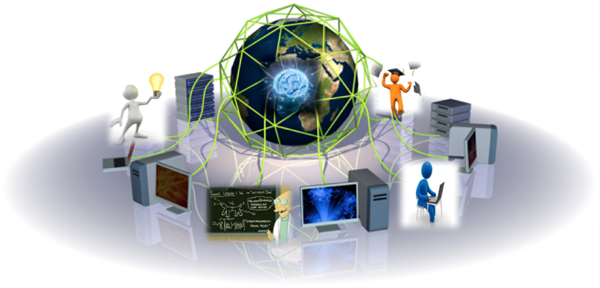
Grid MOOC
Notes:
Target audience: Medical informatics, BioInformatics, Genetic Epidemiology (identify genes), wide experience in teaching
Tell a story about the mooc developed at SURFsara

Slide 2
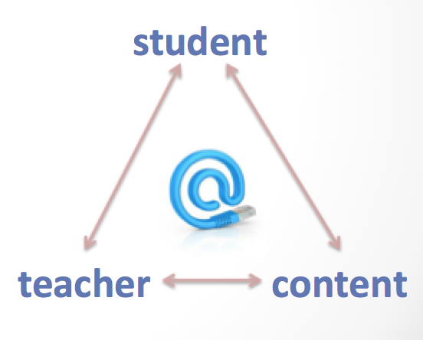
MOOCs
Distance education offered via the internet to a large numbers of people for free.
Massive
Open
Online
Course
Short video lectures (5-10 min)
Virtual class environment: material, quizzes
Discussion forums
Interactive
Sometimes: Certificate of Achievement
Notes:
Massive – teach a course/share ideas with the world. Like teaching a course in a stadium. People who look for further education or career training
Open – without paying (maybe for the credit). Much of the learning comes from online comments, questions and discussions (wiki & online discussion forum – social network based)
Online – only need for internet access. (blogs, tweets, facebook)
Course – Virtual classes, high quality course normally by high quality universities or institutes . A prof is able to tache not 10 but hundreds of students at a time
- The MOOC basic elements:
Student: researchers who want an edge on to facilitate their research, aspiring people who don’t want to pay for a degree or care about the diploma, retirees or similar who enjoy continuous learning, international students who aim remote access to higher education
Teacher: instructors from various scientific fields responsible for the course coordination
Content: video lectures, assignments, quizzes, exams. For the EGI-Inspire project, infrastructure resources will be also provided.
All this communication happens via the web
Long lectures are broken down to short lectures (pause/back /forth)

Slide 3
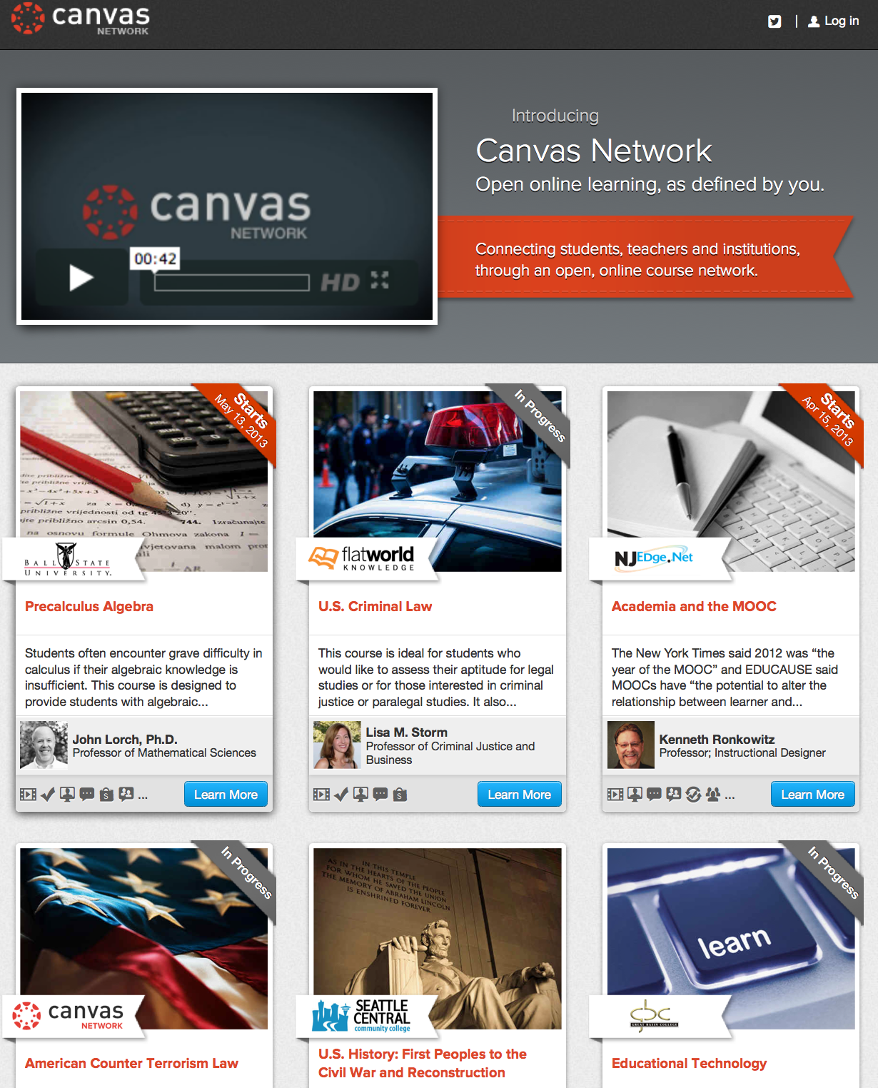
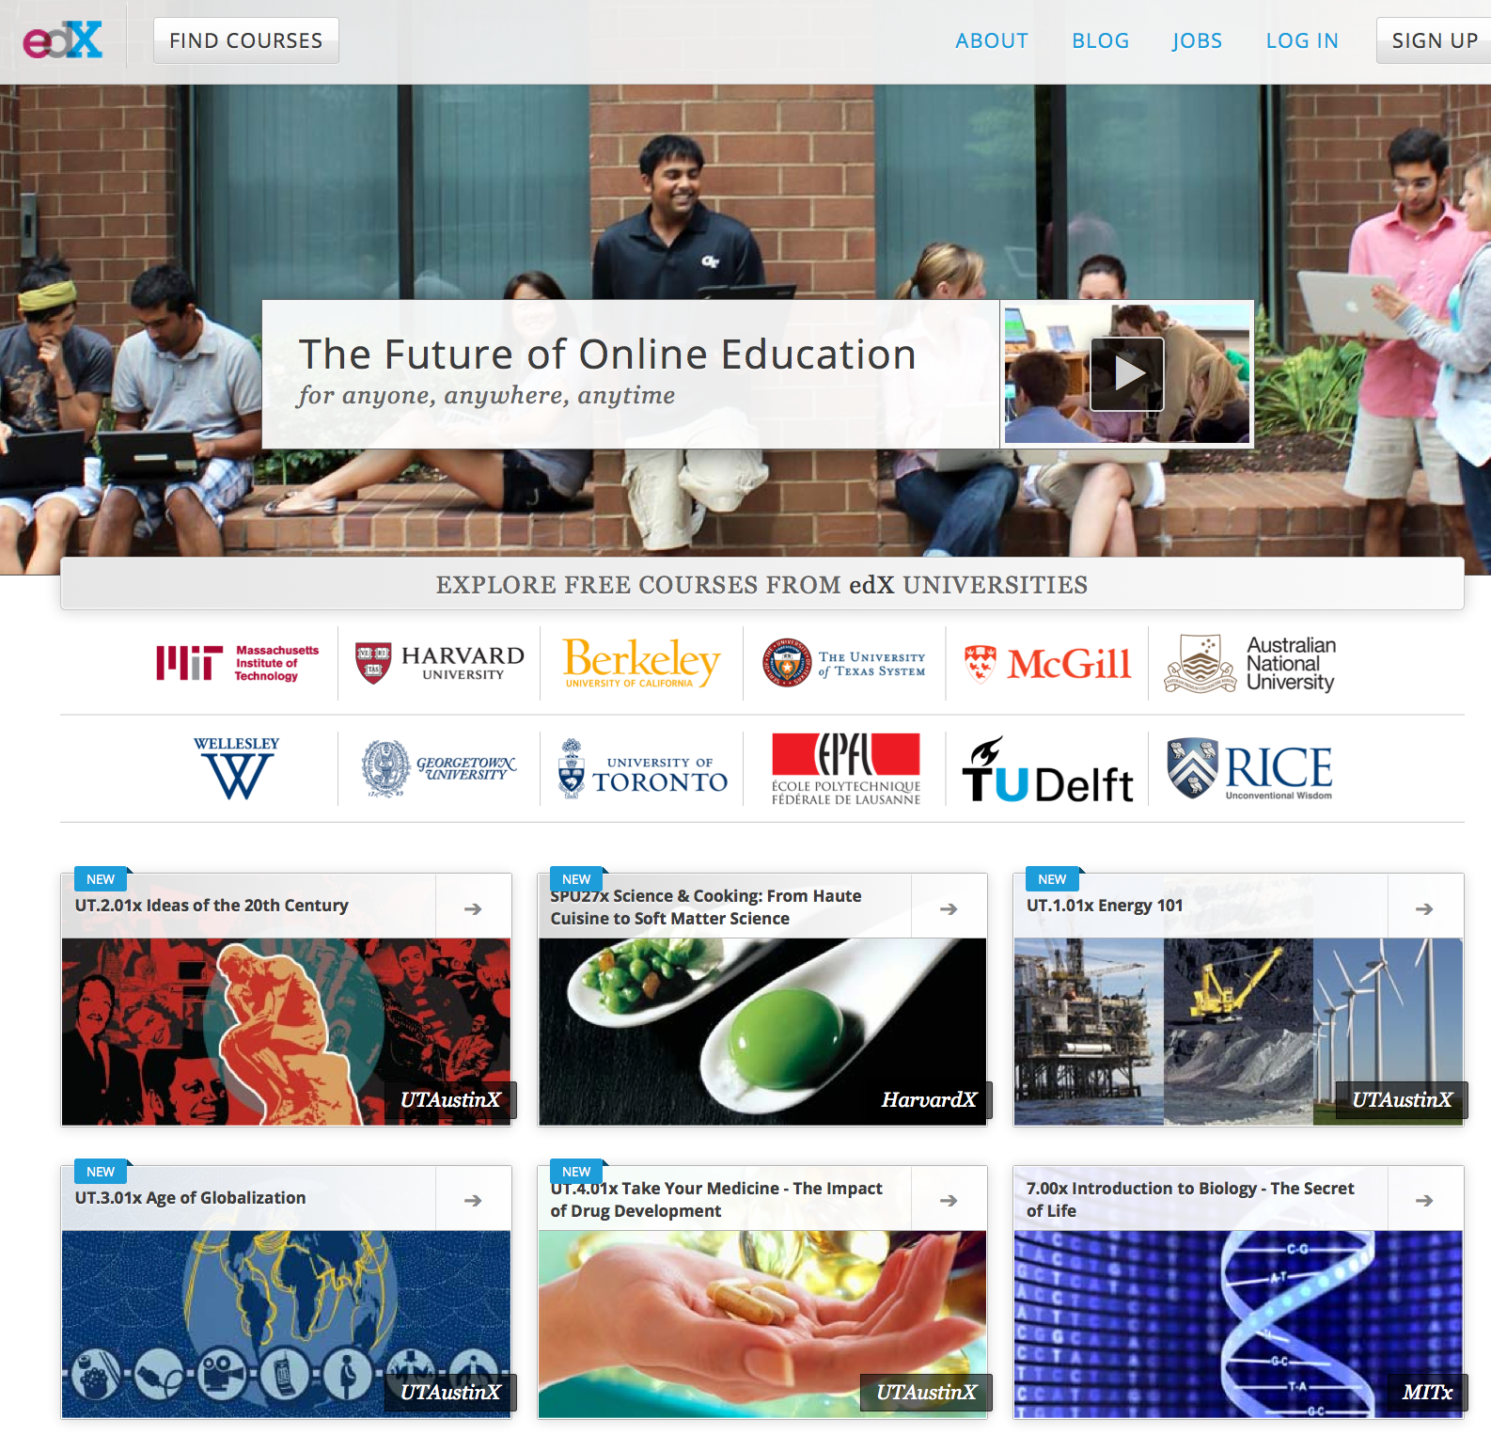
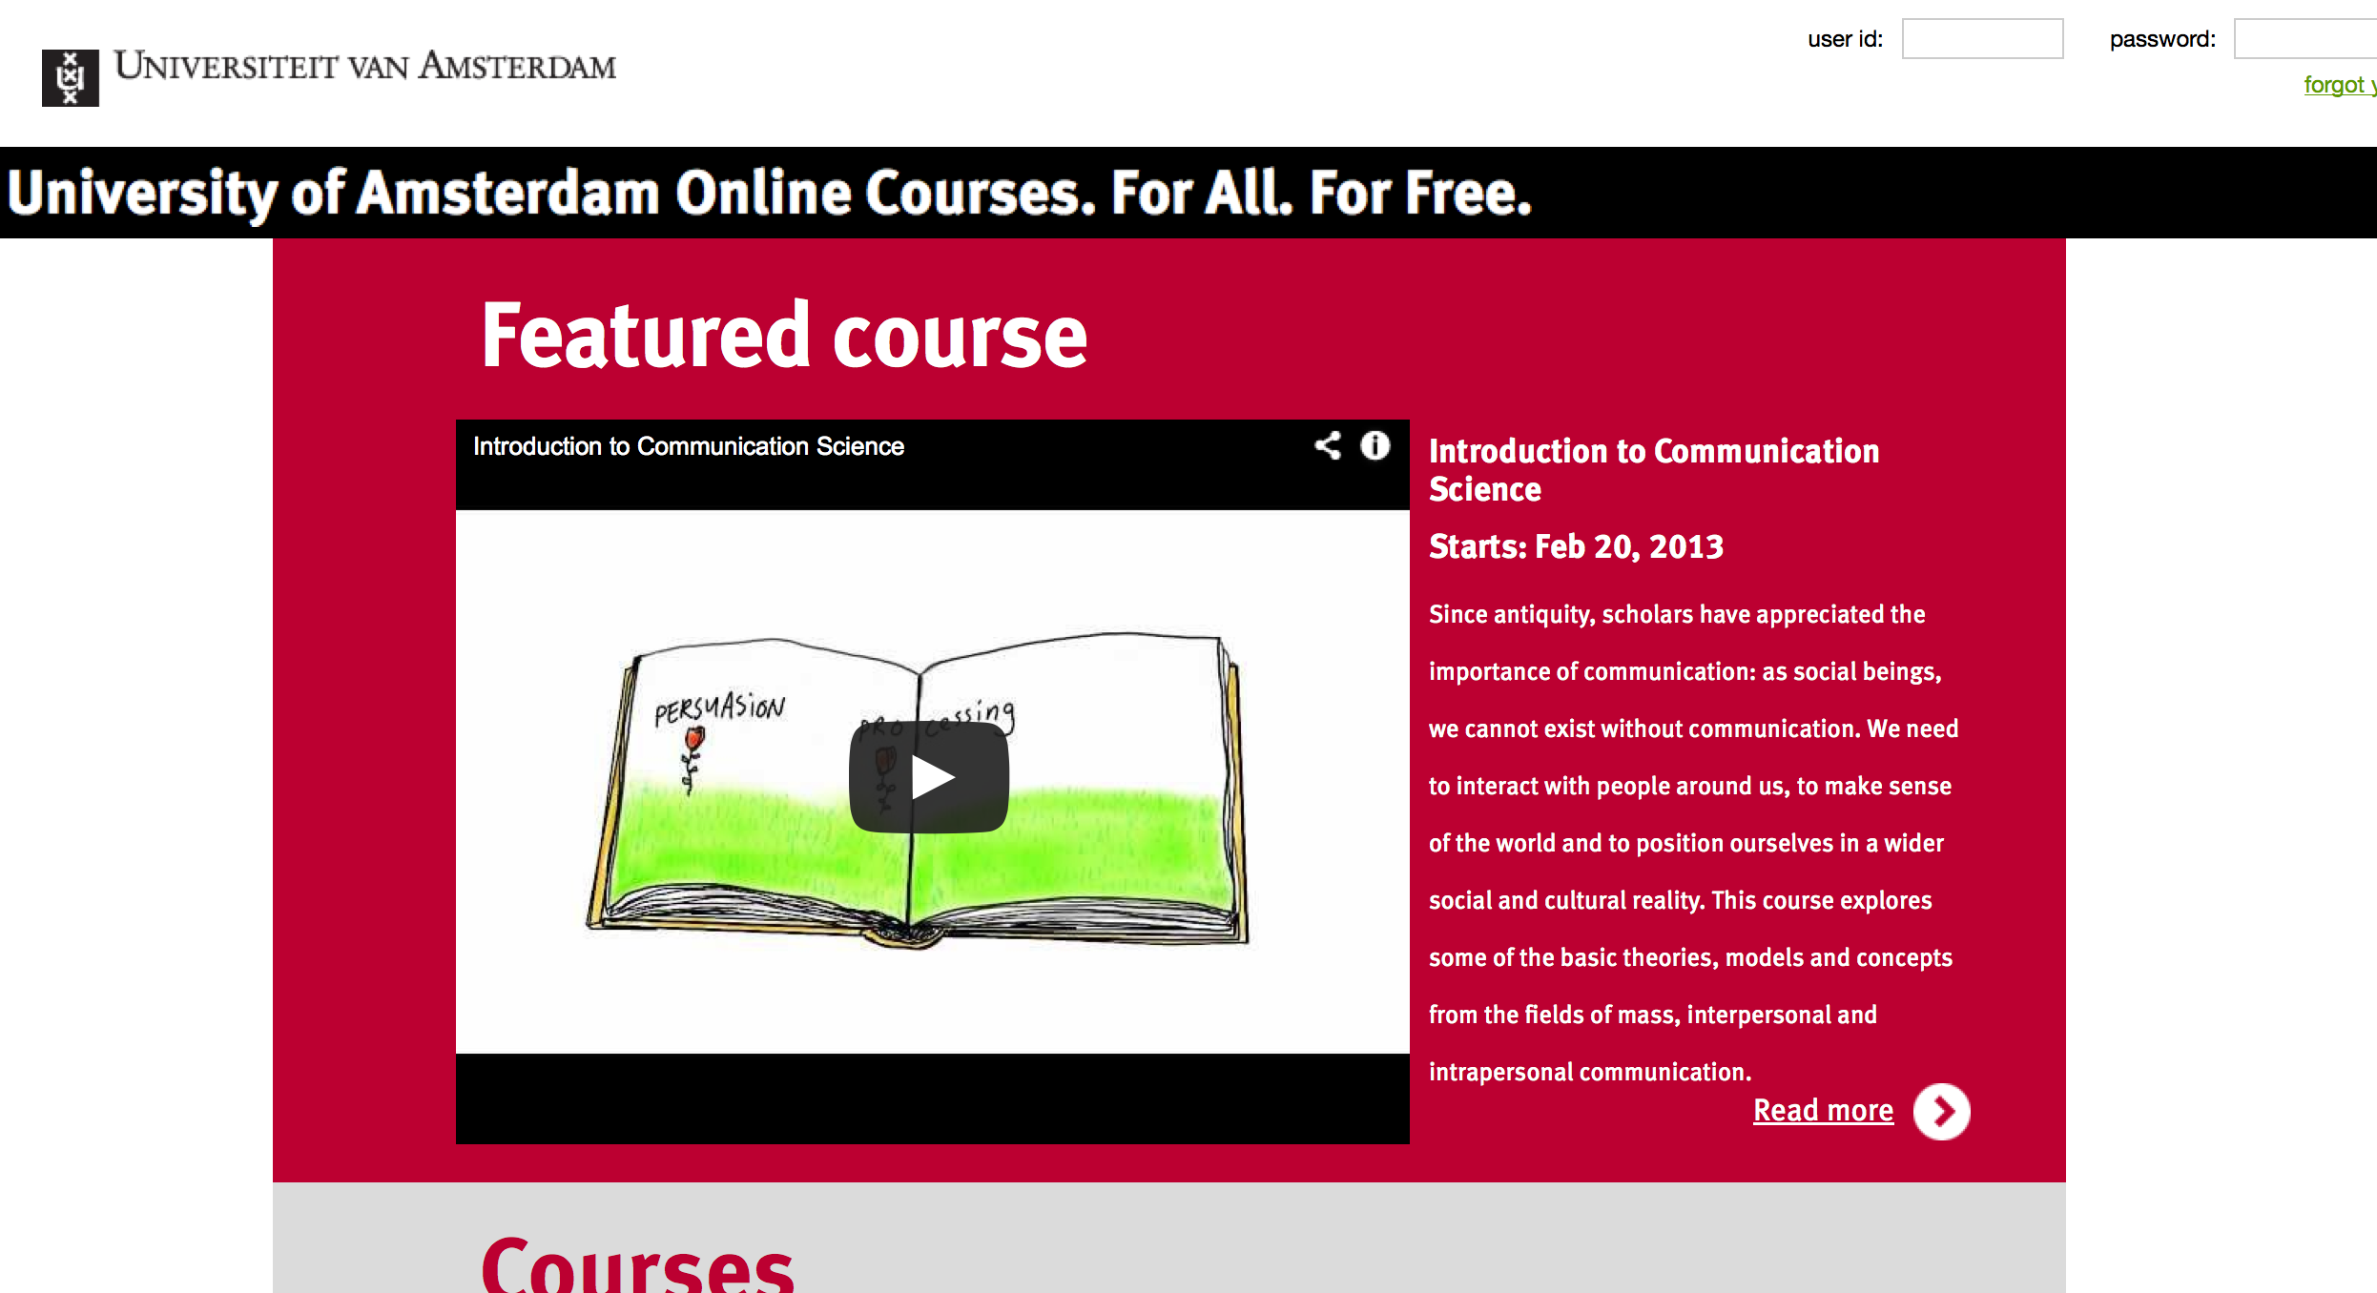
Available platforms
Notes:
History:
More than a decade ago, MIT started a project called OpenCourseWare, to make all of its course materials available free online. But most of those are text-only lecture notes and not interactive.
MOOCs had exploded in 2011, when a free artificial-intelligence course offered by Stanford University in California attracted 160,000 students from around the world, 10% of whom finished it
Who are the major players?
Several start-up companies are working with universities and experts to offer MOOCs:
Coursera: Stanford
Canvas network: startup with an industry-pushing platform (Selected by Cisco Networking Academy to power “the world’s largest classroom”)
- Udacity: Stanford, focused on computer science courses and related fields.
- EdX: MIT+Harvard+Berkeley+Google, freely gives the software platform it is building to offer the free courses, so that anyone can use it to run MOOCs.
Meanwhile, some colleges & Universities or some individual professors are starting their own efforts, eg UvA MOOC

Slide 4
Why a MOOC on grid computing?
Grid computing has a high learning curve
One day seminars don’t have the desired effect
International nature of grid computing

Slide 5
Mini-project goals
Get experience teaching a MOOC
Creating grid documentation
Teach an international audience about grid computing
Increase visibility of the grid community

Slide 6
Preparation
Motivation and target group
Search for real experiences
Follow other MOOCs
Identify roles: instructor, coordinator, developer, tester, video editor, externals
Choose a MOOC platform
Create the material: hand-outs, slides, assignments
Determine restrictions: software, data
Notes:
The primary beneficiaries are researchers and students, because of the knowledge they gain.
SURFsara:
- supports research in the Netherlands with advanced ICT infrastructure, services and expertise.
- providing services in the areas of computing, data storage, visualization, networking, cloud
- supports researchers in the Netherlands and works closely together with the academic community (including researchers, educational institutions and academic medical centers) and industry.
Searched for real experiences – the message was clear: it takes time
We developed a number of animations using the D3.js library. These animations were used to visually explain the key concepts used in grid computing,

Slide 7
Curriculum
Introduction to parallel and distributed computing
Cluster computing
Grid computing overview
Grid security
Certificates
Virtual organizations
Grid job life cycle
Grid toolkit
Scripting
Grid storage
Advance grid jobs
Data management
Workflows
Pilot jobs

Slide 8
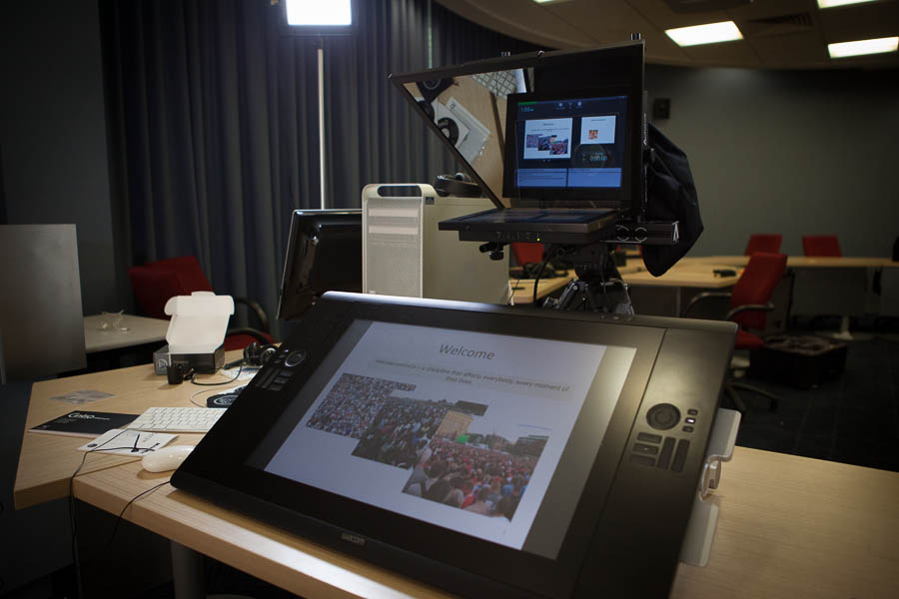
Equipment
Video capture
Laptop
Camera + microphone
Screen recording software
Wacom (+drawing software)
Screencasts with QuickTime Player
Live recordings in Collaboratorium
MOOC platform of the UvA
Notes:
Wacom – a tablet to interact with a computer with a pen instead of a mouse and keyboard,
Look into a webcam above the computer screen while using a Wacom tablet to draw annotations.
The lectures used in the Grid MOOC were either recorded in the Collaboratorium with a HD camera or produced with screen recording software

Slide 9
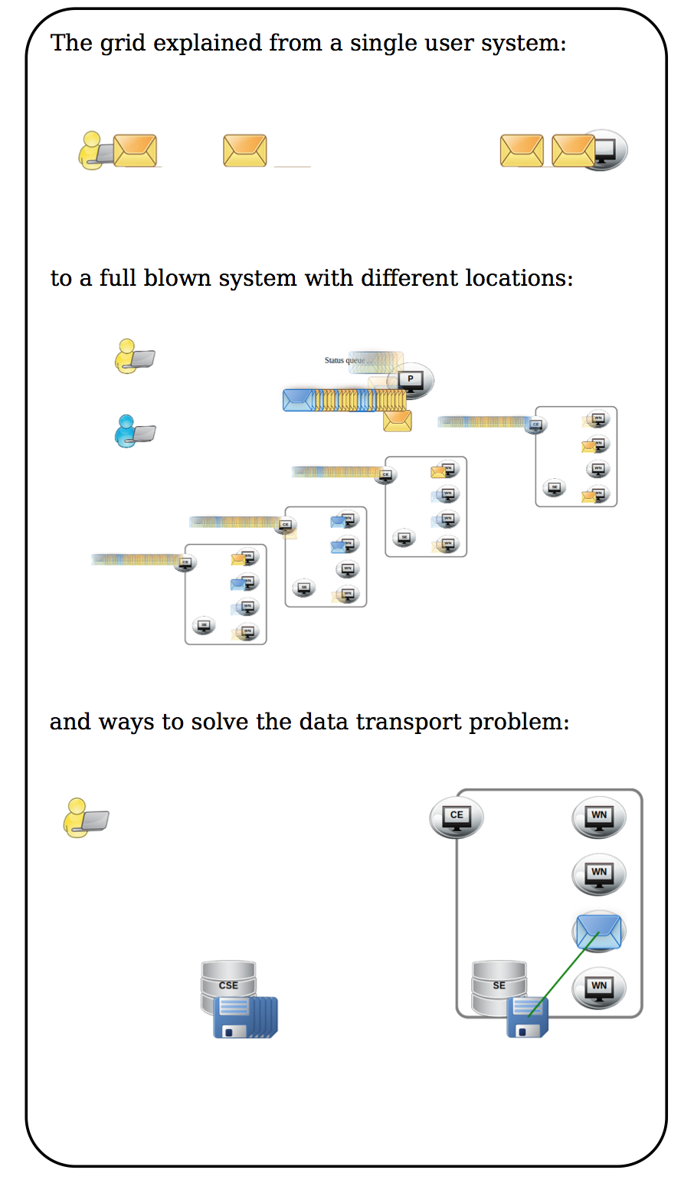
Implementation
MOOC on Grid Computing
EGI-InSPIRE project by SURFsara
8 weeks duration
~ 5 lectures per week
1 mandatory quiz per week
Several exercises per week
Final assignment
37 lectures
Video lectures
Start up guides
Use cases
Hands-On prerequisites
Virtual Machine – software
Grid certificates – authentication
VO memberships – authorization
Certificate of achievement
Notes:
Mooc for the education of students and researchers on e-infrastructures and particularly on the European Grid Infrastructure.

Slide 10
Virtual machines
Main VM
Complete UI installation
Torque queue
WS-Pgrade VM

Slide 11
Evaluation
In overall:
350 participants
13% submitted all the quizzes
9% succeeded: rate of dropouts expected
Effort:
6 months of preparation (4 people crew-part time)
2 months running the course: announcements, discussion forums, extra videos
1 month to wrap up
Benefits:
Increase visibility of ‘Grid Computing’, tools, services (EGI+SURFsara)
Increase availability of knowledge on ‘Grid Computing’: existing & new users
Reusability of the content
Experience in MOOCs
Notes:
Measuring the direct effect of the courseware is difficult due to the educational purpose of the project.
350 participants – intentional not massive to avoid the risk (no prior advertisement, platform not active as coursera)
Increase availability of knowledge on distributed computing and parallel platform infrastructure
Experience on MOOCs: for other topics

Slide 12
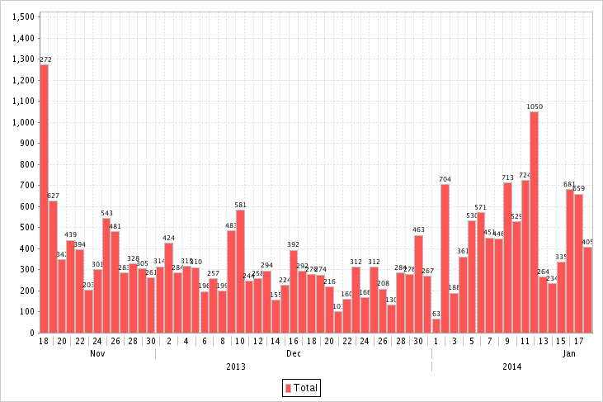
Few statistics
Usage throughout the course (18/11/2013-18/01/2014)

Slide 13
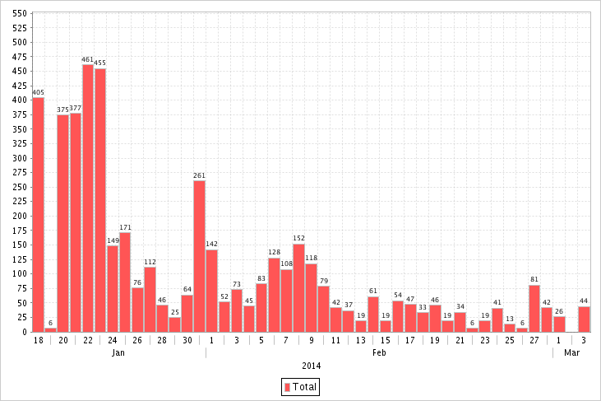
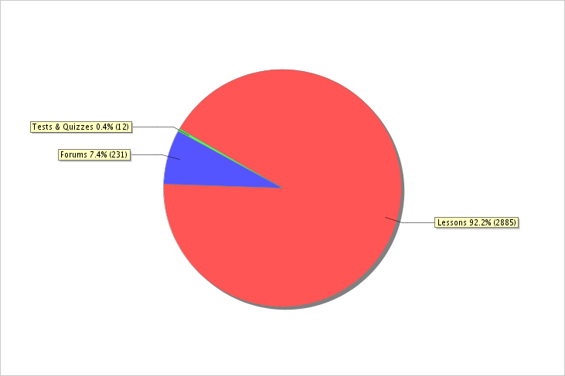
Usage after course end

Slide 14
Participant evaluation
Google docs questionnaire send to participants
User statistics
Participants were often familiar with the Linux command line and scripting languages
Mostly PhDs and scientific programmers
>300 people registered, 29 people got a certificate of participation
Evaluation
Mostly positive feedback, both on the course’s content and structure
The final assignment needs some work though

Slide 15
Project evaluation
Teaching a MOOC is very time consuming
Keep in mind that we are not experienced lecturers
Providing semi-anonymous access to a production compute infrastructure is tricky
Setting up accounts
Grid certificates
VO membership
Having a predefined timeline forces you and the participants to commit to such a project

Slide 16
Discussion
To use a MOOC or not
What is the motivation?
What is the target group?
To create a MOOC
Which platform?
Prior experience in teaching?
Existing content and tools?
What are the restrictions? … infrastructure, software, data access, security
To run a MOOC
Invest time: takes many hours to produce 1 hour of quality video and the content is heavy load to prepare
Get used to the new role model: teachers, students, and universities
Interactive tools (forums, quizzes, monitor commitment)
Notes:
Existing content and tools? – blackboard
What are the restrictions? … software, data access
- Risk of using shared e-infrastructure instead of local resources (like the traditional online courses do): specific configurations, accounts and operational support (VOs, dedicated clusters)

Slide 17
The future
Combine MOOC and ‘real life’ teaching to get more feedback
Involve e.g. universities of applied sciences
Modify teaching platform to directly interface with the compute infrastructure
Consider teaching a class without a time constraint

Slide 18
External contributors for use cases
Afonso Duarte: Structural Biology in the Grid
Eleni Katragkou: Climate change over Europe
Gergely Sipos: EGI
Joeri van Leeuwen: LOFAR: Extreme physics in space
Michiel van Galen: RNA-seq analysis with PiCaS
Eva Sciacca: VisIVO Science Gateway
Jeroen Schot: Data parallel processing with Hadoop
Silvia Delgado Olabarriaga: P-Grade

Slide 19
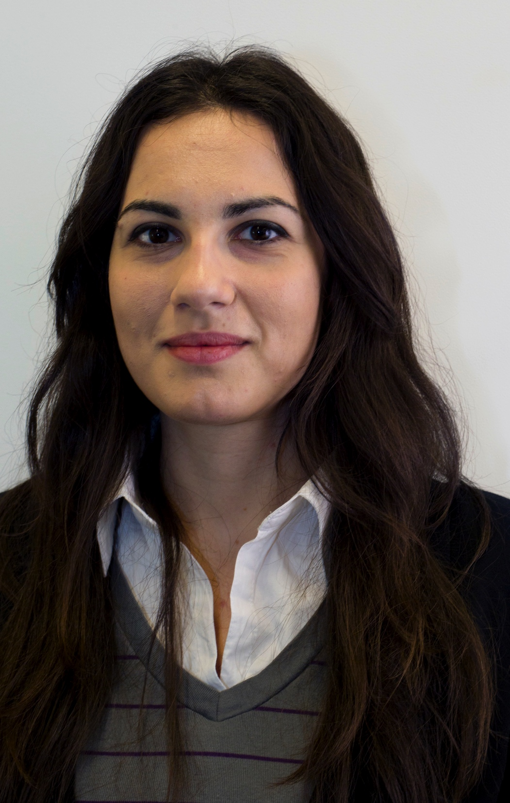
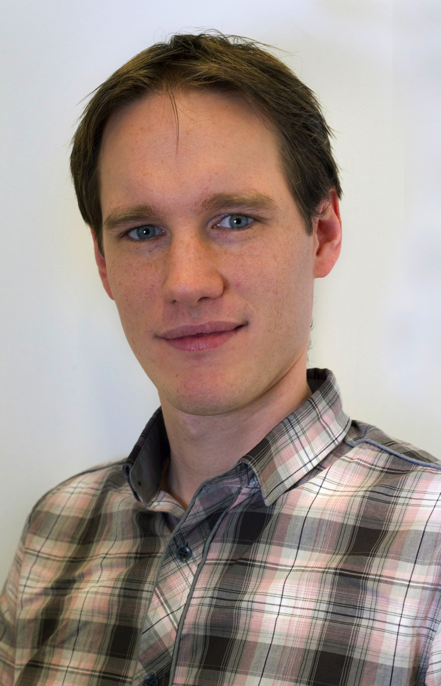
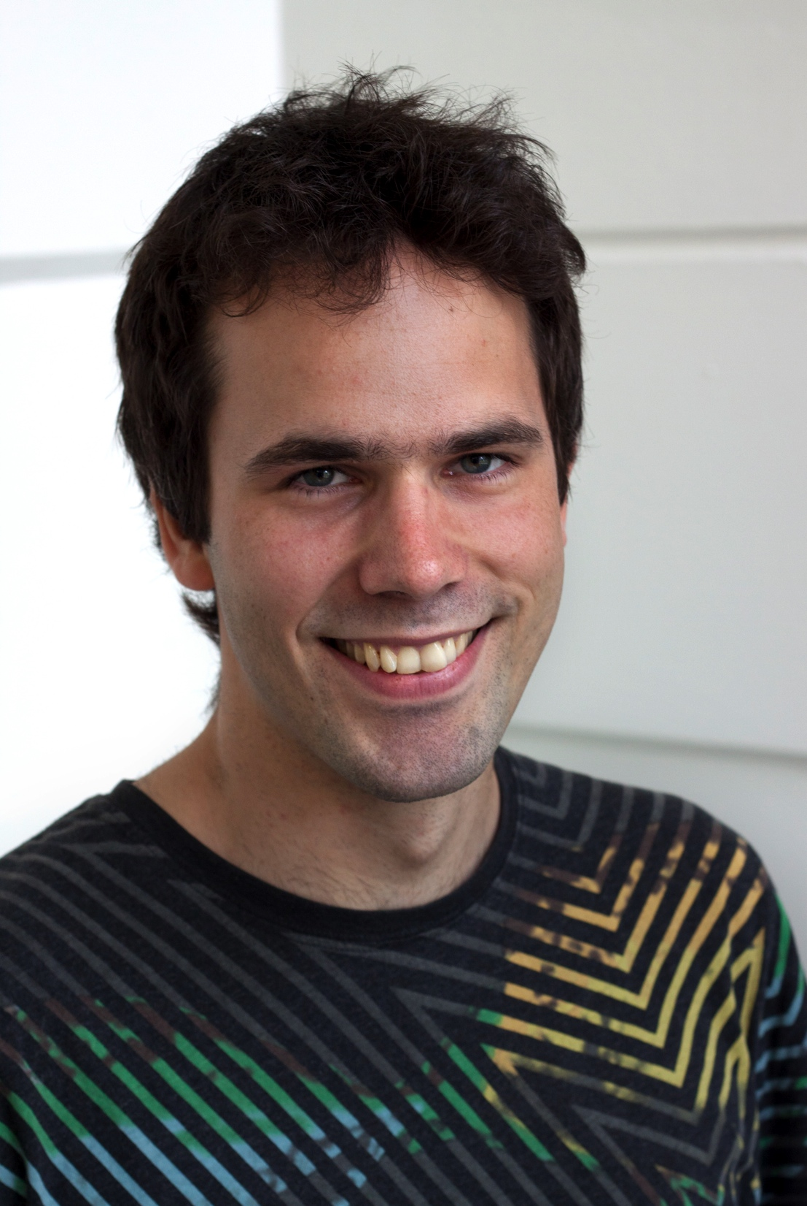
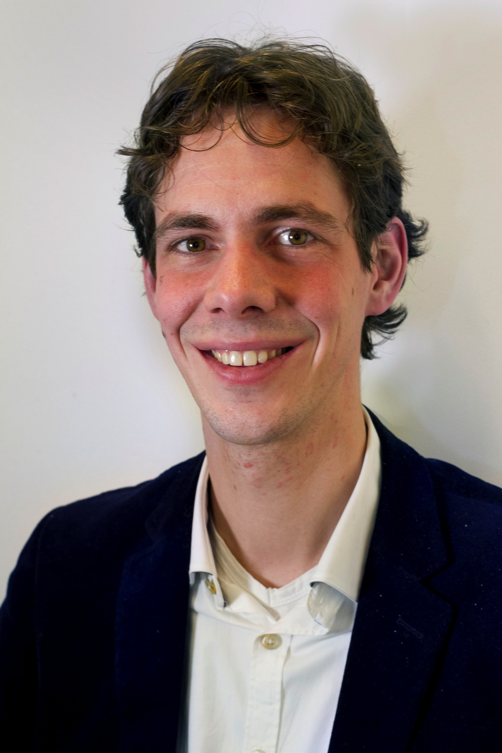
The team
Anatoli
Danezi
Jeroen
Schot
Tijs
de Kler
Nico
Kruithof
Jan
Bot

Slide 20
Useful links
SURFsara MOOC: http://mooc.uva.nl/portal
Enroll to check the content
Animations: http://mooc-inst.sara.cloudlet.sara.nl/mooc/
SURFsara wiki: https://grid.sara.nl/wiki/index.php/MOOC_on_Grid_Computing
Coursera: https://www.coursera.org/
edX: https://www.edx.org/
Try out the openEdX platform: http://code.edx.org/
Navigate to: https://github.com/edx/edx-platform/wiki/Open-edx-sandbox-website
The Pedagogy of MOOCs: http://edtechfrontier.com/2013/05/11/the-pedagogy-of-moocs/

