Slide 1

DP Knowhow: Audit and Certification in ISO Standard 16363
Matthias Hemmje (FTK), David Giaretta (APA)
APARSEN-EGI-Community-Forum Training on Data Preservation
22nd of May 2014
Helsinki, Finland
This work is made available under the terms of the Creative Commons Attribution-ShareAlike 3.0 license, http://creativecommons.org/licenses/by-sa/3.0/.

Slide 2
Why Audit?
Assure higher management that valuable information is safe
Identify improvements
Justify resources needed
Contractual requirements (in the future)

Slide 3
Why ISO Audit?
Well established, well accepted international process
Need for checking compliance to prescribed standards – conformity assessment – inspection/testing/ certification
Confidence in conformity assessment
International acceptability for facilitating trade - Need for recognition of inspection/testing/ certification across borders
Accomplished through accreditation

Slide 4
OAIS
Conformance requirements
  Information model
    A conforming OAIS Archive implementation shall support the model of information described in 2.2. The OAIS Reference Model does not define or require any particular method of implementation of these concepts.
  Mandatory responsibilities
    A conforming OAIS Archive shall fulfill the responsibilities listed in 3.1. Subsection 3.2 provides examples of the mechanisms that may be used to discharge the responsibilities identified in 3.1. These mechanisms are not required for conformance. A separate standard, as noted in 1.5, has been produced on which accreditation and certification processes can be built.
OAIS does not cover everything e.g. financial aspects

Slide 5
OAIS Functional Model
RELEVANT FOR DEFINING TERMINOLOGY
NOT MENTIONED FOR CONFORMANCE

Slide 6
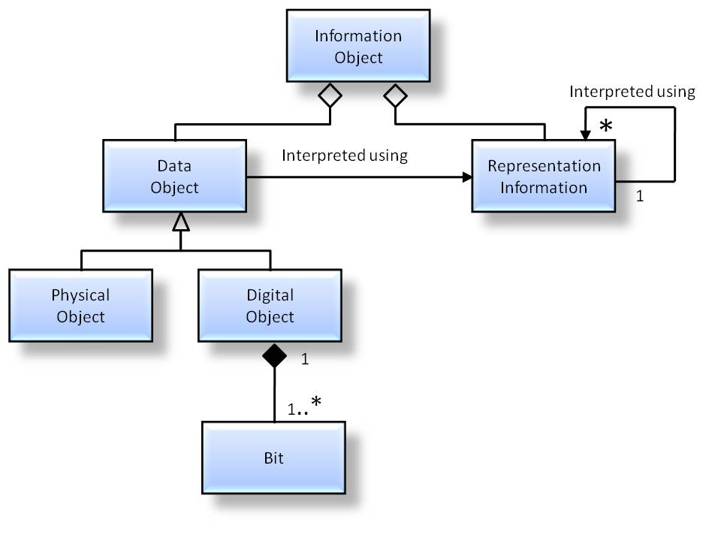
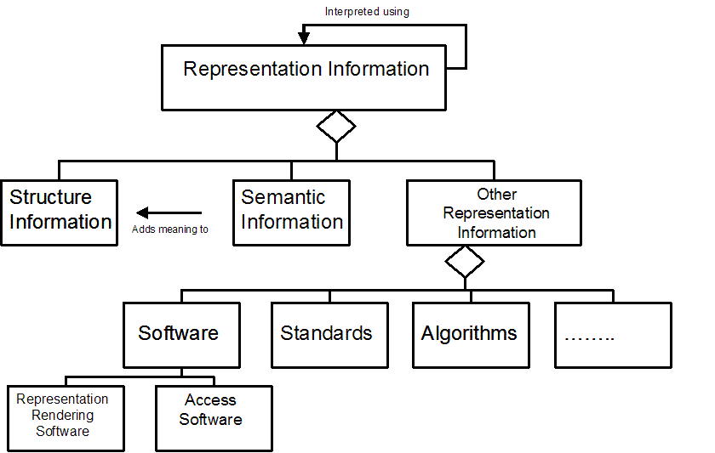
OAIS Information model: Representation Information
The Information Model is key
Recursion ends at KNOWLEDGEBASE of the DESIGNATED COMMUNITY
(this knowledge will change over time and region)
Does not demand that ALL Representation Information be collected at once.
A process which can be tested
Notes:
Just to be clear – I am focussing on the OAIS Information Model

Slide 7
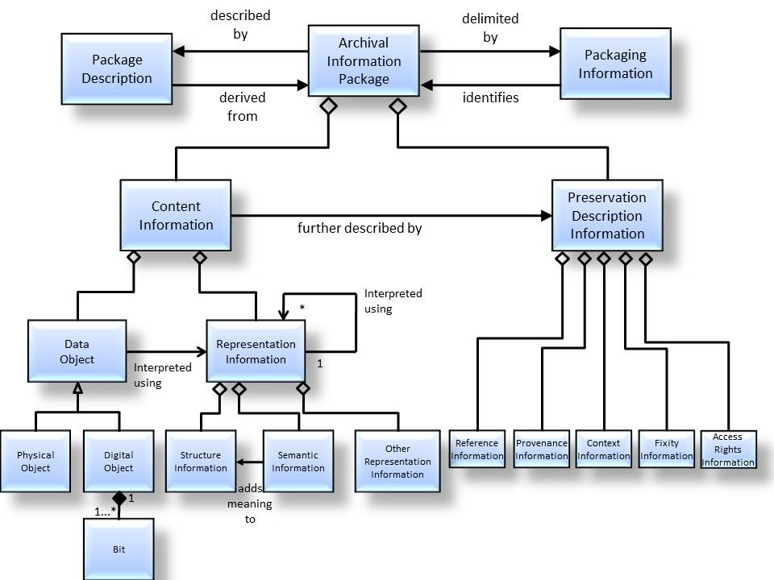
OAIS Information Model

Slide 8
Mandatory responsibilities (1)
Negotiate for and accept appropriate information from information Producers.
Obtain sufficient control of the information provided to the level needed to ensure Long Term Preservation.
Determine, either by itself or in conjunction with other parties, which communities should become the Designated Community and, therefore, should be able to understand the information provided, thereby defining its Knowledge Base.

Slide 9
Mandatory responsibilities (2)
Ensure that the information to be preserved is Independently Understandable to the Designated Community. In particular, the Designated Community should be able to understand the information without needing special resources such as the assistance of the experts who produced the information.
Follow documented policies and procedures which ensure that the information is preserved against all reasonable contingencies, including the demise of the Archive, ensuring that it is never deleted unless allowed as part of an approved strategy. There should be no ad-hoc deletions.
Make the preserved information available to the Designated Community and enable the information to be disseminated as copies of, or as traceable to, the original submitted Data Objects with evidence supporting its Authenticity.

Slide 10
What OAIS does not cover
standard(s) for the interfaces between OAIS type Archives;
standard(s) for the submission (ingest) methodology used by an Archive:
  ISO 20652:2006 Space data and information transfer systems—Producer-Archive Interface—Methodology Abstract Standard (the more specific Producer-Archive Interface Specification (PAIS) is under preparation);
standard(s) for the submission (ingest) of digital data sources to the Archive;
standard(s) for the delivery of digital sources from the Archive;
standard(s) for the submission of digital metadata, about digital or physical data sources, to the Archive:
  PREMIS Data Dictionary for Preservation Metadata. Version 2.0, PREMIS Editorial Committee, March 2008;
  ISO 15889:2003 Space data and information transfer systems—Data Description Language—EAST Specification;
  ISO 21961:2003 Space data and information transfer systems—Data Entity Dictionary Specification Language (DEDSL)—Abstract syntax;
  ISO 21962:2003 Space data and information transfer systems—Data Entity Dictionary Specification Language (DEDSL)—PVL syntax;
  ISO 22643:2003 Space data and information transfer systems—Data Entity Dictionary Specification Language (DEDSL)—XML/DTD;
  ISO 13527:2010 Space data and information transfer systems—XML formatted data unit (XFDU) structure and construction rules;
syntax standard(s) for the identification of digital sources within the Archive;
protocol standard(s) to search and retrieve metadata information about digital and physical data sources;
standard(s) for media access allowing replacement of media management systems without having to rewrite the media;
standard(s) for specific physical media;
standard(s) for the migration of information across media and formats;
standard(s) for recommended archival practices:
  ISO 15489-1:2001 Information and documentation—Records management. Part 1: General;
  ISO/TR 15489-2:2001 Information and documentation—Records management. Part 2: Guidelines;
  ISO 23081-1:2006 Information and documentation—Records management processes—Metadata for records—Part 1: Principles;
  ISO/TS 23081-2:2007 Information and documentation—Records management processes—Metadata for records—Part 2: Conceptual and implementation issues;
standard(s) for certification of Archives:
  CCSDS 652.0-M-1, Audit and Certification of Trustworthy Digital Repositories (Magenta Book, Issue 1), also available as ISO 16363:2011

Slide 11
….
Specific hardware/ software
Funding
Training
Organisational commitment

Slide 12
Standards based Repository Audit and Certification (ISO 16363)
There is a hierarchy of ISO standards concerned with good auditing.
ISO 16919 is positioned within this hierarchy in order to ensure that these good practices can be applied to the evaluation of the trustworthiness of digital repositories using ISO 16363.
It covers principles needed to inspire confidence that third party certification of the management of the digital repository has been performed with impartiality, competence, responsibility, openness, confidentiality, and responsiveness to complaints
OAIS
(ISO 14721)
Requirements For Bodies Providing Audit And Certification
(ISO 16919 )
TRAC
Trusted Digital Repositories:
Attributes and Responsibilities
Audit and Certification of Trustworthy Digital Repositories
(ISO 16363 )
Audit by external, accredited, auditors
Certification
Metrics concerning:
Organizational Infrastructure
  e.g. The repository shall have a documented history of the changes to its operations, procedures, software, and hardware.
Digital Object Management
  e.g. The repository shall have access to necessary tools and resources to provide authoritative Representation Information for all of the digital objects it contains.
Infrastructure and Security Risk Management
  eg. The repository shall have procedures in place to evaluate when changes are needed to current software.
See http://wiki.digitalrepositoryauditandcertification.org and http://www.alliancepermanentaccess.org/membership/member-resources/audit-and-certification
Standards will be available free from http://www.ccsds.org

Slide 13
ISO 16363 (25 mins)
Overall Structure:
  Section A: Organisational Infrastructure
  Section B: Digital Object Management
  Section C: Infrastructure and Security Risk Management
Metrics and their structure:
  Statement of requirement
  Supporting text
  Examples of Ways the Repository can Demonstrate it is Meeting this Requirement
  Discussion

Slide 14
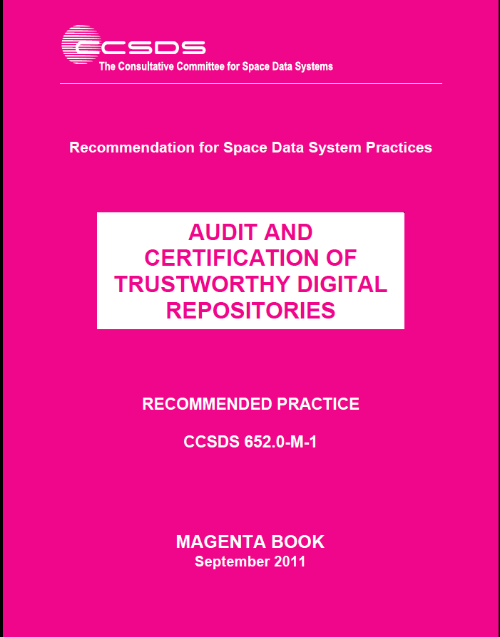
Get Your Copy for Free!
You can download the Magenta Book for ISO 16363 here: http://public.ccsds.org/publications/archive/652x0m1.pdf

Slide 15
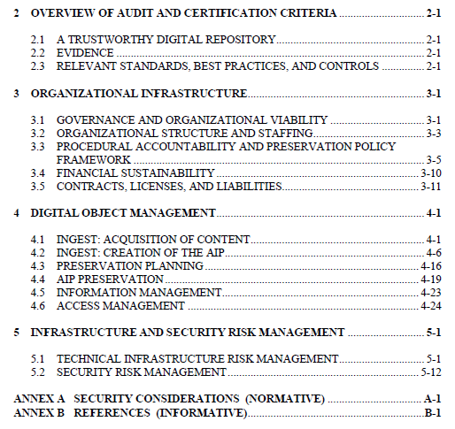

Slide 16
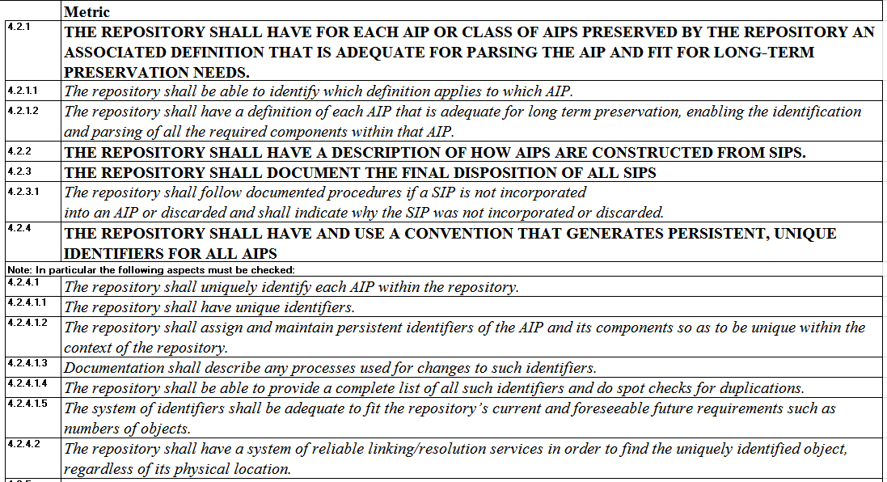

Slide 17
Metrics: too many or too few?
Impossible to anticipate all possibilities
Should be regarded as a “guide” for auditors
Fundamentally depends on auditors’ experience/judgement
Need to try to guarantee consistency of judgements

Slide 18
ISO Process for Audits
Comprehensive view of repository’s capabilities
Preparatory work by repository
First audit and resulting certification
  Identifies improvements needed
  Repository prepares and implements improvement plan
Surveillance audit after 18 months
Re-certification

Slide 19
The audits
Self-audit process covering all metrics, providing information to audit team:
The basics:
  Are the bits safe?
  Are the data understandable/usable by the Designated Community?
  Is authenticity safeguarded (evidence based)
    E.g. Is the information really what it is claimed to be?
  Can the digital holdings be handed over to another repository if/when necessary?
The repository must try to provide evidence
  Why do they think people (including their funders) should trust them?

Slide 20
What would Certification look like?
NOTE: The audit and certification would be undertaken by an accredited organisation
Not a simple statement that “Yes this repository is perfect”!
Should be regarded as part of a process of improvement
  Audit/certification provides information on which an organization can act to improve its performance
  Improvement plan
    “repository OK as long as ….”
  Cycle of certification/ surveillance audit/ re-certification

Slide 21
Example Issues from ISO 16363 Metrics
Metric 3.3.1 THE REPOSITORY SHALL HAVE DEFINED ITS DESIGNATED COMMUNITY AND ASSOCIATED KNOWLEDGE BASE(S) AND SHALL HAVE THESE DEFINITIONS APPROPRIATELY ACCESSIBLE.
  The metric was not satisfied. There were no records or documentary evidence presented to describe any Designated Community, nor any AIP associations with any Designated Community.

Slide 22
Example Issues from ISO 16363 Metrics
Metric 4.2.5.2 THE REPOSITORY SHALL HAVE TOOLS OR METHODS TO DETERMINE WHAT REPRESENTATION INFORMATION IS NECESSARY TO MAKE EACH DATA OBJECT UNDERSTANDABLE TO THE DESIGNATED COMMUNITY.
  This metric was not satisfied. In our discussions, we perceived that <SITE>s view of their designated communities was ambiguous. Consequently, there were few indications that representation information was being organized to support the long term use and understanding of the AIPs. While a great deal of representation information, and indeed, metadata in general is being collected, there appear to be few opportunities within <SITE> for explicit review of those ancillary data in light of changes in long-term preservation needs of one or more Designated Communities.

Slide 23
Example Issues from ISO 16363 Metrics
METRIC 3.1.2 THE REPOSITORY SHALL HAVE A PRESERVATION STRATEGIC PLAN THAT DEFINES THE APPROACH THE REPOSITORY WILL TAKE IN THE LONG-TERM SUPPORT OF ITS MISSION
  Currently there is no preservation strategic plan separate from the overall strategic plan of the organization. However, within the new strategic plan 2011-2015 attention is given to preservation aspects. This Strategic Plan will be published in June. The metric was not satisfied.

Slide 24
IAF
TC
TC
WG
Regional Group
USA: ANSI
ANAB
UK:
UKAS
INDIA:
NABCB
Regional Group
National Accreditation Body (NAB)
ISO 17011(?)
NAB
NAB
Certification Body
ISO 17021
(ISO) 16919
WHO AUDITS
Repository
ISO 16363

Slide 25
Auditors - new CASCO approach
Instead of qualifications and particular experience now the focus is on COMPETENCIES

Slide 26
Example of Competencies
Possesses the knowledge to assess the TDRMS’ procedures and processes when creating Archival Information Packages (AIPs),and its ability to :
  assess the level of detail to which an AIP should be described
  determine the functions of the various components of an AIP and how they may be implemented
  identify the range of provenance information that should be collected
  identify the difference between SIP and AIP and ways in which the former may be converted to the latter
  identify and assess workflows and whether they reliably achieve what they purport to do
  assess the relationship between the various identifiers used within a repository
  assess ways of defining Designated Communities and how the appropriate amount of Representation Information may be obtained
  identify (or assess) possible changes in the Designated Community and its knowledge base and impacts on understandability
  assess the risks to the integrity of digital holdings in various circumstances - both technical and non-technical.

Slide 27
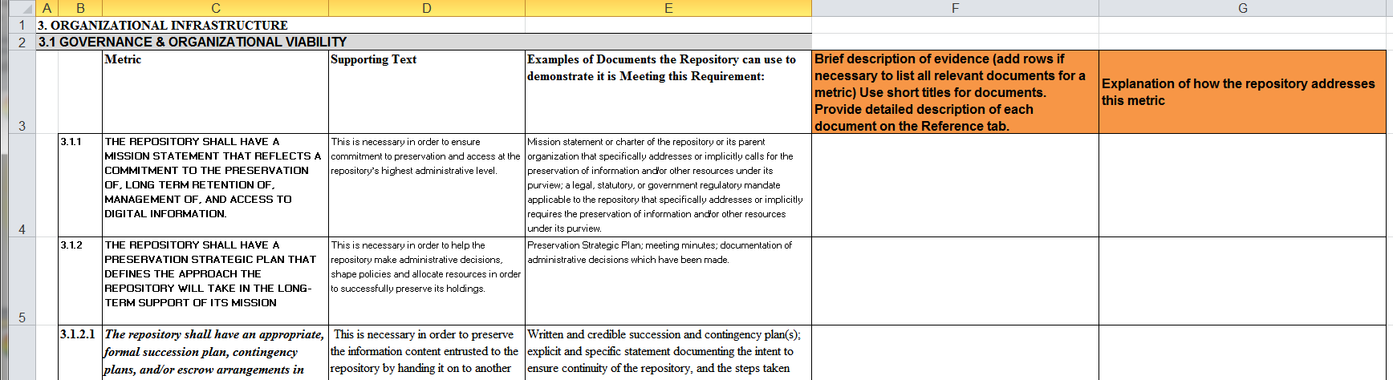
Get Your Copy for Free!
Standard will be available on http://public.ccsds.org/publications/MagentaBooks.aspx
  NOTE: Issue 1. November 2011 is the OLD version
  The revised version will be available in a few days
Self-assessment template is available on the PTAB website http://www.iso16363.org/preparing-for-an-audit/

Slide 28
Steps to take
Self-assessment template is available on the PTAB website www.iso16363.org
Begin gathering (or creating!) the documentation you will need for certification and audit
Find accredited auditor
  Should be available soon!!
Agree scope of audit

Slide 29
Self-assessments
Conduct self-assessments to identify shortcomings and help identify any “surprises.”
Determine which metrics apply to the repository. If the repository believes that any metrics do not apply, document why the metric does not apply.
Determine which metrics are being met successfully and provide examples to document how the repository meets each metric.
Determine which metrics are not being met and what measures need to be implemented to achieve and document success for that metric.
Determine what resources (additional or reallocated) are required to achieve success.
Refer to external resources, such as case studies and best practices, as desired and available.
Incorporate findings from previous audits conducted of the repository or similar institutions if such results are available. These could include information technology security audits, ISO 9000 suite audits, quality assurance audits, risk assessments, and similar evaluations.
Populate and maintain the Self-Assessment Template for ISO 16363 to better organize and track progress on meeting the metrics and prepare for an ISO 16363 audit when they can be performed.

Slide 30
Training Process for Repositories Managers
Handbook for repository being prepared
Information for managers to understand what the repository staff is attempting to accomplish
Training for staff to understand what is required
Helps in preparation for audit and self-audit

Slide 31
Links
ISO Audit
  http://www.iso16363.org/
    http://wiki.digitalrepositoryauditandcertification.org
OAIS Reference Model
  Original version available from http://public.ccsds.org/publications/archive/650x0b1s.pdf
  Updated version at http://public.ccsds.org/publications/archive/650x0m2.pdf
Alliance for Permanent Access
  http://www.alliancepermanentaccess.org
  Information about SCIDIP-ES and APARSEN at http://www.alliancepermanentaccess.org/index.php/current-projects/ and www.aparsen.eu and www.scidip-es.eu
  Additional OAIS and ISO Audit information will be at http://www.alliancepermanentaccess.org/index.php/membership/member-resources/

