Slide 1
Answering Key Questions
Ruben Riestra - Inmark
How APARSEN can help answer the key question “Who pays and Why?”
APARSEN/SCAPEproject Satellite Event – Long term accessibility of digital resources in theory and practice
Vienna, Austria – 21st May 2014

Slide 2
For the sake of clarity…
Digital Preservation
is an unwanted
PROBLEM!

Slide 3
Value?
It is NOT about the cost
It is NOT about the price
It is about the
perceived
BENEFITS

Slide 4
Value?
A
Demand-side
concept

Slide 5
Value?
NATURE
Scientific
Institutional
Societal
Legal
Economic
…………..
METRICS
Mission accomplished
Return on Investment
Customer satisfaction
Excellence in delivery
Revenue flows
Profit generation

Slide 6
DP offers…
Keeping the Value of your Digital Assets
Expanded customers base for your collections
Multiplying opportunities to create Impact
Gateway to become a competitive supplier
..support your institution´s SUSTAINABILITY
Enabling new funding sources

Slide 7
DP sustainability challenges
Explosive growth of DIGITAL
Every organisation becoming DIGITAL
Compliance with mandates NOT enough
Marketisation of public sector
Traditional funding no longer adequate

Slide 8
Value added by DP ?
Additional Quality Assurance
Enhanced/Validated datasets
Ready-to-use
Feasibility
Benchmarking data

Slide 9
Go-to-Mainstream markets
Projects
Business processes
Costs
Business models
Awareness raising
Marketing
Budgets
Revenue flows
Mindset shift:
Problem solving
VALUE Delivery

Slide 10
WHO should preserve?
WHAT should be preserved?
WHEN should preservation start?
HOW to preserve?
HOW MUCH it will cost?
WHO should pay?
Why? Value for Whom?

Slide 11

Common Vision of APARSEN:
Overcoming Fragmentation in the DP Market
Model of the DP Solutions and Services Market (EC DPImpact study, 2009)

Slide 12
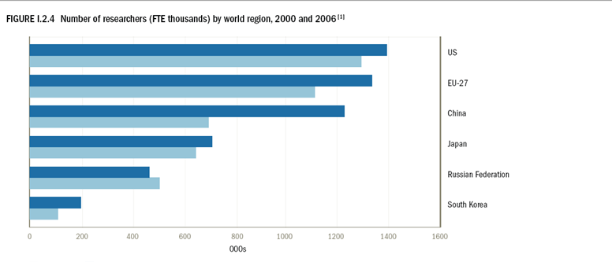
Our “natural” markets?

Slide 13
Niche vs mainstream markets
00s Research Centres vs 000.000s organisations?
<10 Mio. Researchers vs. 8.000 Mio. persons?
Society
Public sector vs. the whole economy?
Secure Information Society´s memory?

Slide 14
Legal
Research
Others?
Niche
Demand Segments
Content
Curators
Training
IT Suppliers
Funding

Slide 15
Legal
Research
Others?
Mainstream
Niche
Demand Segments
Content
Curators
Training
IT Suppliers
Funding

Slide 16
Change management drivers
From generic to well-identified beneficiaries
From users to customers and partners
From curating to offering permanent access
From compliance to meeting changing needs
From monopolies to services providers
From SUPPLY to DEMAND driven

Slide 17
Sustainable DP deployment
Operation
Stages
Business Plan
Design & planning
Value Proposition/
Business Model
Vision & Strategic Objectives
Diagnosis & forecasts
Demand & Competitor Analyses
Time

Slide 18
Demand: Know WHO values us
Modelisation of key groups of users of digital content
Business case: patterns in usage of digital content
Criteria and mechanisms for suppliers selection
Unsatisfied needs/gap solving opportunities
Prioritisation of market segments to be addressed
Market Sizing

Slide 19
Competitor Analysis
Who are our direct/indirect competitors?
What products/services could erode our market share?
What messages are competitors sending?
Who is growing quickly and needs to be watched?

Slide 20
SWOT diagnosis
Opportunities generated from Demand side of market
Opportunities generated in Supply side failures
Why our offering could outperform current suppliers?
Why Demand players will choose our offering?

Slide 21
Value proposition
Brief strategy statement describing:
  Who benefits
  How they benefit
  Why they should resort to us

Slide 22
Compelling Value proposition
Relevant for our targeted users
Highlights OUR differential traits
Measures usage´s IMPACT

Slide 23
Business Models
  What are they?
  Applicability to DP?
  BM re-engineering: a must

Slide 24
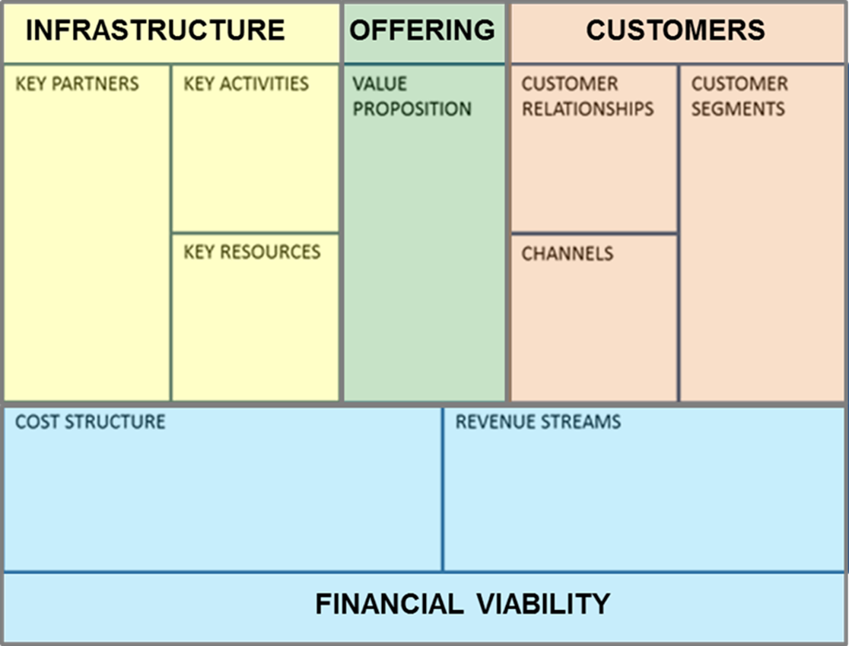


Slide 25
Value delivery paths
Direct t
(Ansoff)
Re-use of datasets
Re-purposing (BMx)
Bundling (BMy)
Indirect t
Services enabled by:
  DP Expertise
  DP Accrued experience
  DP Infrastructure
e.g.1. Consultancy
e.g.2. Outsourced processes

Slide 26
Business Models for DP
Multistakeholder oriented (For and Non for Profit)
Hybrid and multiple (on BM for each stakeholder type)
Implicit versus explicit, mainly due to corporate culture

Slide 27
Business Model innovation
Sustainability is not
“Perpetual movement”
…systematically review your BM and adjust them to the changing needs of Value delivery.

Slide 28
Thank you!
ruben.riestra@grupoinmark.com

