Slide 1
OpenSource GeoSpatial Catalogue Platform-as-a-Service
(EISCAT 3D Pilot)
Salvatore Pinto
Cloud Technologist (EGI.eu)

Slide 2
Outline
Concept
Technologies
Next steps

Slide 3
ENVRI Pilot (Concept with EGI/ENVRI solutions)
On-site
Off-site
EGI Federated Cloud
EISCAT archive
Object Storage
Juelich site (DE)
OpenStack SWIFT
Open Source Geospatial Catalogue (OSGC)
CESNET site (CZ)
5m files, ~1TB in total
CDMI with HTTP export
wget
Web browser
Catalogue
Further metadata have to be extracted from the data
E.g. Number of spikes, type of spikes
Complex search based on data patterns
E.g. Particular shapes of the data FFT, etc…
Processing services (for metadata extraction and visualization)
Integrated analysis tools on the data (eg. With GUISDAP) exposed to OSGC as services
Scientific users
Drop box tool to upload data on-demand from client side
Phase 1: In ENVRI
Phase 2: In a H2020 project
Near Real Time tool to import data automatically from receiving stations
Data administrators
Metadata generator service 1
Metadata generator service N
...
Admin tools
Processing / visulation service 1
Processing / visulation service N
...

Slide 4
Outline
Concept
Technologies
Next steps

Slide 5
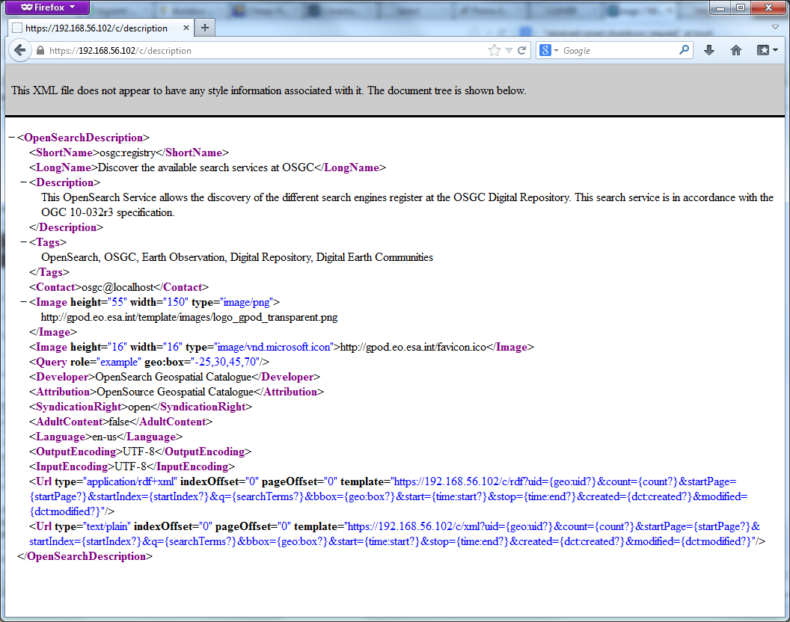
OpenSearch Catalogue

Slide 6
OpenSearch Catalogue
Advantages:
Open Source Standard (no lock-in, natively supported by most of the browsers)
Easy to integrate (RESTful APIs, with 3 methods: GET, PUT, DELETE)
Federate data access services (you can merge the results coming from multiple data access and dissemination services)
Support for multiple search results output formats (ex. RDF, KML, JSON, ATOM…)

Slide 7
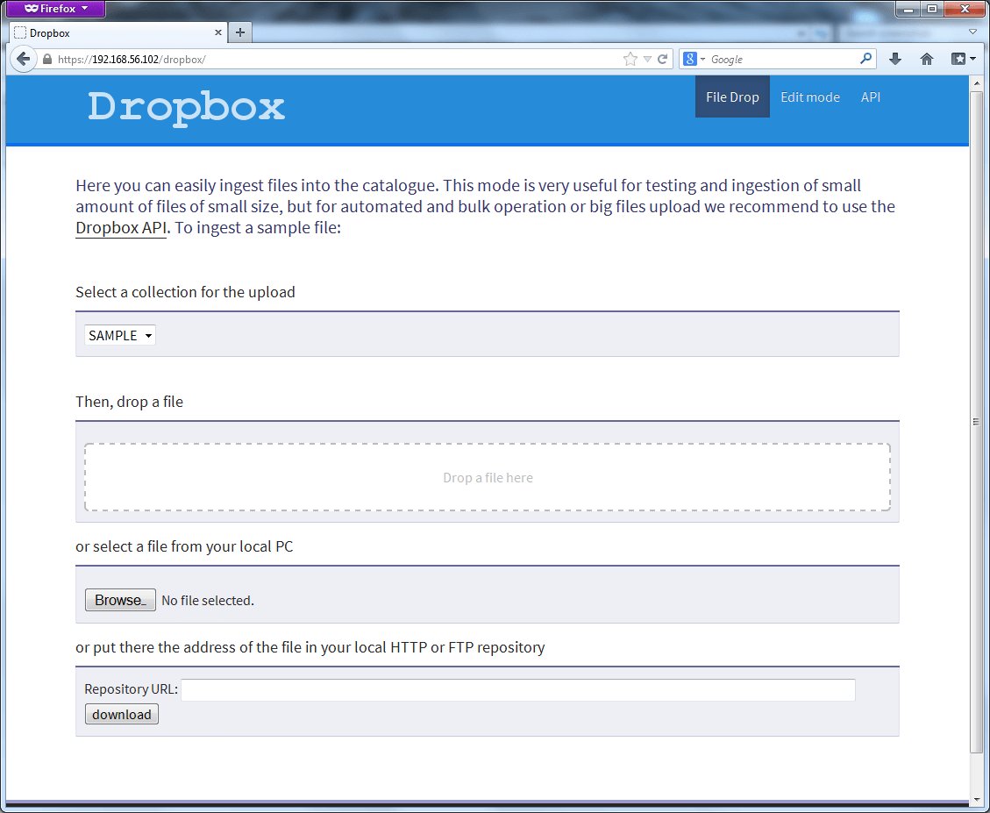
Dropbox

Slide 8
Dropbox
Advantages:
Simple catalogue ingestion (automatize metadata extraction)
Simple storage ingestion (automatize data storage)
Simple APIs (RESTful APIs: PUT for file upload, DELETE for file removal)

Slide 9
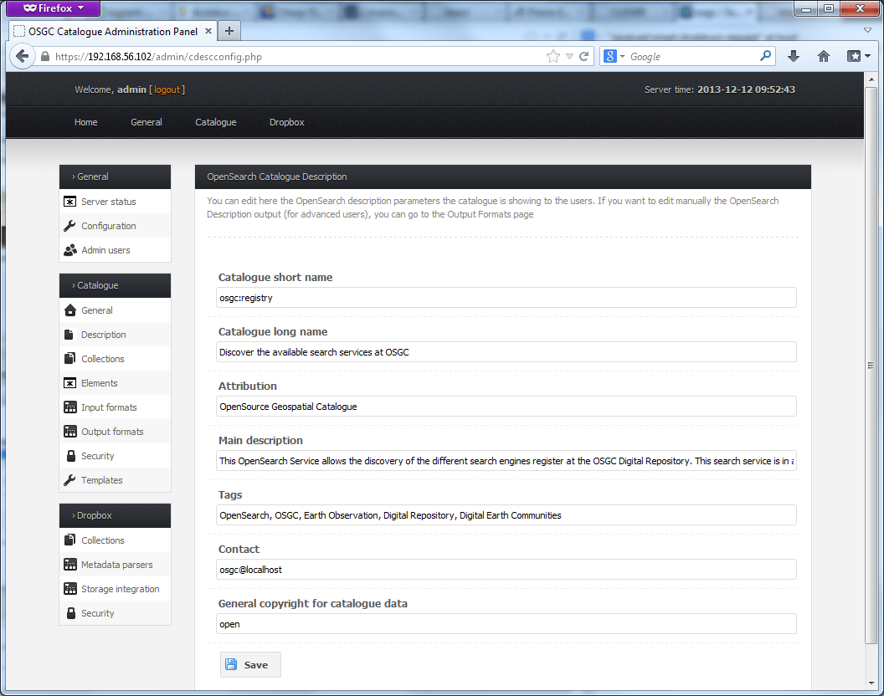
Admin Web Interface

Slide 10
Admin Web Interface
Advantages:
Fully customizable from the web, with the possibility to setup and customize:
Metadata parsers
OpenSearch query fields and rules
Search output formats
Input metadata formats
Integration with storage

Slide 11
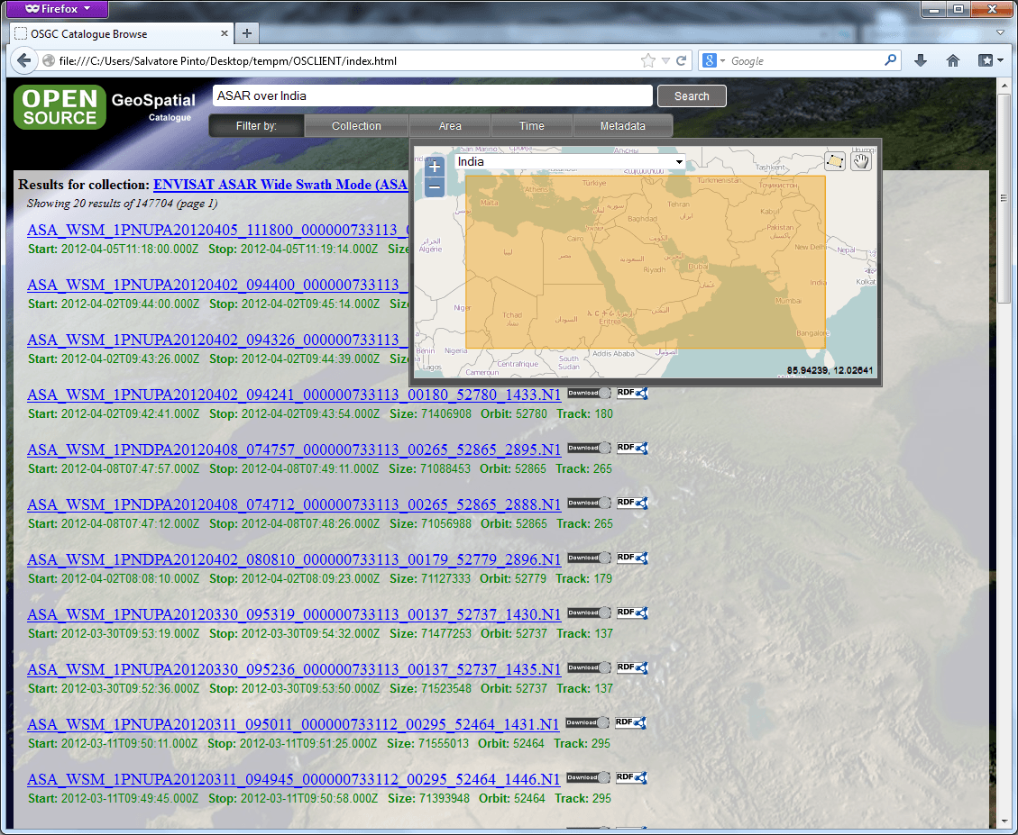
Web Client

Slide 12
Web Client
Advantages:
Easy to use (users needs just a browser to query the catalogue)
Customizable (you can customize query GUI and output metadata)
OpenSearch support (can query any catalogue, supposing that it exposes an OpenSearch interface)
Integration into virtual laboratories (can be integrated as standalone application to provide data access tools inside a virtual laboratory)

Slide 13
Outline
Concept
Technologies
Next steps

Slide 14
Metadata parser (1)
Agree on the metadata to be extracted, published and searched. Our proposal is:
Antenna and measurement info:
sml:azimuth (antenna azimuth)
sml:elevation (antenna elevation)
sml:type (antenna type, e.g. 32p ESR, etc…)
sml:power (combined output power)
sml:integration (measure integration time)
time:start (measurement start time)
time:stop (measurement stop time)
Search
← From % To
← From % To
← From % To
← From % To

Slide 15
Metadata parser (2)
Agree on the metadata to be extracted, published and searched. Our proposal is:
Generic info:
dc:dataset (experiment name, ex. IPY_42P)
dc:identifier (product naming convention, ex. ipy_fixed42p_1.0l_IPY20070301)
dc:aquisitionStation (data acquisition site, ex. Kiruna)
dc:processingStation (processing site, ex. same as acquisitionStation)
dc:processingDate (processing time)
dc:onlineResource (download link)
dc:size (product size)
dc:preview (product preview, ex. via GUISDAP)
Search
← Exact value
← Contains
← Exact value
Exact value
← From % To

Slide 16
Client Interface
Agree on the users client interface:
Layout
Metadata to display in the result
Products aggregation time (if any)

Slide 17
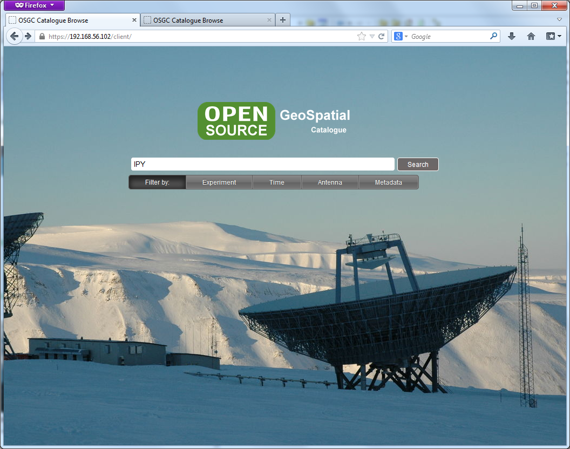
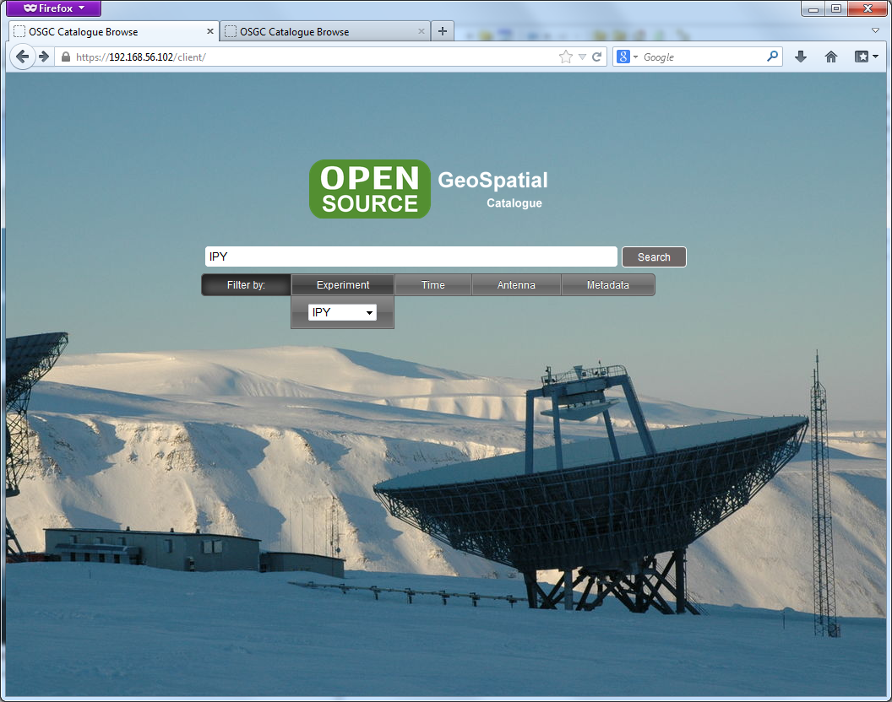
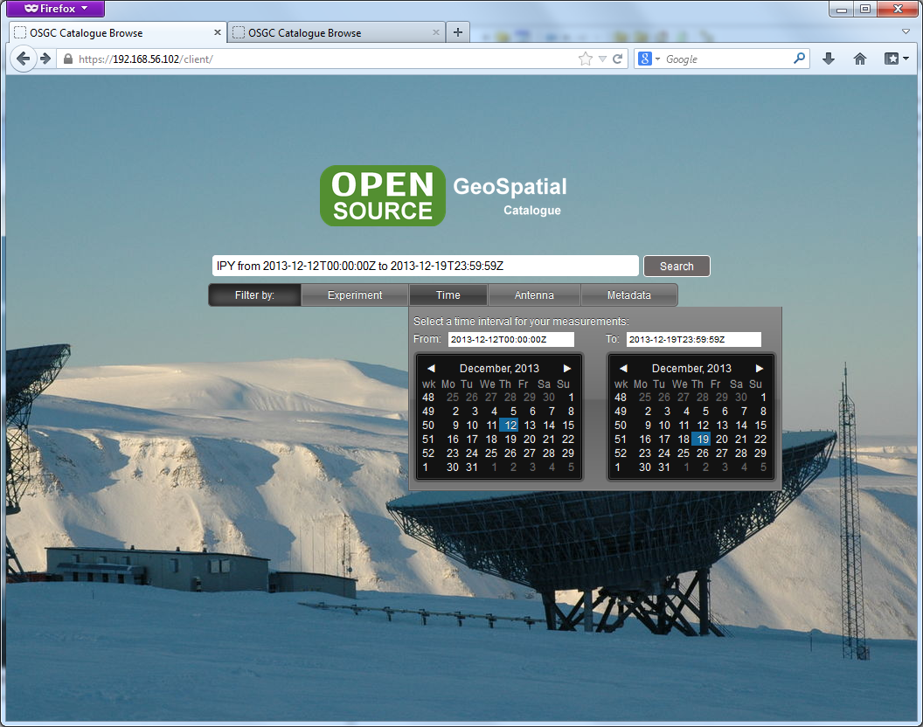
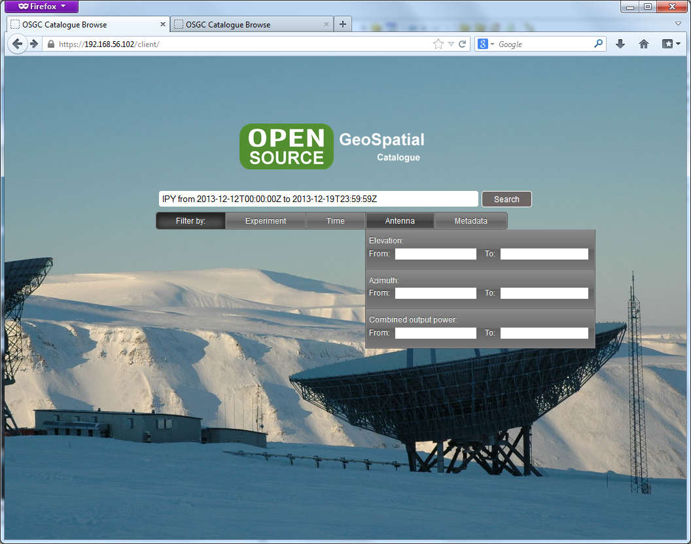
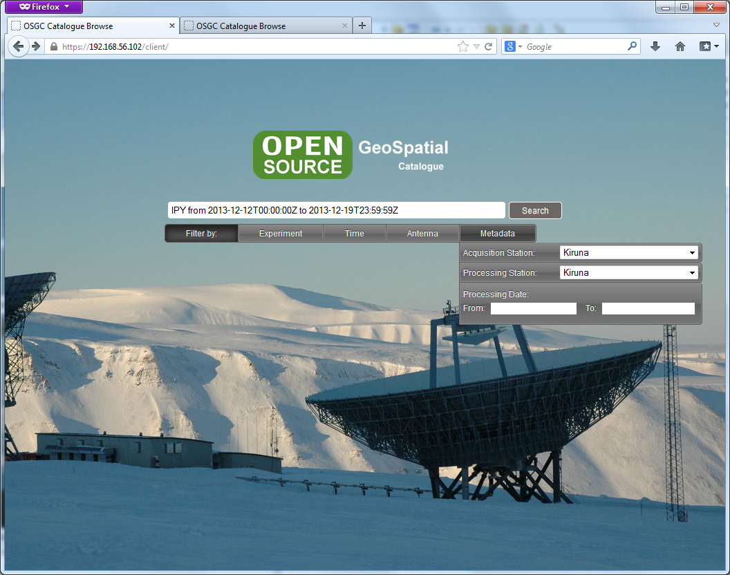
Client Interface (proposal)

Slide 18
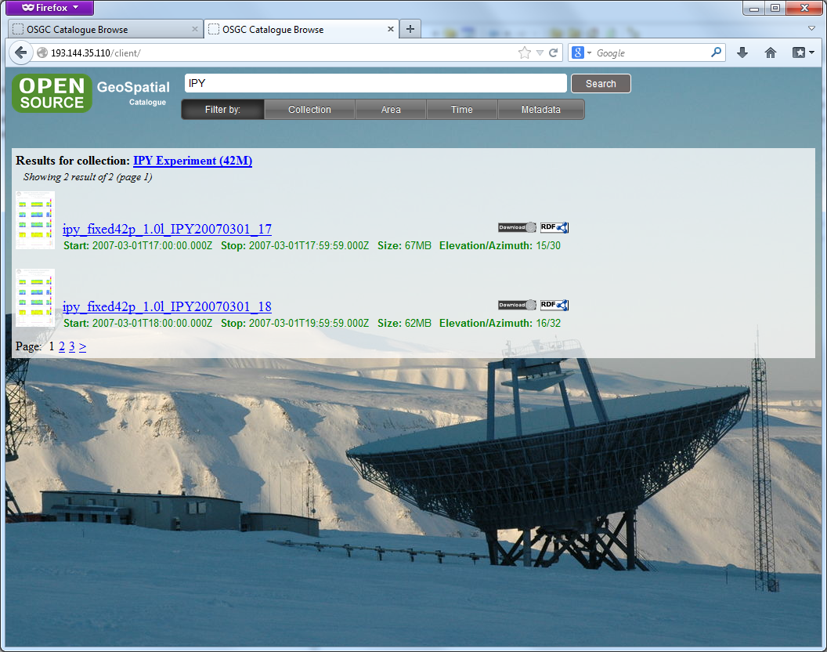
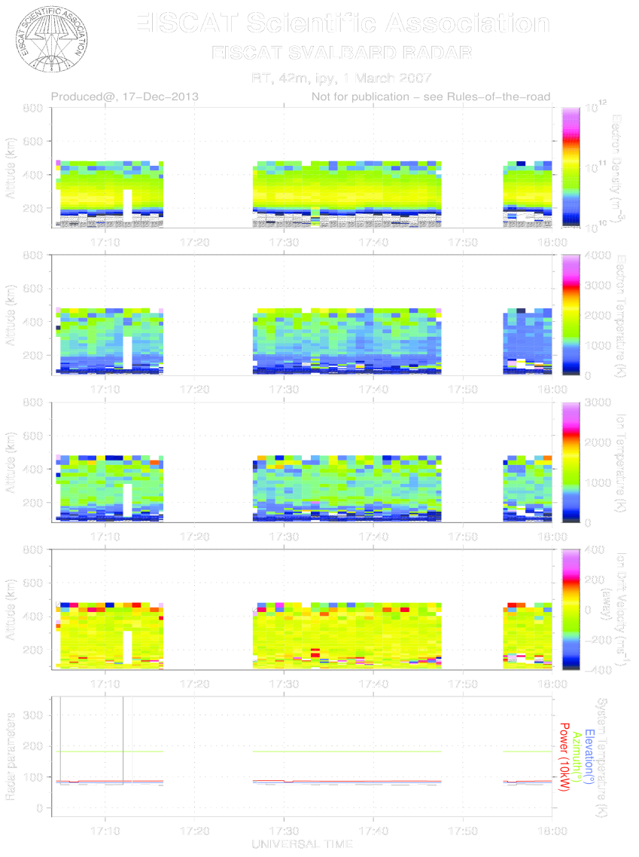
Client Interface (proposal)

Slide 19
Thank you

