Slide 1
Setting up a DIRAC pilot instance for EGI Gilles Mathieu
January 2014

Slide 2
What does "setting up a pilot service" means ?
Define/agree on practical details
Who hosts, who installs, who maintains
When do we do all that -> timeline and roadmap
Define the architecture
Needed services and constraints
Experience from already deployed instances
Refine/improve the environment
Monitoring, supervision, VO administration

Slide 3
Practical details
Who … ?
Hosts : CYFRONET
Installs and maintains : CYFRONET with the help of NGI France DIRAC team
When ?
Defining the architecture : this week
Deployment : by the end of January

Slide 4
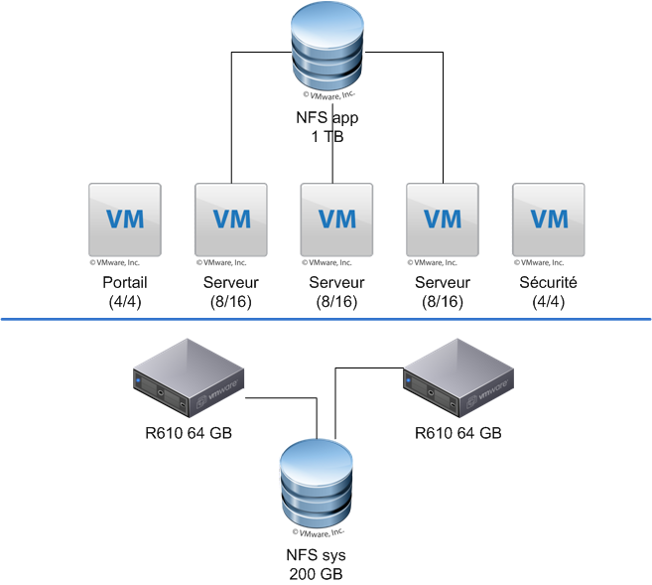
Architecture
Proposal : build an architecture similar to DIRAC French Instance
5 VMs running all services
NFS storage
MySQL DB

Slide 5
Installation/Deployment
Preparing the basics
Hardware, network, domain…
Build installation checklist
Putting all admins together
Quick DIRAC training ?
Step by step installation ?

Slide 6
Following steps : making the damn thing work
Internal monitoring of the services
Disk space & memory consumption, swap space
CPU load, I/O traffic
nb of open file descriptors/sockets
Certificates expiration and CA/CRLs renewals
Pinging crucial services
…
Start testing !

Slide 7
Other things to consider… later
Mirror/replicas
Will try to get this done in NGI France
Community specific services
Will be progressively introduced when pilot communities join
Operations setup

