Slide 1
A worldwide e-Infrastructure for NMR and structural biology
Alexandre M.J.J. Bonvin
Project coordinator
Bijvoet Center for Biomolecular Research
Faculty of Science, Utrecht University
the Netherlands
a.m.j.j.bonvin@uu.nl

Slide 2
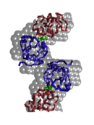
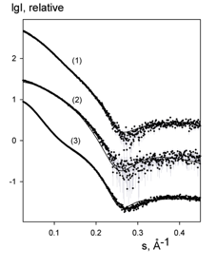
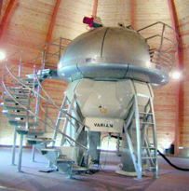
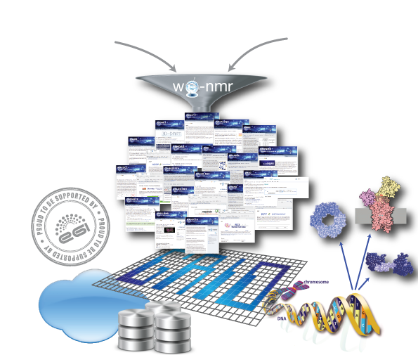
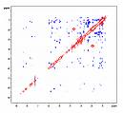
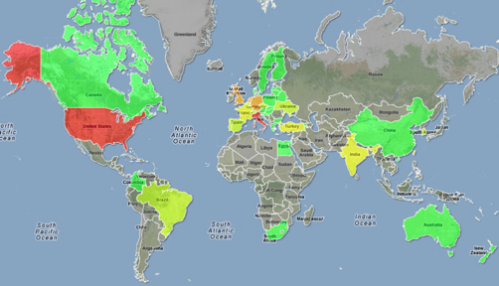
NMR SAXS
A worldwide
e-Infrastructure for NMR and structural biology
WeNMR VRC (Nov. 2013)
One of the largest (#users) VO in life sciences
> 575 VO registered users (36% outside EU)
> 900 VRC members
~ 82 000 CPU cores
> 2M SI2K CPU years
> 5M jobs User-friendly access to Grid via web portals
www.wenmr.eu

Slide 3
The WeNMR Virtual Research Community
Consultancy
Third-party aggregation
Tutorials
Wiki docs
Movies
Knowledge
Grid
Services
VRC
Help Centers
SSO
Marketplace
Portals
Blogs, news,
events…
(often picked up
from eScienceTalk/GridCast)
Exposure
Facebook,
Linkedin
www.wenmr.eu
Users
Notes:
Marketplace: community specific non-intrusive advertisement
The marketplace allows the members of the worldwide NMR community to list, advertise and search information about Events, Jobs, Products, Services and Training
Disperse and aggregates news; blogs, events.. Often picked up by eScience Talk and GridCast

Slide 4
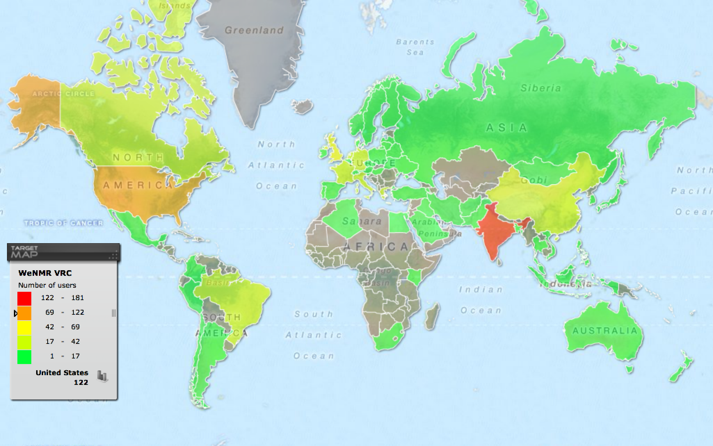
User community
Over 1000 VRC and 595 VO members (36% outside Europe)!

Slide 5
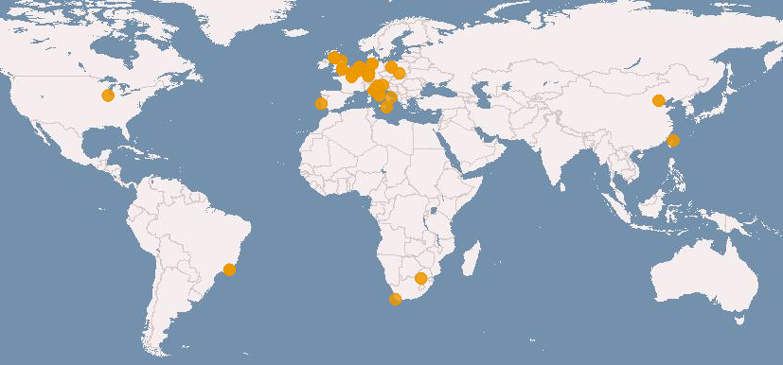
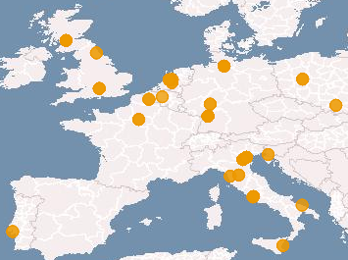
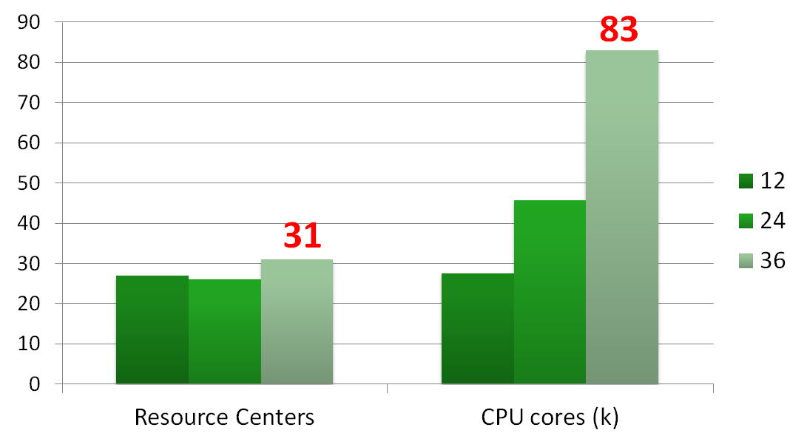
Distribution of resources
Modest variability of the number of centers supporting WeNMR
throughout the project, although some rotation did take place
(4-5 sites per year)
Significant increase of the
number of CPU cores available
(as well as of storage capability,
not shown)
Computational power
is not an issue ☺

Slide 6
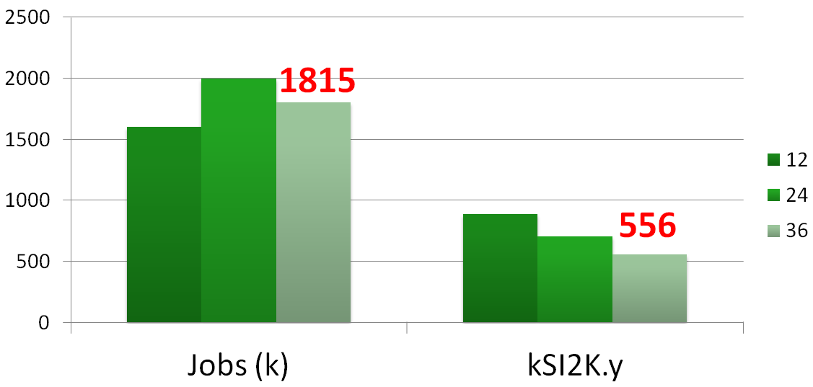
Usage of resources
Modest variability of the number of jobs run per year
(on average 1.8 millions ± 10%)
17% of jobs (and 11% of CPU time) served by the dedicated resource Providers at the NMR labs
Decreasing CPU time usage -> users are selecting the less CPU intensive applications

Slide 7
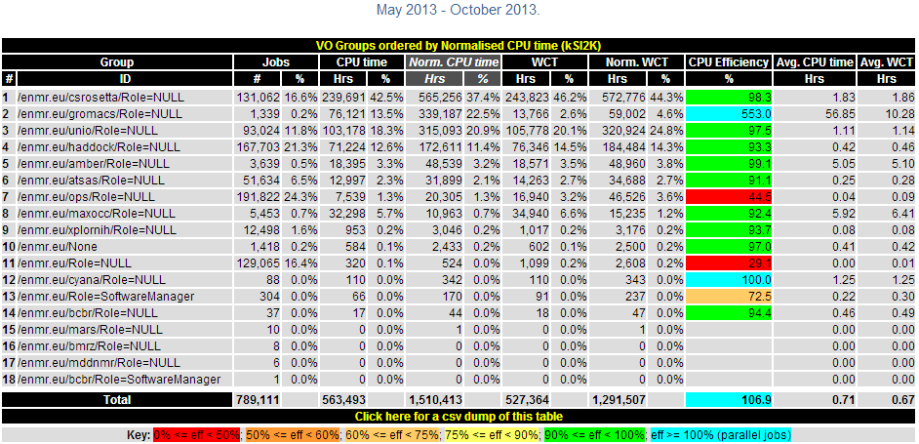
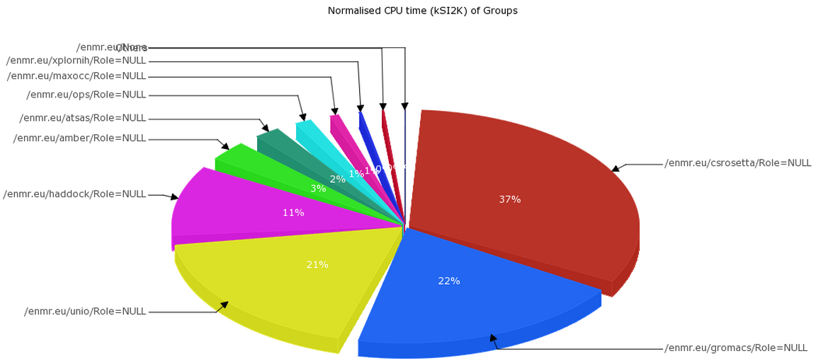
Application accounting
Exploiting the granularity available in the VOMS service:
a VOMS group defined for each application
e.g.: voms-proxy-init –voms enmr.eu:/enmr.eu/haddock
the user proxy (usually a robot cert) carries the VOMS group info
Notes:
The usage records collected and stored by the grid accounting services have the VOMS group information and allow the aggregate usage of each application to be measured and shown through the accounting visualization tools

Slide 8
Possible use case for DIRAC

Slide 9
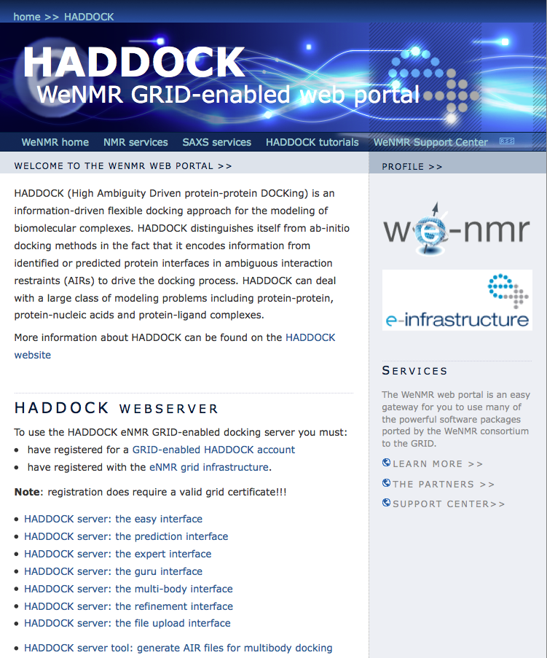
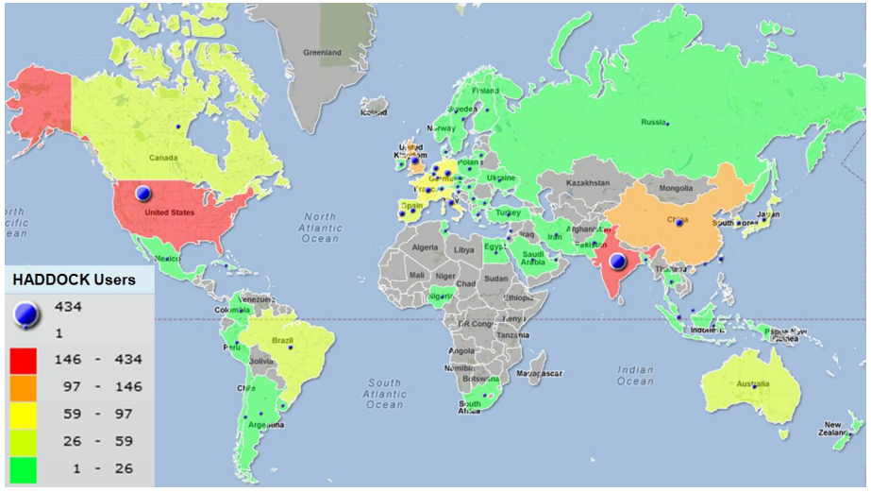
Haddock web portal
> 3500 registered users
>190 with grid access)
> 59500 served runs since June 2008
~ 12% on the GRID
Visit haddock.science.uu.nl
De Vries et al. Nature Prot. 2010

Slide 10
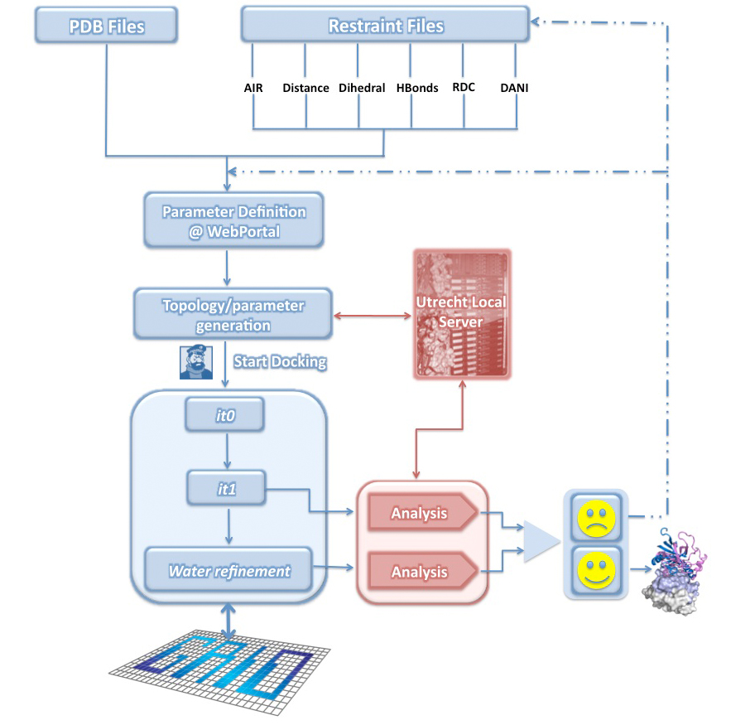
What is happening behind the scene?
Notes:
Behind the scenes

Slide 11
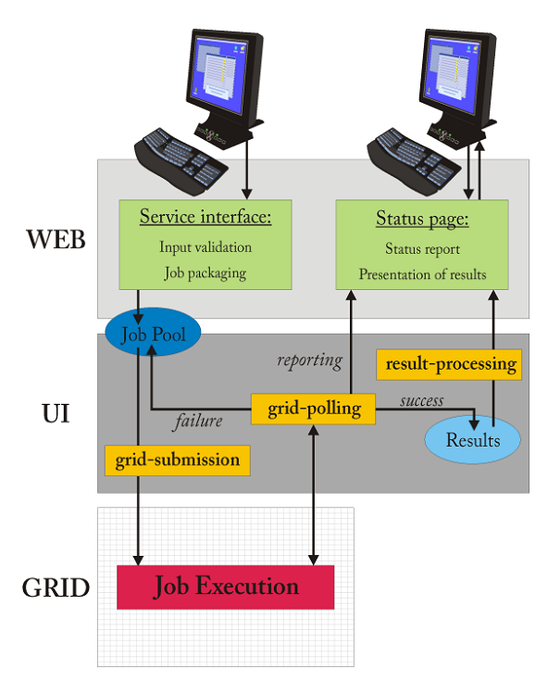
Grid daemons beyond a portal
Data transfer / jobs
User level – data transfer via web interface:
Data input: ~10 kB to 10 MB
Data output: ~10MB to a few GB
Local cluster– data/jobs transfer:
Job submission: ~10 to 50 single jobs
Data: a few GB
Grid level – data/jobs transfer
(UI<->WMS<->CE<->WN):
Job submission: ~250 to 2500 single jobs
Data transfer: ~1 to 10MB
Output: ~1-20MB per job
Some portals make use of storage elements for the data
Notes:
11
11

Slide 12
HADDOCK Grid submission
Each job in the pool directory consists of:
Shell script to be executed on WN
#!/bin/bash
echo "HOSTNAME" `hostname`
HOMED=`pwd`
if [ -z $VO_ENMR_EU_SW_DIR ]; then
export VO_ENMR_EU_SW_DIR=/cvmfs/oasis.opensciencegrid.org/enmr
echo OSG
else
echo EGI
fi
tar xvfz gridjob-0001839950-9153.tar.gz
source $VO_ENMR_EU_SW_DIR/BCBR/cns/1.2/set_cns.bash
for i in protocols/cns*; do rm -f $i; ln -s `which cns` $i; done
for i in *.csh; do csh $i; done
sleep 10
tar cvzf gridjob-0001839950-9153-result.tar.gz *.out.gz structures/it1
Notes:
12
12

Slide 13
HADDOCK Grid submission
Each job in the pool directory consists of:
Shell script to be executed on WN
Compressed tar archive containing the data/directory structure for the job
File specifying the location where results should be copied
JDL script with requirements/ranks for selecting suitable sites, e.g.:
Requirements = (Member("OSG_VERSION",other.GlueHostApplicationSoftwareRunTimeEnvironment) ||
(other.GlueCEPolicyMaxCPUTime < 720 && other.GlueCEPolicyMaxCPUTime > 110 &&
Member("VO-enmr.eu-CNS1.2",other.GlueHostApplicationSoftwareRunTimeEnvironment)) );
Rank = ( other.GlueCEStateFreeJobSlots > 0 ? other.GlueCEStateFreeJobSlots :
(-other.GlueCEStateWaitingJobs * 4 / ( other.GlueCEStateRunningJobs + 1 )) - 1 );
Software is remotely deployed and CE tagged with a software tag:
For HADDOCK: VO-enmr.eu-CNS1.2
Submission via robot proxie – fully automated – no user/operator intervention.
Notes:
13
13

Slide 14
Requirements
DIRAC submission and retrieval of results should allow for full automation at the script level
No changes in the way the jobs are being run (e.g. achieved now for Desktop grid) – i.e. input data/scripts should remain the same irrespective of the architecture (direct submission to EGI/OSG/Desktop Grid/DIRAC
No user intervention (the user only sees web portals)
Ideally still using the enmr.eu VO credentials (accounting)
Software pre-installed on CEs
Notes:
14
14

Slide 15
wordle.net

