Slide 1
iMarine: Accessing and Managing Biodiversity Data
Pasquale Pagano (CNR)
iMarine Technical Director
pasquale.pagano@isti.cnr.it

Slide 2
Concepts
The initiative
(the visionary leadership)
The e-infrastructure
(the operational platform)
The system
(the enabling sw system)
Notes:
“Visionary leaders articulate where a group is going, but not how it will get there – setting people free to innovate, experiment, take calculated risks,” - Wall Street Journal stories

Slide 3
e-Infrastructure
Geographically Distributed Computing Infrastructure
Across administrative boundaries
Across private and commercial providers
Service Allocations, Deployment, Monitoring, and Operation
Uniform resource and data access
Notes:
D4Science infrastructure: set of Generic and Domain/Goal Specific Services and Technologies configured to satisfy also a number of non-functional requirements for being scalable, fault-tolerant, secure, redundant, ….

Slide 4
Infrastructure: key characteristics
Efficient and tailored storage technologies
Computational environments dealing with the volume of the data
Elastic management of the resources, monitoring, alerting, recovery
Collaborative environment to support scientific communities
Rich portfolio of applications to perform access, validation, enriching, processing, sharing, and mash-up of data

Slide 5
Infrastructure: Management as Service
Operation
Machine readable SLAs
Machine readable monitoring, auditing, billing, reporting, and notification
Machine readable resource/performance capabilities description
Trust
Privacy, governance, and attribution
Security, trusted network

Slide 6
Infrastructure: Storage as Service
Virtual Workspace
Secure
Relational Databases
Open source RDBMS
Large and Active data storage
Scalability and high availability
Spatial Database
ISO 19115/10139 Metadata
Fault-tolerant
Replication
Across sites
Catalogue
Up to 1 TB data
TB Currently Used

Slide 7
Data Bonanza
iMarine
OBIS
WoRMS
WoRDS
GBIF
CoL
ITIS
IRMNG
NCBI
MyOcean
EuroStat
Data.FAO
…
WOA
iMarine Registries
Validation
Enriching
Processing
Sharing
Standards
Policies
Private Cloud
Commercial Cloud
Guidelines
Procedures
Notes:
Use of all resources is regulated by policies, enforced by procedures, documented via guidelines and implemented exploiting standards.

Slide 8
Infrastructure: Computing as Service
Hadoop
MapReduce
Statistical Manager
Analysis/clustering/modeling
R clusters
Windows and Linux
330 Cores Currently Allocated

Slide 9
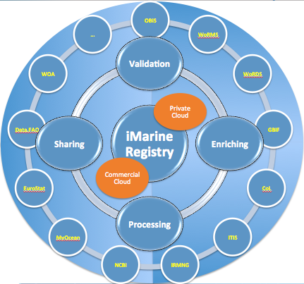
Is this enough?
An ecosystem of participatory data e-Infrastructures
Regulated by policies
Enabled by standards
Promoting not only access but mash-up of heterogeneous data
User centric

Slide 10
Virtual Research Environment
iMarine is user-centric and workflow-oriented thanks to the gCube VRE technology
Virtual Research Environment (VRE) is
a distributed and dynamically created environment
where subset of data, services, computational, and storage resources
regulated by tailored policies
are assigned to a subset of users via interfaces
for a limited timeframe
at little or no cost for the providers of the participatory data e-infrastructures
L. Candela, D. Castelli, P. Pagano (2013) Virtual Research Environments: An Overview and a Research Agenda. Data Science Journal, Vol. 12

Slide 11
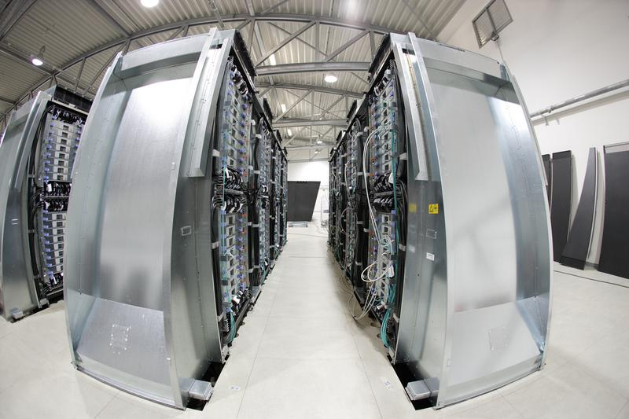
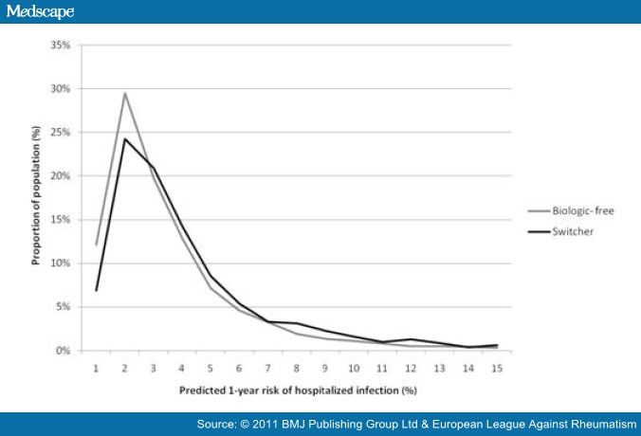
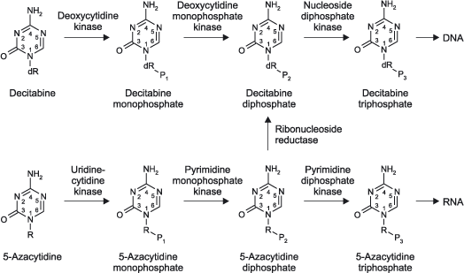
Statistical Manager
Statistical Manager is a set of web services that aim to:
Help scientists in performing biological or climate analyses
Supply precooked state-of-the-art algorithms as-a-Service
Perform calculations by using Cloud Computing approaches in a transparent way to the users
Share input, results, parameters and comments with colleagues by means of Virtual Research Environment in the D4Science e-Infrastructure
Setup and execution
Statistical
Manager
D4Science
Computational
Facilities
Sharing

Slide 12
Architecture

Slide 13
Internal Work

Slide 14
Statistical Manager in D4Science
The Statistical Manager distributed computations may run on the D4Science Infrastructure:
D4Science WNs are VMs equipped with the gCube Container running the gCube Executor Web Service
Executables and Input are remote downloaded (MongoDB and Postgresql)
Tasks queue is implemented trough Messaging (ActiveMQ)

Slide 15
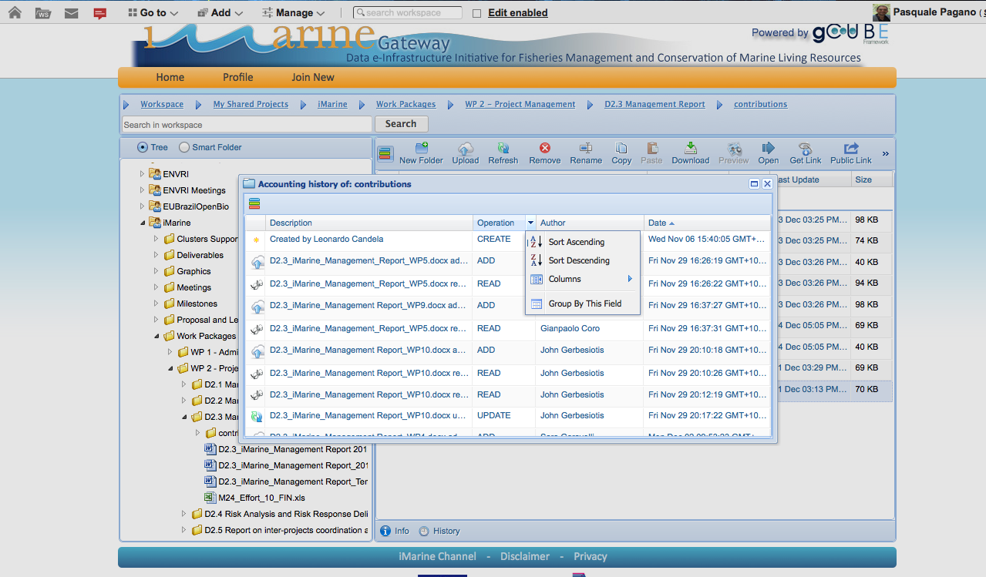
Statistical Manager & DIRAC
The Statistical Manager exploits the assigned D4Science WNs and additional nodes can be added by site managers at any time by using a management control UI.
VRE1
D4Science
WN
WN
WN
assign
WN
WN
WN
WN
WN
WN
WN
WN
VRE2

Slide 16
Statistical Manager & DIRAC
Requirements
Handling of credentials without X509 certificates ( username/password )
Integration of Accounting and Monitoring
Integration steps
Creation of a D4Science WN VM and upload to a VM Repository to test image contextualization
Integration of VM Scheduler API within D4Science Infrastructure.

Slide 17
Landscape
D4Science e-Infrastructure
gCube Framework
gCube Apps
Discussion
www.i-marine.eu
i-marine.d4science.org

Slide 18
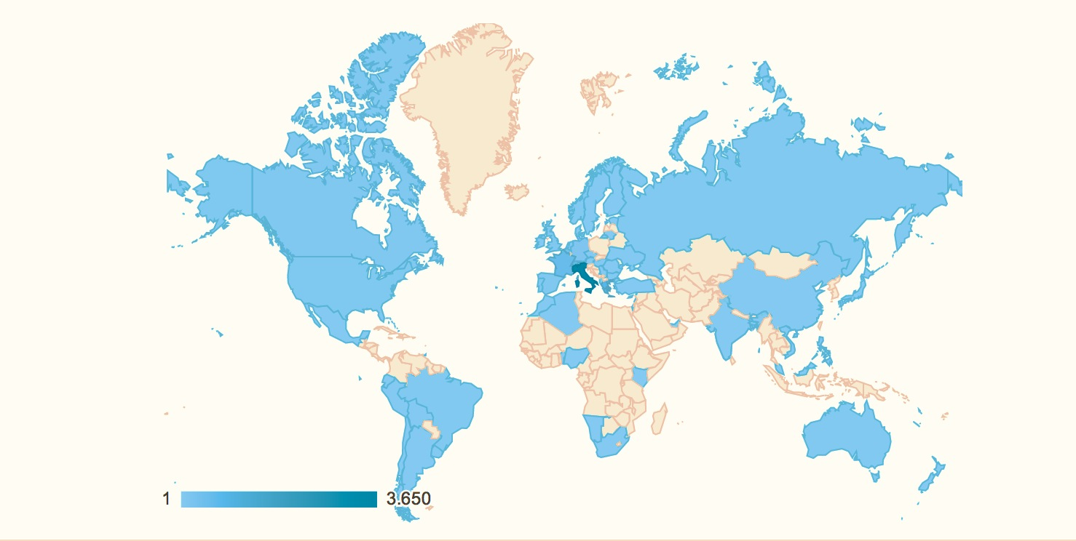
Google Analytics iMarine portal

Slide 19
Application Bundles
Management and interpretation of biological and ecological data in the environment
Complete full life-cycle data framework, from observational data to aggregated data repositories enriched with validation and analytical tools
Storage and interpretation of geospatial explicit information, including WPS processing
Flexible sharing, storage, reporting, search and retrieval, aggregation and projection facilities
A BUNDLE is a set of services and technologies grouped according to a family of related tasks for achieving a common objective
Notes:
These bundles also aids communicating and disseminating the iMarine outcomes.

Slide 20
BiolCube related publications
W. Appeltans, P. Pissierssens, G. Coro, A. Italiano, P. Pagano, A. Ellenbroek, T. Webb (2013). Trendylyzer: a Long-Term Trend Analysis on Biogeographic Data, In Proceedings of the International Conference on Marine Data and Information Systems (IMDIS). Lucca, Italy.
L. Candela, D. Castelli, G. Coro,P. Pagano, F. Sinibaldi (2013) Species Distribution Modeling in the Cloud, Concurrency and Computation: Practice and Experience, Ed. Wiley (DOI: 10.1002/cpe.3030).
D. Castelli, P. Pagano, G. Coro, F. Sinibaldi (2013) Modellazione della Nicchia Ecologica di Specie Marine (Marine Species Ecological Niche Modelling). In Le Tecnologie del CNR per il Mare (CNR Marine Technologies) pp. 140, Ed. CNR (Roma, Italy).
D. Castelli, P. Pagano, L. Candela, G. Coro (2013). The iMarine Data Bonanza: Improving Data Discovery and Management through an Hybrid Data Infrastructure, In Proceedings of the International Conference on Marine Data and Information Systems (IMDIS), Lucca.
G. Coro, P. Pagano, A. Ellenbroek (2013) Combining Simulated Expert Knowledge with Neural Networks to Produce Ecological Niche Models for Latimeria chalumnae, Ecological Modelling, DOI 10.1016/j.ecolmodel.2013.08.005, Ed. Elsevier.
(Acknowledged in) R. Froese, J. Thorson, R. B. Reyes Jr. (2013) A Bayesian Approach to the estimation of length-weight relationships in fishes. Journal of Applied Ichthyology
P. Pagano, G. Coro, D. Castelli, L. Candela, F. Sinibaldi, A. Manzi (2013) Cloud Computing for Ecological Modeling in the D4Science Infrastructure. Proceedings of EGI Community Forum.

Slide 21
Links and References (1/3)
GeosCube Selected Links
http://wiki.i-marine.eu/index.php/Catalogue:Applications#GeosCube
Geospatial Cluster work plan for iMArine Board http://wiki.i-marine.eu/index.php/Geospatial_cluster
Geospatial Data Processing http://gcube.wiki.gcube-system.org/gcube/index.php/Geospatial_Data_Processing
OGC/ISO publishing guidelines
http://wiki.i-marine.eu/index.php/OGC/ISO_Publishing_guidelines_for_Data_and_Services_Providers
OGC OWS Context 1.0 Guidelines http://wiki.i-marine.eu/index.php/OGC_OWS_Context_1.0_Guidelines
Environmental Service https://gcube.wiki.gcube-system.org/gcube/index.php/Environmental_Service

Slide 22
Links and References (2/3)
GeosCube Selected standardization work
P.Gonçalves, R.Brackin, Open Geospatial Consortium, OWS Context 1.0 Conceptual Model, Candidate Standard, 30th June 2013:
https://portal.opengeospatial.org/files/?artifact_id=51860&version=1 (OGC 12-080r1)
P.Gonçalves, R.Brackin, Open Geospatial Consortium, OWS Context 1.0, Atom Encoding Specification, Candidate Standard, 3rd June 2013:
https://portal.opengeospatial.org/files/?artifact_id=51860&version=1 (OGC 12-084r1)

Slide 23
Links and References (3/3)
GeosCube Selected Publications
D. Castelli, P. Pagano, G. Coro. 2013. Variazioni Climatiche ed Effetto sulle Specie Marine (Climate Changes and Effect on Marine Species)”. In Le Tecnologie del CNR per il Mare (CNR Marine Technologies) pp. 139, Ed. CNR (Roma, Italy).
D. Castelli, P. Pagano, G. Coro. 2013. Elaborazione di Dati Trasmessi da Pescherecci (Processing of fishing vessel transmitted information). In Le Tecnologie del CNR per il Mare (CNR Marine Technologies). pp. 133, Ed. CNR (Roma, Italy).
G. Coro, L. Fortunati, P. Pagano. 2013. Deriving Fishing Monthly Effort and Caught Species from Vessel Trajectories. To be published in Oceans 2013, Proceedings of MTS/IEEE.

