Slide 1
DP Knowhow: Open Archival Information Systems (OAIS) in ISO 14721
David Giaretta APA
APA/C-DAC International Conference on Digital Preservation and the Development of Trusted Digital Repositories
5-64 February 2014
New Delhi, India
This work is made available under the terms of the Creative Commons Attribution-ShareAlike 3.0 license, http://creativecommons.org/licenses/by-sa/3.0/.

Slide 2
Digital Preservation…
Easy to do…
…as long as you can provide money forever
Easy to test claims about repositories…
…as long as you live a long time
Notes:
I hope the intention is obvious.
The idea is to introduce a little humour into the presentation – by setting up ideas to then knock down.

Slide 3
Problems when preserving data
Preserve?
Preserve what?
For how long?
How to test?
Which people?
Which organisations?
How well?
Metadata?
– What kind? How much?

Slide 4
Difficulties in digital preservation
}
Many different terminologies
Many different views of preservation
Many different kinds of digital objects
Documents
Data
…… and new types of objects
Tools and Services
Which ones work for which digital objects?
Which tools/techniques fit together?
How to integrate new tools
Consistent training needed
Risks vs Cost
Who can you trust?
OAIS – ISO 14721
Need a consistent, coherent approach to digital preservation
- APARSEN.
Need an Audit and Certification system – ISO 16363

Slide 5
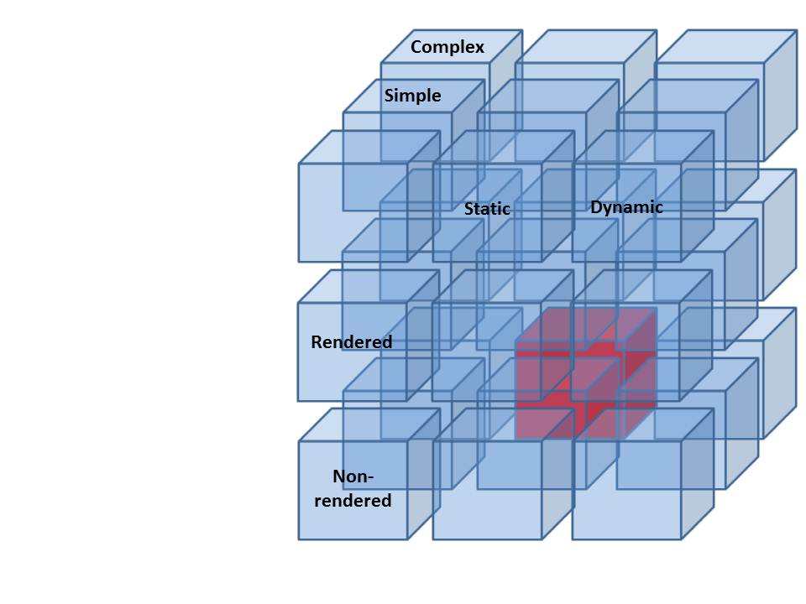
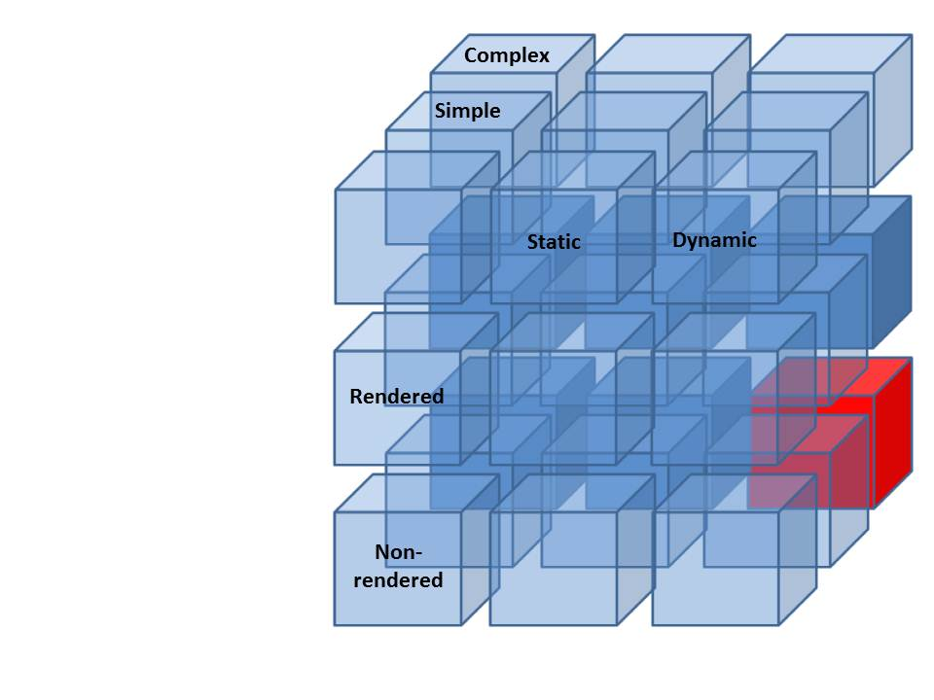
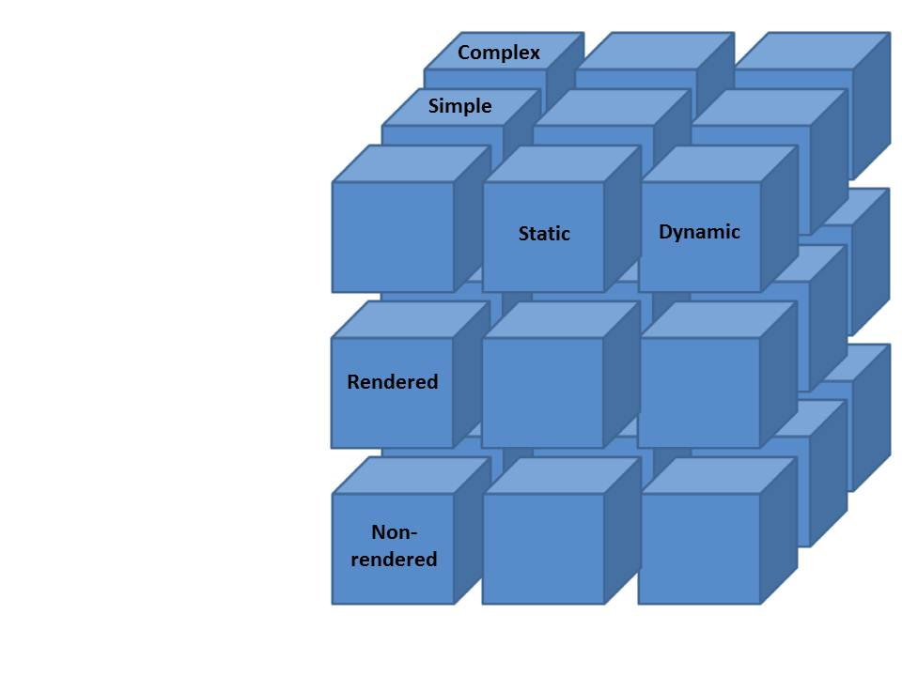
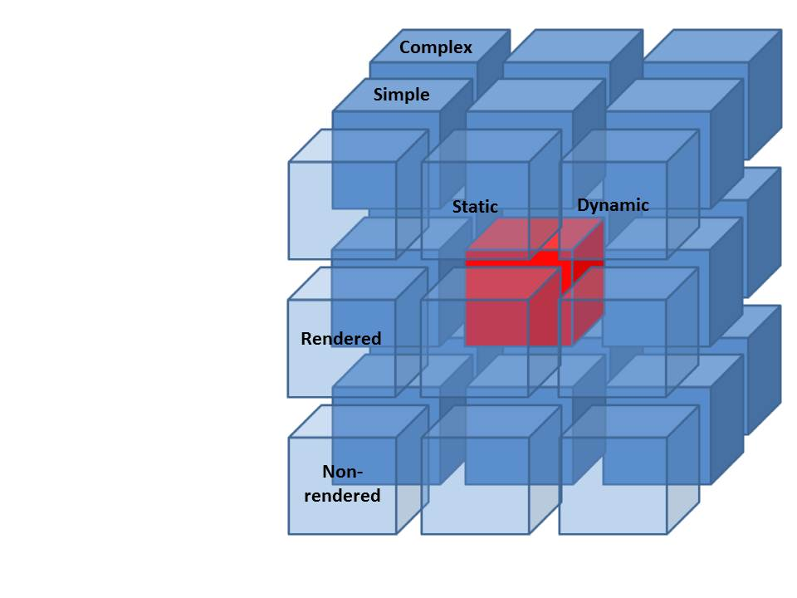
Preservation techniques
For each technique
look for evidence – what evidence?
must at least make sure we consider different types of data
rendered vs non-rendered
composite vs simple
dynamic vs static
active vs passive
must look at all types of threats
Notes:
Image, document
Rendered/ Static/ Simple
Dynamic database with stored procedures
Non-rendered/ Dynamic/ Complex
Scientific dataset
Non-rendered/ Static/ Complex

Slide 6
Basic preservation activities
Can repeat what has been done before
BUT
Cannot use new applications
Libraries say:
“Emulate or migrate”
Works well with data only in special cases
Can repeat what was done before instead of new things
Does not help with building cross-disciplinary communities
Convert to format which new software can use
BUT
What if there are many software systems?
Notes:
Data is migrated – big job but is done sometimes.
Emulation is sometimes used but mainly for repeating processing for some specific reason. More generally users do not want to simply repeat what has been done before.

Slide 7
Contains numbers – need meaning

Slide 8
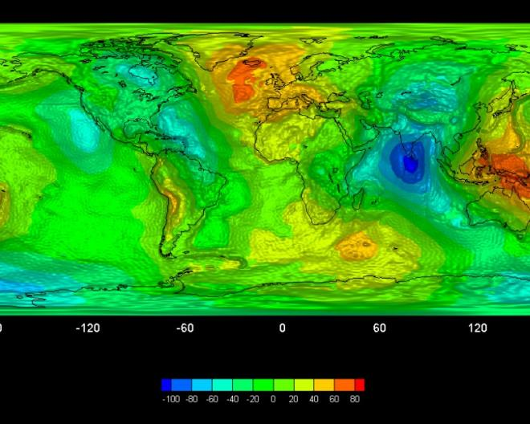
...to be combined and processed to get this
Processing/combining
Processing
Level 0
Level 1
Level 2

Slide 9
...or this

Slide 10
Additional technique: add Representation Information
Descriptions of the digitally encoded object
Ideal description allows a machine to extract information

Slide 11
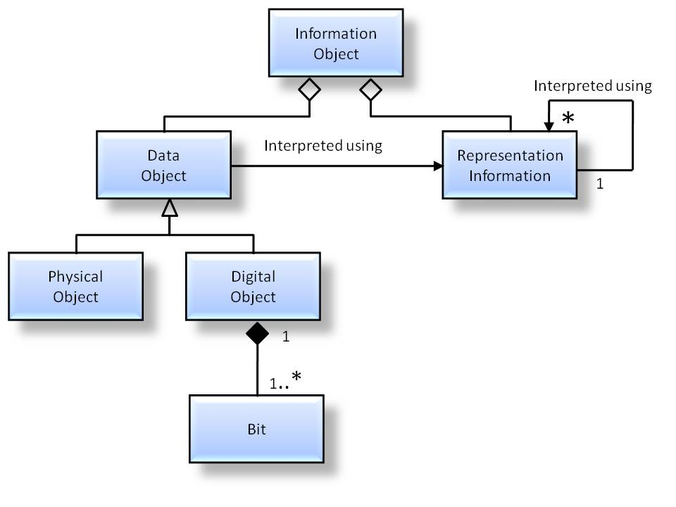
OAIS Information model: Representation Information
The Information Model is key
Recursion ends at KNOWLEDGEBASE of the DESIGNATED COMMUNITY
(this knowledge will change over time and region)
Does not demand that ALL Representation Information be collected at once.
A process which can be tested
Notes:
Just to be clear – I am focussing on the OAIS Information Model

Slide 12
Rep Info Network
FITS FILE
FITS STANDARD
FITS DICTIONARY
DICTIONARY SPECIFICATION
FITS JAVA SOFTWARE
PDF STANDARD
XML SPECIFICATION
PDF SOFTWARE
JAVA VM
UNICODE SPECIFICATION

Slide 13
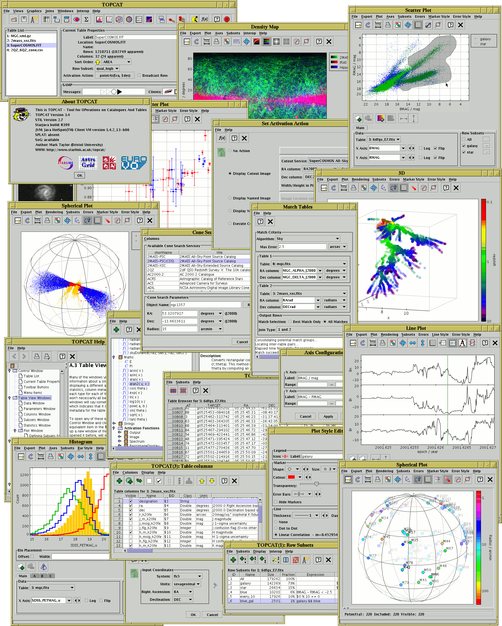
Building on simple virtualisation of tabular data

Slide 14
AND – be prepared to Hand-over
Preservation requires funding
Funding for a dataset (or a repository) may stop
Need to be ready to hand over everything needed for preservation
OAIS (ISO 14721) defines “Archival Information Package (AIP).
Issues:
Storage naming conventions
Representation Information
Provenance
….

Slide 15
END

