Slide 1
Exemplar Introduction to
APA Meta-Data Packing Toolkit in ESA LTDP Domain
Matthias Hemmje – FTK APARSEN-EGI Community Workshop “Managing, computing and preserving big data for research”, Amsterdam , 04.03.2014

Slide 2


Successful Reference Innovation:
DP Infrastructure for Earth Observation Data

Slide 3
















Proof-of Concept Outreach and successful
Pilot Take-Up by SCIDIP-ES Innovation Partners
Notes:
Earth observation repositories
Earth Science repositories
Software house specialized in ES preservation systems (acs, cap, gim)
R&D in preservation Systems (APA, ENG, Forth, ICT, FTK)
University skilled in standards and preservation systems (UTV and JUB)

Slide 4

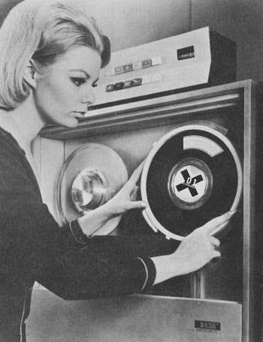

Pilot Scientific Data Domain:
SCIP-ES Stakeholders, i.e., Prospective Users
Data Managers
Scientists & Data Users
Other projects

Slide 5
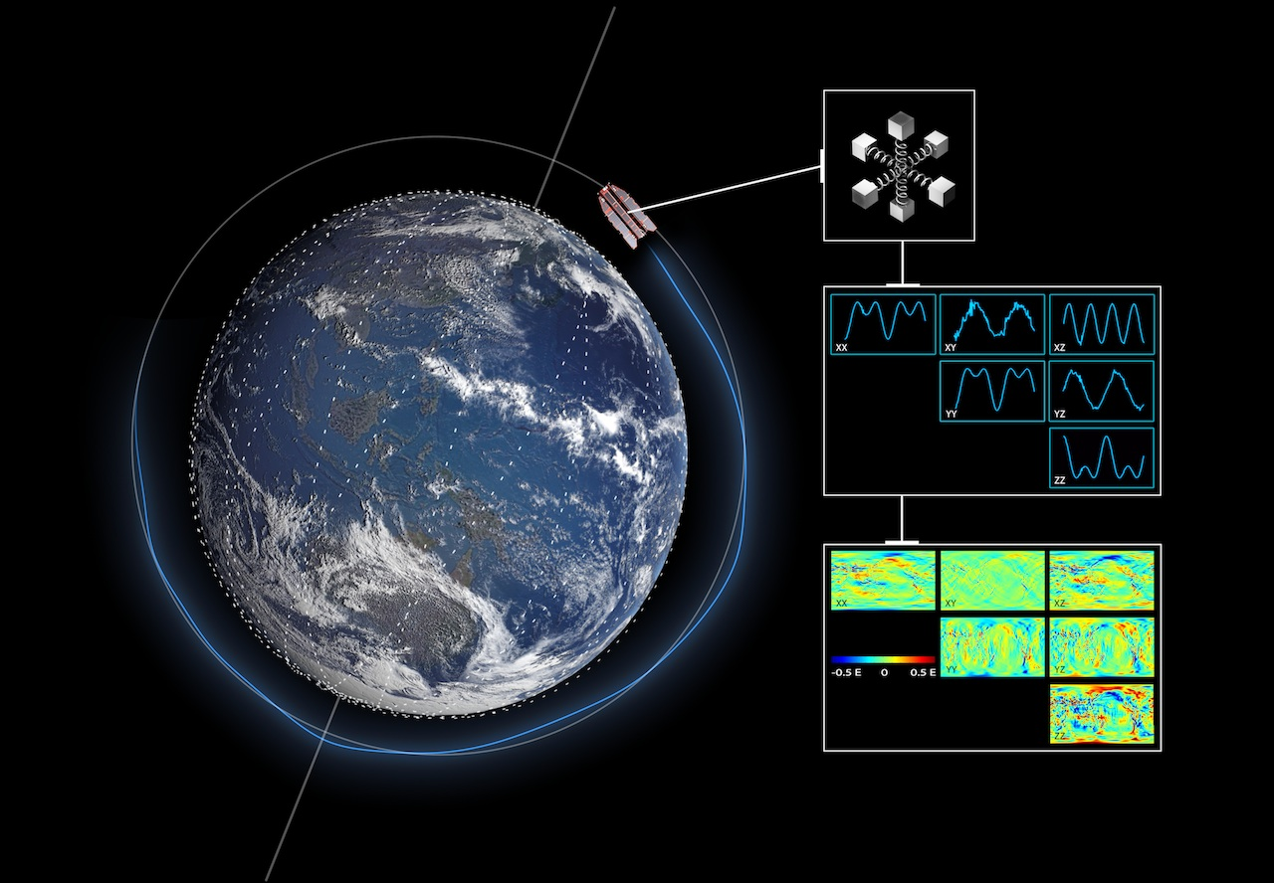

Pilot Scientific Data Domain:
Satelite Data Lifecycle - Acquisition of Data
Level 0
001 | 4100
002 | 4102
003 | 4102
004 | 6144
005 | 6150
006 | 7168
007 | 6146

Slide 6
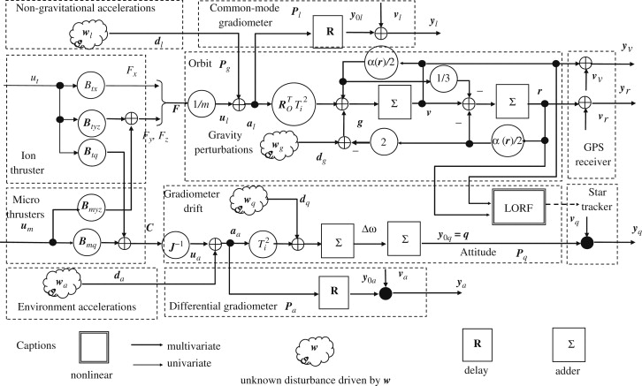
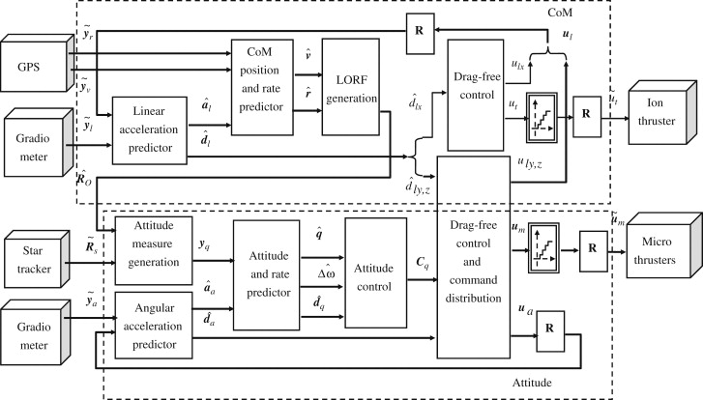
Pilot Scientific Data Domain:
Data Lifecycle - Processing of Data
Algorithm
Manual

Slide 7
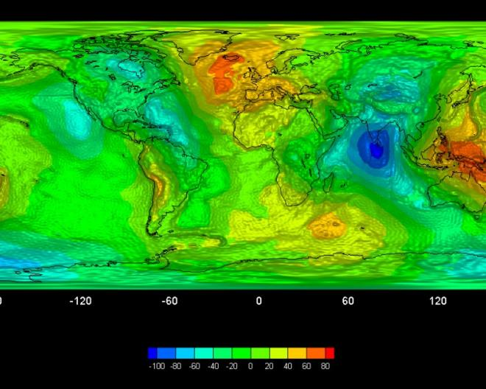
Pilot Scientific Data Domain:
Data Lifecycle - Combination of Data
Processing/combining
Processing
Level 0
Level 1
Level 2

Slide 8
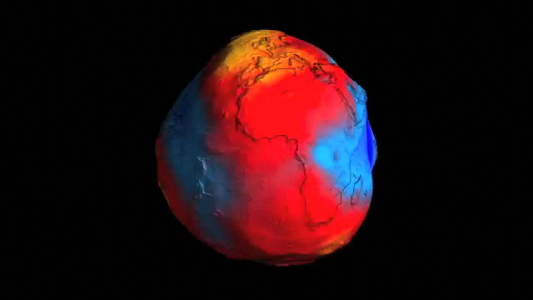
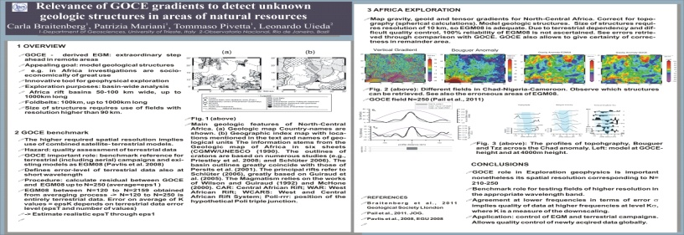
Pilot Scientific Data Domain:
Data Lifecycle - Reuse of Data
Publications

Slide 9
Piloting Specific Use Case Demand:
Knowledge Preservation for Satelite Data
Level 0
Level 1
File specs.
Desc. Info
Processor
Algorithm
User Manual
Publications
The preservation of data (the “bytes”) is useless without the preservation of the knowledge associated with the data (e.g. the “quality”, the process to generate them)
We must:
  Ensure and secure the preservation of archived data and associated knowledge for an unlimited time span.
  Ensure, enhance and facilitate archived data accessibility.

Slide 10
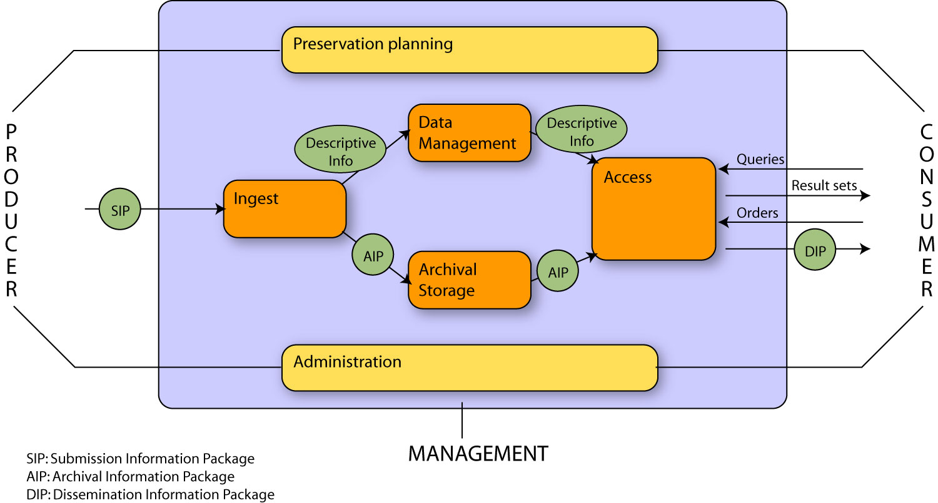
APARSEN Strength: Starting Point OAIS

Slide 11
Unifying Open Standard – Managing DP Meta Data
Challenge: Meta-Information for Preservation (I)
AIP (Archival Information Package)

Slide 12
Unifying Open Standard – Managing DP Meta Data
Challenge: Meta-Information for Preservation (II)

Slide 13
DP Meta-Data in the Archive-centric Information Life-Cycle
Distribution, Processes and Integration of Archive Systems
Exploitation of digital object by consumer
Often re-purposing of digital objects
Potential outcome
  Creation of new digital objects
  Revision of digital objects
  Extension or update of metadata
  Annotation
Production of new digital objects
Use according to original purpose
Archival often right after creation,
in parallel to use
Creation
Assembly
Archival
Reuse
Adoption
Pre-Ingest
Post-Access
Receiving and Examination of Dissemination Information Packages (DIP)
Adaption and integration of digital objects into working environment
Recontextualize digital objects and accompanying information for prospective reuse
Appraisal of objects relevant for archival
Compilation and enrichment of objects to preserve
Creation of Submission Information Package (SIP)
Ingest
Access
Life-time of objects inside archive
Often, perpetual activity
Enable use by designated community
Management of Archival Information Packages (AIP)

Slide 14
APARSEN USP:
Archive-Centric Knowledge Preservation Lifecycle
Move through Repositories
along Life Cycle
For Meta-information Preservation
and re-use: harvest Representation
Information or Extract/Transform
Alternatively move to
another/next repository/lifecycle
Creation
Assembly
Archival
Reuse
Adoption
Pre-Ingest
Post-Access
Ingest
Access
Notes:
The important thing is to say the right words accompanying this and other slides

Slide 15

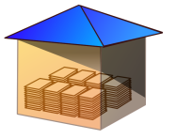



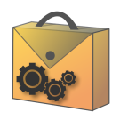

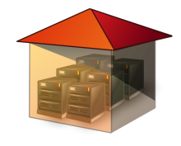
Exemplar Innovation Pilot
AIP-Toolkit (SCIDIP-ES)
GAP MGR
PACKAGING
REGISTRY
AUTHENTICITY
FINDING AIDS
REPINFO TOOLBOX
ORCHESTRATION
DATA STORE
AIP (Archival Information Package)
Notes:
KEY MESSAGE: SCIDIP-ES supports the OAIS Information Model. It SUPPLEMENTS existing archives. Key components are distributed, heterogeneous and asynchronous
This maps the infrastructure to the OAIS INFORMATION MODEL
There will be different nodes in the system (primary and secondary) linked together. ES data owners might use the primary nodes for some services, implement other services in their own infrastructure and provide services through the external world. External SCIDIP-ES providers/users can use the Primary nodes and the services exposed to the external by the secondary nodes.
Note that we CANNOT demand that the existing repositories throw out their existing systems – we supplement existing systems.
We will take as our first example ES – very distributed, very heterogeneous, large number of users across many disciplines:
The bits may be stored in the STORAGE offering or in own storage systems (e.g. ESA (ITALY) will store its own data, STFC will offer paid STORAGE service).
Representation Information is held in the REGISTRY in STFC (UK) or in local registries (we can not say that ALL will use the Central system).
Creation of additional RepInfo is co-ordinated by the ORCHESTRATION () and GAP MANAGER ()
RepInfo is created at various places around Europe e.g. GERMANY using the REPINFO TOOLKIT
The AIP is created where the data is captured/created (where the expertise resides) e.g. Norway using the PACKGING component.
Additional information is needed in the packaging including PROVENANCE [AUTHENTICITY and ANNOTATION], DRM, ACCESS and DESCRIPTIVE INFO.
The “GUARANTOR NODE” provides the services to exchange between the separate service nodes and the fallback if services are withdrawn at other nodes
The mapping to the OAIS Functional Model may be described as:
- creation of AIPs
- ARCHIVAL STORAGE – the STORAGE component
- this would also include at least some of the DATA MANAGEMENT
- INGEST - the PACKAGING component – which picks up information from
REPINFO REGISTRY, AUTHENTICITY/ANNOTATION etc
- PRESERVATION PLANNING – from ORCHESTRATION, GAP MGR and REPINFO REGISTRY
- ACCESS - normally provided by the host archive – this is the front-end which
is heavily branded and made specific for the user community
However use can be made of the GAP MGR and REPINFO REGISTRY to
create packages which are appropriate for the knowledge base of the users
15

Slide 16
Further Exemplar Offerings
beyond Meta-Data Packaging

Slide 17
Further exemplar offerings of the VCOE:
Persistent Identifier Interoperability Framework
DANS
Schema
Protocols
http://93.63.166.138/demonstrator/
Dublin Core
DNB
SRU
IKB
SPARQL
Dublin Core
JLIS
D2R
S1
PI
Harvesting &
processing
OAI-PMH
SQL
RDF
FRD
Dublin Core
S2
PI
OAI-PMH
CERN
MARCXML
WEB
Interoperability
Services
DC-FRBR mapping
MARCXML – FRBR mapping
CERN - Author
WEB
proprietary
Notes:
17

Slide 18
Further exemplar offerings of the VCOE:
Persistent Identifier Interoperability Framework
Contents from all PI domains now
are accessible in the same way
ISNI
VIAF
INTEROPERABILITY
FRAMEWORK
CERN
ORCID
New services
cross-domains
for users requirements
FRD
DNB
DANS
NBN
Handle
DOI
ARK
STM
GLOBIT
CERN

Slide 19
Further exemplar offerings of the VCOE:
Digital Rights Management (DRM)
Layers and Service Categories in DRM
Prevention
unauthorized access
unintentional use
Control
Access
Use
Monitoring
Tracking
Invoice
legal infringements
intentional use

Slide 20

Further exemplar offerings of the VCOE:
Web-based Training (WBT) and Continuous Professional Education (CPE)
6 Categories of
International liaison
Engagement
Stakeholders, inc partners
intensifies closer to
Stakeholders outside the DP
the centre
Community (industry,
commerce, government, ...)
DP Practitioners,
Scientific, Memory
& Archival Inst EU
WP41
WP42
Networks and
multiplier orgs
Formal Qualification & Professional Training
WP43
WP44
WP45
APARSEN
External Advisory
partners
Committee
WP11
Individual DP experts as
mentioned in DoW B2.1.4
Close engagement intended to
establish VCoE (Network of
Networks), in EU and beyond

Slide 21
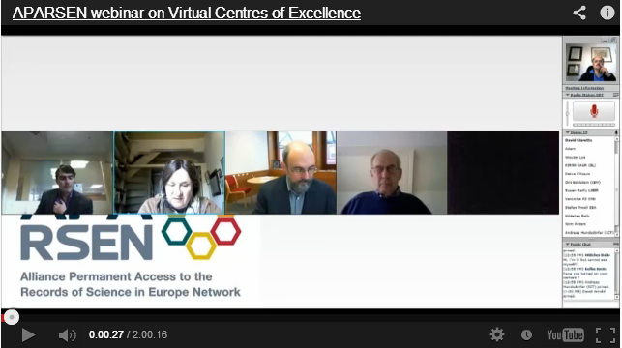
Further exemplar offerings of the VCOE:
Webinars and E-learning, Online Training Portal for CPE

Slide 22
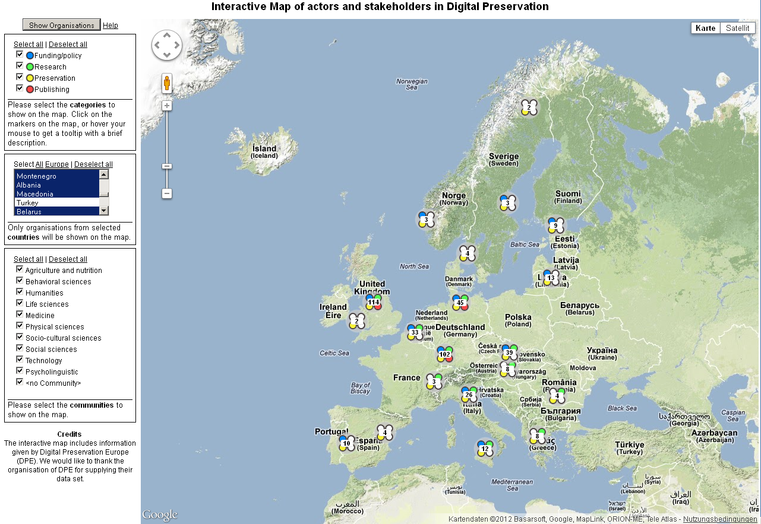
Further exemplar offerings of the VCOE:
Interactive Map Resource Registration and Mediation

Slide 23
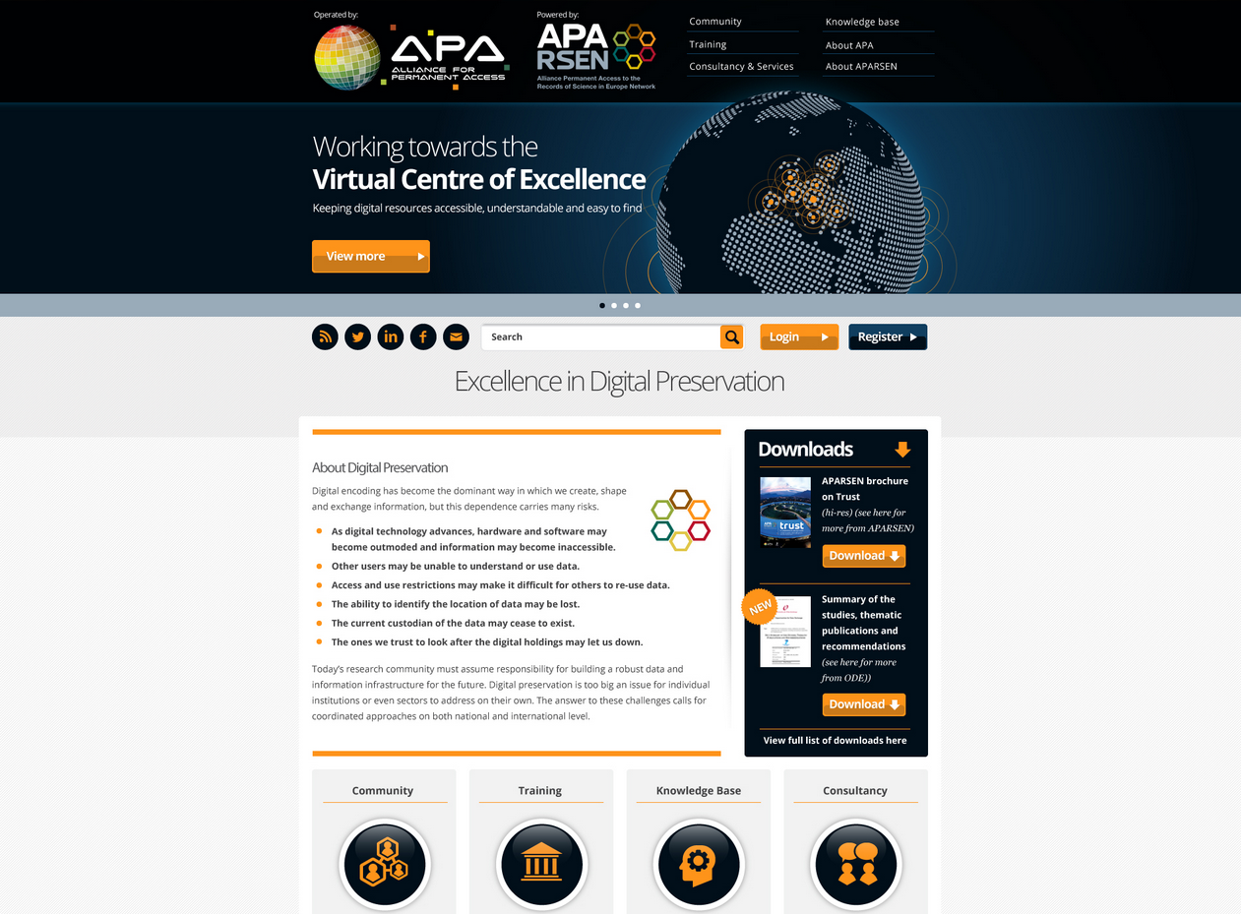

Slide 24
Thanks for your attention
Any Questions?
Prof. Dr.-Ing. Matthias L. Hemmje
APARSEN Stream Leader Sustainability
Member of the Executive Board
mhemmje@ftk.de
FTK Research Institute for
Telecommunication and Cooperation e.V.
Martin-Schmeißer-Weg 4
D-44227 Dortmund
Germany

