Slide 1
DP Sustainability: Towards Value Generation through DP Infrastructures
David Giaretta APA
APARSEN-EGI Community Workshop on Managing, Computing and Preserving Big Data for Research
4-6 March 2014
Amsterdam
This work is made available under the terms of the Creative Commons Attribution-ShareAlike 3.0 license, http://creativecommons.org/licenses/by-sa/3.0/.

Slide 2
Who pays and why?
Digital preservation requires resources
…..forever?
………………..why?
The answer must surely be that what is to be preserved is of value (or may be of future value) to someone

Slide 3
Many kinds of value
Commercial
Legal
Scientific
Pedagogical
Societal
National pride

Slide 4
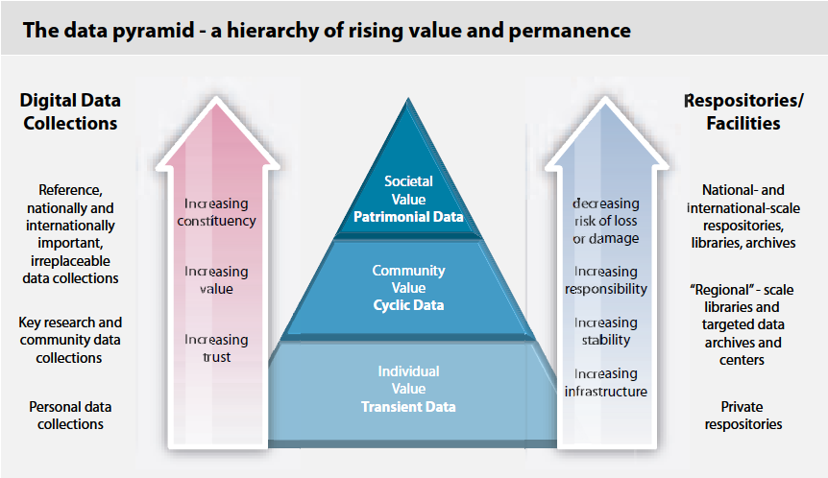
Value pyramid
From Riding the Wave

Slide 5
Preserving digitally encoded information
Ensure that digitally encoded information are understandable and usable over the long term
Long term could start at just a few years
Chain of preservation
Need to do something because things become “unfamiliar” over time
But the same techniques enable use of data which is “unfamiliar” right now

Slide 6
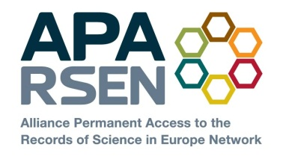
APARSEN
E-Infrastructures (Interoperability and preservation)
COMMON VISION
Testing environment
GENESI-DR
HLEG Sci data e-Infr
Authenticity & Provenance
TRUST
Research provides tools and techniques which feed into e-infrastructure
Universities & Research Institutes
PARSE.Insight
SCIDIP-ES
Annotation, reputation & data quality
DPC, nestor, STM, LIBER
Peer review and 3rd party certification
Vendors: IBM Tessella
Preservation services
SUSTAINABILITY
APARSEN
Network of Excellence
Storage solutions
National libraries
Virtual Centre
of Excellence
Cost/benefit data & modelling
APA
Brokerage
Big science: CERN/MPI/ HA/STFC
Business cases
USABILITY
ESA LTDP
Industrial: Airbus, SMEs
Common tools
Interoperability & intelligibility
Integrated research, best practice, services, tools and training
European Organisations and researchers
Scalability
CASPAR
Identifiers & citability
ACCESS
PLANETS
SHAMAN
Data policies & governance
HLEG Digital Library
Digital rights
Formal qualifications
APARSEN in brief
Create common vision for digital preservation research
de-fragment existing efforts in academia, commerce, research labs, libraries etc
INTEGRATED TOPICS
Common vision allows coherent approaches to training and practice
RESEARCH SILOS
Training & awareness
USA
Asia
Australisia etc
Research (Digital Preservation)
See http://www.aparsen.eu or http://www.alliancepermanentaccess.org/index.php/current-projects/aparsen

Slide 8
END

Slide 9
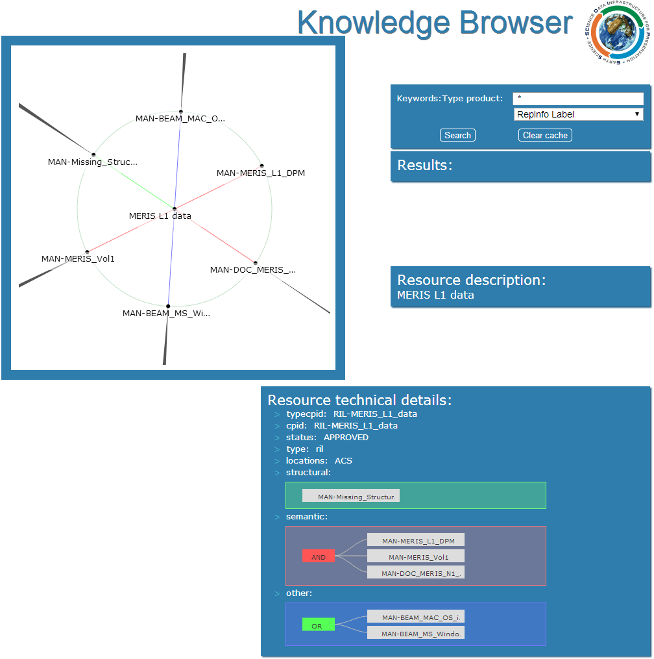
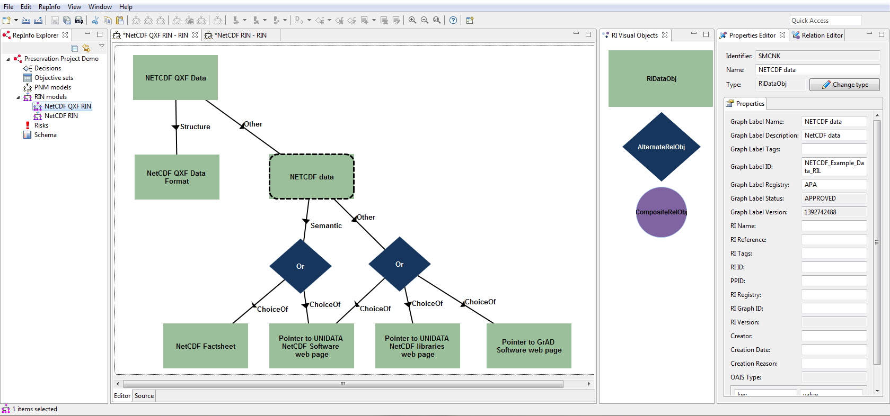
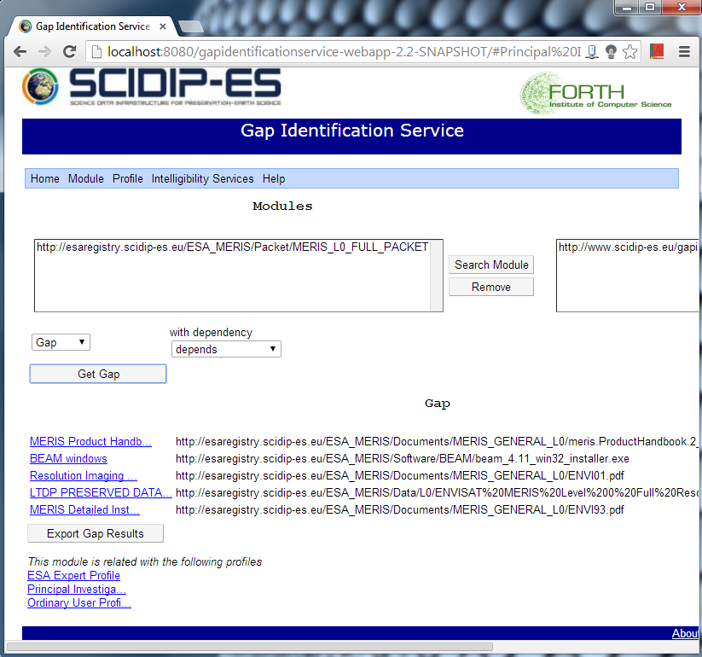
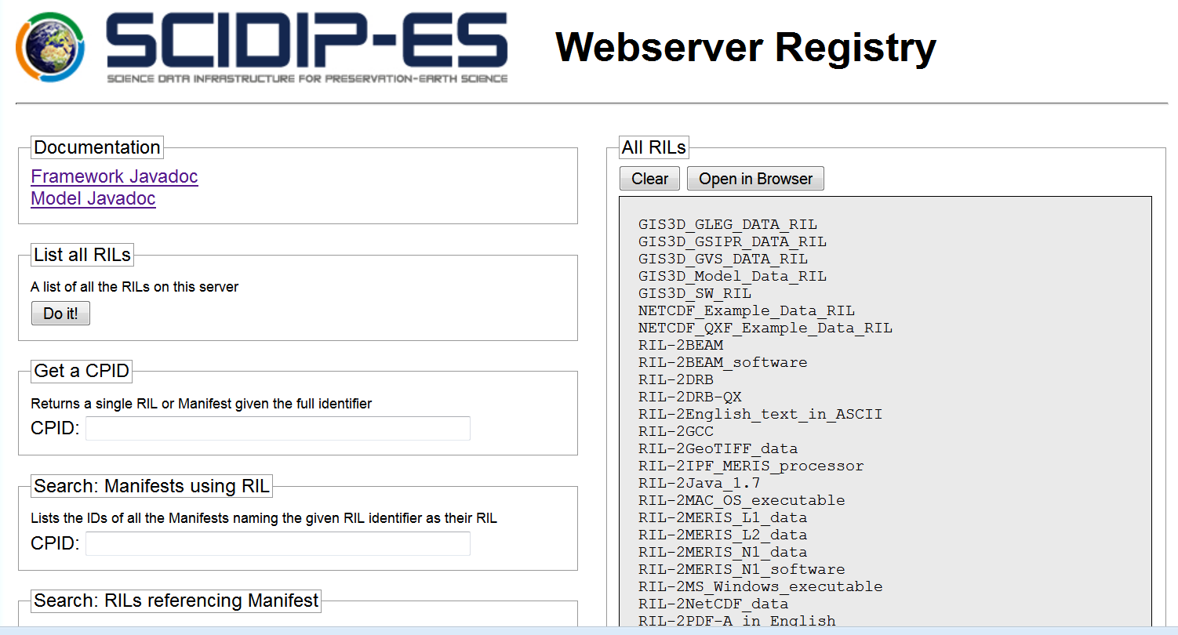
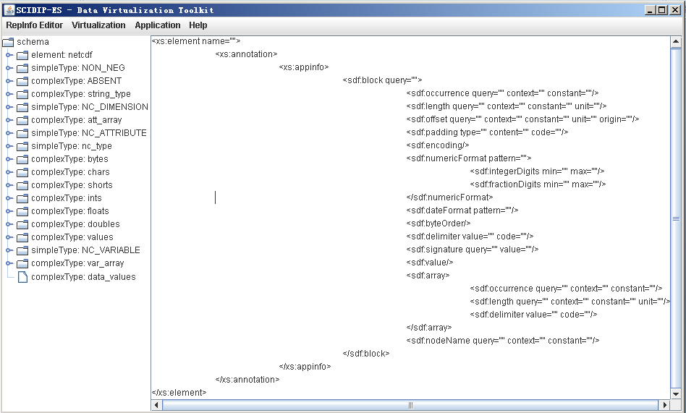
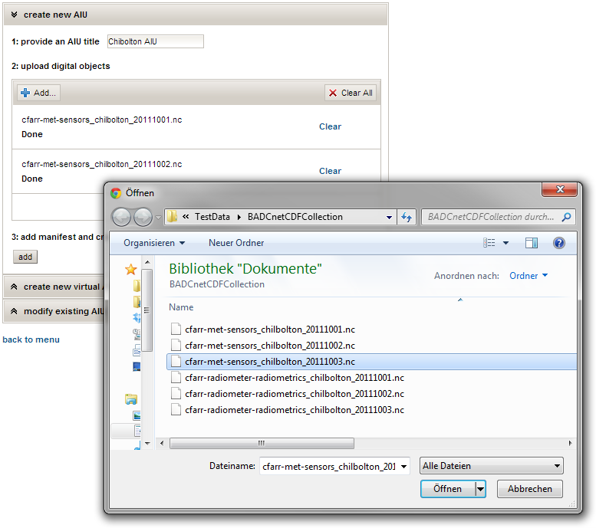
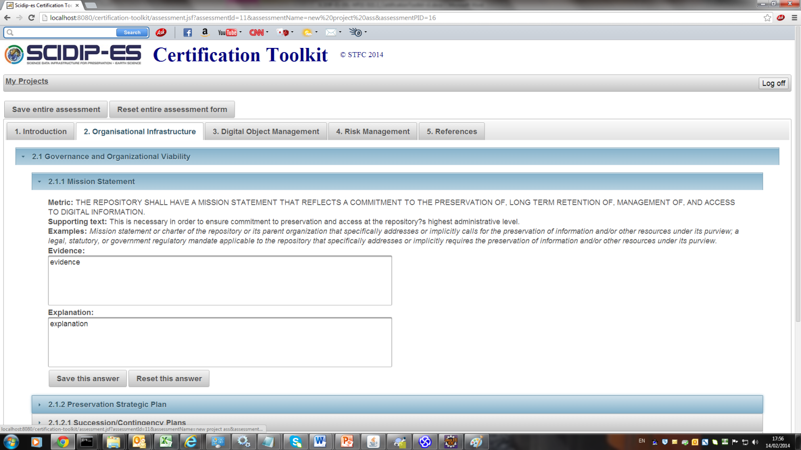
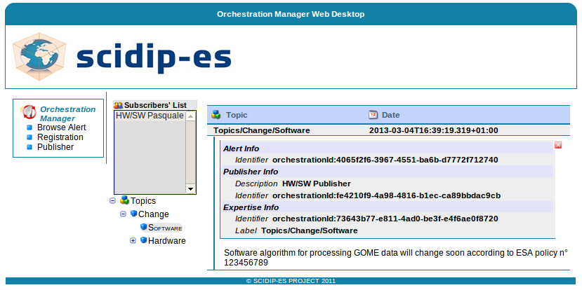
SCIDIP-ES
External PI services
Persistent ID i/f Service
Certification Toolkit
ISO Certification Organisation
Services: run on remote servers
External Access/Use Services
RepInfo Registry Service
Gap Identification Service
Orchestration Service
Storage Service
Toolkits Runs on local machines
Preservation Strategy Toolkit
Finding Aid Toolkit
RepInfo Toolkit
Packaging Toolkit
Cloud Storage
Process Virtualisation Toolkit
Authenticity Toolkit
Data Virtualisation Toolkit
These SUPPLEMENT what repositories do (customised for repositories)
Make it easier for repositories to do preservation – share the effort

