Slide 1
DP & Sustainability Ruben RIESTRA - INMARK APARSEN-EGI Community Workshop “Managing, computing and preserving big data for research”, Amsterdam , 04.03.2014

Slide 2
The EU R&D funding system so far
1984-1988
2007-2013
2014-2020

Slide 3
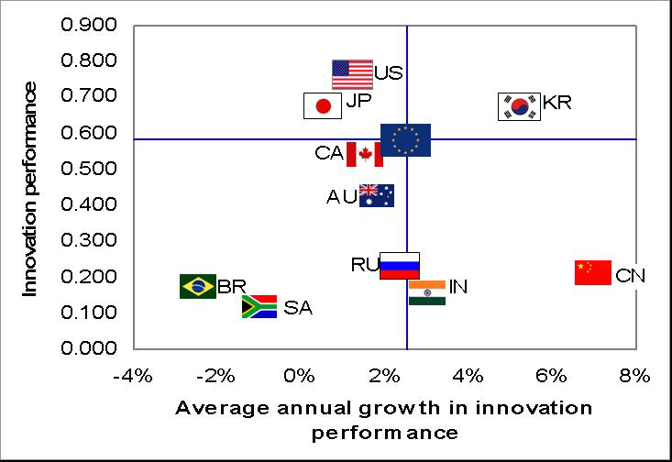
Innovation emergency (EC dixit)

Slide 4
Digital Preservation offers…
Expanded customers base for your datasets
Maintained value of your Digital Assets
Multiplying your opportunities to create Impact
Gateway to become a competitive supplier
..support your institution´s SUSTAINABILITY
By diversifying funding sources

Slide 5
DP sustainability challenges
Explosive growth of DIGITAL
Every organisation becoming DIGITAL
Compliance with mandates NOT enough
Marketisation of public sector
Traditional funding no longer adequate

Slide 6
Sustainability prerequisites
A compelling Value Proposition
Clear and stable Incentives to preserve
Well-defined Roles & Responsibilities.
BRTF

Slide 7
Value Proposition
Brief strategy statement describing:
Who benefits
How they benefit
Why they should resort to us

Slide 9
Compelling Value proposition
Relevant for our targeted users
Highlights OUR differential traits
Measures usage´s IMPACT

Slide 10
Business Model Canvas

Slide 11
Value Proposition deployment
Business Plan
Annual Programme/Budget
Operation
Stages
Design & planning
Value Proposition
Business Model
Vision & Strategic Objectives
Diagnosis & forecasts
Market Research
Competitors Analysis
SWOT
Time

Slide 12
Change management drivers
From generic to well-identified beneficiaries
From compliance to meeting changing needs
From users to customers and partners
From curating to offering permanent access
From “monopolies” to services providers
From SUPPLY push to DEMAND driven

Slide 13
DP path to Production mode
Projects
Business process
Costs
Business models
Awareness raising
Marketing
Revenue flows
Budgets
Mindset shift:
Problem solving
Opportunities enabling

Slide 14
Thank you!
ruben.riestra@grupoinmark.com

