Slide 1
APARSEN-EGI Community Workshop on Managing, Computing and Preserving Big Data for Research
Amsterdam, 04 March 2014
Tiziana Ferrari, EGI.eu Technical Director

Slide 2
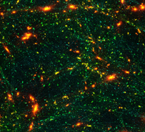
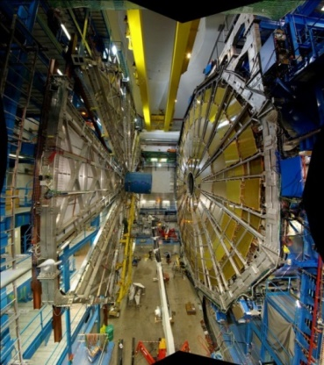
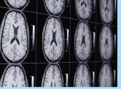
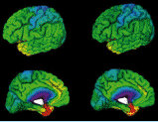
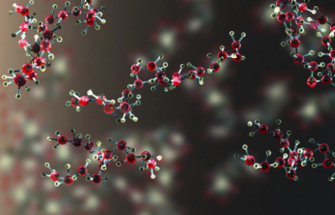
Accelerating Excellent Science
MISSION. To support researchers from all disciplines with the reliable and innovative ICT services they need to accelerate excellent science
Natural sciences
Physical sciences
Medical and health sciences
Engineering and technology
…
http://www.egi.eu/case-studies/

Slide 3
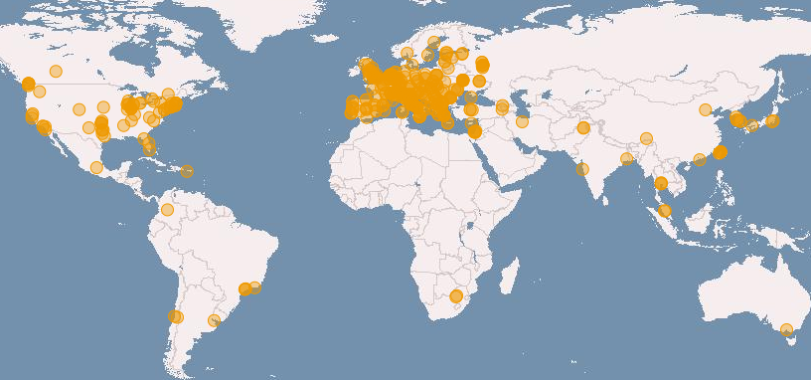
European Grid Infrastructure
Distributed and federated data and computing facilities
Grid and Cloud compute platform
340 data centres in 34 National Grid Initiatives/EIROs
435,000 logical CPU cores
10 years of support to science
> 200 research projects
190 PB disk, 180 PB tape
1.6 M job/day
> 99.6% reliability

Slide 4
Why this workshop
From an EGI perspective
Provide consultancy and training services about digital preservation and data management planning for EGI user communities through the EGI Distributed Competence Centre in collaboration with the APA virtual Centre of Excellence
Promoting solutions and corresponding service offerings in the area of digital preservation
Certification and distribution of APA software through EGI channels
Business models for the sustainability of the digital preservation
Engage with user communities and technological partners to develop a EGI solution leveraging the grid and cloud platforms of EGI
EGI-APARSEN MoU (https://documents.egi.eu/document/2063)

Slide 5
Workshop content
Data preservation knowhow
Open Archival Information Systems (OAIS) in ISO 14721 and OAIS extensions
Audit and Certification in ISO Standard 16363
Long Term Data Preservation Activities in SCIDIP-ES
Data Management Planning
Data Seal of Approval
Analysis of 7 use cases
Requirements gathering and future activities
Service, training, consultancy, business development

Slide 6
Use cases
ESA Long Term Data Preservation Activities
EISCAT-3D – The next generation incoherent scatter radar system
HEP and the ISIS Pulsed Neutron and Muon Source
Space station data – the CIRCE project
Seismology – the VERCE project
Center for Data Science (CDS). Paris Saclay University
Agricultural research data (agINFRA project)
Digital Cultural Heritage
EarthServer project
https://indico.egi.eu/indico/materialDisplay.py?materialId=2&confId=2052

