Slide 1

Trusted Digital Archives and the Data Seal of Approval
Peter Doorn
Data Archiving and Networked Services
EGI Community Workshop focusing on “Managing, computing and preserving big data for research”
Amsterdam, 5th March 2014

Slide 2
Contents
Two slides about DANS
On Trust and certification: what do we rely on?
  Trust in research data
  The need for Trusted Digital Repositories
  How to build trust
European framework for certification
  the Data Seal of Approval (DSA)
  DIN & ISO
Other approaches
Ongoing work
Do we need certification?
  pros and cons

Slide 3

What is DANS?
First predecessor dates back to 1964 (Steinmetz Foundation), Historical Data Archive 1989
Institute of Dutch Academy and Research Funding Organisation (KNAW & NWO) since 2005
Mission: promote and provide permanent access to digital research information

Slide 4
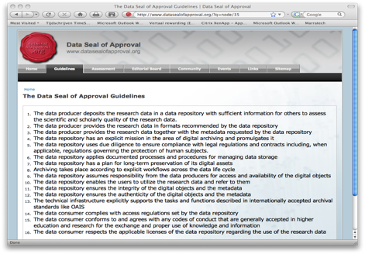
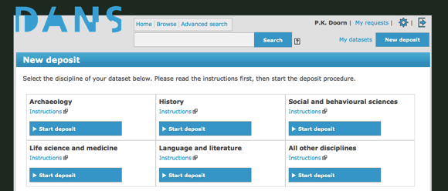
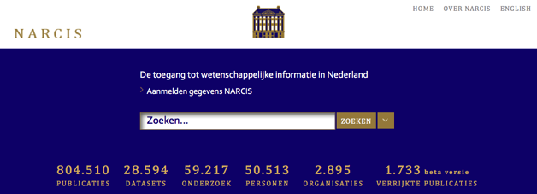

Our services
EASY: Electronic Archiving System for self-deposit
Data Seal of Approval
Persistent Identifier
URN:NBN resolver
NARCIS: Gateway to scholarly information In the Netherlands

Slide 5

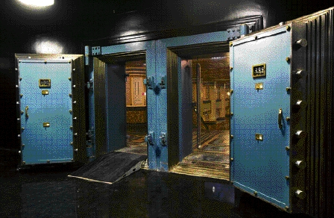
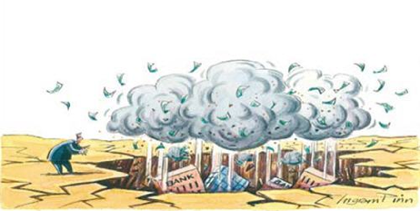
What do we rely on?
RANG IS ALLEEN RANG ALS ER RANG OP STAAT
You can rely on us
Trusted Digital Repository
Can you?

Slide 6
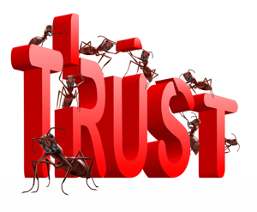
Trust in research data
Trust is at the very heart of storing and sharing data
Trust involves:
  Data creators
  Data users
  Data repositories
  Funders
Trust comes on foot, but leaves on horseback
Notes:
It is clear that trust is at the very heart of storing and sharing research data. And this is so for a number of stakeholders, all for different reasons:
The users of data from a digital repository have questions like:
Have the data been preserved properly?
Are they of high quality?
Have they been changed in some way?
Does the pointer get me to the right object?
The depositors of data want to be sure that in the digital repositories their data are safe and remain accessible, usable and meaningful over time.
Finally the funders,
They want the reassurance that their investment in the production of valuable research data is no waisted but will remain also in the future; re-use of data will give them a higher return on their investment

Slide 7
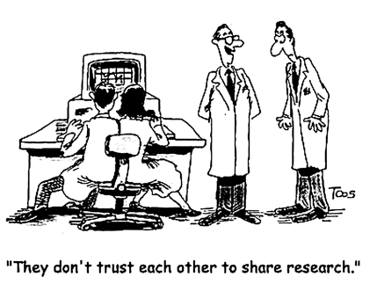
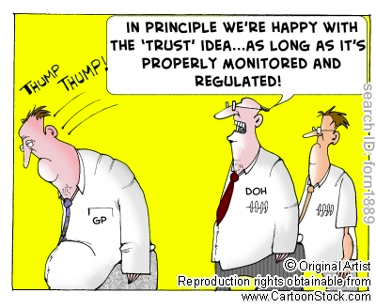
What is trust built on?
Dedicate yourself (mission statement)
Do what you promise (stable, sincere and competent reputation)
Be transparent (peer review, get certified)

Slide 8
The need for trusted digital repositories
In 1996 the Consultative Committee for Space Data Systems established a task force that developed OAIS (Open Archival Information System, accepted as ISO 14721 in 2002), a high-level model for the operation of digital archives.
Independent auditing was deemed necessary to certify OAIS-compliance and thus engender trust.
Development of OAIS auditing metrics began in 2003 and resulted in Trustworthy Repositories Audit & Certification (TRAC 2007).
TRAC is the basis of the Trusted Digital Repository (TDR) document that was accepted as ISO 16363 in 2012.
http://www.iso.org/iso/iso_catalogue/catalogue_tc/catalogue_detail.htm?csnumber=56510

Slide 9
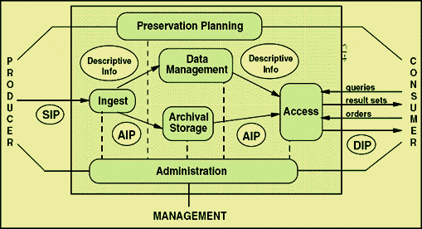
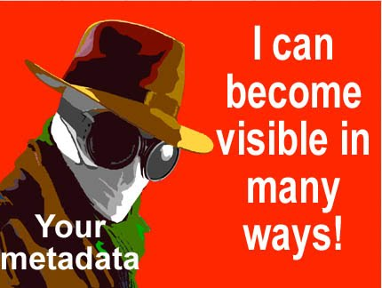
OAIS – Open Archival Information System
SIP = Submission Information Package
AIP = Archival Information Package
DIP = Dissemination Information Package
Note: OAIS <> OAI
OAI = Open Archives Initiative, which develops and promotes interoperability standards that aim to facilitate the efficient dissemination of content.

Slide 10
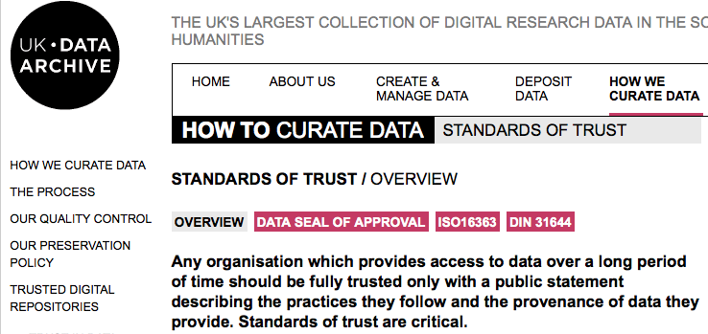
Trust in data archives: an example

Slide 11
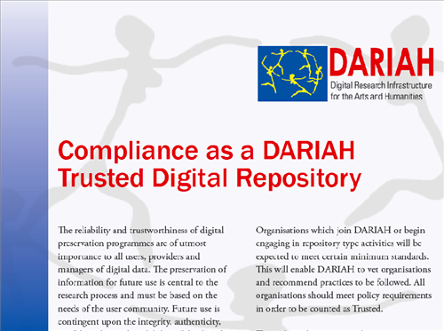
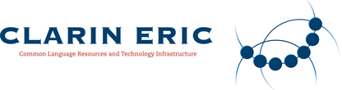
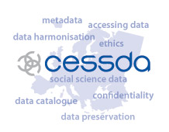
ESFRI Research Infrastructures and Trust
Requirements for CLARIN Centres
“Centres need to have a proper and clearly specified repository system and participate in a quality assessment procedure as proposed by the Data Seal of Approval or MOIMS-RAC approaches”
Building Trust: CESSDA Self-Assessment Project
Participants from fifteen CESSDA member organisations discussed the CESSDA-ERIC requirements and agreed upon using the Data Seal of Approval (DSA) guidelines as a tool to gain information on the level of their conformance with the DSA and the CESSDA-ERIC requirements.

Slide 12

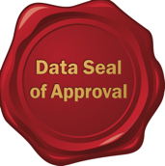


Certification of digital repositories
International framework
3 standards
3 levels (basic, extended, formal)
http://www.trusteddigitalrepository.eu

Slide 13

Framework levels
Basic Certification is granted to repositories which obtain Data Seal of Approval
Extended Certification is granted to Basic Certification repositories which in addition perform a structured, externally reviewed and publicly available self-audit based on ISO 16363 or DIN 31644
Formal Certification is granted to repositories which in addition to Basic Certification obtain full external audit and certification based on ISO 16363 or DIN 31644
http://www.trusteddigitalrepository.eu
Notes:
Basic – extented - formal
The focus of the Data Seal of Approval is on smaller organisations within the research data domain.
The two more formal standards, DIN and ISO, are more demanding.
But they will provide more of a guarantee of „trustworthiness‟.
In some cases, especially where there are higher stakes involved, this might just be what is needed.

Slide 14
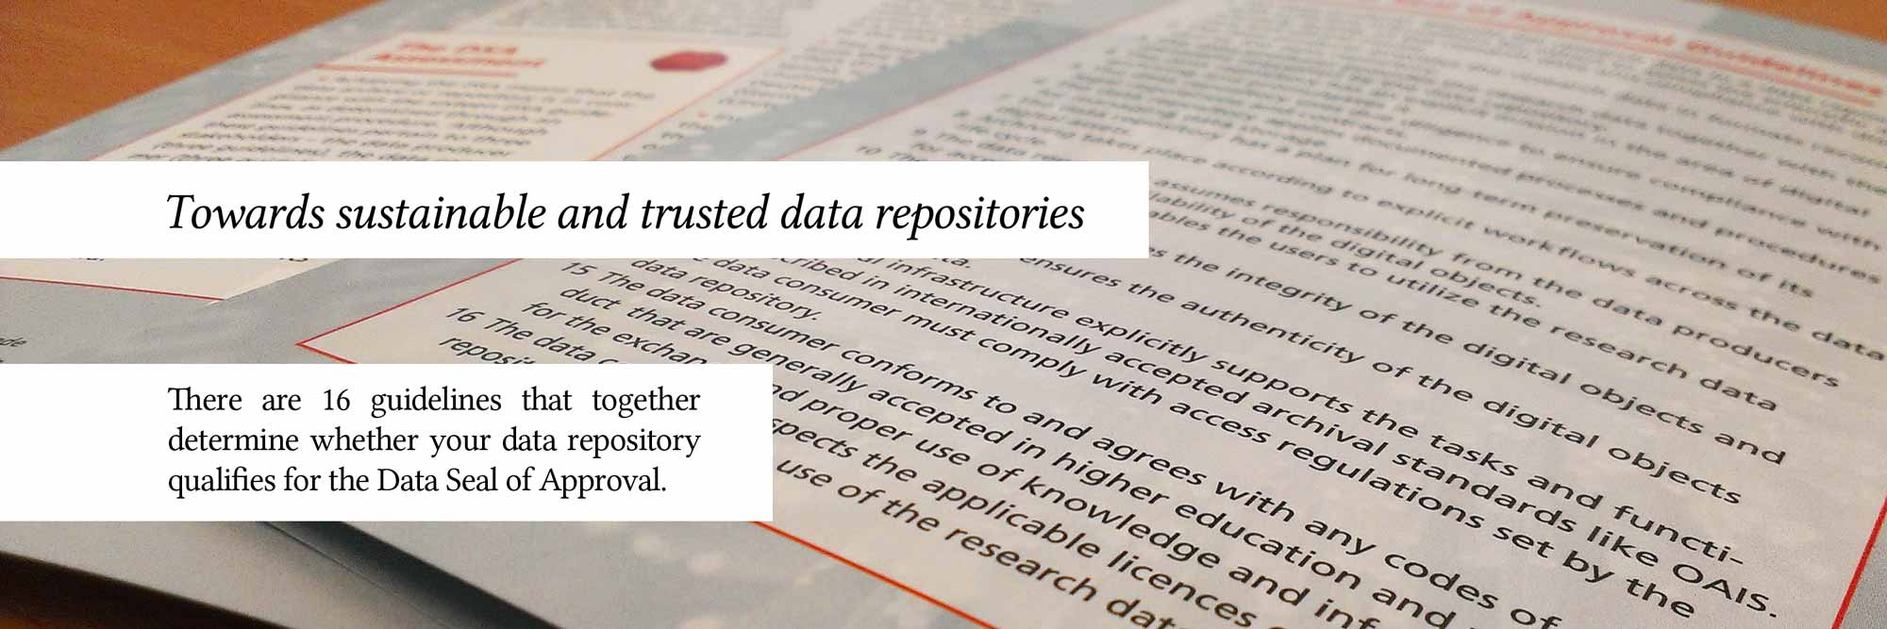
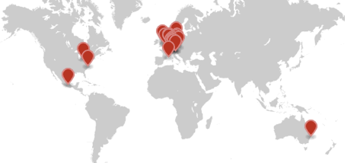
Certification Standards: Data Seal of Approval (DSA)
DANS initiative (2005/6)
International Board
16 guidelines
Self assessment
Transparency
24 seals awarded since 2010
The research data:
can be found on the Internet
are accessible (clear rights and licenses)
are in a usable format
are reliable
can be referred to (persistent identifier)
Data producers are responsible for the quality of research data, repositories for storage and long-term access, and users for correct use of data
http://datasealofapproval.org/
Notes:
There has long been a demand for some way to evaluate, to assess the quality of the services of a digital repository.
Over the last few years a number of evaluation guidelines are becoming available.
Slide
DSA can be seen as an entry point which requires limited effort from the repositories

Slide 15
The Guidelines 2014-2015
Guidelines Relating to Data Producers:
The data producer deposits the data in a data repository with sufficient information for others to assess the quality of the data and compliance with disciplinary and ethical norms.
The data producer provides the data in formats recommended by the data repository.
The data producer provides the data together with the metadata requested by the data repository.

Slide 16
Guidelines Related to Repositories (4-8):
The data repository has an explicit mission in the area of digital archiving and promulgates it.
The data repository uses due diligence to ensure compliance with legal regulations and contracts including, when applicable, regulations governing the protection of human subjects.
The data repository applies documented processes and procedures for managing data storage.
The data repository has a plan for long-term preservation of its digital assets.
Archiving takes place according to explicit work flows across the data life cycle.

Slide 17
Guidelines Related to Repositories (9-13):
The data repository assumes responsibility from the data producers for access and availability of the digital objects.
The data repository enables the users to discover and use the data and refer to them in a persistent way.
The data repository ensures the integrity of the digital objects and the metadata.
The data repository ensures the authenticity of the digital objects and the metadata.
The technical infrastructure explicitly supports the tasks and functions described in internationally accepted archival standards like OAIS.

Slide 18
Guidelines Related to Data Consumers (14-16):
The data consumer complies with access regulations set by the data repository.
The data consumer conforms to and agrees with any codes of conduct that are generally accepted in the relevant sector for the exchange and proper use of knowledge and information.
The data consumer respects the applicable licences of the data repository regarding the use of the data.

Slide 19
DSA self-assessment & peer review
Complete a self-assessment in the DSA online tool. The online tool takes you through the 16 guidelines and provides you with support
Submit self-assessment for peer review. The peer reviewers will go over your answers and documentation
Your self-assessment and review will not become public until the DSA is awarded.
After the DSA is awarded by the Board, the DSA logo may be displayed on the repository’s Web site with a link to the organization’s assessment.
http://datasealofapproval.org/

Slide 20
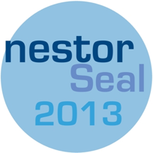

Certification Standards: DIN 31644
Kriterienkatalog vertrauenswürdige digitale Langzeitarchive – NESTOR, Deutsche National Bibliothek
34 criteria
Extended self-assessment process offers digital archives a harmonised and practical method of checking whether they are trustworthy. If the reviewed assessment yields a positive result they are entitled to publicise this by using the nestor Seal for Trustworthy Digital Archives.
http://www.langzeitarchivierung.de
Notes:
The DIN standard is the second one
DIN is an initiative of NESTOR, the German competence network for digital preservation
The DIN standard counts 34 criteria for digital repositories that have to be met
It requires much more detailed information than the DSA.

Slide 21
Certification Standards: ISO 16363
Based on Open Archival Information System (OAIS) and Trusted Repository Audit and Certification (TRAC)
Over 100 metrics
Test audits 2011 by PTAB (Primary Trustworthy Digital Repository Authorisation Body
Full external auditing process
http://www.iso16363.org/
Notes:
The third way to evaluate a digital repository is offered by the ISO standard
The standard is based on the OAIS model and emanates from work done by RLG, OCLC and NARA
The standard is very detailed and presents over a 100 metrics
6 test audits
Entails a full external auditing process
Up to 3 person months to collect the evidence and to take part in the audit.

Slide 22
Other certification/assessment procedures
Certification and Assessment by Center for Research Libraries (CRL) - http://www.crl.edu/archiving-preservation
  Metrics based on Trustworthy Repositories Audit and Certification checklist (TRAC)
  CRL Certification Advisory Panel represents the various sectors of its membership
The Digital Repository Audit Method Based on Risk Assessment (DRAMBORA) - http://www.repositoryaudit.eu/
  toolkit for use by repository administrators to (self) assess the risks to their digital archiving systems
Certification (accreditation) of ICSU World Data System - http://www.icsu-wds.org/community/membership/certification
  aims at transition from existing stand-alone WDCs and Services to a common globally interoperable distributed data system
  criteria even less specific than DSA

Slide 23



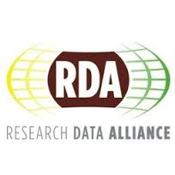
On-going work on Trust
Work Package on “Trust” within APARSEN project: http://www.alliancepermanentaccess.org/
European Framework for Audit and Certification of Digital Repositories – now also in collaboration with accreditation of ICSU World Data System: http://www.trusteddigitalrepository.eu
Research Data Alliance Interest Group on Certification: https://www2.rd-alliance.org/internal-groups/rdawds-certification-digital-repositories-ig.html

Slide 24


Do we need certification?
No (devil’s advocate) | Yes
Trustworthiness of digital repositories is an illusion Too complicated to measure Impossible to maintain over time Too informal, too expensive and too time consuming “Reputation and reuse are more important than certification” (Ron Dekker, NWO) | Trustworthiness of digital repositories is necessary How else underpin claims to be a “trusted digital repository” Different levels for different needs To be repeated at certain intervals
Objective and consistent auditing is an illusion “If auditing becomes a career, what will happen to objectivity?” (Helen Tibbo) Impossible to guarantee consistency around the globe | Objective and consistent auditing can be done Auditing is a career in many other areas Requirements for bodies providing audit and certification of candidate Trustworthy Digital Repositories exist since 2011 Some variation according to local requirements is not a problem

Slide 25

Thank you for your attention
www.dans.knaw.nl
www.narcis.nl
peter.doorn@dans.knaw.nl

