Slide 1


APARSEN-EGI Community Workshop on Managing, Computing and Preserving Big Data for Research
Amsterdam, 4-6 March 2014
Core services across e-infrastructures
Persistent Identifiers Interoperability e-Infrastructure
Prof. Paolo Bouquet
University of Trento and OKKAM srl

Slide 2
A core service ...
Development and promotion of the uptake of a Digital Identifier e-infrastructure for digital objects (articles, datasets, collections, software, nomenclature, etc.), contributors and authors which cuts across geographical, temporal, disciplinary, cultural, organisational and technological boundaries, without relying on a single centralised system but rather federating locally operated systems to ensure interoperability.
The requirements of all relevant stakeholder groups (researchers, libraries, data centres, publishers, etc.) will be addressed
EINFRA-7-2014, Provision of core services across e-infrastructures

Slide 3
Why do (research) (big) data need PIs ?
PI management is an essential building block for enabling value-added services like:
  Ensuring Persistence of Access to data and content
  Fast, large-scale and decentralized Data Sharing & Reuse
  Effective Data Linkage across repositories
  Fine-grained Access Control
  Data and information Quality assessment
  Reputation assessment & Citation indexes
  Impact and ROI assessment (reliable research outputs beyond the scope of published literature)
  Ownership management for data and scholarly content (citability)
  …
on top of scientific data and contents
DIGOIDUNA report, 2011

Slide 4

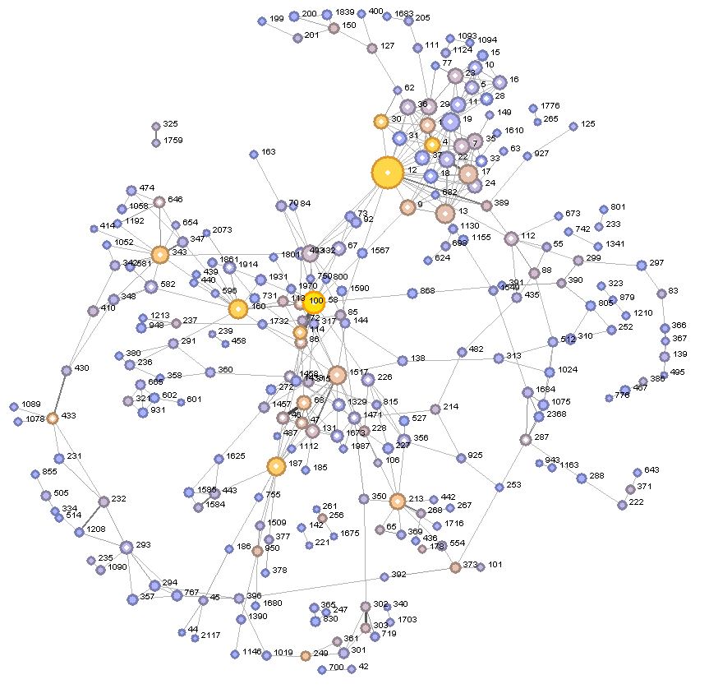
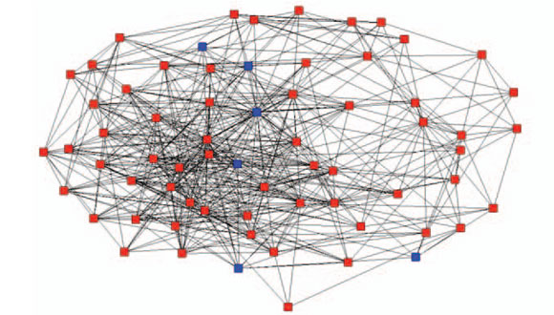
Not only digital objects though ...
Other types of entities are crucial in building value added services:
People (researchers, authors/contributors, ...)
Organizations (research institutions, funding bodies, companies, libraries, repositories, ...)
Events (conferences, experiment runs, projects / grants, publication, ...)
Geographical locations
Artifacts (instruments, sensors, products, ...)

Slide 5
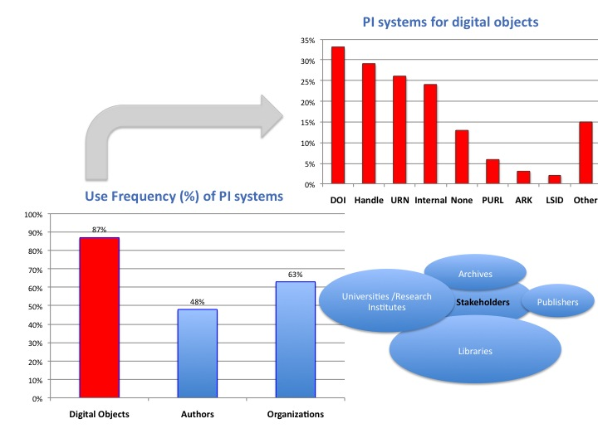
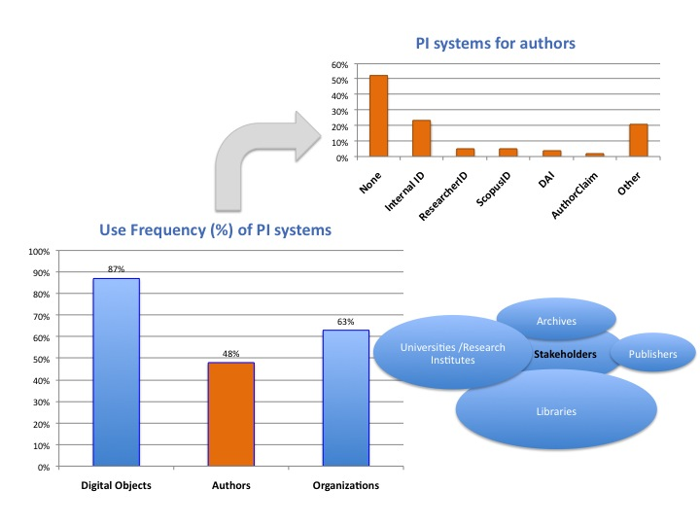
Current situation

Slide 6
The need for an interop PI infrastructure
Fragmentation: there exist already several PI systems for the same categories of objects (mainly for digital objects and authors)
Heterogeneity: different systems provide different information (metadata) and services about the same entity
Scalability: very often interoperability is defined point-to-point, which is not very effective on a big scale
Openness: interoperability should not be managed in a closed silos
Business apps: interoperability enables other (more complex) business services, and therefore should be managed separately

Slide 7
PI INTEROPERABILITY INFRASTRUCTURE
URN-NBN
ORCID
PI Interoperability Infrastructure
Point-to-point Interoperability Solutions
Isolated PI Systems
APARSEN Interoperability Framework for PIs
ARK
Cool URI
DOI
ISNI
PURL
DOI
(DataCite)
ORCID
ISNI
ORCID
VIAF
ISNI
URN-NBN
ORCID
Cool URI
ARK
PURL
ISNI
DOI

Slide 8
PI interoperability Infrastructure:
Examples of KEY SERVICES
PI Service Registration: existing PI systems can register as data and service providers about a set of entities
Entity Matching: supports the alignment between 2 (or more) PI systems
Lifecycle management: support interoperability through time (changing mappings, adding entities, etc.)
PI service lookup: given a PI, returns all known PIs and resolvers for the same entity
Vocabulary Mapping: given an attribute in a PI system, returns equivalent attributes in different PI systems

Slide 9
APARSEN interop framework
Making data and contents from different PI platforms accessible in a seamless way
ISNI
VIAF
INTEROPERABILITY
FRAMEWORK
CERN
ORCID
New services
cross-domains
for users requirements
FRD
DNB
DANS
NBN
Handle
DOI
ARK
STM
GLOBIT
CERN

Slide 10
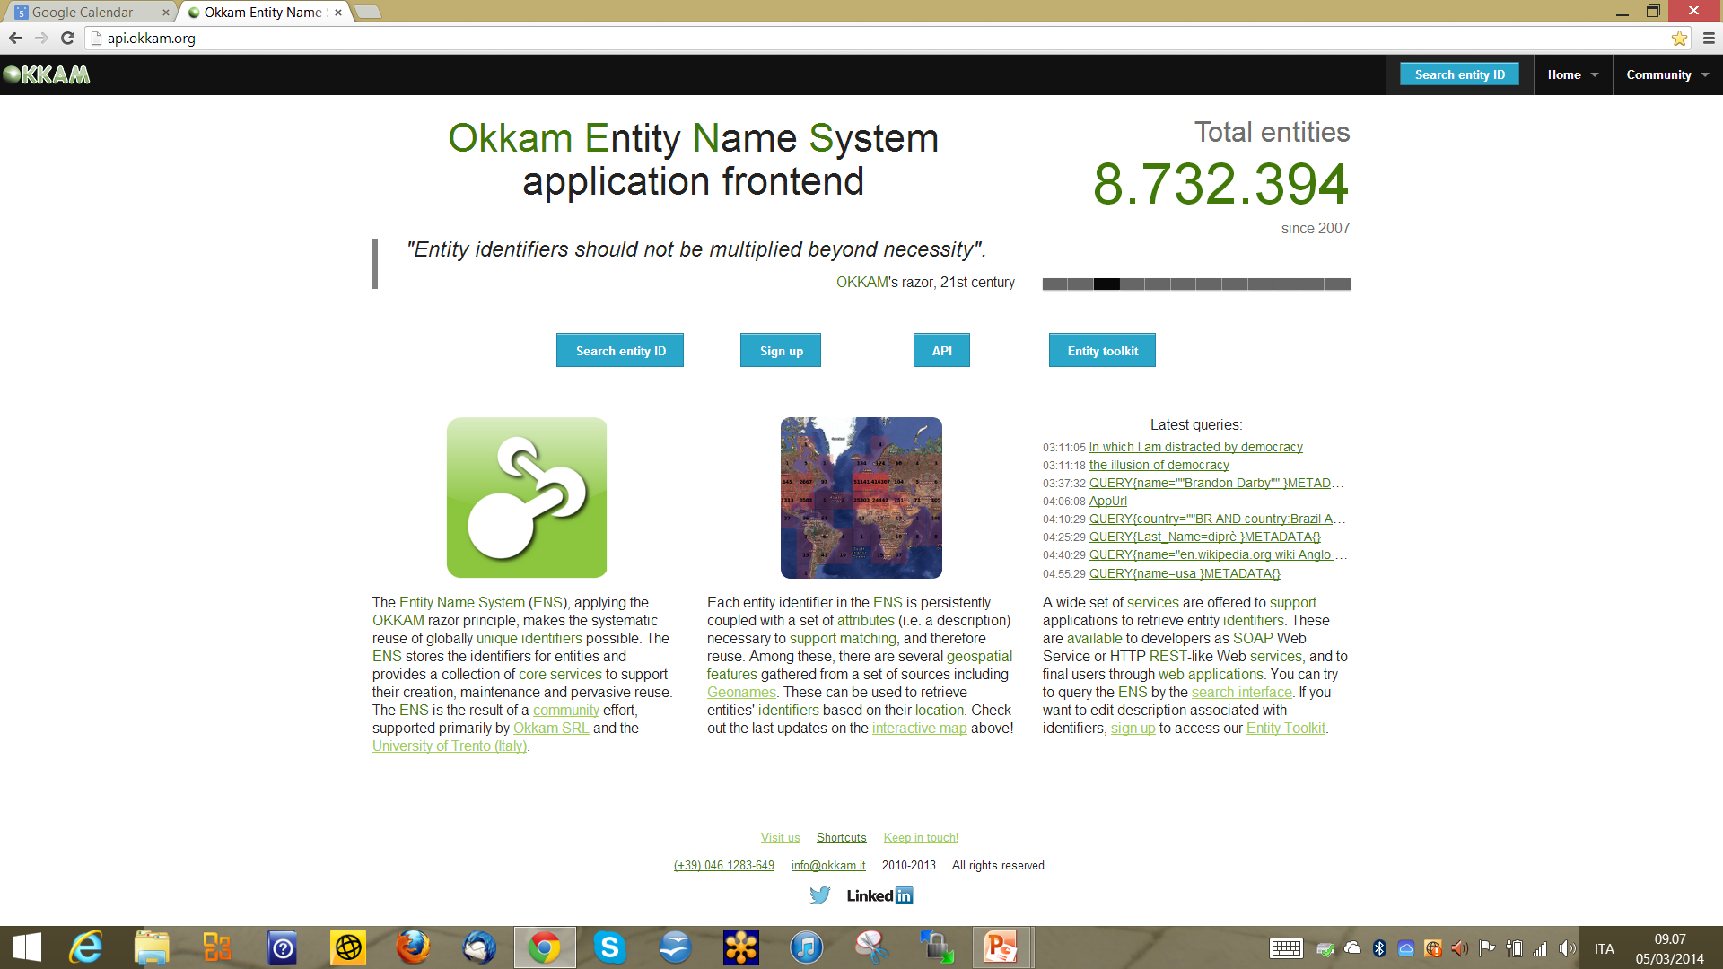
The entity name system (ENS): a technical platform for implementing the aparsen interoperability framework

Slide 11
What is the ENS?
An open, public infrastructure for supporting PI interoperability
Outcome of an FP7 project
Maintained by a company (OKKAM) which was created in 2010 as a follow-up of the research project
Live since 2007
Already provides the technical support for most key services which are needed in an interoperability infrastructure
Constantly updated and improved

Slide 12
ENS in Numbers (March 2014)
8.6 million entities
  largest part Locations, Persons, Organizations
6 top-level categories
  person, location, organization, event, artifact type and artifact instance
5 general purpose Matching Modules
  Fingerprint, FBEM, Jolly Matcher, Group Linkage, Eureka
3 different Persistence layers available
  Apache HBase 0.9x (Hadoop), Oracle MySQL 5.5, Apache Solr (3.6 and 4.5)
~0,2-0,4 second per query (matching)
  deployed on 8 server cluster (144 core AMD Opteron 2,6 GHz) at Unitn
51+ million entity matching requests served
  Since January 2011

Slide 13
Benefits of the ENS as a basis for interop infrastructure
Scalable, BigData-size architecture already available
Key services already available
Implements a thin, neutral layer which is not in competition with the current PI platforms
Access control, preservation policies and trust levels are fully decentralized (as they are delegated to each PI system)
Fully distributed architecture, only a very lightweight form of logical centralization (see analogy with DNS)
Sustainable model, no big costs involved

Slide 14
Conclusions
The fundamental trade-off between centralization / decentralization (the DNS analogy)
Separation of concerns: ID management should be kept independent from the implementation of other value-added community services
Overcoming organizational barriers: PI interoperability as a basis for implementing services and business solutions
ENS full compatibility with existing PI initiatives (e.g. ORCID for authors) and EC recommendations, it can be a technical building block for a PI interoperability e-infrastructure

