Slide 1
Promoting Desktop Grids Virtual Team (Q1/2014 updates)
Robert Lovas
MTA SZTAKI / NGI_HU NIL
[robert.lovas@sztaki.mta.hu]
EGI NIL meeting

Slide 2
General project info
General project info
Start (planned) : November 2013
Duration : 6 months
Leader: Robert Lovas
URL: http://go.egi.eu/vtdg
“EGI-InSPIRE is ideally placed to join together the new Distributed Computing Infrastructures (DCIs) such as clouds, supercomputing networks and desktop grids, for the benefit of user communities within the European Research Area.” --- EGI-InSPIRE Project fact sheet
Motivation
Despite the on-going work and the benefits of the integrated Desktop Grid DCI resources available for EGI users, only a part of the EGI community is aware of the latest Desktop Grid related achievements, and a fraction of the EGI users and infrastructure operators take their advantages in everyday practice.
In order to fill this gap; a part of the targeted objectives are technical ones but there is stronger focus on the human aspects and promotion – training, networking and support activities.

Slide 3
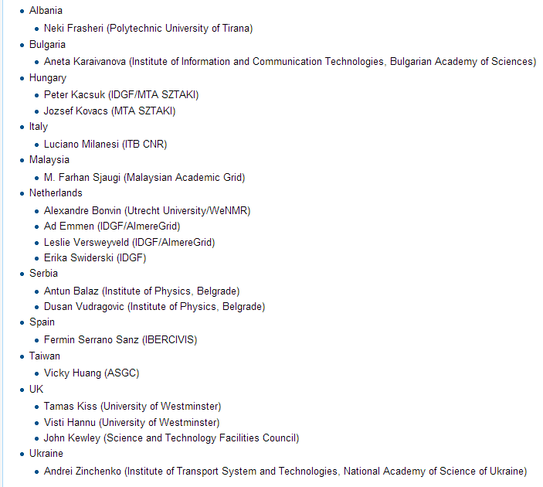
VT members

Slide 4
Detailed objectives
Promote and train the Desktop Grid related technologies in the EGI communities
Increase the number of heavily used EGI applications on the integrated (Desktop Grid) infrastructure with focus on widespread tools/solutions/approaches
Improve documentation, e.g. Road maps, training materials, manuals
Complete the final remaining steps for full integration concerning e.g. dashboard and Operations Centre
Utilize the available bridged Desktop Grid resources by more VOs

Slide 5
New IDGF Operations Centre
The VT initiated the creation of a new, international Operations Centre ‘IDGF’ in EGI in order to put all DG (inter)operational activities under this new umbrella.
Advantage: it would move the accounting and other activities for desktop grids from NGI (Hungary) to international level.
More info and updates: https://ggus.eu/index.php?mode=ticket_info&ticket_id=102390

Slide 6
Potential added value extra resources at no cost
MTA SZTAKI operates large-scale volunteer Desktop Grids, and offers them for EGI users (through production level bridges) with more than 125.000 registered computers available from Desktop Grid resources:
SZTAKI Desktop Grid (http://szdg.lpds.sztaki.hu/szdg) dedicated particularly for NGI_HU users: all-together 100.000 registered computers
EDGeS@home (http://home.edges-grid.eu/) allocated for EGI users: all-together 25.000 registered computers
Already used by BioVEL and several other communities
EDGES@Home will be renamed to a well-known scientist, the volunteers (donors) can vote on the name ➔ joint activities and campaign involving the EGI communication team is in preparation phase

Slide 7
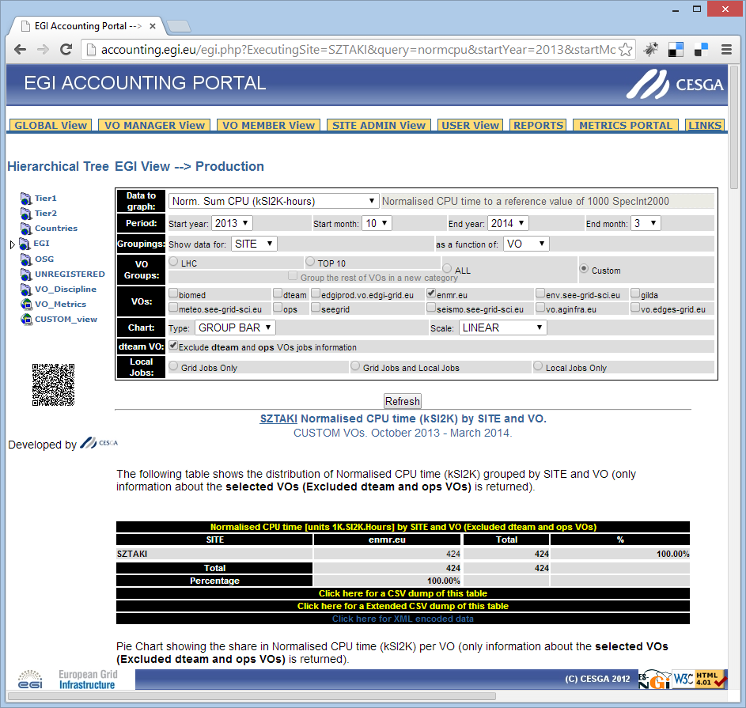
WeNMR jobs on EDGeS@home
Haddock portal is sending 1 out of 20 jobs to EDGeS@home desktop Grid through the modified computing element (Bridge).
The recently provided CPU hours in the EGI accounting portal for executing the workunits (jobs) originated from WeNMR.
The application can be started to be used in promotion.

Slide 8
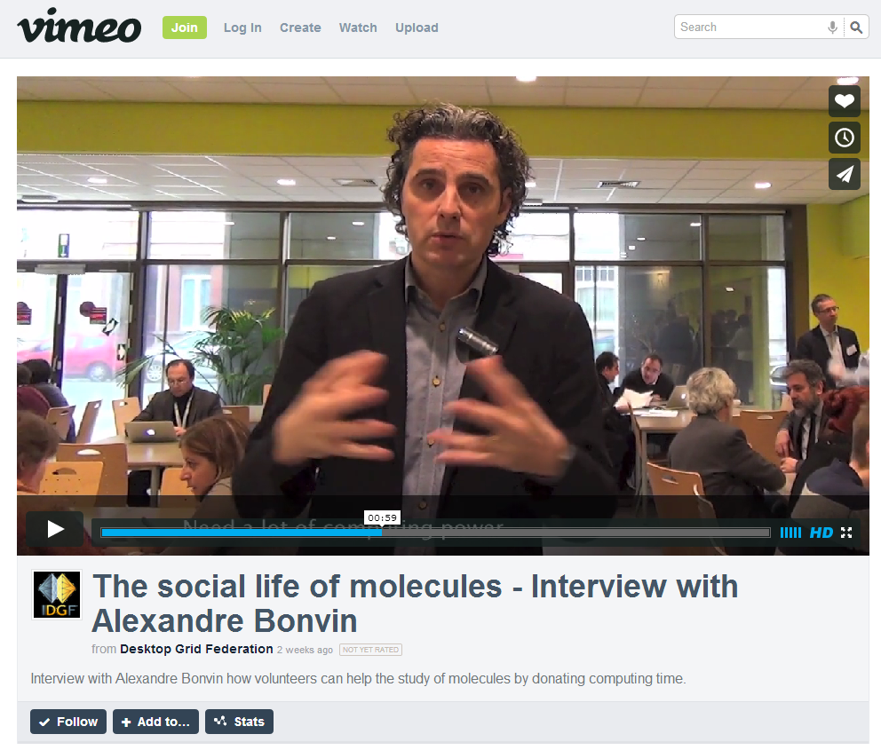
WeNMR jobs on EDGeS@home
Haddock portal is sending 1 out of 20 jobs to EDGeS@home desktop Grid through the modified computing element (Bridge).
The recently provided CPU hours in the EGI accounting portal for executing the workunits (jobs) originated from WeNMR.
The application can be started to be used in promotion.

Slide 9
1-page promo materials (under preparation)
The working document consists of two parts:
Define the groups in EGI who can benefit from IDGF services and the channels through which they can be reached by IDGF;
Define the messages that IDGF should use to promote IDGF services to these EGI groups.
VT members is to provide feedback and suggestions for improvement.
Finalise the content in about one week, then start DG promotion to some target groups.
Discuss the first feedbacks at the next teleconference.

Slide 10
Short interview with NILs
VT plans to individually approach the NIL of each NGI via skype or phone and start a direct discussion
if there is any grand challenge and/or
parameter sweep (or other DG ready) application in that NGI that could be supported by DG systems

Slide 11
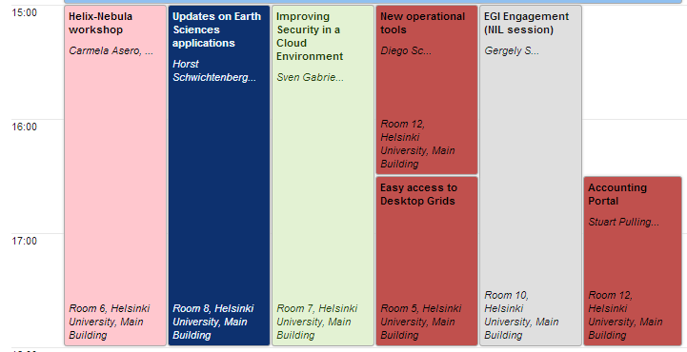
DG workshop @ EGI CF 19 May 2014 (Monday) from 16:30

