Slide 1
SAM Roadmap
Emir Imamagic
SRCE
Pedro Andrade, Marian Babik, David Collados, Wojciech Lapka CERN

Slide 2
SAM
SAM
Roadmap

Slide 3
SAM

Slide 4
SAM
Infrastructure for distributed monitoring
submission, transport, storage and visualization of probes
relies on existing technologies (Nagios, ActiveMQ, Django)
deployed at each NGI
Results are used to measure the availability and reliability of EGI sites.

Slide 5
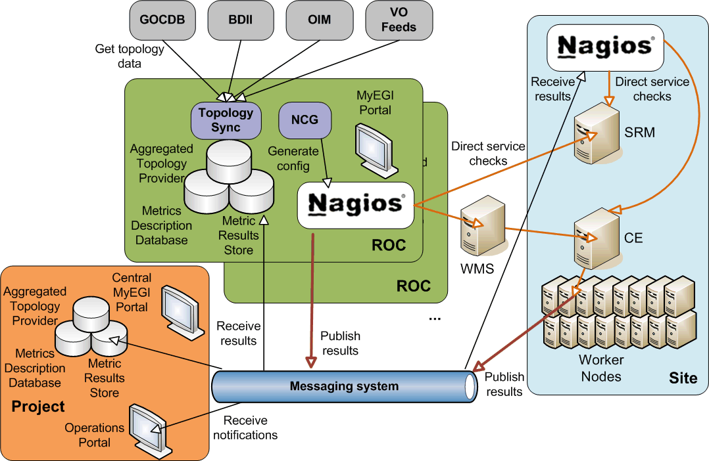
Architecture

Slide 6
MyEGI
Visualization tool for monitoring the grid infrastructure
replaces the SAM Portal and programmatic interfaces (PI)s
Provides
status and history of services and sites
visualization of services & sites availabilities
gridmap style views
web services for data export in JSON/XML

Slide 7
Central Databases
Aggregated Topology Provider (ATP)
grid topology
synchronizer gathers information from external sources
custom grouping of services (VO feeds)
web interface for data visualization
https://twiki.cern.ch/twiki/bin/view/LCG/ATP

Slide 8
Central Databases
Metric Description Database (MDDB)
stores metric definitions
maps profiles, services and metrics
web interface to display data
will be phased out and replaced by Profile Management Database (POEM)
https://tomtools.cern.ch/confluence/display/SAM/MDDB

Slide 9
Central Databases
Metric Results Store (MRS)
monitoring results
local (NGI) & central instances
central instance aggregates NGIs’ results

Slide 10
Nagios Config Generator
Automatic generation of Nagios configuration
simple bootstrap of Nagios instances
Based on multiple information sources
ATP, BDII, GOCDB, MDDB, SAM, static files
https://tomtools.cern.ch/confluence/display/SAMDOC/Nagios+Config+Generator

Slide 11
Roadmap

Slide 12
MyEGI
Improvements on existing functionality
gridmap views
August 2011
Better support for FQANs (integration of POEM)
by the end of 2011

Slide 13
Central Databases - ATP
Better support for VO feeds
March 2011
Support for of site changes history
August 2011

Slide 14
Central Databases - POEM
Successor of MDDB
Profiles synchronization
July 2011
Profiles web interface
end of 2011

Slide 15
Nagios Config Generator
Support for failover SAM instance
May 2011
Integration of new resources and probes
UNICORE and Globus
May 2011

Slide 16
Nagios Config Generator
Integration with POEM
metric description in probe packages
July 2011

Slide 17
Thank you!
Questions?

