Slide 1
Software Quality Assurance in EMI
Maria Alandes Pradillo (CERN)
SA2.2 Task Leader

Slide 2
Outline
Introduction
QA workflow
SQAP
SQA factors
Product Quality Evaluation
SQA management
SQA tasks
SQA in practice
Standard Practices and Conventions
Status and Next steps
Conclusions
Links

Slide 3
Introduction
Software Quality Assurance is:
Process of assuring that standards and procedures are followed during the software lifecycle.
Evaluation of the adherence to software standards, process and procedures.
Evaluation of the software product.
SA2 is the activity within EMI responsible for software quality assurance.

Slide 4
QA workflow
SA2
participates
SA2.1
Coordination
SQAP + Policies
defines
endorses
PEB
SA2.2
SQAP
SA2.3
Metrics
SA1
Metrics
SA1.4
QC
SA2.4
Tools
EMI releases
JRA1
SA2.5
QA Review
reviews
reviews
JRA1.8
QC
SA2.6
Testbeds
reviews
deploys

Slide 5
Software Quality Assurance Plan
The software quality assurance plan (SQAP) describes:
SQA factors
SQA management
SQA in practice (procedures)
Standard Practices and conventions
The SQAP can be found in:
https://twiki.cern.ch/twiki/bin/view/EMI/DeliverableDSA21

Slide 6
SQA factors
Non-functional requirements:
Reliability (maturity, fault tolerance)
Usability (operability, learnability)
Efficiency (time behaviour, resource utilisation)
Maintainability (changeability, stability)
Portability (adaptability)
Functionality (suitability, accuracy, security)
Evaluated
SA2 Metrics
PriorityBug
BugSeverityDistribution
Backlog
SuccesfulBuilds
CertificationTestEffectiveness
UpdateDoc
DelayOnRelease
TestCoverage
MemoryLeak
CodeComments
SupportedPlatforms
TotalBugDensity
BugDensityPerRelease

Slide 7
Product Quality Evaluation
Quality Factors
Reliability Usability Efficiency
Maintainability Portability Functionality
Product quality evaluation
SA2.2
SQAP
evaluates
QA report
SA2.3
Metrics
EMI -1 release
Metrics Report
coordinates
SA2.4
Tools
Metrics calculation
Report generation

Slide 8
SQA management
SQA organisation and tasks:
The different roles and responsibilities within the SQA process
Quality Control (QC) roles
Quality Assurance (QA) roles
Interaction between the different activities within the project
SQA tasks
Documentation tasks
Review tasks
Reporting tasks

Slide 9
SQA tasks
Documentation tasks:
Documents governing the SW lifecycle
Software Documentation
Review tasks
Component Release verification
https://twiki.cern.ch/twiki/bin/view/EMI/ProductionReleaseCriteria
SW lifecycle Documentation
http://cdsweb.cern.ch/record/1277562/files/EMI-D3.3.2-1277562-Software_Maintenance_Quality_Control-v1.0.pdf
Software Documentation reviews
https://twiki.cern.ch/twiki/bin/view/EMI/EMIDocReviewProcess
Reporting tasks
Periodic QA reports
http://cdsweb.cern.ch/record/1277600/files/EMI-DSA2.3.1-1277600-Periodic_QA_Reports_v1.0.pdf

Slide 10
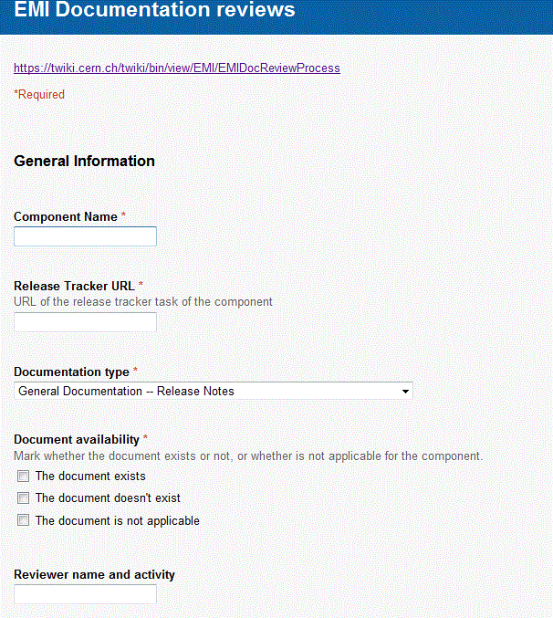
Documentation Review Form

Slide 11
Certification Report Template
**********************************
* EMI Certification Report *
**********************************
- Component:
- Savannah task:
- ETICS Subsystem Configuration Name:
- VCS Tag:
- EMI Major Release:
- Platform:
- Author:
- Date:
**********************************************
1. CR entry exists in the release tracker with core info properly provided:
1.1. Proper component name AND version is specified [yes/no]
1.2. All the RfCs corresponding to the CR listed [yes/no]
2. VCS tag available: [yes/no]
3. Etics configuration available: [yes/no]
4. The CR can be built in ETICS without errors: [yes/no]
5. Binary packages are available in EMI registered repo:
5.1. rpms [yes/no]
5.2. tarballs [yes/no]
6. Source packages are available in EMI registered repo:
6.1. rpms [yes/no]
6.2. tarballs [yes/no]
7. List of binary packages are specified in the tracker: [yes/no]
8. List of source packages are specified in the tracker: [yes/no]
9. Test Plan exists and it's specified in the tracker: [yes/no]
10. The CR testing has been performed and the Test Report is attached to the tracker. The report contains:
10.1. result of static code analysis [yes/no/na]
10.2. unit test execution [yes/no/na]
10.3. logs of deployment tests [yes/no]
10.4. result/logs of functionality tests [yes/no]
10.5. result/logs of regression tests [yes/no/na]
10.6. result/logs of standard conformance tests [yes/no/na]
10.7. result/logs of performance tests [yes/no/na]
10.8. result/logs of scalability tests [yes/no/na]
11. Minimum Required Documentation is complete:
11.1: up-to-date Functional Description is available and specified in the tracker [yes/no/na]
11.2: up-to-date User Guide is available and specified in the tracker [yes/no/na]
11.3: up-to-date Client Installation and Configuration is available and specified in the tracker [yes/no/na]
11.4: up-to-date System Administrator Guide is available and specified in the tracker [yes/no/na]
11.5: up-to-date Service Reference Card is available and specified in the tracker [yes/no/na]
12. Component Release notes are provided in the tracker [yes/no]
13. All the RfCs of the component release listed on the RC tracker are "Fixed" [yes/no]
14. Successful in-house deployment of the component from the EMI repo [yes/no]
15. Licence information is provided in the tracker and the component has an "EMI-compatible" licence [yes/no/na]
**********************************************
REMARKS:

Slide 12
SQA in Practice
SA2
Report deviations
SA2.1
Coordination
Report deviations
Monitor
PEB/EMT
SA2.2
QAP
SA1
SA2.3
Metrics
QC report
SA1.4
QC
SA2.4
Tools
Monitor adherence to SQAP & policies
JRA1
SA2.5
QA Review
QC report
JRA1.8
QC
SA2.6
Testbeds

Slide 13
Standard Practices and conventions
Policies: internal documents describing in detail the different stages of the SW lifecycle.
Release management: description of the different trackers to be used in the release process and the release management process.
Change management: description of the Request for Change (RfC) and Component Release (CR) objects.
Configuration and Integration: configuration and integration of the middleware.
Packaging: packaging of the middleware.
Testing: Test plans and Test Reports.
Documentation: description of the software documents that need to be provided.
Certification: Certification Reports.
Check List: description of all the steps needed to release middleware into EMI.
https://twiki.cern.ch/twiki/bin/view/EMI/SA2

Slide 14
Status and Next Steps
Current Status
Policies and Documentation describing the SW lifecycle for EMI are now finished.
Review tasks for EMI-1 are on going.
QA and QC Reports for the first year of the project also in progress.
Next Steps
Evaluation of the middleware quality for EMI-1.
Lessons learned from EMI-1 release process.
Improvement of SQA process after the evaluation.

Slide 15
Conclusions
EMI middleware is installed in the main EU grid infrastructure. Important scientific projects depend on the EMI quality, therefore SQA is really a necessary activity.
SQA needs to be supported as well by metrics, tools and test infrastructure (see other talks in the session).
The SQA process helps organizing the work of the EMI development teams in a uniform way.
SQA defines quality criteria for the EMI middleware. It evaluates whether the criteria is met helping to improve the middleware.

Slide 16
Links
SA2 main twiki page: Links to policies and any other SQA document
https://twiki.cern.ch/twiki/bin/view/EMI/SA2
SQAP:
https://twiki.cern.ch/twiki/bin/view/EMI/DeliverableDSA21
SA2.2 twiki page: QA reports and QA Standards
https://twiki.cern.ch/twiki/bin/view/EMI/TSA22

Slide 17
Thank you
EMI is partially funded by the European Commission under Grant Agreement INFSO-RI-261611

