Slide 1

Dynamic networks for e-Infrastructure
David O’Callaghan
Trinity College Dublin
david.ocallaghan@cs.tcd.ie
EGI User Forum 2011
11th April 2011 – Vilnius, Lithuania
Notes:
You’re familiar with cloud computing: providing infrastructure as a service over the network.
Mantychore is about allowing cloud-like control of the network
And this can be particularly useful for virtual research communities, grid

Slide 2
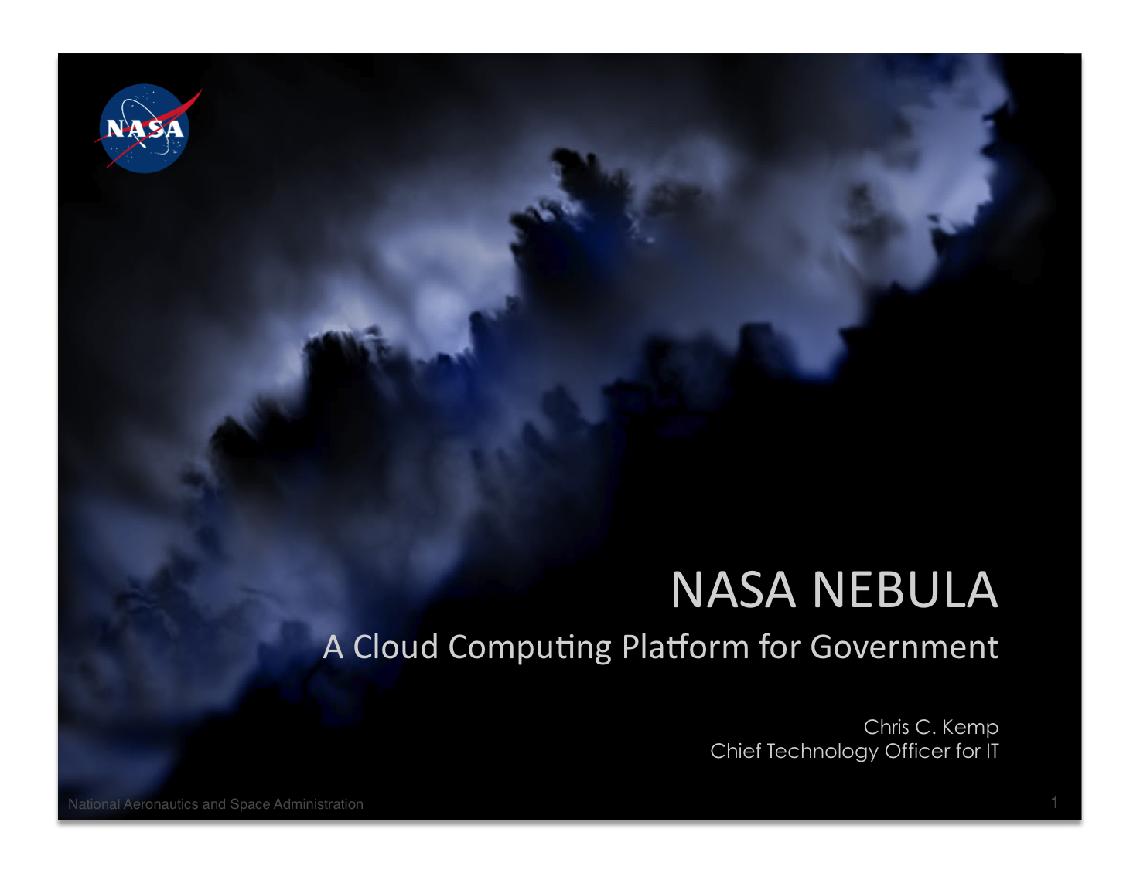
Introduction
goes here
Notes:
Example: shows benefit of providing on-demand self-service computing
NASA’s Nebula platform grew out of a desire to do more with less funding

Slide 3
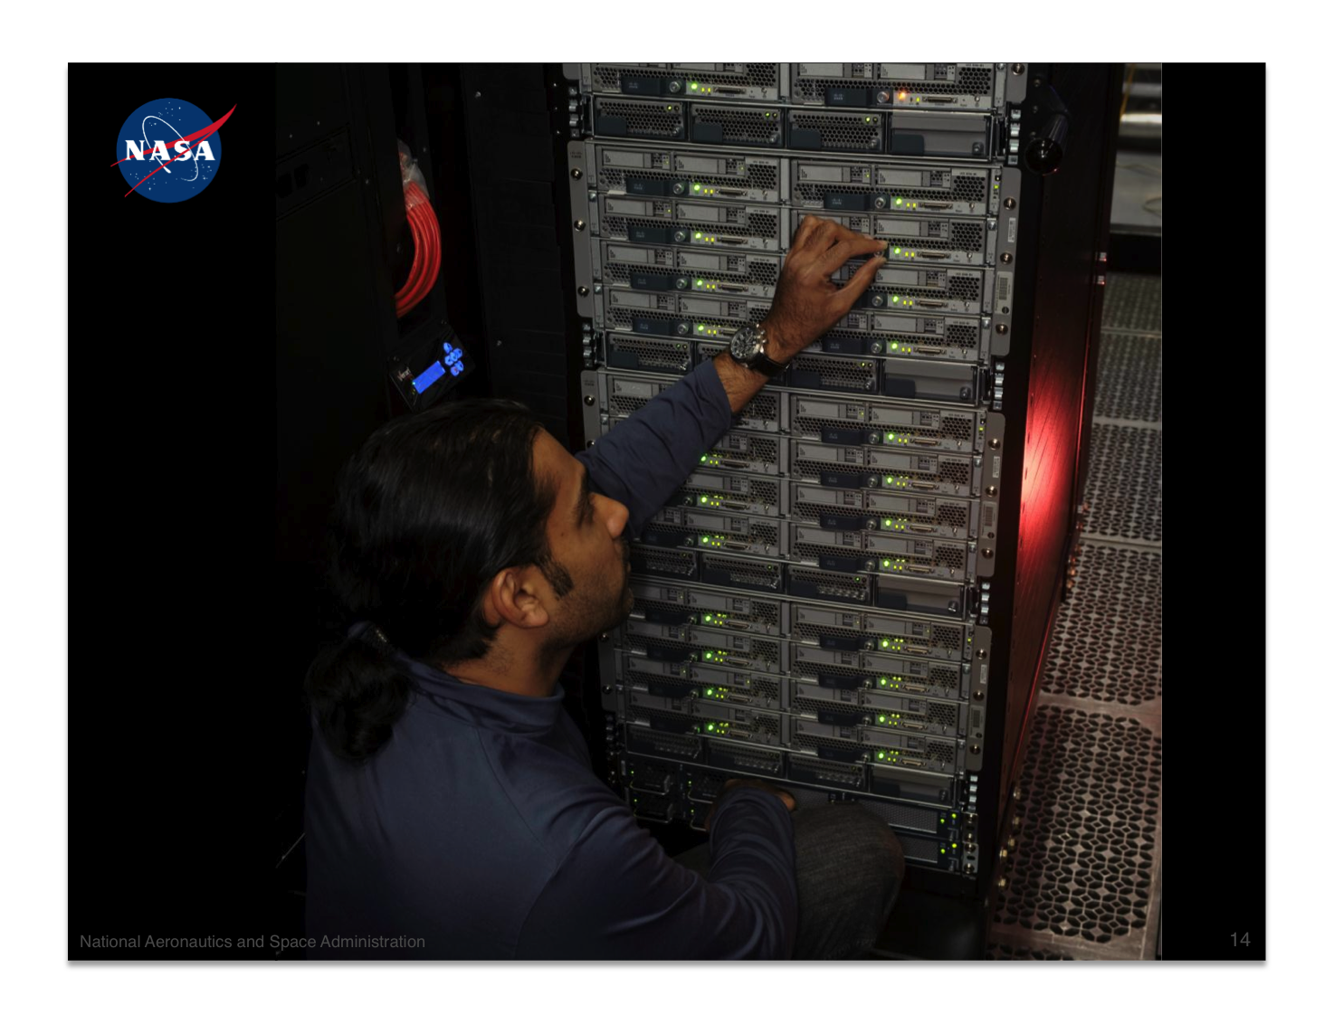

Slide 4
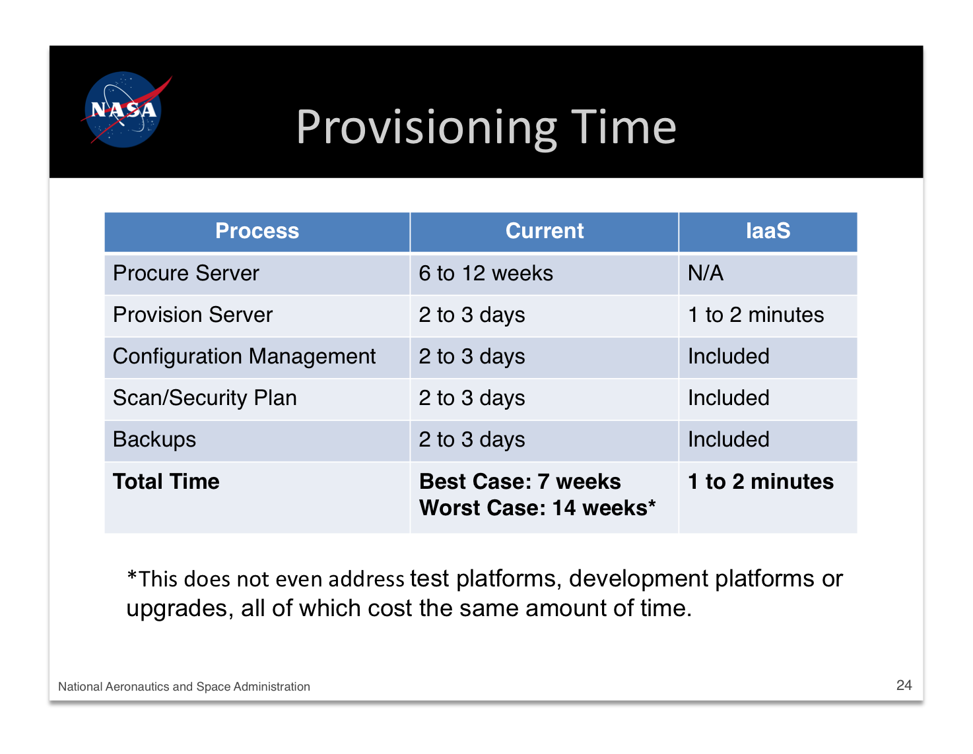
Notes:
Reduced the time taken to provision a server from months to minutes.
Researchers and scientists see the benefits.
Mantychore aims to do the same for networking: provisioning networks as a cloud service.

Slide 5

Manticore
Proof of concept for
IP network and
router as a service
2006
Notes:
With the aim of creating a proof-of-concept for (Layer 3) IP networks and routers as a servivce
The first Manticore project was started in 2006 between NRENs, developers and network vendors such as Cisco and Juniper

Slide 6
Manticore II
Improved capabilities
Pilot on NRENs
2007
Notes:
Partition physical routers into logical routers
Configure external (BGP) and internal (OSPF, RIP) routing protocols

Slide 7
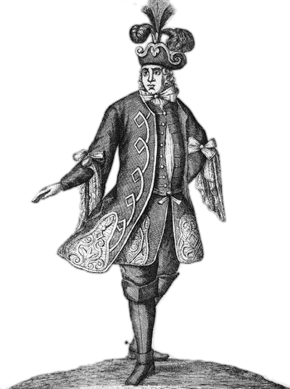
What about the
network
users?
Notes:
Focused on NRENs’ internal operations.
The next step was to involve real network users.

Slide 8

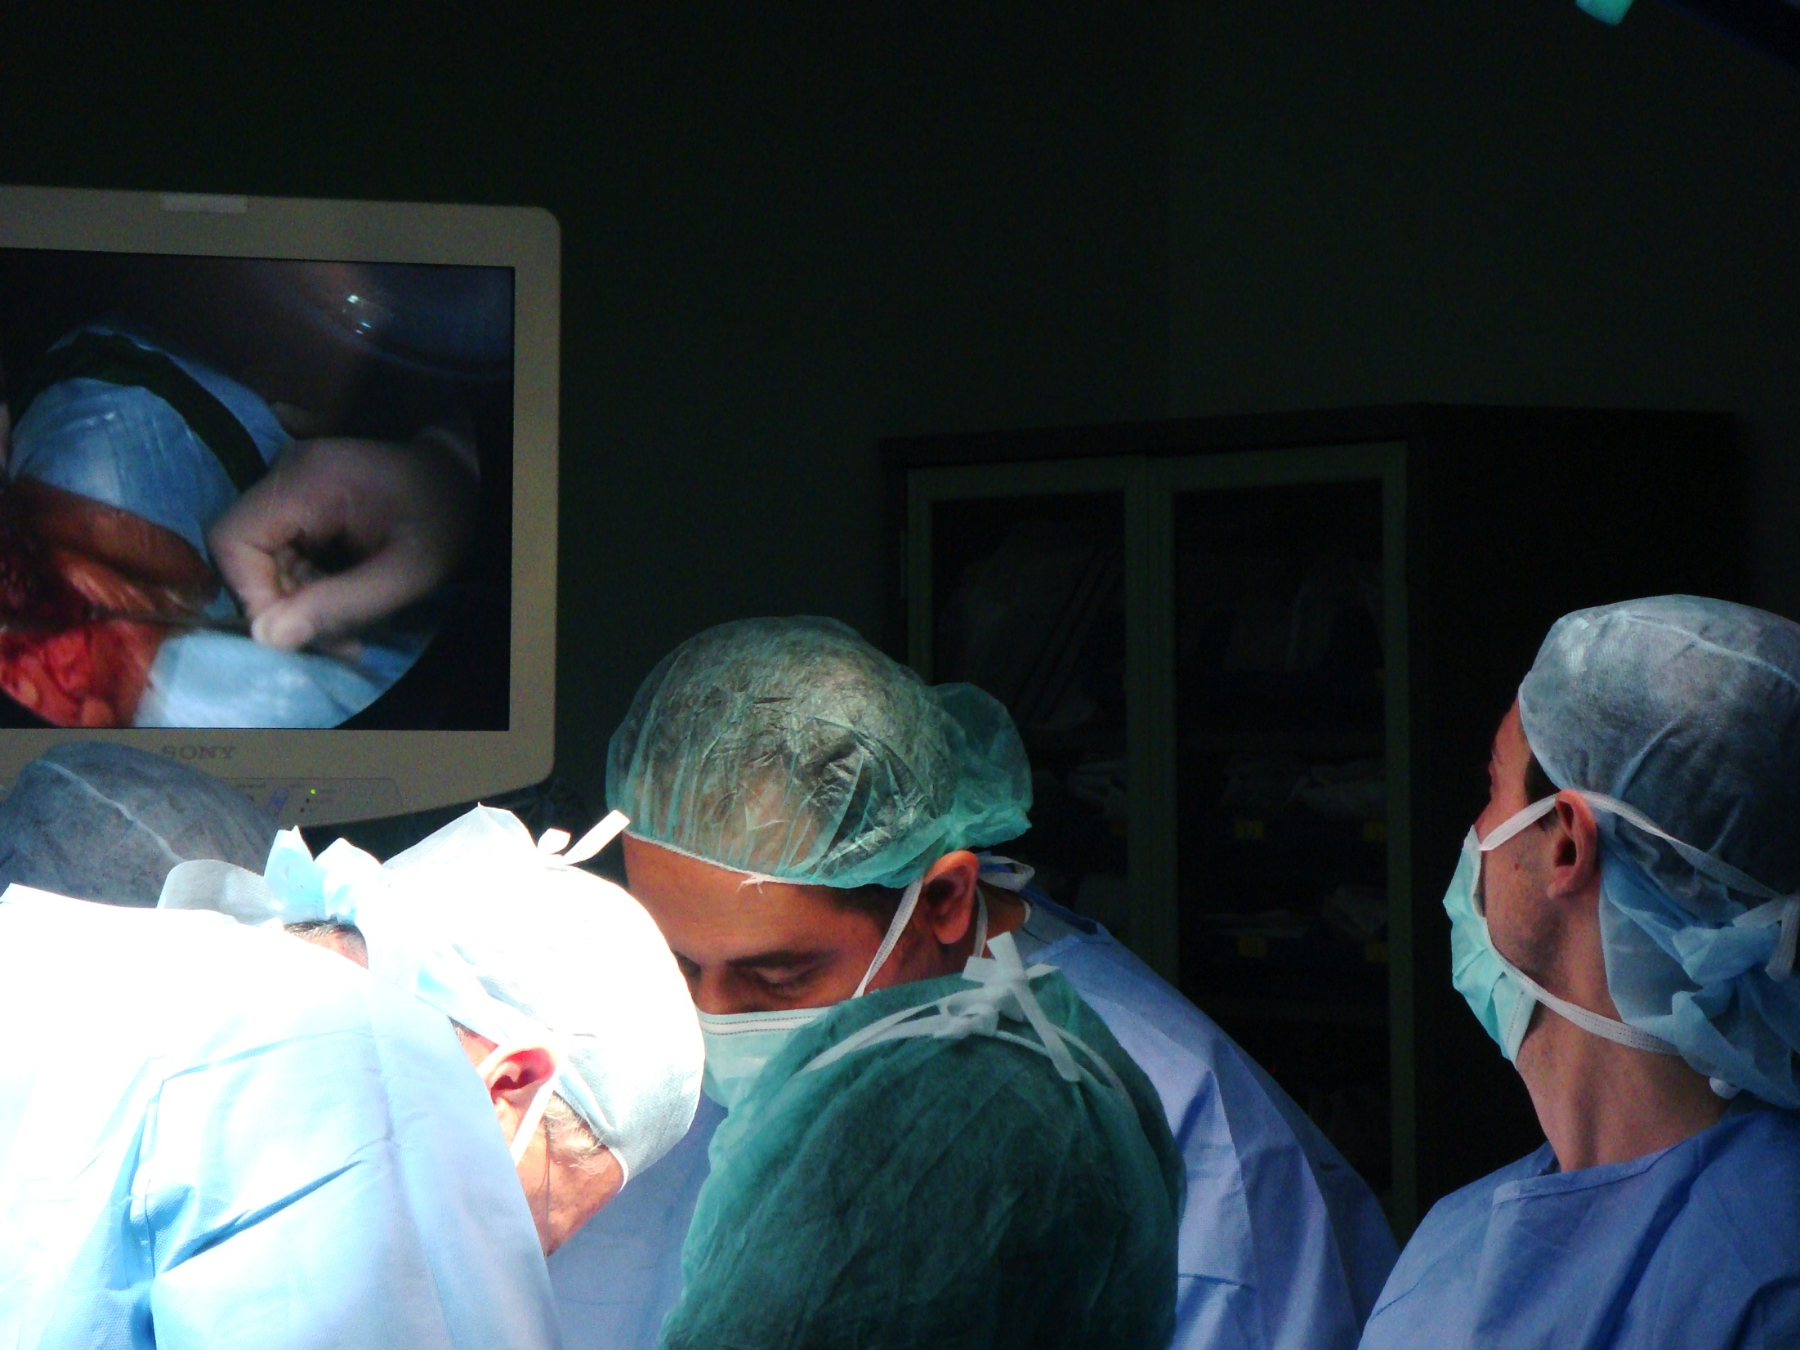
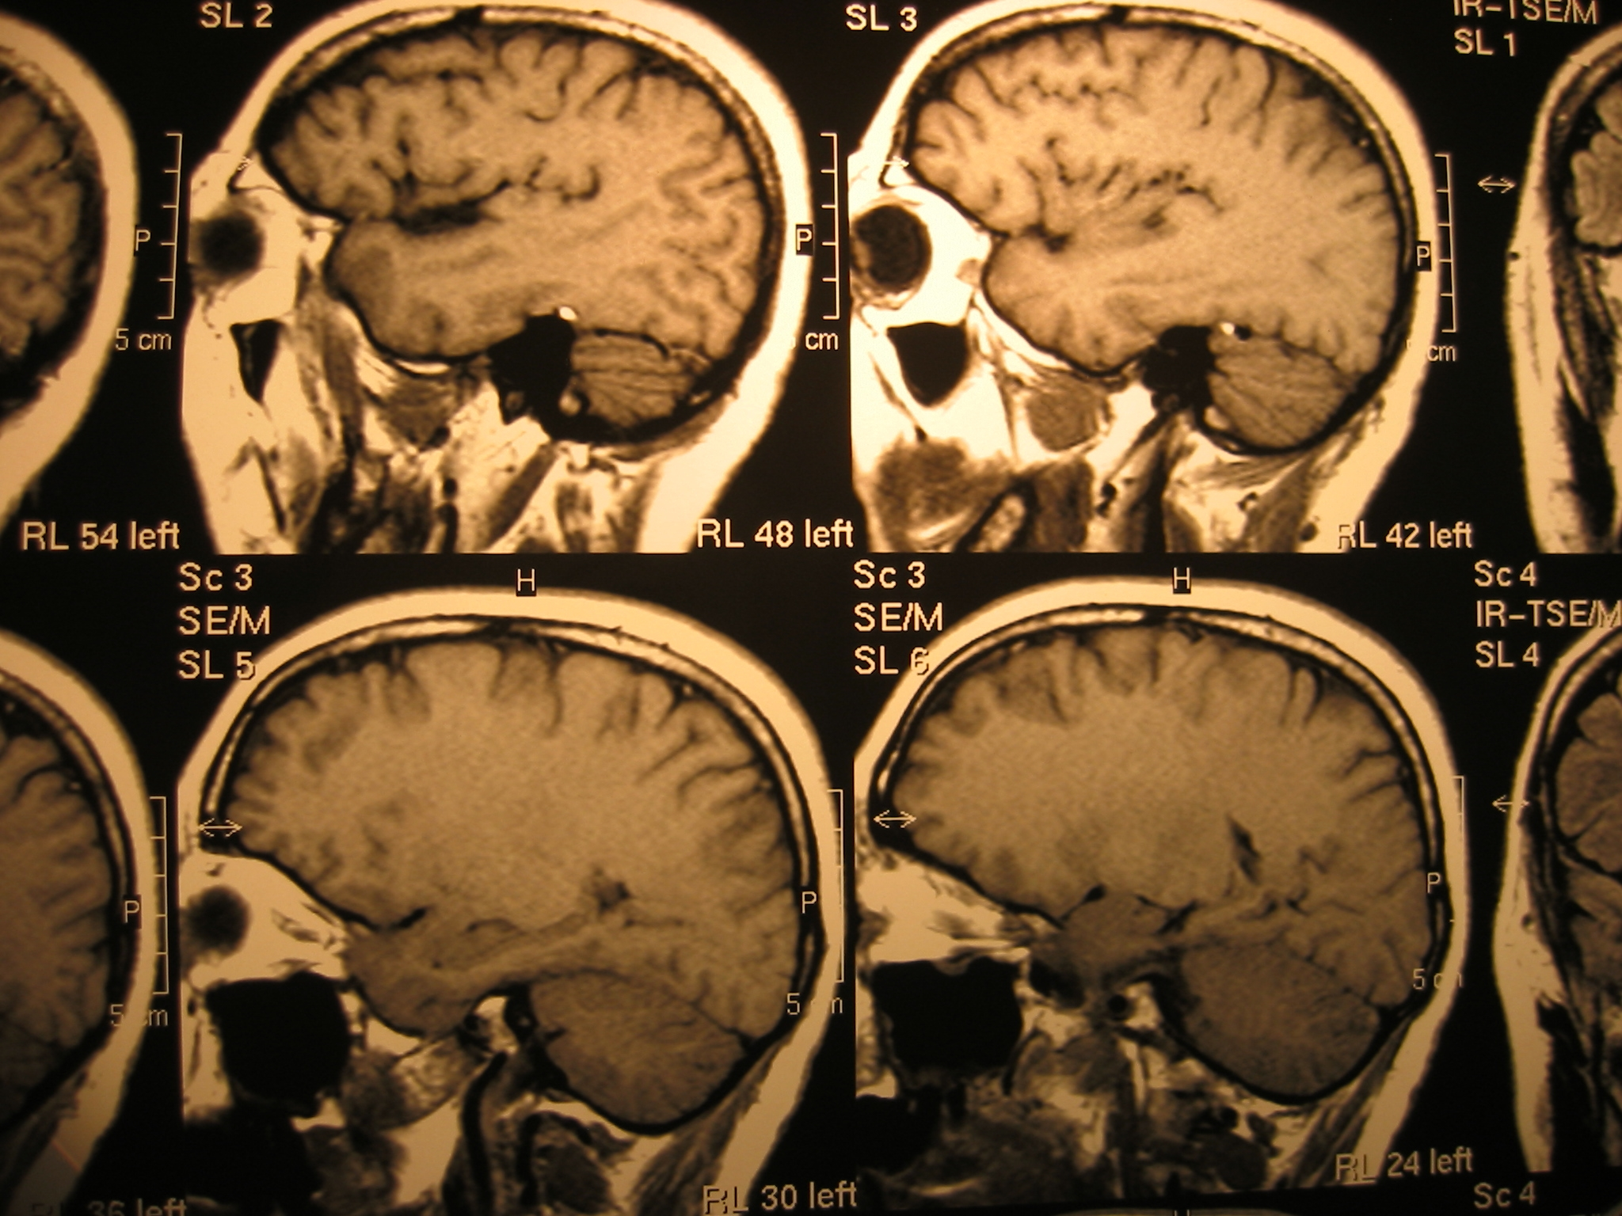


Grid and Cloud
3D and UHD
Health
Multimedia
Virtual CPE
Notes:
With Real-world requirements with more control of network
from Layer 1 optical links, Layer 2 ethernet as well as Layer 3 Internet Protocol

Slide 9
2007

Slide 10

ICT-2009 Call 5
1.2.3 – Virtual Research Communities
October 2010
Notes:
A consortium including NRENs and users submitted an FP7 proposal for a pre-production service,
Total Project Cost: 1,564,386€
EC contribution: 1,399,740€
Start date: October 1st, 2010
Duration: March 31st, 2013 (30 months)
(Name changed to avoid conflict)

Slide 11

Research Centre
Consortium Mix
Research
NRENs
Users
Commercial
Spain
Coordination
Development
Notes:
Consortium is a good mix of organizations
I2cat from Barcelona coordinates the FP7 project and develops the Mantychore software

Slide 12


Research & Education Networking
Ireland
Virtual Customer
Premises Equipment
Nordic Region
Cloud Networking
and Migration
Zero Carbon
Notes:
HEAnet is the Irish NREN. It would like to use Mantychore to virtualize the equipment deployed to their customers
Also, leads Dissemination
NORDUnet is an international research & education education in the Nordic region.
Also, leads Training and user community development
Both organizations have an interest in carbon-neutral infrastructures

Slide 13



Network Users
United Kingdom
Multimedia
Marketplace
Denmark
Health
Ireland
Grid & Cloud
Notes:
UNI-C is the Danish IT Centre for Education and Research

Slide 14

Commercial
Spain
Commercial
Exploitation
Notes:
Telefonica leads commercial exploitation of the project results

Slide 15

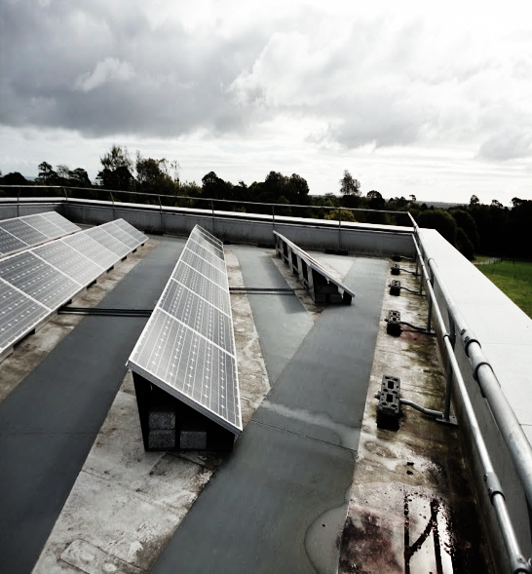
Ireland
Virtual Customer
Premises Equipment
Zero Carbon
Nordic Region
Cloud Networking
and Migration
United Kingdom
Multimedia
Marketplace
Denmark
Health
Ireland
Grid & Cloud
Notes:
Users were invited to submit use-cases with the focus on what they would like, rather than what is already possible.
Let's start with the University of Essex.

Slide 16
Streaming 3D and
Ultra High Definition
multimedia
Notes:
The use case comes from the high performance networking group at Essex
Deployment of next generation multimedia applications
Entertainment and tourism applications in 3D and ultra high definition
and cultural heritage content (laser scans) from Scotland

Slide 17
Streaming 3D and
Ultra High Definition
multimedia
Notes:
medical imaging from NHS trusts in Wales

Slide 18





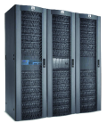


USERS
USERS
ESSEX
GLASGOW
JANET UK-IP
USERS
USERS
CARDIFF
USERS
USERS
Notes:
Mantychore should provide Bandwidth on Demand for live events
Or be able to schedule advance reservations
Flexibility to adjust network, independent of underlying infrastructure.

Slide 19
Virtual
Customer Premises Equipment
Notes:
As Irish NREN, HEAnet serves universities and schools.
The NREN provides Customer Premises Equipment for each customer.
HEAnet is interested in reducing costs and simplifying provisioning

Slide 20




Provider’s domain
(HEAnet)
Physical Router
CPE
Logical Router
Client A domain
Client B
Notes:
Providers enforce parts of the CPE configuration i.e. BGP policies.
Delegation of partial configuration rights to clients. Internal routing / Firewall
Automatic provisioning of new clients.
Reduce need for new hardware deployments.

Slide 21
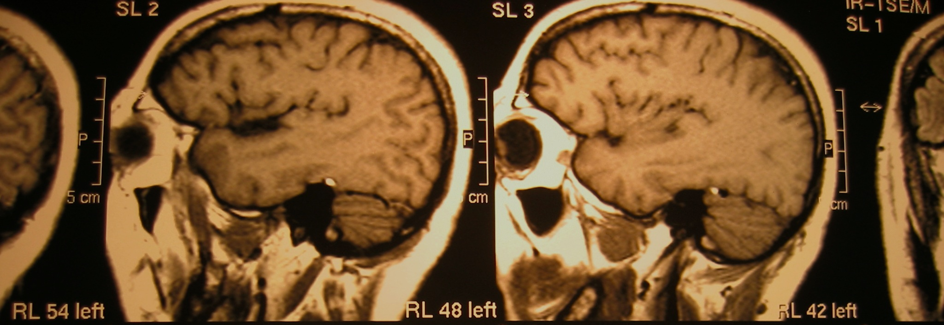
Networking for
e-Health in Denmark
Notes:
Currently health providers in the Danish Health Network are connected through a mix of VPNs and fixed links.
Mantychore will provide a convenient alternative, which
doesn’t require installation of new hardware

Slide 22
Provider’s domain
(Health Data Net.)
MPLS LSP’s
Provider’s domain
(UNI·C)
Physical Router
Logical Router
CPE
VPN
Client A domain
Notes:
As before, the provider can control and delegate some control to clients
Automatic provisioning of access to provider LSP channels.
Directly or via a VPN.
Reporting to existing accounting infrastructure.

Slide 23
Grid and Cloud
computing
Notes:
TCD will explore using Mantychore for related grid and cloud use cases.
The idea is to federate distributed resources into a single grid or cloud site at the network level,
This should simplify adding resources at sites with little manpower.

Slide 24
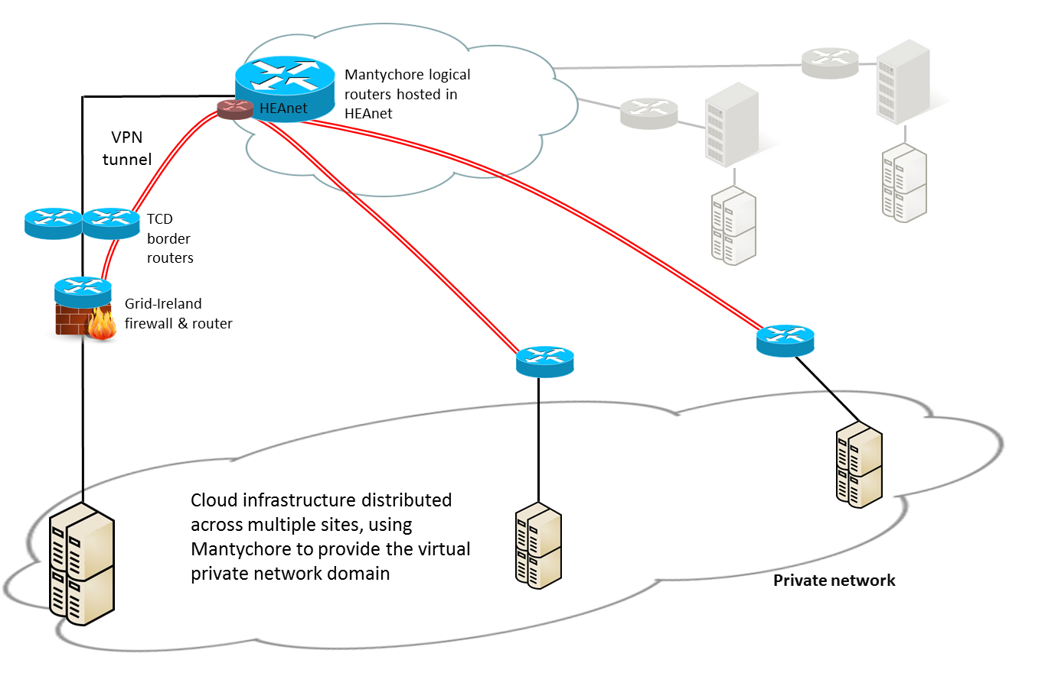
Notes:
In the first case we will connect sites via a Mantychore-managed VPN running over regular Layer 3 IP connections.
This avoids disruption to local networks.
We intend to use gLite or EMI grid middleware, and StratusLab cloud software,
This should not require modification to the grid or cloud middleware.

Slide 25
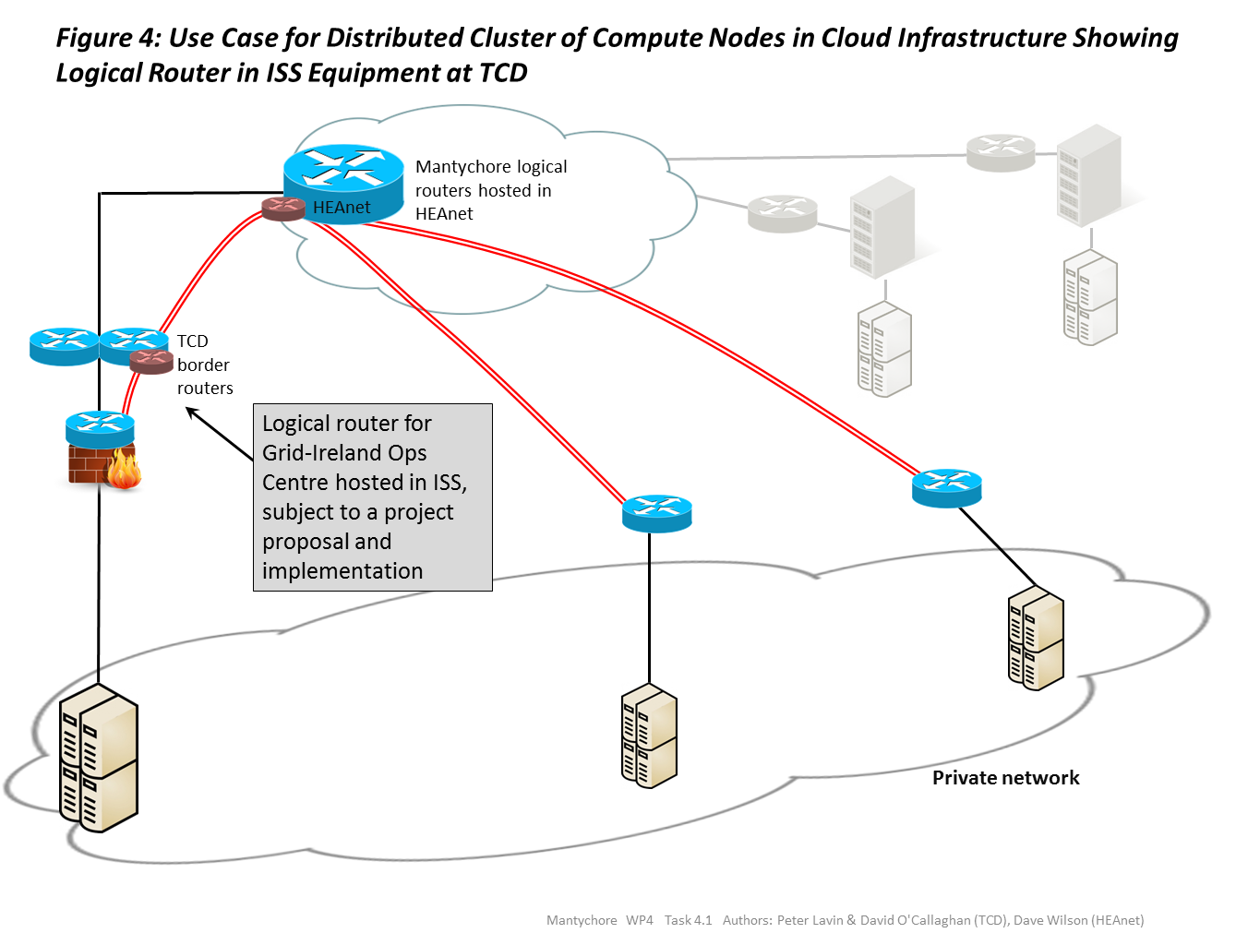
Notes:
Later, we plan use Mantychore control of lower network layers to eliminate the VPN overhead.
This will require more involvement with local network administrators: an experiment in itself.
MetaCentrum and CESNET have a poster with some similar work

Slide 26
Cloud Migration
Notes:
Nordunet proposes a use case for migration of legacy services at research and education institutions to the cloud
In a completely transparent fashion.
The aim is to avoid any configuration changes above the IP network level.

Slide 27
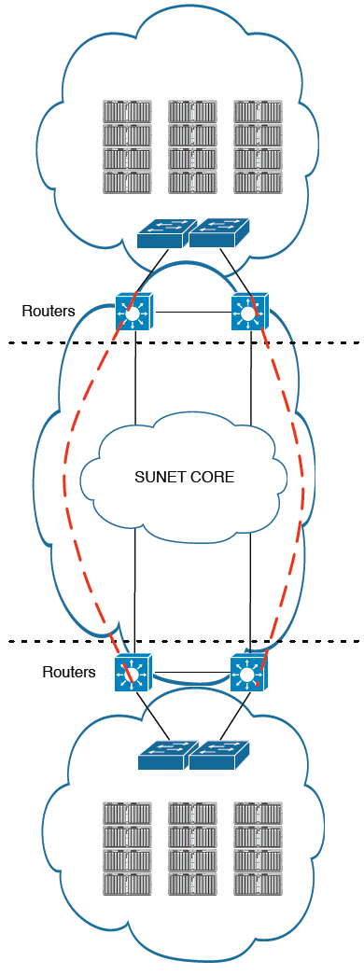
VM migration
Notes:
The NREN provides a configurable network.
A cloud computing provider, the NREN or commercial provides clouds with a configurable address space
The university campus grants partial access to Mantychore.
This will allow migration of services to the cloud without changing network addresses, etc.

Slide 28

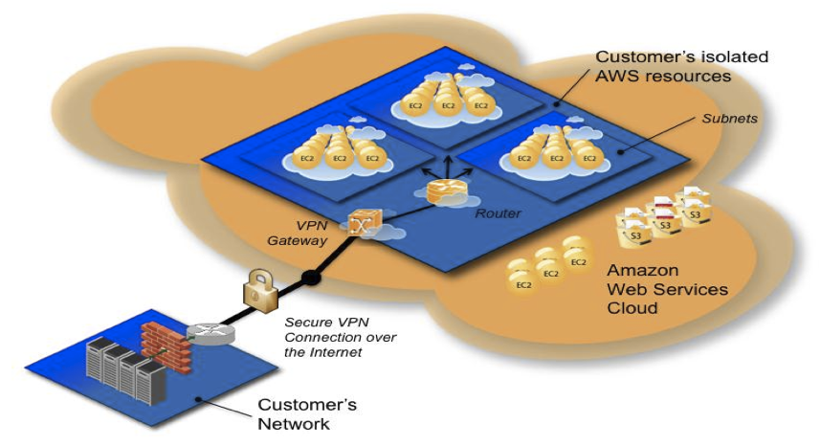
Virtual Private Cloud
Notes:
Compare with Amazon VPC, which launched a dynamic network component recently.
Amazon VPC allows various configurations of public and private subnets and with/without internet access.
Mantychore aims to provide similar support, with the advantage that it can operate at the lower, physical layers of the network.
Mantychore will also support IPv6.

Slide 29
Year 1
Deployment
Software Development
Requirements
Oct 2010
Mar 2011
Jul 2011
Notes:
With these requirements provided by the network users, it was possible for software development to begin in full.
So now let’s take a look at the deployment and architecture of Mantychore.

Slide 30
Year 1
Deployment
Software Development
Requirements
Oct 2010
Mar 2011
Jul 2011

Slide 31
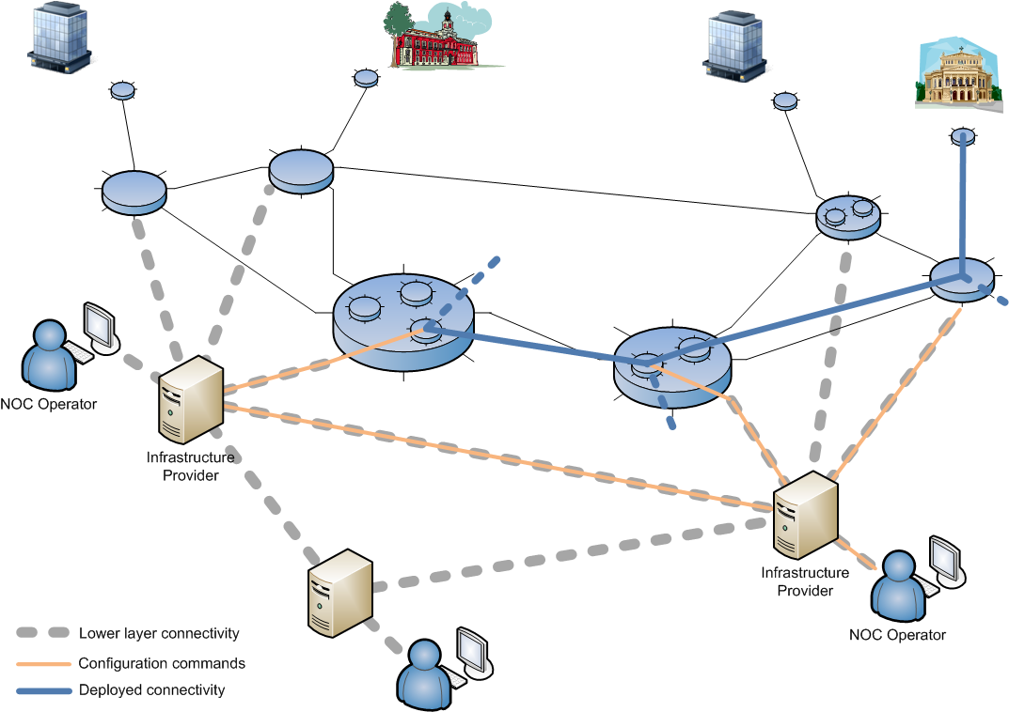
Deployment
Notes:
Mantychore is deployed in a federated fashion.
Each network infrastructure provider deploys a Mantychore server which can communicate with others.
Each server controls network hardware such as routers
In the example, an operator connects to her local Mantychore server
To configure the network highlighted in blue for the user at the top-right

Slide 32
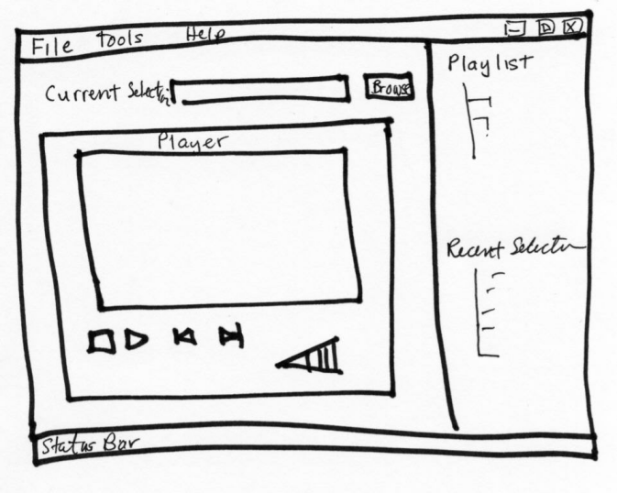
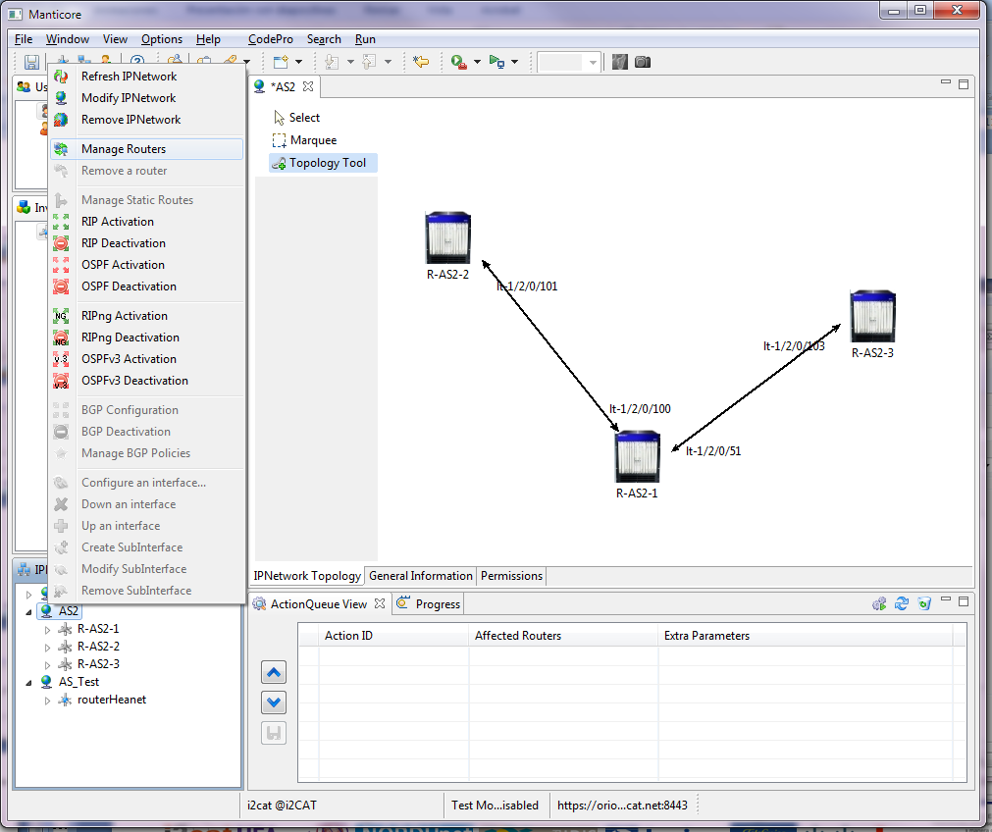



Architecture
Fuse Service Mix
Router WS
Router Engine
Protocols
Web
IP Network WS
User Management WS
External
Identity
Provider
Policies WS
Notes:
On the right are the routers and other devices controlled by Mantychore. Currently these include Juniper routers
with the aim to support software routers and VPNs to meet the use case requirements.
User management will make use of external federated identity providers, hopefully via EDUgain, and initially individual national federations.
The web services are based on FUSE ServiceMix platform
And the user interface will be provided as a web interface, with a number of specialised user interfaces tailored to the use cases.

Slide 33
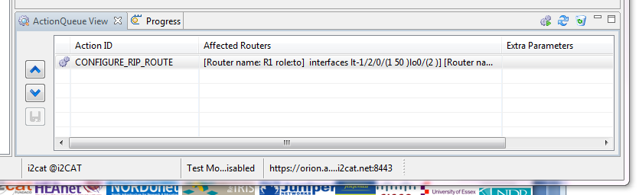
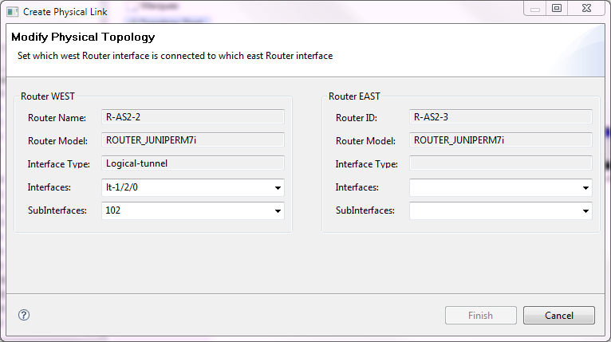
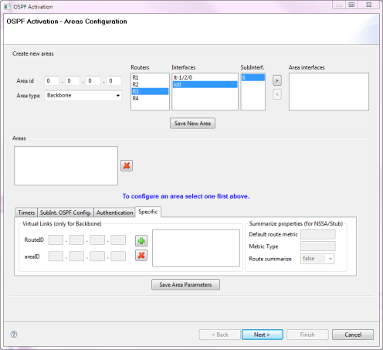
User Interface
Notes:
The existing user interface from the previous Manticore projects allows a user to create virtual routers and draw links between them.

Slide 34
Year 1
Zero Carbon
Marketplace
Deployment
Software Development
Requirements
Oct 2010
Mar 2011
Jul 2011
Notes:
In parallel with requirements analysis and software development are a number of research activities

Slide 35

Marketplace
for Infrastructure Resources
Notes:
Users from VRCs will be able to access resources from several providers
Create a logical network based on price.
The NRENs will announce their own infrastructure as resources of MANTYCHORE services
Exploring Algorithms for negotiation and reservation of best resources for a given request.

Slide 36
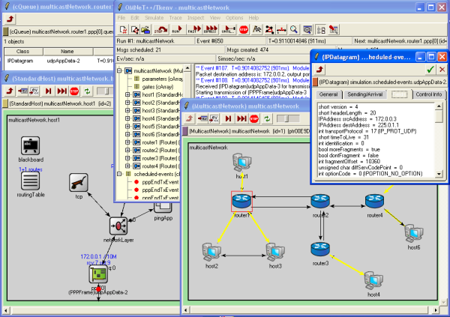
Network Simulation
Notes:
Omnet+ Simulation to analyse performance of marketplace algorithms
To be followed by emulation of use case scenarios involving
streaming ultra high-definition content, mentioned earlier

Slide 37
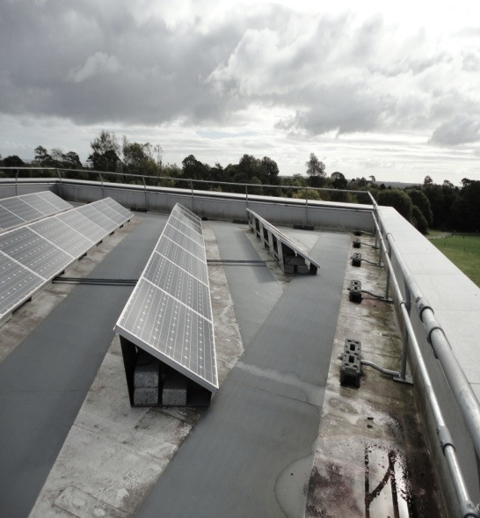
Zero Carbon
Notes:
Use Mantychore to create networks that can adapt to green power sources,
and to migrate networking or computing services to where green power is available.
This picture is taken in Ireland.

Slide 38

Notes:
In collaboration with…
GreenStar is a consortium of industry, universities and government agencies
with the common goal of reducing greenhouse gas emissions arising
from information & communication technology (ICT) services
Support service providers that offers customers the lowest price and greenest services

Slide 39
Year 1
Zero Carbon
Marketplace
Deployment
Software Development
Requirements
Oct 2010
Mar 2011
Apr 2011
Jul 2011
Notes:
Let’s look at where we are now.
Software developers are analysing and implementing required software
Network users are preparing for deployment

Slide 40
Year 2
Zero Carbon
Marketplace
Deployment
Software Development
Oct 2011
Jul 2012
Oct 2011
Notes:
The software will be developed using the Scrum agile method, with a tight feedback loop between deployment and development.

Slide 41
Year 3
Zero Carbon
Deployment
Software Development
Oct 2012
Mar 2013
Notes:
At the end, the results should form part of the NREN service portfolios.

Slide 42

Open Wiki
Open Mail
Open Source
Open Web
.eu
Notes:
We are an open project!
See mantychore.eu on the web

Slide 43


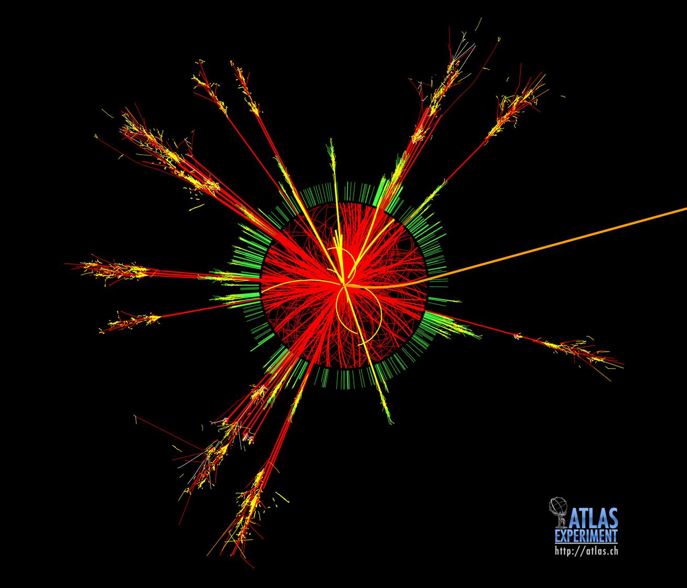
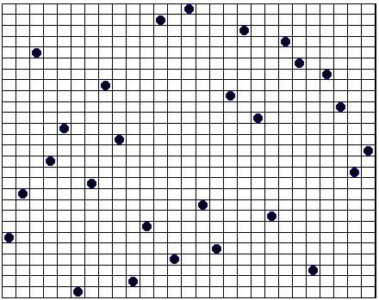
Please, get involved!
Notes:
Mantychore would like virtual research communities and infrastructure providers
from the grid and cloud worlds to get involved at any level,
from detailed technical discussion to suggestions or questions.

Slide 44
Notes:
I hope I’ve given you a flavour of Mantychore and its aims
to provide cloud-like control of all layers of the network at all layers as a service

Slide 45
.eu
Notes:
For more information see the website Mantychore.eu or talk to David O’Callaghan (TCD) or Pau Minoves (i2cat)

Slide 46
Photo Credits
Manticore Wikimedia Commons
Actor Wikimedia Commons
Operating room Wikimedia Commons
Cameraman Stock Exchange
Head x-rays Stock Exchance
Investment bank Encyclopædia Britannica
Merchant bank, London. Photograph. Encyclopædia Britannica Online. Web. 10 Apr. 2011.
http://www.britannica.com/EBchecked/media/101352/The-trading-floor-of-a-merchant-bank-in-London

