Slide 1
Operating grid services on the StratusLab cloud
Vangelis Floros, GRNET
EGI User Forum 2011
11-14 April 2011, Vilnius
Notes:
Needs update

Slide 2
Presentation Outline
Project overview and Goals
StratusLab Cloud Distribution
Reference Cloud Service
Grid sites over cloud
Deployment
Configuration
Experience and Issues
Future work
Conclusions

Slide 3
StratusLab Project
Goal
Create comprehensive, open-source, IaaS cloud distribution
Focus on supporting grid services
Information
1 June 2010—31 May 2012 (2 years)
6 partners from 5 countries
Budget : 3.3 M€ (2.3 M€ EC)
Contacts
Site web: http://stratuslab.eu/
Twitter: @StratusLab
Support: support@stratuslab.eu
CNRS (FR)
UCM (ES)
GRNET (GR)
SIXSQ (CH)
TID (ES)
TCD (IE)

Slide 4
Primary Use Cases
Grid sites on top of cloud infrastructures
Bridge cloud and grid technologies
Understand technology gaps and implications from combining these two approaches in the same environment
Demonstrate production level grid services on top of cloud technologies
Cloud-like approaches for grid service provision
Dynamic management / Elasticity of computing resources
VO-based authentication and authorization for accessing cloud resources

Slide 5
Grid and Cloud Integrations
users
Grid Resource Center
Grid Services
Cloud API and Service Manager API
StratusLab
Distribution
Private/Public Cloud
Public Clouds

Slide 6
Target User Communities/ Application Domains
System Administrators
Will use the StratusLab distribution to deploy their own cloud infrastructure
Manual installation
Installation through the Quattor system
Grid Site administrators
Will use a StratusLab-based cloud infrastructure to deploy their Grid sites
Will re-use existing appliances with grid middleware or build their own images
End Users
Focus on Scientific applications (same as with Grid applications)
Bioinformatics community participates in the project (CNRS/IBCP). Early adopters of StratusLab technology
Will run their applications either as Grid jobs or by accessing computing resources directly from the cloud APIs.

Slide 7
So far, so good…
Series of public/preview releases of StratusLab distribution
Latest release: v0.3 (9 March 2011)
RPMs available from the StratusLab repo: http://yum.stratuslab.eu
OpenNebula 2.2 core virtual machine manager
Public reference cloud service
Operated by GRNET
Provides access to external users. Requests send to support@stratuslab.eu
Based on the latest at time StratusLab release
Appliance repository
Operated by TCD
Offers base OS and appliance images (pre-cooked with app-level software).
Is evolving towards a “Marketplace” of VM Appliances (registry of VM metadata – actual images stored in the cloud)

Slide 8
Architecture of StratusLab v1.0
Appliance Management
users
HTTP(S) REST Interface
StratusLab Marketplace
Appliance Storage (Web, Grid, Cloud)
IaaS Cloud
TCloud
Service Manager (Claudia)
XML-RPC → OCCI
REST/CDMI
Virtual Machine Manager (OpenNebula)
Storage Manager
KVM
Xen
VMware
…
iSCSI (?)
…
Physical Computing Resources
Physical Storage Resources

Slide 9
Reference deployment

Slide 10
Deploying a new gLite grid site
Appliance Repository
CE image
WN image
stratus-* cli commands
stratus-run-instance,
stratus-describe-instance,
stratus-kill-instance
SE image
UI image
APEL image
VM Instantiation
IaaS Cloud Service running StratusLab distribution
CE instance
SE instance
Cloud Storage
WN instance
WN instance
WN instance
…
WN instance

Slide 11
Configuring the site
Yaim files configuration
VO setup
LRMS setup
Site definition
…
SSH pubkey-based authentication
Access and configure CE, SE nodes
IaaS Cloud Service running StratusLab distribution
CE instance
SE instance
Cloud Storage
WN instance
WN instance
WN instance
…
WN instance

Slide 12
Expanding the site (adding more WNs)
Appliance Repository
Yaim files configuration
LRMS setup
Site definition
…
WN image
stratus-run-instance
Update site-info.def with more WNs
Run yaim
WN VM Instantiation
IaaS Cloud Service running StratusLab distribution
CE instance
WN instance
WN instance
WN instance
…
WN instance
WN instance
WN instance
WN instance
WN instance

Slide 13
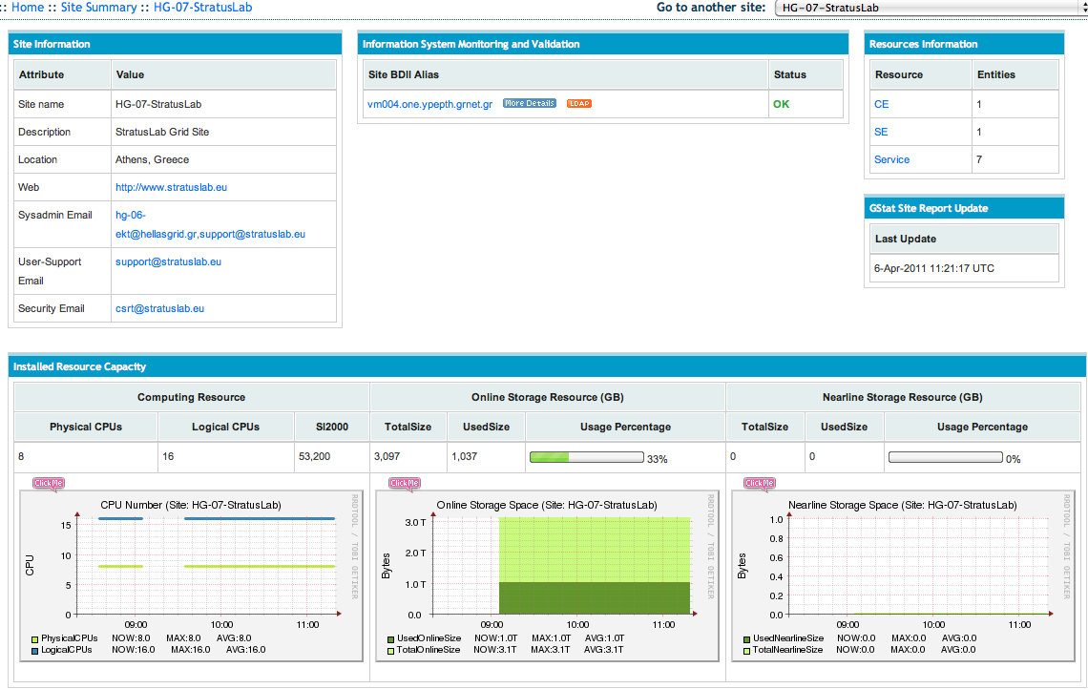
In action: HG-07-StratusLab
The first (?) fully virtualized production grid site running on a cloud infrastructure
1 CE, 8 dual-core WNs, 1 SE (3TB of storage), 1 gLite-APEL monitoring node, 1 UI
Certified in Greek NGI, officially part of the national grid infrastructure
Gstat details: http://gstat-prod.cern.ch/gstat/site/HG-07-StratusLab/

Slide 14
Benefits
Grid admins
Reduced time to production
Minimize chances of downtimes due to hardware problems
Easier to quickly scale on high load demands
Hardware administration delegated to cloud provider
Cost-efficient access to computing resources (?)
Grid end-users
Experience a more reliable Grid service
Additional work is needed in order to exploit the full potential of the cloud

Slide 15
Issues - Installation
Provision of official grid images
Verified for proper operation
Secure
Up-to-date with latest releases
Available from VM Marketplaces
Will facilitate the adoption of cloud services for quick deployment of secure and stable virtualized grid sites
CE image
gLite CE 3.2 R52
SL 5.5
QCOW
CERTIFIED

Slide 16
Issues – YAIM Configuration
YAIM configuration approach not cloud-friendly - leads to a static site definition
Site locality
Geo-location (Lat, Long) might not be known – “It’s somewhere in the cloud” ☺
Location may also change – VM migration to different datacenter
Site structure
Not all WNs are the same (easy to instantiate different VM profiles in cloud context)
Hardware information
Number of Physical CPUs? Number of Logical CPUs? Should be able to define “Number of Virtual CPUs”
CPU_ARCH? SMP_SIZE? Does it really make sense?

Slide 17
Issues – site operation
Dynamic management and elasticity
Should be able to fully exploit the capabilities of the underlying IaaS cloud
“Unknown” territories
Grid sites hosted in datacenters outside the home NGI
Grid sites split in multiple cloud datacenters
In different service providers
In different countries
Outside Europe
Which NGI certifies the site?
Which CA issues the service certificates

Slide 18
Towards elastic Grid sites
Exploit the full potential of cloud infrastructures
Elastic CE/WN management
Dynamic site re-configuration based on workload
Add more WNs to accommodate increased number of job submissions
Increase storage to accommodate increased volumes of Data
Will require interoperability with the underlying Grid middleware
Service manager (Claudia) to facilitate grid elasticity in StratusLab (work in progress)
Relevant work:
INFN’s Worker nodes on-demand (WNoDeS)
SARA’s BiG Grid

Slide 19
Bringing real benefits to the end user
Direct access to cloud resources
Collaborative cloud environments
VO-aware cloud services
“By-pass” grid central services and queuing systems
Evolve existing grid information systems and AAA frameworks
Leverage IaaS cloud capabilities
Access to “infinite” computing resources
WN images customized by VO-managers/end-users

Slide 20
Conclusions
StratusLab working on cloud / grid integration/interoperability scenarios
StratusLab pre-1.0 released. Final version expected end of May
Reference cloud service publicly available
Production grid site running on reference cloud
Working on elastic grid site functionality
Exploring grid-like access to cloud resources

Slide 21
For more information…
StratusLab wiki: http://www.stratuslab.eu
Support mailing list: support@stratuslab.eu (also for requesting access to the reference cloud service)
Appliance Repository: http://appliances.stratuslab.eu
Git (source code): http://code.stratuslab.eu/public/git/
Package repository: http://yum.stratuslab.eu
OpenNebula toolkit: http://opennebula.org/
Quattor toolkit: http://quattor.sourceforge.net/

