Slide 1
Reducing cloud boundaries in the ATLAS experiment
Fernando H. Barreiro Megino, CERN and SA3,
on behalf of the ATLAS Distributed Data Management (DDM) collaboration

Slide 2
Acknowledgements
David Tuckett
Andrii Thykonov
Some slides are courtesy of Simone Campana

Slide 3
Outline
Overview of the situation
Optimizing data transfers and enabling cross cloud transfers
Sonar tests: measurements of the full ATLAS Grid mesh
T2Ds: “Directly connected T2s”
Conclusions

Slide 4
Overview

Slide 5
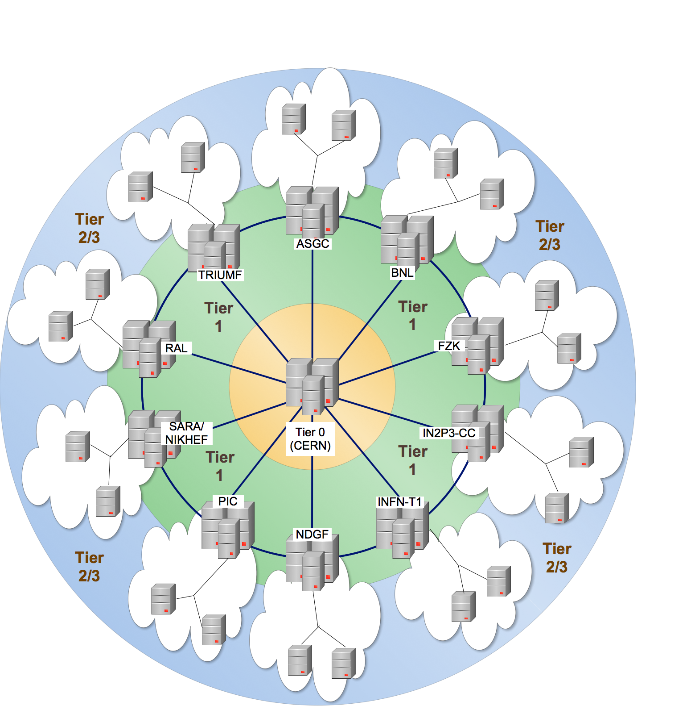
Original data distribution model
Hierarchical tier organization based on Monarc network topology
Sites are grouped into clouds for organizational reasons
Possible communications:
Optical Private Network
T0-T1
T1-T1
National networks
Intra-cloud T1-T2
Restricted communications: General public network
Inter-cloud T1-T2
Inter-cloud T2-T2

Slide 6
Reasons to reduce cloud boundaries
Data distribution is moving from a fixed data pre-placement towards a dynamic data caching model
maintain minimal data repositories and replicate ”hot” data for analysis
this model is less flexible if the replication can only be done in the same cloud
User analysis output aggregation
No complete copy of input data in each cloud
Jobs produce output in many clouds
Need to hop the data through the Tier1s for final consolidation
MonteCarlo production must confine one task to one cloud to facilitate the output aggregation at Tier1s
High priority production tasks should use as many CPUs as possible

Slide 7
Having said that…
Network bandwidth has significantly increased since Computing Model was first published
The current connectivity between sites does not really resemble the Monarc model anymore
Many Tier2s are connected very well with many Tier1s
Many Tier2s are not that well connected with their Tier1
Therefore it seems reasonable to
reduce the cloud boundaries
let DDM optimize cross-cloud transfers
evolve the Computing Model where possible

Slide 8
DDM Transfer Service: Optimizing data transfers and enabling cross-cloud transfers

Slide 9
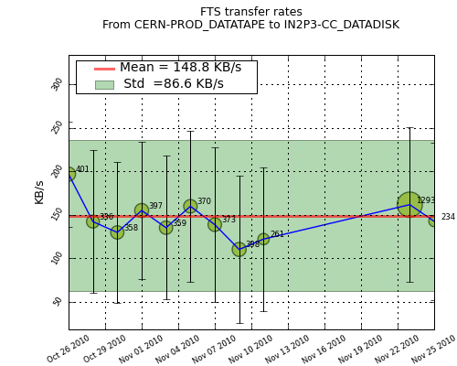
Machinery in place
Transfer Service
WLCG File Transfer Service
Scheduling agent
1. Transfer jobs
FTS
The Sonar
0. Subscriptions
Polling agent
2. Job status
3. Event callbacks (with
transfer duration on success)
Callback collector
4. Event callbacks
Web service
Event DB
FTS stats
5. FTS stats
DDM Dashboard
DDM FTS monitor
6. FTS stats
Purpose: Generate transfer statistics for monitoring and for feedback to the system

Slide 10
Collected FTS Statistics
FTS statistics include SRM negotiation time
Transfer of small files will be dominated by SRM overhead
Transfer of big files will be dominated by actual transfer
➔Definition of three file-size types
Small files: 0 – 100MB
Medium files: 100MB – 1GB
Large files: 1GB - ∞
Statistics are separated in the Dashboard DB by file-size types
10 minute bin aggregation
Available via simple API

Slide 11
Optimized source selection
Transfer Service file buffers
FTS transfer queues
Definitions
Small file: 0 – 100 MB
Medium file: 100MB – 1GB
Large file: 1GB - ∞
Source 1
Source 2
Destination
Source 3
If multiple sources are available for a file, estimate the waiting and service time of each buffer
Considering files of each type (S,M,L) in buffers
Using channel statistics of last 2 week
Penalizing channels without statistics
The model is a simple approach but can be extended in the future
No FTS stats means channel failed or was not tested in weekly tests

Slide 12
Cross-cloud transfers
Tier2
Tier1
Tier1’
Tier2’
FTS STAR-Channel transfer
Multi-hop
Cloud1
Cloud2
Originally cross-cloud subscriptions were submitted by the Data Transfer Request Interface(DaTRI) doing a multi-hop
Since recently DDM is taking care of it in an optimized way
Optimize cross-cloud transfers choosing between direct transfers and multi-hop based on FTS statistics
Generally direct transfers perform better for small files

Slide 13
Sonar tests: measurements of the full ATLAS Grid mesh

Slide 14
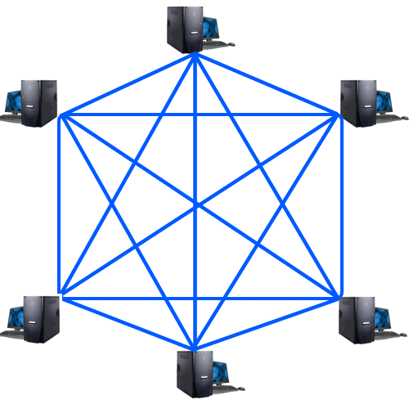
Sonar tests
Weekly file transfers between all ATLAS sites
Provide recent transfer statistics for the complete ATLAS Grid mesh
Excepting few small sites that have asked to be excluded
O(10.000) links
Tests consists of 10-15 FTS transfers
1 dataset with 5 small files: 20 MB each
1 dataset with 5 medium files: 200 MB each
1 dataset with 5 large files: 2 GB each
for a subset of pairs only
Workflow
Each site owns the 3 datasets (site in name)
Dataset is pre-placed and stored permanently on custodial site
Destination replica is copied and deleted each week
Transfer subscriptions are injected safely between Monday and Friday
In order not to overload the ATLAS grid
Unfinished subscriptions are canceled after 5 days

Slide 15
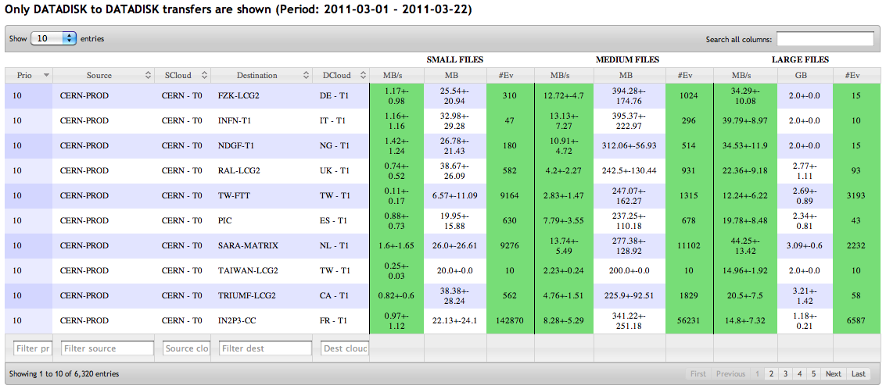
Sonar monitoring
http://bourricot.cern.ch/dq2/ftsmon/sonar_view/cached/
Technologies: Django, jQuery, DataTables
DESTINATION | Tier3 | 0 | 0 | 0 | 0
 |  |  | Cloud 3 | Cloud 1
 | Tier2 | 4 | 4 | 2 | 0
 |  | Close 7
 |  |  | Close 7 | Close 5
 |  |  | Cloud 8 | Cloud 6
 | Tier1 | 10 | 9 | 4 | 0
 |  |  |  | Close 7
 |  |  |  |  | Cloud 3
 |  |  |  | Cloud 8
 | Tier0 | 9 | 9 | 4 | 0
 |  |  |  | Close 7
 |  | Tier0 | Tier1 | Tier2 | Tier3
 |  | SOURCE
 | Avg(Byterate)+StD(Byterate)
SMALL | <0.05MB/s | <0.1MB/s | ≥0.1MB/s
MEDIUM | <1MB/s | <2MB/s | ≥2MB/s
LARGE | <10MB/s | <15MB/s | ≥15MB/s
 | Number of files transferred
SMALL | ≤3 | 4 | ≥5
MEDIUM | ≤2 | 3 | ≥4
LARGE | ≤1 | 2 | ≥3

Slide 16
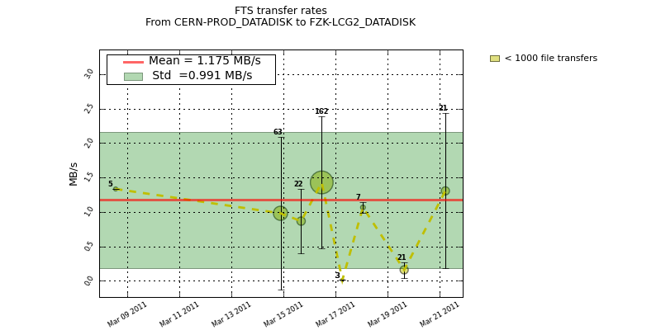
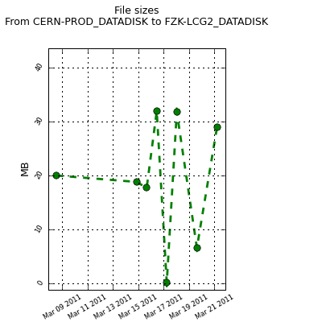
Channel history
http://bourricot.cern.ch/dq2/ftsmon/
Technologies: Django, Matplotlib, jQuery

Slide 17
T2Ds: “Directly connected T2s”

Slide 18
Commissioning work – T2Ds
Create the T2Ds category: “D” stands for Directly connected
Old model: In DDM every T1 is topologically close with the other T1s and its T2s
New model: In DDM every T1 is topologically close with the other T1s, its T2s and all the T2Ds
Selection based on
Storage and network capabilities (measurable)
Level of commitment and reliability (not measureable)
Initial selection: 22 T2s in 6 clouds
Many T2Ds commissioned in less than 2 months
Selected T2Ds represent large fraction of resources
Some clouds have no T2Ds
Very permissive commissioning metrics

Slide 19
Consequences for T2Ds and their clouds
Immediate: FTS service providers were asked to create 2 new channels to connect T2Ds to all T1s
Foreign T2Ds to local T1
Foreign T1s to local T2Ds
In the medium term: T2Ds will be used more actively in multi-cloud analysis, dynamic data placement and local users on T2Ds will have faster data access
T1-T2D links need to be monitored in case they degrade
For clouds with many T2Ds this means
Less pressure on T1 (SRM access and buffer space)
Faster cross-cloud subscriptions
Local users of T2Ds will receive their outputs faster
Tier2
Tier1
Tier1’
Tier2D’
Cloud1
Cloud2

Slide 20
Conclusions

Slide 21
Conclusions
Still at an early stage
Immediate consequences of link commissioning
Creation of T2D category: reduce cloud boundaries in a controlled fashion
Sites optimizing network connections
E.g. UK experience http://tinyurl.com/3p23m2p
Revealed different network issues
E.g. asymmetric network throughput for various sites
Gradual flattening of the ATLAS Computing Model in order to reduce limitations on
multi-cloud dynamic data placement
output collection of multi-cloud analysis
multi-cloud Monte Carlo simulations
Generic and detailed FTS monitor available in the future(under discussion)
FTS servers publishing file level information
Expose them through generic web interface and API

