Slide 1
Reflections on the first year of EGI & EGI-InSPIRE
Steven Newhouse
Project Director EGI-InSPIRE

Slide 2
Overview
Current Status:
EGI.eu, EGI and EGI-InSPIRE
User Community Support
Developing the EGI User Support platform
The EGI User Forum
What’s on when

Slide 3
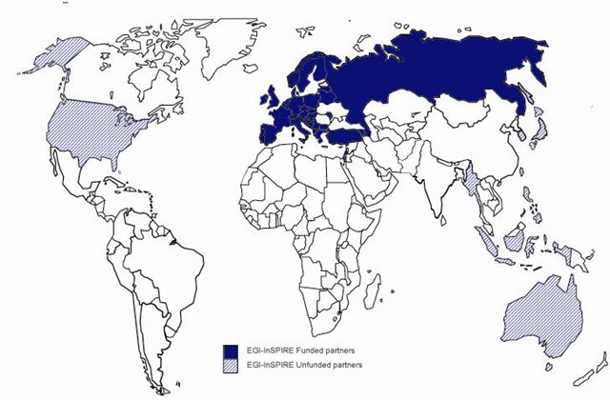
EGI-InSPIRE
Integrated Sustainable Pan-European Infrastructure for Researchers in Europe
A 4 year project with €25M EC contribution
Project cost €72M
Total Effort ~€330M
Effort: 9261PMs
Funded
Un-Funded
Project Partners (50)
EGI.eu, 38 NGIs, 2 EIROs
Asia Pacific (9 partners)

Slide 4
EGI.eu
EGI.eu = Stichting European Grid Initiative
Overseen by the EGI Council
33 NGIs (countries) & / EIROs (research communities)
Governed by an Executive Board
21 members of staff
Science Park, Amsterdam
First birthday on 8th February!
Community Coordination
Operations & Technology
User Communities
Policy & Dissemination

Slide 5
A Virtuous Service Cycle
GISELA
MAPPER
WeNMR
European Grid Infrastructure
Ecosystem
SAGrid
Resource Providers
Used by Researchers
Gathering New Requirements
New Technology Assessed
Deployed Infrastructure Services
Current User Communities
DECIDE
OLAs
MoUs
gSLM
EGI.eu
eScienceTalk
ERINA+
EMI, IGE &
SAGA, StratusLab
MoUs & SLAs
New User Communities
DCH
Technology Providers
CLARIN
DARIAH

Slide 6
EGI Policy Groups
Technology
TCB
Operations
OMB
OTAG
Users
UCB
USAG
OAT
Security
SPG
SCG
SVG/RAT
CSIRT
PDP
More info: http://www.egi.eu/policy/groups/

Slide 7
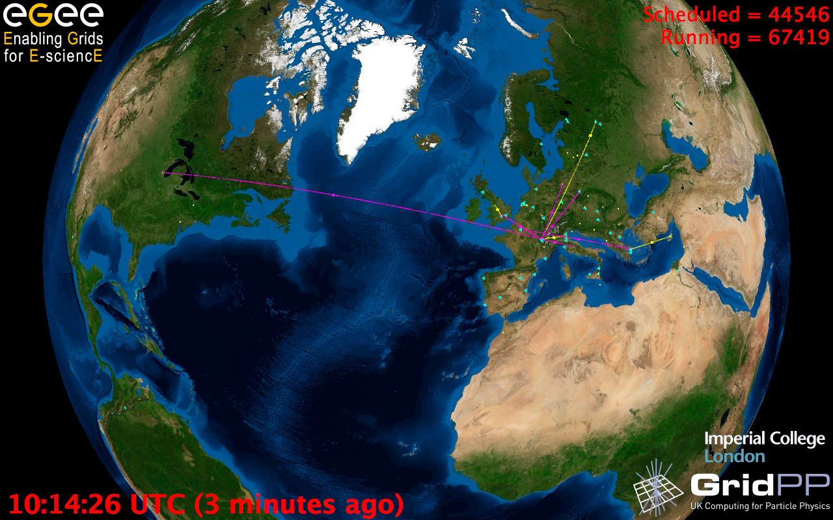
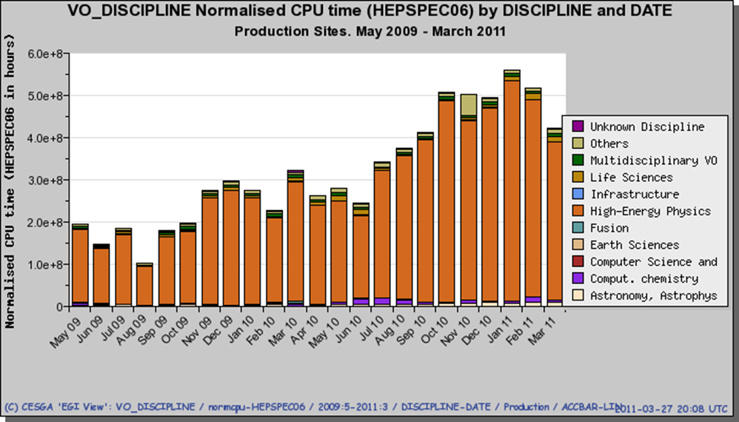
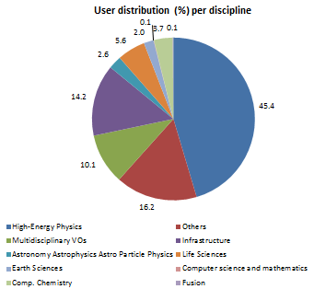
European Grid Infrastructure (Status April 2011 – yearly increase)
Archeology
Astronomy
Astrophysics
Civil Protection
Comp. Chemistry
Earth Sciences
Finance
Fusion
Geophysics
High Energy Physics
Life Sciences
Multimedia
Material Sciences
…
13319 end-users (+9%)
186 VOs (+6%)
~30 active VOs: constant
Logical CPUs (cores)
207,200 EGI (+8%)
308,500 All
90 MPI sites
101 PB disk
80 PB tape
25.7 million jobs/month
933,000 jobs/day (+91%)
320 sites (1.4%)
58 countries (+11.5%)
Non-HEP users ~ 3.3M jobs / month
Notes:
Figures are from D4.2 , increase computed using figures from Slide 1 (April 2010), unless differently specified
13319 users, 9.5% increase: as reference value in April 2010 I have taken the number of users documented in SA1.2.2 (EGEE deliverable), where the number of users reported was much more than 10000 units as reported in slide 1!
Million job/month: the increase percentage is computed using the *average* million job/month from May 2009 to April 2010

Slide 8
ROCs → EGI Ops Centres
PQ1
May 2010:
Creation of NGI_NDGF
PQ2
July 2010: End of CE & DE-CH ROC. Creation of IberGrid
PQ3
Jan 2011: End of South East Europe ROC
PQ4
Feb 2011: End of South West Europe & Italy ROCs
Denmark, Finland,
Norway, Sweden
Estonia, Latvia,
Lithuania
Poland, Slovenia
Croatia, Slovakia,
Czech Republic,
Belarus, Hungary,
Austria;
Germany,
Switzerland
Greece, Serbia,
Turkey, Romania,
Cyprus, Georgia,
Free Rep. Macedonia,
Bosnia and H.,
Montenegro,
Bulgaria, Armenia
Italy

Slide 9
What do we do for users?
Connecting Researchers to Distributed Resources
Distributed Researchers
Within a country, within Europe & the world
Any NGI resource that needs to be shared
Compute, storage, data, virtualised, …
Through the EGI User Support Platform
Services for support and exploitation
Customisable for NGIs and VRCs

Slide 10
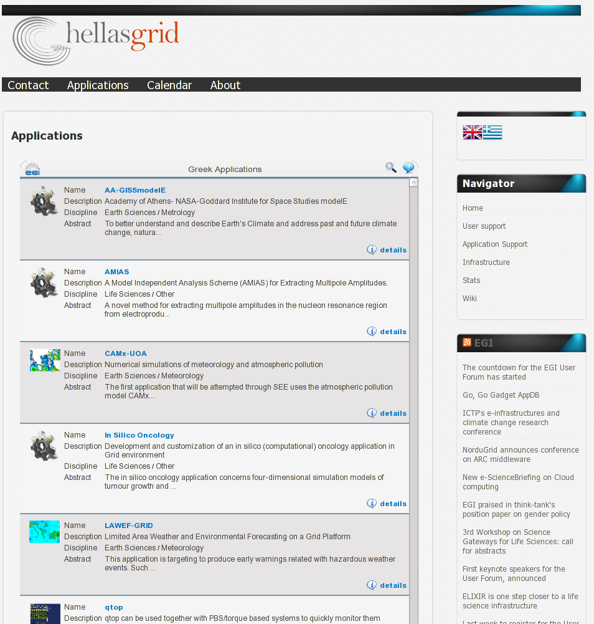
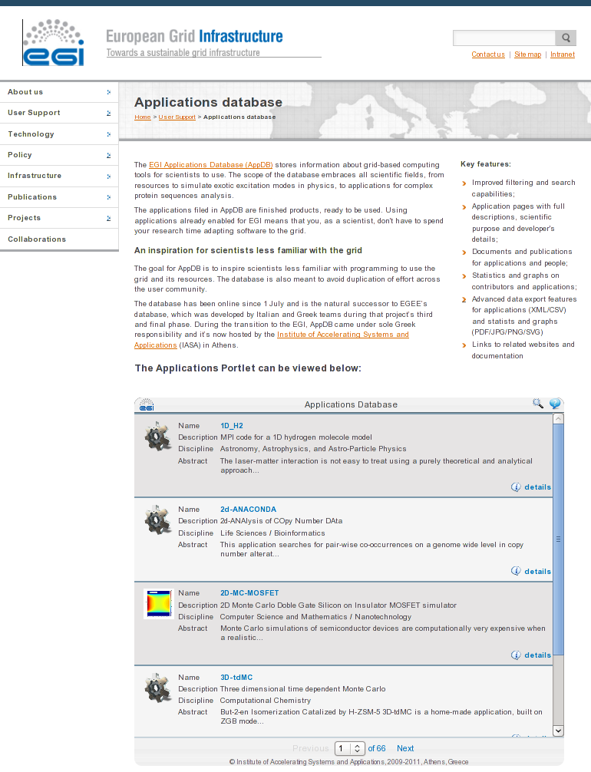
EGI User Support Platform
Embeddable Applications database
Training marketplace for events & material
Services to improve a VOs use of EGI
Helpdesk for problem solving
Requirements Database & Analysis
See more at the
EGI Community Support Stand
Embed in NGI or VRC portal
Consultancy & Help Desk
Evaluation of support tools
Provision of Services for VOs & VRCs

Slide 11
Exploiting the Resources
Share services, applications and tools
Developed by EGI Users for EGI Users
Reuse & adapt the work of others
See the rich variety this week
User Environments Track:
E-workplaces such as portals & applications
Register in the Applications database?
User Support Services:
Services from EGI.eu and user communities
Include in the EGI User Support platform?

Slide 12
EGI User Forum

Slide 13
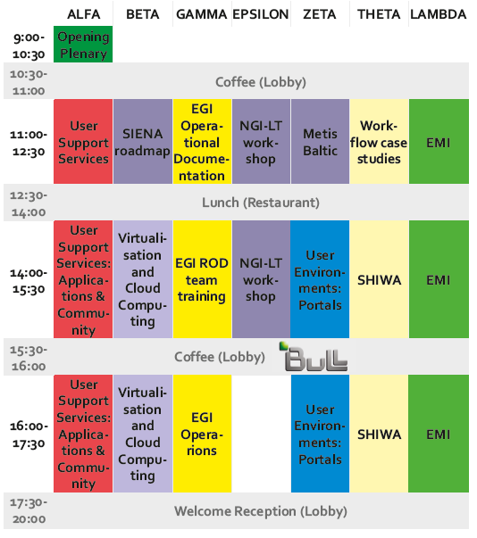
Monday
European Middleware Initiative’s 1st
Technical Conference
Demos & Posters
Portals & user environments used to access EGI resources
Standards and results relating from using virtualisation and the cloud
Services, applications and tools from EGI.eu and from within the EGI user communities

Slide 14
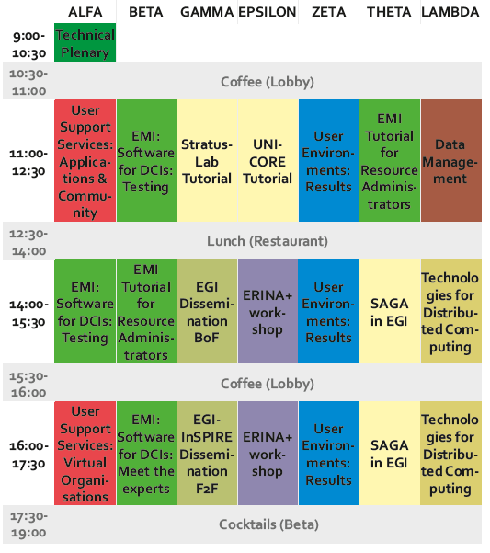
Tuesday
Applications coming form the User Community
Demos & Posters
EMI Tutorials & Testing Infrastructure
Technologies for Distributed Computing
Environments to access EGI resources to obtain results
Data Management
EMI Meet the Experts

Slide 15
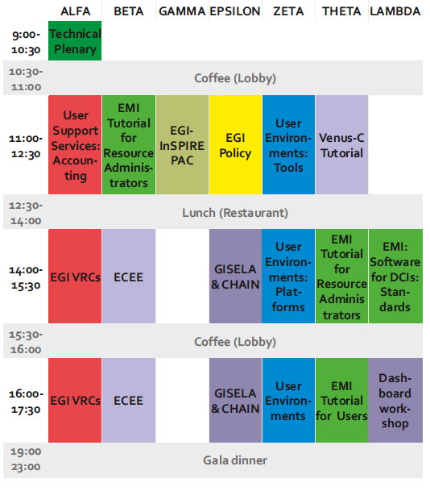
Wednesday
Services, applications and tools from EGI.eu and from within the EGI user communities
Demos & Posters
Results obtained by using environments to access EGI resources
EGI VRCs: Results from the last year, discussion on the plans for next year.
Continuing the cloud experience in EGI
CHECK THE BUS TIMETABLES

Slide 16
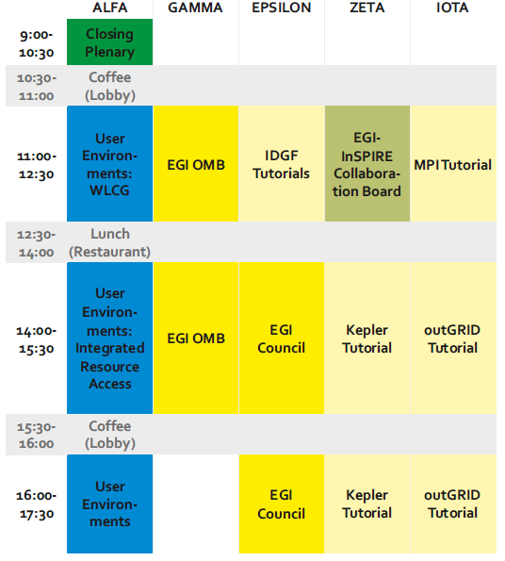
Thursday
Tutorials During the EGI User Forum
SHIWA: Multi-system workflows (Askalon, MOTEUR, P-GRADE & Triana) focussing on Life Sciences.
StratusLab: Open Source IaaS cloud system.
Earth Science Data Processing Tools & Applications: Using the OPeNDAP protocol & Hyrax Data Server.
Ganga: Hob management tool across different resources.
Experiment Dashboard: Integration of VO specific tests for VO oriented site status.
MPI Start: How to get MPI based applications integrated in gLite.
Kepler: Used extensively by the Fusion community and able to access different middlewares.
SAGA in EGI: How to use Simple APIs for Grid Applications on EGI middleware.
IDGF: Establishing and porting Applications to Desktop Grids.
outGrid: Interoperability across EU & USA e-Infrastructures to support neuroscience.
PLUS: EMI Tutorials for end-users and resource administrators
User Environments

Slide 17
Follow EGI on line
Read the conference blog at www.gridcast.org
Follow EGI on at http://twitter.com/egi_inspire (#egiuf11)
Photos will appear on our stream at http://www.flickr.com/photos/european_grid_initiative (use the egiuf11 tag for your own photos)
Videos online on at http://www.youtube.com/europeangrid
Read the EGI blog at www.egi.eu/blog
Exhibition treasure hunt! Find out more at the EGI Dissemination Booth (#3)….

