Slide 1
ELIXIR needs for e-Infrastructure
Tommi Nyrönen (CSC), EGI User Forum April 12 in Vilnus 2011

Slide 2
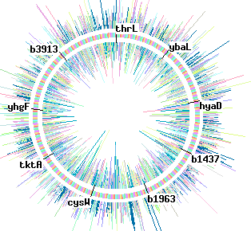
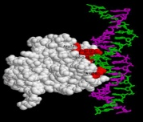
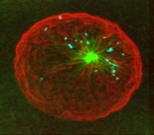
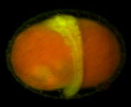

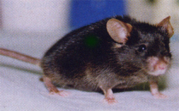

ELIXIR Mission
To construct and operate a sustainable infrastructure for biological information in Europe, to support life science research and its translation to medicine and the environment, the bio-industries and society.
www.elixir-europe.org

Slide 3
ELIXIR preparatory phase
November 2007: Mobilisation and planning (3 months)
January 2008: Committee and recommendations phase (18 months)
Hold stakeholder meetings
Establish working committees to write reports
Present the reports at an open stakeholders meeting for wider discussion
Define ELIXIR
July 2009: Documentation and negotiation phase (18 months)
Consolidate reports into a proposal to be sent to all the member states and funding agencies with a draft Memorandum of Understanding by month 26.
Define how or which parts will be funded by whom
Reach agreement after 38 months, so that “construction” can start
November 2010: Extension (lasting 12 months)
Initiate construction of Hub building and European Data Centre
Issue call for nodes
Prepare business case
Prepare MOU and get six signatories to sign it
Create ELIXIR Council

Slide 4
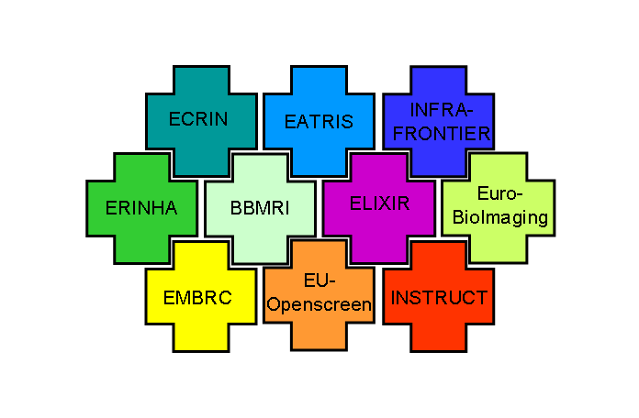
ESFRI biomedical RIs

Slide 5
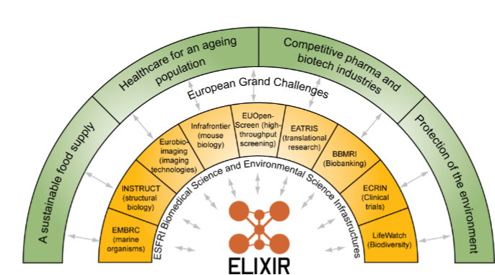
The European Grand Challenges

Slide 6
ELIXIR data is comprehensive, universal, integrated
Literature and
ontologies
Literature and
ontologies
Life sciences
Medicine
Agriculture
Pharmaceuticals
Biotechnology
Environment
Bio-fuels
Cosmaceuticals
Neutraceuticals
Consumer products
Personal genomes
Etc…
CitExplore
, GO
CitExplore
, GO
Genomes
Genomes
Nucleotide sequence
Ensembl
,
Ensembl
Nucleotide sequence
Ensembl
,
Ensembl
EMBL
-
Bank
Genomes,
EGA
EMBL
-
Bank
Genomes,
EGA
Proteomes
Proteomes
Gene expression
UniProt
, PRIDE
Gene expression
UniProt
, PRIDE
ArrayExpress
ArrayExpress
Protein structure
Protein structure
PDBe
Protein families,
PDBe
Protein families,
motifs and domains
motifs and domains
Chemical entities
InterPro
Chemical entities
InterPro
ChEBI
,
ChEMBL
ChEBI
,
ChEMBL
Protein interactions
Protein interactions
IntAct
IntAct
Pathways
Pathways
Reactome
Reactome
Systems
Systems
3,3M data requests/day at EMBL-EBI
BioModels
BioModels

Slide 7
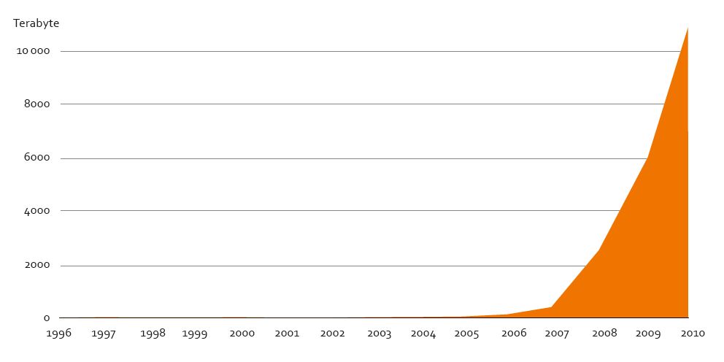
Growth of disk storage at EMBL-EBI
Ten petabytes at May 2010

Slide 8
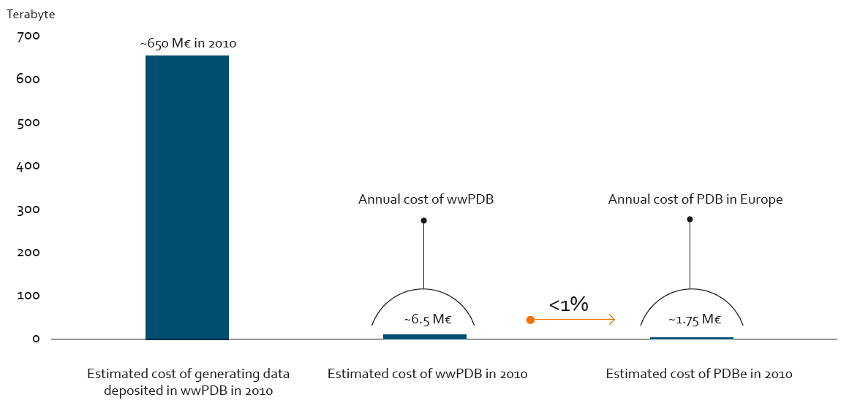
Securing data investments

Slide 9
Disruptive technologies in biology
Next-generation DNA sequencing NGS
  Data will be 1,000 <> 1,000,000 times cheaper to produce, enabling personalized medicine applications at the deep genomic level.
  Data production rates will be 1,000 <> 1,000,000 more by the end of the ESFRI period.
2011
  Full genome 30X sequence 13,000 €
  Full exome sequencing (mutations in all genes) 1,500 €
  RNAseq 1200 €
2012 (estimate)
  Full genome 30X sequence < 5000 €
  Full exome sequencing (mutations in all genes) 800 €
  RNAseq 600 €
Bioinformatics services to extract knowledge, store key data 2000-5000 €?
There is a maximum acceptable end-user total cost for e.g. diagnostic service relying on biological information

Slide 10
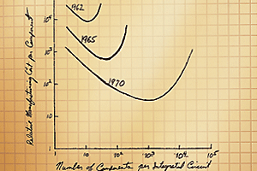
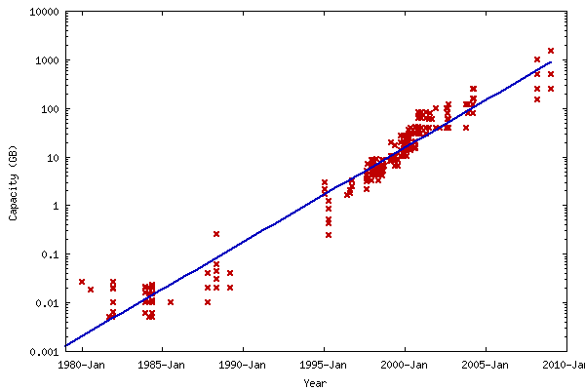
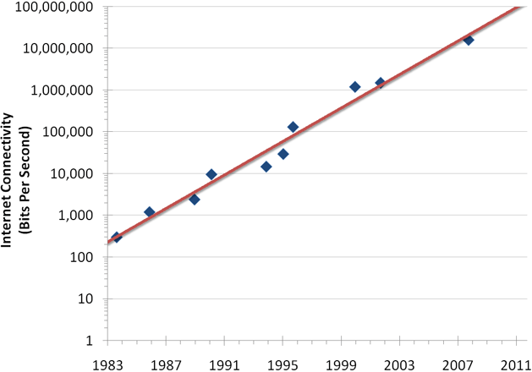
Data growth exceeds growth in IT capability
CPU Power doubles <> 24 months (Moores Law)
Disk capacity doubles <> 18 months
1000
800
600
No. of Racks
400
200
0
2009
2018
Racks in EMBL-EBI machine room double <> 12 months
Network bandwidth doubles <> 20 months

Slide 11
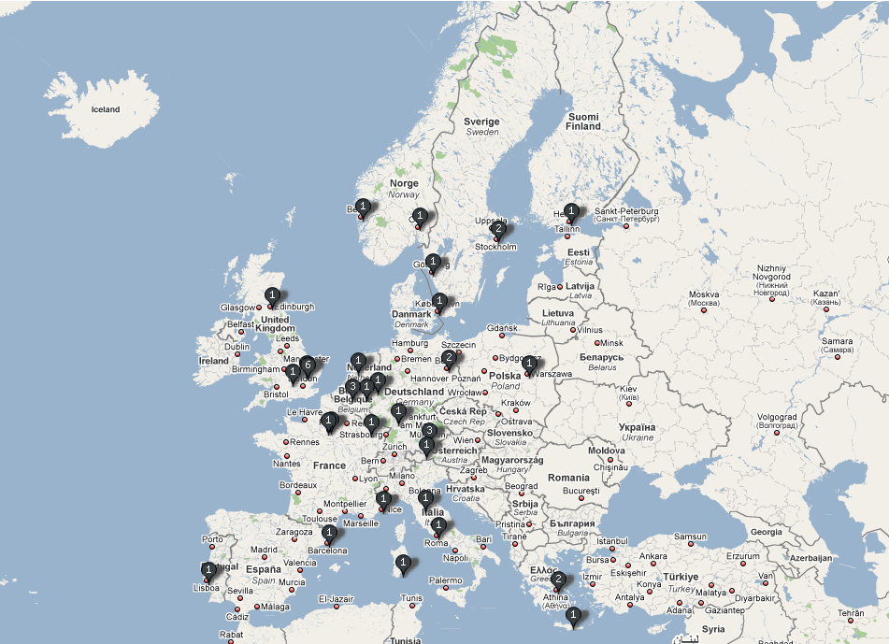
Visits during consultation phase
Notes:
11

Slide 12
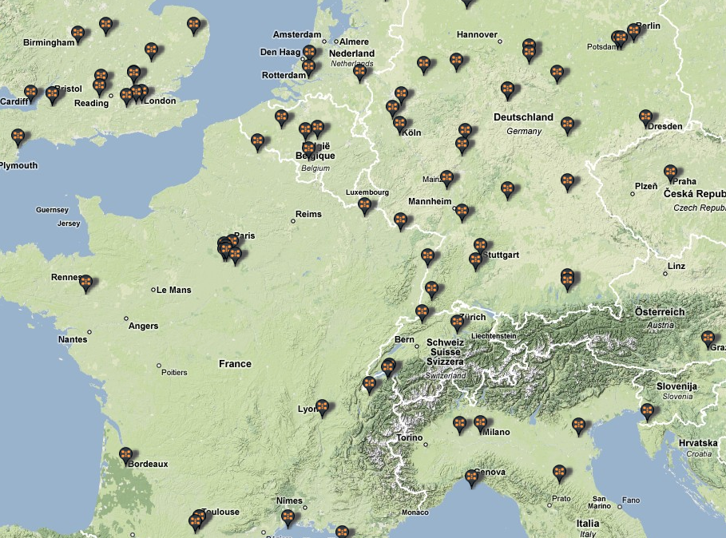
Sites of ELIXIR survey: data providers and collections
Notes:
12

Slide 13
What might ELIXIR be?
A reliable distributed infrastructure to provide equality of access to biological information across all of Europe
Sustainable funding for the core European biological data collections (genomes, sequences, structures etc)
Sustainable funding for the global biological data collaborations (UniProt, ww-PDB, INSDC etc)
Processes for
developing new core data collections
supporting interoperability of bioinformatics tools
developing bioinformatics standards and ontologies
Enhanced use of biological information in Academic Research, the Pharmaceutical Industry, Biotechnology, Agriculture and for the Protection of the Environment

Slide 14
A reliable distributed Infrastructure
Elixir will be constructed by enhancing and linking existing infrastructures in the member states.
It will integrate member state infrastructures into a single infrastructure or a ‘Grid’.
Each member-state will
  Identify and catalogue its requirements
  Identify funding agencies that are prepared to fund bioinformatics
  Identify projects and organisations that could become part of Elixir
  Include funding for Elixir in its National Research Infrastructure Plan
  Where appropriate, identify structural funds that can be used for Elixir
  Make suggestions for ELIXIR Nodes
  Take part in the ELIXIR Construction Phase

Slide 15

ELIXIR Technical structure
ELIXIR node
(not a national centre)
ELIXIR hub
@EMBL-EBI
ELIXIR
ELIXIR node
+ national centre

Slide 16
Requirements for ELIXIR Nodes
Scientific
  Scientific excellence
  Fit of thematic area: data; compute; tools infrastructure; BMS links; training
Service
  High reliability
  service-mentality
  Eager to interoperate
  participation in software and standards development
National role
  coordinator of national activities
  national contact point for ELIXIR
Funding
  availability of funding
  multi-year commitment (min. 5 years)
  supported by host country government
  subject to regular reviews

Slide 17
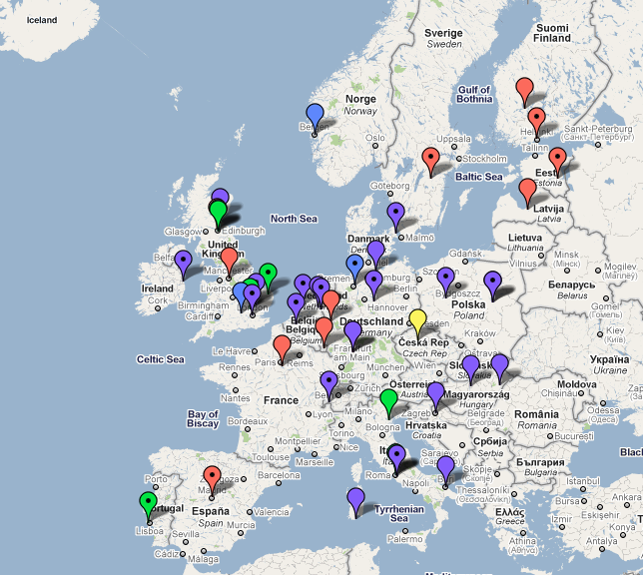
Locations of suggestions for Nodes
Medical
Agriculture
Environmental
Pharmaceutical
General
Training
53 Suggestions
23 Countries

Slide 18
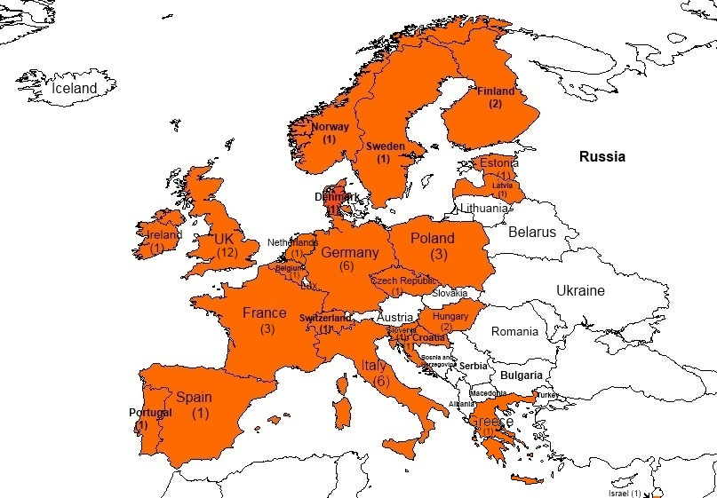
53 Node suggestions
Very varied
  Content
  Size
  Funding commitment
Cover all node types
Almost all include training
Some countries have coordinated internally; others have not
Domains addressed include clinical, biomedical, genomics, agriculture, fisheries etc

Slide 19
Role of ELIXIR steering committee
Read node suggestions on 22nd and 23rd July 2010
  Prepared recommendations for Node Principal Investigators
  Proposed a mechanism for the construction process
  Made suggestions as a group
In general committee was impressed with the quality of the node suggestions
  Generic observations that were made into a document and send to the Node PIs

Slide 20
The ELIXIR node suggestions have not been reviewed
No attempt was made to review the scientific or technical aspects of the suggestions
No specific comments were made about any particular suggestion
Funding agencies have their own processes and procedures for reviewing proposals for activities
Suggestions leading to funding proposals will have to fit the strategic priorities of their state funding agencies as well as meeting the ELIXIR criteria

Slide 21
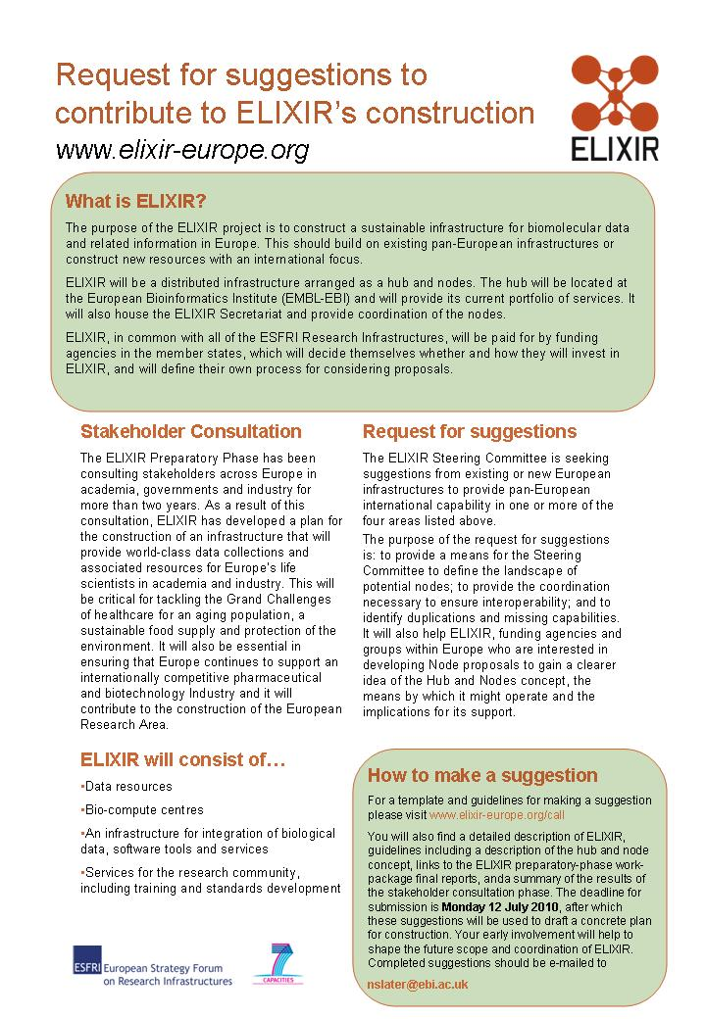
ELIXIR Construction phase
Request for suggestions for nodes
Advertisement in Nature and WWW
Funders meeting fall 2010
One year extension to Preparatory Phase until end of 2011
Elixir MoU suggestion targeting ICA

Slide 22
Sweden is first country to commit
Sweden to be the first country to pledge long-term funding
for ELIXIR
Posted on Tue Jun 23, 2009 7:32 am
The Swedish funding agencies (the Swedish Energy Agency, Fas, Formas,
the Swedish Research Council and VINNOVA) have suggested that the
Government allocate a total of 19 million SEK (1.7 million Euro) over three
years to ELIXIR & the Swedish Bioinformatics Infrastructure for Life Sciences
(BILS), which would make Sweden the first country to secure long-term
funding for ELIXIR. A final decision along these lines is expected during the
Autumn 2009.
Contact: Prof. Bengt Persson, Linköping University & Karolinska Institutet
Web site: www.bils.se
Notes:
22

Slide 23
UK commits to ELIXIR
UK leads European research programme with £10M investment in
bioscience data handling capacity
Posted on Tue Aug 25, 2009 8:35 am
The UK has made its first substantial commitment to ELIXIR with a
£10M (11,4 Meur) investment by the Biotechnology and Biological Sciences Research Council
(BBSRC). BBSRC has awarded funding to the European Molecular Biology
Laboratory’s European Bioinformatics Institute to permit a dramatic increase
in the institute’s data storage and handling capacity. The funding is the first
step in developing the existing data resources and IT infrastructure of
EMBL-EBI towards its planned role as the central hub of the emerging
European Life-Science Infrastructure for Biological Information.
Contact: Matt Goode, BBSRC External Relations
Web site: www.ebi.ac.uk
Notes:
23

Slide 24
Denmark commits to ELIXIR
Denmark invests €5 million in pan-European infrastructure for
biology
Posted on Jan 10, 2010 9:00 am
Denmark has made its first substantial commitment to the European
Life-Science Infrastructure for Biological Information (ELIXIR), a major
emerging pan-European science project, with a €3.5M investment by the
Danish Agency for Science, Technology and Innovation. Substantial
co-financing from the University of Copenhagen, Aarhus University, the
University of Southern Denmark, and the Technical University of Denmark
will increase the total amount invested in ELIXIR to €5 million.
Contact: Katrina Pavelin, EMBL-EBI Scientific Outreach Officer - Hinxton, UK
Web site: www.ebi.ac.uk

Slide 25
Finland commits to ELIXIR
Finland invests €1.85 million in 2010, and €5 million in 2011 in
pan-European infrastructure for biomedical research
Posted on Feb 3, 2010 9:00 am
Finland has made its first specific commitment to the development of
European biomedical research infrastructures (BMS ESFRIs) by supporting
a joint pilot infrastructure project in bioinformatics (ELIXIR), biobanking
(BBMRI) and translational research (EATRIS). The initial commitment of
1.85 M€ is to support preparation and pilot studies in 2010. The purpose
of the funding is to ensure Finland's commitment to the building of these
European infrastructures. The level of funding in future years was left
open as this depends on the outcome and structures that will be developed
in the pilot phase.
Contact: Katrina Pavelin, EMBL-EBI Scientific Outreach Officer - Hinxton, UK
Web site: www.bbsrc.ac.uk

Slide 26

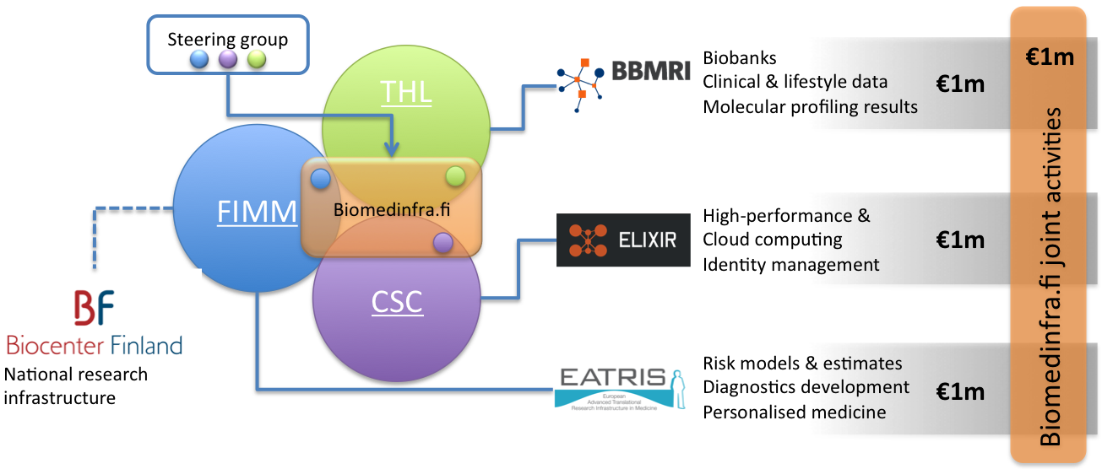

Slide 27
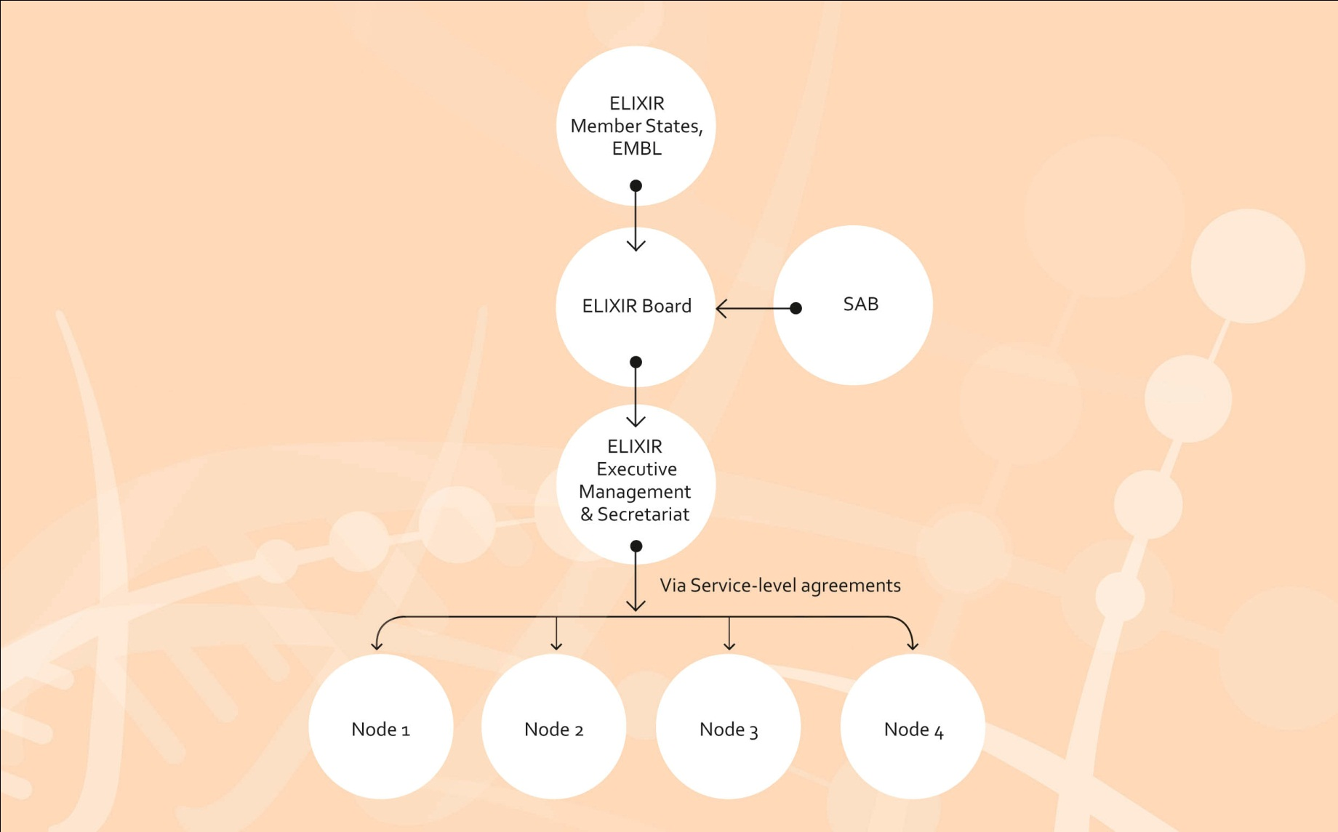
ELIXIR Management structure

Slide 28
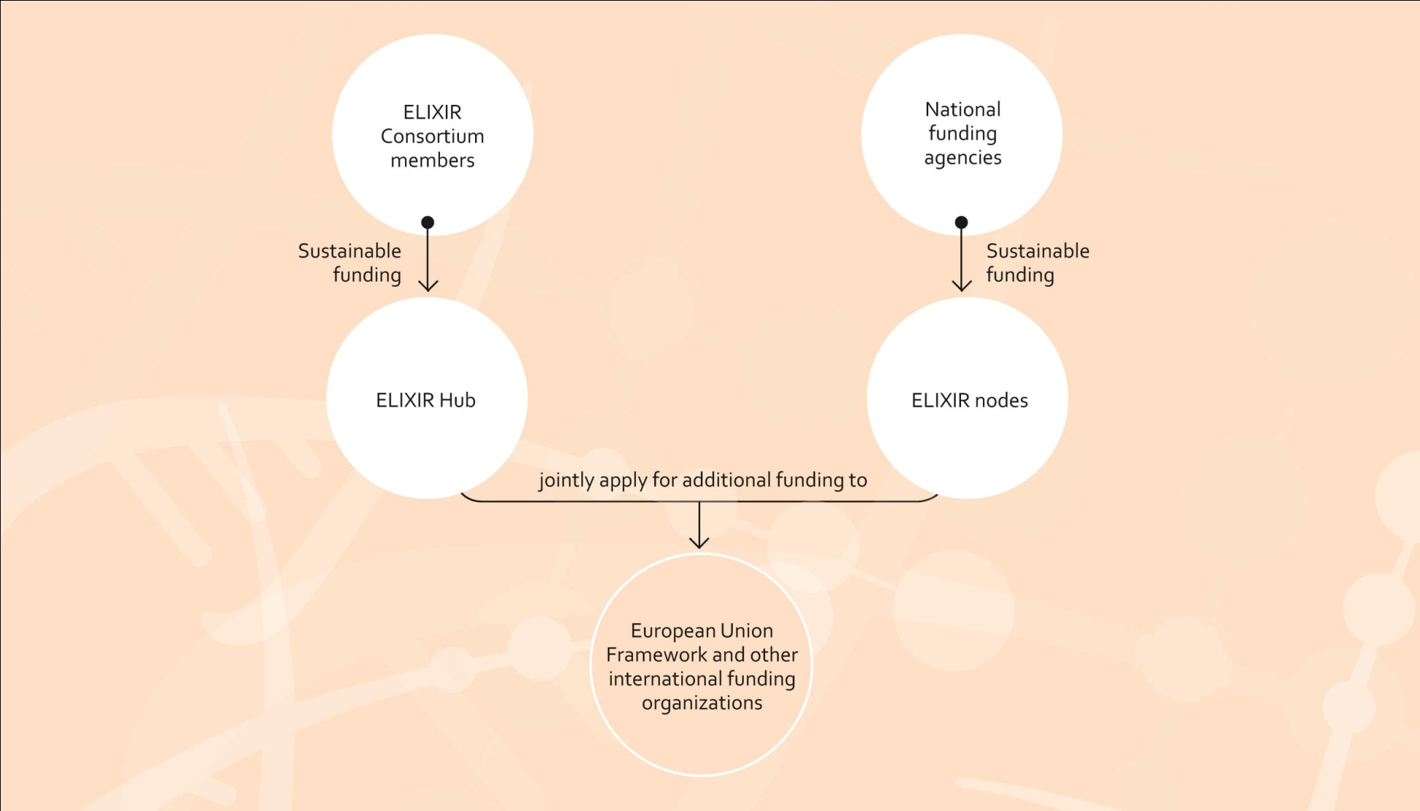
Elixir Funding structure

Slide 29
Summary of ELIXIR components
Biomolecular and related data collections
Computational resources
Standards and ontology development
Training infrastructure
Tools and services integration infrastructure

Slide 30
ELIXIR needs for e-Infrastructure

Slide 31
ELIXIR European Data Centre
Currently insufficient capacity at the ELIXIR Hub EMBL-EBI data centre
  Tape is no longer feasible for Backup and Disaster Recovery
  Geographical separation provides resilience against disasters
  Data Center 99,98% availability is sufficient confirmed by consultation with Industrial and Academic Users)

Slide 32
Resilient data service provision
Geographically separated
Both systems active
Less than 2h/y downtime
No planned downtime
Protection from local & regional disaster
DC1
DC2
Global load balancer
Internet

Slide 33
ELIXIR European Data Centre
Internet

Slide 34
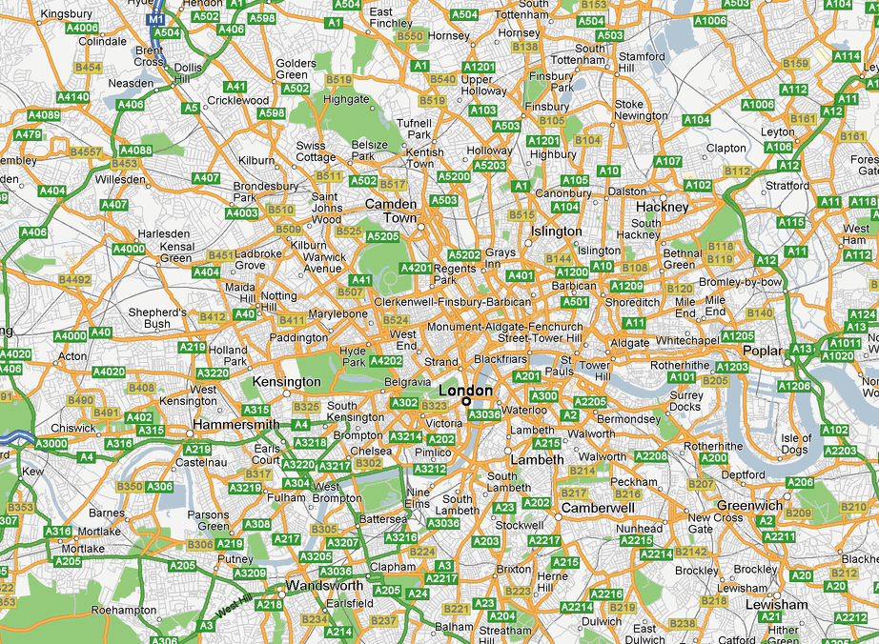
Data centre topology provides resilience
Powergate
Oliver’s Yard
Harbour Exchange

Slide 35
ELIXIR Computing
ELIXIR preparative stage technical feasibility study
  use of European Supercomputing centres for distributed computing
Evolution towards an ELIXIR Node Suggestion
  Provide biomedical institutes compute and storage through a cloud interface
  Role: component for strenghtening local IT operations

Slide 36
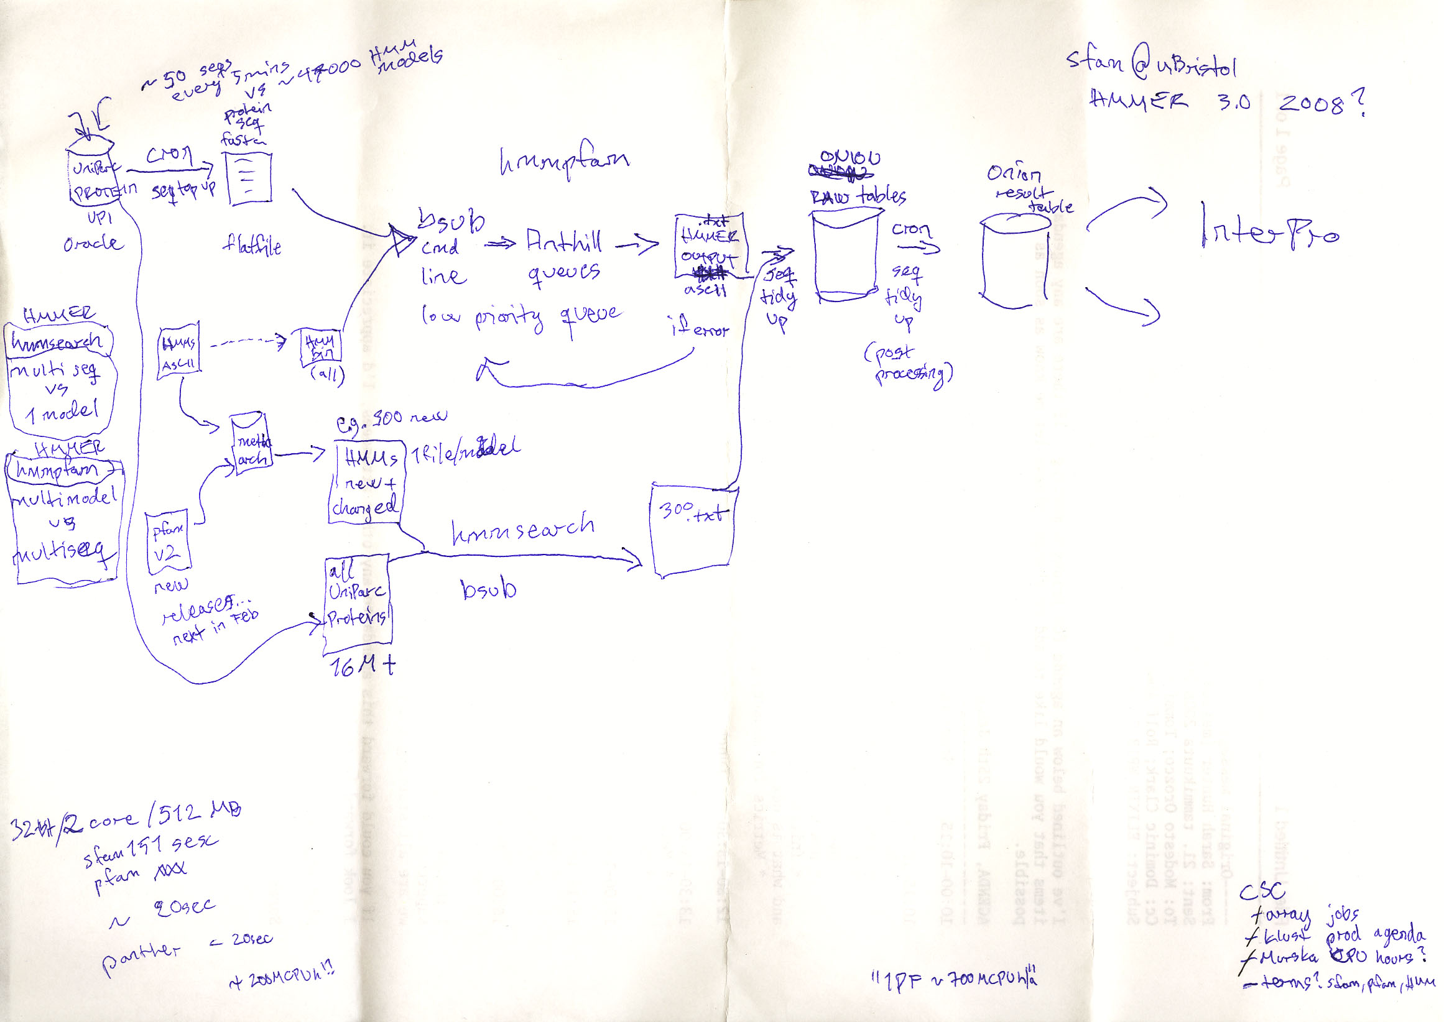
Use case: Classification of all known proteins into families
ELIXIR technical feasibility study : Assessment of Supercomputing Facilities for genomic data
  HMMER InterProScan Calculations for the InterPro Database
  InterPro full update estimate in 2008: 700 Mcpuh/year
Represents only a fraction of the identified ICT needs at EMBL EBI
Barcelona Supercomputing Center (BSC); CSC - IT Center for Science Ltd (CSC); European Bioinformatics Institute (EMBL-EBI).

Slide 37
Compute-intensive part of the SOFTWARE ENVIRONMENT
was externalized from EBI to CSC and BSC
Drawing by Marko Myllynen, CSC, now at Redhat

Slide 38
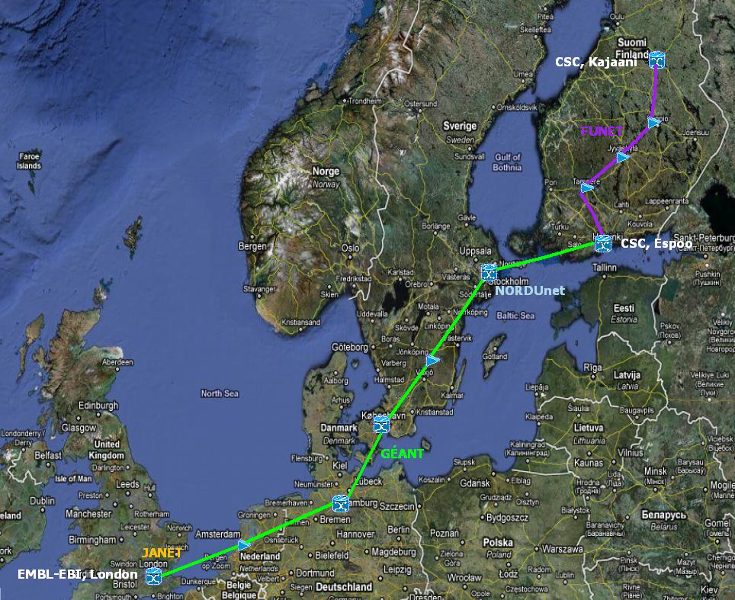
How does the Network perform?
Funet-Nordunet-Géant-Janet
The performance of the public network infrastructure was sufficient for the Interpro use case
  Stable, optimized, average rate for bulk transfer over Internet was over 50 MB/s
  Latency between endpoints was about 50 ms
  Network upgrade is recommended if more complex services or larger data volumes are communicated between sites
  Dialogue or bulk transfer? Need to Optimize the network to a particular biomed service use case
  Simply replacing SSH with HPN-SSH on both ends means better performance
What will be the ELIXIR service provider’s network solution?

Slide 39
Conclusions of the ELIXIR technical feasibility study
CSC and EBI IT expert involvement focusing on the use case was the key to success
  necessary to set up and optimise workflow and service
  once this was established, the amount of expert support reduces (running hmmer in hpc cluster and grid “gsub”)
Higher-level scientific and technical topical expertise is required to design/build/develop service compared to maintaining/supporting it
  Keeping critical mass of highest-level topical expertise staff anywhere is a challenge in terms of costs and development of competences
There is a need to evolve supercomputing centres’ interface offering according to demands placed upon the ELIXIR infrastructure

Slide 40
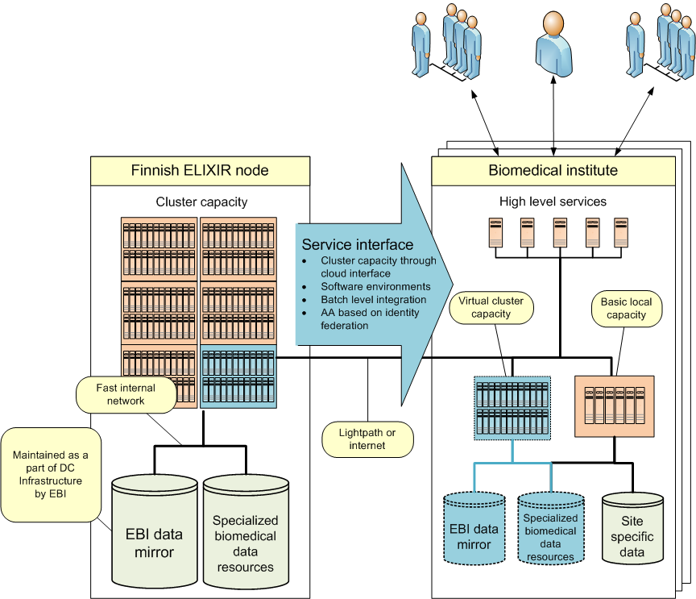
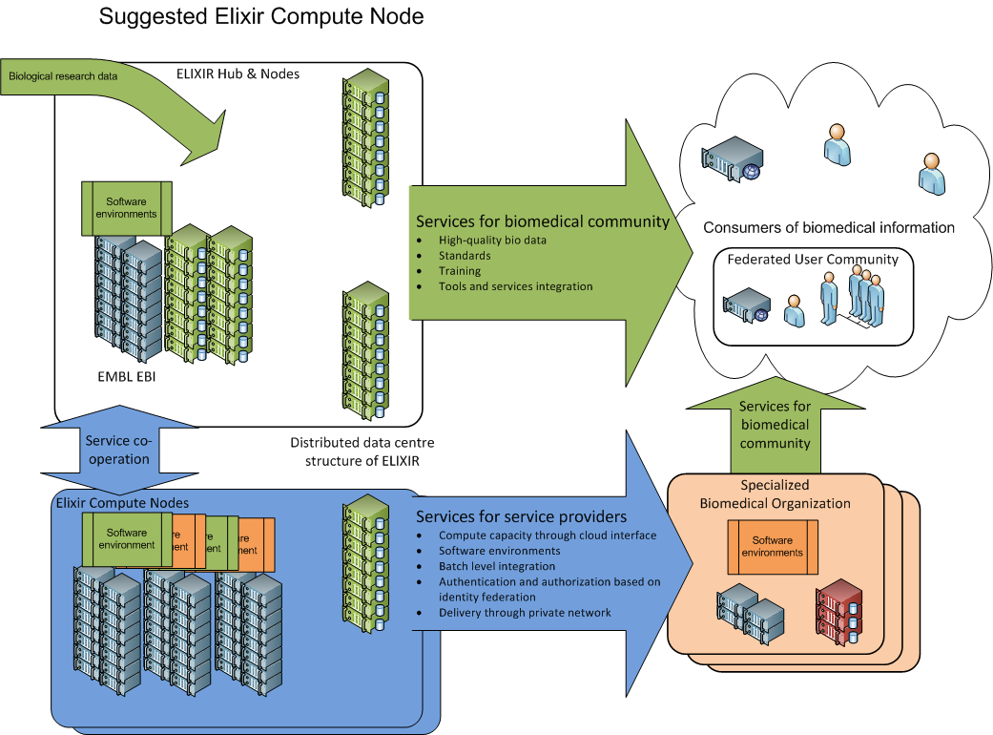
ELIXIR Compute Node Suggestion

Slide 41
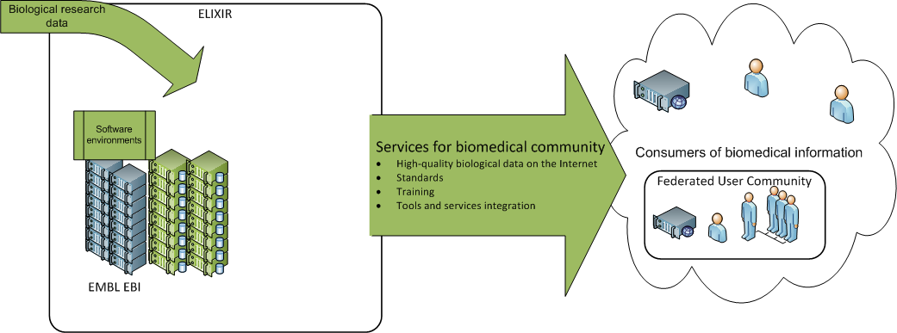
EMBL EBI – ELIXIR hub operations as of 2009

Slide 42
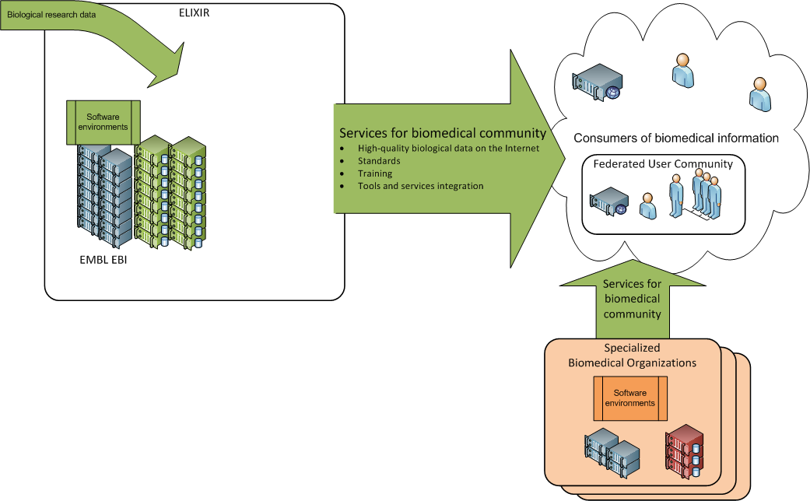
Ecosystem of data collections and providers!

Slide 43
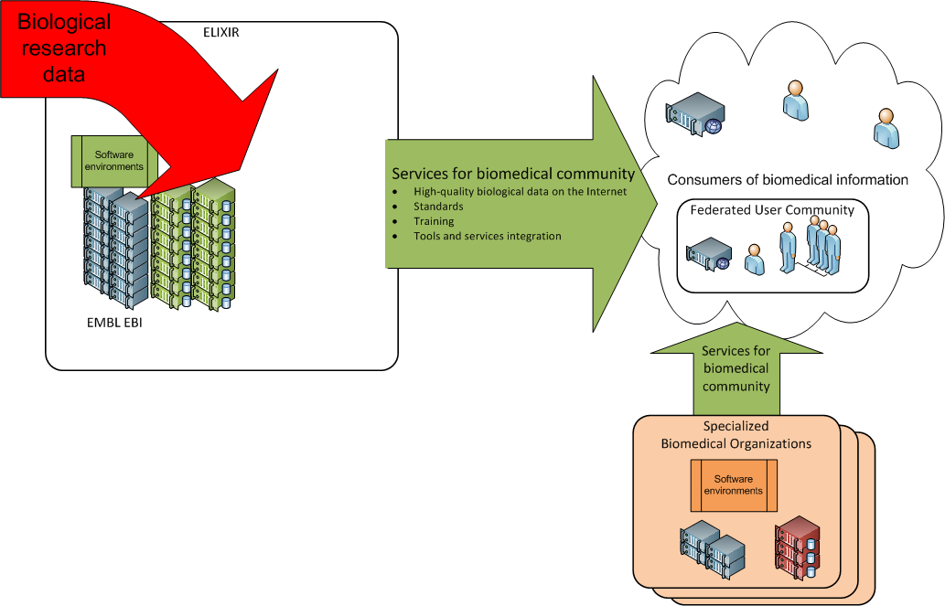
Data production rate increases

Slide 44
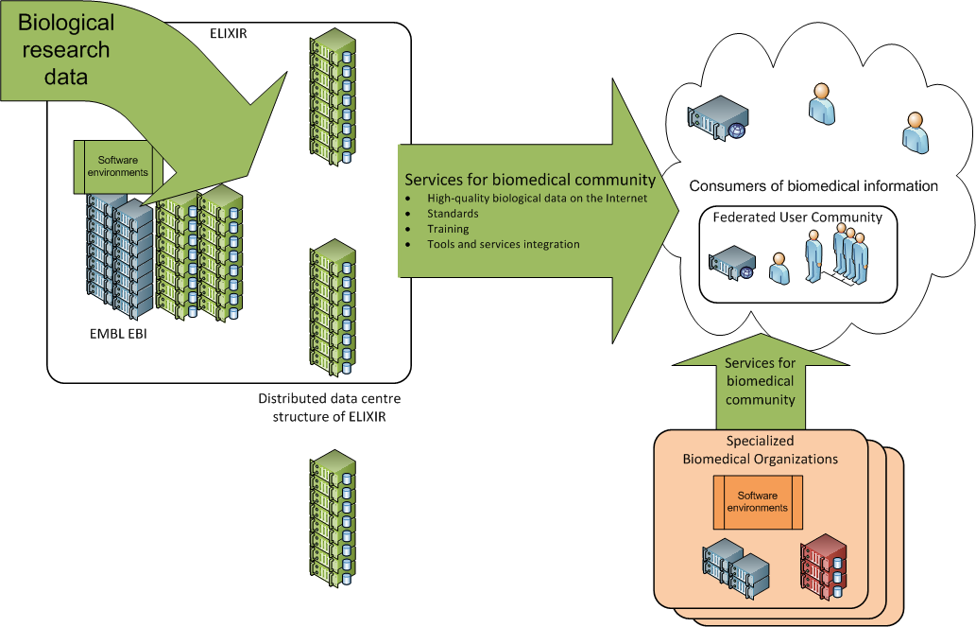
Resilience with
distribution

Slide 45
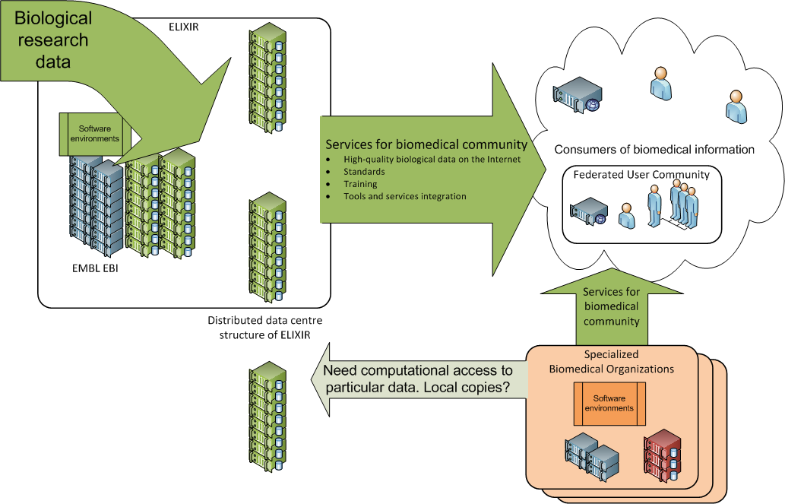
Integration with
specialized organizations?

Slide 46
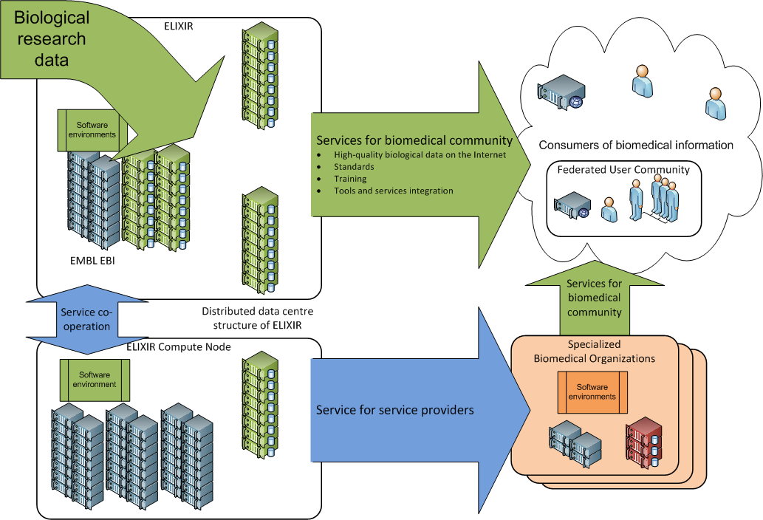

Slide 47
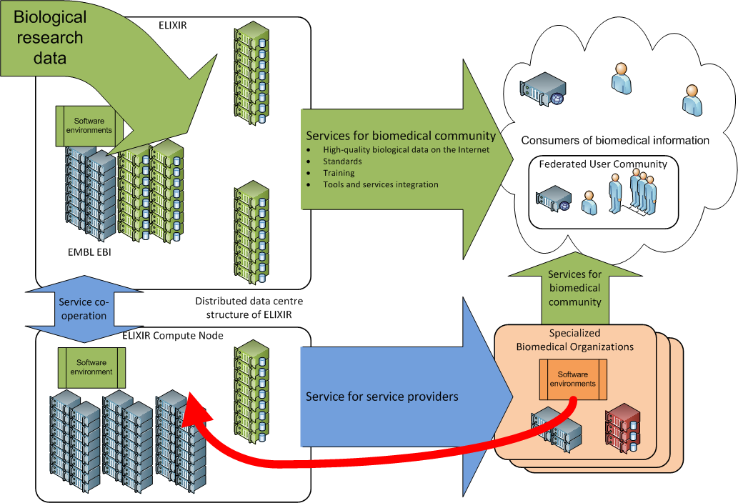

Slide 49
Pilot implementation with the Finnish Institute for Molecular Medicine - FIMM
Finland in BMS ESFRI : integrated approach
  CSC – Computing & ICT – ELIXIR
  FIMM – Diagnostics development – EATRIS
  THL – Health & Biobank collections – BBMRI
Biomedical researchers have to construct complex, rapidly evolving (fragile?) software stacks
Large data files and short update periods
  For example: research on Finnish Gene Atlas with genome-wide gene marker data for more than 40,000 Finns. (www.euengage.org)
Requirement : biomedical software and workflows should not need to be changed to use e-Infrastructure services
  Metadata! (e.g. biobank descriptions)
  Security! is an added cost to compute service provider in biomedical arena

Slide 50



Biomedical perspective
Medicine
e-Infrastructures
Biobanks
Biomedical
research
Bioinformatics & IT
Translational research & personalized medicine
IPR
Spinoffs
Companies
Patients
Society

Slide 51



What do biomed’s compute with next generation gene sequences?
2008: 4 genetic traits to be correlated with 300 000 markers (observables)
132 CPU wall-clock hours
2010: 9000 genetic traits to be correlated with 4 500 000 markers
3 000 000 CPU hours
~3.4 “CPU centuries”

Slide 52
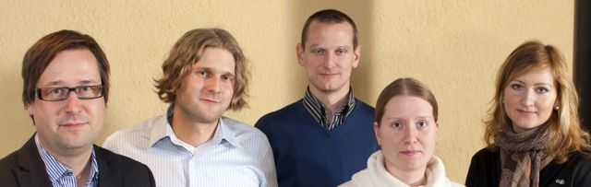
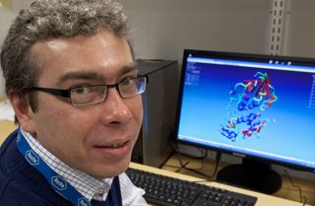
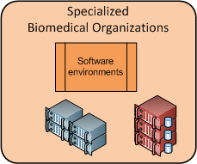
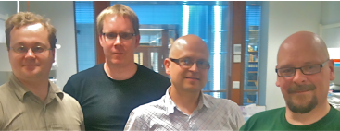
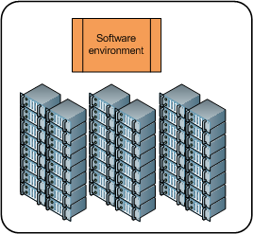
Available service level
Biomed Users
Develop & test locally
Challenge:
Need to maintain 2 environments
Need dedicated sysadmin support
How to combine best of both worlds?
IT support
Deploy at Compute centre
Notes:
A typical IT setup for bioinformatics

Slide 53
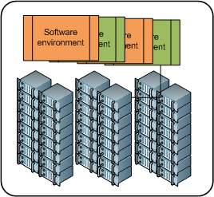

Biomed cloud service pilot
Lightpath
Benefits:
End user
  Maintain only 1 environment !
  Seemingly bigger local resources (“transparency”)
Group/department/institute
  Less local hardware
e-Infrastructure provider (CSC)
  Less tailoring

Slide 54
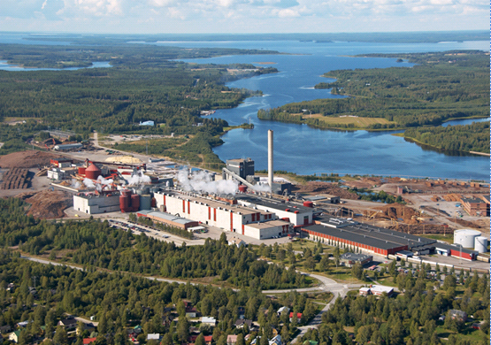


Implementation“extends” the FIMM computing cluster
In operation since August 2010
~23 400 CPU hours / day
208 cores
@FIMM
768 cores @CSC
(on dedicated Biomedinfra/ ELIXIR hardware)

Slide 55
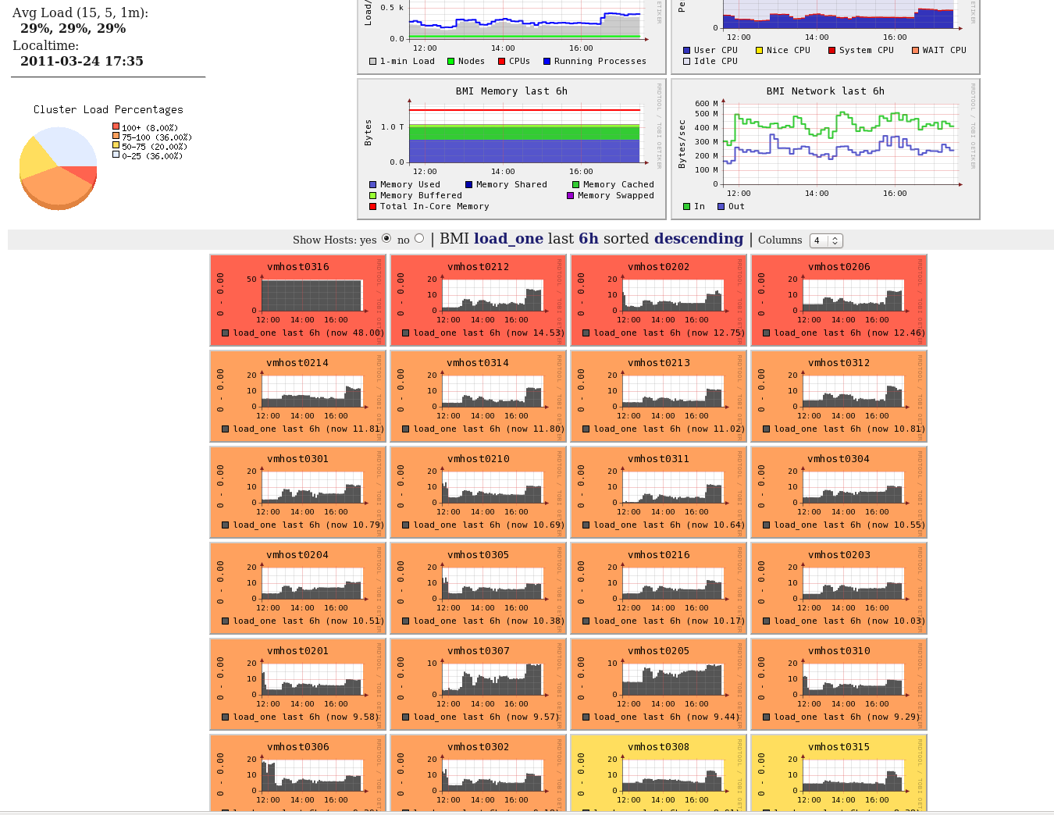
Appears to be a good way to deliver

Slide 56
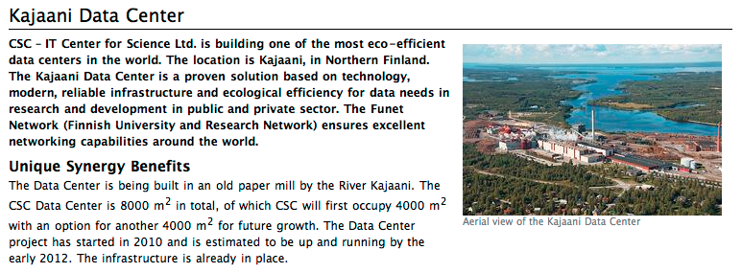
The next level: large-scale green data- and computational centers

Slide 57
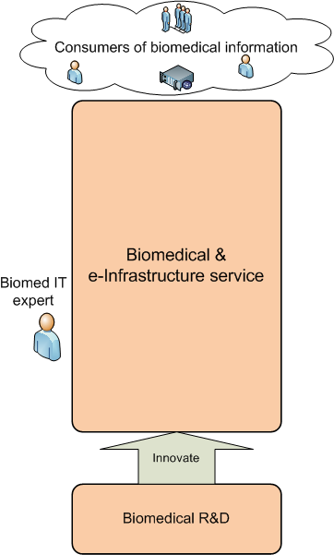
Collaboration opportunities between e-Infrastructure and biomedical sciences research infrastructures

Slide 58
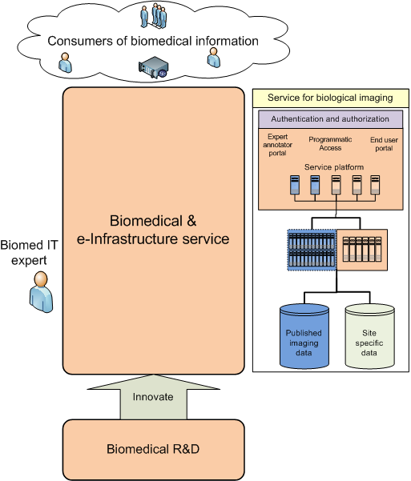
Example:
biological imaging

Slide 59
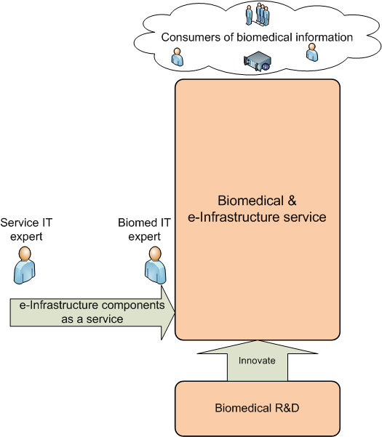
How to integrate e-Infra with imaging SP’s workflow?

Slide 60
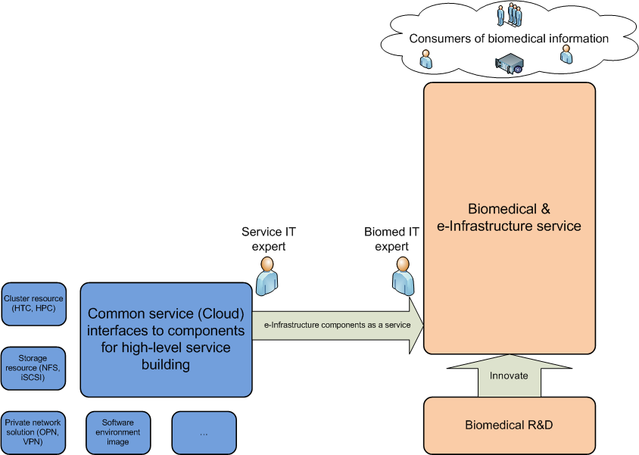
Components for higher level service building

Slide 61
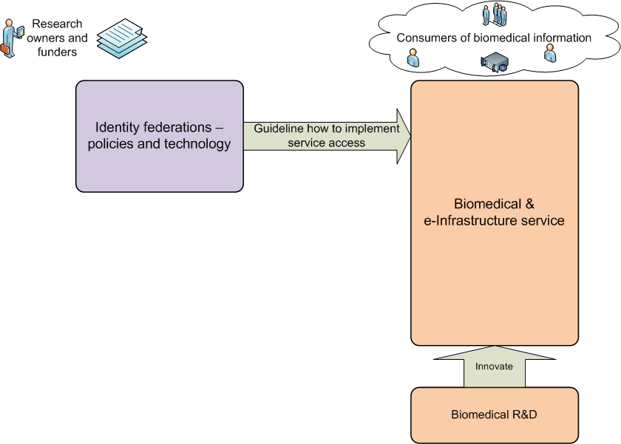
Is service access control needed?

Slide 62
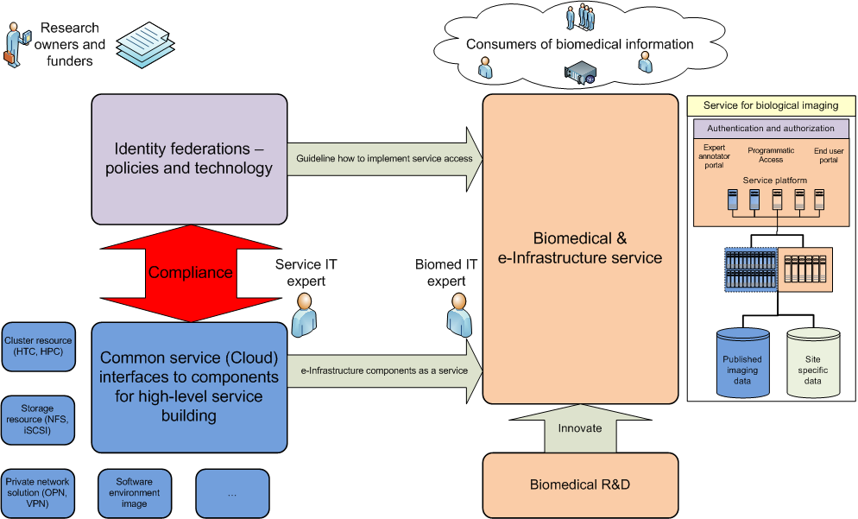

Slide 63
Conclusions
Distributed computing is feasible for BMS use cases
  Cloud interfaces are becoming available from public e-Infrastructures
  Biomedical software tool stacks can be made “cloud-ready" and run on the chosen provider
  Constructive expert-to-expert interactions between collaborating specialized service organizations are key to success
If so, then consider economics of scale and ecological factors in choosing compute locations
  Data needs to be delivered for end users , ”consumers”, one way or the other – marginal added cost for distributed data centers to do it

Slide 64
Call 8 Research Topic INFRA-2011-2.3.2
Implementation of common solutions for a cluster of ESFRI
infrastructures in the field of "Life sciences”
Call 30/7. Close 25/11. Budget €30Meur. Scheme CP-CSA
Life Sciences: Jean-Emmanuel Faure, Lorenza Saracco
One of 4. Maximum award €15Meur, competition between 4
To ensure a larger harmonisation and interoperability between ESFRI facilities, to exploit synergies, to optimise technological implementation
Mature ESFRI infrastructures that have ensured clear commitments for their construction

Slide 65
EMBL-EBI responded for ELIXIR and created BioMedBridges proposal
Mainly ESFRI BMS Involvement with Substantial ELIXIR involvement (21 participating organisations)
€12 Meur over four years
To “build bridges” between the infrastructures
Deliverables are infrastructure components that will link data from the different domains of the ESFRI BMS RI to ELIXIR Core Datasets
It is anticipated that these components will be incorporated into ELIXIR Construction Phase
e-Infrastructure Advisory Involvement: DANTE, EGI.eu, PRACE

Slide 66
Summary
Europe is facing unprecedented (grand) challenges
The solutions are (mainly) biological
There are emerging (disruptive) technologies that offer ways forward
These are very demanding of IT (e-Infrastructure)
Biology has not been here before
It will be necessary to move quickly to arrange the necessary funding streams
Action is needed at every level (scientific, technical, funding, political, ...).

Slide 67

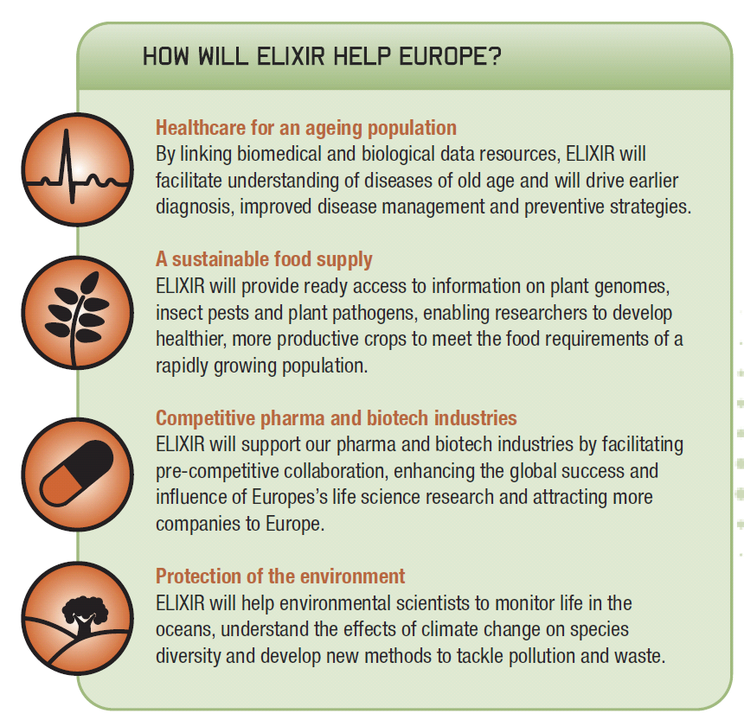
More information

