Slide 1
accounting service for Belarusian grid infrastructure
Andrew Lukoshko, M.Sc.
United Institute of Informatics Problems
BELARUS

Slide 2
Why do we like ?
Because it is…
Cross-platform
Small
Easy to deploy and administer
Constantly evolved
Accurately maintained

Slide 3
How does work?
Gateway
XUUDB
UNICORE/X
Perl TSI
Torque PBS

Slide 4
What data we need to collect?
Task id (from batch system)
Task owner
Start time
End time
CPU*hour
CPU*hour*Linpack rate
CPU*hour*SPEC int rate
CPU*hour*SPEC fp rate
Price

Slide 5
What we need to collect usage data?
Gateway
XUUDB
UNICORE/X
Perl TSI
Torque PBS

Slide 6
SERVER
AGENT
USER

Slide 7
Application server
Database (MySQL)
Accounting app (PHP)
Certs
Users
SSL server (Apache)
Sites
Job logs
Grid site
User/Admin
XUUDB
Agent (PHP+Curl)
Resource usage reports
TSI
Administration tasks
PBS
Etc.

Slide 8
X
Y
Z
anonymous

Slide 9
DC=uk, O=thescienceofdeduction.co.uk, CN=Sherlock Holmes
d41d8cd98f00b204e9800998ecf8427e

Slide 10
04/01/2011 00:45:03;E;13422.node1;user=agu group=unicore jobname=Unicore_Job queue=batch ctime=1259102701 qtime=1259102701 etime=1259102701 start=1259102702 owner=anon@node1 exec_host=node4/0+node3/0 Resource_List.mem=0mb Resource_List.neednodes=2:ppn=1 Resource_List.nodect=2 Resource_List.nodes=2:ppn=1 Resource_List.walltime=00:00:30 session=0 end=1259102703 Exit_status=0 resources_used.cput=00:00:00 resources_used.mem=0kb resources_used.vmem=0kb resources_used.walltime=00:00:01
+
13422;d41d8cd98f00b204e9800998ecf8427e
=
13422;
d41d8cd98f00b204e9800998ecf8427e; Resource_List.nodes=2:ppn=1 ; resources_used.walltime=00:00:01;
ctime=1259102701 qtime=1259102701 etime=1259102701 start=1259102702

Slide 11
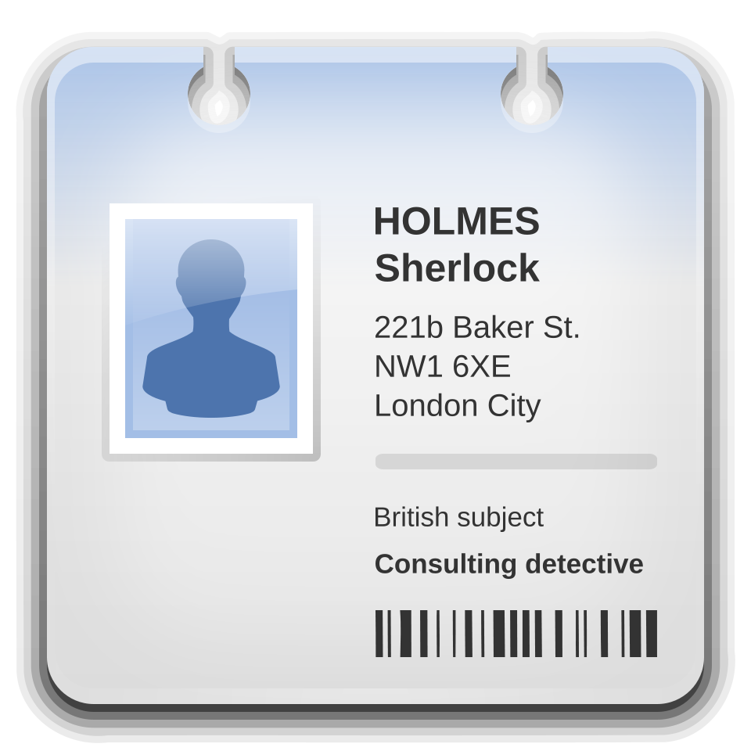
d41d8cd98f00b204e9800998ecf8427e

Slide 12
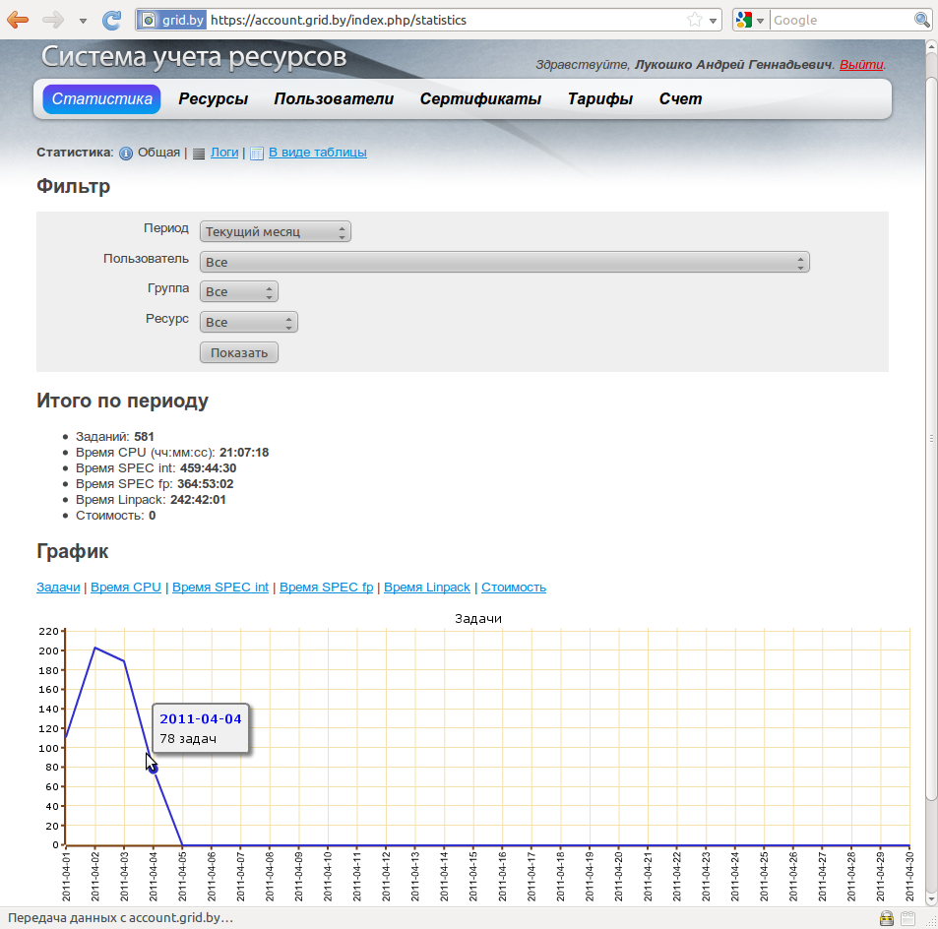

Slide 13
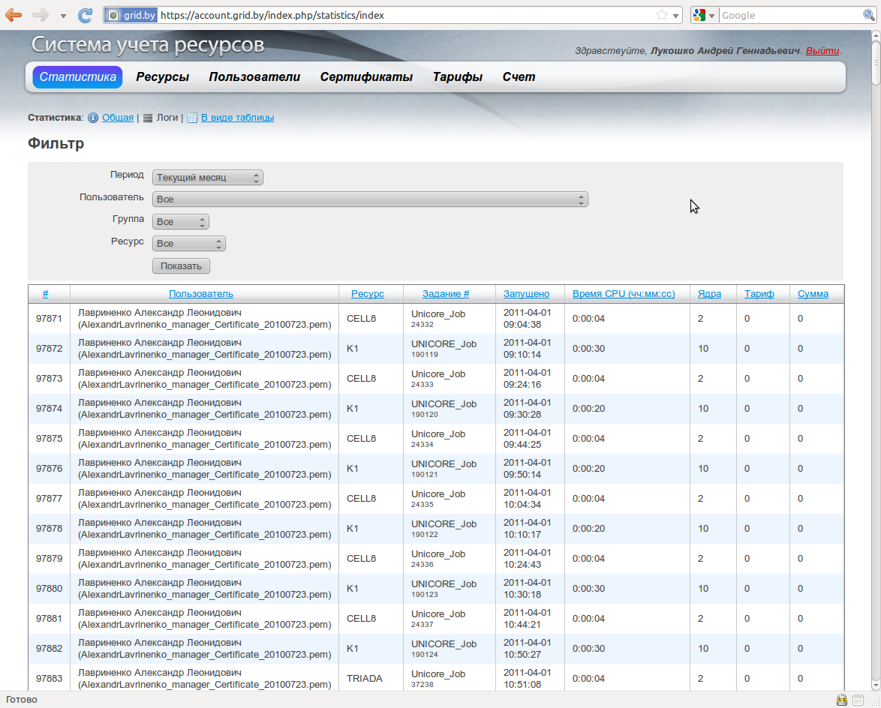

Slide 14
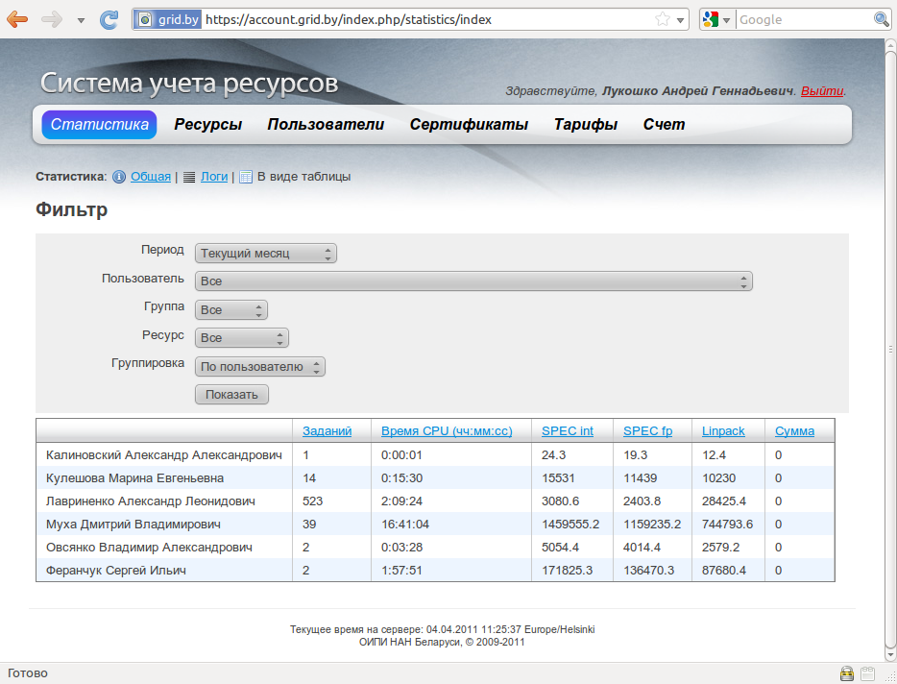

Slide 15
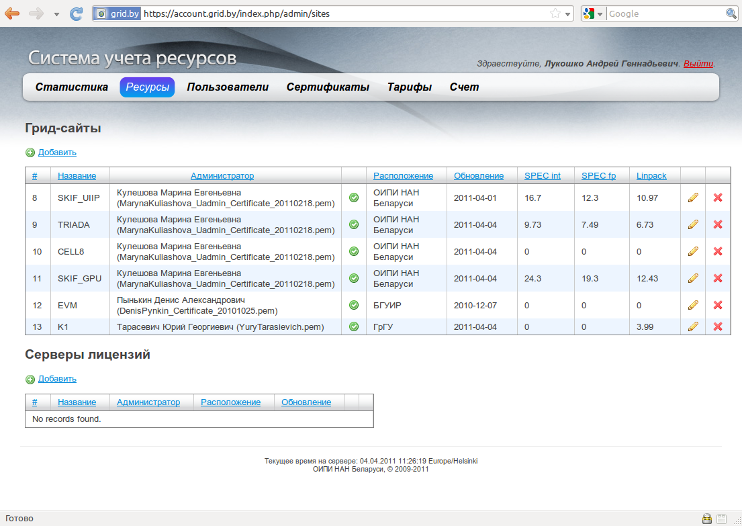

Slide 16
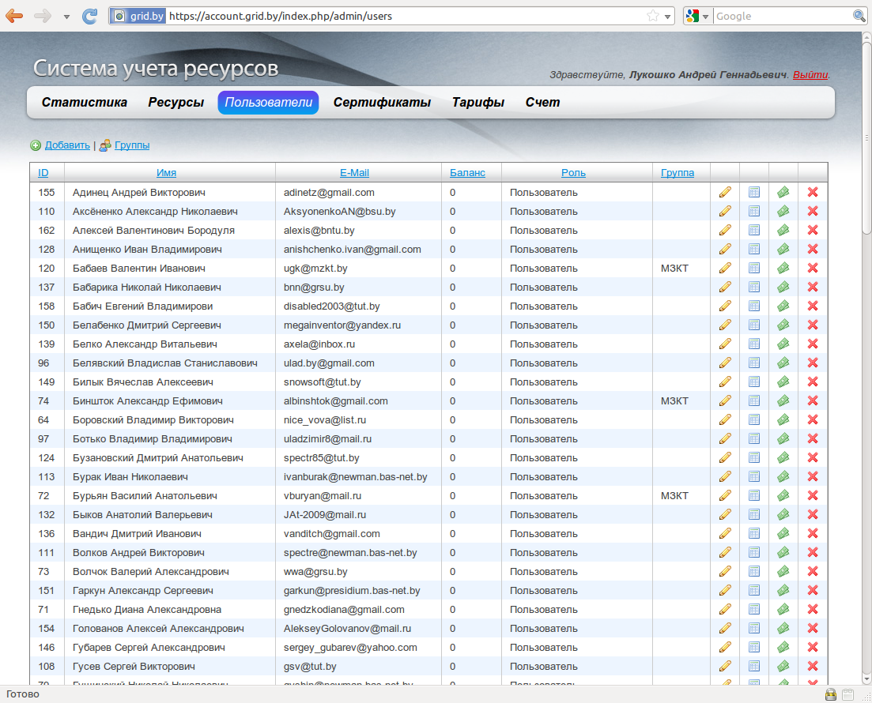

Slide 17
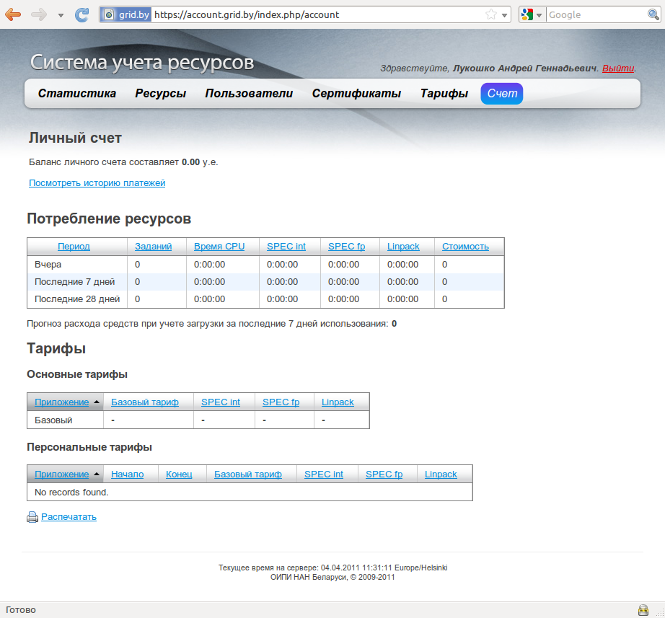

Slide 19
AGENT
SERVER

Slide 20
Torque changelog:
2.5.0
f - added full support (server-scheduler-mom)
for Cygwin (UIIP NAS of Belarus, uiip.bas-net.by)

Slide 21
Q&A
http://account.grid.by

