Slide 1
EGI User Community Support: NGIs and VRCs
Steve Brewer: Chief Community Officer, EGI.eu

Slide 2
Outline
The VRC model
How we get there – Support for users
Finding support through the EGI website
Support teams
Support services
Procedures
Achievements
Plans

Slide 3
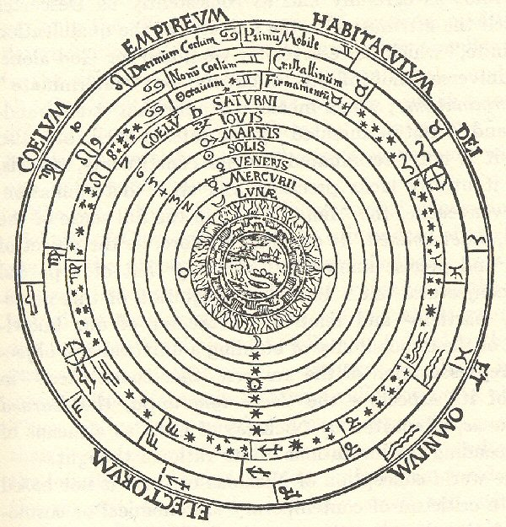
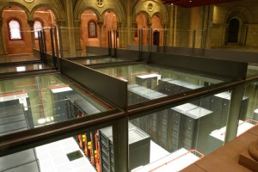
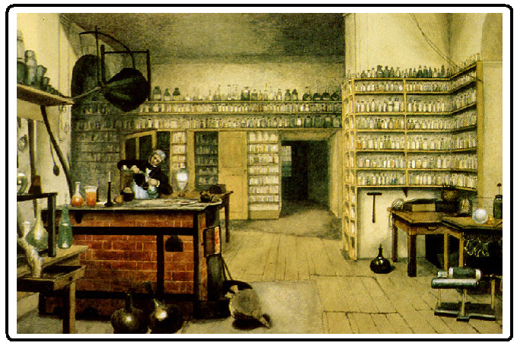
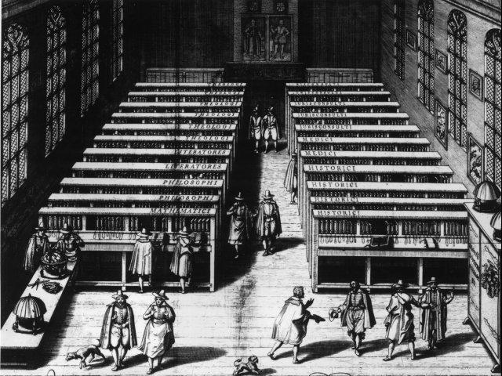
The Data Deluge
Michael Faraday's laboratory, 1830s
Barcelona Super Computer
The LHC
The Geocentric universe, pre-1500
Leiden University chained library 1610

Slide 4
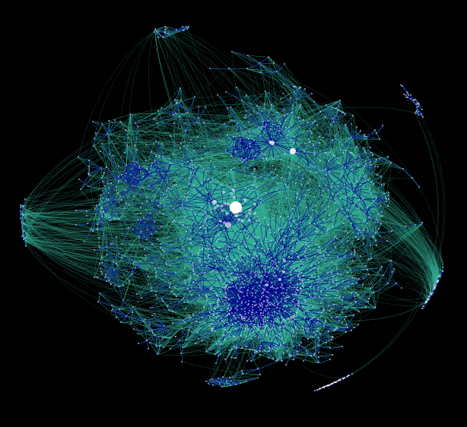
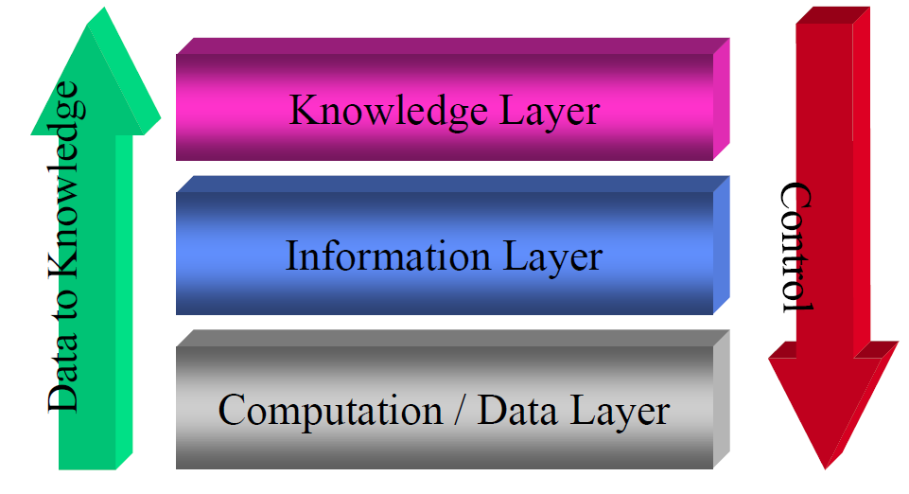
Exploiting research knowledge
Exploitation is driven by international collaborations
Data-driven sharing & analysis occur at scale: both size and geography
a hyperbolic display of blogs – an infinite web of collaboration and interaction

Slide 5
European e-Infrastructure
Applications
Networking
Resources
Desktops
HTC Grids
HPC Grids
Petascale
HPC
EGI
EGEE
PRACE
Virtualised Resources

Slide 6
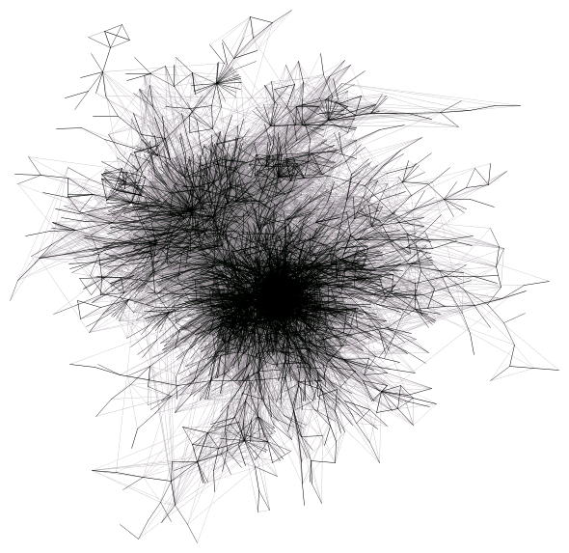
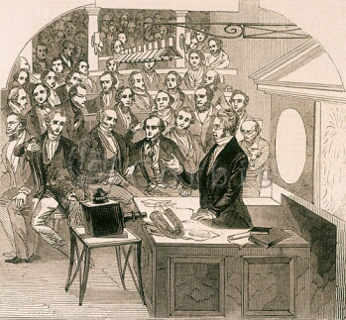
Research communities
Members of the Royal Institution attend a lecture given by Professor Faraday on Magnetism and Light, London 1846.
Virtual communities
“looking at the core of the blogosphere, 2007”
Physical communities

Slide 7
Tools and services for NGIs and their clients
Provided by a few NGIs for the whole community
To facilitate the work of NGI support teams
To improve communication among NGIs, among users and with users
Tools, services:
Database of EGI applications
Domain specific application – for scientific end users
Reusable toolkits and services – for support teams
Services for VRCs and VOs
Tools, manuals, assistance for VO setup and management
Training Marketplace
Repository of events and materials
Place to request and provide training services
Requirement Tracker
To capture needs, to invite external solution providers
Training Working Group
To discuss and define strategy for training services

Slide 8
Goal of EGI user support
Success stories
Communities
Scientific end users
Self-sustainable
EGI Virtual Research Communities (VRCs)
Support
activities, teams, tools and services
Dissemination
Software and technology experts
System administrators
Community representatives
Lessons learnt
Self-sustainability of user communities is the key to achieve a sustainable e-Infrastructure.

Slide 9
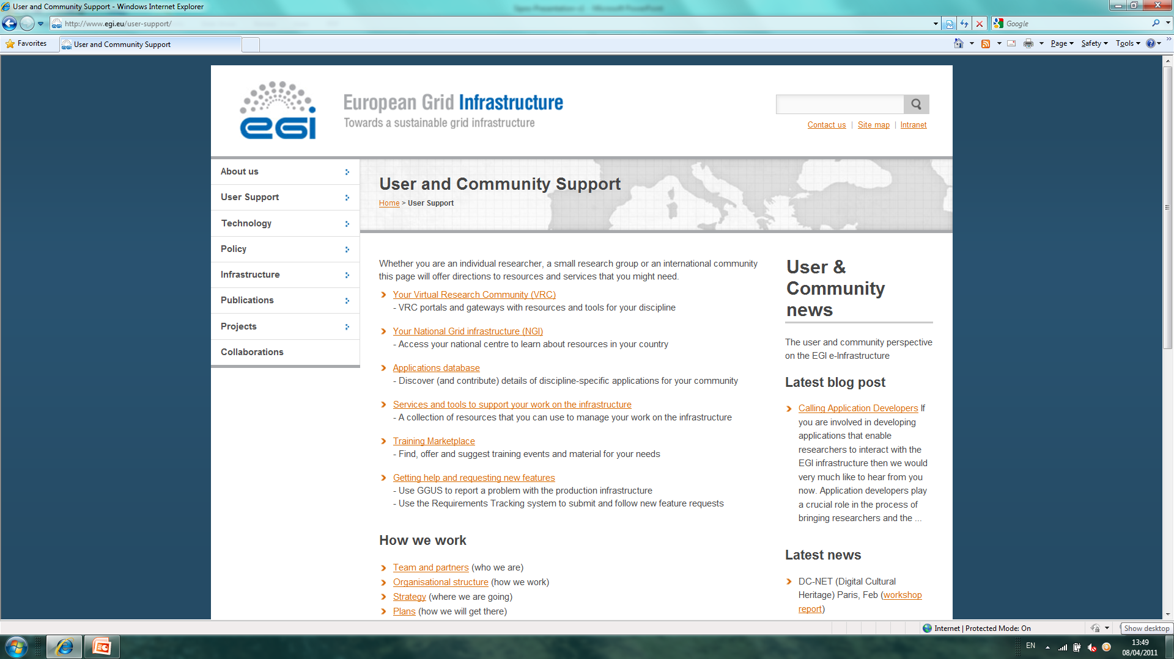
Finding user support – http://www.egi.eu

Slide 10
User Support structure
Support teams
NGI User Support Teams
Experts within established user communities
Site administrators
Projects with focus on specific areas. E.g.EDGI; MAPPER; StratusLab; ...
User Community Support Team of EGI.eu (ucst@egi.eu)
Ensures the flow of information , knowledge and solutions among stakeholders
Technical services
EGI Application Database
EGI Training Marketplace
VO services
Requirements Tracker
Processes
VRC accreditation
Processing requirements
Training Working Group

Slide 11
A Virtuous Service Cycle
European Grid Infrastructure
Resource Providers
NGIs
Current User Communities
Used by Researchers
Gathering New Requirements
New Technology Assessed
Deployed Infrastructure Services
SLAs
NGIs
MoUs
NGIs
NGIs
EGI.eu
EIROs
EIROs
NGIs
Established February 8th 2010
Coordinating core from Amsterdam (~20 people)
Technical services from partners (~20 people)
Technology Providers
New User Communities

Slide 12
A Virtuous User Cycle
Aka: “the chicken and egg conundrum...
Design
Deliver
Discover
Feedback through VRCs in the User Community Board
User Services Advisory Group to drive detailed design
Where is the community?
How can I contribute?
- VRCs
Mailing lists
Workshops
Forums
Blogs
Projects
Sharing stories
Collaborating
Applications
Data collections
Requirements
Proposals
Projects
Success stories
How do I use these resources?
Integrated Services
Human
Technical
Infrastructure
Attend training courses
Utilise training material
Access data
Run applications on the grid

Slide 13
User Support structure
Support teams
NGI User Support Teams
Experts within established user communities
Site administrators
Projects with focus on specific areas. E.g.EDGI; MAPPER; StratusLab; ...
User Community Support Team of EGI.eu (ucst@egi.eu)
Ensures the flow of information , knowledge and solutions among stakeholders
Technical services
EGI Application Database
EGI Training Marketplace
VO services
Requirements Tracker
Processes
VRC accreditation
Processing requirements
Training Working Group

Slide 14
Locating support teams and services - the EGI.eu Website

Slide 15
User Support structure
Support teams
NGI User Support Teams
Experts within established user communities
Site administrators
Projects with focus on specific areas. E.g.EDGI; MAPPER; StratusLab; ...
User Community Support Team of EGI.eu (ucst@egi.eu)
Ensures the flow of information , knowledge and solutions among stakeholders
Technical services
EGI Application Database
EGI Training Marketplace
VO services
Requirements Tracker
Processes
VRC accreditation
Processing requirements
Training Working Group

Slide 16
NGI User Support Teams
NGI User Support Teams
Consultancy
Training
Porting applications
Providing access to grid and software services
Developing and operating software services
Collecting Feedback
Documen-tation
Helpdesk
Consultancy
Training
Providing access to grid and software services
Porting applications
Developing and operating software services
Collecting feedback
Documentation
Helpdesk
NGIs are different in many ways...
...so are their support services!

Slide 17
User Support structure
Support teams
NGI User Support Teams
Experts within established user communities
Site administrators
Projects with focus on specific areas. E.g.EDGI; MAPPER; StratusLab; ...
User Community Support Team of EGI.eu (ucst@egi.eu)
Ensures the flow of information , knowledge and solutions among stakeholders
Technical services
EGI Application Database
Services for VOs
EGI Training Marketplace
Requirements Tracker
Processes
VRC accreditation
Processing requirements
Training Working Group

Slide 18
Tools and services for NGIs and their clients
Provided by a few NGIs for the whole community
To facilitate the work of NGI support teams
To improve communication among NGIs, among users and with users
Tools, services:
EGI Application Database
Domain specific application – for scientific end users
Reusable toolkits and services – for NGI support teams
Services for VOs
Tools, manuals, assistance for VO setup and management
Training Marketplace
Repository of events and materials
Place to request and provide NGI training services
Requirement Tracker
To capture needs
To offer solutions from NGIs

Slide 19
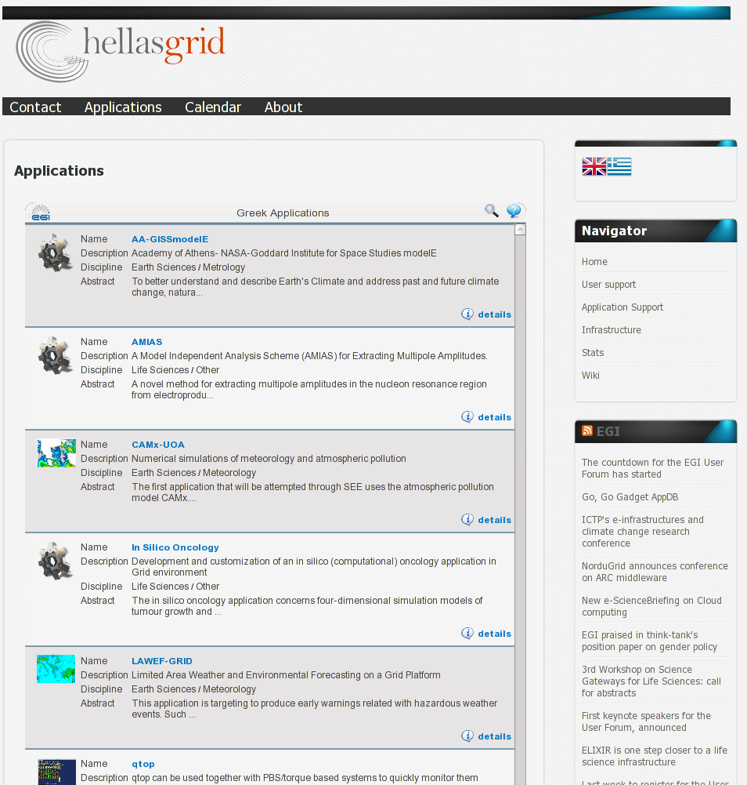
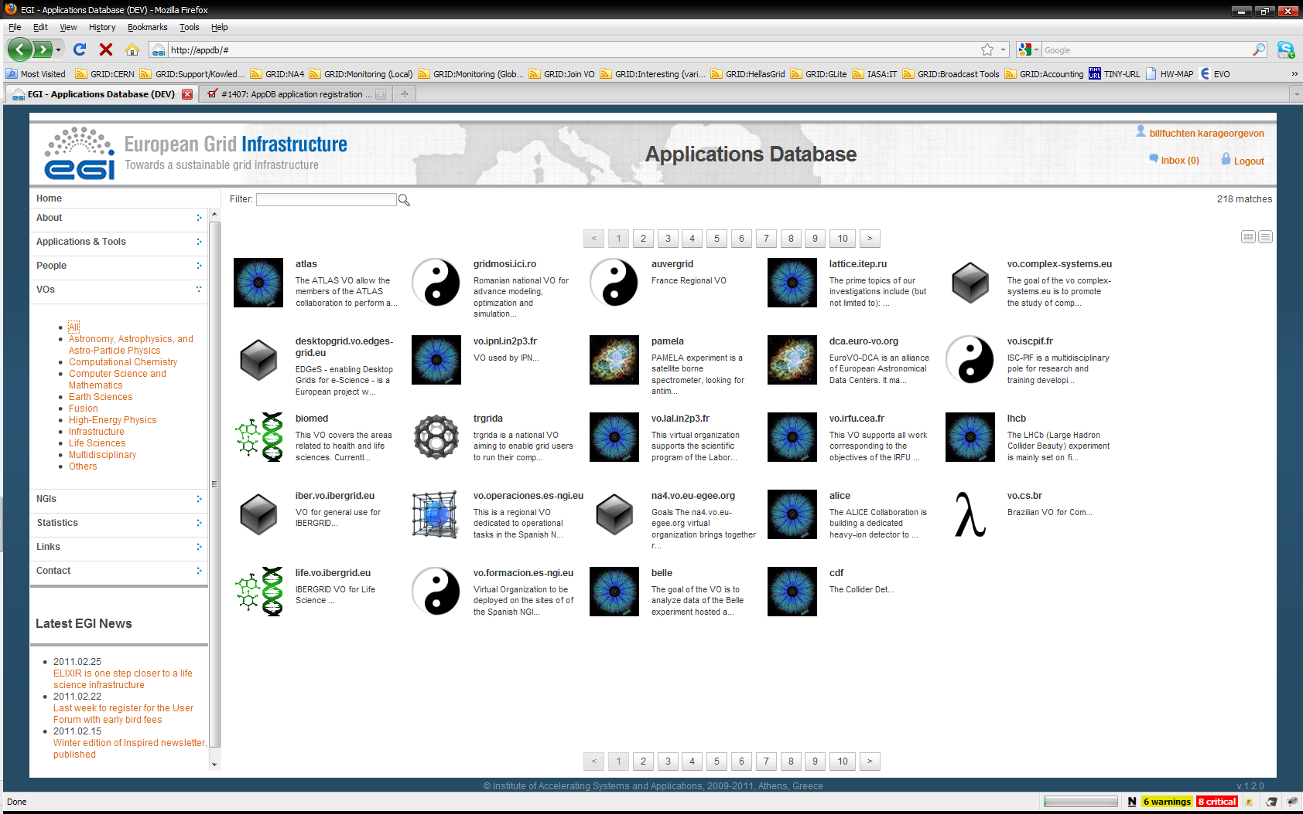
EGI Application Database http://appdb.egi.eu
To give recognition to reusable applications
To give recognition for application developers
How to get involved
Register applications
Reuse applications
Integrate AppDB through its gadget into any Webpage!

Slide 20
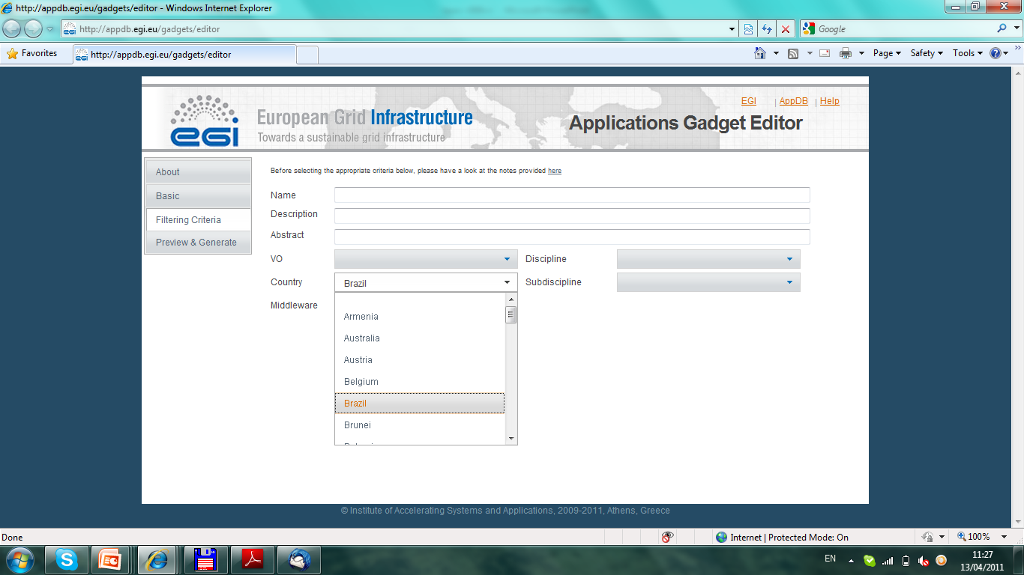
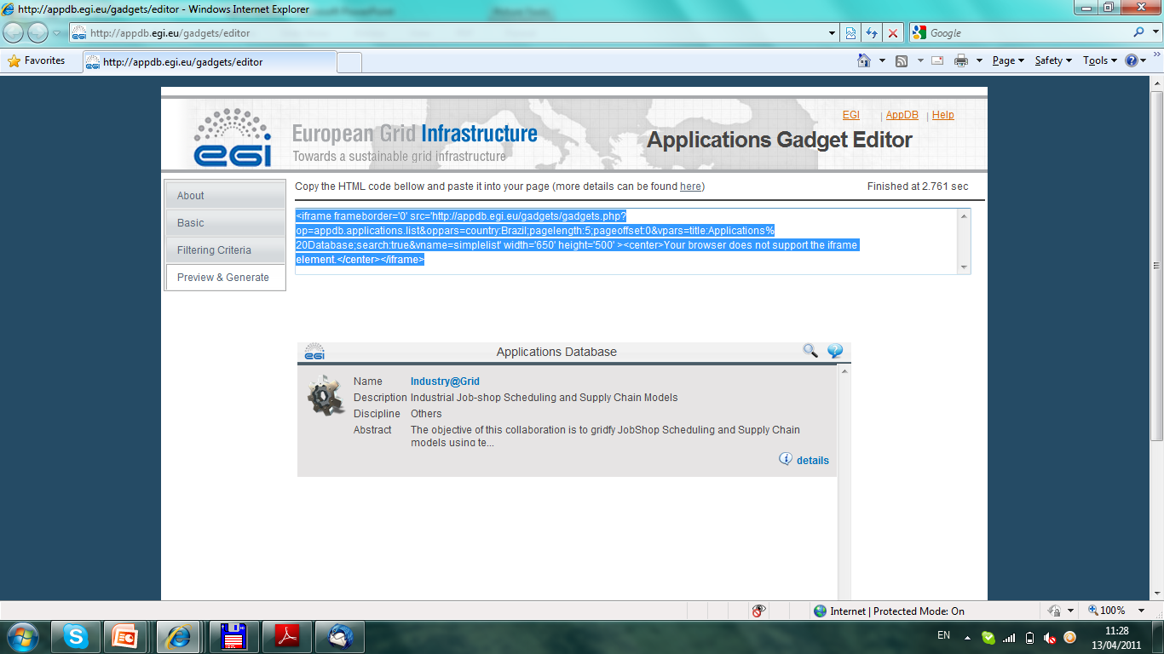
The AppDB gadget
Copy – paste this into your Website

Slide 21
Services for VOs
Activities
Consultancy and helpdesk for VO managers
Evaluation of VO management, monitor and accounting tools
Provision of VO support software for VRCs
VO-specific monitoring
Monitor only those sites that support you
Create and plug-in VO-specific probes
How to get involved?
Request support
Prepare and share reviews of VO tools
Offer local solutions for Vos through the group
NGI
NGI
VO
monitor
NGI
NGI

Slide 22
Training marketplace
Integration of
training event calendar
Digital library (of training materials)
Service offering and requesting form
How to get involved?
Register training events
Use, reuse and share training materials
Offer training-related services (infrastructure, VO, CA, ...)
Feed training-requirements
Delegate representative to EGI Training Working Group

Slide 23
Training working group https://wiki.egi.eu/wiki/Training_Working_Group
To develop and monitor a training coordination strategy for the EGI community
Drive the evolution of Training Marketplace and content in it
Delegates from NGIs and DCI projects
Monthly teleconferences
How to get involved
Send a delegate to our meetings
Find topics, actions and decisions in meeting minutes

Slide 24
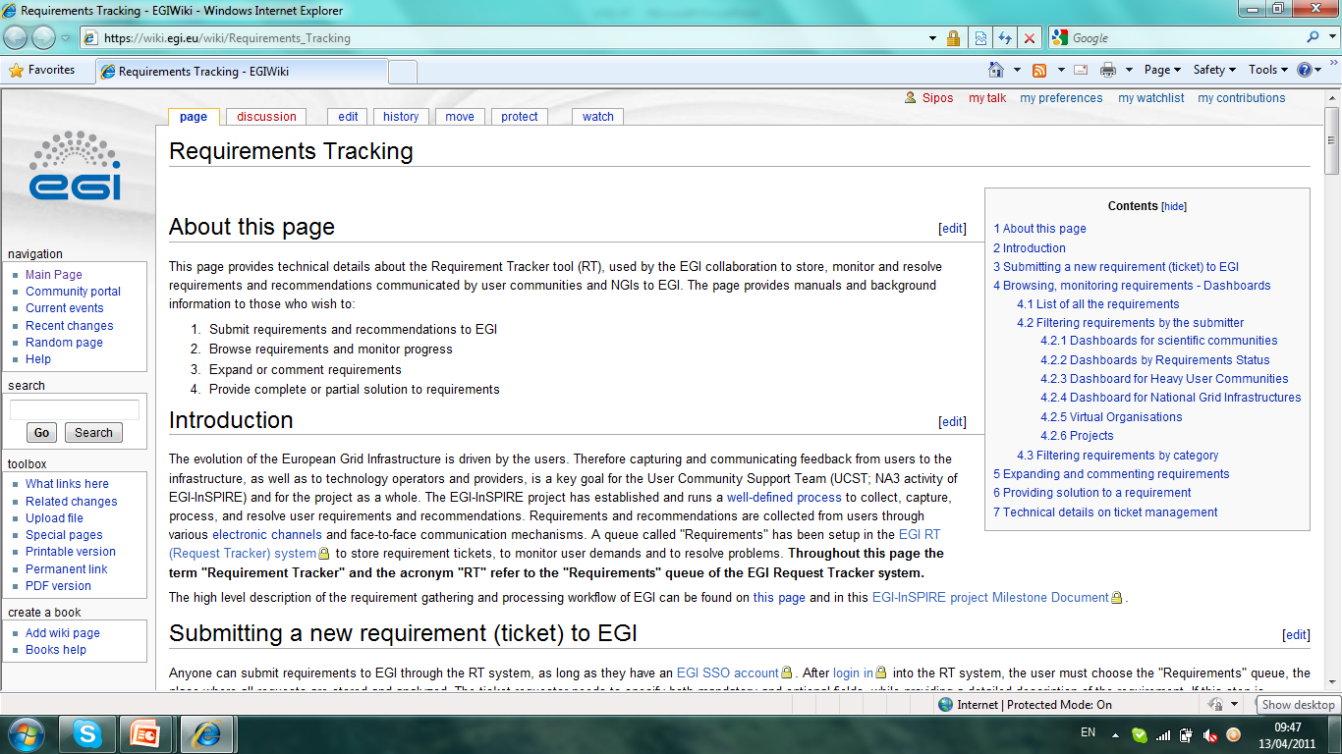
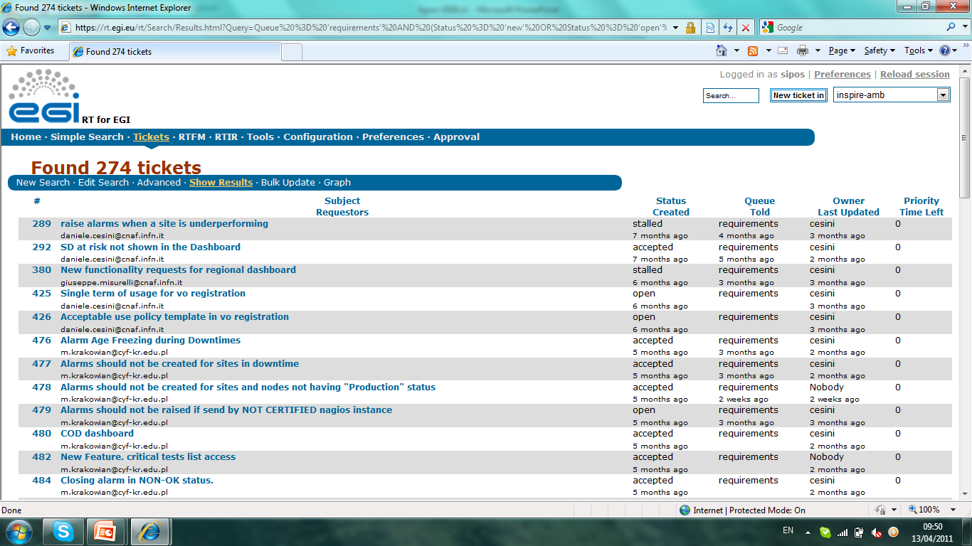
Requirements Tracker (RT)
Permanent storage for EGI requirements
User
Operational
Complete transparency
For user communities
For NGIs
For technology providers
Requirement submission interface
Query interfaces
Manuals

Slide 25
User Support structure
Support teams
NGI User Support Teams
Experts within established user communities
Site administrators
Projects with focus on specific areas. E.g.EDGI; MAPPER; StratusLab; ...
User Community Support Team of EGI.eu (ucst@egi.eu)
Ensures the flow of information , knowledge and solutions among stakeholders
Technical services
EGI Application Database
Services for VOs
EGI Training Marketplace
Requirements Tracker
Processes
VRC accreditation
Processing requirements
Training Working Group

Slide 26
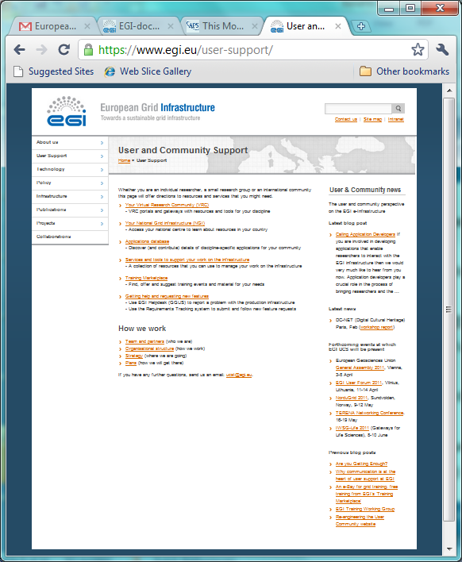
UCST: web site
Portals and gateways for research communities (including EGI VRCs)
Support contact points for NGIs (national contact points for users)
Applications database (AppDB)
Services and Tools to support users within VOs
Training Marketplace:
the training calendar & digital library brought together
Getting help (GGUS) and requesting New Features: Requirements Gathering)

Slide 27
Processing EGI requirements, implementing solutions
UCST and EGI-InSPIRE developers
NGIs and VRCs
USAG, OTAG
HUCs
1) 2) 3)
EIROs
VRCs
EEF
Input Channels for User requirements
EGI Requirements Tracker
TCB
External technology providers
UCB
4) 5)
VOs
NGIs
Input Channels for Operation requirements
EMI
IGE
SAGA,
...
ESFRIs
EGI Heldpesk (GGUS system)
USAG: User Services Advisory Group
OTAG: Operational Services Advisory Group
UCB: User Community Board
TCB: Technology Coordination Board

Slide 28
Achievements since May 2010
National/regional support teams are available in 37 countries
>200 requirements captured (50 from NGI)
Most of these are resolved by NGIs
Others sent to external technology providers through the TCB
46 training events held
28 in Europe, 18 outside of Europe
More than 30 new applications registered in Application Database
Regular posts about community support in the EGI newsletter and EGI blog

Slide 29
VRC accreditation
VRC = Discipline-based community
Structural Biology and NMR, Life Sciences Grid Community, Arts and Humanities, Language resources, ...
Accreditation through
Memorandum of Understanding (https://documents.egi.eu/document/205)
(Possible intermediate step – Letter of Intent)
Benefits:
Recognition by NGIs (part of accreditation)
Delegate in the UCB (prioritisation of requirements)
EGI channels to reach NGIs

Slide 30
10 point strategy
Website to draw in all categories of users: (www.egi.eu/user-support)
Gather intelligence: metrics, data, trends, knowledge, geo-spatial info.
Investigate key requirements:
share knowledge with users/developers/middleware providers
Blog – post updates on all aspects of NA3: stimulate discussion
Meet the Application Developers: workshops to support key topics
EGI Community Roadshow: in conjunction with NGIs
Training ‘marketplace’ : combined Training Calendar and Digital Library
Video material & online courses for training: supply tools and support
VRC Representatives: support & promote their role as EGI ‘champions’
Technical Services – integrates platform of technical services:
NGIs and VRCs can embed in their own gateways and portals

Slide 31
User Forum opportunities
The UCST Booth
Meet the UCST team, brochures and leaflets
discuss your needs and those of your community
UCST demonstrations
VO Services and AppDB – will follow this talk
Available again on the booth at various times
Visit the web site
All of the above plus interaction
Submit bug reports and suggest feature reqs.
Many User Support sessions to follow
Services and tools for EGI Virtual Research Communities – open discussion about future plans

Slide 32
Questions & discussions
Supporting NGI teams
Do we have the right tools? Suggestions of existing tools and services
Do we have the right content? Are we talking to the right people?
Content validation: moderation v. Commentry
Other tools?
Event organisation, online training, commercial s/w, video conferencing, help desk
Promote different routes into using the infrastructure
AppDB – more info - how to use apps? Community-originated, integrated
Obtaining community participation in porting etc.
Links to repositories - where s/w can be obtained
Hoe do I make use of s/w that I don’t have access to?
Discussion around apps, triggers to NGIs, users and developers
How much detail should contributors be obliged to contribute?
How to obtain critical mass?
How to find info across repos?
s/w development platform
Communication channels:
In reach & outreach
Workshops:
Roadshows:
New communities: large (ESFRI) and small...
Support for emerging communites

