Slide 1
Supporting Distributed Computing Infrastructures
Torsten Antoni, KIT
torsten.antoni@kit.edu

Slide 2
User support is…
Application integration and support
User education
Simple access to a broad range of information
Day-to-day support for the users of grid data, compute, networking and VO-specific services

Slide 3
Areas of user support
First Line
Support
GGUS
MW Support
Operations
Support
Community
Applications
Support
Second & Third
Level Support

Slide 4
Support for…

Slide 5
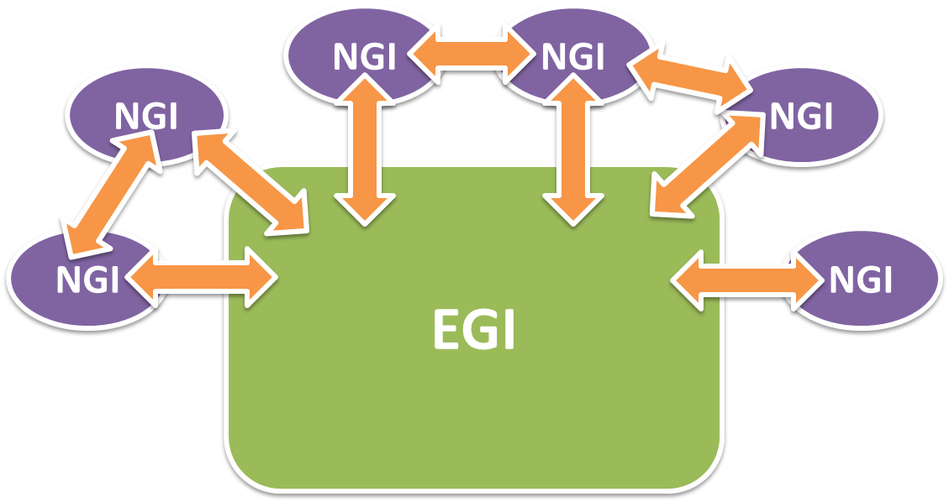
Structure of EGI

Slide 6
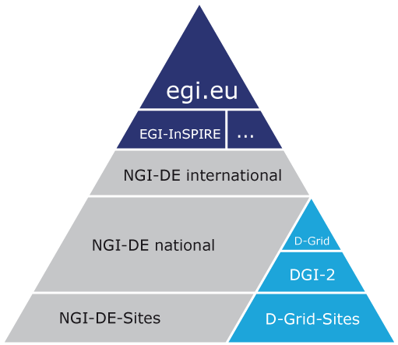
NGIs in EGI

Slide 7
Distributed support
with central coordination

Slide 8
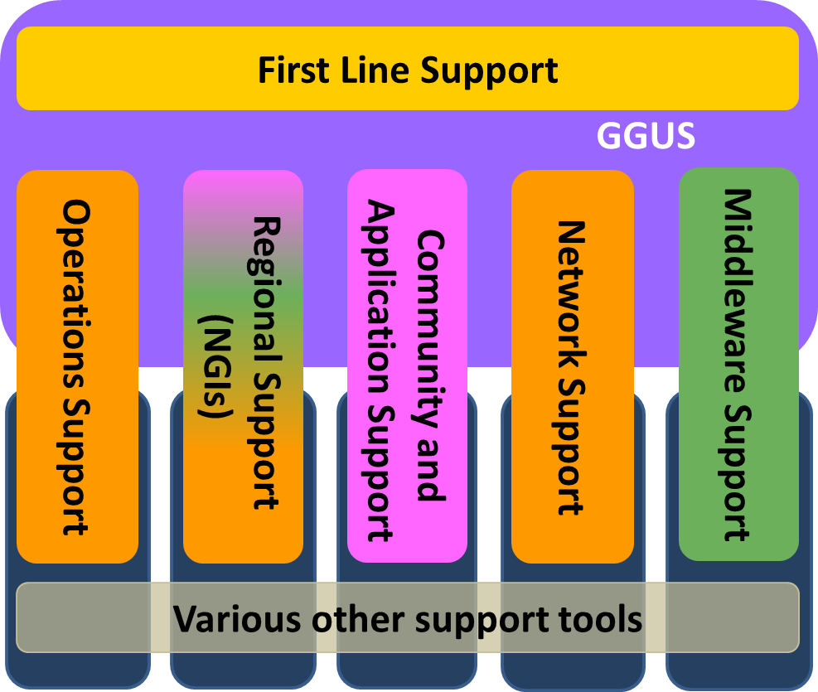
EGI support infrastructure

Slide 9
Communities and applications

Slide 10
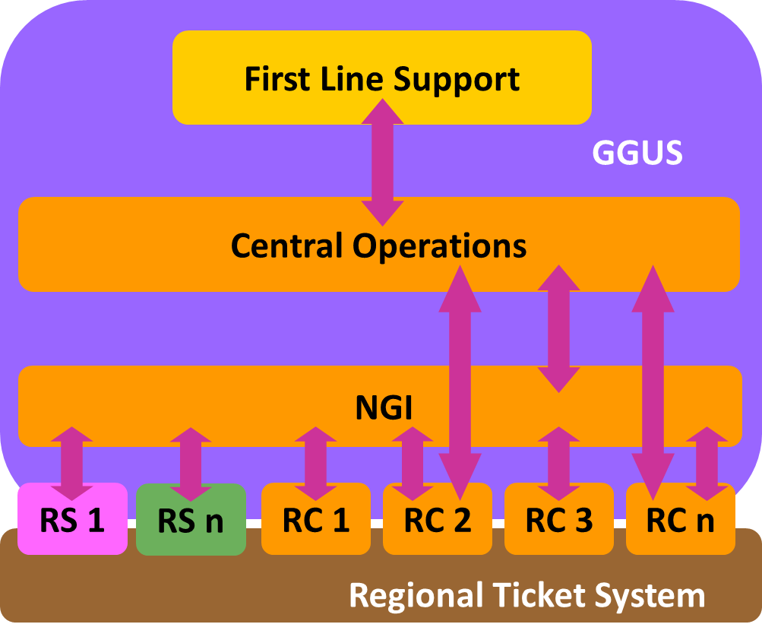
Operations

Slide 11
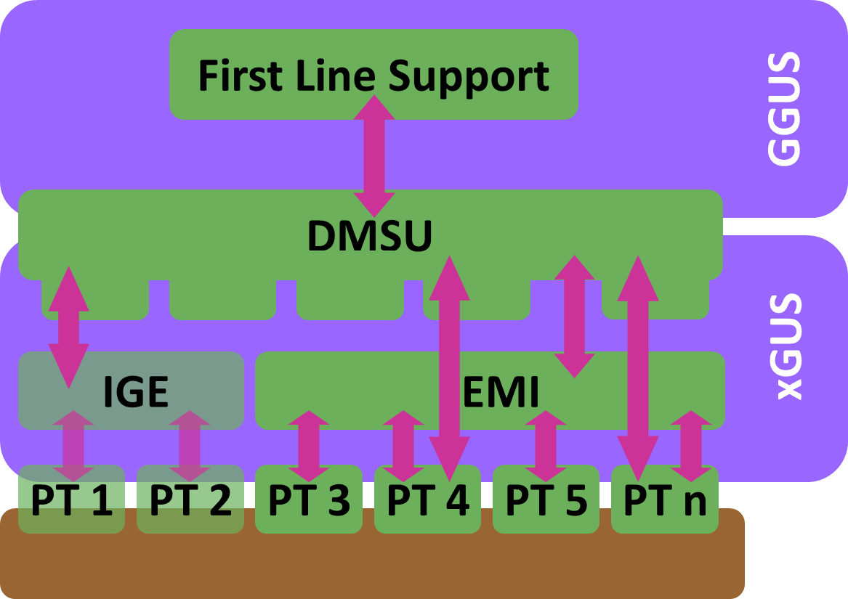
Technology support

Slide 12
Technology workflows
TPM
Technology Helpdesk
DMSU
EGI-SA2
GGUS
RT
accept/reject
announce
Workflow for bugs
found in production
Technology Provider (EMI / IGE)
Software release
workflow

Slide 13
Detailed bug workflow

Slide 14
Seamless support across multiple projects and infrastructures

Slide 15
Central helpdesk
helpdesk.egi.eu

Slide 16
Helpdesk tools in EGI
GGUS - the tool behind
the central EGI helpdesk
www.ggus.eu
xGUS – a helpdesk template for
NGIs and user communities
xgus.ggus.eu

Slide 17
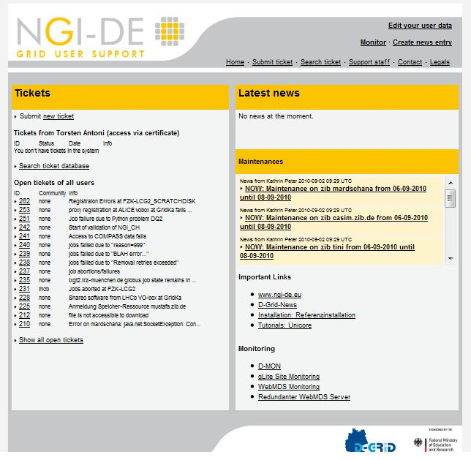
xGUS example
helpdesk.ngi-de.eu

Slide 18
Commercial break
xGUS Live Demo
during the Welcome Reception
at Booth 13
xGUS – a helpdesk template for
NGIs and user communities
xgus.ggus.eu

Slide 19
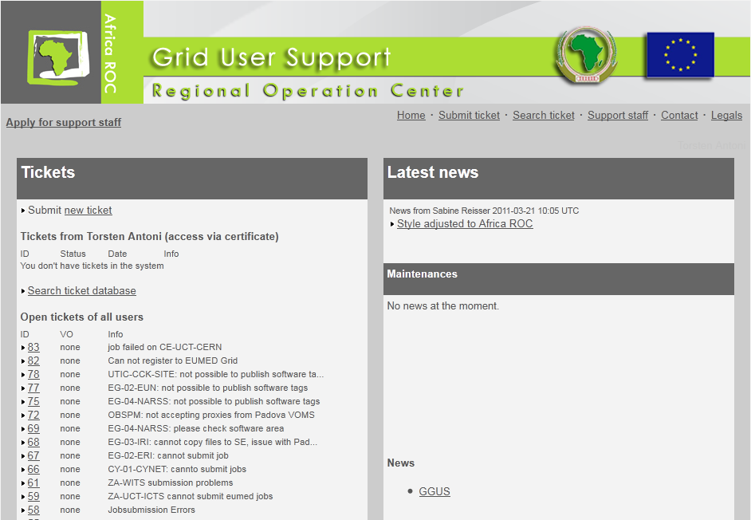
Another xGUS example
support.africa-grid.org

Slide 20
Federated DCIs

Slide 21
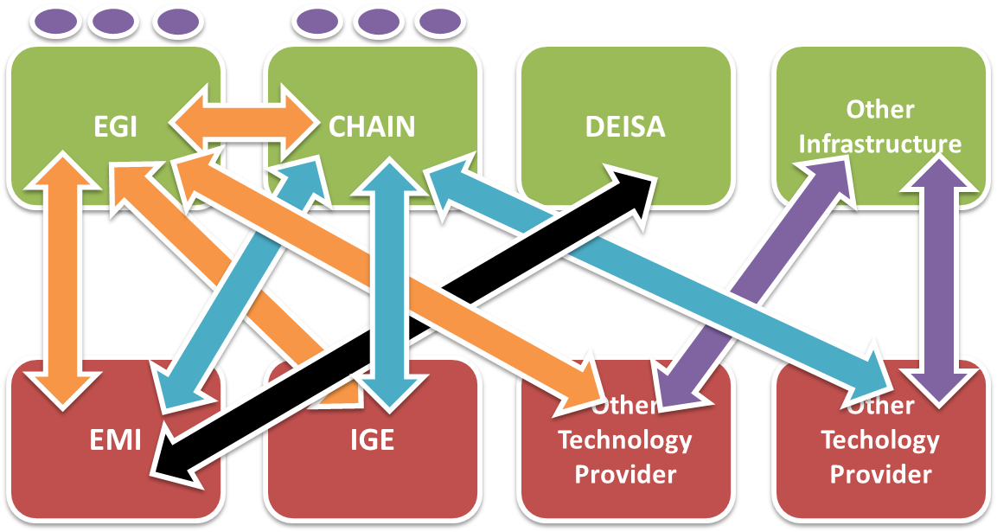
Federated DCIs - today

Slide 23
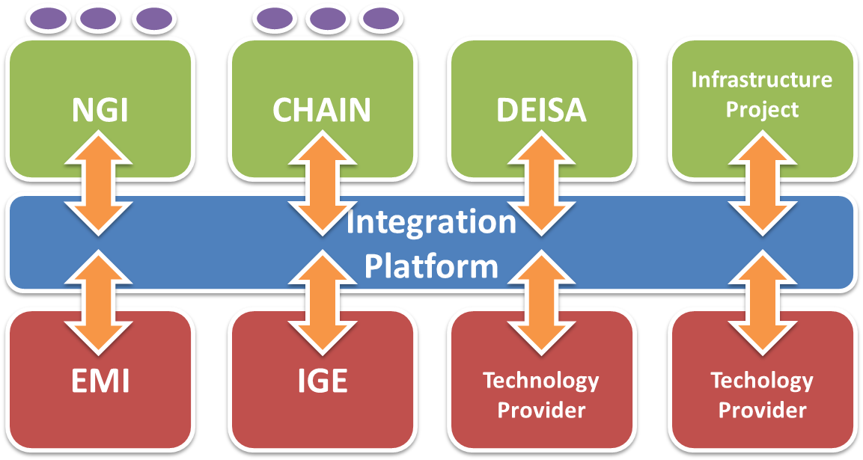
Federated DCIs - future

Slide 24
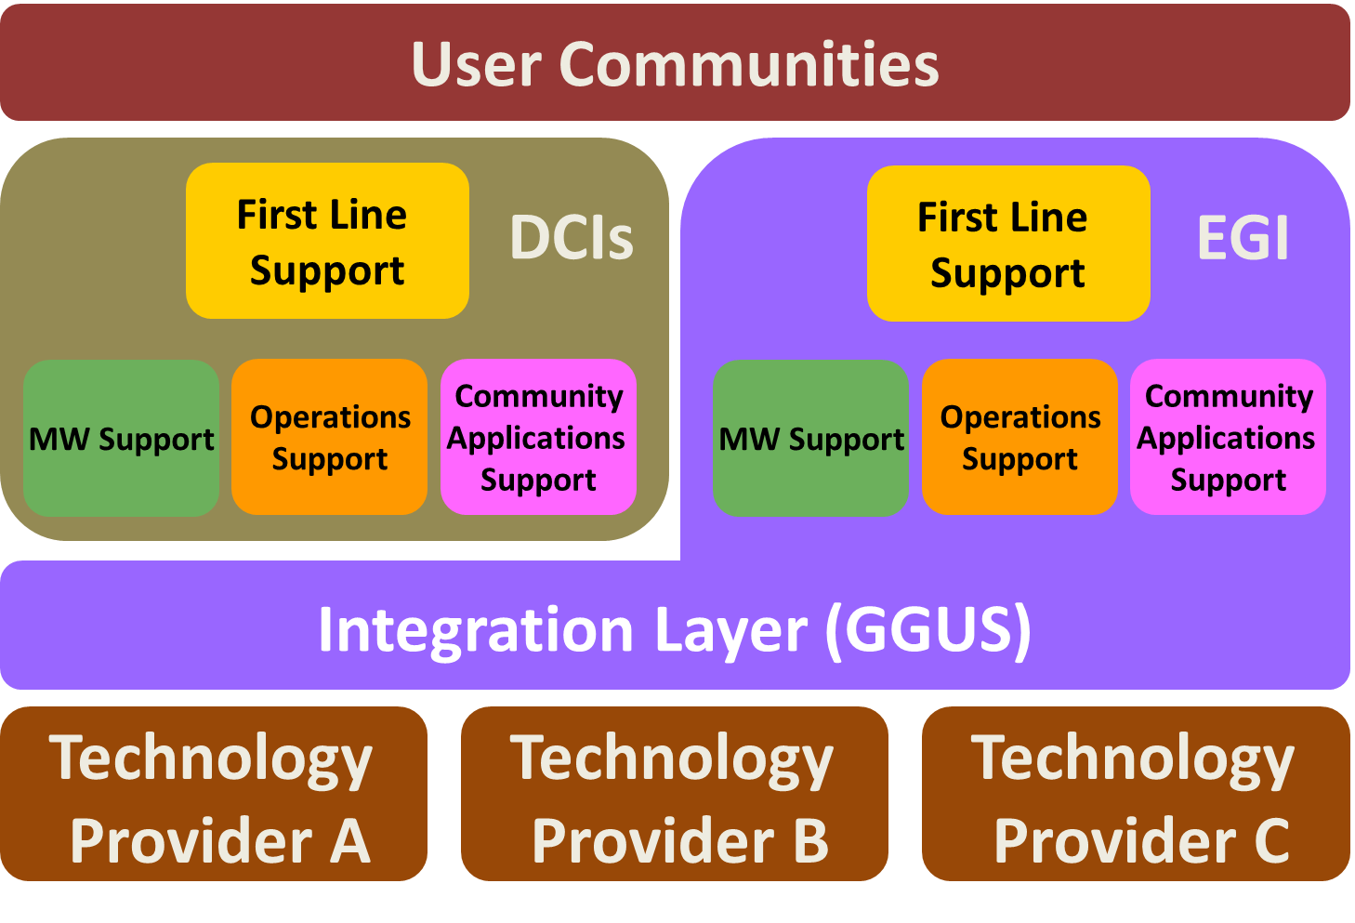

Slide 25
Conclusions

Slide 26
Conclusions
Integration! Federation! Collaboration!
The user does care about projects, infrastructures, technology providers, …
Do not re-invent the wheel!
Evaluate what‘s already there
Agree on standards!
Standard ticket layout
Standard ticket exchange interface
Keep it simple!
Submitting a ticket should not require reading a 100 page documentation
Think user-centric!
Understand how the user communities work
Hide complexity from the users where possible

