Slide 1
SA4: Advancing EGI’s Strategic Goals
Michel Drescher
Technical Manager, EGI.eu
Michel.Drescher@egi.eu

Slide 2
Outline
Introduction
Achievements
Conclusions
Notes:
Approximate schedule
Brief introduction to why mini projects and which (5’)
Highlights of select mini projects (10’ – 15’)
Conclusions (2’)
Questions & Answers (10’)

Slide 3
Outline
Introduction
Achievements
Conclusions

Slide 4
SA4 Overview
12 Countries
13 Beneficiaries
PY4 effort
103 PMs
8.6 FTEs
Total effort
113 PMs
9 FTEs
Task started April 2013
The Netherlands
Croatia
Czech Republic
France
Greece
Germany
Hungary
Italy
Portugal
Spain
Sweden
UK
WP | Task | Beneficiary | Total PMs
WP8-S | TSA4.1 | EGI.EU | 1
WP8-S | TSA4.2 | SURF | 13
WP8-S | TSA4.3 | MTA SZTAKI | 3
WP8-S | TSA4.3 | EGI.EU | 0
WP8-S | TSA4.3 | INFN | 2
WP8-S | TSA4.3 | CESNET | 5
WP8-S | TSA4.4 | CESNET | 8
WP8-S | TSA4.5 | UU (KTH) | 6
WP8-S | TSA4.6 | CNRS | 7
WP8-S | TSA4.7 | CSIC (FCTSG) | 18
WP8-S | TSA4.8 | KIT-G (JUELICH) | 4
WP8-S | TSA4.8 | CESNET | 4
WP8-S | TSA4.9 | CNRS | 12
WP8-S | TSA4.2 | EGI.EU | 0
WP8-S | TSA4.10 | GRNET | 7
WP8-S | TSA4.10 | SRCE | 5
WP8-S | TSA4.11 | STFC | 6
WP8-S | TSA4.12 | CNRS | 5
WP8-S | TSA4.12 | CYFRONET | 10
Transfer of budget between Beneficiary 14-CNRS and Beneficiary 1 EGI.eu in order to perform activities related to task TSA4.6 “Dynamic Deployments for OCCI Compliant Clouds”
Notes:
Why mini projects?
VTs are voluntary/unfunded
Best effort, thus timelines not assured
Topics tend to be “nice to have”
11 mini projects funded (out of 29 submissions)

Slide 5
Mini projects overview
TSA4.2: Massive Open Online Course Development
TSA4.3: Evaluation of Liferay modules
Gergely Sipos
UCST
TSA4.4: Providing OCCI support for arbitrary Cloud Management Frameworks
TSA4.5: CDMI Support in Cloud Management Frameworks
TSA4.6: Dynamic Deployments for OCCI Compliant Clouds
TSA4.7: Automatic Deployment and Execution of Applications using Cloud Services
TSA4.8: Transforming Scientific Research Platforms to Exploit Cloud Capacity
Michel Drescher,
EGI Federated Clouds
TSA4.9: VO Administration and operations PORtal (VAPOR)
TSA4.10: A new approach to Computing Availability and Reliability Reports
TSA4.11: GOCDB Scoping Extensions and Management Interface
TSA4.12: Tools for automating applying for and allocating federated resources
Diego Scardacci,
Operational Tools
Notes:
Mini projects
Focus in strategic pillars & EGI Objectives
Provide Enabling Services to Researchers
TSA4.3 Liferay, TSA4.9 VAPOR
Provide Flexible Virtual Research Environments
TSA4.7 AppDeployment
Operate an Unprecedented European Capability for High Throughput Data Analysis
TSA4.4 OCCI, TSA4.5 CDMI, TSA4.6 DynOCCI,
TSA4.10 A/R Comp, TSA4.11 GOCDB tags, TSA4.12 e-GRANT
Develop the human capital
TSA4.2 MOOC, TSA4.8 CloudCaps
Outcome of a clear gap analysis
Shepherds assigned for each target domain

Slide 6
Mini projects structure
Formal integration with EGI-InSPIRE
Inherit management and funding schemes
Administrative WP management
Mini projects treated as project tasks
Domain shepherd leadership
Oversee progress & manage deviations from plans
Ensure prompt integration of results in target platforms
Facilitate cross-pollination between mini projects and platforms
Mini project management
As much freedom as possible
Minimal invasive formal requirements
Notes:
Similar to matrix management in corporations
Line management (→ WP admin and reporting)
Project management (→ shepherd)
Guidance and steering by shepherd,
While teams decide for themselves *how* they want to deliver

Slide 7
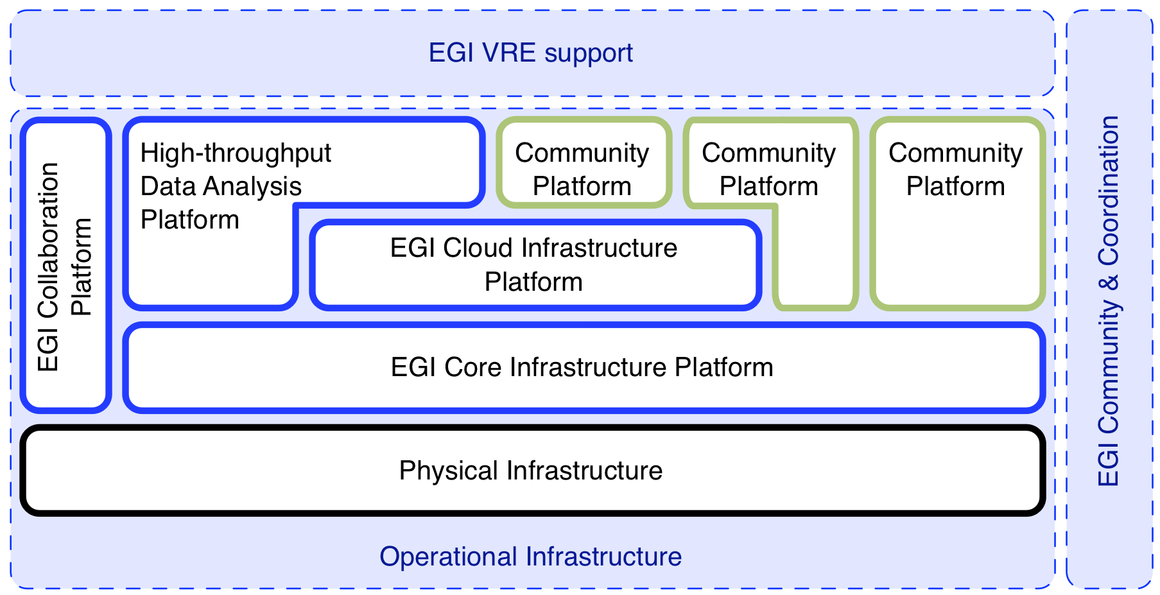
Mapping to EGI strategic pillars
TSA4.2
User Training
TSA4.3
Evaluating Liferay
TSA4.4.8
Cloud Patterns
TSA4.4
VM
Mgmt.
TSA4.5
Data Mgmt.
TSA4.6
Cloud
Autoscale
TSA4.7
Contextualisation
TSA4.9
VO Portal
TSA4.10
Monitor/SAM
TSA4.11
Service
Registry
TSA4.12
e-GRANT
Notes:
Selection along strategy pillars and platforms

Slide 8
Outline
Introduction
Achievements
Conclusions

Slide 9
Highlighting selected achievements
TSA4.2
User Training
TSA4.3
Evaluating Liferay
TSA4.4.8
Cloud Patterns
TSA4.4
VM
Mgmt.
TSA4.5
Data Mgmt.
TSA4.6
Cloud
Autoscale
TSA4.7
Contextualisation
TSA4.9
VO Portal
TSA4.10
Monitor/SAM
TSA4.11
Service
Registry
TSA4.12
e-GRANT
Notes:
A select number to highlight (time constraints)
Grouped by platforms
All referenced in slides

Slide 10
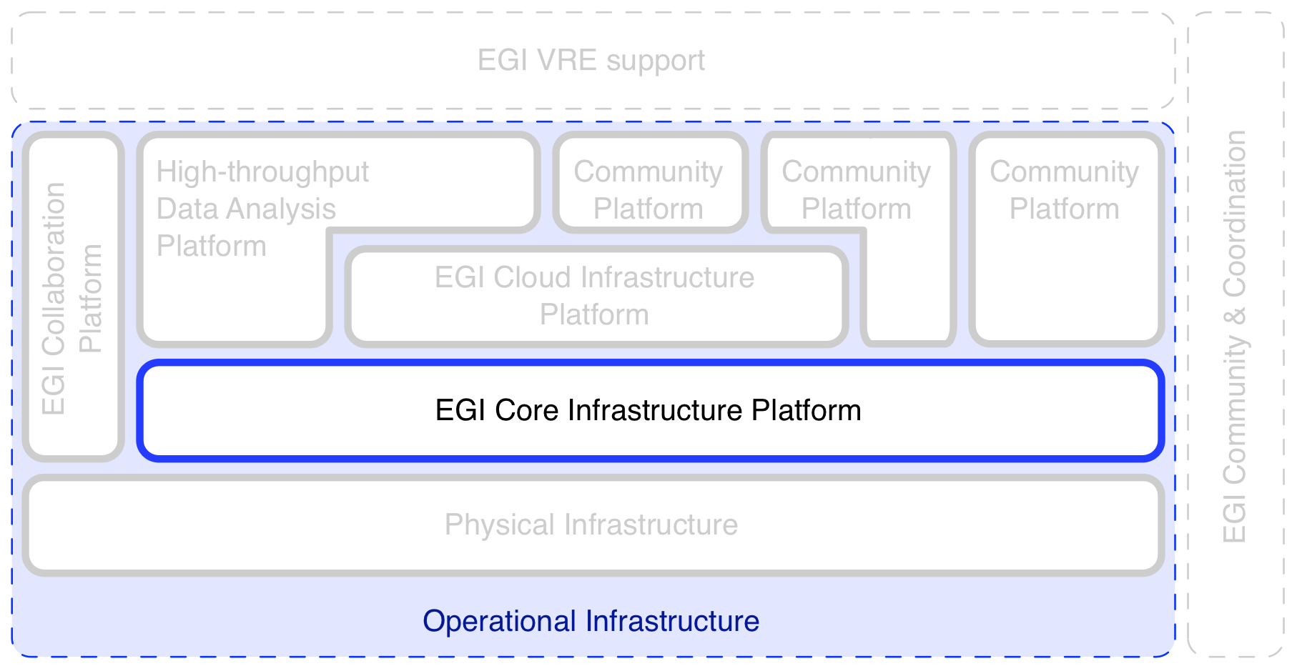
Core Infrastructure: Virtual Organisation support
TSA4.2
User Training
TSA4.4
VM
Mgmt.
TSA4.6
Cloud
Autoscale
TSA4.9
VO Portal
TSA4.12
e-GRANT

Slide 11
TSA4.9: VO Administration and operations PORtal (VAPOR)
Objectives
Develop web-based portal for small/medium VOs
VO membership administration
VO resource status dashboard
VO data management
Outcomes
Portal deployed for early adopters (Nov ‘13)
Resource status dashboard
Operational reports
VAPOR in production since January 2014
VO membership administration NOT implemented
Impact
Expand EGI’s solution portfolio for small & medium VOs
Reduce TCO of integrating / making use of EGI infrastructure
Already in use by 6 Virtual Organisations
Biomed, compchem, enmr.eu, shiwa-workflow.eu, vlemed, vo.france-grilles.fr
Notes:
Problem:
VOs often left alone with too little information
We’re not able to proactively manage the allocated resources
VO membership service issue:
Hired developer did not have the expected expertise in SW engineering
VO resource dashboard development took longer than expected
JSAGA & firewall issues
Lavoisier integration more challenging than expected

Slide 12
Core Infrastructure: Resource Allocation service
TSA4.2
User Training
TSA4.4
VM
Mgmt.
TSA4.6
Cloud
Autoscale
TSA4.9
VO Portal
TSA4.12
e-GRANT

Slide 13
TSA4.12: Tools for automating applying for and allocating federated resources
Objectives
Develop service backing the Resource Allocation Task Force
Outcomes
First version operational in November 2013
Used for first round of resource requests (http://go.egi.eu/resreq-1)
Version 1.5 deployed in January 2014
Integrated with EGI AAI and GOCDB v5
Version 2 deployed in March 2014
Includes resource brokering, SLAs
Impact
Single point of contact for users and providers: https://e-grant.egi.eu
Reduced TCO for users & providers of the EGI infrastructure
5 Virtual Organisations have already used it
Peachnote, eli-beams, biomed, SAGrid, compchem
Notes:
Problems:
Difficult for users to find resources (one, or among more)
RPs have no resources to do “business development”
VOs having used the tool:
Peachnote (SSO user viro)
Eli-beams (klimo)
Biomed (fmichel)
SAGrid (bbecker)
Compchem (sergio_maffioletti)
??? (SSO user yocto)

Slide 14
Core Infrastructure: other
TSA4.10: A new approach to Computing Availability and Reliability Reports
To replace existing, but aging calculation engine
Runs under production conditions, transition planned for 1Q15
Greater reporting flexibility for EGI at less TCO
TSA4.11: GOCDB Scoping Extensions and Management Interface
To allow custom tagging of resources in Service Registry
In production since October 2015
Flexible grouping of resources in any aspect possible

Slide 15
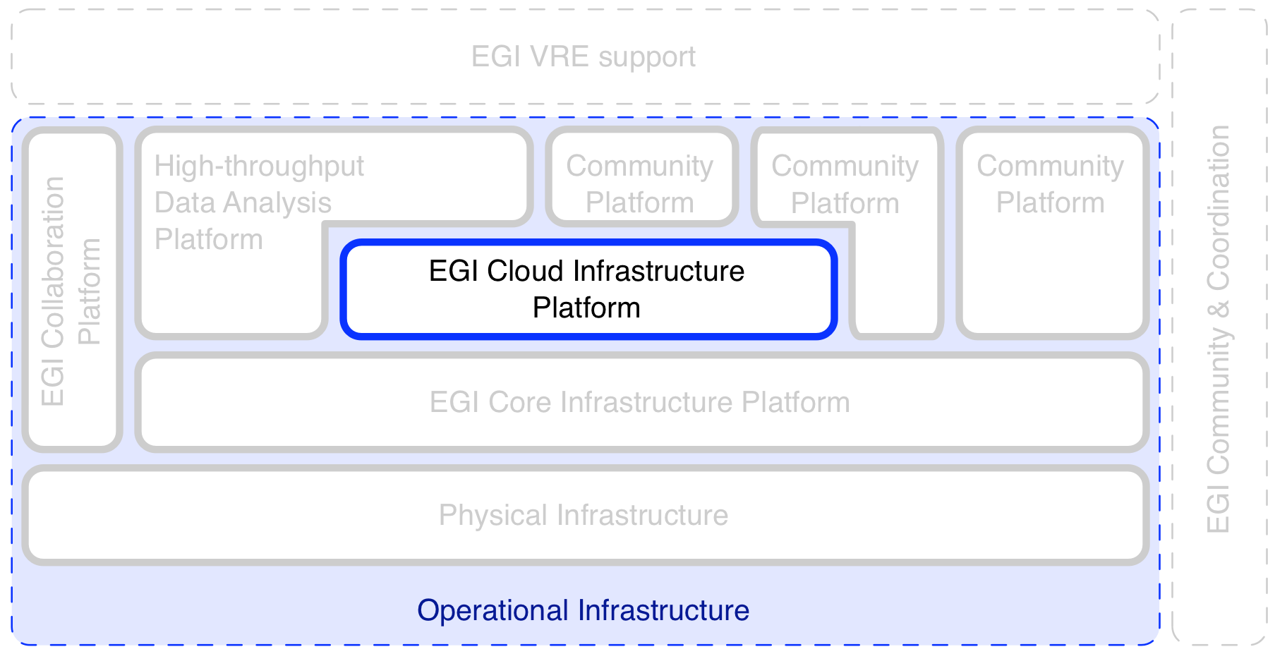
Cloud Infrastructure: Interoperable OCCI framework
TSA4.2
User Training
TSA4.4
VM
Mgmt.
TSA4.6
Cloud
Autoscale
TSA4.9
VO Portal
TSA4.12
e-GRANT

Slide 16
TSA4.4: Providing OCCI support for arbitrary Cloud Management Frameworks
Objectives
Provide Cloud interoperability framework through OCCI
Provide flexible CMF backend integration
Outcomes
Completely rewritten modularised framework
Concrete tools and services in production
OCCI cli, OCCI server
Available in EGI’s AppDB
OCCI CLI already used in different use case integrations
Impact
Reference implementation for federated OCCI in EGI
Many different backend integrations possible/underway
E.g. Apache CloudStack, VMWare vServer, StratusLab
EGI Federated Cloud uptake
rOCCI Server: 85 AppDB visits, 7 FedCloud provider deployments
rOCCI Client: 90 AppDB visits, 7 confirmed integrations
Notes:
Problem/Gap:
Production-quality OCCI implementation missing
Seeding uptake of OCCI
FedCloud providers
FCTSG (ES)
CESNET (CZ)
GWDG (DE)
INFN Catania (IT)
KTH (SE)
MTA SZTAKI (HU)
UKIM (MK)
rOCCI client users:
II-SAS (SK) UI integration
JSAGA adaptor
VMDIRAC
CSGF (Catania Science Gateway Framework)
COMPSs
Slipstream connector
Peachnote

Slide 17
Cloud Infrastructure: Elastic & multi-site Cloud usage
TSA4.2
User Training
TSA4.4
VM
Mgmt.
TSA4.6
Cloud
Autoscale
TSA4.9
VO Portal
TSA4.12
e-GRANT

Slide 18
TSA4.6: Dynamic Deployments for OCCI Compliant Clouds
Objectives
Provide services for complex & multi-site VM deployments
Provide auto-scaling capabilities for users
Outcomes
Production quality connector for Slipstream 2 in final testing
Incl. preliminary OCCI connector for Slipstream 1.x
Successfully deployed HelixNebula ESA use case
Impact
EGI Federated Cloud architecture validated through high-profile use case
Initiated Broker capability development in EGI Federated Cloud
Enables EGI as first class e-Infrastructure provider in the Helix Nebula Marketplace (http://hnx.helix-nebula.eu)
C.f. Pay for use pilot activities
C.f. e-Grant & central resource allocation , TSA4.12
Notes:
Problem:
Not many (if at all) automated solutions exist for automated VM deployments
EGI seeks a way to remedy this
OCCI connector planned for production release end of June 2014
HNX Marketplace is an EGI pioneering activity for Cloud Marketplaces
HNX marketplace for big science, others for the long tail

Slide 19
Cloud Infrastructure: other
TSA4.5: CDMI Support in Cloud Management Frameworks
Provide interoperable CDMI SDK
CDMI SDK in Python; CDMI service deployed in EGI Federated Cloud
Reference implementation for federated CDMI in EGI
TSA4.7: Automatic Deployment and Execution of Applications using Cloud Services
OCCI-based contextualisation capability
Reference service and OCI specification extensions deployed
Scalable, standards-based contextualisation across EGI

Slide 20
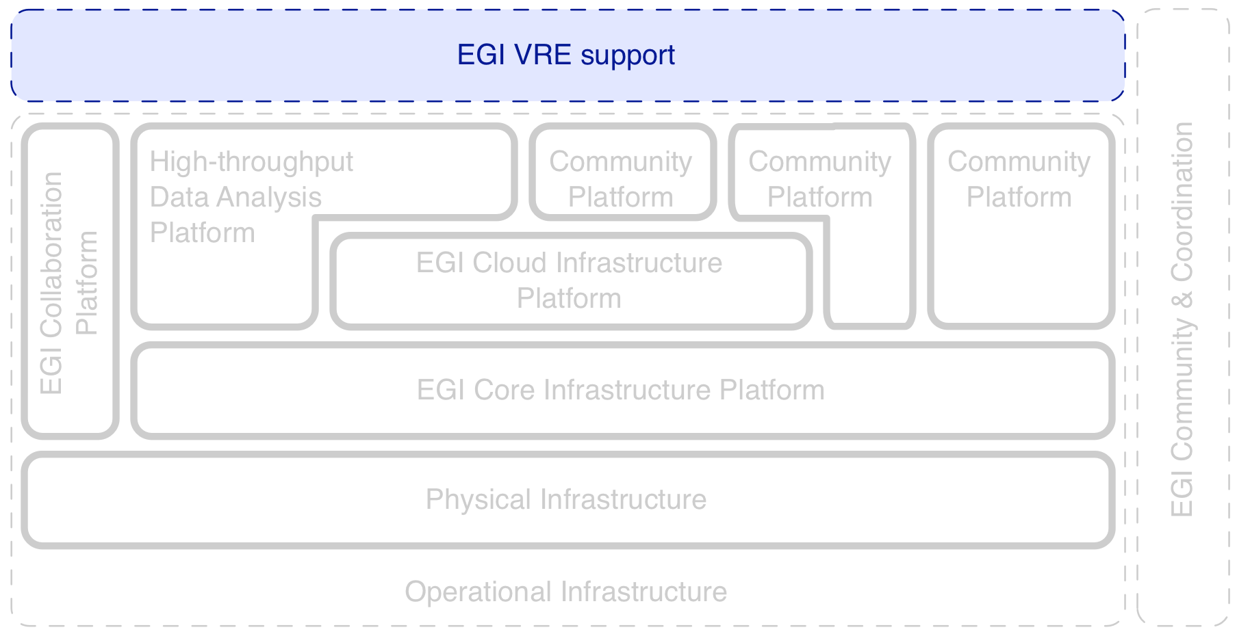
VRE support: Scalable user training on EGI services
TSA4.2
User Training
TSA4.4
VM
Mgmt.
TSA4.6
Cloud
Autoscale
TSA4.9
VO Portal
TSA4.12
e-GRANT

Slide 21
TSA4.2: Massive Open Online Course (MOOC) Development
Objectives
Prepare and conduct a MOOC on Grid Computing and storage services
Provision for assignments, grading and certification
Outcomes
Course successfully conducted (Nov’ 2013 – Jan ‘14)
Course material available on YouTube
Use cases: http://go.egi.eu/MOOC-UseCases
Lectures: http://go.egi.eu/MOOC-Lectures
350 participants, with 30 final certifications
Life sciences, Astronomy, Engineering, Computer Science
Netherlands, Italy, Greece, Russia, United Kingdom
Impact
Leverages massive and parallel education
No immobile facilities to achieve tuition
Self-tuition possible in the future
IEEE Intercloud committee interested in re-conducting the course
Notes:
Problems:
Lecturers are a scarce resource when teaching F2F
Resources were too limited to reach out properly

Slide 22
VRE support: other
TSA4.3: Evaluation of Liferay modules
Evaluate Liferay for EGI back-office & VRE support service
Liferay 6 incl. plugins may be offered as a VRE support service
Extend EGI service portfolio for small & medium virtual organisations
TSA4.8: Transforming Scientific Research Platforms to Exploit Cloud Capacity
Explore and document Cloud Computing best practices for researchers
Most common and representative patterns documented and implemented as a reference
Support ERA scientists in designing and maintaining efficient VREs

Slide 23
Outline
Introduction
Achievements
Conclusions

Slide 24
Effort consumption
Task | PM Declared | Committed PM | Achieved PM
TSA4.1 | 0,0 | 0,4 | 0,0%
TSA4.2 | 14,5 | 12,0 | 120,6%
TSA4.3 | 6,9 | 9,0 | 76,5%
TSA4.4 | 7,9 | 6,9 | 115,0%
TSA4.5 | 3,2 | 5,1 | 63,1%
TSA4.6 | 4,3 | 6,0 | 71,3%
TSA4.7 | 21,1 | 15,4 | 137,0%
TSA4.8 | 8,8 | 6,9 | 128,1%
TSA4.9 | 11,7 | 10,3 | 113,8%
TSA4.10 | 12,4 | 13,3 | 93,2%
TSA4.11 | 5,2 | 4,3 | 120,6%
TSA4.12 | 15,0 | 13,3 | 113,1%
Total: | 111,0 | 102,9 | 107,9%
Long & incompatible update cycles in Liferay and modules
Overreporting of effort skewed planning
One partner unable to deliver, Subcontract with SixSq for remaining effort
Notes:
TSA4.1 – Management (but discontinued)
TSA4.2 – MOOC
TSA4.3 – Liferay
TSA4.4 – OCCI for CMF
TSA4.5 – CDMI for CMF
TSA4.6 – DynOCCI
TSA4.7 – AppDeployment
TSA4.8 – CloudCaps
TSA4.9 – VAPOR
TSA4.10 – A/R calculation engine
TSA4.11 – GOCDB extension
TSA4.12 – e-Grant

Slide 25
Impact
EGI Federated Clouds infrastructure
Key to its success
Some outcomes on roadmap for inclusion
Reduced TCO for engaging with EGI
Supports evolving EGI into a one-stop-shop for researchers
Single point of contact for key services
Lowering the barrier for users
Reduced time to market for EGI services
Notes:
Services to be included/funny included:
TSA4.5 CDMI
TSA4.6 Dynamic OCCI / Slipstream
TSA4.7 Application Deployment
TSA4.10 VAPOR

Slide 26
Lessons learned
Carefully manage voluntary contributions
Needs proactive risk management
Clear closure for project duration
Closure reports for all mini projects (D8.1)
360° retrospection for team members and administration
Shepherds provided continuous scope
Very close to SCRUM Product Owner
Potential agile template for VT programme
Notes:
Clear scope
Clear goals per mini project
Methodology worth pursuing for within EGI

Slide 27
Summary
Clear scope, clear goals, clear duration
Blueprint for future activities, and VTs
Strategic contributions to EGI’s service portfolio
Filling gaps in existing platforms
Improving EGI’s user experience
Funding & cost analysis
Effort consumption under control
Might include partners beyond original project consortium in the future

Slide 28
Questions
Members of the EGI-InSPIRE collaboration thank the EC for supporting EGI

