Slide 1
EGI Solutions and Business Models
Sergio Andreozzi
Strategy & Policy Manager, EGI.eu
sergio.andreozzi@egi.eu

Slide 2
Outline
EGI Offering
From Services to Solutions
Innovating Business Models
Diversifying revenue streams
Pay-for-Use
Procurement
Exploring different broker models
Engagement with SMEs

Slide 3
EGI Offering From Services to Solutions

Slide 4
Service Providers & Consumers
EGI Partnership
Consumers
Resource Centres
Resource Provider
Technology Providers
NGIs/EIROs
EGI.eu
Product/Service

Slide 5
From Services to Solution
EGI
Solution
Portfolio
user
EGI
Service
Portfolio
solution
user-facing
service
service
component
process
document
record
EGI.eu
NGI/RP/RC

Slide 6
Services for Long Tail and Big Science
Putting the User into Focus
Identify the needs of customers, to develop services that best satisfy them
Understanding the customers’ value chain or processes
User-focused services
Offering consistently meeting their needs enhancing usability, reliability, and experience
Individual Researchers
& Teams
Research Communities
& Institutions
Resource Centres & IT Institutions

Slide 7
EGI Service Portfolio
Services coordinated by EGI.eu and
delivered in collaboration with NGIs/EIROs
Services coordinated by
NGIs/EIROs/RCs
Coordination
Consulting and Support
Marketing and Outreach
Software and Services
Project and Programme Management
Operations Coordination
Technology Coordination
Security Coordination
Governance & Project Consultancy
Strategy & Policy Decision Support
Policy Development
Technical Consultancy and Support
Helpdesk Support
Marketing
Outreach
Federated Operations
Applications Database
Training Marketplace
Repository of Validated Software
HTC Platform
Grid Compute
Grid Storage
File Transfer
File Metadata Catalogue
Cloud Platform
Cloud Compute
Cloud Storage
Virtual Appliance Marketplace
http://www.egi.eu/services/

Slide 8
New Service Development
Service development needed to adapt to the constantly changing needs of customers and technology. It is an action of the EGI strategy
Federated Storage: Enhanced Cloud STaaS service with a single entry point, for virtually unlimited storage, single data management system, co-location of data to computing
iPaaS: General-purpose integration Platform-as-a-service, where users can put directly algorithm and run it over a big amount of data
Data access and dissemination: A general-purpose system for storing, extracting metadata, cataloguing, organising, searching and accessing scientific data
Virtual Laboratory-as-a-Service: Enabling easy integration of Virtual Laboratories or a collection of software processing and access tools
Secure Personal Storage: Storage solution for data sharing and collaboration, with enhanced security capabilities privacy, data ownership, data access delegation, etc.
LTDP-on-the-cloud: Provide a Long Data Preservation service for small communities or scientific projects

Slide 9
EGI Solutions
A combination of products, services, and intellectual property focused on solving a problem (opportunity) that creates and/or drives value (measurable) and can be significantly standardised
Federated Operations
High-Throughput Data Analysis
Federated Cloud
Community Driven Innovation & Support
Ingredients from the EGI community:
Services from EGI.eu
Services from NGI/Resource Centres
Software products from technology providers
Data, knowledge, expertise from the community

Slide 10
High-Throughput Data Analysis
Do you need to manage and analyse large datasets, or to execute thousands of computational tasks?
Federated Cloud
Community Driven Innovation & Support
High-Throughput Data Analysis
Federated Operations
European federation of publicly-funded clusters
for High-Throughput Computing (HTC)
Main services:
Grid Compute: run large-scale computational jobs
Grid Storage: store/access/retrieve files
File Transfer: file data movement service
File Metadata Catalogue: metadata catalogue service
Based on open standards, integrate heterogeneous infrastructure or technologies
Added Value
Uniform access to distributed computing capabilities to run large-scale computational jobs processing big data and preventing single vendor lock-in‏
Possibility to federate your own resources
Facilitate collaboration across communities and borders by sharing compute and data

Slide 11
Federated Cloud
Do you need an infrastructure to deploy on-demand IT services for managing and processing your research data?
Federated Cloud
Community Driven Innovation & Support
High-Throughput Data Analysis
Federated Operations
European federation of publicly-funded community clouds Main Services:
Cloud Compute: deploy/manage virtual machines (VM)
Cloud Storage: store/access/retrieve digital objects
Virtual Appliance Marketplace: store/retrieve certified VM images
Based on open standards
Integrate heterogeneous cloud technologies
OpenStack, OpenNebula, CloudStack, …
Integrate with commercial providers
Within EGI or through the Helix Nebula Marketplace
Added Value
Uniform access, no lock-in and on-demand scale out capabilities
Easy deployment of own/customised services
Possibility to federate existing institutional clouds
Efficiency by co-locating big data + cloud computing
Launched into production: May 2014

Slide 12
Community-Driven Innovation and Support
Do you want to discover and implement the best approach to your data-intensive compute needs?
Federated Cloud
Community Driven Innovations and Support
High-Throughput Data Analysis
Federated Operations
Expert assistance for easy and seamless integration and access to the computing and data services
European Distributed Competence Centres
Leveraging expertise of user communities and technology providers
Partnership with National Grid Initiatives and external competence centres
Support at both national and EU level
Added Value
Avoid duplication of solutions
Leverage expertise from the community
Facilitate collaboration across communities and borders‏
User-driven innovation

Slide 13
Federated Operations
Do you need operational services and tools to run a distributed IT infrastructure for research?
Technologies, processes and expertise:
To manage operations of heterogeneous distributed infrastructures
To integrate resources from multiple independent providers with lightweight central coordination
Federated Cloud
High-Throughput Data Analysis
Community Driven Innovation & Support
Federated Operations
Relies on the best practices for IT service management (FitSM)
Main services:
Operations, technology, and security coordination
Helpdesk support
Governance and project specialised consultancy services
Technical consultancy and support
Operations tools
Added Value
A cost-efficient framework to manage operations within a federated environment, while retaining responsibility of local infrastructure.
Allows efficient implementation of Best Management Practices for IT services

Slide 14
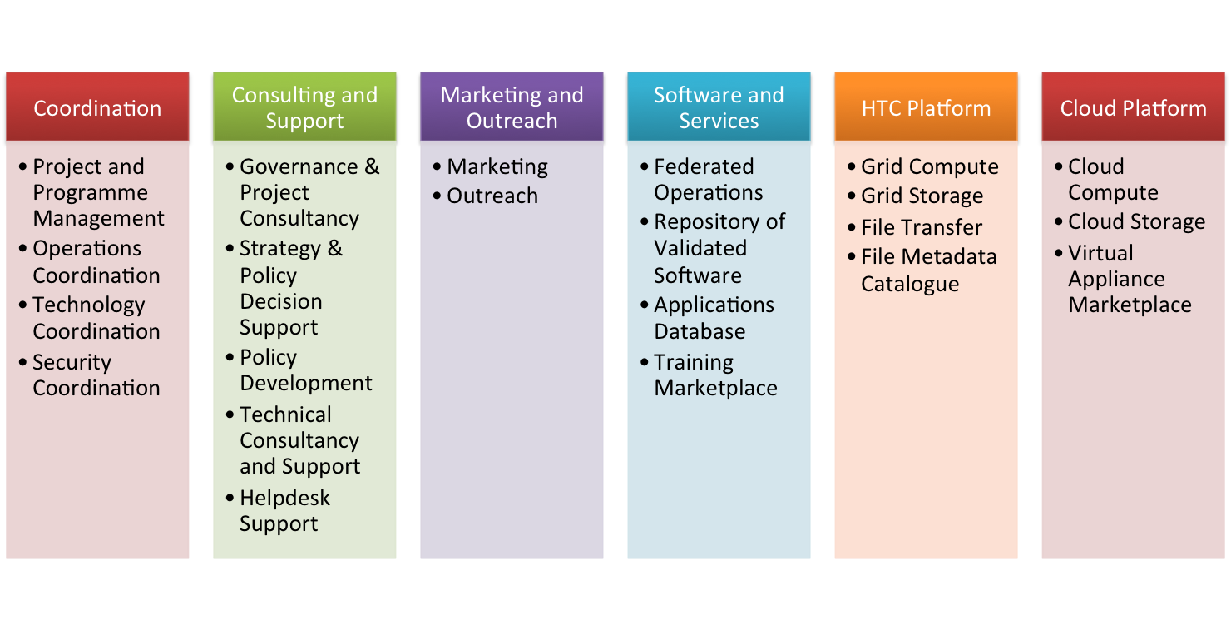
Progress during PY4
Services
Description for 7 services
Part of HTC and Cloud platform
Identification of new services
Solutions
Merged two solutions into one → “Community-Driven Innovation & Support”
Authoring of 4 white papers (one per solution)
Same content structure
Target Groups & Challenges
Solution
Description
How to access
How it is build
Value Proposition
Success stories
http://www.egi.eu/services/
http://www.egi.eu/solutions/

Slide 15
Innovating Business Models Diversifying Revenue Streams

Slide 16
Current Model: Free at Point of Delivery
Funding Agency
Funding Agency
Resource Provider
Service provision:
a complex network of players interacting for providing products, services and solutions for excellent research
Funding Agency
Resource Provider
Funding Agency
Resource Provider
Funding Agency
EGI.eu
Service

Slide 17
Pay-for-use: Motivations
Increase awareness of economic value for service delivered
Incentivise resource providers to expand user base outside their own remit
Intercept increasing revenue streams from customers focusing on OPEX

Slide 18
Model under Analysis: Charging for Services
Funding Agency
Funding Agency
Resource Provider
Service provision:
a complex network of players interacting for providing products, services and solutions for excellent research
Funding Agency
Resource Provider
Funding Agency
Resource Provider
Funding Agency
EGI.eu
Service

Slide 19
Pay-for-Use: Where we come from
2012: Awareness
“Arguments supporting the notion of pay-per-use or subscription-based access to eScience e-Infrastructure should be formulated in anticipation of circumstances changing” (2nd EGI-InSPIRE Review report Jun 2012)
2013: Policy recommendation
the EGI Council approved a policy to explore business models for pay-for-use service delivery to couple together with the traditional method of free-at-point-of-use (http://go.egi.eu/1391)
2014: Implementation of proof of concept (PoC)
Jan-Apr: best effort
May-Dec: funded in EGI-InSPIRE PY5 with dedicated task (NA5.2) and manpower (28PMs)

Slide 20
Pay-for-Use PoC: Objectives
Articulate appropriate business and responsibility models through defined business scenarios/cases
Define prices for services from participating sites (compute and storage)
Understand required agreements and service management processes
Identify the tools required and necessary development to facilitate pay-for-use service provisioning
Analyze the changes within a pre-production environment that would be needed to support and roll out the new functionalities in the production environment
Evaluate legal, policy, and organizational issues around the full implementation of the pay-for-use model
Submit a report covering the overall activities and recommendations

Slide 21
Pay-for-Use PoC: Participants
43 Members and Observers
EGI.eu (Lead), Resource Centers, NGI NILs, Commercial Company
Resource Providers
15 Organizations across 12 Countries
19 Grid Sites (CPU)
Belarus; Bulgaria; Germany; Greece; Italy; Latvia; Poland; Spain; Switzerland; Turkey
7 Cloud Sites
Greece; Italy; Poland; Slovakia; Spain; UK (Turkey to be added)
Notes:
We are also exploring taxation and VAT aspects

Slide 22
Pay-for-Use PoC: Phases
Activities split in 3 Phases
Phase 1: Jan-June 2014
Set up and implement minimum/basic requirements/functionality
Present at EC review: https://documents.egi.eu/document/2256
Phase 2: July-Oct 2014
Expand with pricing schemes and service packages
Increase automated functionality
Phase 3: Nov-Dec 2014
Stand alone, easy to read report published
Officially part of EGI-InSPIRE Final Periodic Report

Slide 23
Pay-for-Use PoC: Business Scenario for Phase 1
2. Searches
1. Publishes Services
Service / Price List
3. Selects / Submits Request
4. Agrees SLA
10. Provides Invoice & Reports
11. Makes payment
8. Adds Users / 9. Uses Services
7. Allocates
Capacity
Customer
Service Provider
5. Informs About New Customer
6. Informs VO
Virtual Organization
Broker

Slide 24
Pay-for-Use PoC: Current results
Processes in business scenario for phase 1 defined
Tools adaptation
GOCDB extensions added to set prices
Accounting Portal accounting information
Providers
26 sites publishing pricing information (19 Grid, 7 Cloud)
Legal and Policy solutions emerging
Research-only purpose statement
Charging on joint innovation project
3 Business Cases being explored
Helix Nebula, ESA, Cloud for Europe
Pay-for-Use PoC
public draft - 1 July 2014
https://documents.egi.eu/document/2256

Slide 25
Business Cases
Helix Nebula Marketplace (HNX)
EGI Cloud providers can participate in HNX
Cloud For Europe
Pre-Commercial Procurement (PCP)
EGI Cloud providers could bid
ESA
Procurement of cloud services
EGI Cloud providers could bid

Slide 26
Innovating Business Models Exploring Different Broker Models

Slide 27
Business Models: Broker Roles for EGI.eu
Model | Certification | API | Monit. & Usage Acc. | Consultancy | Allocation | Single SLA | Accounting | Invoicing
Invisible Federator | ✔ | ✔ | ✔
Advisor | ✔ | ✔ | ✔ | ✔
Matchmaker | ✔ | ✔ | ✔ | ✔ | ✔ | ✔
One Stop Shop | ✔ | ✔ | ✔ | ✔ | ✔ | ✔ | ✔ | ✔
Notes:
Won’t go through this in detail, just to have a reference slide for the possible broker models mentioned in the previous slide.

Slide 28
Innovating Business Models Engaging with SMEs

Slide 29
Developing Engagement Program with SMEs
Virtual Team created in April 2014
Business Engagement Programme
Bringing SMEs into the EGI ecosystem to create mutual value
Value creation through innovation will aim at improving the operational flexibility, so that its supply chain can quickly and economically adapt to new realities
Output:
Definition of a framework for relationship
What can a federated EGI collaboration can offer? What is the value for both parts? What would be the forms of engagement? What cannot be done?
Leads: Identification of SMEs potentially interested
Ideally, a few pilot cases and KPIs
https://wiki.egi.eu/wiki/VT_Business_Engagement

Slide 30
Business Scenario SMEs supporting the long tail
User Communities
EGI
Infrastructure
(Federated Cloud)
The Long Tail
Research Group
Research Group
Research Group
Commercial Partner
Research Group
Enables, reaches, functions as a distribution channel

Slide 31
Business Scenario SMEs in the data value chain
Researchers
Aggregators
Open Data Supplier
Data Enabler
Business
Developers
Enrichers
Revenue Streams
Public
Institutions
Business
Public Institutions
Revenue Streams
First Level Processor
Downstream Processor
Consumers

Slide 32
Plan for PY5
Services & Solutions
Formalise service & solutions development process
Pay for Use PoC
Explore the role of EGI.eu as financial broker
Develop richer pricing schemes and service packages
Analyse Resource Center feedback on policy and legal issues and solutions
Run a test with selected users, provide usage report, produce (virtual) invoice
Try out campaign
Produce final report
Engagement with SMEs
Develop engagement plan
Promote (website update, train NILs)
Pilot use cases

Slide 33
Summary
EGI Offering
Strengthened service and solution portfolio
Improve manageability and promotion
Innovating Business Models
Economic value of services is becoming clear
Mechanisms for setting/tracking costs in place
New business models being explored
Developing an engagement plan for SMEs

Slide 34
Questions
Members of the EGI-InSPIRE collaboration thank the EC for supporting EGI

