Slide 1
EGI Sustainability Yannick Legré Director, EGI.eu yannick.legre@egi.eu

Slide 2
Outline
Sustainability
The Current EGI Solutions & Services
Strategic Planning Process
Sustainability Perspectives
Strategic Actions
Conclusion

Slide 3
Sustainability
“Sustainability is ensuring confidence that a certain service/organisation will persist in the future with no concern that it will disappear; technological transitions should not be disruptive; the quality of management of infrastructures is very important”
Head of Unit eInfra – European Commission, 10th e-Concertation Meeting, 04/2013

Slide 4
EGI Service Portfolio
Services coordinated by EGI.eu and
delivered in collaboration with NGIs/EIROs
Services coordinated by
NGIs/EIROs/RCs
Coordination
Consulting and Support
Marketing and Outreach
Software and Services
Project and Programme Management
Operations Coordination
Technology Coordination
Security Coordination
Governance & Project Consultancy
Strategy & Policy Decision Support
Policy Development
Technical Consultancy and Support
Helpdesk Support
Marketing
Outreach
Federated Operations
Applications Database
Training Marketplace
Repository of Validated Software
HTC Platform
Grid Compute
Grid Storage
File Transfer
File Metadata Catalogue
Cloud Platform
Cloud Compute
Cloud Storage
Virtual Appliance Marketplace
http://www.egi.eu/services/

Slide 5
Services and solutions for the Long Tail and Big Science
A combination of products, services, and intellectual property focused on solving a problem (opportunity) that creates and/or drives value (measurable) and can be significantly standardised
Individual Researchers
& Teams
Federated Operations
High-Throughput Data Analysis
Federated Cloud
Community Driven Innovation & Support
Research Communities
& Institutions
Resource Centres & IT Institutions

Slide 6
Why sustain EGI services & solutions
Enabling transnational services
Cost saving
Support the production of excellent science
Favour mobility and collaboration

Slide 7
Strategic Planning Process
Vision & Mission
External Analysis
Definition of Opportunities & Threats
Internal Analysis
Definition of Strengths & Weaknesses
SWOT Analysis
Strategy Formulation
PEST Analysis
Core Values
EGI’s purpose & value
Industry/sector Analysis
Resources
Governance
For EGI
For EGI.eu
Growth Strategies
Engagement
Sustainability Actions
Review/ Update

Slide 8
Sustainability Perspectives
Organisational
Recruitment plan, training and retention of qualified professionals and knowledge
Technological
Ensure a reliable pipeline of technology and innovation driven by user needs
Collaboration with private sector for knowledge transfer
Investigating service provisioning vs. technology provisioning

Slide 9
Sustainability Perspectives
Financial
Cover costs
Optimise costs
Long-term financial support
Legal
Alignment with procurement, privacy, intellectual property and competition laws
Legal statute change

Slide 10
Main Actions Foreseen
Engagement Activity: Reaching communities and Addressing the long tail of Science
New Services & Solution Development
New Revenue Streams
Communicating with Policy Makers
Financial Sustainability of Services Coordinated by EGI.eu
Evolving the EGI Governance

Slide 11
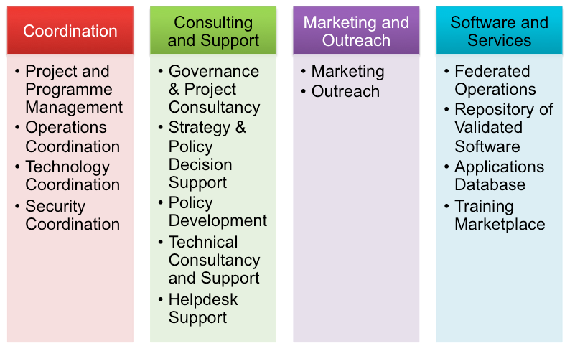
Cost of Services coordinated by EGI.eu within EGI-InSPIRE Project
Federated Operations 24%
Others 6%
Average yearly cost: 4M€
including the co-funding from NGIs on core activities
EGI-InSPIRE mechanism:
EC funding: 50%
Membership fees: 25%
NGIs In-kind contr.: 25%

Slide 12
Core activities
Performed by manpower located at NGIs through a bidding mechanism.
2-year contracts signed with attached binding OLAs
Sum up to >1.5M€ and support the following services:
federated operations
repository of validated software
helpdesk support
security coordination
Supported from May – Dec. 2014
60% in-kind contribution from NGIs
40% contribution from EGI.eu

Slide 13
EGI.eu staff
Provides the following services
Project and program management
Operations coordination
Technology coordination
Strategy and policy decision support
Policy development
Technical consultancy and support
Marketing & outreach
19 FTE in 2013 for about 1.8M€
Decrease in 2014 by ~2 FTEs.
2 FTEs are partly contributed by EGI partner as in-kind to support operations coordination and user support.
Other costs for 0.7M€
EGI.eu Facilities, Project & office travel, Administrative costs…

Slide 14
Plan for 2015-2016
NGI International Tasks
EGI-InSPIRE funded NGIs to support federated operations at national level
NGIs managed to mature these services and embed them in their current national activities
Therefore no further support will be expected from the EC for the next 2 years
Service portfolio will be rationalised
Services coordinated by EGI.eu
Staff at NGIs:
50% will be supported by EGI.eu
50% will be provided as in-kind contribution from NGIs
Staff at EGI.eu:
Membership fees: the goal is to maintain the current fee level, and possibly to increase it
Project under call E-INFRA1, sub-topic 6: the current idea is to attract around 1.5M€/year for EGI.eu and the rest to be split among NGIs and user communities
Seeking a few additional projects to support some activities such as dissemination, user engagement and policy coordination (INFRASUPP-7)

Slide 15
Plan beyond 2016
During 2014-2015, EGI aims to solve the short-term funding cycle problem:
by finding different mechanisms that could guarantee the collaboration to ensure delivering of European added value services to the research communities
The EC and EGI.eu members should support the added value services coordinated by EGI.eu
A long-term financial commitment should be achieved:
From the EC, via exploring the option of a Framework Program Agreement (FPA)
From the EGI.eu members, through a multi-annual financial commitment coupled with the yearly membership fees

Slide 16
Governance

Slide 17
Governance Task Force
Members
Matthew Dovey (Jisc) – Chair; Luciano Gaido (INFN); Jacko Koster (SNIC); Steven Newhouse (EBI); Arjen van Rijn (NIKHEF); Yannick Legré (EGI.eu)
Original Terms of Reference
Revise membership model to allow a more flexible partnership and to address the need for a more flexible user representatives’ participation
Modify the governance model based on a new contribution and voting scheme
Council Workshop Recommendations
Smaller governance rather than larger
Country mandated members important
Funding agencies should be involved; “Resource Providers” may have conflict
Clear separation of roles
ERIC compatibility

Slide 18
Council
Member States
Associate Countries
Third Countries
International Organisations
ERICs
ESFRIs / Research Infrastructures of pan-European interest
EIROs

Slide 19
Council Representative
Countries represented by the NGI entity mandated by the country
International Organisations represented in the Council by the lead organisation or their delegate

Slide 20
Associate Membership
Permits participation in EGI.eu lead activities\proposals
Allows involvement of e-Infrastructure Providers not associated with National e-Infrastructures or International Initiatives
Allows involvement of technology providers
Incurs lower membership fee
Not part of Council\governance
Non-voting observer status in the Council

Slide 21
Membership Fees and Votes
Fee and votes based on type and “size” of organisation
Single fee covering both governance and services
Six voting categories

Slide 22
Conclusion
Sustaining EGI means ensuring that value is delivered and long-term funding is guaranteed
Actions for growth and sustainability for EGI have been identified and are being pursued
Revision of the Governance
ERIC statute further analysed
Opening to user communities
Broadening outside Europe
Financial sustainability
Potential Framework Partnership Agreement
Long term commitment from the participants
EGI-ENGAGE proposal

Slide 23
Questions
Members of the EGI-InSPIRE collaboration thank the EC for supporting EGI

