Slide 1
The EGI Federated Cloud, architecture and use cases
David Wallom
University of Oxford
Chair, EGI Federated Cloud
david.wallom@oerc.ox.ac.uk

Slide 2
Overview
Principles and Value
Capabilities, Technology and Services
User Communities and usage models

Slide 3
Overview
Principles and Value
Capabilities, Technology and Services
User Communities and usage models

Slide 4







EGI Services
Individual Researchers
& Teams
Federated Operations
High-Throughput Data Analysis
Federated Cloud
Community Driven Innovation & Support
Research Communities
& Institutions
Resource Centres & Institutions

Slide 5
EGI Services
Individual Researchers
& Teams
Federated Operations
High-Throughput Data Analysis
Federated Cloud
Community Driven Innovation & Support
Research Communities
& Institutions
Resource Centres & Institutions

Slide 6
Value proposition
The EGI Federated Cloud, a federation of public and private Clouds, offering Services to researchers initially in Europe, in future sharing and collaborating globally.
Multiple IaaS Cloud providers visible to the user as a single system able to
Scale to user needs
Provide resilience
Prevent provider/vendor lock-in
Targeted towards the research community
Standards based federation of IaaS cloud:
Exposes a set of independent cloud services accessible to users utilising a common standards profile
Simplifies connection of existing community specific production services
Deployment of services across multiple providers and capacity bursting
Production launch May 2014

Slide 7
Principles of Federation
Resource integration: IaaS Cloud Computing to be integrated into the existing production infrastructure.
Heterogeneous implementation: no mandate on the cloud technology.
Standards and validation: Use recommended and common open standards for interfaces and images
Provider agnosticism: the only condition to federate resources is to expose at least one of the chosen user facing interfaces and services.
Notes:
Original Task Force Mandate: 18 months, September 2011 – March 2013
EGI-Inspire Integration: Formalised scope as Task SA2.6 from April 2013

Slide 8
Overview
Principles and Value
Capabilities, Technology and Services
User Communities and usage models

Slide 9
Required Cloud Capabilities
  Uniform interface to manage VM instances across multiple, heterogeneous, cloud providers
  Consistent method to customise instantiated services
  Uniform access/transfer interface to object storage
  Single point of information on available Cloud resources
  Single sign-on across available resources and services
  Cloud service availability monitoring and functionality testing
  Management of distributed virtual images across multiple clouds
  Tooling to support automated user choice between cloud providers
  Resources available through consistent SLAs and known business models
  Resources operating to known security standards using technologies of known levels of security

Slide 10
EGI Cloud Infrastructure
EGI Collaboration Tools
EGI Cloud Infrastructure Platform
Virtual Instance Mgmt
Storage Management
Image Repository
EGI Cloud Marketplace
Cloud Management Framework
(OpenStack, OpenNebula, Synnefo, …)
EGI Application DB
EGI Core Platform
Service
Registry
Information Discovery
Federated AAI
Monitoring
Accounting
Help and Support
Security Co-ordination
Training and Outreach
Sustainable Business Models

Slide 11
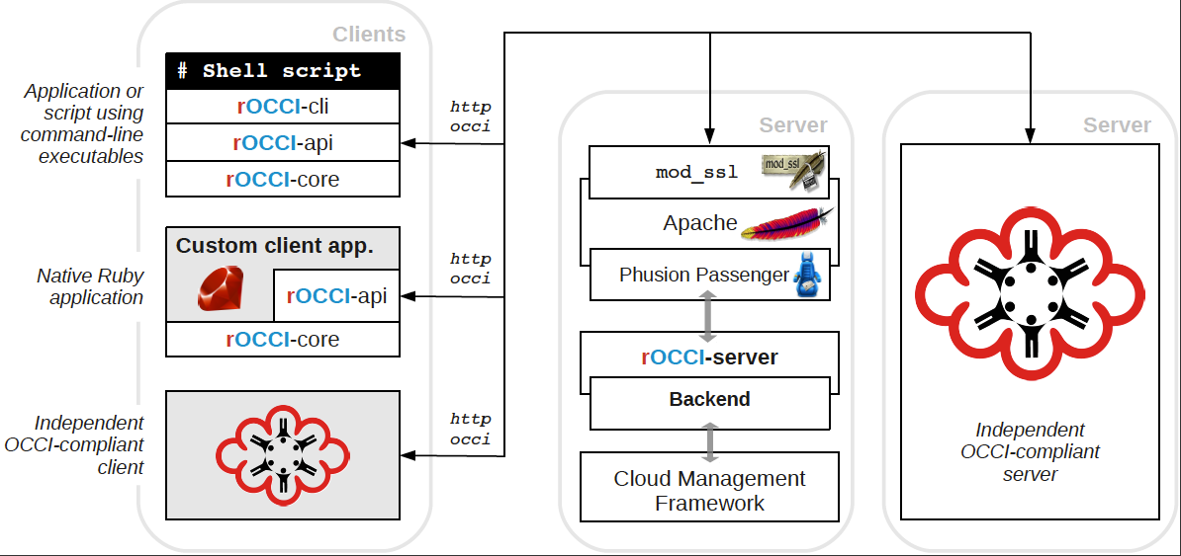


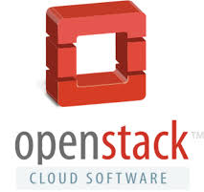

Instance Management through OCCI
rOCCI-Server
Cloud Management Framework

Slide 12
Contextualisation
Process of installing, configuring and preparing software upon boot
Policy that images build to support Cloudinit
All supported CMF OCCI implementations extended appropriately

Slide 13
CDMI Technology and status
Cloud Object Storage Service, PUT and GET files into the storage, accessible by cloud appliances and other applications
Pioneering open implementation (Stoxy)
Multiplatform
Support for flexible authentication schemas (incl. PAM)
OpenStack Keystone token compliant
Selected as a supporting technology for FP7 Strategic project for OpenData use case
Other implementations from BSC (Emotive), DESY (dCache)

Slide 14
Federated AAI
Inherited from the EGI AAI framework
Scalable with many users
Uniform authentication across multiple service providers
Users manage their community via Virtual Organisations

Slide 15
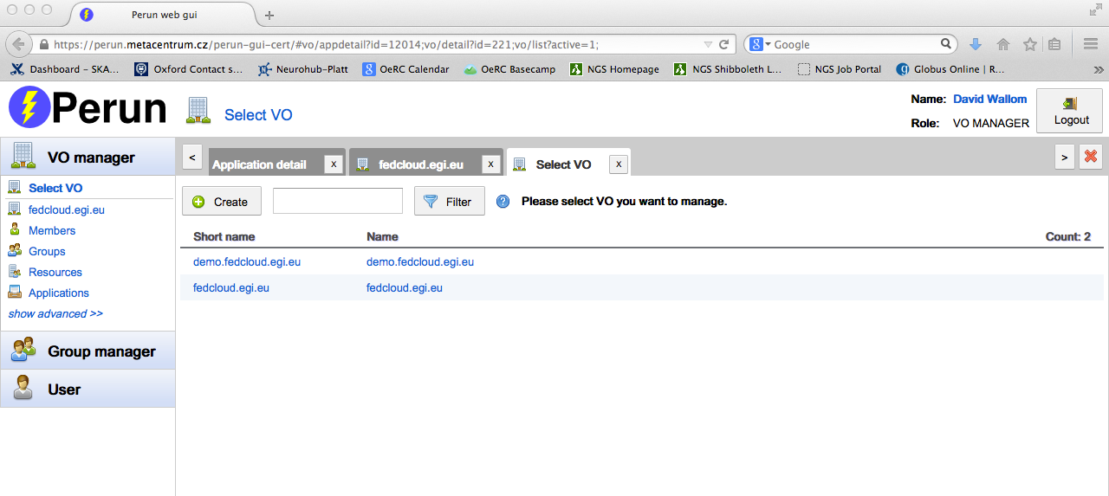
Federated AAI
Inherited from the EGI AAI framework
Scalable with many users
Uniform authentication across multiple service providers
Users manage their community via Virtual Organisations

Slide 16
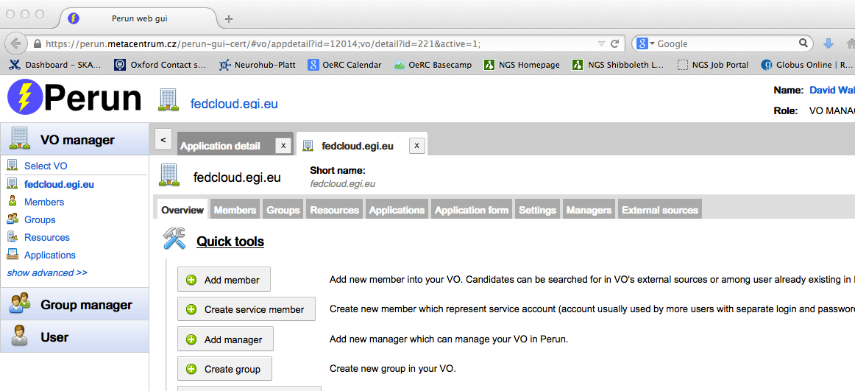
Federated AAI
Inherited from the EGI AAI framework
Scalable with many users
Uniform authentication across multiple service providers
Users manage their community via Virtual Organisations

Slide 17
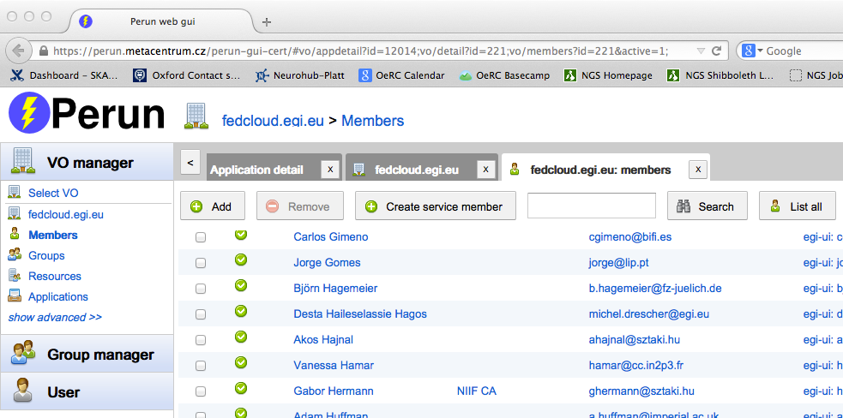
Federated AAI
Inherited from the EGI AAI framework
Scalable with many users
Uniform authentication across multiple service providers
Users manage their community via Virtual Organisations

Slide 18
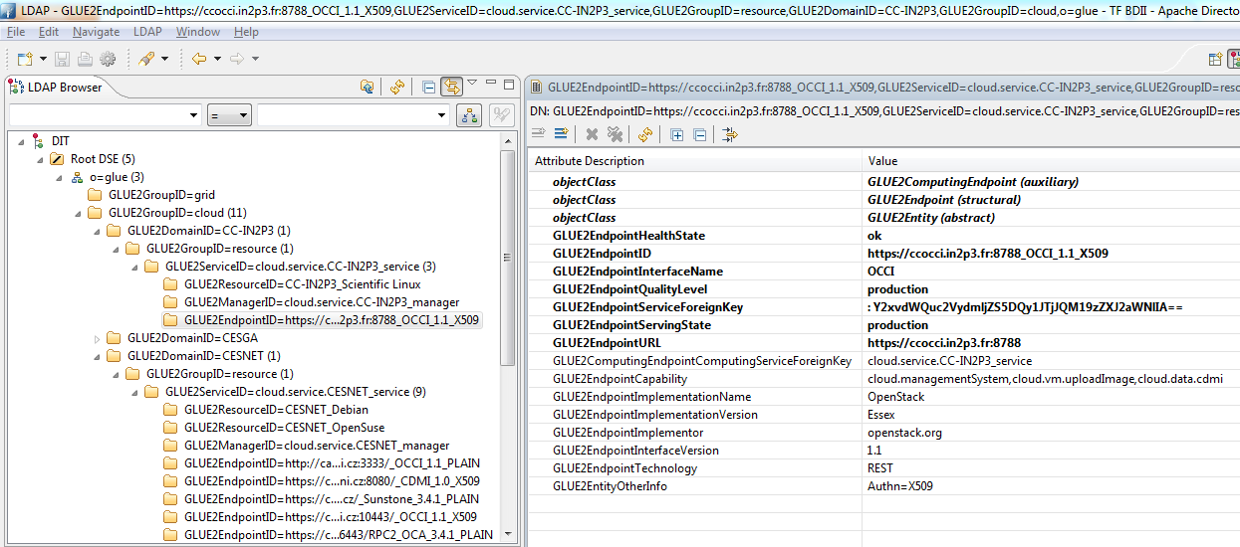
Service Discovery & Information Publishing
Information Service. Each cloud infrastructure exposes a LDAP server publishing information by means of a customised GLUE2 schema. Each LDAP server is polled by a top-BDII server.

Slide 19
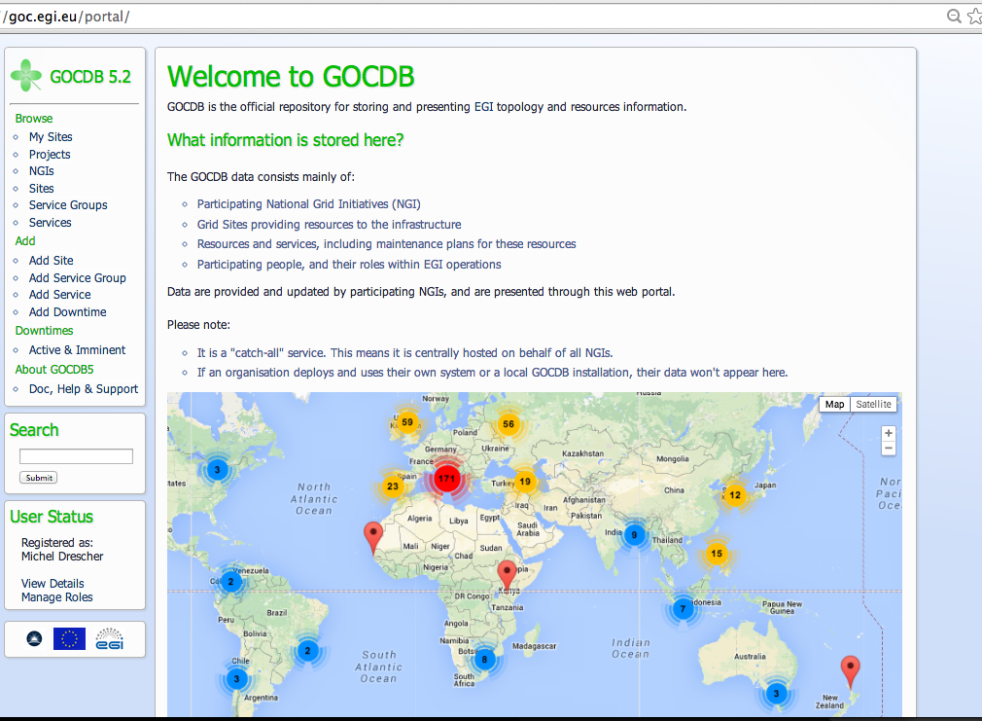
GOCDB Illustrating Cloud type

Slide 20
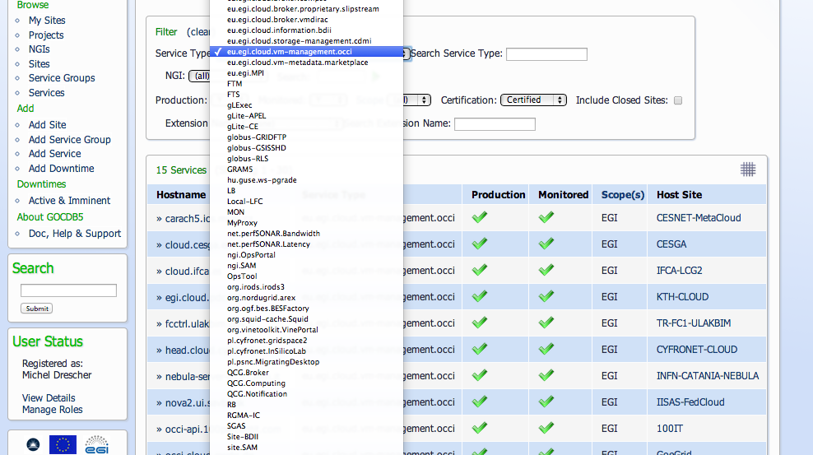
GOCDB Illustrating Cloud type

Slide 21
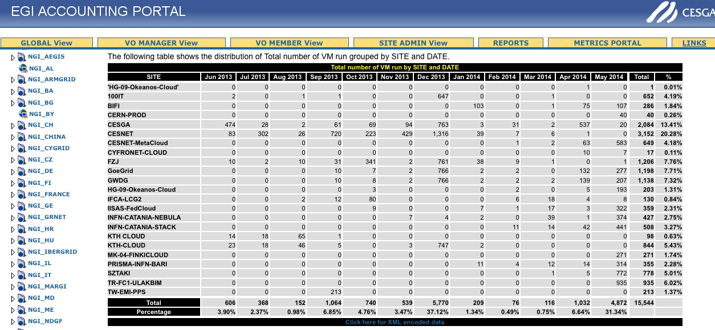
Accounting
161980 VMs launched across 24 clouds
Notes:
Shim clients have been developed for each CMF to ensure that standardised accounting records are generated and published into the standards STOMP messenger framework.
- EGI Accounting Portal data for the fedcloud VO, not all instantiated VMs

Slide 22
Accounting
Current Usage Record Content
  Site
  User: local user/group, Digital Certificate DN
  VMUUID (VM instance identifier)
  Start (and End) Time
  Status
  Wall and CPU Duration
  VM source image
  Cloud Type
161980 VMs launched across 24 clouds
Notes:
Shim clients have been developed for each CMF to ensure that standardised accounting records are generated and published into the standards STOMP messenger framework.
- EGI Accounting Portal data for the fedcloud VO, not all instantiated VMs

Slide 23
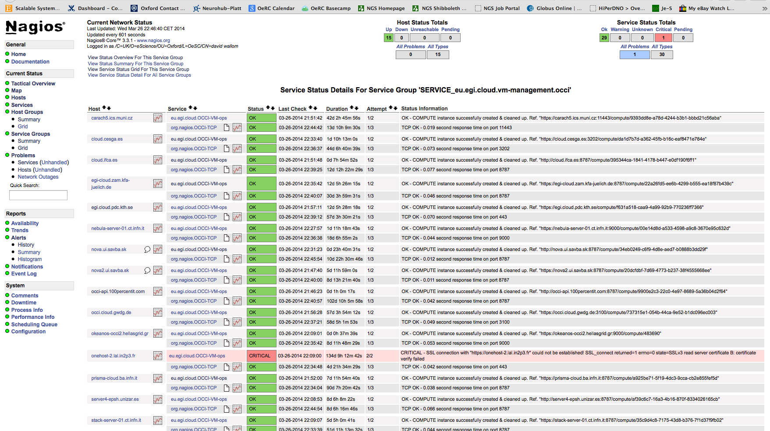
Service Monitoring

Slide 24
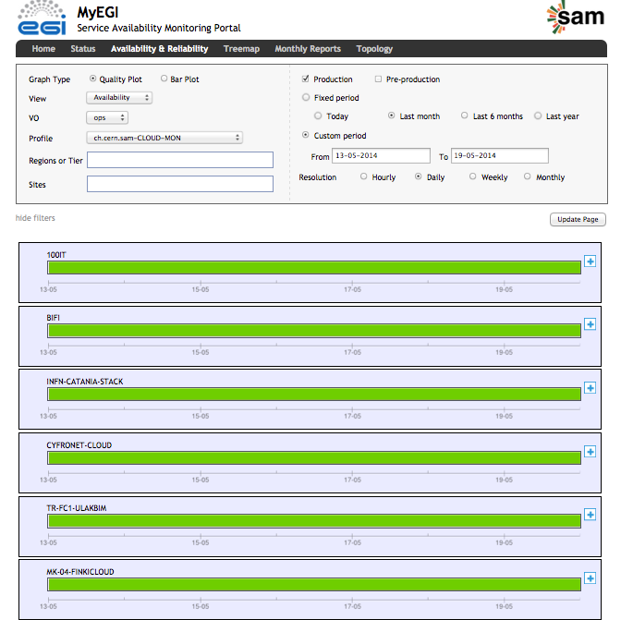
Service Monitoring

Slide 25
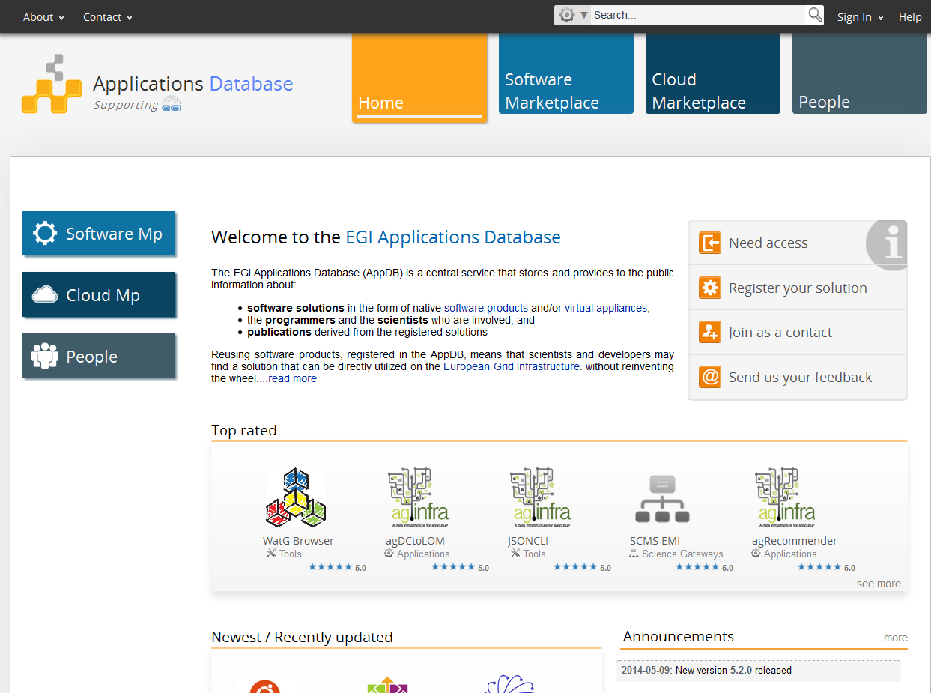
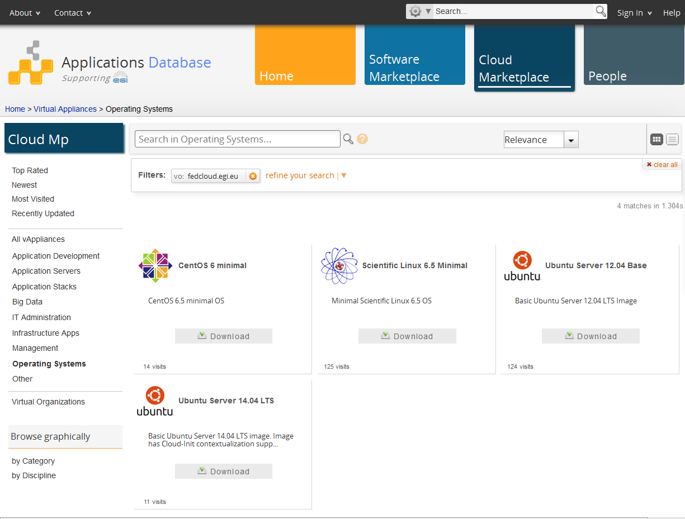
AppDB, our Cloud Marketplace
Rich and diverse set of individual offerings
Application/VM Image repository
User community choice of provider at all levels
Academic and commercial resource & service providers
User communities from the public and private sector

Slide 26
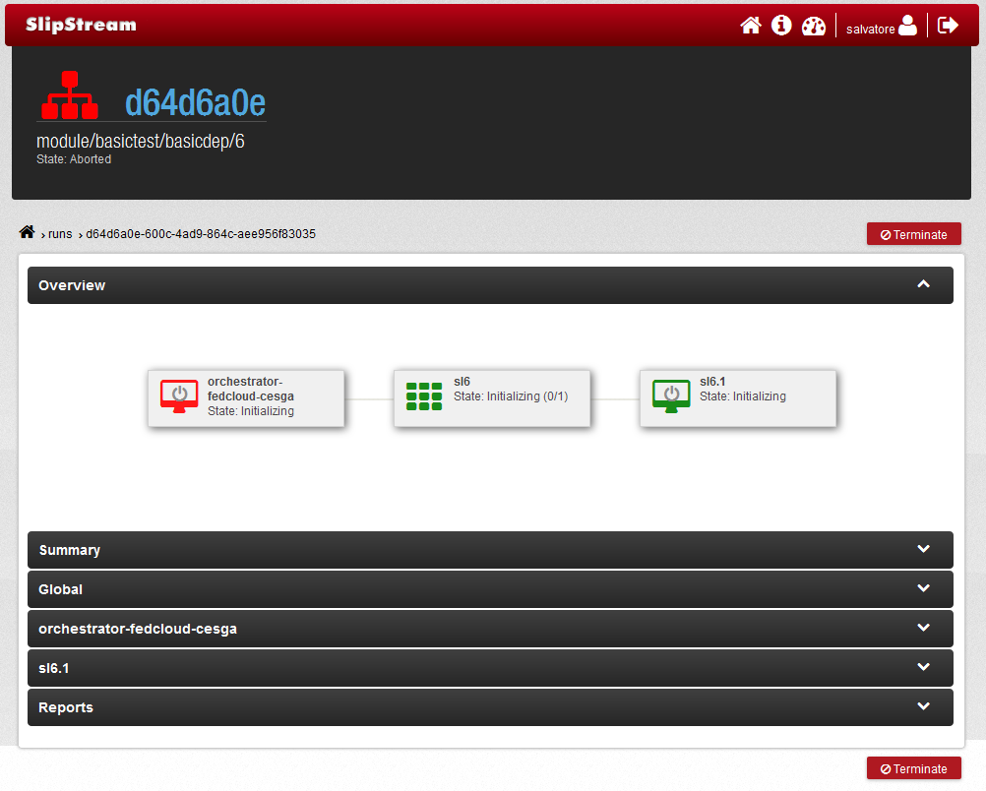
Brokering

Slide 27
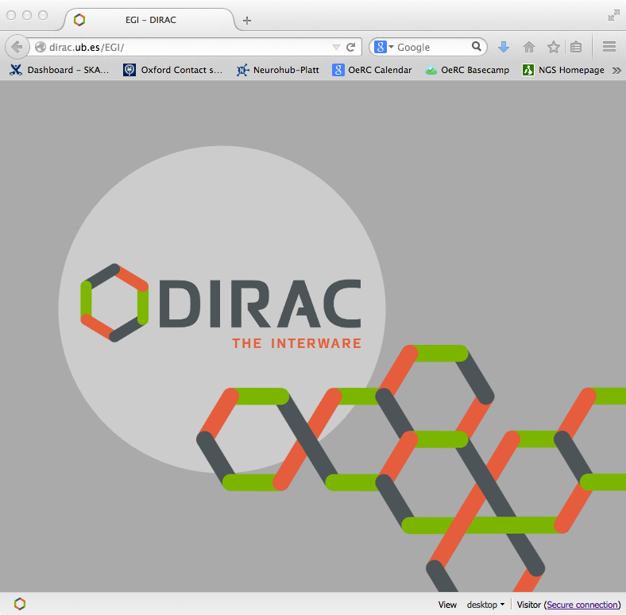
Brokering

Slide 28
EGI Cloud Infrastructure
EGI Collaboration Tools
EGI Cloud Infrastructure Platform
Virtual Instance Mgmt
Storage Management
Image Repository
EGI Cloud Service Marketplace
Cloud Management Stacks
(OpenStack, OpenNebula, Synnefo, …)
EGI Application DB
EGI Core Platform
Service
Registry
Information Discovery
Federated AAI
Monitoring
Accounting
Help and Support
Security Co-ordination
Training and Outreach
Sustainable Business Models

Slide 29
EGI Cloud Infrastructure
EGI Collaboration Tools
EGI Cloud Infrastructure Platform
Virtual Instance Mgmt
Storage Management
Image Repository
OCCI
CDMI
EGI Cloud Service Marketplace
Cloud Management Stacks
(OpenStack, OpenNebula, Synnefo, …)
OVF
EGI Application DB
EGI Core Platform
Service
Registry
GLUE2
GSI
SAM
UR
Information Discovery
Federated AAI
Monitoring
Accounting
Help and Support
Security Co-ordination
Training and Outreach
Sustainable Business Models

Slide 30
EGI Cloud Infrastructure
EGI Collaboration Tools
EGI Cloud Infrastructure Platform
Virtual Instance Mgmt
Storage Management
Image Repository
OCCI
CDMI
Providers Cloud Management Framework
(new one we don’t now about and don’t want to care about)
EGI Cloud Service Marketplace
Cloud Management Stacks
(OpenStack, OpenNebula, Synnefo, …)
OVF
EGI Application DB
EGI Core Platform
Service
Registry
GLUE2
GSI
SAM
UR
Information Discovery
Federated AAI
Monitoring
Accounting
Help and Support
Security Co-ordination
Training and Outreach
Sustainable Business Models

Slide 31
EGI Cloud Infrastructure
User Community
EGI Collaboration Tools
EGI Cloud Infrastructure Platform
Virtual Instance Mgmt
Storage Management
Image Repository
OCCI
CDMI
Providers Cloud Management Framework
(new one we don’t now about and don’t want to care about)
EGI Cloud Service Marketplace
Cloud Management Stacks
(OpenStack, OpenNebula, Synnefo, …)
OVF
EGI Application DB
EGI Core Platform
Service
Registry
GLUE2
GSI
SAM
UR
Information Discovery
Federated AAI
Monitoring
Accounting
Help and Support
Security Co-ordination
Training and Outreach
Sustainable Business Models

Slide 32
Resource Membership
Certified
15 certified resource providers from 12 countries from the public and private sector
  Czech Republic, Germany, Greece, Hungary, Italy, Macedonia, Poland, Slovakia, Spain, Sweden, Turkey, United Kingdom
2 countries currently integrating
  Croatia, Finland
6 countries interested
  Bulgaria, France, Israel*, The Netherlands, Portugal, Switzerland
Worldwide partnership/interest
  Australia* (NECTAR)
  South Africa* (SAGrid)
  South Korea* (KISTI)
  United States* (NIST, NSF Centres)
Integrating
Interested
* Not shown on map

Slide 33
Compatibility for Technology providers
Cloud Mgmt. Fram. | Fed. AAI | Information Pub | Monitoring | Accounting | Img. Mgmt. | OCCI | CDMI
OpenStack | Yes | Yes | Yes | Yes | Yes | Yes | Yes
OpenNebula | Yes | Yes | Yes | Yes | Yes | Yes | Yes
Synnefo | Yes | Yes | Yes | Yes | - | Yes | -
Cloudstack |  |  |  |  |  | Yes
Emotive | Yes |  |  |  |  | N/A | Yes
Stoxy | Yes |  | Yes* |  |  | N/A | Yes
Example documentation for a CMF:-
https://wiki.egi.eu/wiki/Fedcloud-tf:ResourceProviders:OpenStack

Slide 34
Federated Cloud Services
Tier 4:
Zero ICT
Infrastructures
PaaS
PaaS
VRE
Virtual
eLaboratory
Secure storage
Tier 3:
Platform as a Service
Tier 2:
General-purpose platform services
DB aaS
Hadoop
aaS
Key Mgmt
Encryption
ACL mgmt
Tier 1:
Reliable
Infrastructure Cloud
Federated IaaS Cloud

Slide 35
Overview
Principles and Value
Capabilities, Technology and Services
User Communities and usage models

Slide 36










EGI FedCloud Communities PY4
Ecology – BioVeL: Biodiversity Virtual e-Laboratory
Structural biology – WeNMR: a worldwide e-Infrastructure for NMR and structural biology
Linguistics – CLARIN: ‘British National Corpus’ service (BNCWeb)
Earth Observation – SSEP: European Space Agency’s Supersites Exploitation Platform for volcano and earthquakes monitoring (Collaboration with Helix Nebula)
Software Engineering – SCI-BUS: simulated environments for portal testing
Software Engineering – DIRAC: deploying ready-to-use distributed computing systems
Interdisciplinary research– Catania Science Gateway Framework
Musicology – Peachnote: dynamic analysis of musical scores
Earth Observation – ENVRI: Common Operations of Environmental Research infrastructures (collaboration with EISCAT3D)
Geology – VERCE: Virtual Earthquake and seismology Research
Ecology – LifeWatch: E-Science European Infrastructure for Biodiversity and Ecosystem Research
High Energy Physics – CERN ATLAS: ATLAS processing cluster via HelixNebula
More info: https://wiki.egi.eu/wiki/Fedcloud-tf:Users

Slide 37






WeNMR e-Infrastructure (VirtualCing)
Virtual Common Interface for NMR structure generation (VirtualCing), developed in WeNMR, has been deployed via the EGI Federated Cloud
NMR
Protein DB
ToPoS
OCCI client
EGI Federated Cloud Infrastructure
Virtual
CING
Virtual
CING
Virtual
CING
Virtual
CING
Virtual
CING
Virtual
CING
Virtual
Cing
Virtual
Cing
Virtual
Cing
…
Notes:
VirtualCing
Cing = Common Interface for NMR structure generation
Packaged into VM image for deployment

Slide 38
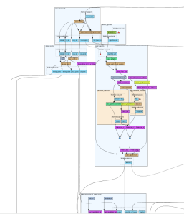

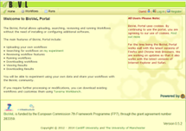
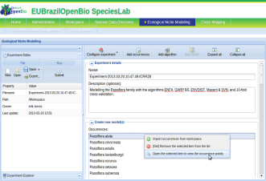





BioVeL
EGI FedCloud
Services are accessed from the BioVeL Portal, Taverna Workbench and EU-Brazil OpenBio VRE.
BioVeL Portal is running on the EGI Federated Cloud
The openModeller Web Service interface is integrated into the COMPs Workflow Orchestrator, which, using the VENUS-C middleware, dynamically instantiates openModeller workflows.
BioSTIFF and Google OpenRefine services are also integrated in the EGI Federated Cloud, to be used in the ENM and other workflow.
Portal
Open Modeller Web Service Interface
(OMWS2)
EGI FedCloud
Refine
COMPSs Workflow Orchestrator
VENUS-C Cloud Middleware
OCCI
CDMI
EGI Federated Cloud
EGI FedCloud
BioSTIFF
In order to provide BioVeL with a cloud enabled openModeller endpoint, the EUBrazilOpenBio ENM service is exposed through an extended openModeller Web Service interface (OMWS+ in the picture).
Such interface in EUBrazilOpenBio supports multi-staging and multiparametric experiments implemented through COMPSs and the openModeller software and managed through a Virtual Research Environment (VRE) portal.
The OMWS extensions are backwards compatible with the original specification, allowing existing clients, as the Taverna Workflow Management System in BioVeL, to be fully supported in the new implementation.
An Experiment Orchestrator Service acts as dispatcher of user’s requests towards different infrastructures. In the case of the EGI Federated Cloud, the VENUS-C middleware is used to instantiate openModeller workflows on cloud resources.
The COMPSs Workflow Orchestrator receives the execution requests and takes care of the execution of the openModeller pipelines on dynamically deployed virtual machines.
An rOCCI connector is used for the VMs management while data management supports CDMI endpoints.
Notes:
The ENM architecture is described in this figure. The users interact through the ENM GUI deployed on the EUBrazilOpenBio SpeciesLab VRE. This VRE includes the services for Species Data Discovery, described in detail in the part of the training for biodiversity experts. This service provides with the occurrence points and the taxonomic descriptions. The SpeciesLab also provides Access to the workspace (where the user stores the occurrence points required for the ENM study and the geospatial data service).
The ENM GUI constructs an OM2 request and sends it to the ENM Submission service, an auxiliary service that deals with common management tasks, such as job monitoring and the resubmission of the failed jobs.
The OMWS2 Service is the main entry point to the different computing back-ends available for ENM in the infrastructure. The access to this service depends on the client used to submit ENM experiments to the infrastructure. As was previously described, the ENM GUI can be used to submit experiments to the ENM Submission Service, which uses the OMWS2 to execute the experiments in one of the available back-ends. In addition, other OMWS/OMWS2 compatible clients (such as OM desktop) can be used too.
An HTCondor cluster and a PMES/COMPSs-based Cloud infrastructure are the two major providers of computing resources in the infrastructure. The
OMWS2 Service uses the Orchestration Service to allocate resources for the execution of experiments in the most appropriate back-end. Resource allocation is based on several factors, such as the workload of the back-end or the ENM algorithms available to the back-end.

Slide 39





ESA HN Flagship on the EGI Federated Cloud
The European Space Agency deployed part of the ESA Helix Nebula Flagship into the EGI Federated Cloud:
Use SlipStream Infrastructure Broker to deploy a custom computing cluster on multiple Federated Cloud sites (CESNET, GRNET)
Connect the computing cluster to the ESA Grid Platform on Demand system and run SAR processing for volcano and earthquake monitoring
Automatic Cluster Deployment
OCCI
EGI Federated Cloud
BLUE BOX
Computing Cluster
Globus
Cluster Head
Working Nodes
Job submission

Slide 40
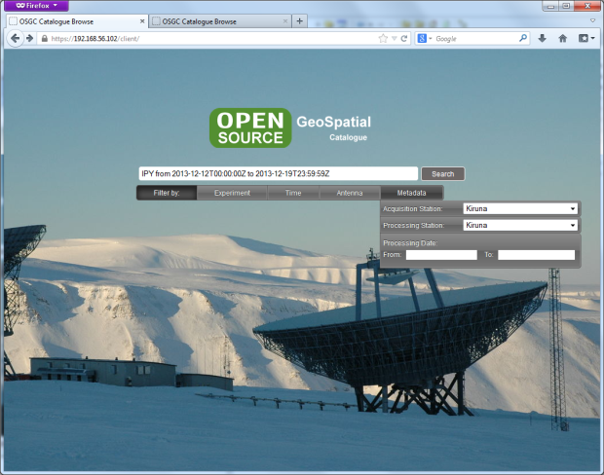
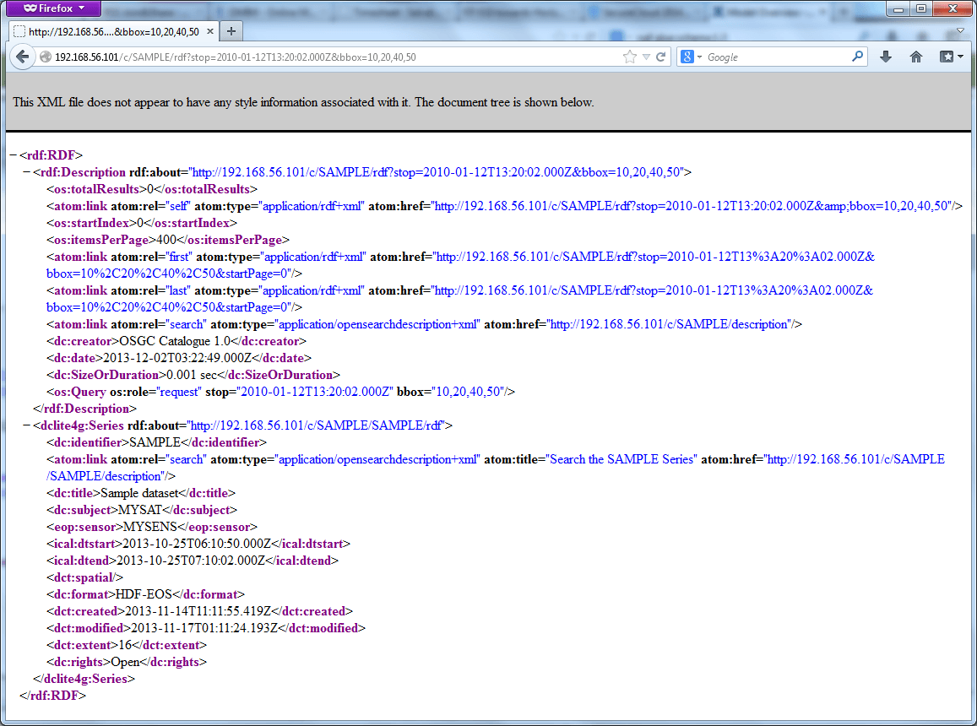
EISCAT 3D PoC
EISCAT_3D is a three-dimensional imaging radar to be located in the northernmost parts of Europe, to study Earth atmosphere and its coupling to space.
The EISCAT 3D Proof of Concept is a PaaS built on top of the EGI Federated Cloud for Data Access and Dissemination, based on the ENVRI tools, the EGI Federated Cloud Infrastructure and Storage services and the current EISCAT data.

Slide 41

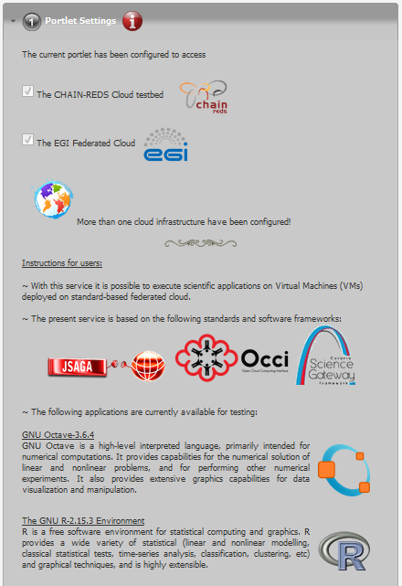
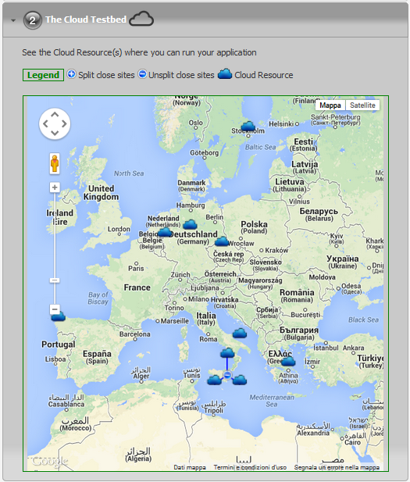

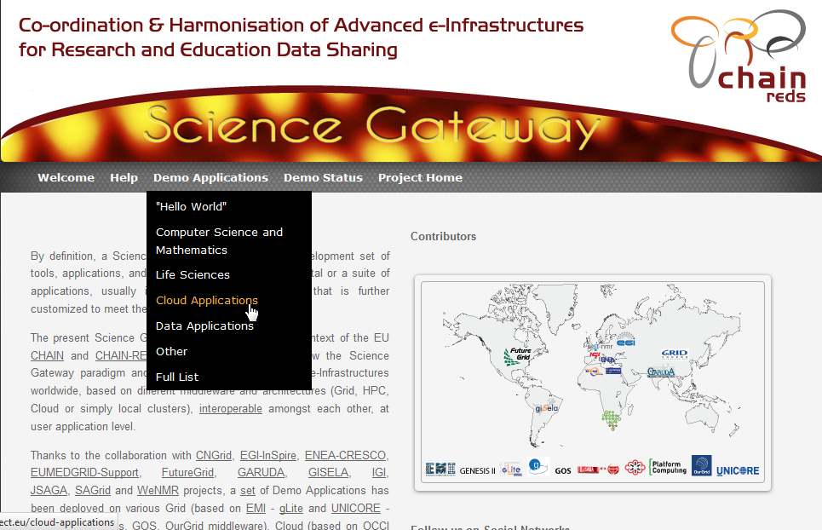




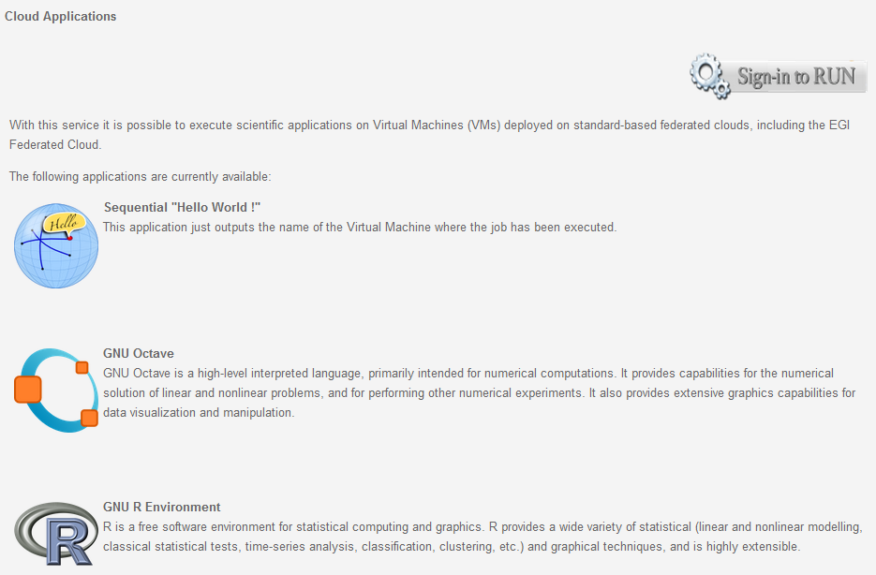



CHAIN-REDS Science Gateway (running GNU Octave and R)
CHAIN-REDS Science Gateway
CHAIN-REDS RI-306819
41

Slide 42
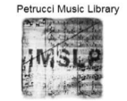
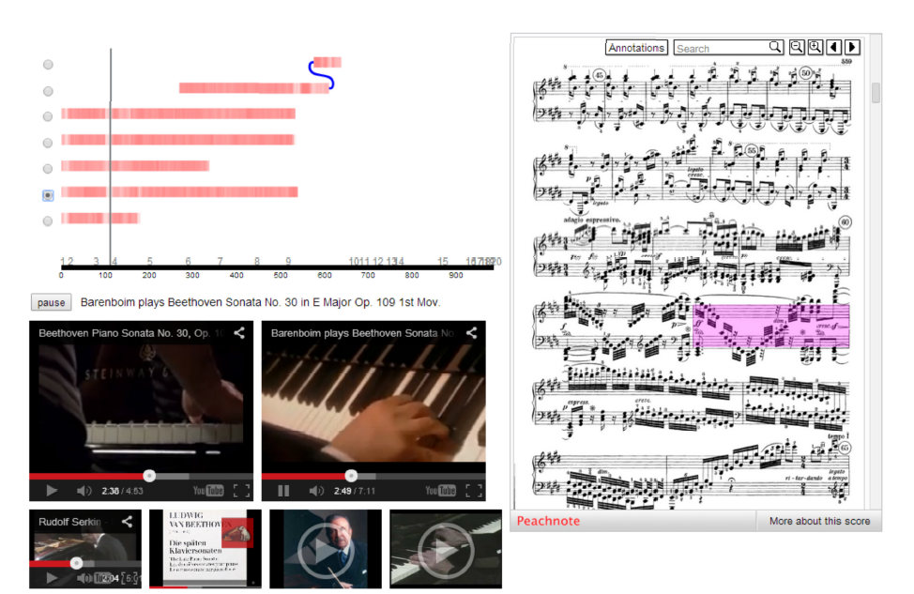

Peachnote
Peachnote is a music score search engine and analysis platform.
Analogue to Google Books for music scores
Leverage on the EGI Federated Cloud for Optical Music Recognition (OMR) processing and image/scores storage
EGI Federated Cloud
OMR Feeder
PDF Splitter
OMR Worker
Peachnote Portal
…
OMR Worker

Slide 43
Technology Evolution
Broader support for open standards in Cloud management frameworks (private and public clouds)
Innovate and deploy higher service layer tools
Continual improvements on documentation
Value added services for User Communities
Strengthening the underpinning platform

Slide 44
Conclusions
Paving the way for a global federated cloud marketplace
  Established best practice
  Illustrating European leadership
  Open standards, open technology
  Open membership, open processes
  Open competition, open market
New communities and resource providers @ ~ 1 per week
  Launch capability – 5,000 cores, 225 TB storage
  Q4 2014 (planned) – 18,000 cores, 6000 TB storage
  2020 Vision – 1,000,000 cores, 1 EB storage

Slide 45
Conclusions
Paving the way for a global federated cloud marketplace
  Established best practice
  Illustrating European leadership
  Open standards, open technology
  Open membership, open processes
  Open competition, open market
New communities and resource providers @ ~ 1 per week
  Launch capability – 5,000 cores, 225 TB storage
  Q4 2014 (planned) – 18,000 cores, 6000 TB storage
  2020 Vision – 1,000,000 cores, 1 EB storage
The key aspect of the EGI Federated Cloud, which will surely play a role
in its expansion and sustainability, is the uptake of official standards
such as OCCI and CDMI. It is just thanks to its standard interfaces that
the integration in the FedCloud of the two cloud sites at INFN Catania,
one running OpenStack and the other running OpenNebula, was smooth as silk. The same applies to the seamless interoperability with the sites of the Cloud Testbed of the CHAIN-REDS project (www.chain-project.eu).
Roberto Barbera, INFN Catania

Slide 46


Questions
Members of the EGI-InSPIRE collaboration thank the EC for supporting EGI

